Slide 1
DATA SCIENCE PROJECT
Give Me Some Credit
Predicting serious delinquency risk
Data, methods and results
Notes:
Analysis: give_me_some_credit_tutorial.ipynb.
Measured results: run_results/give_me_some_credit_tutorial/results.json.

Slide 2
01 Summary
Summary
Best model
0.8696
Tuned CatBoost reaches ROC-AUC 0.8696, versus 0.8145 for logistic regression.
Test ROC-AUC
Review capacity
Reviewing the highest-scored 10% captures 55.7% of positive cases at 37.2% precision.
Decision
Validate a review policy using workload and error costs. Check calibration before interpreting scores as absolute risk.
Give Me Some Credit
02 / 48
Notes:
Analysis: give_me_some_credit_tutorial.ipynb.
Measured results: run_results/give_me_some_credit_tutorial/results.json.
{"CatBoost (tuned)": {"ROC_AUC": 0.8696363663087325, "Accuracy": 0.9365, "Precision": 0.5762195121951219, "Recall": 0.1885286783042394, "F1": 0.28410372040586246, "LogLoss": 0.1766425262758299}, "CatBoost": {"ROC_AUC": 0.8695257124201463, "Accuracy": 0.9363666666666667, "Precision": 0.5752351097178683, "Recall": 0.18304239401496258, "F1": 0.2777147181233447, "LogLoss": 0.17654621402754475}, "XGBoost (tuned)": {"ROC_AUC": 0.8689674545552531, "Accuracy": 0.9366666666666666, "Precision": 0.5806451612903226, "Recall": 0.1885286783042394, "F1": 0.28463855421686746, "LogLoss": 0.17679260671138763}, "RandomForest (tuned)": {"ROC_AUC": 0.8682972066173199, "Accuracy": 0.9362333333333334, "Precision": 0.5836363636363636, "Recall": 0.1600997506234414, "F1": 0.2512720156555773, "LogLoss": 0.1774147424463194}, "LightGBM (tuned)": {"ROC_AUC": 0.8681778764376789, "Accuracy": 0.9366666666666666, "Precision": 0.5808936825885979, "Recall": 0.18802992518703243, "F1": 0.28409947249434814, "LogLoss": 0.17700380871895993}, "XGBoost": {"ROC_AUC": 0.866489233248367, "Accuracy": 0.9360333333333334, "Precision": 0.5628654970760234, "Recall": 0.19201995012468828, "F1": 0.2863518036444775, "LogLoss": 0.17805200815200806}, "LightGBM": {"ROC_AUC": 0.8662377455183261, "Accuracy": 0.9359666666666666, "Precision": 0.562874251497006, "Recall": 0.18753117206982545, "F1": 0.28133183688739244, "LogLoss": 0.1781006852679014}, "Stacking": {"ROC_AUC": 0.8647012670146388, "Accuracy": 0.9360333333333334, "Precision": 0.5584239130434783, "Recall": 0.20498753117206983, "F1": 0.2998905508938344, "LogLoss": 0.18857205534705712}, "RandomForest": {"ROC_AUC": 0.8558033207746841, "Accuracy": 0.936, "Precision": 0.5677830940988836, "Recall": 0.17755610972568578, "F1": 0.270516717325228, "LogLoss": 0.1898006413742805}, "MLP": {"ROC_AUC": 0.8353242986479149, "Accuracy": 0.9355, "Precision": 0.553680981595092, "Recall": 0.1800498753117207, "F1": 0.2717350395182537, "LogLoss": 0.18876437408072258}, "MLP (tuned)": {"ROC_AUC": 0.8337623168369486, "Accuracy": 0.9344666666666667, "Precision": 0.5249679897567221, "Recall": 0.20448877805486285, "F1": 0.29432878679109836, "LogLoss": 0.18933674983812646}, "LogReg (L2)": {"ROC_AUC": 0.8168002925353164, "Accuracy": 0.9358, "Precision": 0.5920745920745921, "Recall": 0.12668329177057355, "F1": 0.20870994248151192, "LogLoss": 0.20209867836693093}, "LogReg (L1)": {"ROC_AUC": 0.8164336524290275, "Accuracy": 0.9358666666666666, "Precision": 0.5824847250509165, "Recall": 0.142643391521197, "F1": 0.22916666666666666, "LogLoss": 0.20037569643164985}, "LogReg (ElasticNet)": {"ROC_AUC": 0.8158014233927594, "Accuracy": 0.9358666666666666, "Precision": 0.5814889336016097, "Recall": 0.14413965087281796, "F1": 0.23101518784972022, "LogLoss": 0.20029194730927666}, "LogisticRegression": {"ROC_AUC": 0.8144810860863558, "Accuracy": 0.9360666666666667, "Precision": 0.5854616895874263, "Recall": 0.1486284289276808, "F1": 0.23707239459029436, "LogLoss": 0.20015314340915583}, "KNN": {"ROC_AUC": 0.7789980220016133, "Accuracy": 0.9316, "Precision": 0.46998722860791825, "Recall": 0.18354114713216957, "F1": 0.26398852223816355, "LogLoss": 0.639195029472109}, "KNN (tuned)": {"ROC_AUC": 0.7789980220016133, "Accuracy": 0.9316, "Precision": 0.46998722860791825, "Recall": 0.18354114713216957, "F1": 0.26398852223816355, "LogLoss": 0.639195029472109}}

Slide 3
02 Objective and data
Objective
Objective
Rank applicants by their risk of serious delinquency within two years and evaluate how the ranking supports a review process.
Prediction unit
One applicant. The positive outcome is 90 or more days of delinquency within two years.
Evaluation
ROC-AUC for ranking, log loss for probabilities, and precision–recall at a chosen cutoff.
Give Me Some Credit
03 / 48
Notes:
Analysis: give_me_some_credit_tutorial.ipynb.
Measured results: run_results/give_me_some_credit_tutorial/results.json.

Slide 4
02 Objective and data
Dataset
Item | Details
Records | 150,000 source applicants, 149,999 retained
Features | 10 original financial variables plus an income-missing indicator
Target | Serious delinquency within two years
Class balance | 6.684% positive in the cleaned dataset
Give Me Some Credit
04 / 48
Notes:
Analysis: give_me_some_credit_tutorial.ipynb.
Measured results: run_results/give_me_some_credit_tutorial/results.json.

Slide 5
02 Objective and data
Preprocessing
Step | Processing
Age | Remove the single record with age zero.
Past-due counts | Replace sentinel values 96 and 98 with missing values.
Income | Add an indicator for missing income.
Missing values | Fill numerical gaps with medians. Scaling uses the training partition.
Give Me Some Credit
05 / 48
Notes:
Analysis: give_me_some_credit_tutorial.ipynb.
Measured results: run_results/give_me_some_credit_tutorial/results.json.

Slide 6
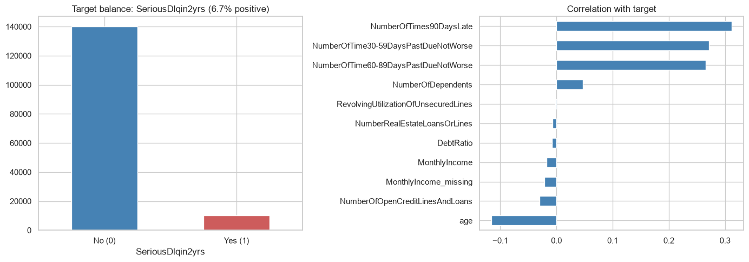
03 EDA and features
Class balance and feature associations
About 6.68% of applicants have the positive outcome. Accuracy alone would favor the majority class.
Give Me Some Credit
06 / 48
Notes:
Analysis: give_me_some_credit_tutorial.ipynb.
Figure: figures/notebook/give_me_some_credit/cell_008_figure_1.png
Measured results: run_results/give_me_some_credit_tutorial/results.json.
Notebook cell ID: a4c371ab.

Slide 7
03 EDA and features
EDA findings
Outcome balance
About 6.68% of applicants have the positive outcome. Accuracy alone would favor the majority class.
Risk features
Past delinquency and credit utilization are useful predictors.
Data quality
Past-due sentinels and missing income need explicit handling before modeling.
Give Me Some Credit
07 / 48
Notes:
Analysis: give_me_some_credit_tutorial.ipynb.
Measured results: run_results/give_me_some_credit_tutorial/results.json.

Slide 8
03 EDA and features
Feature engineering
Feature group | Predictors
Repayment history | Counts of 30–59, 60–89 and 90+ days past due
Utilization | Revolving credit utilization and debt ratio
Applicant | Age, monthly income and number of dependents
Credit exposure | Number of open credit lines and real-estate loans
Give Me Some Credit
08 / 48
Notes:
Analysis: give_me_some_credit_tutorial.ipynb.
Measured results: run_results/give_me_some_credit_tutorial/results.json.

Slide 9
04 Validation
Train–test split
Partition
Stratified random 80/20 split with seed 42. Training has 119,999 applicants and testing has 30,000 applicants. Each split preserves about 6.68% positives.
Transforms
Scaling uses training rows. The imputation and filtering scope is listed under Limitations.
Evaluation
The test partition is separate from the rows used to fit each model.
Give Me Some Credit
09 / 48
Notes:
Analysis: give_me_some_credit_tutorial.ipynb.
Measured results: run_results/give_me_some_credit_tutorial/results.json.

Slide 10
05 Methods
Methods
Family | Models | Role
Logistic | Logistic regression with L2, L1 and Elastic Net penalties | Interpretable reference
Local | K-nearest neighbors | Predict from similar records
Neural | Multilayer perceptron | Learn nonlinear relationships
Trees | Random Forest, XGBoost, CatBoost and LightGBM | Learn thresholds and interactions
Ensemble | Stacking of Random Forest, XGBoost and LightGBM | Combine predictions using a fitted meta-model
Give Me Some Credit
10 / 48
Notes:
Analysis: give_me_some_credit_tutorial.ipynb.
Measured results: run_results/give_me_some_credit_tutorial/results.json.

Slide 11
05 Methods
Logistic regression
Model | Strength | Weakness
Reference logistic | Easy to inspect and use as a baseline | Misses nonlinear effects without added features
L2 logistic | Stabilizes coefficients when predictors overlap | Keeps all predictors and introduces shrinkage bias
L1 logistic | Can remove weak predictors with zero coefficients | Can select inconsistently among correlated inputs
Elastic Net | Combines sparse selection with L2 shrinkage | Requires penalty strength and mixing to be selected
Give Me Some Credit
11 / 48
Notes:
Analysis: give_me_some_credit_tutorial.ipynb.
https://scikit-learn.org/stable/modules/linear_model.html
Measured results: run_results/give_me_some_credit_tutorial/results.json.

Slide 12
05 Methods
KNN and neural networks
Model | Strength | Weakness
KNN | Simple local prediction with few modeling assumptions | Distances depend on scaling. Prediction slows as the reference set grows.
MLP | Learns smooth nonlinear effects and interactions | Sensitive to scaling and optimization. Needs regularization and convergence checks.
Give Me Some Credit
12 / 48
Notes:
Analysis: give_me_some_credit_tutorial.ipynb.
Measured results: run_results/give_me_some_credit_tutorial/results.json.

Slide 13
05 Methods
Tree-based models
Model | Strength | Weakness
Random Forest | Averaging many trees reduces variance and captures interactions | Large ensembles use memory and extrapolate poorly
XGBoost | Regularized boosting handles complex tabular relationships | Tree depth, learning rate and tree count need joint selection
CatBoost | Supports categorical features alongside numerical features | Training can be costly. Data quality still limits performance
LightGBM | Histogram splits support efficient training on large tables | Flexible leaf growth can overfit small groups
Give Me Some Credit
13 / 48
Notes:
Analysis: give_me_some_credit_tutorial.ipynb.
Measured results: run_results/give_me_some_credit_tutorial/results.json.

Slide 14
05 Methods
Stacking
Random Forest, XGBoost and LightGBM generate out-of-fold predictions. A logistic meta-model learns how to combine them.
Strengths
Weaknesses
Can reduce error when the base models make different mistakes. The meta-model learns the weights from training predictions.
Adds fitting and inference cost. Similar base-model errors can limit the gain.
RESULT IN THIS STUDY
ROC-AUC 0.8647 and log loss 0.1886. It does not exceed the best individual model on the primary metric.
Give Me Some Credit
14 / 48
Notes:
Analysis: give_me_some_credit_tutorial.ipynb.
Base models: fitted reference configurations, each cloned and refitted by StackingRegressor/Classifier. cv=2. Meta-model: LogisticRegression(C=1.0, max_iter=2000).
https://scikit-learn.org/stable/modules/ensemble.html#stacking
Measured results: run_results/give_me_some_credit_tutorial/results.json.

Slide 15
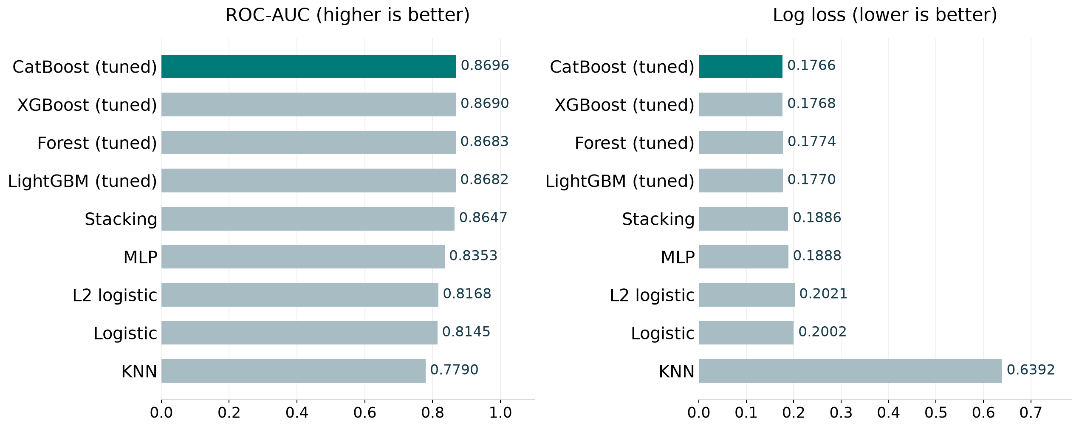
06 Results
Model comparison
Best test score per family, including the strongest penalized linear model. Full results appear in the appendix.
Give Me Some Credit
15 / 48
Notes:
Analysis: give_me_some_credit_tutorial.ipynb.
Figure: figures/give_me_some_credit/comparison.png
Measured results: run_results/give_me_some_credit_tutorial/results.json.

Slide 16
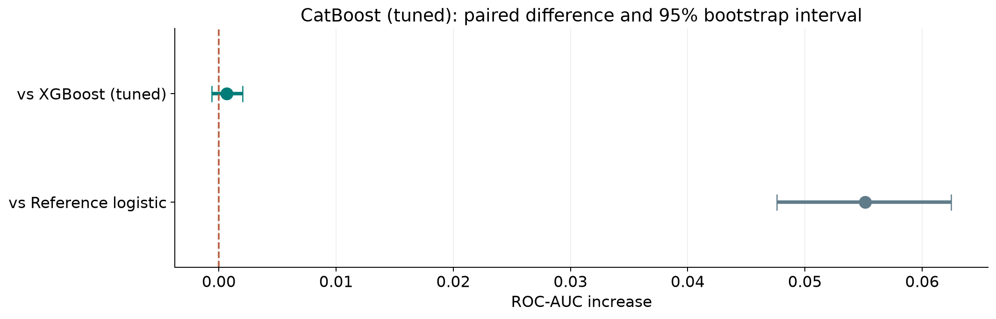
06 Results
Ranking stability
The 95% interval includes zero for CatBoost (tuned) versus XGBoost (tuned). Their ordering remains uncertain.
Give Me Some Credit
16 / 48
Notes:
Analysis: give_me_some_credit_tutorial.ipynb.
paired stratified row bootstrap. 1,000 paired resamples. Fitted models remain fixed.
[{"comparison": "CatBoost (tuned) versus XGBoost (tuned)", "other": "XGBoost (tuned)", "advantage": 0.0006689117534793843, "ci_low": -0.0005937522687297969, "ci_high": 0.0020104211252542107}, {"comparison": "CatBoost (tuned) versus Reference logistic", "other": "Reference logistic", "advantage": 0.0551552802223767, "ci_low": 0.04758234392586138, "ci_high": 0.06246994230800919}]
Figure: figures/give_me_some_credit/ranking_stability.png
Measured results: run_results/give_me_some_credit_tutorial/results.json.

Slide 17
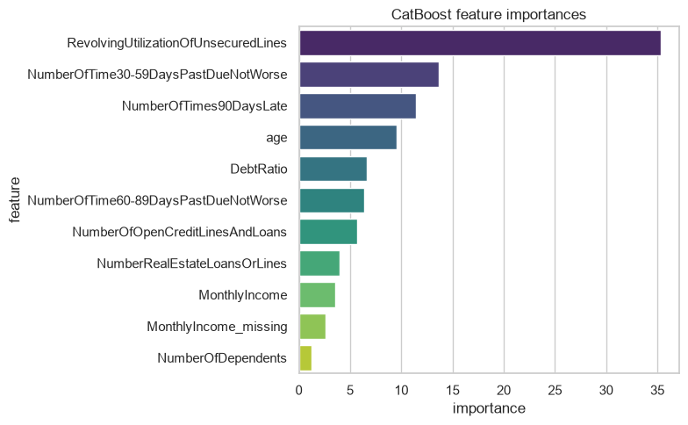
06 Results
CatBoost feature importance
Delinquency history and utilization provide useful risk information. Check their contribution with feature-group tests.
Give Me Some Credit
17 / 48
Notes:
Analysis: give_me_some_credit_tutorial.ipynb.
Figure: figures/notebook/give_me_some_credit/cell_047_figure_1.png
Measured results: run_results/give_me_some_credit_tutorial/results.json.
Notebook cell ID: d42356ca.

Slide 18
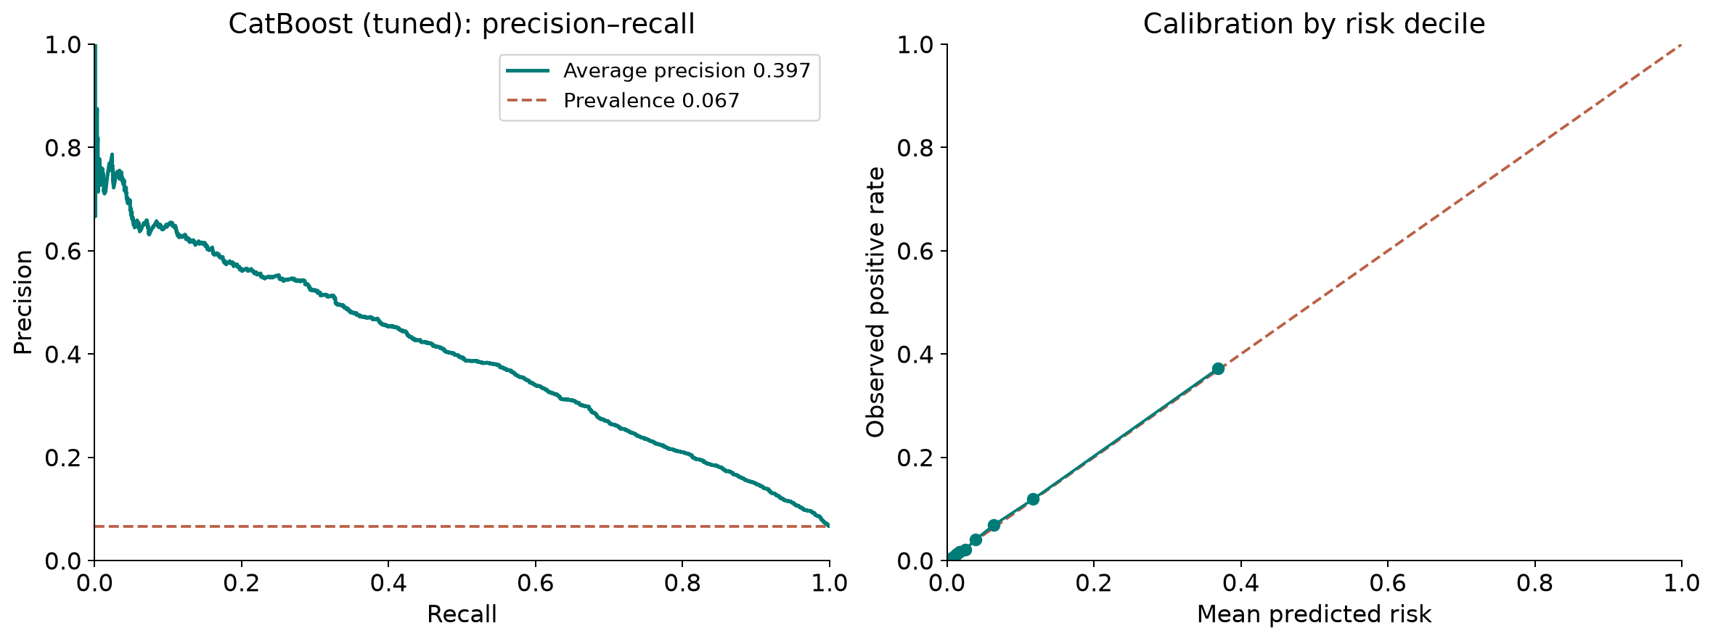
06 Results
Precision–recall and calibration
CatBoost (tuned): average precision 0.397, positive prevalence 0.067, Brier score 0.0491.
Give Me Some Credit
18 / 48
Notes:
Analysis: give_me_some_credit_tutorial.ipynb.
Figure: figures/give_me_some_credit/pr_calibration.png
Measured results: run_results/give_me_some_credit_tutorial/results.json.
Diagnostics use CatBoost (tuned) predictions.

Slide 19
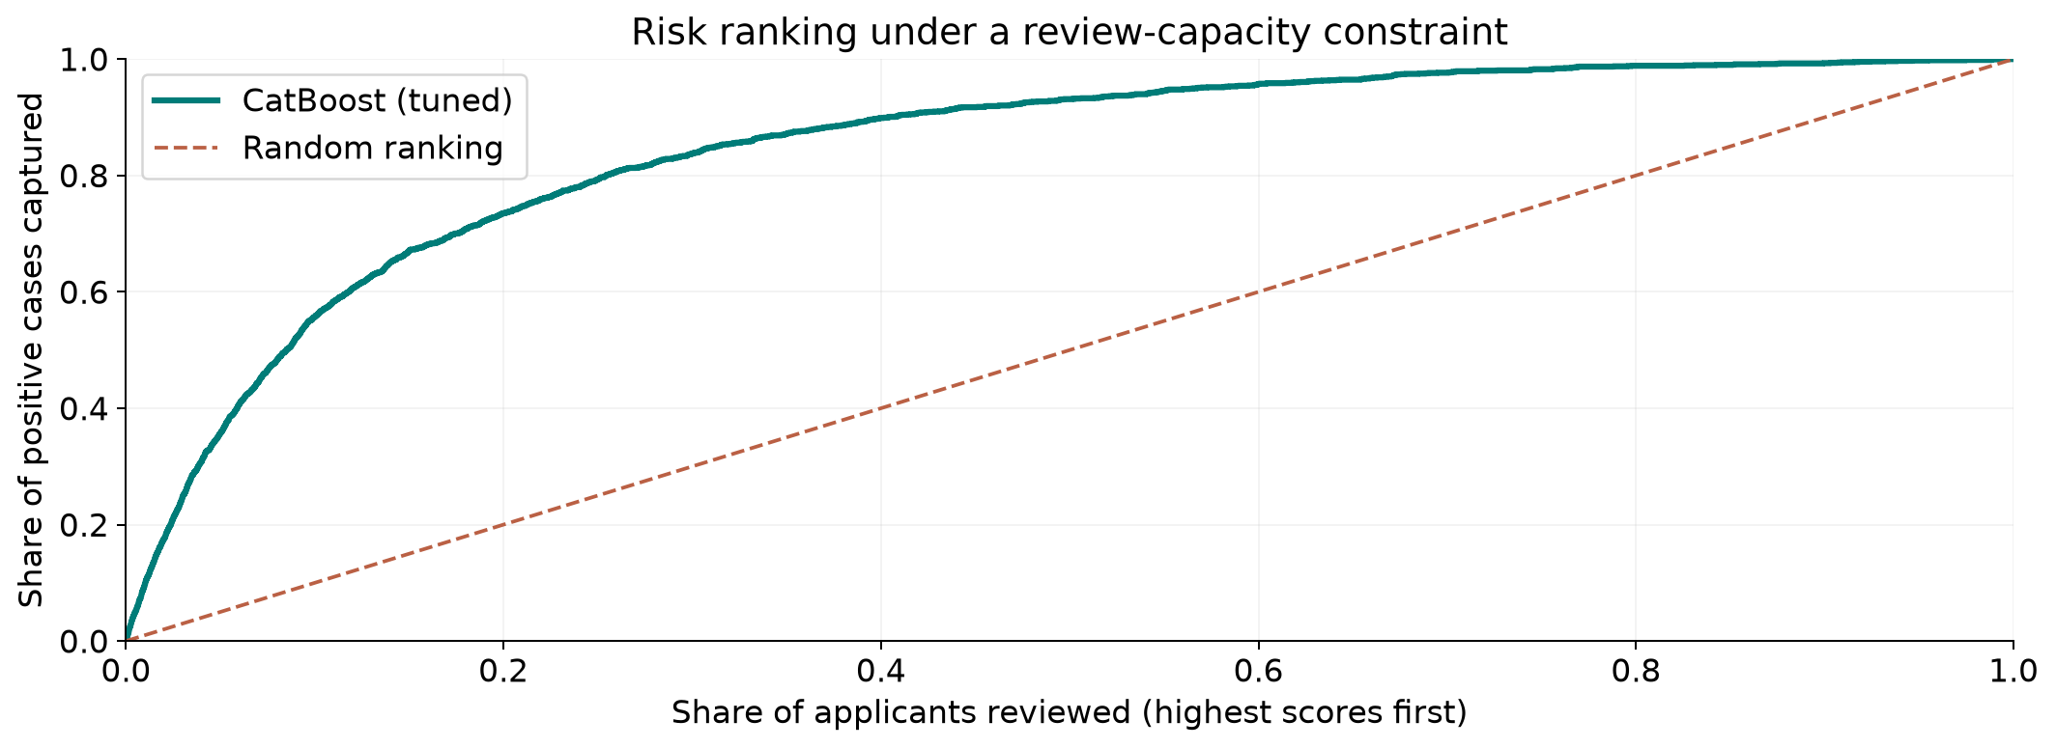
06 Results
Review capacity
CatBoost (tuned), top 10% reviewed: 55.7% recall and 37.2% precision.
Give Me Some Credit
19 / 48
Notes:
Analysis: give_me_some_credit_tutorial.ipynb.
Figure: figures/give_me_some_credit/review_capacity.png
Measured results: run_results/give_me_some_credit_tutorial/results.json.
Diagnostics use CatBoost (tuned) predictions.

Slide 20
06 Results
Results
Risk ranking
Tuned CatBoost improves AUC by 0.0552 over logistic regression. Its lead over tuned XGBoost is uncertain.
Review workload
A 10% review share captures 55.7% of positives. Cutoff 0.5 captures only 18.9%.
Probability quality
Average precision is 0.397, against prevalence 6.7%. Brier score is 0.0491. Validate the chosen cutoff separately.
Give Me Some Credit
20 / 48
Notes:
Analysis: give_me_some_credit_tutorial.ipynb.
Measured results: run_results/give_me_some_credit_tutorial/results.json.
{"CatBoost (tuned)": {"ROC_AUC": 0.8696363663087325, "Accuracy": 0.9365, "Precision": 0.5762195121951219, "Recall": 0.1885286783042394, "F1": 0.28410372040586246, "LogLoss": 0.1766425262758299}, "CatBoost": {"ROC_AUC": 0.8695257124201463, "Accuracy": 0.9363666666666667, "Precision": 0.5752351097178683, "Recall": 0.18304239401496258, "F1": 0.2777147181233447, "LogLoss": 0.17654621402754475}, "XGBoost (tuned)": {"ROC_AUC": 0.8689674545552531, "Accuracy": 0.9366666666666666, "Precision": 0.5806451612903226, "Recall": 0.1885286783042394, "F1": 0.28463855421686746, "LogLoss": 0.17679260671138763}, "RandomForest (tuned)": {"ROC_AUC": 0.8682972066173199, "Accuracy": 0.9362333333333334, "Precision": 0.5836363636363636, "Recall": 0.1600997506234414, "F1": 0.2512720156555773, "LogLoss": 0.1774147424463194}, "LightGBM (tuned)": {"ROC_AUC": 0.8681778764376789, "Accuracy": 0.9366666666666666, "Precision": 0.5808936825885979, "Recall": 0.18802992518703243, "F1": 0.28409947249434814, "LogLoss": 0.17700380871895993}, "XGBoost": {"ROC_AUC": 0.866489233248367, "Accuracy": 0.9360333333333334, "Precision": 0.5628654970760234, "Recall": 0.19201995012468828, "F1": 0.2863518036444775, "LogLoss": 0.17805200815200806}, "LightGBM": {"ROC_AUC": 0.8662377455183261, "Accuracy": 0.9359666666666666, "Precision": 0.562874251497006, "Recall": 0.18753117206982545, "F1": 0.28133183688739244, "LogLoss": 0.1781006852679014}, "Stacking": {"ROC_AUC": 0.8647012670146388, "Accuracy": 0.9360333333333334, "Precision": 0.5584239130434783, "Recall": 0.20498753117206983, "F1": 0.2998905508938344, "LogLoss": 0.18857205534705712}, "RandomForest": {"ROC_AUC": 0.8558033207746841, "Accuracy": 0.936, "Precision": 0.5677830940988836, "Recall": 0.17755610972568578, "F1": 0.270516717325228, "LogLoss": 0.1898006413742805}, "MLP": {"ROC_AUC": 0.8353242986479149, "Accuracy": 0.9355, "Precision": 0.553680981595092, "Recall": 0.1800498753117207, "F1": 0.2717350395182537, "LogLoss": 0.18876437408072258}, "MLP (tuned)": {"ROC_AUC": 0.8337623168369486, "Accuracy": 0.9344666666666667, "Precision": 0.5249679897567221, "Recall": 0.20448877805486285, "F1": 0.29432878679109836, "LogLoss": 0.18933674983812646}, "LogReg (L2)": {"ROC_AUC": 0.8168002925353164, "Accuracy": 0.9358, "Precision": 0.5920745920745921, "Recall": 0.12668329177057355, "F1": 0.20870994248151192, "LogLoss": 0.20209867836693093}, "LogReg (L1)": {"ROC_AUC": 0.8164336524290275, "Accuracy": 0.9358666666666666, "Precision": 0.5824847250509165, "Recall": 0.142643391521197, "F1": 0.22916666666666666, "LogLoss": 0.20037569643164985}, "LogReg (ElasticNet)": {"ROC_AUC": 0.8158014233927594, "Accuracy": 0.9358666666666666, "Precision": 0.5814889336016097, "Recall": 0.14413965087281796, "F1": 0.23101518784972022, "LogLoss": 0.20029194730927666}, "LogisticRegression": {"ROC_AUC": 0.8144810860863558, "Accuracy": 0.9360666666666667, "Precision": 0.5854616895874263, "Recall": 0.1486284289276808, "F1": 0.23707239459029436, "LogLoss": 0.20015314340915583}, "KNN": {"ROC_AUC": 0.7789980220016133, "Accuracy": 0.9316, "Precision": 0.46998722860791825, "Recall": 0.18354114713216957, "F1": 0.26398852223816355, "LogLoss": 0.639195029472109}, "KNN (tuned)": {"ROC_AUC": 0.7789980220016133, "Accuracy": 0.9316, "Precision": 0.46998722860791825, "Recall": 0.18354114713216957, "F1": 0.26398852223816355, "LogLoss": 0.639195029472109}}

Slide 21
07 Conclusion
Limitations
Limitation | Details
Preprocessing | Imputation statistics were calculated before the train–test split.
Class imbalance | A fixed 0.5 cutoff misses many positive cases.
Calibration | Class weighting can affect the interpretation of predicted probabilities.
Validation | The final model and review policy need a separate evaluation sample.
Give Me Some Credit
21 / 48
Notes:
Analysis: give_me_some_credit_tutorial.ipynb.
Measured results: run_results/give_me_some_credit_tutorial/results.json.

Slide 22
07 Conclusion
Next steps
# | Test | Method | Measure
1 | Fold-safe pipeline | Learn imputers and transformations separately within every training fold. | No preprocessing leakage
2 | PR and calibration | Measure average precision, calibration and recall at a fixed review rate. | Useful minority-class detection
3 | Threshold study | Choose the operating cutoff on validation data under stated costs. | A reviewable policy trade-off
4 | Final validation | Refit the selected model on all training data and test once. | A credible final generalization estimate
Give Me Some Credit
22 / 48
Notes:
Analysis: give_me_some_credit_tutorial.ipynb.
Measured results: run_results/give_me_some_credit_tutorial/results.json.

Slide 23
07 Conclusion
Conclusion
CatBoost leads the risk ranking
ROC-AUC 0.8696
Its lead over XGBoost is uncertain. Review capacity and calibrated probabilities should guide the operating policy.
Give Me Some Credit
23 / 48
Notes:
Analysis: give_me_some_credit_tutorial.ipynb.
Measured results: run_results/give_me_some_credit_tutorial/results.json.
{"CatBoost (tuned)": {"ROC_AUC": 0.8696363663087325, "Accuracy": 0.9365, "Precision": 0.5762195121951219, "Recall": 0.1885286783042394, "F1": 0.28410372040586246, "LogLoss": 0.1766425262758299}, "CatBoost": {"ROC_AUC": 0.8695257124201463, "Accuracy": 0.9363666666666667, "Precision": 0.5752351097178683, "Recall": 0.18304239401496258, "F1": 0.2777147181233447, "LogLoss": 0.17654621402754475}, "XGBoost (tuned)": {"ROC_AUC": 0.8689674545552531, "Accuracy": 0.9366666666666666, "Precision": 0.5806451612903226, "Recall": 0.1885286783042394, "F1": 0.28463855421686746, "LogLoss": 0.17679260671138763}, "RandomForest (tuned)": {"ROC_AUC": 0.8682972066173199, "Accuracy": 0.9362333333333334, "Precision": 0.5836363636363636, "Recall": 0.1600997506234414, "F1": 0.2512720156555773, "LogLoss": 0.1774147424463194}, "LightGBM (tuned)": {"ROC_AUC": 0.8681778764376789, "Accuracy": 0.9366666666666666, "Precision": 0.5808936825885979, "Recall": 0.18802992518703243, "F1": 0.28409947249434814, "LogLoss": 0.17700380871895993}, "XGBoost": {"ROC_AUC": 0.866489233248367, "Accuracy": 0.9360333333333334, "Precision": 0.5628654970760234, "Recall": 0.19201995012468828, "F1": 0.2863518036444775, "LogLoss": 0.17805200815200806}, "LightGBM": {"ROC_AUC": 0.8662377455183261, "Accuracy": 0.9359666666666666, "Precision": 0.562874251497006, "Recall": 0.18753117206982545, "F1": 0.28133183688739244, "LogLoss": 0.1781006852679014}, "Stacking": {"ROC_AUC": 0.8647012670146388, "Accuracy": 0.9360333333333334, "Precision": 0.5584239130434783, "Recall": 0.20498753117206983, "F1": 0.2998905508938344, "LogLoss": 0.18857205534705712}, "RandomForest": {"ROC_AUC": 0.8558033207746841, "Accuracy": 0.936, "Precision": 0.5677830940988836, "Recall": 0.17755610972568578, "F1": 0.270516717325228, "LogLoss": 0.1898006413742805}, "MLP": {"ROC_AUC": 0.8353242986479149, "Accuracy": 0.9355, "Precision": 0.553680981595092, "Recall": 0.1800498753117207, "F1": 0.2717350395182537, "LogLoss": 0.18876437408072258}, "MLP (tuned)": {"ROC_AUC": 0.8337623168369486, "Accuracy": 0.9344666666666667, "Precision": 0.5249679897567221, "Recall": 0.20448877805486285, "F1": 0.29432878679109836, "LogLoss": 0.18933674983812646}, "LogReg (L2)": {"ROC_AUC": 0.8168002925353164, "Accuracy": 0.9358, "Precision": 0.5920745920745921, "Recall": 0.12668329177057355, "F1": 0.20870994248151192, "LogLoss": 0.20209867836693093}, "LogReg (L1)": {"ROC_AUC": 0.8164336524290275, "Accuracy": 0.9358666666666666, "Precision": 0.5824847250509165, "Recall": 0.142643391521197, "F1": 0.22916666666666666, "LogLoss": 0.20037569643164985}, "LogReg (ElasticNet)": {"ROC_AUC": 0.8158014233927594, "Accuracy": 0.9358666666666666, "Precision": 0.5814889336016097, "Recall": 0.14413965087281796, "F1": 0.23101518784972022, "LogLoss": 0.20029194730927666}, "LogisticRegression": {"ROC_AUC": 0.8144810860863558, "Accuracy": 0.9360666666666667, "Precision": 0.5854616895874263, "Recall": 0.1486284289276808, "F1": 0.23707239459029436, "LogLoss": 0.20015314340915583}, "KNN": {"ROC_AUC": 0.7789980220016133, "Accuracy": 0.9316, "Precision": 0.46998722860791825, "Recall": 0.18354114713216957, "F1": 0.26398852223816355, "LogLoss": 0.639195029472109}, "KNN (tuned)": {"ROC_AUC": 0.7789980220016133, "Accuracy": 0.9316, "Precision": 0.46998722860791825, "Recall": 0.18354114713216957, "F1": 0.26398852223816355, "LogLoss": 0.639195029472109}}

Slide 24
08 Appendix
Evaluation metrics
Metric | Meaning | Role
ROC-AUC | Ranking across thresholds | Primary model comparison
Log loss | Quality of predicted probabilities | Probability assessment
Precision and recall | Detection and false-positive trade-off | Threshold analysis
Calibration | Agreement of predicted and observed risk | Probability interpretation
Give Me Some Credit
24 / 48
Notes:
Analysis: give_me_some_credit_tutorial.ipynb.
Measured results: run_results/give_me_some_credit_tutorial/results.json.

Slide 25
08 Appendix
Logistic regularization
Variant | Training objective | Main effect
Reference logistic | Logistic loss with reference settings | Linear log-odds reference
L2 logistic | Logistic loss + Ridge penalty | Shrinks correlated coefficients
L1 logistic | Logistic loss + Lasso penalty | Can remove coefficients
Elastic Net logistic | Logistic loss + mixed penalty | Balances sparsity and shrinkage
Give Me Some Credit
25 / 48
Notes:
Analysis: give_me_some_credit_tutorial.ipynb.
https://scikit-learn.org/stable/modules/linear_model.html
Measured results: run_results/give_me_some_credit_tutorial/results.json.

Slide 26
08 Appendix
Logistic model results
Model | ROC-AUC | Log loss | Recall at 0.5
Logistic | 0.8145 | 0.2002 | 0.1486
L2 logistic | 0.8168 | 0.2021 | 0.1267
L1 logistic | 0.8164 | 0.2004 | 0.1426
Elastic Net logistic | 0.8158 | 0.2003 | 0.1441
Give Me Some Credit
26 / 48
Notes:
Analysis: give_me_some_credit_tutorial.ipynb.
Measured results: run_results/give_me_some_credit_tutorial/results.json.
{"CatBoost (tuned)": {"ROC_AUC": 0.8696363663087325, "Accuracy": 0.9365, "Precision": 0.5762195121951219, "Recall": 0.1885286783042394, "F1": 0.28410372040586246, "LogLoss": 0.1766425262758299}, "CatBoost": {"ROC_AUC": 0.8695257124201463, "Accuracy": 0.9363666666666667, "Precision": 0.5752351097178683, "Recall": 0.18304239401496258, "F1": 0.2777147181233447, "LogLoss": 0.17654621402754475}, "XGBoost (tuned)": {"ROC_AUC": 0.8689674545552531, "Accuracy": 0.9366666666666666, "Precision": 0.5806451612903226, "Recall": 0.1885286783042394, "F1": 0.28463855421686746, "LogLoss": 0.17679260671138763}, "RandomForest (tuned)": {"ROC_AUC": 0.8682972066173199, "Accuracy": 0.9362333333333334, "Precision": 0.5836363636363636, "Recall": 0.1600997506234414, "F1": 0.2512720156555773, "LogLoss": 0.1774147424463194}, "LightGBM (tuned)": {"ROC_AUC": 0.8681778764376789, "Accuracy": 0.9366666666666666, "Precision": 0.5808936825885979, "Recall": 0.18802992518703243, "F1": 0.28409947249434814, "LogLoss": 0.17700380871895993}, "XGBoost": {"ROC_AUC": 0.866489233248367, "Accuracy": 0.9360333333333334, "Precision": 0.5628654970760234, "Recall": 0.19201995012468828, "F1": 0.2863518036444775, "LogLoss": 0.17805200815200806}, "LightGBM": {"ROC_AUC": 0.8662377455183261, "Accuracy": 0.9359666666666666, "Precision": 0.562874251497006, "Recall": 0.18753117206982545, "F1": 0.28133183688739244, "LogLoss": 0.1781006852679014}, "Stacking": {"ROC_AUC": 0.8647012670146388, "Accuracy": 0.9360333333333334, "Precision": 0.5584239130434783, "Recall": 0.20498753117206983, "F1": 0.2998905508938344, "LogLoss": 0.18857205534705712}, "RandomForest": {"ROC_AUC": 0.8558033207746841, "Accuracy": 0.936, "Precision": 0.5677830940988836, "Recall": 0.17755610972568578, "F1": 0.270516717325228, "LogLoss": 0.1898006413742805}, "MLP": {"ROC_AUC": 0.8353242986479149, "Accuracy": 0.9355, "Precision": 0.553680981595092, "Recall": 0.1800498753117207, "F1": 0.2717350395182537, "LogLoss": 0.18876437408072258}, "MLP (tuned)": {"ROC_AUC": 0.8337623168369486, "Accuracy": 0.9344666666666667, "Precision": 0.5249679897567221, "Recall": 0.20448877805486285, "F1": 0.29432878679109836, "LogLoss": 0.18933674983812646}, "LogReg (L2)": {"ROC_AUC": 0.8168002925353164, "Accuracy": 0.9358, "Precision": 0.5920745920745921, "Recall": 0.12668329177057355, "F1": 0.20870994248151192, "LogLoss": 0.20209867836693093}, "LogReg (L1)": {"ROC_AUC": 0.8164336524290275, "Accuracy": 0.9358666666666666, "Precision": 0.5824847250509165, "Recall": 0.142643391521197, "F1": 0.22916666666666666, "LogLoss": 0.20037569643164985}, "LogReg (ElasticNet)": {"ROC_AUC": 0.8158014233927594, "Accuracy": 0.9358666666666666, "Precision": 0.5814889336016097, "Recall": 0.14413965087281796, "F1": 0.23101518784972022, "LogLoss": 0.20029194730927666}, "LogisticRegression": {"ROC_AUC": 0.8144810860863558, "Accuracy": 0.9360666666666667, "Precision": 0.5854616895874263, "Recall": 0.1486284289276808, "F1": 0.23707239459029436, "LogLoss": 0.20015314340915583}, "KNN": {"ROC_AUC": 0.7789980220016133, "Accuracy": 0.9316, "Precision": 0.46998722860791825, "Recall": 0.18354114713216957, "F1": 0.26398852223816355, "LogLoss": 0.639195029472109}, "KNN (tuned)": {"ROC_AUC": 0.7789980220016133, "Accuracy": 0.9316, "Precision": 0.46998722860791825, "Recall": 0.18354114713216957, "F1": 0.26398852223816355, "LogLoss": 0.639195029472109}}

Slide 27
08 Appendix
Linear model discussion
Results
L2 logistic reaches AUC 0.8168, slightly above the reference logistic model.
Interpretation
Delinquency counts and utilization have positive fitted associations with risk. Penalties help stabilize overlapping inputs.
Further work
Check nonlinear transformations and compare calibration across applicant groups and separate validation folds.
Give Me Some Credit
27 / 48
Notes:
Analysis: give_me_some_credit_tutorial.ipynb.
https://scikit-learn.org/stable/modules/linear_model.html
Measured results: run_results/give_me_some_credit_tutorial/results.json.

Slide 28
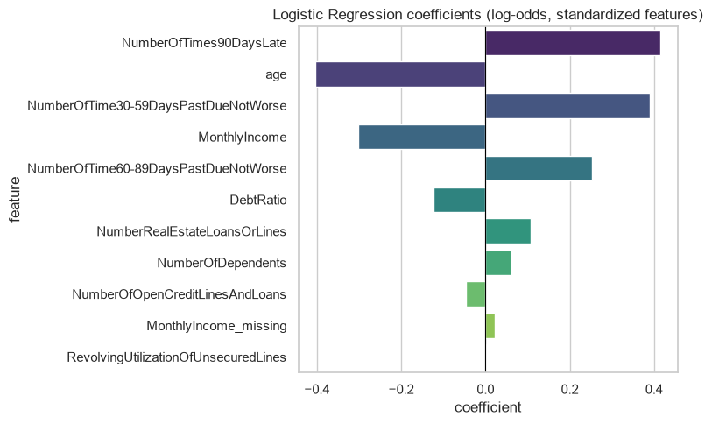
08 Appendix
Logistic regression coefficients
Coefficients describe fitted associations after accounting for the other encoded inputs.
Give Me Some Credit
28 / 48
Notes:
Analysis: give_me_some_credit_tutorial.ipynb.
Figure: figures/notebook/give_me_some_credit/cell_015_figure_1.png
Measured results: run_results/give_me_some_credit_tutorial/results.json.
Notebook cell ID: b7246305.

Slide 29
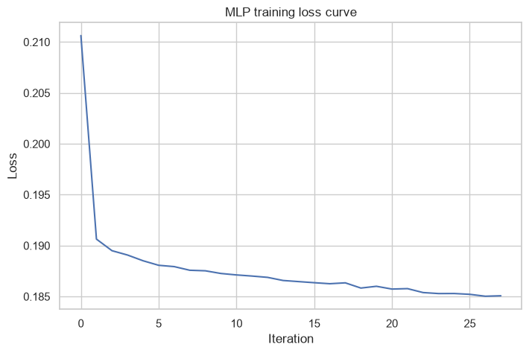
08 Appendix
MLP training loss
Training loss by optimization iteration.
Give Me Some Credit
29 / 48
Notes:
Analysis: give_me_some_credit_tutorial.ipynb.
Figure: figures/notebook/give_me_some_credit/cell_029_figure_1.png
Measured results: run_results/give_me_some_credit_tutorial/results.json.
Notebook cell ID: 104a6d9c.

Slide 30
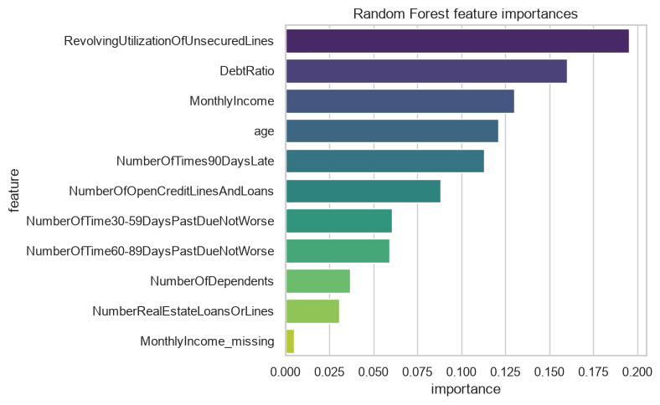
08 Appendix
Random Forest feature importance
Delinquency history and utilization provide useful risk information. Check their contribution with feature-group tests.
Give Me Some Credit
30 / 48
Notes:
Analysis: give_me_some_credit_tutorial.ipynb.
Figure: figures/notebook/give_me_some_credit/cell_035_figure_1.png
Measured results: run_results/give_me_some_credit_tutorial/results.json.
Notebook cell ID: 3d7404df.

Slide 31
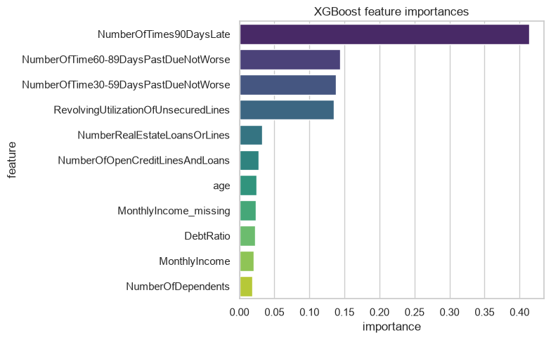
08 Appendix
XGBoost feature importance
Delinquency history and utilization provide useful risk information. Check their contribution with feature-group tests.
Give Me Some Credit
31 / 48
Notes:
Analysis: give_me_some_credit_tutorial.ipynb.
Figure: figures/notebook/give_me_some_credit/cell_041_figure_1.png
Measured results: run_results/give_me_some_credit_tutorial/results.json.
Notebook cell ID: fb14f52c.

Slide 32
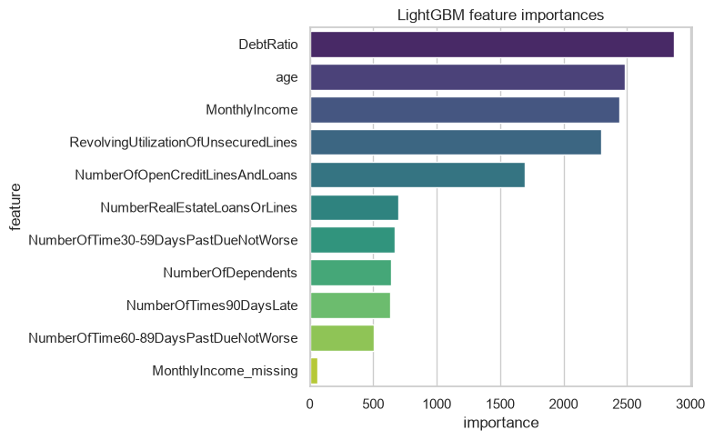
08 Appendix
LightGBM feature importance
Delinquency history and utilization provide useful risk information. Check their contribution with feature-group tests.
Give Me Some Credit
32 / 48
Notes:
Analysis: give_me_some_credit_tutorial.ipynb.
Figure: figures/notebook/give_me_some_credit/cell_053_figure_1.png
Measured results: run_results/give_me_some_credit_tutorial/results.json.
Notebook cell ID: 9dac3dda.

Slide 33
08 Appendix
Review capacity results
Reviewed | Applicants | Precision | Recall | Lift
1.0% | 300 | 65.0% | 9.7% | 9.73×
5.0% | 1,500 | 47.7% | 35.7% | 7.13×
10.0% | 3,000 | 37.2% | 55.7% | 5.57×
20.0% | 6,000 | 24.6% | 73.5% | 3.67×
CatBoost (tuned). Highest scores selected first. Capacity is the share reviewed.
Give Me Some Credit
33 / 48
Notes:
Analysis: give_me_some_credit_tutorial.ipynb.
Measured results: run_results/give_me_some_credit_tutorial/results.json.

Slide 34
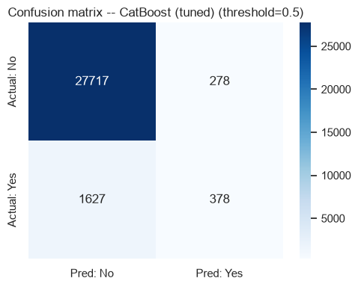
08 Appendix
Confusion matrix at 0.5
Rows show actual classes. Columns show predicted classes.
Give Me Some Credit
34 / 48
Notes:
Analysis: give_me_some_credit_tutorial.ipynb.
Figure: figures/notebook/give_me_some_credit/cell_060_figure_1.png
Measured results: run_results/give_me_some_credit_tutorial/results.json.
Notebook cell ID: c2106393.

Slide 35
08 Appendix
Threshold results
Cutoff | Flagged share | Precision | Recall
0.1 | 16.6% | 27.7% | 68.5%
0.2 | 8.9% | 38.7% | 51.5%
0.3 | 5.5% | 46.7% | 38.5%
0.5 | 2.2% | 57.6% | 18.9%
CatBoost (tuned). Cutoffs are descriptive test results. Select the operating rule using validation data.
Give Me Some Credit
35 / 48
Notes:
Analysis: give_me_some_credit_tutorial.ipynb.
Measured results: run_results/give_me_some_credit_tutorial/results.json.

Slide 36
08 Appendix
Calibration results
Risk group | Test cases | Mean prediction | Observed positive rate
Q1 lowest risk | 6,000 | 0.64% | 0.38%
Q2 | 6,000 | 1.16% | 1.07%
Q3 | 6,000 | 2.14% | 1.93%
Q4 | 6,000 | 5.14% | 5.48%
Q5 highest risk | 6,000 | 24.32% | 24.55%
CatBoost (tuned). Equal-count score groups compare average risk with observed outcomes.
Give Me Some Credit
36 / 48
Notes:
Analysis: give_me_some_credit_tutorial.ipynb.
Measured results: run_results/give_me_some_credit_tutorial/results.json.

Slide 37
08 Appendix
Application
Topic | Application
Ranking | Use the score to order applicants for further review.
Review policy | A fixed workload creates a measurable precision–recall trade-off.
Probability use | Check calibration before interpreting the score as an absolute risk.
Give Me Some Credit
37 / 48
Notes:
Analysis: give_me_some_credit_tutorial.ipynb.
Measured results: run_results/give_me_some_credit_tutorial/results.json.

Slide 38
08 Appendix
Model selection Q&A
Why include penalized linear models?
Ridge uses L2 shrinkage to stabilize coefficients. Lasso uses L1 to encourage zeros. Elastic Net combines the penalties. Logistic models use the same penalty types for classification.
Why standardize the predictors?
Penalties and distance calculations depend on feature units. Scaling also helps neural-network optimization. Estimate the scaling parameters from training data.
Why include stacking?
It does not improve the leading individual model here. Combining models helps only when their errors are sufficiently different. Compare its gain with inference and maintenance cost.
Give Me Some Credit
38 / 48
Notes:
Analysis: give_me_some_credit_tutorial.ipynb.
https://scikit-learn.org/stable/modules/linear_model.html
https://scikit-learn.org/stable/modules/neighbors.html
https://scikit-learn.org/stable/modules/neural_networks_supervised.html
Measured results: run_results/give_me_some_credit_tutorial/results.json.

Slide 39
08 Appendix
Model interpretation Q&A
How do forests and boosting differ?
Random Forest averages trees trained with randomized rows and features. Boosting adds trees sequentially to reduce the chosen loss.
What does feature importance mean?
It describes how the fitted model uses its inputs. Related predictors can share importance. A high value does not establish a causal effect.
What do the resampling intervals cover?
They measure variation in the available test predictions with the fitted models fixed. A new split also tests sensitivity to training and model selection.
Give Me Some Credit
39 / 48
Notes:
Analysis: give_me_some_credit_tutorial.ipynb.
https://scikit-learn.org/stable/modules/ensemble.html
https://xgboost.readthedocs.io/en/stable/tutorials/model.html
Measured results: run_results/give_me_some_credit_tutorial/results.json.

Slide 40
08 Appendix
Data Q&A
Why use ROC-AUC?
It measures risk ranking across score cutoffs. Precision and recall describe the workload and detection at a chosen cutoff.
Why is recall low at 0.5?
The model assigns scores above 0.5 to relatively few applicants. A lower cutoff captures more positive cases and increases review workload.
Give Me Some Credit
40 / 48
Notes:
Analysis: give_me_some_credit_tutorial.ipynb.
Measured results: run_results/give_me_some_credit_tutorial/results.json.

Slide 41
08 Appendix
Results Q&A
Does class weighting calibrate probabilities?
Weighting changes the training loss. Check calibration on representative held-out applicants before using scores as absolute probabilities.
How should the cutoff be selected?
Choose a review capacity or error-cost rule using validation data. Lock the rule and measure it on separate evaluation data.
Give Me Some Credit
41 / 48
Notes:
Analysis: give_me_some_credit_tutorial.ipynb.
Measured results: run_results/give_me_some_credit_tutorial/results.json.

Slide 42
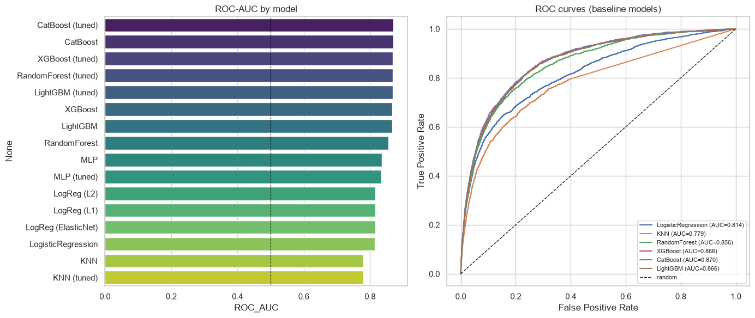
08 Appendix
ROC curves and model ranking
ROC curves and test results for the individual models. Stacking appears in the full results tables.
Give Me Some Credit
42 / 48
Notes:
Analysis: give_me_some_credit_tutorial.ipynb.
Figure: figures/notebook/give_me_some_credit/cell_059_figure_1.png
Measured results: run_results/give_me_some_credit_tutorial/results.json.
Notebook cell ID: f95c8d10.

Slide 43
08 Appendix
Full results (1 of 2)
Model | AUC | Accuracy | Precision | Recall | F1 | Log loss
CatBoost (tuned) | 0.8696 | 0.9365 | 0.5762 | 0.1885 | 0.2841 | 0.1766
CatBoost | 0.8695 | 0.9364 | 0.5752 | 0.1830 | 0.2777 | 0.1765
XGBoost (tuned) | 0.8690 | 0.9367 | 0.5806 | 0.1885 | 0.2846 | 0.1768
Forest (tuned) | 0.8683 | 0.9362 | 0.5836 | 0.1601 | 0.2513 | 0.1774
LightGBM (tuned) | 0.8682 | 0.9367 | 0.5809 | 0.1880 | 0.2841 | 0.1770
XGBoost | 0.8665 | 0.9360 | 0.5629 | 0.1920 | 0.2864 | 0.1781
LightGBM | 0.8662 | 0.9360 | 0.5629 | 0.1875 | 0.2813 | 0.1781
Stacking | 0.8647 | 0.9360 | 0.5584 | 0.2050 | 0.2999 | 0.1886
Random Forest | 0.8558 | 0.9360 | 0.5678 | 0.1776 | 0.2705 | 0.1898
Precision, recall and F1 use cutoff 0.5. All configurations use the same test applicants.
Give Me Some Credit
43 / 48
Notes:
Analysis: give_me_some_credit_tutorial.ipynb.
Measured results: run_results/give_me_some_credit_tutorial/results.json.
{"CatBoost (tuned)": {"ROC_AUC": 0.8696363663087325, "Accuracy": 0.9365, "Precision": 0.5762195121951219, "Recall": 0.1885286783042394, "F1": 0.28410372040586246, "LogLoss": 0.1766425262758299}, "CatBoost": {"ROC_AUC": 0.8695257124201463, "Accuracy": 0.9363666666666667, "Precision": 0.5752351097178683, "Recall": 0.18304239401496258, "F1": 0.2777147181233447, "LogLoss": 0.17654621402754475}, "XGBoost (tuned)": {"ROC_AUC": 0.8689674545552531, "Accuracy": 0.9366666666666666, "Precision": 0.5806451612903226, "Recall": 0.1885286783042394, "F1": 0.28463855421686746, "LogLoss": 0.17679260671138763}, "RandomForest (tuned)": {"ROC_AUC": 0.8682972066173199, "Accuracy": 0.9362333333333334, "Precision": 0.5836363636363636, "Recall": 0.1600997506234414, "F1": 0.2512720156555773, "LogLoss": 0.1774147424463194}, "LightGBM (tuned)": {"ROC_AUC": 0.8681778764376789, "Accuracy": 0.9366666666666666, "Precision": 0.5808936825885979, "Recall": 0.18802992518703243, "F1": 0.28409947249434814, "LogLoss": 0.17700380871895993}, "XGBoost": {"ROC_AUC": 0.866489233248367, "Accuracy": 0.9360333333333334, "Precision": 0.5628654970760234, "Recall": 0.19201995012468828, "F1": 0.2863518036444775, "LogLoss": 0.17805200815200806}, "LightGBM": {"ROC_AUC": 0.8662377455183261, "Accuracy": 0.9359666666666666, "Precision": 0.562874251497006, "Recall": 0.18753117206982545, "F1": 0.28133183688739244, "LogLoss": 0.1781006852679014}, "Stacking": {"ROC_AUC": 0.8647012670146388, "Accuracy": 0.9360333333333334, "Precision": 0.5584239130434783, "Recall": 0.20498753117206983, "F1": 0.2998905508938344, "LogLoss": 0.18857205534705712}, "RandomForest": {"ROC_AUC": 0.8558033207746841, "Accuracy": 0.936, "Precision": 0.5677830940988836, "Recall": 0.17755610972568578, "F1": 0.270516717325228, "LogLoss": 0.1898006413742805}, "MLP": {"ROC_AUC": 0.8353242986479149, "Accuracy": 0.9355, "Precision": 0.553680981595092, "Recall": 0.1800498753117207, "F1": 0.2717350395182537, "LogLoss": 0.18876437408072258}, "MLP (tuned)": {"ROC_AUC": 0.8337623168369486, "Accuracy": 0.9344666666666667, "Precision": 0.5249679897567221, "Recall": 0.20448877805486285, "F1": 0.29432878679109836, "LogLoss": 0.18933674983812646}, "LogReg (L2)": {"ROC_AUC": 0.8168002925353164, "Accuracy": 0.9358, "Precision": 0.5920745920745921, "Recall": 0.12668329177057355, "F1": 0.20870994248151192, "LogLoss": 0.20209867836693093}, "LogReg (L1)": {"ROC_AUC": 0.8164336524290275, "Accuracy": 0.9358666666666666, "Precision": 0.5824847250509165, "Recall": 0.142643391521197, "F1": 0.22916666666666666, "LogLoss": 0.20037569643164985}, "LogReg (ElasticNet)": {"ROC_AUC": 0.8158014233927594, "Accuracy": 0.9358666666666666, "Precision": 0.5814889336016097, "Recall": 0.14413965087281796, "F1": 0.23101518784972022, "LogLoss": 0.20029194730927666}, "LogisticRegression": {"ROC_AUC": 0.8144810860863558, "Accuracy": 0.9360666666666667, "Precision": 0.5854616895874263, "Recall": 0.1486284289276808, "F1": 0.23707239459029436, "LogLoss": 0.20015314340915583}, "KNN": {"ROC_AUC": 0.7789980220016133, "Accuracy": 0.9316, "Precision": 0.46998722860791825, "Recall": 0.18354114713216957, "F1": 0.26398852223816355, "LogLoss": 0.639195029472109}, "KNN (tuned)": {"ROC_AUC": 0.7789980220016133, "Accuracy": 0.9316, "Precision": 0.46998722860791825, "Recall": 0.18354114713216957, "F1": 0.26398852223816355, "LogLoss": 0.639195029472109}}

Slide 44
08 Appendix
Full results (2 of 2)
Model | AUC | Accuracy | Precision | Recall | F1 | Log loss
MLP | 0.8353 | 0.9355 | 0.5537 | 0.1800 | 0.2717 | 0.1888
MLP (tuned) | 0.8338 | 0.9345 | 0.5250 | 0.2045 | 0.2943 | 0.1893
L2 logistic | 0.8168 | 0.9358 | 0.5921 | 0.1267 | 0.2087 | 0.2021
L1 logistic | 0.8164 | 0.9359 | 0.5825 | 0.1426 | 0.2292 | 0.2004
Elastic Net logistic | 0.8158 | 0.9359 | 0.5815 | 0.1441 | 0.2310 | 0.2003
Logistic | 0.8145 | 0.9361 | 0.5855 | 0.1486 | 0.2371 | 0.2002
KNN | 0.7790 | 0.9316 | 0.4700 | 0.1835 | 0.2640 | 0.6392
KNN (tuned) | 0.7790 | 0.9316 | 0.4700 | 0.1835 | 0.2640 | 0.6392
Precision, recall and F1 use cutoff 0.5. All configurations use the same test applicants.
Give Me Some Credit
44 / 48
Notes:
Analysis: give_me_some_credit_tutorial.ipynb.
Measured results: run_results/give_me_some_credit_tutorial/results.json.
{"CatBoost (tuned)": {"ROC_AUC": 0.8696363663087325, "Accuracy": 0.9365, "Precision": 0.5762195121951219, "Recall": 0.1885286783042394, "F1": 0.28410372040586246, "LogLoss": 0.1766425262758299}, "CatBoost": {"ROC_AUC": 0.8695257124201463, "Accuracy": 0.9363666666666667, "Precision": 0.5752351097178683, "Recall": 0.18304239401496258, "F1": 0.2777147181233447, "LogLoss": 0.17654621402754475}, "XGBoost (tuned)": {"ROC_AUC": 0.8689674545552531, "Accuracy": 0.9366666666666666, "Precision": 0.5806451612903226, "Recall": 0.1885286783042394, "F1": 0.28463855421686746, "LogLoss": 0.17679260671138763}, "RandomForest (tuned)": {"ROC_AUC": 0.8682972066173199, "Accuracy": 0.9362333333333334, "Precision": 0.5836363636363636, "Recall": 0.1600997506234414, "F1": 0.2512720156555773, "LogLoss": 0.1774147424463194}, "LightGBM (tuned)": {"ROC_AUC": 0.8681778764376789, "Accuracy": 0.9366666666666666, "Precision": 0.5808936825885979, "Recall": 0.18802992518703243, "F1": 0.28409947249434814, "LogLoss": 0.17700380871895993}, "XGBoost": {"ROC_AUC": 0.866489233248367, "Accuracy": 0.9360333333333334, "Precision": 0.5628654970760234, "Recall": 0.19201995012468828, "F1": 0.2863518036444775, "LogLoss": 0.17805200815200806}, "LightGBM": {"ROC_AUC": 0.8662377455183261, "Accuracy": 0.9359666666666666, "Precision": 0.562874251497006, "Recall": 0.18753117206982545, "F1": 0.28133183688739244, "LogLoss": 0.1781006852679014}, "Stacking": {"ROC_AUC": 0.8647012670146388, "Accuracy": 0.9360333333333334, "Precision": 0.5584239130434783, "Recall": 0.20498753117206983, "F1": 0.2998905508938344, "LogLoss": 0.18857205534705712}, "RandomForest": {"ROC_AUC": 0.8558033207746841, "Accuracy": 0.936, "Precision": 0.5677830940988836, "Recall": 0.17755610972568578, "F1": 0.270516717325228, "LogLoss": 0.1898006413742805}, "MLP": {"ROC_AUC": 0.8353242986479149, "Accuracy": 0.9355, "Precision": 0.553680981595092, "Recall": 0.1800498753117207, "F1": 0.2717350395182537, "LogLoss": 0.18876437408072258}, "MLP (tuned)": {"ROC_AUC": 0.8337623168369486, "Accuracy": 0.9344666666666667, "Precision": 0.5249679897567221, "Recall": 0.20448877805486285, "F1": 0.29432878679109836, "LogLoss": 0.18933674983812646}, "LogReg (L2)": {"ROC_AUC": 0.8168002925353164, "Accuracy": 0.9358, "Precision": 0.5920745920745921, "Recall": 0.12668329177057355, "F1": 0.20870994248151192, "LogLoss": 0.20209867836693093}, "LogReg (L1)": {"ROC_AUC": 0.8164336524290275, "Accuracy": 0.9358666666666666, "Precision": 0.5824847250509165, "Recall": 0.142643391521197, "F1": 0.22916666666666666, "LogLoss": 0.20037569643164985}, "LogReg (ElasticNet)": {"ROC_AUC": 0.8158014233927594, "Accuracy": 0.9358666666666666, "Precision": 0.5814889336016097, "Recall": 0.14413965087281796, "F1": 0.23101518784972022, "LogLoss": 0.20029194730927666}, "LogisticRegression": {"ROC_AUC": 0.8144810860863558, "Accuracy": 0.9360666666666667, "Precision": 0.5854616895874263, "Recall": 0.1486284289276808, "F1": 0.23707239459029436, "LogLoss": 0.20015314340915583}, "KNN": {"ROC_AUC": 0.7789980220016133, "Accuracy": 0.9316, "Precision": 0.46998722860791825, "Recall": 0.18354114713216957, "F1": 0.26398852223816355, "LogLoss": 0.639195029472109}, "KNN (tuned)": {"ROC_AUC": 0.7789980220016133, "Accuracy": 0.9316, "Precision": 0.46998722860791825, "Recall": 0.18354114713216957, "F1": 0.26398852223816355, "LogLoss": 0.639195029472109}}

Slide 45
08 Appendix
Model settings
Model | Parameters
KNN | n_neighbors=15, weights='distance'
MLP | hidden_layer_sizes=(64, 32), alpha=0.0001, max_iter=500, early_stopping=True
Random Forest | n_estimators=300, max_depth=None, min_samples_leaf=2
XGBoost | n_estimators=500, learning_rate=0.05, max_depth=5
CatBoost | iterations=500, learning_rate=0.05, depth=6
LightGBM | n_estimators=500, learning_rate=0.05, num_leaves=31
Searches use two folds and two candidates. Each selected estimator refits on the full training partition.
Give Me Some Credit
45 / 48
Notes:
Analysis: give_me_some_credit_tutorial.ipynb.
Seed 42. Stacking uses two ordinary folds. Penalized linear models test three strengths. See the notebook for all constructor arguments.
Measured results: run_results/give_me_some_credit_tutorial/results.json.

Slide 46
08 Appendix
Selected hyperparameters (1 of 2)
Model | Selected parameters
KNN | n_neighbors=15, p=2, weights=distance
MLP | hidden_layer_sizes=(64, 32), alpha=0.001
Random Forest | n_estimators=300, min_samples_leaf=5, max_depth=12
Give Me Some Credit
46 / 48
Notes:
Analysis: give_me_some_credit_tutorial.ipynb.
Measured results: run_results/give_me_some_credit_tutorial/results.json.

Slide 47
08 Appendix
Selected hyperparameters (2 of 2)
Model | Selected parameters
XGBoost | n_estimators=500, max_depth=5, learning_rate=0.03
CatBoost | learning_rate=0.05, iterations=500, depth=6
LightGBM | num_leaves=31, n_estimators=500, learning_rate=0.03
Give Me Some Credit
47 / 48
Notes:
Analysis: give_me_some_credit_tutorial.ipynb.
Measured results: run_results/give_me_some_credit_tutorial/results.json.

Slide 48
08 Appendix
Sources
Dataset
Methods
Kaggle Give Me Some Credit training data
scikit-learn, XGBoost, CatBoost and LightGBM documentation.
Project analysis
give_me_some_credit_tutorial.ipynb
Statistical analysis
Paired resampling of test predictions, residual analysis and group-level error checks.
Give Me Some Credit
48 / 48
Notes:
Analysis: give_me_some_credit_tutorial.ipynb.
https://scikit-learn.org/stable/modules/linear_model.html
https://scikit-learn.org/stable/modules/neighbors.html
https://scikit-learn.org/stable/modules/neural_networks_supervised.html
https://scikit-learn.org/stable/modules/ensemble.html
https://xgboost.readthedocs.io/en/stable/tutorials/model.html
https://catboost.ai/docs/en/concepts/algorithm-main-stages_cat-to-numberic
https://lightgbm.readthedocs.io/en/stable/Features.html
https://www.statsmodels.org/stable/generated/statsmodels.tsa.statespace.sarimax.SARIMAX.html
Measured results: run_results/give_me_some_credit_tutorial/results.json.

