Slide 1
DATA SCIENCE PROJECT
Home Credit Default Risk
Predicting payment difficulty from loan applications
Data, methods and results
Notes:
Analysis: home_credit_tutorial.ipynb.
Measured results: run_results/home_credit_tutorial/results.json.

Slide 2
01 Summary
Summary
Best model
0.7579
XGBoost reaches ROC-AUC 0.7579 using all 246,008 training applications.
Test ROC-AUC
Review capacity
Reviewing the highest-scored 10% captures 33.8% of positive cases at 27.2% precision.
Next step
Add customer-history features and validate a cutoff that matches the intended review workload.
Home Credit Default Risk
02 / 48
Notes:
Analysis: home_credit_tutorial.ipynb.
Measured results: run_results/home_credit_tutorial/results.json.
{"XGBoost": {"ROC_AUC": 0.7579147580767804, "Accuracy": 0.9195974180121295, "Precision": 0.5581395348837209, "Recall": 0.01933534743202417, "F1": 0.03737590033093245, "LogLoss": 0.2459821254014969}, "XGBoost (tuned)": {"ROC_AUC": 0.7564511362337308, "Accuracy": 0.9197437523372843, "Precision": 0.6178861788617886, "Recall": 0.015307150050352467, "F1": 0.029874213836477988, "LogLoss": 0.24639832973480225}, "LightGBM (tuned)": {"ROC_AUC": 0.7561654707220948, "Accuracy": 0.9195161211648212, "Precision": 0.5609756097560976, "Recall": 0.013897280966767372, "F1": 0.027122641509433963, "LogLoss": 0.24652489334646221}, "LightGBM": {"ROC_AUC": 0.7559431104932519, "Accuracy": 0.919662455489976, "Precision": 0.5681818181818182, "Recall": 0.02014098690835851, "F1": 0.03890293717175647, "LogLoss": 0.2464248869516287}, "CatBoost": {"ROC_AUC": 0.7558497440625537, "Accuracy": 0.9196136773815912, "Precision": 0.5801526717557252, "Recall": 0.015307150050352467, "F1": 0.029827315541601257, "LogLoss": 0.24666543693439086}, "CatBoost (tuned)": {"ROC_AUC": 0.7558497440625537, "Accuracy": 0.9196136773815912, "Precision": 0.5801526717557252, "Recall": 0.015307150050352467, "F1": 0.029827315541601257, "LogLoss": 0.24666543693439086}, "Stacking": {"ROC_AUC": 0.7531354416712381, "Accuracy": 0.919060858819895, "Precision": 0.4883720930232558, "Recall": 0.05498489425981873, "F1": 0.09884141926140477, "LogLoss": 0.25036744221350404}, "LogisticRegression": {"ROC_AUC": 0.7459082586560414, "Accuracy": 0.9194673430564363, "Precision": 0.5576923076923077, "Recall": 0.011681772406847936, "F1": 0.02288419806667982, "LogLoss": 0.24963839883446673}, "LogReg (L1)": {"ROC_AUC": 0.7442854945886193, "Accuracy": 0.9194023055785897, "Precision": 0.5444444444444444, "Recall": 0.00986908358509567, "F1": 0.019386745796241344, "LogLoss": 0.250159537246833}, "MLP": {"ROC_AUC": 0.7431767179054543, "Accuracy": 0.9191584150366648, "Precision": 0.4567901234567901, "Recall": 0.0074521651560926485, "F1": 0.01466508125247721, "LogLoss": 0.2526334681582281}, "MLP (tuned)": {"ROC_AUC": 0.7399530663493014, "Accuracy": 0.9186706339528153, "Precision": 0.4359861591695502, "Recall": 0.025377643504531724, "F1": 0.04796345641416064, "LogLoss": 0.25319293027799367}, "RandomForest (tuned)": {"ROC_AUC": 0.7394335537128786, "Accuracy": 0.9192722306228964, "Precision": 0.0, "Recall": 0.0, "F1": 0.0, "LogLoss": 0.25566439244498473}, "LogReg (ElasticNet)": {"ROC_AUC": 0.7370269163140176, "Accuracy": 0.9191909337755881, "Precision": 0.45614035087719296, "Recall": 0.0052366565961732125, "F1": 0.010354440461967344, "LogLoss": 0.2523408216964693}, "RandomForest": {"ROC_AUC": 0.7313019446287086, "Accuracy": 0.9192884899923581, "Precision": 1.0, "Recall": 0.0002014098690835851, "F1": 0.0004027386226339106, "LogLoss": 0.2536532058295237}, "LogReg (L2)": {"ROC_AUC": 0.728896744650382, "Accuracy": 0.9192071931450498, "Precision": 0.43333333333333335, "Recall": 0.0026183282980866062, "F1": 0.005205205205205205, "LogLoss": 0.25480006924541143}, "KNN": {"ROC_AUC": 0.6415521583982569, "Accuracy": 0.9191258962977416, "Precision": 0.38461538461538464, "Recall": 0.0030211480362537764, "F1": 0.005995203836930456, "LogLoss": 0.8148754352999926}, "KNN (tuned)": {"ROC_AUC": 0.6415521583982569, "Accuracy": 0.9191258962977416, "Precision": 0.38461538461538464, "Recall": 0.0030211480362537764, "F1": 0.005995203836930456, "LogLoss": 0.8148754352999926}}

Slide 3
02 Objective and data
Objective
Objective
Predict payment difficulty from the main application table and compare models for mixed numerical and categorical data.
Prediction unit
One loan application. Preprocessing uses all 307,511 available applications.
Evaluation
ROC-AUC for ranking, log loss for probabilities, and precision–recall at a chosen cutoff.
Home Credit Default Risk
03 / 48
Notes:
Analysis: home_credit_tutorial.ipynb.
Measured results: run_results/home_credit_tutorial/results.json.

Slide 4
02 Objective and data
Dataset
Item | Details
Records | 307,511 loan applications and 122 source columns
Features | 79 predictors after filtering, encoded to 195 columns
Inputs | All available applications from the main application table
Class balance | 8.07% payment-difficulty outcomes
Home Credit Default Risk
04 / 48
Notes:
Analysis: home_credit_tutorial.ipynb.
Measured results: run_results/home_credit_tutorial/results.json.

Slide 5
02 Objective and data
Preprocessing
Step | Processing
Identifiers | Remove SK_ID_CURR from the predictors.
Employment | Replace DAYS_EMPLOYED = 365243 with missing values.
Income | Cap income at the 99th percentile of the full dataset.
Missing values | Drop columns above 50% missing. Fill numerical gaps with medians and label missing categories.
Home Credit Default Risk
05 / 48
Notes:
Analysis: home_credit_tutorial.ipynb.
Measured results: run_results/home_credit_tutorial/results.json.

Slide 6
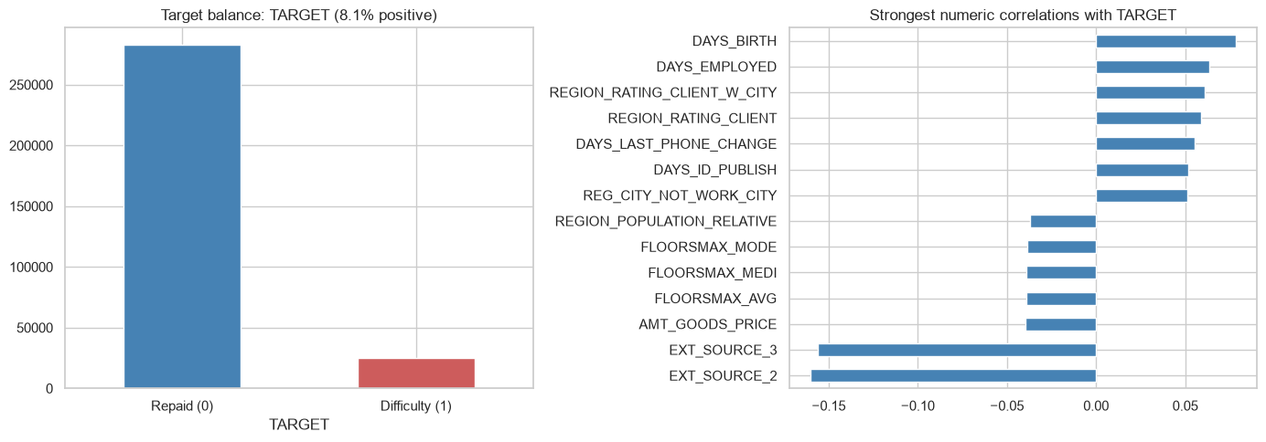
03 EDA and features
Class balance and feature associations
About 8.07% of applicants have payment difficulty.
Home Credit Default Risk
06 / 48
Notes:
Analysis: home_credit_tutorial.ipynb.
Measured results: run_results/home_credit_tutorial/results.json.
Notebook cell ID: b027d54e.
Figure: figures/notebook/home_credit/cell_008_figure_1.png

Slide 7
03 EDA and features
EDA findings
Outcome balance
About 8.07% of applicants have payment difficulty.
Mixed features
Financial values, demographic fields and application categories have different missingness patterns.
Additional data
Bureau and previous-application histories could add information beyond the main table.
Home Credit Default Risk
07 / 48
Notes:
Analysis: home_credit_tutorial.ipynb.
Measured results: run_results/home_credit_tutorial/results.json.

Slide 8
03 EDA and features
Feature engineering
Feature group | Predictors
Financial profile | Income, credit amount, annuity and goods price
Applicant | Age, household information and application categories
External scores | External-source score fields in the main application table
Data used | Main application table only
Home Credit Default Risk
08 / 48
Notes:
Analysis: home_credit_tutorial.ipynb.
Measured results: run_results/home_credit_tutorial/results.json.

Slide 9
04 Validation
Train–test split
Partition
Stratified 80/20 split with seed 42 gives 246,008 training applications and 61,503 test applications. Search uses two stratified folds.
Transforms
Fit scaling and categorical encoding on training rows. Full-data imputation and filtering remain a validation limitation.
Evaluation
All fitted models use this training partition and the same held-out applicants.
Home Credit Default Risk
09 / 48
Notes:
Analysis: home_credit_tutorial.ipynb.
Measured results: run_results/home_credit_tutorial/results.json.

Slide 10
05 Methods
Methods
Family | Models | Role
Logistic | Logistic regression with L2, L1 and Elastic Net penalties | Interpretable reference
Local | K-nearest neighbors | Predict from similar records
Neural | Multilayer perceptron | Learn nonlinear relationships
Trees | Random Forest, XGBoost, CatBoost and LightGBM | Learn thresholds and interactions
Ensemble | Stacking of Random Forest, XGBoost and LightGBM | Combine predictions using a fitted meta-model
Home Credit Default Risk
10 / 48
Notes:
Analysis: home_credit_tutorial.ipynb.
Measured results: run_results/home_credit_tutorial/results.json.

Slide 11
05 Methods
Logistic regression
Model | Strength | Weakness
Reference logistic | Easy to inspect and use as a baseline | Misses nonlinear effects without added features
L2 logistic | Stabilizes coefficients when predictors overlap | Keeps all predictors and introduces shrinkage bias
L1 logistic | Can remove weak predictors with zero coefficients | Can select inconsistently among correlated inputs
Elastic Net | Combines sparse selection with L2 shrinkage | Requires penalty strength and mixing to be selected
Home Credit Default Risk
11 / 48
Notes:
Analysis: home_credit_tutorial.ipynb.
https://scikit-learn.org/stable/modules/linear_model.html
Measured results: run_results/home_credit_tutorial/results.json.

Slide 12
05 Methods
KNN and neural networks
Model | Strength | Weakness
KNN | Simple local prediction with few modeling assumptions | Distances depend on scaling. Prediction slows as the reference set grows.
MLP | Learns smooth nonlinear effects and interactions | Sensitive to scaling and optimization. Needs regularization and convergence checks.
Home Credit Default Risk
12 / 48
Notes:
Analysis: home_credit_tutorial.ipynb.
Measured results: run_results/home_credit_tutorial/results.json.

Slide 13
05 Methods
Tree-based models
Model | Strength | Weakness
Random Forest | Averaging many trees reduces variance and captures interactions | Large ensembles use memory and extrapolate poorly
XGBoost | Regularized boosting handles complex tabular relationships | Tree depth, learning rate and tree count need joint selection
CatBoost | Supports categorical features alongside numerical features | Training can be costly. Data quality still limits performance
LightGBM | Histogram splits support efficient training on large tables | Flexible leaf growth can overfit small groups
Home Credit Default Risk
13 / 48
Notes:
Analysis: home_credit_tutorial.ipynb.
Measured results: run_results/home_credit_tutorial/results.json.

Slide 14
05 Methods
Stacking
Random Forest, XGBoost and LightGBM generate out-of-fold predictions. A logistic meta-model learns how to combine them.
Strengths
Weaknesses
Can reduce error when the base models make different mistakes. The meta-model learns the weights from training predictions.
Adds fitting and inference cost. Similar base-model errors can limit the gain.
RESULT IN THIS STUDY
ROC-AUC 0.7531 and log loss 0.2504. It does not exceed the best individual model on the primary metric.
Home Credit Default Risk
14 / 48
Notes:
Analysis: home_credit_tutorial.ipynb.
Base models: fitted reference configurations, each cloned and refitted by StackingRegressor/Classifier. cv=2. Meta-model: LogisticRegression(C=1.0, max_iter=2000).
https://scikit-learn.org/stable/modules/ensemble.html#stacking
Measured results: run_results/home_credit_tutorial/results.json.

Slide 15
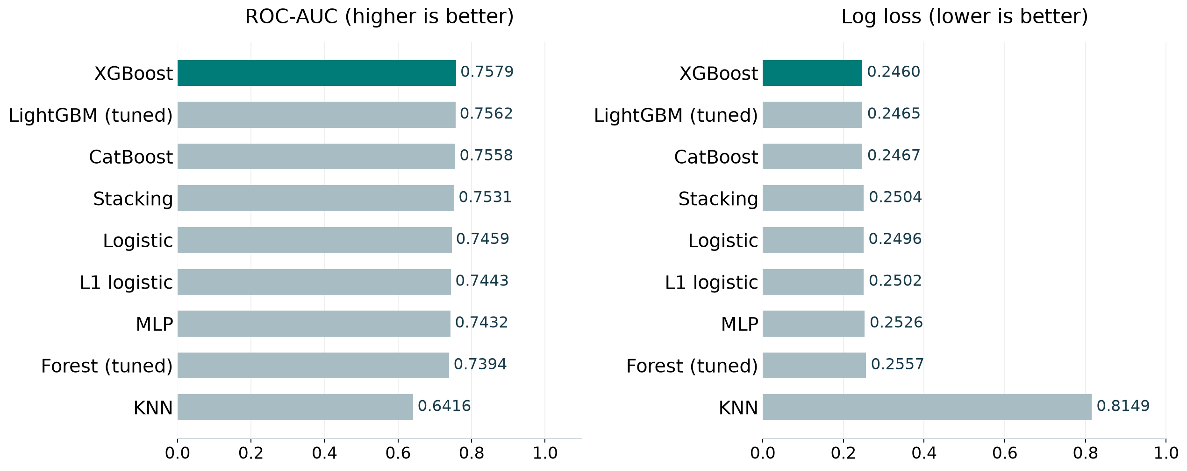
06 Results
Model comparison
Best test score per family, including the strongest penalized linear model. Full results appear in the appendix.
Home Credit Default Risk
15 / 48
Notes:
Analysis: home_credit_tutorial.ipynb.
Measured results: run_results/home_credit_tutorial/results.json.
Figure: figures/home_credit/comparison.png

Slide 16
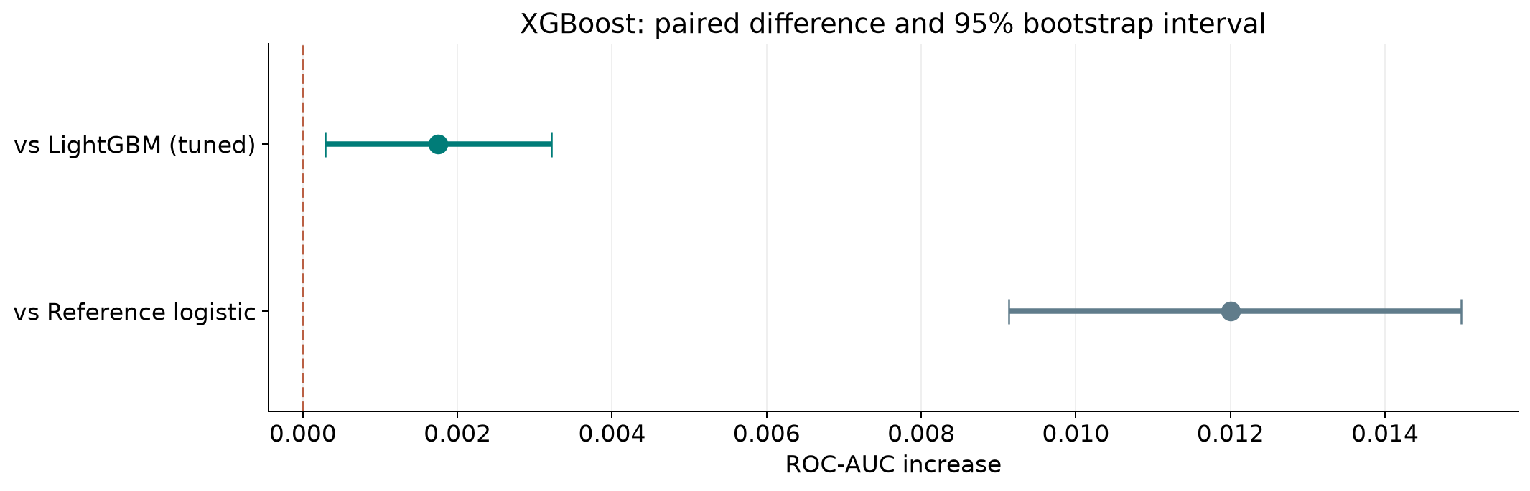
06 Results
Ranking stability
XGBoost has higher AUC than LightGBM (tuned) across the 95% resampling interval.
Home Credit Default Risk
16 / 48
Notes:
Analysis: home_credit_tutorial.ipynb.
paired stratified row bootstrap. 1,000 paired resamples. Fitted models remain fixed.
[{"comparison": "XGBoost versus LightGBM (tuned)", "other": "LightGBM (tuned)", "advantage": 0.0017492873546856025, "ci_low": 0.00029312994563071847, "ci_high": 0.0032169645226443025}, {"comparison": "XGBoost versus Reference logistic", "other": "Reference logistic", "advantage": 0.012006499420739059, "ci_low": 0.009128066581746605, "ci_high": 0.014983527997835028}]
Measured results: run_results/home_credit_tutorial/results.json.
Figure: figures/home_credit/ranking_stability.png

Slide 17
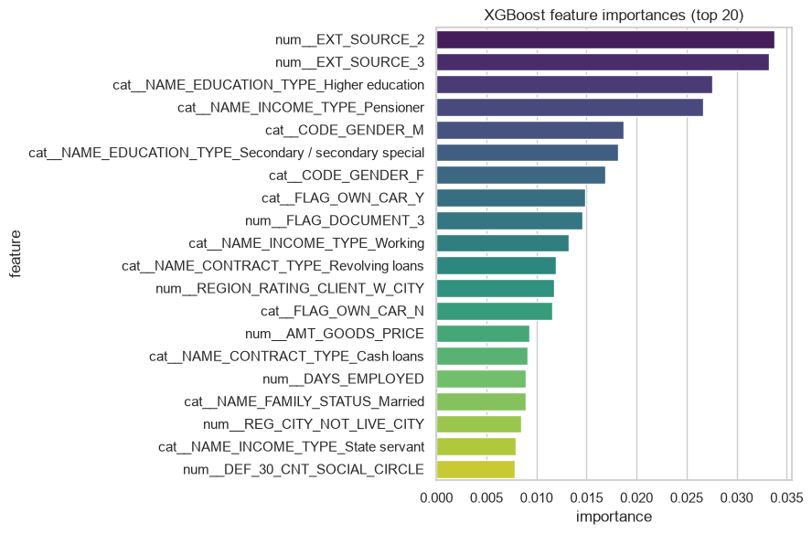
06 Results
XGBoost feature importance
External-source scores and applicant history fields recur across models. Related historical tables may add useful information.
Home Credit Default Risk
17 / 48
Notes:
Analysis: home_credit_tutorial.ipynb.
Measured results: run_results/home_credit_tutorial/results.json.
Notebook cell ID: d6eb51ba.
Figure: figures/notebook/home_credit/cell_040_figure_1.png

Slide 18
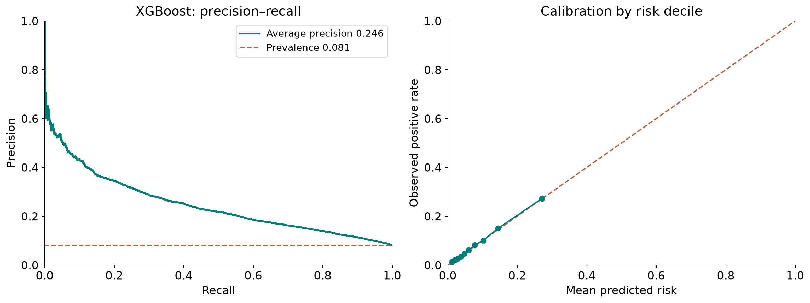
06 Results
Precision–recall and calibration
XGBoost: average precision 0.246, positive prevalence 0.081, Brier score 0.0677.
Home Credit Default Risk
18 / 48
Notes:
Analysis: home_credit_tutorial.ipynb.
Measured results: run_results/home_credit_tutorial/results.json.
Diagnostics use XGBoost predictions.
Figure: figures/home_credit/pr_calibration.png

Slide 19
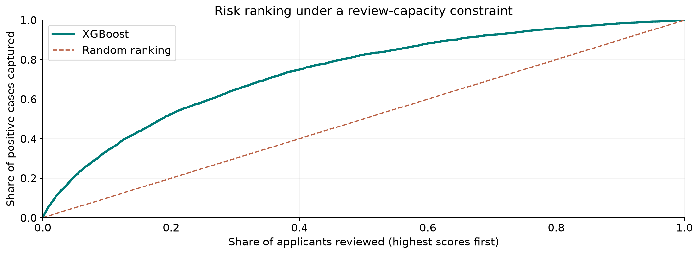
06 Results
Review capacity
XGBoost, top 10% reviewed: 33.8% recall and 27.2% precision.
Home Credit Default Risk
19 / 48
Notes:
Analysis: home_credit_tutorial.ipynb.
Measured results: run_results/home_credit_tutorial/results.json.
Diagnostics use XGBoost predictions.
Figure: figures/home_credit/review_capacity.png

Slide 20
06 Results
Results
Risk ranking
XGBoost improves AUC by 0.0120 over logistic regression. Its lead over LightGBM remains small.
Detection
Cutoff 0.5 captures 1.9% of positives. A 10% review share captures 33.8%.
Feature coverage
The model uses the application table alone. Bureau, previous-application and payment histories are the next feature sources.
Home Credit Default Risk
20 / 48
Notes:
Analysis: home_credit_tutorial.ipynb.
Measured results: run_results/home_credit_tutorial/results.json.
{"XGBoost": {"ROC_AUC": 0.7579147580767804, "Accuracy": 0.9195974180121295, "Precision": 0.5581395348837209, "Recall": 0.01933534743202417, "F1": 0.03737590033093245, "LogLoss": 0.2459821254014969}, "XGBoost (tuned)": {"ROC_AUC": 0.7564511362337308, "Accuracy": 0.9197437523372843, "Precision": 0.6178861788617886, "Recall": 0.015307150050352467, "F1": 0.029874213836477988, "LogLoss": 0.24639832973480225}, "LightGBM (tuned)": {"ROC_AUC": 0.7561654707220948, "Accuracy": 0.9195161211648212, "Precision": 0.5609756097560976, "Recall": 0.013897280966767372, "F1": 0.027122641509433963, "LogLoss": 0.24652489334646221}, "LightGBM": {"ROC_AUC": 0.7559431104932519, "Accuracy": 0.919662455489976, "Precision": 0.5681818181818182, "Recall": 0.02014098690835851, "F1": 0.03890293717175647, "LogLoss": 0.2464248869516287}, "CatBoost": {"ROC_AUC": 0.7558497440625537, "Accuracy": 0.9196136773815912, "Precision": 0.5801526717557252, "Recall": 0.015307150050352467, "F1": 0.029827315541601257, "LogLoss": 0.24666543693439086}, "CatBoost (tuned)": {"ROC_AUC": 0.7558497440625537, "Accuracy": 0.9196136773815912, "Precision": 0.5801526717557252, "Recall": 0.015307150050352467, "F1": 0.029827315541601257, "LogLoss": 0.24666543693439086}, "Stacking": {"ROC_AUC": 0.7531354416712381, "Accuracy": 0.919060858819895, "Precision": 0.4883720930232558, "Recall": 0.05498489425981873, "F1": 0.09884141926140477, "LogLoss": 0.25036744221350404}, "LogisticRegression": {"ROC_AUC": 0.7459082586560414, "Accuracy": 0.9194673430564363, "Precision": 0.5576923076923077, "Recall": 0.011681772406847936, "F1": 0.02288419806667982, "LogLoss": 0.24963839883446673}, "LogReg (L1)": {"ROC_AUC": 0.7442854945886193, "Accuracy": 0.9194023055785897, "Precision": 0.5444444444444444, "Recall": 0.00986908358509567, "F1": 0.019386745796241344, "LogLoss": 0.250159537246833}, "MLP": {"ROC_AUC": 0.7431767179054543, "Accuracy": 0.9191584150366648, "Precision": 0.4567901234567901, "Recall": 0.0074521651560926485, "F1": 0.01466508125247721, "LogLoss": 0.2526334681582281}, "MLP (tuned)": {"ROC_AUC": 0.7399530663493014, "Accuracy": 0.9186706339528153, "Precision": 0.4359861591695502, "Recall": 0.025377643504531724, "F1": 0.04796345641416064, "LogLoss": 0.25319293027799367}, "RandomForest (tuned)": {"ROC_AUC": 0.7394335537128786, "Accuracy": 0.9192722306228964, "Precision": 0.0, "Recall": 0.0, "F1": 0.0, "LogLoss": 0.25566439244498473}, "LogReg (ElasticNet)": {"ROC_AUC": 0.7370269163140176, "Accuracy": 0.9191909337755881, "Precision": 0.45614035087719296, "Recall": 0.0052366565961732125, "F1": 0.010354440461967344, "LogLoss": 0.2523408216964693}, "RandomForest": {"ROC_AUC": 0.7313019446287086, "Accuracy": 0.9192884899923581, "Precision": 1.0, "Recall": 0.0002014098690835851, "F1": 0.0004027386226339106, "LogLoss": 0.2536532058295237}, "LogReg (L2)": {"ROC_AUC": 0.728896744650382, "Accuracy": 0.9192071931450498, "Precision": 0.43333333333333335, "Recall": 0.0026183282980866062, "F1": 0.005205205205205205, "LogLoss": 0.25480006924541143}, "KNN": {"ROC_AUC": 0.6415521583982569, "Accuracy": 0.9191258962977416, "Precision": 0.38461538461538464, "Recall": 0.0030211480362537764, "F1": 0.005995203836930456, "LogLoss": 0.8148754352999926}, "KNN (tuned)": {"ROC_AUC": 0.6415521583982569, "Accuracy": 0.9191258962977416, "Precision": 0.38461538461538464, "Recall": 0.0030211480362537764, "F1": 0.005995203836930456, "LogLoss": 0.8148754352999926}}

Slide 21
07 Conclusion
Limitations
Limitation | Details
Preprocessing | Income caps, column filters and imputation use full-data statistics.
Validation | A single random split does not establish performance for future applicants.
Feature coverage | Related history tables are outside the current model.
Detection | AUC alone does not describe recall or calibration at the chosen cutoff.
Home Credit Default Risk
21 / 48
Notes:
Analysis: home_credit_tutorial.ipynb.
Measured results: run_results/home_credit_tutorial/results.json.

Slide 22
07 Conclusion
Next steps
# | Test | Method | Measure
1 | Fold-safe cleaning | Learn caps, column filters and imputers from training folds. | An uncontaminated validation pipeline
2 | Relational features | Aggregate bureau, prior-application and balance histories by customer. | Incremental signal beyond the main table
3 | Temporal validation | Reserve later applications and compare performance by applicant group. | Stable future performance
4 | Policy evaluation | Compare PR performance, calibration and recall at review capacity. | A measurable operating threshold
Home Credit Default Risk
22 / 48
Notes:
Analysis: home_credit_tutorial.ipynb.
Measured results: run_results/home_credit_tutorial/results.json.

Slide 23
07 Conclusion
Conclusion
XGBoost leads application scoring
ROC-AUC 0.7579
History features and a validated review policy are the next priorities. Confirm performance on future applicants and relevant subgroups.
Home Credit Default Risk
23 / 48
Notes:
Analysis: home_credit_tutorial.ipynb.
Measured results: run_results/home_credit_tutorial/results.json.
{"XGBoost": {"ROC_AUC": 0.7579147580767804, "Accuracy": 0.9195974180121295, "Precision": 0.5581395348837209, "Recall": 0.01933534743202417, "F1": 0.03737590033093245, "LogLoss": 0.2459821254014969}, "XGBoost (tuned)": {"ROC_AUC": 0.7564511362337308, "Accuracy": 0.9197437523372843, "Precision": 0.6178861788617886, "Recall": 0.015307150050352467, "F1": 0.029874213836477988, "LogLoss": 0.24639832973480225}, "LightGBM (tuned)": {"ROC_AUC": 0.7561654707220948, "Accuracy": 0.9195161211648212, "Precision": 0.5609756097560976, "Recall": 0.013897280966767372, "F1": 0.027122641509433963, "LogLoss": 0.24652489334646221}, "LightGBM": {"ROC_AUC": 0.7559431104932519, "Accuracy": 0.919662455489976, "Precision": 0.5681818181818182, "Recall": 0.02014098690835851, "F1": 0.03890293717175647, "LogLoss": 0.2464248869516287}, "CatBoost": {"ROC_AUC": 0.7558497440625537, "Accuracy": 0.9196136773815912, "Precision": 0.5801526717557252, "Recall": 0.015307150050352467, "F1": 0.029827315541601257, "LogLoss": 0.24666543693439086}, "CatBoost (tuned)": {"ROC_AUC": 0.7558497440625537, "Accuracy": 0.9196136773815912, "Precision": 0.5801526717557252, "Recall": 0.015307150050352467, "F1": 0.029827315541601257, "LogLoss": 0.24666543693439086}, "Stacking": {"ROC_AUC": 0.7531354416712381, "Accuracy": 0.919060858819895, "Precision": 0.4883720930232558, "Recall": 0.05498489425981873, "F1": 0.09884141926140477, "LogLoss": 0.25036744221350404}, "LogisticRegression": {"ROC_AUC": 0.7459082586560414, "Accuracy": 0.9194673430564363, "Precision": 0.5576923076923077, "Recall": 0.011681772406847936, "F1": 0.02288419806667982, "LogLoss": 0.24963839883446673}, "LogReg (L1)": {"ROC_AUC": 0.7442854945886193, "Accuracy": 0.9194023055785897, "Precision": 0.5444444444444444, "Recall": 0.00986908358509567, "F1": 0.019386745796241344, "LogLoss": 0.250159537246833}, "MLP": {"ROC_AUC": 0.7431767179054543, "Accuracy": 0.9191584150366648, "Precision": 0.4567901234567901, "Recall": 0.0074521651560926485, "F1": 0.01466508125247721, "LogLoss": 0.2526334681582281}, "MLP (tuned)": {"ROC_AUC": 0.7399530663493014, "Accuracy": 0.9186706339528153, "Precision": 0.4359861591695502, "Recall": 0.025377643504531724, "F1": 0.04796345641416064, "LogLoss": 0.25319293027799367}, "RandomForest (tuned)": {"ROC_AUC": 0.7394335537128786, "Accuracy": 0.9192722306228964, "Precision": 0.0, "Recall": 0.0, "F1": 0.0, "LogLoss": 0.25566439244498473}, "LogReg (ElasticNet)": {"ROC_AUC": 0.7370269163140176, "Accuracy": 0.9191909337755881, "Precision": 0.45614035087719296, "Recall": 0.0052366565961732125, "F1": 0.010354440461967344, "LogLoss": 0.2523408216964693}, "RandomForest": {"ROC_AUC": 0.7313019446287086, "Accuracy": 0.9192884899923581, "Precision": 1.0, "Recall": 0.0002014098690835851, "F1": 0.0004027386226339106, "LogLoss": 0.2536532058295237}, "LogReg (L2)": {"ROC_AUC": 0.728896744650382, "Accuracy": 0.9192071931450498, "Precision": 0.43333333333333335, "Recall": 0.0026183282980866062, "F1": 0.005205205205205205, "LogLoss": 0.25480006924541143}, "KNN": {"ROC_AUC": 0.6415521583982569, "Accuracy": 0.9191258962977416, "Precision": 0.38461538461538464, "Recall": 0.0030211480362537764, "F1": 0.005995203836930456, "LogLoss": 0.8148754352999926}, "KNN (tuned)": {"ROC_AUC": 0.6415521583982569, "Accuracy": 0.9191258962977416, "Precision": 0.38461538461538464, "Recall": 0.0030211480362537764, "F1": 0.005995203836930456, "LogLoss": 0.8148754352999926}}

Slide 24
08 Appendix
Evaluation metrics
Metric | Meaning | Role
ROC-AUC | Ranking across thresholds | Primary model comparison
Log loss | Quality of predicted probabilities | Probability assessment
Precision and recall | Detection and false-positive trade-off | Threshold analysis
Calibration | Agreement of predicted and observed risk | Probability interpretation
Home Credit Default Risk
24 / 48
Notes:
Analysis: home_credit_tutorial.ipynb.
Measured results: run_results/home_credit_tutorial/results.json.

Slide 25
08 Appendix
Logistic regularization
Variant | Training objective | Main effect
Reference logistic | Logistic loss with reference settings | Linear log-odds reference
L2 logistic | Logistic loss + Ridge penalty | Shrinks correlated coefficients
L1 logistic | Logistic loss + Lasso penalty | Can remove coefficients
Elastic Net logistic | Logistic loss + mixed penalty | Balances sparsity and shrinkage
Home Credit Default Risk
25 / 48
Notes:
Analysis: home_credit_tutorial.ipynb.
https://scikit-learn.org/stable/modules/linear_model.html
Measured results: run_results/home_credit_tutorial/results.json.

Slide 26
08 Appendix
Logistic model results
Model | ROC-AUC | Log loss | Recall at 0.5
Logistic | 0.7459 | 0.2496 | 0.0117
L2 logistic | 0.7289 | 0.2548 | 0.002618
L1 logistic | 0.7443 | 0.2502 | 0.009869
Elastic Net logistic | 0.7370 | 0.2523 | 0.005237
Home Credit Default Risk
26 / 48
Notes:
Analysis: home_credit_tutorial.ipynb.
Measured results: run_results/home_credit_tutorial/results.json.
{"XGBoost": {"ROC_AUC": 0.7579147580767804, "Accuracy": 0.9195974180121295, "Precision": 0.5581395348837209, "Recall": 0.01933534743202417, "F1": 0.03737590033093245, "LogLoss": 0.2459821254014969}, "XGBoost (tuned)": {"ROC_AUC": 0.7564511362337308, "Accuracy": 0.9197437523372843, "Precision": 0.6178861788617886, "Recall": 0.015307150050352467, "F1": 0.029874213836477988, "LogLoss": 0.24639832973480225}, "LightGBM (tuned)": {"ROC_AUC": 0.7561654707220948, "Accuracy": 0.9195161211648212, "Precision": 0.5609756097560976, "Recall": 0.013897280966767372, "F1": 0.027122641509433963, "LogLoss": 0.24652489334646221}, "LightGBM": {"ROC_AUC": 0.7559431104932519, "Accuracy": 0.919662455489976, "Precision": 0.5681818181818182, "Recall": 0.02014098690835851, "F1": 0.03890293717175647, "LogLoss": 0.2464248869516287}, "CatBoost": {"ROC_AUC": 0.7558497440625537, "Accuracy": 0.9196136773815912, "Precision": 0.5801526717557252, "Recall": 0.015307150050352467, "F1": 0.029827315541601257, "LogLoss": 0.24666543693439086}, "CatBoost (tuned)": {"ROC_AUC": 0.7558497440625537, "Accuracy": 0.9196136773815912, "Precision": 0.5801526717557252, "Recall": 0.015307150050352467, "F1": 0.029827315541601257, "LogLoss": 0.24666543693439086}, "Stacking": {"ROC_AUC": 0.7531354416712381, "Accuracy": 0.919060858819895, "Precision": 0.4883720930232558, "Recall": 0.05498489425981873, "F1": 0.09884141926140477, "LogLoss": 0.25036744221350404}, "LogisticRegression": {"ROC_AUC": 0.7459082586560414, "Accuracy": 0.9194673430564363, "Precision": 0.5576923076923077, "Recall": 0.011681772406847936, "F1": 0.02288419806667982, "LogLoss": 0.24963839883446673}, "LogReg (L1)": {"ROC_AUC": 0.7442854945886193, "Accuracy": 0.9194023055785897, "Precision": 0.5444444444444444, "Recall": 0.00986908358509567, "F1": 0.019386745796241344, "LogLoss": 0.250159537246833}, "MLP": {"ROC_AUC": 0.7431767179054543, "Accuracy": 0.9191584150366648, "Precision": 0.4567901234567901, "Recall": 0.0074521651560926485, "F1": 0.01466508125247721, "LogLoss": 0.2526334681582281}, "MLP (tuned)": {"ROC_AUC": 0.7399530663493014, "Accuracy": 0.9186706339528153, "Precision": 0.4359861591695502, "Recall": 0.025377643504531724, "F1": 0.04796345641416064, "LogLoss": 0.25319293027799367}, "RandomForest (tuned)": {"ROC_AUC": 0.7394335537128786, "Accuracy": 0.9192722306228964, "Precision": 0.0, "Recall": 0.0, "F1": 0.0, "LogLoss": 0.25566439244498473}, "LogReg (ElasticNet)": {"ROC_AUC": 0.7370269163140176, "Accuracy": 0.9191909337755881, "Precision": 0.45614035087719296, "Recall": 0.0052366565961732125, "F1": 0.010354440461967344, "LogLoss": 0.2523408216964693}, "RandomForest": {"ROC_AUC": 0.7313019446287086, "Accuracy": 0.9192884899923581, "Precision": 1.0, "Recall": 0.0002014098690835851, "F1": 0.0004027386226339106, "LogLoss": 0.2536532058295237}, "LogReg (L2)": {"ROC_AUC": 0.728896744650382, "Accuracy": 0.9192071931450498, "Precision": 0.43333333333333335, "Recall": 0.0026183282980866062, "F1": 0.005205205205205205, "LogLoss": 0.25480006924541143}, "KNN": {"ROC_AUC": 0.6415521583982569, "Accuracy": 0.9191258962977416, "Precision": 0.38461538461538464, "Recall": 0.0030211480362537764, "F1": 0.005995203836930456, "LogLoss": 0.8148754352999926}, "KNN (tuned)": {"ROC_AUC": 0.6415521583982569, "Accuracy": 0.9191258962977416, "Precision": 0.38461538461538464, "Recall": 0.0030211480362537764, "F1": 0.005995203836930456, "LogLoss": 0.8148754352999926}}

Slide 27
08 Appendix
Linear model discussion
Results
Reference logistic reaches AUC 0.7459. The selected L1, L2 and Elastic Net penalties do not improve it.
Interpretation
Rare categories and correlated financial fields can make individual coefficients unstable.
Further work
Inspect category support and test a wider, justified penalty range within training folds.
Home Credit Default Risk
27 / 48
Notes:
Analysis: home_credit_tutorial.ipynb.
https://scikit-learn.org/stable/modules/linear_model.html
Measured results: run_results/home_credit_tutorial/results.json.

Slide 28
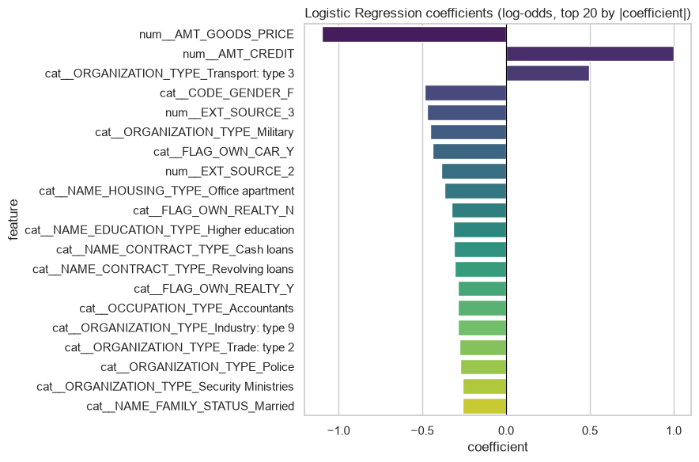
08 Appendix
Logistic regression coefficients
Coefficients describe fitted associations after accounting for the other encoded inputs.
Home Credit Default Risk
28 / 48
Notes:
Analysis: home_credit_tutorial.ipynb.
Measured results: run_results/home_credit_tutorial/results.json.
Notebook cell ID: 4e19cadd.
Figure: figures/notebook/home_credit/cell_015_figure_1.png

Slide 29
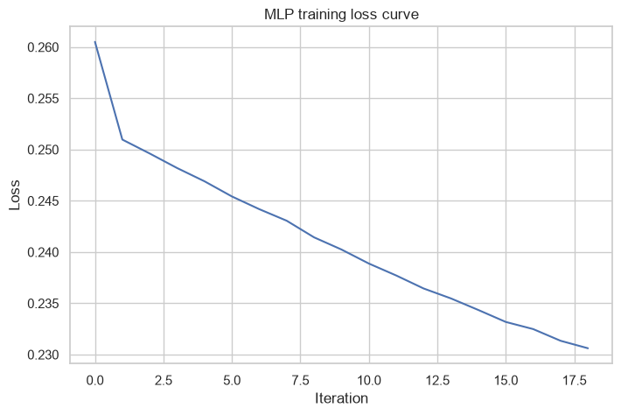
08 Appendix
MLP training loss
Training loss by optimization iteration.
Home Credit Default Risk
29 / 48
Notes:
Analysis: home_credit_tutorial.ipynb.
Measured results: run_results/home_credit_tutorial/results.json.
Notebook cell ID: 021f82a7.
Figure: figures/notebook/home_credit/cell_028_figure_1.png

Slide 30
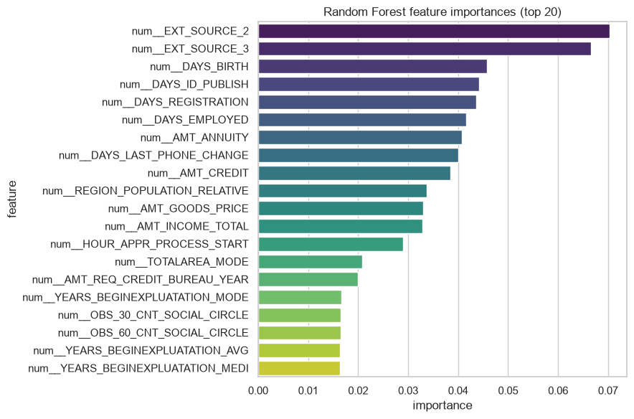
08 Appendix
Random Forest feature importance
External-source scores and applicant history fields recur across models. Related historical tables may add useful information.
Home Credit Default Risk
30 / 48
Notes:
Analysis: home_credit_tutorial.ipynb.
Measured results: run_results/home_credit_tutorial/results.json.
Notebook cell ID: 4939b918.
Figure: figures/notebook/home_credit/cell_034_figure_1.png

Slide 31
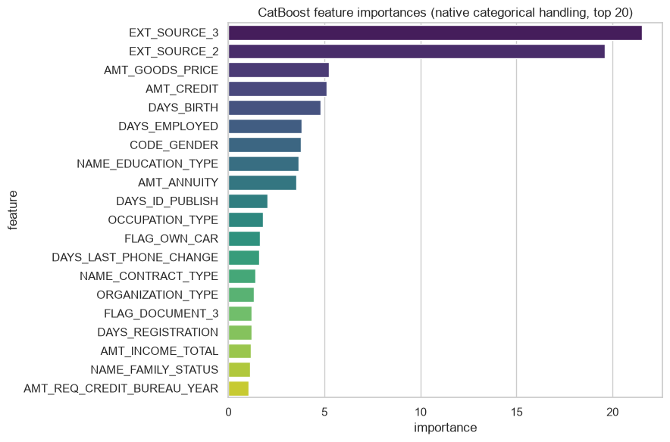
08 Appendix
CatBoost feature importance
External-source scores and applicant history fields recur across models. Related historical tables may add useful information.
Home Credit Default Risk
31 / 48
Notes:
Analysis: home_credit_tutorial.ipynb.
Measured results: run_results/home_credit_tutorial/results.json.
Notebook cell ID: b13cf0b4.
Figure: figures/notebook/home_credit/cell_046_figure_1.png

Slide 32
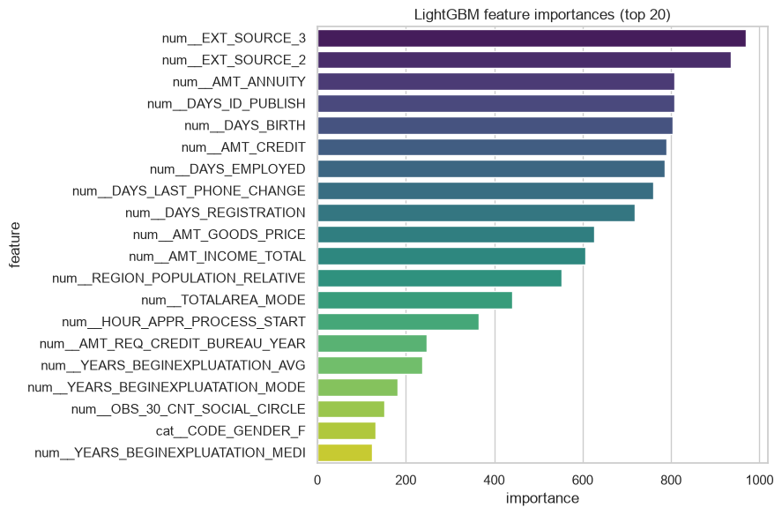
08 Appendix
LightGBM feature importance
External-source scores and applicant history fields recur across models. Related historical tables may add useful information.
Home Credit Default Risk
32 / 48
Notes:
Analysis: home_credit_tutorial.ipynb.
Measured results: run_results/home_credit_tutorial/results.json.
Notebook cell ID: f4f2fe5a.
Figure: figures/notebook/home_credit/cell_052_figure_1.png

Slide 33
08 Appendix
Review capacity results
Reviewed | Applicants | Precision | Recall | Lift
1.0% | 616 | 48.9% | 6.1% | 6.05×
5.0% | 3,076 | 33.9% | 21.0% | 4.20×
10.0% | 6,151 | 27.2% | 33.8% | 3.38×
20.0% | 12,301 | 21.1% | 52.4% | 2.62×
XGBoost. Highest scores selected first. Capacity is the share reviewed.
Home Credit Default Risk
33 / 48
Notes:
Analysis: home_credit_tutorial.ipynb.
Measured results: run_results/home_credit_tutorial/results.json.

Slide 34
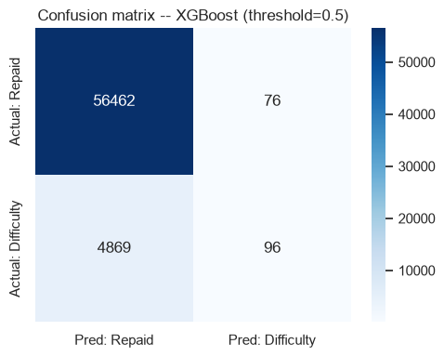
08 Appendix
Confusion matrix at 0.5
Rows show actual classes. Columns show predicted classes.
Home Credit Default Risk
34 / 48
Notes:
Analysis: home_credit_tutorial.ipynb.
Measured results: run_results/home_credit_tutorial/results.json.
Notebook cell ID: f8f3bb07.
Figure: figures/notebook/home_credit/cell_059_figure_1.png

Slide 35
08 Appendix
Threshold results
Cutoff | Flagged share | Precision | Recall
0.1 | 25.4% | 18.8% | 59.1%
0.2 | 8.0% | 29.3% | 28.9%
0.3 | 2.8% | 38.9% | 13.6%
0.5 | 0.3% | 55.8% | 1.9%
XGBoost. Cutoffs are descriptive test results. Select the operating rule using validation data.
Home Credit Default Risk
35 / 48
Notes:
Analysis: home_credit_tutorial.ipynb.
Measured results: run_results/home_credit_tutorial/results.json.

Slide 36
08 Appendix
Calibration results
Risk group | Test cases | Mean prediction | Observed positive rate
Q1 lowest risk | 12,301 | 1.72% | 1.69%
Q2 | 12,301 | 3.34% | 3.06%
Q3 | 12,301 | 5.38% | 5.37%
Q4 | 12,300 | 8.95% | 9.10%
Q5 highest risk | 12,300 | 20.81% | 21.14%
XGBoost. Equal-count score groups compare average risk with observed outcomes.
Home Credit Default Risk
36 / 48
Notes:
Analysis: home_credit_tutorial.ipynb.
Measured results: run_results/home_credit_tutorial/results.json.

Slide 37
08 Appendix
Application
Topic | Application
Current model | The comparison uses only the main application table.
Feature extension | Aggregate bureau, previous applications and payment histories by customer.
Decision policy | Choose a cutoff using review capacity and the costs of missed cases and false positives.
Home Credit Default Risk
37 / 48
Notes:
Analysis: home_credit_tutorial.ipynb.
Measured results: run_results/home_credit_tutorial/results.json.

Slide 38
08 Appendix
Model selection Q&A
Why include penalized linear models?
Ridge uses L2 shrinkage to stabilize coefficients. Lasso uses L1 to encourage zeros. Elastic Net combines the penalties. Logistic models use the same penalty types for classification.
Why standardize the predictors?
Penalties and distance calculations depend on feature units. Scaling also helps neural-network optimization. Estimate the scaling parameters from training data.
Why include stacking?
It does not improve the leading individual model here. Combining models helps only when their errors are sufficiently different. Compare its gain with inference and maintenance cost.
Home Credit Default Risk
38 / 48
Notes:
Analysis: home_credit_tutorial.ipynb.
https://scikit-learn.org/stable/modules/linear_model.html
https://scikit-learn.org/stable/modules/neighbors.html
https://scikit-learn.org/stable/modules/neural_networks_supervised.html
Measured results: run_results/home_credit_tutorial/results.json.

Slide 39
08 Appendix
Model interpretation Q&A
How do forests and boosting differ?
Random Forest averages trees trained with randomized rows and features. Boosting adds trees sequentially to reduce the chosen loss.
What does feature importance mean?
It describes how the fitted model uses its inputs. Related predictors can share importance. A high value does not establish a causal effect.
What do the resampling intervals cover?
They measure variation in the available test predictions with the fitted models fixed. A new split also tests sensitivity to training and model selection.
Home Credit Default Risk
39 / 48
Notes:
Analysis: home_credit_tutorial.ipynb.
https://scikit-learn.org/stable/modules/ensemble.html
https://xgboost.readthedocs.io/en/stable/tutorials/model.html
Measured results: run_results/home_credit_tutorial/results.json.

Slide 40
08 Appendix
Data Q&A
Which applications enter the comparison?
All 307,511 applications enter preprocessing. The stratified split reserves 61,503 applicants for testing.
Why compare categorical encodings?
CatBoost uses categories directly, while other models use one-hot encoding. A controlled ablation can test the contribution of each representation.
Home Credit Default Risk
40 / 48
Notes:
Analysis: home_credit_tutorial.ipynb.
Measured results: run_results/home_credit_tutorial/results.json.

Slide 41
08 Appendix
Results Q&A
Why is recall low at 0.5?
Only a small share of applicants exceed that score. A 10% review share captures 33.8% of positive cases, with greater workload.
Which features should be added next?
Aggregate bureau, previous applications and payment histories by customer, using only information available before the decision.
Home Credit Default Risk
41 / 48
Notes:
Analysis: home_credit_tutorial.ipynb.
Measured results: run_results/home_credit_tutorial/results.json.

Slide 42
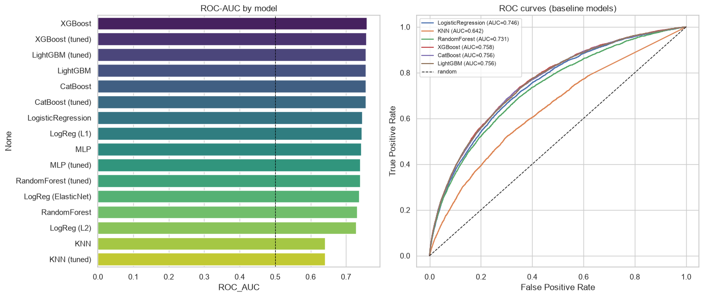
08 Appendix
ROC curves and model ranking
ROC curves and test results for the individual models. Stacking appears in the full results tables.
Home Credit Default Risk
42 / 48
Notes:
Analysis: home_credit_tutorial.ipynb.
Measured results: run_results/home_credit_tutorial/results.json.
Notebook cell ID: eb52f45a.
Figure: figures/notebook/home_credit/cell_058_figure_1.png

Slide 43
08 Appendix
Full results (1 of 2)
Model | AUC | Accuracy | Precision | Recall | F1 | Log loss
XGBoost | 0.7579 | 0.9196 | 0.5581 | 0.0193 | 0.0374 | 0.2460
XGBoost (tuned) | 0.7565 | 0.9197 | 0.6179 | 0.0153 | 0.0299 | 0.2464
LightGBM (tuned) | 0.7562 | 0.9195 | 0.5610 | 0.0139 | 0.0271 | 0.2465
LightGBM | 0.7559 | 0.9197 | 0.5682 | 0.0201 | 0.0389 | 0.2464
CatBoost | 0.7558 | 0.9196 | 0.5802 | 0.0153 | 0.0298 | 0.2467
CatBoost (tuned) | 0.7558 | 0.9196 | 0.5802 | 0.0153 | 0.0298 | 0.2467
Stacking | 0.7531 | 0.9191 | 0.4884 | 0.0550 | 0.0988 | 0.2504
Logistic | 0.7459 | 0.9195 | 0.5577 | 0.0117 | 0.0229 | 0.2496
L1 logistic | 0.7443 | 0.9194 | 0.5444 | 0.009869 | 0.0194 | 0.2502
Precision, recall and F1 use cutoff 0.5. All configurations use the same test applicants.
Home Credit Default Risk
43 / 48
Notes:
Analysis: home_credit_tutorial.ipynb.
Measured results: run_results/home_credit_tutorial/results.json.
{"XGBoost": {"ROC_AUC": 0.7579147580767804, "Accuracy": 0.9195974180121295, "Precision": 0.5581395348837209, "Recall": 0.01933534743202417, "F1": 0.03737590033093245, "LogLoss": 0.2459821254014969}, "XGBoost (tuned)": {"ROC_AUC": 0.7564511362337308, "Accuracy": 0.9197437523372843, "Precision": 0.6178861788617886, "Recall": 0.015307150050352467, "F1": 0.029874213836477988, "LogLoss": 0.24639832973480225}, "LightGBM (tuned)": {"ROC_AUC": 0.7561654707220948, "Accuracy": 0.9195161211648212, "Precision": 0.5609756097560976, "Recall": 0.013897280966767372, "F1": 0.027122641509433963, "LogLoss": 0.24652489334646221}, "LightGBM": {"ROC_AUC": 0.7559431104932519, "Accuracy": 0.919662455489976, "Precision": 0.5681818181818182, "Recall": 0.02014098690835851, "F1": 0.03890293717175647, "LogLoss": 0.2464248869516287}, "CatBoost": {"ROC_AUC": 0.7558497440625537, "Accuracy": 0.9196136773815912, "Precision": 0.5801526717557252, "Recall": 0.015307150050352467, "F1": 0.029827315541601257, "LogLoss": 0.24666543693439086}, "CatBoost (tuned)": {"ROC_AUC": 0.7558497440625537, "Accuracy": 0.9196136773815912, "Precision": 0.5801526717557252, "Recall": 0.015307150050352467, "F1": 0.029827315541601257, "LogLoss": 0.24666543693439086}, "Stacking": {"ROC_AUC": 0.7531354416712381, "Accuracy": 0.919060858819895, "Precision": 0.4883720930232558, "Recall": 0.05498489425981873, "F1": 0.09884141926140477, "LogLoss": 0.25036744221350404}, "LogisticRegression": {"ROC_AUC": 0.7459082586560414, "Accuracy": 0.9194673430564363, "Precision": 0.5576923076923077, "Recall": 0.011681772406847936, "F1": 0.02288419806667982, "LogLoss": 0.24963839883446673}, "LogReg (L1)": {"ROC_AUC": 0.7442854945886193, "Accuracy": 0.9194023055785897, "Precision": 0.5444444444444444, "Recall": 0.00986908358509567, "F1": 0.019386745796241344, "LogLoss": 0.250159537246833}, "MLP": {"ROC_AUC": 0.7431767179054543, "Accuracy": 0.9191584150366648, "Precision": 0.4567901234567901, "Recall": 0.0074521651560926485, "F1": 0.01466508125247721, "LogLoss": 0.2526334681582281}, "MLP (tuned)": {"ROC_AUC": 0.7399530663493014, "Accuracy": 0.9186706339528153, "Precision": 0.4359861591695502, "Recall": 0.025377643504531724, "F1": 0.04796345641416064, "LogLoss": 0.25319293027799367}, "RandomForest (tuned)": {"ROC_AUC": 0.7394335537128786, "Accuracy": 0.9192722306228964, "Precision": 0.0, "Recall": 0.0, "F1": 0.0, "LogLoss": 0.25566439244498473}, "LogReg (ElasticNet)": {"ROC_AUC": 0.7370269163140176, "Accuracy": 0.9191909337755881, "Precision": 0.45614035087719296, "Recall": 0.0052366565961732125, "F1": 0.010354440461967344, "LogLoss": 0.2523408216964693}, "RandomForest": {"ROC_AUC": 0.7313019446287086, "Accuracy": 0.9192884899923581, "Precision": 1.0, "Recall": 0.0002014098690835851, "F1": 0.0004027386226339106, "LogLoss": 0.2536532058295237}, "LogReg (L2)": {"ROC_AUC": 0.728896744650382, "Accuracy": 0.9192071931450498, "Precision": 0.43333333333333335, "Recall": 0.0026183282980866062, "F1": 0.005205205205205205, "LogLoss": 0.25480006924541143}, "KNN": {"ROC_AUC": 0.6415521583982569, "Accuracy": 0.9191258962977416, "Precision": 0.38461538461538464, "Recall": 0.0030211480362537764, "F1": 0.005995203836930456, "LogLoss": 0.8148754352999926}, "KNN (tuned)": {"ROC_AUC": 0.6415521583982569, "Accuracy": 0.9191258962977416, "Precision": 0.38461538461538464, "Recall": 0.0030211480362537764, "F1": 0.005995203836930456, "LogLoss": 0.8148754352999926}}

Slide 44
08 Appendix
Full results (2 of 2)
Model | AUC | Accuracy | Precision | Recall | F1 | Log loss
MLP | 0.7432 | 0.9192 | 0.4568 | 0.007452 | 0.0147 | 0.2526
MLP (tuned) | 0.7400 | 0.9187 | 0.4360 | 0.0254 | 0.0480 | 0.2532
Forest (tuned) | 0.7394 | 0.9193 | 0.0000 | 0.0000 | 0.0000 | 0.2557
Elastic Net logistic | 0.7370 | 0.9192 | 0.4561 | 0.005237 | 0.0104 | 0.2523
Random Forest | 0.7313 | 0.9193 | 1.0000 | 0.000201 | 0.000403 | 0.2537
L2 logistic | 0.7289 | 0.9192 | 0.4333 | 0.002618 | 0.005205 | 0.2548
KNN | 0.6416 | 0.9191 | 0.3846 | 0.003021 | 0.005995 | 0.8149
KNN (tuned) | 0.6416 | 0.9191 | 0.3846 | 0.003021 | 0.005995 | 0.8149
Precision, recall and F1 use cutoff 0.5. All configurations use the same test applicants.
Home Credit Default Risk
44 / 48
Notes:
Analysis: home_credit_tutorial.ipynb.
Measured results: run_results/home_credit_tutorial/results.json.
{"XGBoost": {"ROC_AUC": 0.7579147580767804, "Accuracy": 0.9195974180121295, "Precision": 0.5581395348837209, "Recall": 0.01933534743202417, "F1": 0.03737590033093245, "LogLoss": 0.2459821254014969}, "XGBoost (tuned)": {"ROC_AUC": 0.7564511362337308, "Accuracy": 0.9197437523372843, "Precision": 0.6178861788617886, "Recall": 0.015307150050352467, "F1": 0.029874213836477988, "LogLoss": 0.24639832973480225}, "LightGBM (tuned)": {"ROC_AUC": 0.7561654707220948, "Accuracy": 0.9195161211648212, "Precision": 0.5609756097560976, "Recall": 0.013897280966767372, "F1": 0.027122641509433963, "LogLoss": 0.24652489334646221}, "LightGBM": {"ROC_AUC": 0.7559431104932519, "Accuracy": 0.919662455489976, "Precision": 0.5681818181818182, "Recall": 0.02014098690835851, "F1": 0.03890293717175647, "LogLoss": 0.2464248869516287}, "CatBoost": {"ROC_AUC": 0.7558497440625537, "Accuracy": 0.9196136773815912, "Precision": 0.5801526717557252, "Recall": 0.015307150050352467, "F1": 0.029827315541601257, "LogLoss": 0.24666543693439086}, "CatBoost (tuned)": {"ROC_AUC": 0.7558497440625537, "Accuracy": 0.9196136773815912, "Precision": 0.5801526717557252, "Recall": 0.015307150050352467, "F1": 0.029827315541601257, "LogLoss": 0.24666543693439086}, "Stacking": {"ROC_AUC": 0.7531354416712381, "Accuracy": 0.919060858819895, "Precision": 0.4883720930232558, "Recall": 0.05498489425981873, "F1": 0.09884141926140477, "LogLoss": 0.25036744221350404}, "LogisticRegression": {"ROC_AUC": 0.7459082586560414, "Accuracy": 0.9194673430564363, "Precision": 0.5576923076923077, "Recall": 0.011681772406847936, "F1": 0.02288419806667982, "LogLoss": 0.24963839883446673}, "LogReg (L1)": {"ROC_AUC": 0.7442854945886193, "Accuracy": 0.9194023055785897, "Precision": 0.5444444444444444, "Recall": 0.00986908358509567, "F1": 0.019386745796241344, "LogLoss": 0.250159537246833}, "MLP": {"ROC_AUC": 0.7431767179054543, "Accuracy": 0.9191584150366648, "Precision": 0.4567901234567901, "Recall": 0.0074521651560926485, "F1": 0.01466508125247721, "LogLoss": 0.2526334681582281}, "MLP (tuned)": {"ROC_AUC": 0.7399530663493014, "Accuracy": 0.9186706339528153, "Precision": 0.4359861591695502, "Recall": 0.025377643504531724, "F1": 0.04796345641416064, "LogLoss": 0.25319293027799367}, "RandomForest (tuned)": {"ROC_AUC": 0.7394335537128786, "Accuracy": 0.9192722306228964, "Precision": 0.0, "Recall": 0.0, "F1": 0.0, "LogLoss": 0.25566439244498473}, "LogReg (ElasticNet)": {"ROC_AUC": 0.7370269163140176, "Accuracy": 0.9191909337755881, "Precision": 0.45614035087719296, "Recall": 0.0052366565961732125, "F1": 0.010354440461967344, "LogLoss": 0.2523408216964693}, "RandomForest": {"ROC_AUC": 0.7313019446287086, "Accuracy": 0.9192884899923581, "Precision": 1.0, "Recall": 0.0002014098690835851, "F1": 0.0004027386226339106, "LogLoss": 0.2536532058295237}, "LogReg (L2)": {"ROC_AUC": 0.728896744650382, "Accuracy": 0.9192071931450498, "Precision": 0.43333333333333335, "Recall": 0.0026183282980866062, "F1": 0.005205205205205205, "LogLoss": 0.25480006924541143}, "KNN": {"ROC_AUC": 0.6415521583982569, "Accuracy": 0.9191258962977416, "Precision": 0.38461538461538464, "Recall": 0.0030211480362537764, "F1": 0.005995203836930456, "LogLoss": 0.8148754352999926}, "KNN (tuned)": {"ROC_AUC": 0.6415521583982569, "Accuracy": 0.9191258962977416, "Precision": 0.38461538461538464, "Recall": 0.0030211480362537764, "F1": 0.005995203836930456, "LogLoss": 0.8148754352999926}}

Slide 45
08 Appendix
Model settings
Model | Parameters
KNN | n_neighbors=15, weights='distance'
MLP | hidden_layer_sizes=(64, 32), alpha=0.0001, max_iter=500, early_stopping=True
Random Forest | n_estimators=300, max_depth=None, min_samples_leaf=2
XGBoost | n_estimators=500, learning_rate=0.05, max_depth=5
CatBoost | iterations=500, learning_rate=0.05, depth=6
LightGBM | n_estimators=500, learning_rate=0.05, num_leaves=31
Searches use two folds and two candidates. Each selected estimator refits on the full training partition.
Home Credit Default Risk
45 / 48
Notes:
Analysis: home_credit_tutorial.ipynb.
Seed 42. Stacking uses two ordinary folds. Penalized linear models test three strengths. See the notebook for all constructor arguments.
Measured results: run_results/home_credit_tutorial/results.json.

Slide 46
08 Appendix
Selected hyperparameters (1 of 2)
Model | Selected parameters
KNN | n_neighbors=15, p=2, weights=distance
MLP | hidden_layer_sizes=(64, 32), alpha=0.001
Random Forest | n_estimators=300, min_samples_leaf=5, max_depth=12
Home Credit Default Risk
46 / 48
Notes:
Analysis: home_credit_tutorial.ipynb.
Measured results: run_results/home_credit_tutorial/results.json.

Slide 47
08 Appendix
Selected hyperparameters (2 of 2)
Model | Selected parameters
XGBoost | n_estimators=500, max_depth=5, learning_rate=0.03
CatBoost | learning_rate=0.05, iterations=500, depth=6
LightGBM | num_leaves=31, n_estimators=500, learning_rate=0.03
Home Credit Default Risk
47 / 48
Notes:
Analysis: home_credit_tutorial.ipynb.
Measured results: run_results/home_credit_tutorial/results.json.

Slide 48
08 Appendix
Sources
Dataset
Methods
Kaggle Home Credit Default Risk application_train.csv
scikit-learn, XGBoost, CatBoost and LightGBM documentation.
Project analysis
Statistical analysis
home_credit_tutorial.ipynb
Paired resampling of test predictions, residual analysis and group-level error checks.
Home Credit Default Risk
48 / 48
Notes:
Analysis: home_credit_tutorial.ipynb.
https://scikit-learn.org/stable/modules/linear_model.html
https://scikit-learn.org/stable/modules/neighbors.html
https://scikit-learn.org/stable/modules/neural_networks_supervised.html
https://scikit-learn.org/stable/modules/ensemble.html
https://xgboost.readthedocs.io/en/stable/tutorials/model.html
https://catboost.ai/docs/en/concepts/algorithm-main-stages_cat-to-numberic
https://lightgbm.readthedocs.io/en/stable/Features.html
https://www.statsmodels.org/stable/generated/statsmodels.tsa.statespace.sarimax.SARIMAX.html
Measured results: run_results/home_credit_tutorial/results.json.

