Slide 1
DATA SCIENCE PROJECT
American Express Default
Predicting default from customer account statements
Data, methods and results
Notes:
Analysis: amex_default_tutorial.ipynb.
Measured results: run_results/amex_default_tutorial/results.json.

Slide 2
01 Summary
Summary
Leading models
0.9627
Random Forest has AUC 0.9627. Stacking reaches 0.9626. Their difference is uncertain.
Test ROC-AUC
Probability quality
CatBoost has log loss 0.2161, versus 0.2393 for Random Forest.
Next step
Compare customer-history features and the official competition metric before selecting the final approach.
American Express Default
02 / 48
Notes:
Analysis: amex_default_tutorial.ipynb.
Measured results: run_results/amex_default_tutorial/results.json.
{"RandomForest": {"ROC_AUC": 0.9627058928845464, "Accuracy": 0.9084967320261438, "Precision": 0.8287037037037037, "Recall": 0.7920353982300885, "F1": 0.8099547511312217, "LogLoss": 0.23927156733268878}, "Stacking": {"ROC_AUC": 0.9625620236329223, "Accuracy": 0.906318082788671, "Precision": 0.8211009174311926, "Recall": 0.7920353982300885, "F1": 0.8063063063063063, "LogLoss": 0.22549276705742724}, "CatBoost": {"ROC_AUC": 0.9622934676965574, "Accuracy": 0.9095860566448801, "Precision": 0.820627802690583, "Recall": 0.8097345132743363, "F1": 0.8151447661469933, "LogLoss": 0.2160584743020264}, "RandomForest (tuned)": {"ROC_AUC": 0.9622934676965573, "Accuracy": 0.9095860566448801, "Precision": 0.8294930875576036, "Recall": 0.7964601769911505, "F1": 0.8126410835214447, "LogLoss": 0.24061838621887505}, "LogReg (L2)": {"ROC_AUC": 0.9608164100465497, "Accuracy": 0.9052287581699346, "Precision": 0.8357487922705314, "Recall": 0.7654867256637168, "F1": 0.7990762124711316, "LogLoss": 0.22532819304537977}, "XGBoost (tuned)": {"ROC_AUC": 0.9590068545705662, "Accuracy": 0.9019607843137255, "Precision": 0.8119266055045872, "Recall": 0.7831858407079646, "F1": 0.7972972972972973, "LogLoss": 0.22726324200630188}, "CatBoost (tuned)": {"ROC_AUC": 0.9586807509335518, "Accuracy": 0.8965141612200436, "Precision": 0.8046511627906977, "Recall": 0.7654867256637168, "F1": 0.7845804988662132, "LogLoss": 0.22594194255062694}, "LightGBM": {"ROC_AUC": 0.9581564274387436, "Accuracy": 0.8965141612200436, "Precision": 0.8075117370892019, "Recall": 0.7610619469026548, "F1": 0.7835990888382688, "LogLoss": 0.3360604026079515}, "LightGBM (tuned)": {"ROC_AUC": 0.9581564274387436, "Accuracy": 0.8965141612200436, "Precision": 0.8075117370892019, "Recall": 0.7610619469026548, "F1": 0.7835990888382688, "LogLoss": 0.3360604026079515}, "XGBoost": {"ROC_AUC": 0.9581180623049772, "Accuracy": 0.8986928104575164, "Precision": 0.812206572769953, "Recall": 0.7654867256637168, "F1": 0.7881548974943052, "LogLoss": 0.24457305669784546}, "LogReg (ElasticNet)": {"ROC_AUC": 0.9569351373471788, "Accuracy": 0.9030501089324618, "Precision": 0.8407960199004975, "Recall": 0.7477876106194691, "F1": 0.7915690866510539, "LogLoss": 0.24496741616519727}, "LogReg (L1)": {"ROC_AUC": 0.9537316486776818, "Accuracy": 0.9019607843137255, "Precision": 0.8333333333333334, "Recall": 0.7522123893805309, "F1": 0.7906976744186046, "LogLoss": 0.2326247748188888}, "MLP": {"ROC_AUC": 0.9512954626835132, "Accuracy": 0.9019607843137255, "Precision": 0.8238095238095238, "Recall": 0.7654867256637168, "F1": 0.7935779816513762, "LogLoss": 0.24569114276660797}, "MLP (tuned)": {"ROC_AUC": 0.9512507033607858, "Accuracy": 0.9030501089324618, "Precision": 0.8246445497630331, "Recall": 0.7699115044247787, "F1": 0.7963386727688787, "LogLoss": 0.2456155000259258}, "KNN": {"ROC_AUC": 0.9428231623100924, "Accuracy": 0.8758169934640523, "Precision": 0.8636363636363636, "Recall": 0.588495575221239, "F1": 0.7, "LogLoss": 0.4032710976452569}, "KNN (tuned)": {"ROC_AUC": 0.9428231623100924, "Accuracy": 0.8758169934640523, "Precision": 0.8636363636363636, "Recall": 0.588495575221239, "F1": 0.7, "LogLoss": 0.4032710976452569}, "LogisticRegression": {"ROC_AUC": 0.9420558596347639, "Accuracy": 0.8954248366013072, "Precision": 0.8155339805825242, "Recall": 0.7433628318584071, "F1": 0.7777777777777778, "LogLoss": 0.27210948931200873}}

Slide 3
02 Objective and data
Objective
Objective
Predict customer default from monthly account statements and compare a simple customer snapshot across model families.
Prediction unit
One customer. Statements are aggregated before the train–test split.
Evaluation
ROC-AUC for ranking, log loss for probabilities, and precision–recall at a chosen cutoff.
American Express Default
03 / 48
Notes:
Analysis: amex_default_tutorial.ipynb.
Measured results: run_results/amex_default_tutorial/results.json.

Slide 4
02 Objective and data
Dataset
Item | Details
Records | 55,249 statement rows for 4,589 customers
Features | 1 to 13 statements per customer, averaging about 12
Inputs | 162 features after aggregation and missingness filtering
Class balance | 24.624% positive customer outcomes
American Express Default
04 / 48
Notes:
Analysis: amex_default_tutorial.ipynb.
Measured results: run_results/amex_default_tutorial/results.json.

Slide 5
02 Objective and data
Preprocessing
Step | Processing
Customer snapshot | Sort statements by date and take the last nonmissing value in each customer–column group.
Column filtering | Remove 26 columns with more than 50% missing values after aggregation.
Missing values | Fill numerical gaps with medians and label missing categories.
Identifiers | Remove customer ID and statement date from the predictors.
American Express Default
05 / 48
Notes:
Analysis: amex_default_tutorial.ipynb.
Measured results: run_results/amex_default_tutorial/results.json.

Slide 6
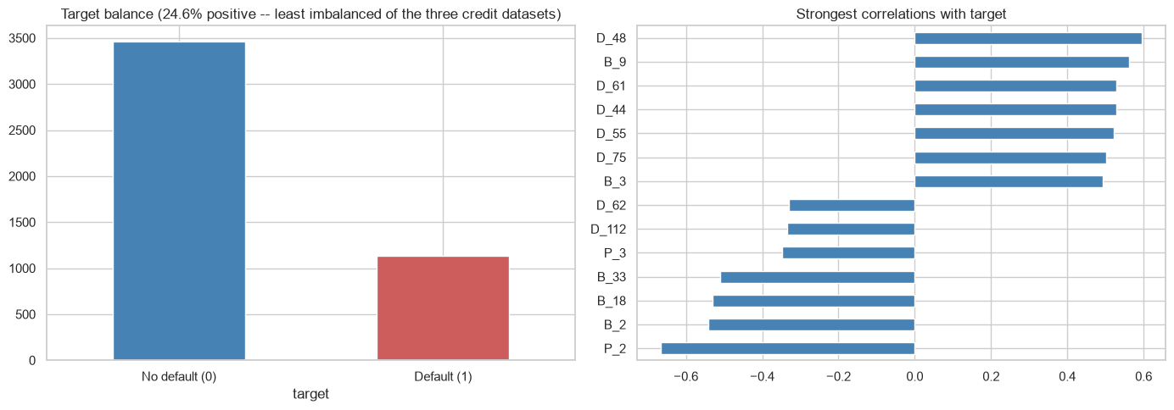
03 EDA and features
Class balance and feature associations
Most customers have multiple monthly statements. A customer must remain in a single evaluation partition.
American Express Default
06 / 48
Notes:
Analysis: amex_default_tutorial.ipynb.
Figure: figures/notebook/amex_default/cell_008_figure_1.png
Measured results: run_results/amex_default_tutorial/results.json.
Notebook cell ID: fda07118.

Slide 7
03 EDA and features
EDA findings
Customer history
Most customers have multiple monthly statements. A customer must remain in a single evaluation partition.
Feature size
The snapshot contains 162 features after filtering. Many fields are correlated and anonymized.
Snapshot definition
The last nonmissing value in each column can come from a different statement date.
American Express Default
07 / 48
Notes:
Analysis: amex_default_tutorial.ipynb.
Measured results: run_results/amex_default_tutorial/results.json.

Slide 8
03 EDA and features
Feature engineering
Feature group | Predictors
Statement families | Anonymized D, S, P, B and R fields
Categories | D_63 and D_64
Numerical fields | 160 numerical predictors after filtering
Snapshot | Last nonmissing value per field, giving 162 predictors in total
American Express Default
08 / 48
Notes:
Analysis: amex_default_tutorial.ipynb.
Measured results: run_results/amex_default_tutorial/results.json.

Slide 9
04 Validation
Train–test split
Partition
Aggregate before splitting so a customer appears in only one partition. Stratified 80/20 split with seed 42 gives 3,671 training customers and 918 test customers.
Transforms
Scaling uses training rows. The imputation and filtering scope is listed under Limitations.
Evaluation
The test partition is separate from the rows used to fit each model.
American Express Default
09 / 48
Notes:
Analysis: amex_default_tutorial.ipynb.
Measured results: run_results/amex_default_tutorial/results.json.

Slide 10
05 Methods
Methods
Family | Models | Role
Logistic | Logistic regression with L2, L1 and Elastic Net penalties | Interpretable reference
Local | K-nearest neighbors | Predict from similar records
Neural | Multilayer perceptron | Learn nonlinear relationships
Trees | Random Forest, XGBoost, CatBoost and LightGBM | Learn thresholds and interactions
Ensemble | Stacking of Random Forest, XGBoost and LightGBM | Combine predictions using a fitted meta-model
American Express Default
10 / 48
Notes:
Analysis: amex_default_tutorial.ipynb.
Measured results: run_results/amex_default_tutorial/results.json.

Slide 11
05 Methods
Logistic regression
Model | Strength | Weakness
Reference logistic | Easy to inspect and use as a baseline | Misses nonlinear effects without added features
L2 logistic | Stabilizes coefficients when predictors overlap | Keeps all predictors and introduces shrinkage bias
L1 logistic | Can remove weak predictors with zero coefficients | Can select inconsistently among correlated inputs
Elastic Net | Combines sparse selection with L2 shrinkage | Requires penalty strength and mixing to be selected
American Express Default
11 / 48
Notes:
Analysis: amex_default_tutorial.ipynb.
https://scikit-learn.org/stable/modules/linear_model.html
Measured results: run_results/amex_default_tutorial/results.json.

Slide 12
05 Methods
KNN and neural networks
Model | Strength | Weakness
KNN | Simple local prediction with few modeling assumptions | Distances depend on scaling. Prediction slows as the reference set grows.
MLP | Learns smooth nonlinear effects and interactions | Sensitive to scaling and optimization. Needs regularization and convergence checks.
American Express Default
12 / 48
Notes:
Analysis: amex_default_tutorial.ipynb.
Measured results: run_results/amex_default_tutorial/results.json.

Slide 13
05 Methods
Tree-based models
Model | Strength | Weakness
Random Forest | Averaging many trees reduces variance and captures interactions | Large ensembles use memory and extrapolate poorly
XGBoost | Regularized boosting handles complex tabular relationships | Tree depth, learning rate and tree count need joint selection
CatBoost | Supports categorical features alongside numerical features | Training can be costly. Data quality still limits performance
LightGBM | Histogram splits support efficient training on large tables | Flexible leaf growth can overfit small groups
American Express Default
13 / 48
Notes:
Analysis: amex_default_tutorial.ipynb.
Measured results: run_results/amex_default_tutorial/results.json.

Slide 14
05 Methods
Stacking
Random Forest, XGBoost and LightGBM generate out-of-fold predictions. A logistic meta-model learns how to combine them.
Strengths
Weaknesses
Can reduce error when the base models make different mistakes. The meta-model learns the weights from training predictions.
Adds fitting and inference cost. Similar base-model errors can limit the gain.
RESULT IN THIS STUDY
ROC-AUC 0.9626 and log loss 0.2255. It does not exceed the best individual model on the primary metric.
American Express Default
14 / 48
Notes:
Analysis: amex_default_tutorial.ipynb.
Base models: fitted reference configurations, each cloned and refitted by StackingRegressor/Classifier. cv=2. Meta-model: LogisticRegression(C=1.0, max_iter=2000).
https://scikit-learn.org/stable/modules/ensemble.html#stacking
Measured results: run_results/amex_default_tutorial/results.json.

Slide 15
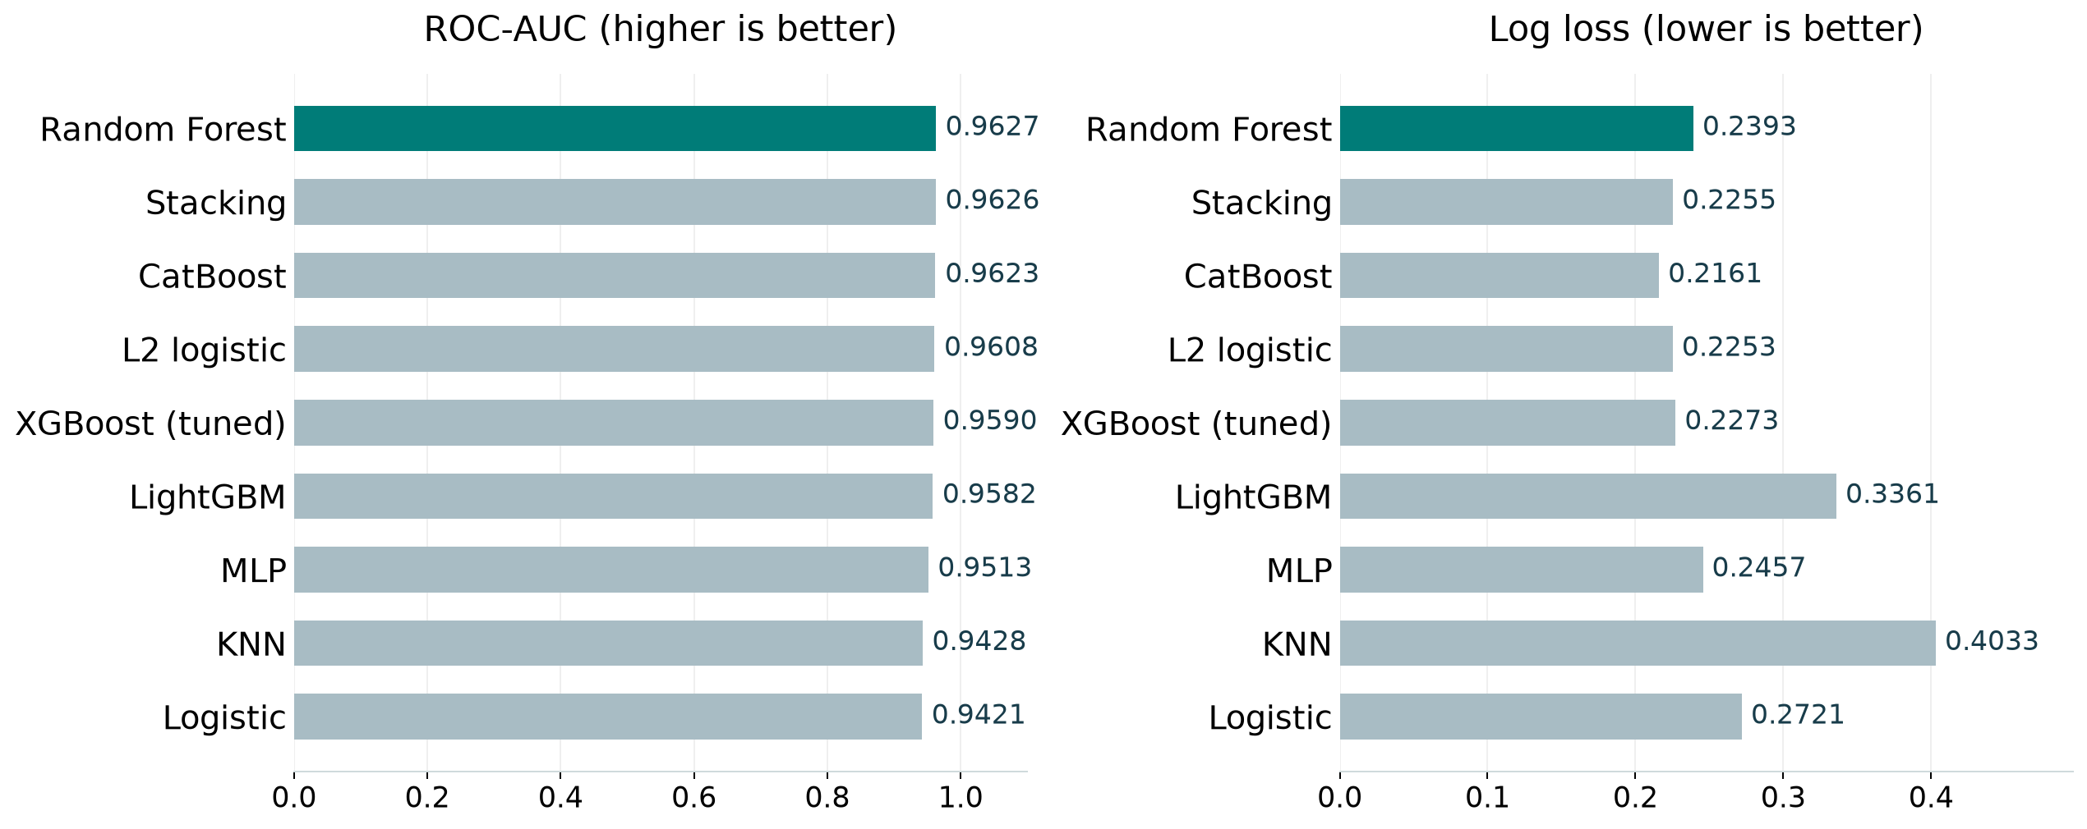
06 Results
Model comparison
Best test score per family, including the strongest penalized linear model. Full results appear in the appendix.
American Express Default
15 / 48
Notes:
Analysis: amex_default_tutorial.ipynb.
Figure: figures/amex_default/comparison.png
Measured results: run_results/amex_default_tutorial/results.json.

Slide 16
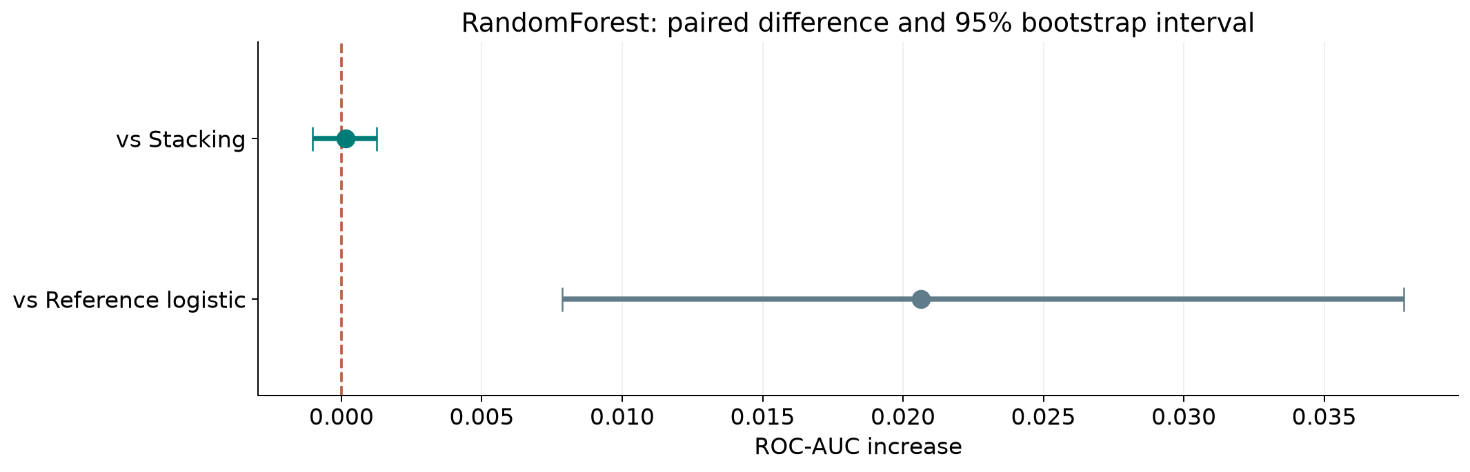
06 Results
Ranking stability
The 95% interval includes zero for Random Forest versus Stacking. Their ordering remains uncertain.
American Express Default
16 / 48
Notes:
Analysis: amex_default_tutorial.ipynb.
paired stratified row bootstrap. 1,000 paired resamples. Fitted models remain fixed.
[{"comparison": "RandomForest versus Stacking", "other": "Stacking", "advantage": 0.0001438692516241291, "ci_low": -0.0010201129213770117, "ci_high": 0.0012596552253311161}, {"comparison": "RandomForest versus Reference logistic", "other": "Reference logistic", "advantage": 0.02065003324978254, "ci_low": 0.007870127628011555, "ci_high": 0.0378324178986136}]
Figure: figures/amex_default/ranking_stability.png
Measured results: run_results/amex_default_tutorial/results.json.

Slide 17
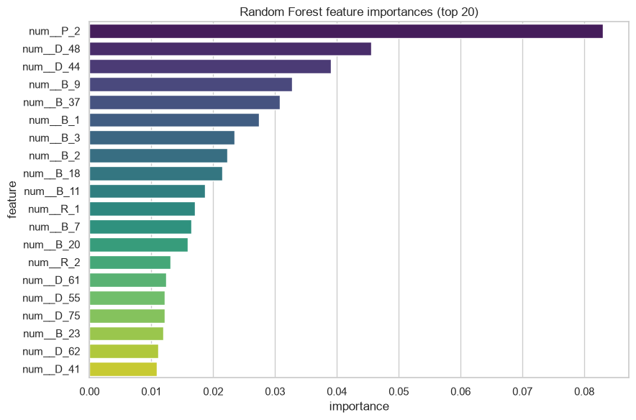
06 Results
Random Forest feature importance
Feature codes are anonymized. Compare their stability and feature families without assigning unsupported business meanings.
American Express Default
17 / 48
Notes:
Analysis: amex_default_tutorial.ipynb.
Figure: figures/notebook/amex_default/cell_034_figure_1.png
Measured results: run_results/amex_default_tutorial/results.json.
Notebook cell ID: 38815278.

Slide 18
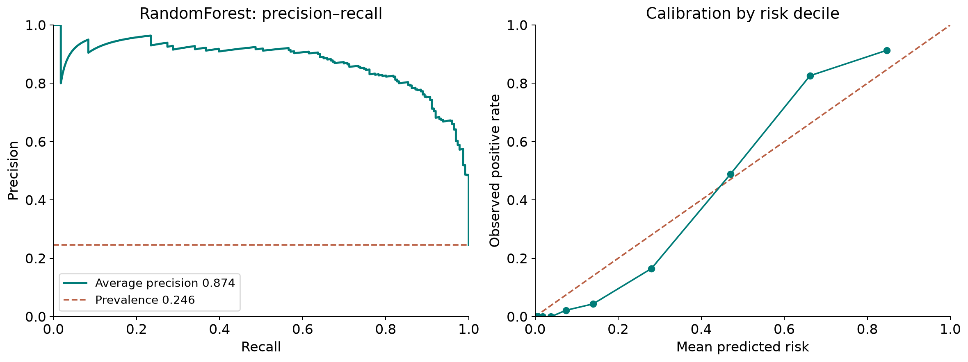
06 Results
Precision–recall and calibration
Random Forest: average precision 0.874, positive prevalence 0.246, Brier score 0.0712.
American Express Default
18 / 48
Notes:
Analysis: amex_default_tutorial.ipynb.
Figure: figures/amex_default/pr_calibration.png
Measured results: run_results/amex_default_tutorial/results.json.
Diagnostics use Random Forest predictions.

Slide 19
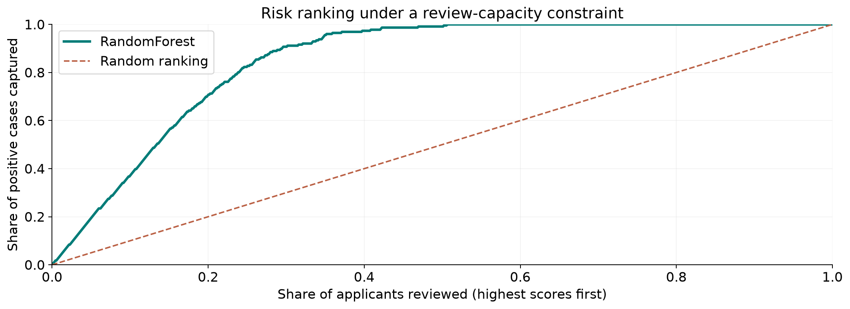
06 Results
Review capacity
Random Forest, top 10% reviewed: 37.2% recall and 91.3% precision.
American Express Default
19 / 48
Notes:
Analysis: amex_default_tutorial.ipynb.
Figure: figures/amex_default/review_capacity.png
Measured results: run_results/amex_default_tutorial/results.json.
Diagnostics use Random Forest predictions.

Slide 20
06 Results
Results
Risk ranking
Random Forest and stacking differ by only 0.00014 AUC. The resampling interval includes zero.
Other metrics
CatBoost has lower log loss and higher recall at cutoff 0.5. The AUC leader does not lead every measure.
Further work
Add statement changes, trends and observation counts, then evaluate the official competition metric.
American Express Default
20 / 48
Notes:
Analysis: amex_default_tutorial.ipynb.
Measured results: run_results/amex_default_tutorial/results.json.
{"RandomForest": {"ROC_AUC": 0.9627058928845464, "Accuracy": 0.9084967320261438, "Precision": 0.8287037037037037, "Recall": 0.7920353982300885, "F1": 0.8099547511312217, "LogLoss": 0.23927156733268878}, "Stacking": {"ROC_AUC": 0.9625620236329223, "Accuracy": 0.906318082788671, "Precision": 0.8211009174311926, "Recall": 0.7920353982300885, "F1": 0.8063063063063063, "LogLoss": 0.22549276705742724}, "CatBoost": {"ROC_AUC": 0.9622934676965574, "Accuracy": 0.9095860566448801, "Precision": 0.820627802690583, "Recall": 0.8097345132743363, "F1": 0.8151447661469933, "LogLoss": 0.2160584743020264}, "RandomForest (tuned)": {"ROC_AUC": 0.9622934676965573, "Accuracy": 0.9095860566448801, "Precision": 0.8294930875576036, "Recall": 0.7964601769911505, "F1": 0.8126410835214447, "LogLoss": 0.24061838621887505}, "LogReg (L2)": {"ROC_AUC": 0.9608164100465497, "Accuracy": 0.9052287581699346, "Precision": 0.8357487922705314, "Recall": 0.7654867256637168, "F1": 0.7990762124711316, "LogLoss": 0.22532819304537977}, "XGBoost (tuned)": {"ROC_AUC": 0.9590068545705662, "Accuracy": 0.9019607843137255, "Precision": 0.8119266055045872, "Recall": 0.7831858407079646, "F1": 0.7972972972972973, "LogLoss": 0.22726324200630188}, "CatBoost (tuned)": {"ROC_AUC": 0.9586807509335518, "Accuracy": 0.8965141612200436, "Precision": 0.8046511627906977, "Recall": 0.7654867256637168, "F1": 0.7845804988662132, "LogLoss": 0.22594194255062694}, "LightGBM": {"ROC_AUC": 0.9581564274387436, "Accuracy": 0.8965141612200436, "Precision": 0.8075117370892019, "Recall": 0.7610619469026548, "F1": 0.7835990888382688, "LogLoss": 0.3360604026079515}, "LightGBM (tuned)": {"ROC_AUC": 0.9581564274387436, "Accuracy": 0.8965141612200436, "Precision": 0.8075117370892019, "Recall": 0.7610619469026548, "F1": 0.7835990888382688, "LogLoss": 0.3360604026079515}, "XGBoost": {"ROC_AUC": 0.9581180623049772, "Accuracy": 0.8986928104575164, "Precision": 0.812206572769953, "Recall": 0.7654867256637168, "F1": 0.7881548974943052, "LogLoss": 0.24457305669784546}, "LogReg (ElasticNet)": {"ROC_AUC": 0.9569351373471788, "Accuracy": 0.9030501089324618, "Precision": 0.8407960199004975, "Recall": 0.7477876106194691, "F1": 0.7915690866510539, "LogLoss": 0.24496741616519727}, "LogReg (L1)": {"ROC_AUC": 0.9537316486776818, "Accuracy": 0.9019607843137255, "Precision": 0.8333333333333334, "Recall": 0.7522123893805309, "F1": 0.7906976744186046, "LogLoss": 0.2326247748188888}, "MLP": {"ROC_AUC": 0.9512954626835132, "Accuracy": 0.9019607843137255, "Precision": 0.8238095238095238, "Recall": 0.7654867256637168, "F1": 0.7935779816513762, "LogLoss": 0.24569114276660797}, "MLP (tuned)": {"ROC_AUC": 0.9512507033607858, "Accuracy": 0.9030501089324618, "Precision": 0.8246445497630331, "Recall": 0.7699115044247787, "F1": 0.7963386727688787, "LogLoss": 0.2456155000259258}, "KNN": {"ROC_AUC": 0.9428231623100924, "Accuracy": 0.8758169934640523, "Precision": 0.8636363636363636, "Recall": 0.588495575221239, "F1": 0.7, "LogLoss": 0.4032710976452569}, "KNN (tuned)": {"ROC_AUC": 0.9428231623100924, "Accuracy": 0.8758169934640523, "Precision": 0.8636363636363636, "Recall": 0.588495575221239, "F1": 0.7, "LogLoss": 0.4032710976452569}, "LogisticRegression": {"ROC_AUC": 0.9420558596347639, "Accuracy": 0.8954248366013072, "Precision": 0.8155339805825242, "Recall": 0.7433628318584071, "F1": 0.7777777777777778, "LogLoss": 0.27210948931200873}}

Slide 21
07 Conclusion
Limitations
Limitation | Details
Sample size | The study uses a 1% customer sample and 918 test customers.
Preprocessing | Missingness filters and imputation use the full customer sample.
Metric | ROC-AUC differs from the official competition scoring rule.
Aggregation | The snapshot leaves most monthly changes unused.
American Express Default
21 / 48
Notes:
Analysis: amex_default_tutorial.ipynb.
Measured results: run_results/amex_default_tutorial/results.json.

Slide 22
07 Conclusion
Next steps
# | Test | Method | Measure
1 | Aggregation audit | Compare actual final rows with columnwise last-nonmissing values. | A precise, consistent snapshot definition
2 | Temporal features | Add changes, ranges, means and observation counts by customer. | Value from the 13-statement histories
3 | Metric alignment | Implement the official metric from verified competition rules before submission. | Validation that matches the competition objective
4 | Customer validation | Use fold-safe preprocessing, repeated customer folds and a final untouched holdout. | Stable performance without customer overlap
American Express Default
22 / 48
Notes:
Analysis: amex_default_tutorial.ipynb.
Measured results: run_results/amex_default_tutorial/results.json.

Slide 23
07 Conclusion
Conclusion
Several models remain in contention
ROC-AUC 0.9627
Random Forest, stacking and CatBoost are close on AUC. Compare probability quality and the competition metric using richer customer histories.
American Express Default
23 / 48
Notes:
Analysis: amex_default_tutorial.ipynb.
Measured results: run_results/amex_default_tutorial/results.json.
{"RandomForest": {"ROC_AUC": 0.9627058928845464, "Accuracy": 0.9084967320261438, "Precision": 0.8287037037037037, "Recall": 0.7920353982300885, "F1": 0.8099547511312217, "LogLoss": 0.23927156733268878}, "Stacking": {"ROC_AUC": 0.9625620236329223, "Accuracy": 0.906318082788671, "Precision": 0.8211009174311926, "Recall": 0.7920353982300885, "F1": 0.8063063063063063, "LogLoss": 0.22549276705742724}, "CatBoost": {"ROC_AUC": 0.9622934676965574, "Accuracy": 0.9095860566448801, "Precision": 0.820627802690583, "Recall": 0.8097345132743363, "F1": 0.8151447661469933, "LogLoss": 0.2160584743020264}, "RandomForest (tuned)": {"ROC_AUC": 0.9622934676965573, "Accuracy": 0.9095860566448801, "Precision": 0.8294930875576036, "Recall": 0.7964601769911505, "F1": 0.8126410835214447, "LogLoss": 0.24061838621887505}, "LogReg (L2)": {"ROC_AUC": 0.9608164100465497, "Accuracy": 0.9052287581699346, "Precision": 0.8357487922705314, "Recall": 0.7654867256637168, "F1": 0.7990762124711316, "LogLoss": 0.22532819304537977}, "XGBoost (tuned)": {"ROC_AUC": 0.9590068545705662, "Accuracy": 0.9019607843137255, "Precision": 0.8119266055045872, "Recall": 0.7831858407079646, "F1": 0.7972972972972973, "LogLoss": 0.22726324200630188}, "CatBoost (tuned)": {"ROC_AUC": 0.9586807509335518, "Accuracy": 0.8965141612200436, "Precision": 0.8046511627906977, "Recall": 0.7654867256637168, "F1": 0.7845804988662132, "LogLoss": 0.22594194255062694}, "LightGBM": {"ROC_AUC": 0.9581564274387436, "Accuracy": 0.8965141612200436, "Precision": 0.8075117370892019, "Recall": 0.7610619469026548, "F1": 0.7835990888382688, "LogLoss": 0.3360604026079515}, "LightGBM (tuned)": {"ROC_AUC": 0.9581564274387436, "Accuracy": 0.8965141612200436, "Precision": 0.8075117370892019, "Recall": 0.7610619469026548, "F1": 0.7835990888382688, "LogLoss": 0.3360604026079515}, "XGBoost": {"ROC_AUC": 0.9581180623049772, "Accuracy": 0.8986928104575164, "Precision": 0.812206572769953, "Recall": 0.7654867256637168, "F1": 0.7881548974943052, "LogLoss": 0.24457305669784546}, "LogReg (ElasticNet)": {"ROC_AUC": 0.9569351373471788, "Accuracy": 0.9030501089324618, "Precision": 0.8407960199004975, "Recall": 0.7477876106194691, "F1": 0.7915690866510539, "LogLoss": 0.24496741616519727}, "LogReg (L1)": {"ROC_AUC": 0.9537316486776818, "Accuracy": 0.9019607843137255, "Precision": 0.8333333333333334, "Recall": 0.7522123893805309, "F1": 0.7906976744186046, "LogLoss": 0.2326247748188888}, "MLP": {"ROC_AUC": 0.9512954626835132, "Accuracy": 0.9019607843137255, "Precision": 0.8238095238095238, "Recall": 0.7654867256637168, "F1": 0.7935779816513762, "LogLoss": 0.24569114276660797}, "MLP (tuned)": {"ROC_AUC": 0.9512507033607858, "Accuracy": 0.9030501089324618, "Precision": 0.8246445497630331, "Recall": 0.7699115044247787, "F1": 0.7963386727688787, "LogLoss": 0.2456155000259258}, "KNN": {"ROC_AUC": 0.9428231623100924, "Accuracy": 0.8758169934640523, "Precision": 0.8636363636363636, "Recall": 0.588495575221239, "F1": 0.7, "LogLoss": 0.4032710976452569}, "KNN (tuned)": {"ROC_AUC": 0.9428231623100924, "Accuracy": 0.8758169934640523, "Precision": 0.8636363636363636, "Recall": 0.588495575221239, "F1": 0.7, "LogLoss": 0.4032710976452569}, "LogisticRegression": {"ROC_AUC": 0.9420558596347639, "Accuracy": 0.8954248366013072, "Precision": 0.8155339805825242, "Recall": 0.7433628318584071, "F1": 0.7777777777777778, "LogLoss": 0.27210948931200873}}

Slide 24
08 Appendix
Evaluation metrics
Metric | Meaning | Role
ROC-AUC | Ranking across thresholds | Primary model comparison
Log loss | Quality of predicted probabilities | Probability assessment
Precision and recall | Detection and false-positive trade-off | Threshold analysis
Calibration | Agreement of predicted and observed risk | Probability interpretation
American Express Default
24 / 48
Notes:
Analysis: amex_default_tutorial.ipynb.
Measured results: run_results/amex_default_tutorial/results.json.

Slide 25
08 Appendix
Logistic regularization
Variant | Training objective | Main effect
Reference logistic | Logistic loss with reference settings | Linear log-odds reference
L2 logistic | Logistic loss + Ridge penalty | Shrinks correlated coefficients
L1 logistic | Logistic loss + Lasso penalty | Can remove coefficients
Elastic Net logistic | Logistic loss + mixed penalty | Balances sparsity and shrinkage
American Express Default
25 / 48
Notes:
Analysis: amex_default_tutorial.ipynb.
https://scikit-learn.org/stable/modules/linear_model.html
Measured results: run_results/amex_default_tutorial/results.json.

Slide 26
08 Appendix
Logistic model results
Model | ROC-AUC | Log loss | Recall at 0.5
Logistic | 0.9421 | 0.2721 | 0.7434
L2 logistic | 0.9608 | 0.2253 | 0.7655
L1 logistic | 0.9537 | 0.2326 | 0.7522
Elastic Net logistic | 0.9569 | 0.2450 | 0.7478
American Express Default
26 / 48
Notes:
Analysis: amex_default_tutorial.ipynb.
Measured results: run_results/amex_default_tutorial/results.json.
{"RandomForest": {"ROC_AUC": 0.9627058928845464, "Accuracy": 0.9084967320261438, "Precision": 0.8287037037037037, "Recall": 0.7920353982300885, "F1": 0.8099547511312217, "LogLoss": 0.23927156733268878}, "Stacking": {"ROC_AUC": 0.9625620236329223, "Accuracy": 0.906318082788671, "Precision": 0.8211009174311926, "Recall": 0.7920353982300885, "F1": 0.8063063063063063, "LogLoss": 0.22549276705742724}, "CatBoost": {"ROC_AUC": 0.9622934676965574, "Accuracy": 0.9095860566448801, "Precision": 0.820627802690583, "Recall": 0.8097345132743363, "F1": 0.8151447661469933, "LogLoss": 0.2160584743020264}, "RandomForest (tuned)": {"ROC_AUC": 0.9622934676965573, "Accuracy": 0.9095860566448801, "Precision": 0.8294930875576036, "Recall": 0.7964601769911505, "F1": 0.8126410835214447, "LogLoss": 0.24061838621887505}, "LogReg (L2)": {"ROC_AUC": 0.9608164100465497, "Accuracy": 0.9052287581699346, "Precision": 0.8357487922705314, "Recall": 0.7654867256637168, "F1": 0.7990762124711316, "LogLoss": 0.22532819304537977}, "XGBoost (tuned)": {"ROC_AUC": 0.9590068545705662, "Accuracy": 0.9019607843137255, "Precision": 0.8119266055045872, "Recall": 0.7831858407079646, "F1": 0.7972972972972973, "LogLoss": 0.22726324200630188}, "CatBoost (tuned)": {"ROC_AUC": 0.9586807509335518, "Accuracy": 0.8965141612200436, "Precision": 0.8046511627906977, "Recall": 0.7654867256637168, "F1": 0.7845804988662132, "LogLoss": 0.22594194255062694}, "LightGBM": {"ROC_AUC": 0.9581564274387436, "Accuracy": 0.8965141612200436, "Precision": 0.8075117370892019, "Recall": 0.7610619469026548, "F1": 0.7835990888382688, "LogLoss": 0.3360604026079515}, "LightGBM (tuned)": {"ROC_AUC": 0.9581564274387436, "Accuracy": 0.8965141612200436, "Precision": 0.8075117370892019, "Recall": 0.7610619469026548, "F1": 0.7835990888382688, "LogLoss": 0.3360604026079515}, "XGBoost": {"ROC_AUC": 0.9581180623049772, "Accuracy": 0.8986928104575164, "Precision": 0.812206572769953, "Recall": 0.7654867256637168, "F1": 0.7881548974943052, "LogLoss": 0.24457305669784546}, "LogReg (ElasticNet)": {"ROC_AUC": 0.9569351373471788, "Accuracy": 0.9030501089324618, "Precision": 0.8407960199004975, "Recall": 0.7477876106194691, "F1": 0.7915690866510539, "LogLoss": 0.24496741616519727}, "LogReg (L1)": {"ROC_AUC": 0.9537316486776818, "Accuracy": 0.9019607843137255, "Precision": 0.8333333333333334, "Recall": 0.7522123893805309, "F1": 0.7906976744186046, "LogLoss": 0.2326247748188888}, "MLP": {"ROC_AUC": 0.9512954626835132, "Accuracy": 0.9019607843137255, "Precision": 0.8238095238095238, "Recall": 0.7654867256637168, "F1": 0.7935779816513762, "LogLoss": 0.24569114276660797}, "MLP (tuned)": {"ROC_AUC": 0.9512507033607858, "Accuracy": 0.9030501089324618, "Precision": 0.8246445497630331, "Recall": 0.7699115044247787, "F1": 0.7963386727688787, "LogLoss": 0.2456155000259258}, "KNN": {"ROC_AUC": 0.9428231623100924, "Accuracy": 0.8758169934640523, "Precision": 0.8636363636363636, "Recall": 0.588495575221239, "F1": 0.7, "LogLoss": 0.4032710976452569}, "KNN (tuned)": {"ROC_AUC": 0.9428231623100924, "Accuracy": 0.8758169934640523, "Precision": 0.8636363636363636, "Recall": 0.588495575221239, "F1": 0.7, "LogLoss": 0.4032710976452569}, "LogisticRegression": {"ROC_AUC": 0.9420558596347639, "Accuracy": 0.8954248366013072, "Precision": 0.8155339805825242, "Recall": 0.7433628318584071, "F1": 0.7777777777777778, "LogLoss": 0.27210948931200873}}

Slide 27
08 Appendix
Linear model discussion
Results
L2 logistic reaches AUC 0.9608, close to the tree models, with log loss 0.2253.
Interpretation
Shrinkage helps with correlated account fields. Anonymized names limit business interpretation of individual coefficients.
Further work
Check stability across customer folds and test changes and trends from the monthly statements.
American Express Default
27 / 48
Notes:
Analysis: amex_default_tutorial.ipynb.
https://scikit-learn.org/stable/modules/linear_model.html
Measured results: run_results/amex_default_tutorial/results.json.

Slide 28
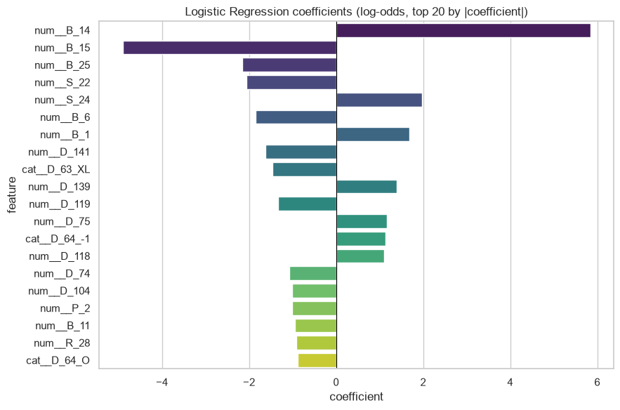
08 Appendix
Logistic regression coefficients
Coefficients describe fitted associations after accounting for the other encoded inputs.
American Express Default
28 / 48
Notes:
Analysis: amex_default_tutorial.ipynb.
Figure: figures/notebook/amex_default/cell_015_figure_1.png
Measured results: run_results/amex_default_tutorial/results.json.
Notebook cell ID: 4e85a845.

Slide 29
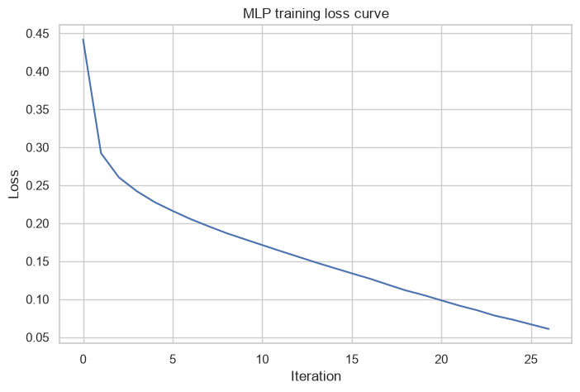
08 Appendix
MLP training loss
Training loss by optimization iteration.
American Express Default
29 / 48
Notes:
Analysis: amex_default_tutorial.ipynb.
Figure: figures/notebook/amex_default/cell_028_figure_1.png
Measured results: run_results/amex_default_tutorial/results.json.
Notebook cell ID: e16dac82.

Slide 30
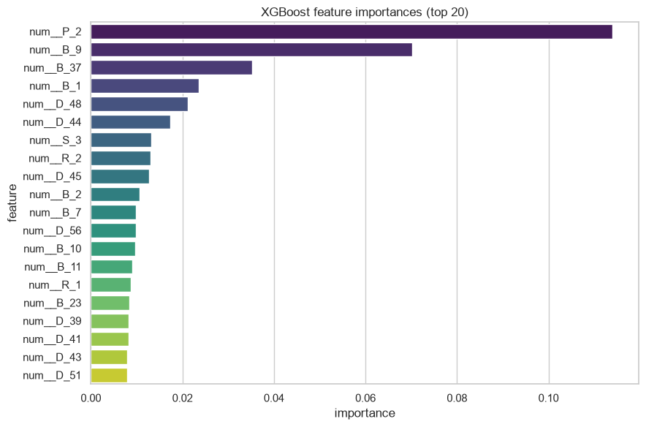
08 Appendix
XGBoost feature importance
Feature codes are anonymized. Compare their stability and feature families without assigning unsupported business meanings.
American Express Default
30 / 48
Notes:
Analysis: amex_default_tutorial.ipynb.
Figure: figures/notebook/amex_default/cell_040_figure_1.png
Measured results: run_results/amex_default_tutorial/results.json.
Notebook cell ID: bc5cc0f9.

Slide 31
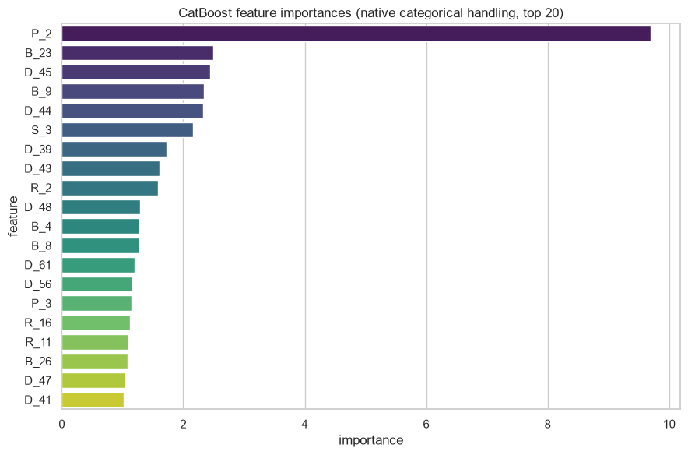
08 Appendix
CatBoost feature importance
Feature codes are anonymized. Compare their stability and feature families without assigning unsupported business meanings.
American Express Default
31 / 48
Notes:
Analysis: amex_default_tutorial.ipynb.
Figure: figures/notebook/amex_default/cell_046_figure_1.png
Measured results: run_results/amex_default_tutorial/results.json.
Notebook cell ID: 1b2076d8.

Slide 32
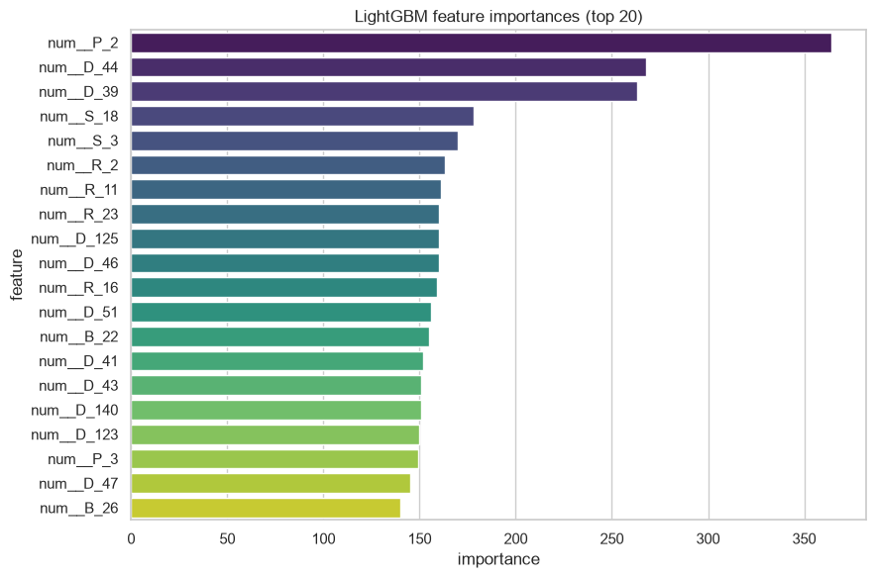
08 Appendix
LightGBM feature importance
Feature codes are anonymized. Compare their stability and feature families without assigning unsupported business meanings.
American Express Default
32 / 48
Notes:
Analysis: amex_default_tutorial.ipynb.
Figure: figures/notebook/amex_default/cell_052_figure_1.png
Measured results: run_results/amex_default_tutorial/results.json.
Notebook cell ID: e5eb8ec3.

Slide 33
08 Appendix
Review capacity results
Reviewed | Applicants | Precision | Recall | Lift
1.1% | 10 | 90.0% | 4.0% | 3.66×
5.0% | 46 | 95.7% | 19.5% | 3.89×
10.0% | 92 | 91.3% | 37.2% | 3.71×
20.0% | 184 | 87.0% | 70.8% | 3.53×
Random Forest. Highest scores selected first. Capacity is the share reviewed.
American Express Default
33 / 48
Notes:
Analysis: amex_default_tutorial.ipynb.
Measured results: run_results/amex_default_tutorial/results.json.

Slide 34
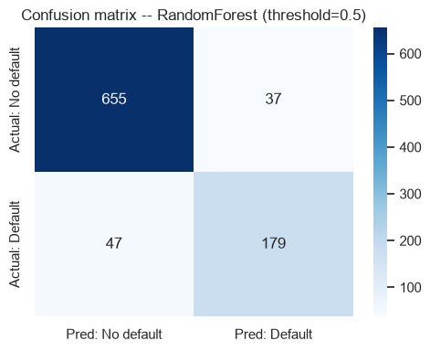
08 Appendix
Confusion matrix at 0.5
Rows show actual classes. Columns show predicted classes.
American Express Default
34 / 48
Notes:
Analysis: amex_default_tutorial.ipynb.
Figure: figures/notebook/amex_default/cell_059_figure_1.png
Measured results: run_results/amex_default_tutorial/results.json.
Notebook cell ID: 3fc02d7d.

Slide 35
08 Appendix
Threshold results
Cutoff | Flagged share | Precision | Recall
0.1 | 49.3% | 49.4% | 99.1%
0.2 | 39.8% | 60.3% | 97.3%
0.3 | 33.7% | 68.0% | 92.9%
0.5 | 23.5% | 82.9% | 79.2%
Random Forest. Cutoffs are descriptive test results. Select the operating rule using validation data.
American Express Default
35 / 48
Notes:
Analysis: amex_default_tutorial.ipynb.
Measured results: run_results/amex_default_tutorial/results.json.

Slide 36
08 Appendix
Calibration results
Risk group | Test cases | Mean prediction | Observed positive rate
Q1 lowest risk | 184 | 0.45% | 0.00%
Q2 | 184 | 2.87% | 0.00%
Q3 | 184 | 10.78% | 3.26%
Q4 | 183 | 37.80% | 33.33%
Q5 highest risk | 183 | 75.53% | 86.89%
Random Forest. Equal-count score groups compare average risk with observed outcomes.
American Express Default
36 / 48
Notes:
Analysis: amex_default_tutorial.ipynb.
Measured results: run_results/amex_default_tutorial/results.json.

Slide 37
08 Appendix
Application
Topic | Application
Snapshot | Columnwise last-nonmissing values can combine several statement dates.
History features | Test last-minus-first changes, means, variability and observation counts.
Metric | Compute the official competition metric before selecting a competition submission.
American Express Default
37 / 48
Notes:
Analysis: amex_default_tutorial.ipynb.
Measured results: run_results/amex_default_tutorial/results.json.

Slide 38
08 Appendix
Model selection Q&A
Why include penalized linear models?
Ridge uses L2 shrinkage to stabilize coefficients. Lasso uses L1 to encourage zeros. Elastic Net combines the penalties. Logistic models use the same penalty types for classification.
Why standardize the predictors?
Penalties and distance calculations depend on feature units. Scaling also helps neural-network optimization. Estimate the scaling parameters from training data.
Why include stacking?
It does not improve the leading individual model here. Combining models helps only when their errors are sufficiently different. Compare its gain with inference and maintenance cost.
American Express Default
38 / 48
Notes:
Analysis: amex_default_tutorial.ipynb.
https://scikit-learn.org/stable/modules/linear_model.html
https://scikit-learn.org/stable/modules/neighbors.html
https://scikit-learn.org/stable/modules/neural_networks_supervised.html
Measured results: run_results/amex_default_tutorial/results.json.

Slide 39
08 Appendix
Model interpretation Q&A
How do forests and boosting differ?
Random Forest averages trees trained with randomized rows and features. Boosting adds trees sequentially to reduce the chosen loss.
What does feature importance mean?
It describes how the fitted model uses its inputs. Related predictors can share importance. A high value does not establish a causal effect.
What do the resampling intervals cover?
They measure variation in the available test predictions with the fitted models fixed. A new split also tests sensitivity to training and model selection.
American Express Default
39 / 48
Notes:
Analysis: amex_default_tutorial.ipynb.
https://scikit-learn.org/stable/modules/ensemble.html
https://xgboost.readthedocs.io/en/stable/tutorials/model.html
Measured results: run_results/amex_default_tutorial/results.json.

Slide 40
08 Appendix
Data Q&A
Why split by customer?
Statements from one customer share history and the same outcome. Keep all statements for a customer in one partition.
Does last() select one complete final statement?
It selects the last nonmissing value separately for each column. Use the final row when all snapshot fields must refer to the same date.
American Express Default
40 / 48
Notes:
Analysis: amex_default_tutorial.ipynb.
Measured results: run_results/amex_default_tutorial/results.json.

Slide 41
08 Appendix
Results Q&A
Is Random Forest clearly best?
Its AUC lead over stacking is only 0.00014. Compare customer folds, probability quality and the official competition metric.
What features would you add?
Test first-to-last changes, trends, variability and observation counts. Measure the value of each history feature group.
American Express Default
41 / 48
Notes:
Analysis: amex_default_tutorial.ipynb.
Measured results: run_results/amex_default_tutorial/results.json.

Slide 42
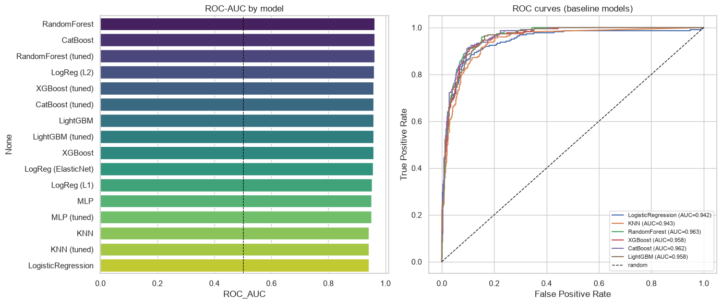
08 Appendix
ROC curves and model ranking
ROC curves and test results for the individual models. Stacking appears in the full results tables.
American Express Default
42 / 48
Notes:
Analysis: amex_default_tutorial.ipynb.
Figure: figures/notebook/amex_default/cell_058_figure_1.png
Measured results: run_results/amex_default_tutorial/results.json.
Notebook cell ID: d4eb0a33.

Slide 43
08 Appendix
Full results (1 of 2)
Model | AUC | Accuracy | Precision | Recall | F1 | Log loss
Random Forest | 0.9627 | 0.9085 | 0.8287 | 0.7920 | 0.8100 | 0.2393
Stacking | 0.9626 | 0.9063 | 0.8211 | 0.7920 | 0.8063 | 0.2255
CatBoost | 0.9623 | 0.9096 | 0.8206 | 0.8097 | 0.8151 | 0.2161
Forest (tuned) | 0.9623 | 0.9096 | 0.8295 | 0.7965 | 0.8126 | 0.2406
L2 logistic | 0.9608 | 0.9052 | 0.8357 | 0.7655 | 0.7991 | 0.2253
XGBoost (tuned) | 0.9590 | 0.9020 | 0.8119 | 0.7832 | 0.7973 | 0.2273
CatBoost (tuned) | 0.9587 | 0.8965 | 0.8047 | 0.7655 | 0.7846 | 0.2259
LightGBM | 0.9582 | 0.8965 | 0.8075 | 0.7611 | 0.7836 | 0.3361
LightGBM (tuned) | 0.9582 | 0.8965 | 0.8075 | 0.7611 | 0.7836 | 0.3361
Precision, recall and F1 use cutoff 0.5. All configurations use the same test applicants.
American Express Default
43 / 48
Notes:
Analysis: amex_default_tutorial.ipynb.
Measured results: run_results/amex_default_tutorial/results.json.
{"RandomForest": {"ROC_AUC": 0.9627058928845464, "Accuracy": 0.9084967320261438, "Precision": 0.8287037037037037, "Recall": 0.7920353982300885, "F1": 0.8099547511312217, "LogLoss": 0.23927156733268878}, "Stacking": {"ROC_AUC": 0.9625620236329223, "Accuracy": 0.906318082788671, "Precision": 0.8211009174311926, "Recall": 0.7920353982300885, "F1": 0.8063063063063063, "LogLoss": 0.22549276705742724}, "CatBoost": {"ROC_AUC": 0.9622934676965574, "Accuracy": 0.9095860566448801, "Precision": 0.820627802690583, "Recall": 0.8097345132743363, "F1": 0.8151447661469933, "LogLoss": 0.2160584743020264}, "RandomForest (tuned)": {"ROC_AUC": 0.9622934676965573, "Accuracy": 0.9095860566448801, "Precision": 0.8294930875576036, "Recall": 0.7964601769911505, "F1": 0.8126410835214447, "LogLoss": 0.24061838621887505}, "LogReg (L2)": {"ROC_AUC": 0.9608164100465497, "Accuracy": 0.9052287581699346, "Precision": 0.8357487922705314, "Recall": 0.7654867256637168, "F1": 0.7990762124711316, "LogLoss": 0.22532819304537977}, "XGBoost (tuned)": {"ROC_AUC": 0.9590068545705662, "Accuracy": 0.9019607843137255, "Precision": 0.8119266055045872, "Recall": 0.7831858407079646, "F1": 0.7972972972972973, "LogLoss": 0.22726324200630188}, "CatBoost (tuned)": {"ROC_AUC": 0.9586807509335518, "Accuracy": 0.8965141612200436, "Precision": 0.8046511627906977, "Recall": 0.7654867256637168, "F1": 0.7845804988662132, "LogLoss": 0.22594194255062694}, "LightGBM": {"ROC_AUC": 0.9581564274387436, "Accuracy": 0.8965141612200436, "Precision": 0.8075117370892019, "Recall": 0.7610619469026548, "F1": 0.7835990888382688, "LogLoss": 0.3360604026079515}, "LightGBM (tuned)": {"ROC_AUC": 0.9581564274387436, "Accuracy": 0.8965141612200436, "Precision": 0.8075117370892019, "Recall": 0.7610619469026548, "F1": 0.7835990888382688, "LogLoss": 0.3360604026079515}, "XGBoost": {"ROC_AUC": 0.9581180623049772, "Accuracy": 0.8986928104575164, "Precision": 0.812206572769953, "Recall": 0.7654867256637168, "F1": 0.7881548974943052, "LogLoss": 0.24457305669784546}, "LogReg (ElasticNet)": {"ROC_AUC": 0.9569351373471788, "Accuracy": 0.9030501089324618, "Precision": 0.8407960199004975, "Recall": 0.7477876106194691, "F1": 0.7915690866510539, "LogLoss": 0.24496741616519727}, "LogReg (L1)": {"ROC_AUC": 0.9537316486776818, "Accuracy": 0.9019607843137255, "Precision": 0.8333333333333334, "Recall": 0.7522123893805309, "F1": 0.7906976744186046, "LogLoss": 0.2326247748188888}, "MLP": {"ROC_AUC": 0.9512954626835132, "Accuracy": 0.9019607843137255, "Precision": 0.8238095238095238, "Recall": 0.7654867256637168, "F1": 0.7935779816513762, "LogLoss": 0.24569114276660797}, "MLP (tuned)": {"ROC_AUC": 0.9512507033607858, "Accuracy": 0.9030501089324618, "Precision": 0.8246445497630331, "Recall": 0.7699115044247787, "F1": 0.7963386727688787, "LogLoss": 0.2456155000259258}, "KNN": {"ROC_AUC": 0.9428231623100924, "Accuracy": 0.8758169934640523, "Precision": 0.8636363636363636, "Recall": 0.588495575221239, "F1": 0.7, "LogLoss": 0.4032710976452569}, "KNN (tuned)": {"ROC_AUC": 0.9428231623100924, "Accuracy": 0.8758169934640523, "Precision": 0.8636363636363636, "Recall": 0.588495575221239, "F1": 0.7, "LogLoss": 0.4032710976452569}, "LogisticRegression": {"ROC_AUC": 0.9420558596347639, "Accuracy": 0.8954248366013072, "Precision": 0.8155339805825242, "Recall": 0.7433628318584071, "F1": 0.7777777777777778, "LogLoss": 0.27210948931200873}}

Slide 44
08 Appendix
Full results (2 of 2)
Model | AUC | Accuracy | Precision | Recall | F1 | Log loss
XGBoost | 0.9581 | 0.8987 | 0.8122 | 0.7655 | 0.7882 | 0.2446
Elastic Net logistic | 0.9569 | 0.9031 | 0.8408 | 0.7478 | 0.7916 | 0.2450
L1 logistic | 0.9537 | 0.9020 | 0.8333 | 0.7522 | 0.7907 | 0.2326
MLP | 0.9513 | 0.9020 | 0.8238 | 0.7655 | 0.7936 | 0.2457
MLP (tuned) | 0.9513 | 0.9031 | 0.8246 | 0.7699 | 0.7963 | 0.2456
KNN | 0.9428 | 0.8758 | 0.8636 | 0.5885 | 0.7000 | 0.4033
KNN (tuned) | 0.9428 | 0.8758 | 0.8636 | 0.5885 | 0.7000 | 0.4033
Logistic | 0.9421 | 0.8954 | 0.8155 | 0.7434 | 0.7778 | 0.2721
Precision, recall and F1 use cutoff 0.5. All configurations use the same test applicants.
American Express Default
44 / 48
Notes:
Analysis: amex_default_tutorial.ipynb.
Measured results: run_results/amex_default_tutorial/results.json.
{"RandomForest": {"ROC_AUC": 0.9627058928845464, "Accuracy": 0.9084967320261438, "Precision": 0.8287037037037037, "Recall": 0.7920353982300885, "F1": 0.8099547511312217, "LogLoss": 0.23927156733268878}, "Stacking": {"ROC_AUC": 0.9625620236329223, "Accuracy": 0.906318082788671, "Precision": 0.8211009174311926, "Recall": 0.7920353982300885, "F1": 0.8063063063063063, "LogLoss": 0.22549276705742724}, "CatBoost": {"ROC_AUC": 0.9622934676965574, "Accuracy": 0.9095860566448801, "Precision": 0.820627802690583, "Recall": 0.8097345132743363, "F1": 0.8151447661469933, "LogLoss": 0.2160584743020264}, "RandomForest (tuned)": {"ROC_AUC": 0.9622934676965573, "Accuracy": 0.9095860566448801, "Precision": 0.8294930875576036, "Recall": 0.7964601769911505, "F1": 0.8126410835214447, "LogLoss": 0.24061838621887505}, "LogReg (L2)": {"ROC_AUC": 0.9608164100465497, "Accuracy": 0.9052287581699346, "Precision": 0.8357487922705314, "Recall": 0.7654867256637168, "F1": 0.7990762124711316, "LogLoss": 0.22532819304537977}, "XGBoost (tuned)": {"ROC_AUC": 0.9590068545705662, "Accuracy": 0.9019607843137255, "Precision": 0.8119266055045872, "Recall": 0.7831858407079646, "F1": 0.7972972972972973, "LogLoss": 0.22726324200630188}, "CatBoost (tuned)": {"ROC_AUC": 0.9586807509335518, "Accuracy": 0.8965141612200436, "Precision": 0.8046511627906977, "Recall": 0.7654867256637168, "F1": 0.7845804988662132, "LogLoss": 0.22594194255062694}, "LightGBM": {"ROC_AUC": 0.9581564274387436, "Accuracy": 0.8965141612200436, "Precision": 0.8075117370892019, "Recall": 0.7610619469026548, "F1": 0.7835990888382688, "LogLoss": 0.3360604026079515}, "LightGBM (tuned)": {"ROC_AUC": 0.9581564274387436, "Accuracy": 0.8965141612200436, "Precision": 0.8075117370892019, "Recall": 0.7610619469026548, "F1": 0.7835990888382688, "LogLoss": 0.3360604026079515}, "XGBoost": {"ROC_AUC": 0.9581180623049772, "Accuracy": 0.8986928104575164, "Precision": 0.812206572769953, "Recall": 0.7654867256637168, "F1": 0.7881548974943052, "LogLoss": 0.24457305669784546}, "LogReg (ElasticNet)": {"ROC_AUC": 0.9569351373471788, "Accuracy": 0.9030501089324618, "Precision": 0.8407960199004975, "Recall": 0.7477876106194691, "F1": 0.7915690866510539, "LogLoss": 0.24496741616519727}, "LogReg (L1)": {"ROC_AUC": 0.9537316486776818, "Accuracy": 0.9019607843137255, "Precision": 0.8333333333333334, "Recall": 0.7522123893805309, "F1": 0.7906976744186046, "LogLoss": 0.2326247748188888}, "MLP": {"ROC_AUC": 0.9512954626835132, "Accuracy": 0.9019607843137255, "Precision": 0.8238095238095238, "Recall": 0.7654867256637168, "F1": 0.7935779816513762, "LogLoss": 0.24569114276660797}, "MLP (tuned)": {"ROC_AUC": 0.9512507033607858, "Accuracy": 0.9030501089324618, "Precision": 0.8246445497630331, "Recall": 0.7699115044247787, "F1": 0.7963386727688787, "LogLoss": 0.2456155000259258}, "KNN": {"ROC_AUC": 0.9428231623100924, "Accuracy": 0.8758169934640523, "Precision": 0.8636363636363636, "Recall": 0.588495575221239, "F1": 0.7, "LogLoss": 0.4032710976452569}, "KNN (tuned)": {"ROC_AUC": 0.9428231623100924, "Accuracy": 0.8758169934640523, "Precision": 0.8636363636363636, "Recall": 0.588495575221239, "F1": 0.7, "LogLoss": 0.4032710976452569}, "LogisticRegression": {"ROC_AUC": 0.9420558596347639, "Accuracy": 0.8954248366013072, "Precision": 0.8155339805825242, "Recall": 0.7433628318584071, "F1": 0.7777777777777778, "LogLoss": 0.27210948931200873}}

Slide 45
08 Appendix
Model settings
Model | Parameters
KNN | n_neighbors=15, weights='distance'
MLP | hidden_layer_sizes=(64, 32), alpha=0.0001, max_iter=500, early_stopping=True
Random Forest | n_estimators=300, max_depth=None, min_samples_leaf=2
XGBoost | n_estimators=500, learning_rate=0.05, max_depth=5
CatBoost | iterations=500, learning_rate=0.05, depth=6
LightGBM | n_estimators=500, learning_rate=0.05, num_leaves=31
Searches use two folds and two candidates. Each selected estimator refits on the full training partition.
American Express Default
45 / 48
Notes:
Analysis: amex_default_tutorial.ipynb.
Seed 42. Stacking uses two ordinary folds. Penalized linear models test three strengths. See the notebook for all constructor arguments.
Measured results: run_results/amex_default_tutorial/results.json.

Slide 46
08 Appendix
Selected hyperparameters (1 of 2)
Model | Selected parameters
KNN | n_neighbors=15, p=2, weights=distance
MLP | hidden_layer_sizes=(64, 32), alpha=0.001
Random Forest | n_estimators=300, min_samples_leaf=5, max_depth=8
American Express Default
46 / 48
Notes:
Analysis: amex_default_tutorial.ipynb.
Measured results: run_results/amex_default_tutorial/results.json.

Slide 47
08 Appendix
Selected hyperparameters (2 of 2)
Model | Selected parameters
XGBoost | n_estimators=500, max_depth=5, learning_rate=0.03
CatBoost | learning_rate=0.05, iterations=500, depth=4
LightGBM | num_leaves=31, n_estimators=500, learning_rate=0.05
American Express Default
47 / 48
Notes:
Analysis: amex_default_tutorial.ipynb.
Measured results: run_results/amex_default_tutorial/results.json.

Slide 48
08 Appendix
Sources
Dataset
Methods
Kaggle American Express customer statements and labels
scikit-learn, XGBoost, CatBoost and LightGBM documentation.
Project analysis
Statistical analysis
amex_default_tutorial.ipynb
Paired resampling of test predictions, residual analysis and group-level error checks.
American Express Default
48 / 48
Notes:
Analysis: amex_default_tutorial.ipynb.
https://scikit-learn.org/stable/modules/linear_model.html
https://scikit-learn.org/stable/modules/neighbors.html
https://scikit-learn.org/stable/modules/neural_networks_supervised.html
https://scikit-learn.org/stable/modules/ensemble.html
https://xgboost.readthedocs.io/en/stable/tutorials/model.html
https://catboost.ai/docs/en/concepts/algorithm-main-stages_cat-to-numberic
https://lightgbm.readthedocs.io/en/stable/Features.html
https://www.statsmodels.org/stable/generated/statsmodels.tsa.statespace.sarimax.SARIMAX.html
Measured results: run_results/amex_default_tutorial/results.json.

