Slide 1
Simulating Human Learning Effects in Convolutional Neural Networks
Anisha Bhogale, Josh Cabral, Tianyi Liu, Naum Markenzon

Slide 2
Introduction
Modeling human learning effects in a neural network
Successfully simulation indicates usefulness of CNN

Slide 3
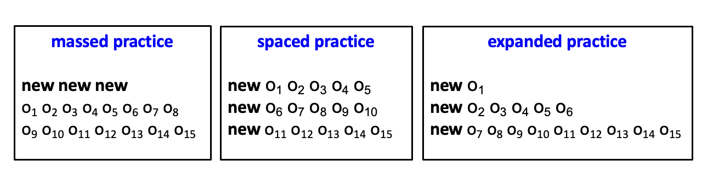
Literature Review
Rohrer and Taylor (2007)
Study of massed vs spaced math problems, spaced practice improved test performance
Landauer and Bjork (1978)
Increasing interval between learning improved test performance
Varma (2021), Landauer & Bjork (1978)

Slide 4
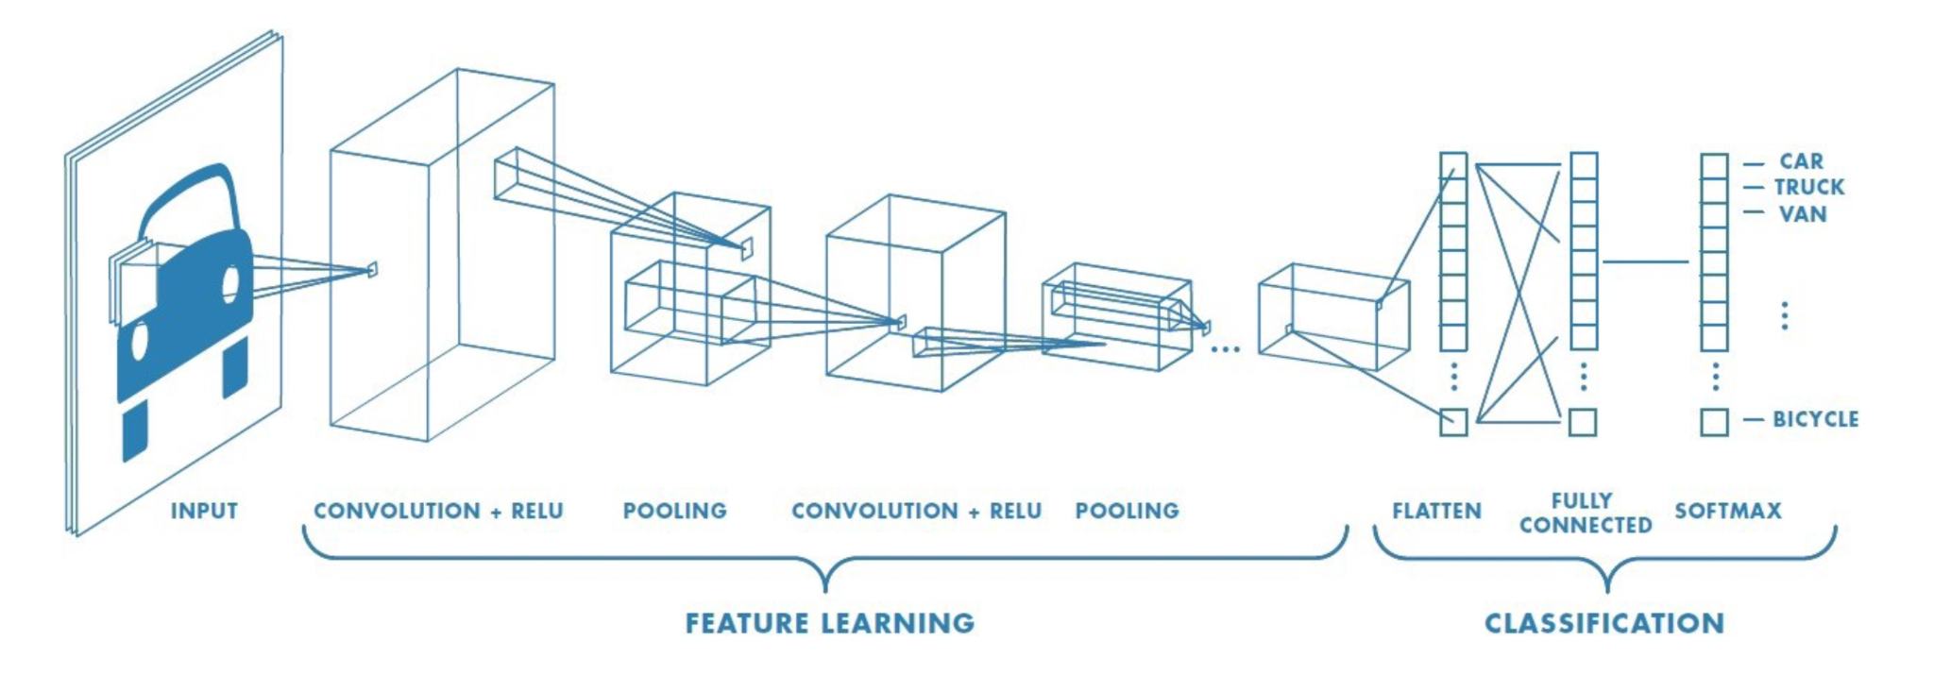
Convolutional Neural Network
Apply relevant filters to capture important features while reducing image size
Krizhevsky, A., Sutskever, I. and Hinton, G. E. (2012)
Success of CNNs
Saha (2018)

Slide 5
VGG
Karen Simonyan and Andrew Zisserman (2015)
Creation of VGG architecture
Based off of AlexNet with improvements
More weight layers = better performance

Slide 6
Research Question
Can we observe the effects found in human learning of massed/spaced/expanded practice when sequencing the dataset on a convolutional neural network?

Slide 7
Results
We will evaluate the success of our research by measuring if the convolutional neural network shows the prior mentioned human learning effects.

Slide 8
Method

Slide 9
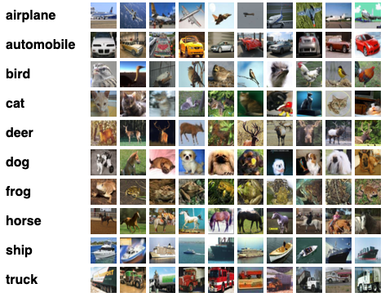
Dataset
CIFAR-10
Why CIFAR-10?
10 is a good # of classes
Separability of classes
Interpretable
10k images / class
Notes:
6000 images per class
Mutually exclusive classes

Slide 10
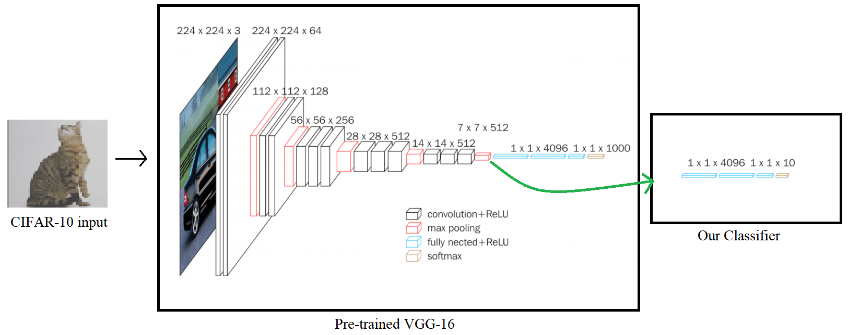
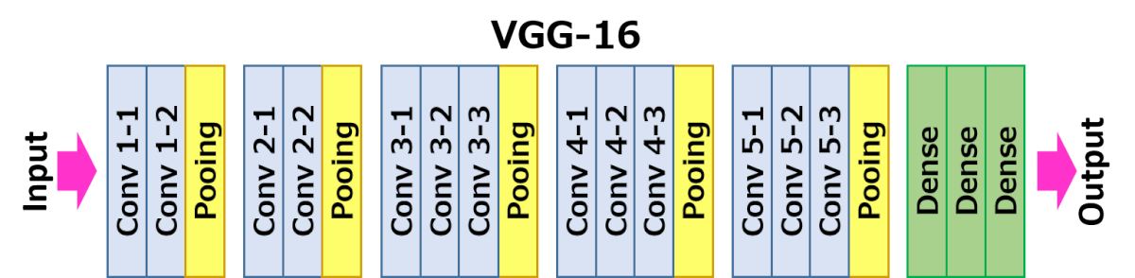
Model

Slide 11
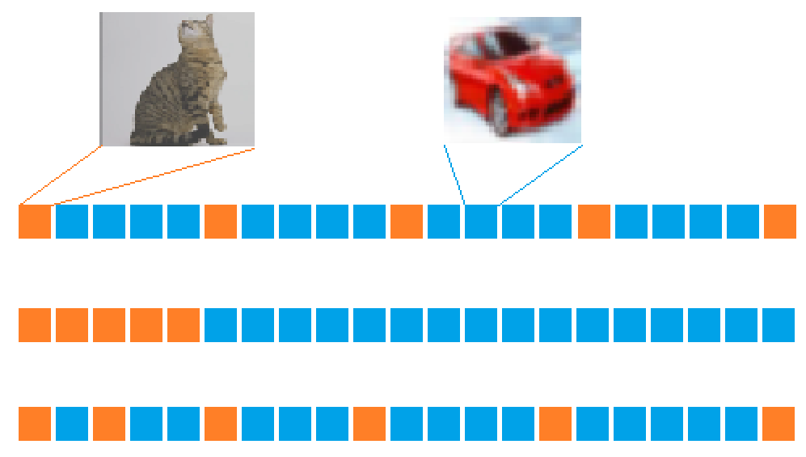
Representing Spaced vs Massed vs Expanded
Spaced
Massed
Expanded
2.0x
1.6x
1.2x
0.8x
0.4x
Expanded

Slide 12
Discussion
Expected Results:
We expect Massing to perform worst
We expect Expanded Practice to perform best
Limitations:
Issues with Training
Number of Training Iterations
Future research:
Oversample data with high error rates in later epochs
Different Problems and Domains

