Slide 1
C Programming II
Utin Liu

Slide 2
Syllabus
Loop
Array
Function
Recursion
Pointer
Data Structure

Slide 3
Loop
Do something again and again

Slide 4
When do we use loop?
When we want to do something again and again
Ex:
Count n! = n(n – 1)(n – 2)... * 2 * 1

Slide 5

While Loop
If loop condition is true, then while loop will run repeatedly
Something you want while loop to do repeatedly

Slide 6
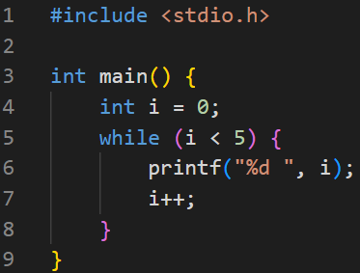

While Loop - Example
i = 0
i++
i = 1
i++
i = 2
i++
i = 3
i++
i = 4
i = 5
i++

Slide 7

For Loop
Something you want for loop do repeatedly

Slide 8
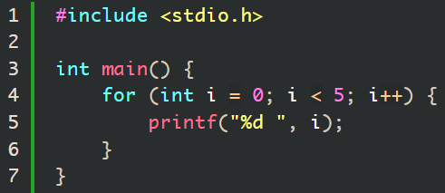
For Loop - Example
i = 0
i++
i = 1
i++
i = 2
i++
i = 3
i++
i = 4
i = 5
i++

Slide 9
Loop Control - break
break
Loop

Slide 10
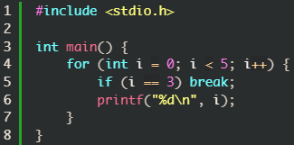

Loop Control - break

Slide 11
Loop Control - continue
continue
Loop

Slide 12
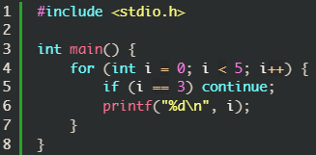
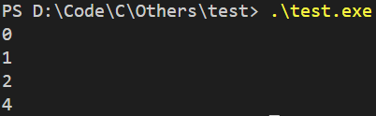
Loop Control - continue

Slide 13
Array
A Data Sequence With The Same Data Type

Slide 14
What is array?
A sequence that can store several values of the same type
Index starts from 0
Element0 | Element1 | Element2 | Element3 | Element4 | Element5 | Element6

Slide 15
When do we use array?
When we need to store a lot of data with same type
Ex:
Student list
Encode table
Map (2D array)
Eric | Amy | Roger | Jerry | Mary

Slide 16
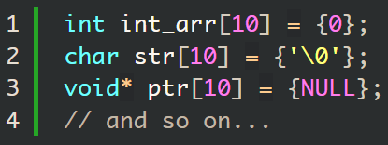
Array - Declaration

Slide 17
Array - Initialization
If we declare an array as a global variable, it would automatically set every element to 0. Otherwise, every element would have random value.
If we have given value to some of the elements in the array, the others would be automatically set to 0.

Slide 18
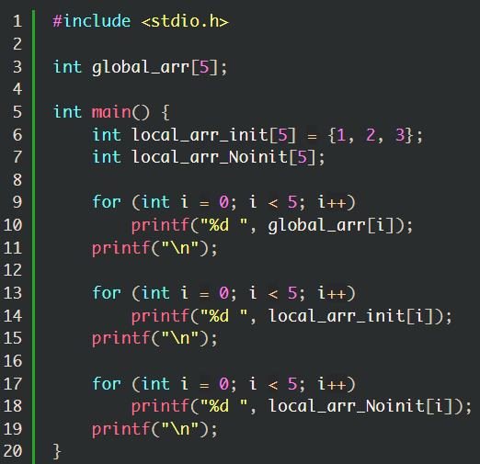
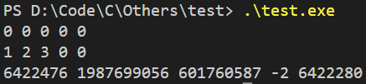
Array – Initialization Example

Slide 19
Array - Operation
We use [] to get the element in array.
name[index] means the index-th element of the array called name.
We can do some operations as variables, such as +, -, *, /, %, &, |, ^.
We can use for-loop to access many elements in an array more easily.

Slide 20
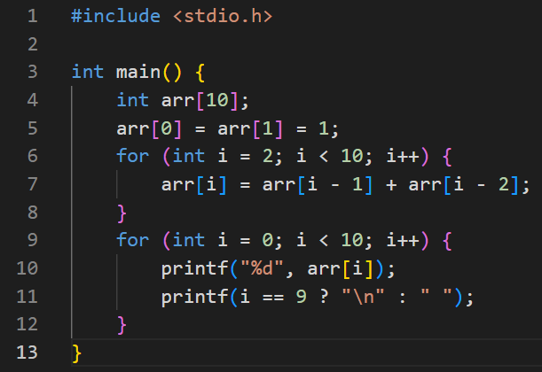

Array – Example: Fibonacci Sequence

Slide 21
Array – 2D Array
Arr[row][col]
Row \ Col | Col 0 | Col 1 | Col 2 | Col 3 | Col 4
Row 0 | arr[0][0] | arr[0][1] | arr[0][2] | arr[0][3] | arr[0][4]
Row 1 | arr[1][0] | arr[1][1] | arr[1][2] | arr[1][3] | arr[1][4]
Row 2 | arr[2][0] | arr[2][1] | arr[2][2] | arr[2][3] | arr[2][4]
Row 3 | arr[3][0] | arr[3][1] | arr[3][2] | arr[3][3] | arr[3][4]
Row 4 | arr[4][0] | arr[4][1] | arr[4][2] | arr[4][3] | arr[4][4]

Slide 22
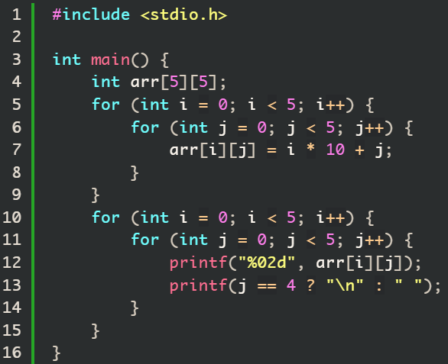
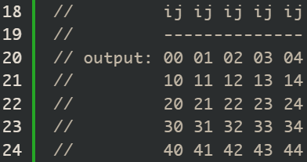
Array - 2D Array Example

Slide 23
Array – String (Character Array)
There must be an element ‘\0’ at the end of the string.
A | B | C
A | B | C | \0

Slide 24
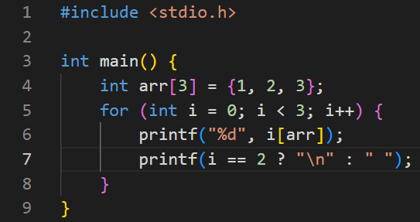

Array – A Fun Fact
If we have an array called arr, we can access its element as arr[index] or index[arr].
arr[index] means arr + index (address), so does index[arr].

Slide 25
Function
Pack Some Repeated Code

Slide 26


Function - Declaration
If the type is void, we don’t have to return anything.
Otherwise, we should return a value depend on the type you declare.

Slide 27
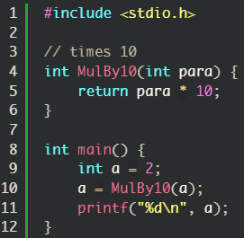
Function – Call Function

Slide 28
Function - Example
main
pass 2 into MulBy10
return 20 back to main
MulBy10

Slide 29
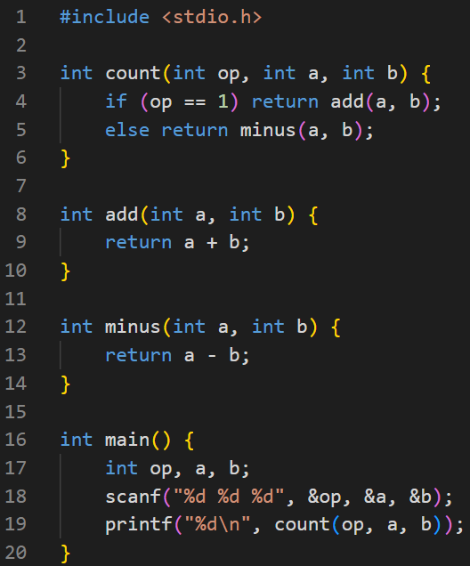
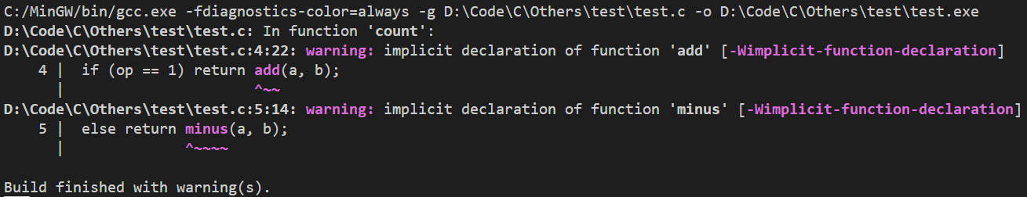
Function – Declare Order Problem

Slide 30
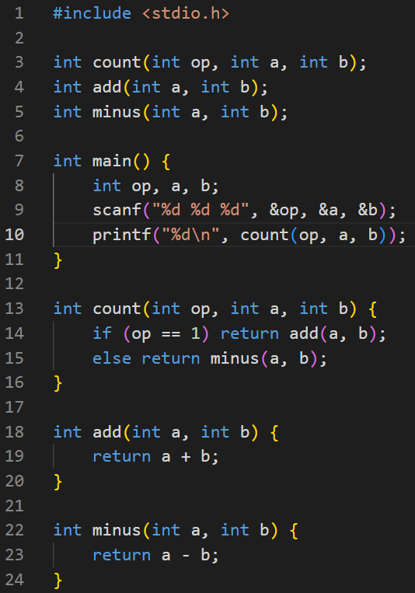

Function – Solution of Declare Order Problem
Declare the functions above
Implement the functions below

Slide 31
Recursion
A Function Calls Itself Repeated

Slide 32
Recursion
A function call itself again and again
func_f
call
func_f
call
return
func_f
return
stop condition

Slide 33
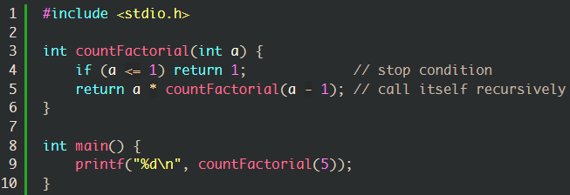
Recursion – Example: Factorial
Return 5*24
Pass 5
a = 5
Return 4*6
Pass 5-1
a = 4
We all know that n! = n(n – 1)(n – 2) *... * 2 * 1.
Let’s use recursion to design a code for counting n!.
Return 3*2
Pass 4-1
a = 3
Return 2*1
Pass 3-1
a = 2
Return 1
Pass 2-1
a = 1

Slide 34
Recursion – Example: Maze
Given a map with start point and end point, please find the minimum steps to reach end point from start point.
6 7
#######
##S...#
#...#.#
#.##E.#
#.....#
#######
‘S’: Start point
‘E’: End point
‘.’: path
‘#’: wall
Output: 6
Input

Slide 35

Recursion – Example: Maze | Variables
R: Total row
C: Total column
Start[2]: record the start point
min_distance: record the minimum step to reach the end point
map: store the maze

Slide 36
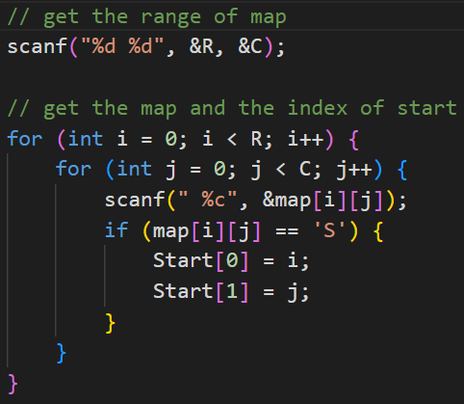
Recursion – Example: Maze | Main Function
6 7
#######
##S...#
#...#.#
#.##E.#
#.....#
#######
Input

Slide 37
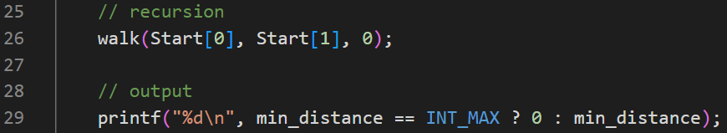
Recursion – Example: Maze | Main Function

Slide 38
Recursion – Example: Maze | Recursive Function
Decide the parameters

Slide 39
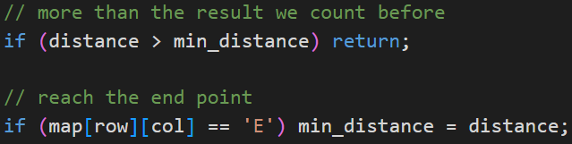
Recursion – Example: Maze | Recursive Function
Decide the stop conditions

Slide 40
Recursion – Example: Maze | Recursive Function
###########
#...#..#..#
#...#.#...#
#.....#...#
###########

Slide 41
Recursion – Example: Maze | Recursive Function
###########
#...#..#..#
#...###...#
#.....#...#
###########

Slide 42
Recursion – Example: Maze | Recursive Function
###########
#...##.#..#
#...###...#
#.....#...#
###########

Slide 43
Recursion – Example: Maze | Recursive Function
###########
#...####..#
#...###...#
#.....#...#
###########

Slide 44
Recursion – Example: Maze | Recursive Function
###########
#...##.#..#
#...###...#
#.....#...#
###########

Slide 45
Recursion – Example: Maze | Recursive Function
###########
#...#..#..#
#...###...#
#.....#...#
###########

Slide 46
Recursion – Example: Maze | Recursive Function
###########
#...#..#..#
#...###...#
#.....#...#
###########

Slide 47
Recursion – Example: Maze | Recursive Function
###########
#...#..#..#
#...###...#
#....##...#
###########

Slide 48
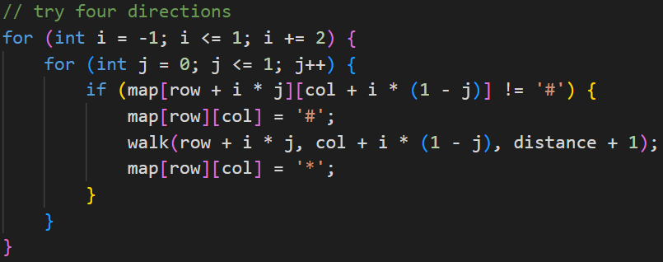
Recursion – Example: Maze | Recursive Function

Slide 49
Pointer
Variable’s Address

Slide 50
Pointer
Stored the variable’s address
type* name; -> store the address of the variable of this type in the variable name.
This part is important for learning C. But it is not friendly to a beginner.

Slide 51
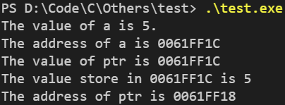
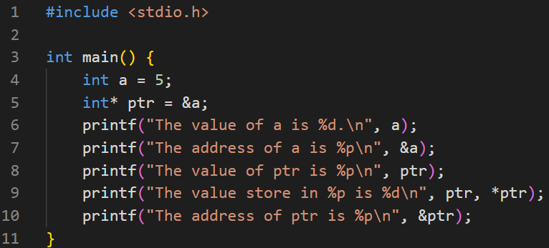
Pointer - Example
Name: a
Type: int
Value: 5
Address: 0061FF1C
Name: ptr
Type: int*
Value: 0061FF1C Address: 0061FF18

Slide 52
Pointer & Function
Pass value? Pass address?

Slide 53
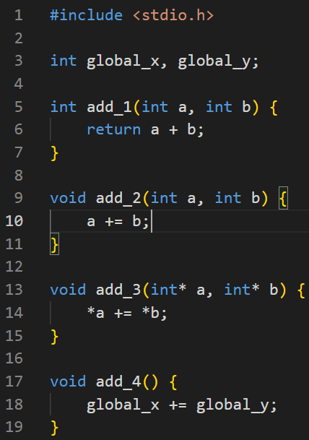
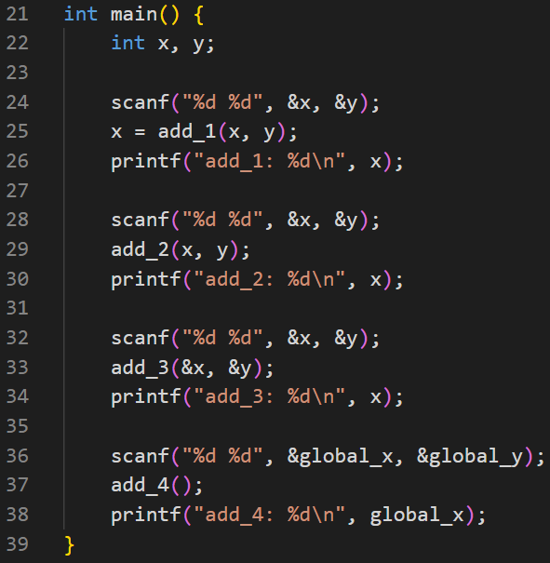

Pointer & Function Example

Slide 54
Data Structure
Make Some Concept Into Graph

Slide 55
Data Structure
Tree, Stack, Queue, Linked List…
Push in
Pop out
Root
Push in
Pop out
Queue
NULL
Linked List
Tree
Stack

Slide 56

Data Structure - struct
Profit: Easier to pass data

Slide 57
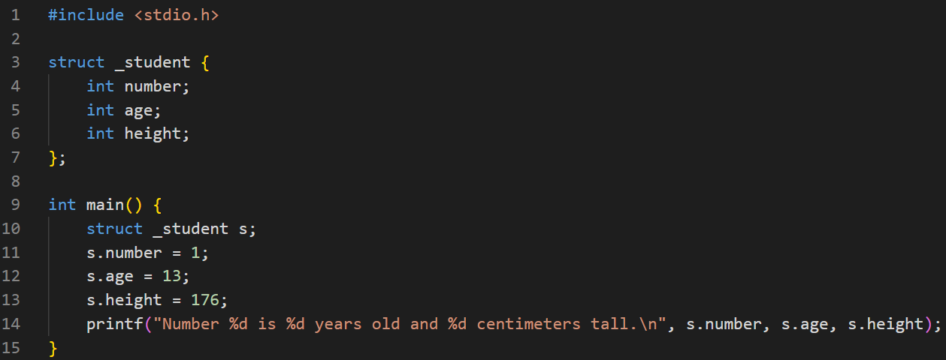
Data Structure - struct

Slide 58
Data Structure - typedef
Make struct more convenient

Slide 59
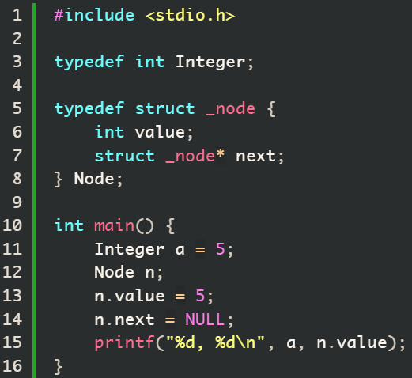

Data Structure - typedef

Slide 60
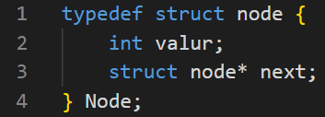
Data Structure – Linked List
NULL
Linked List
Node with its own data
Next node address

Slide 61
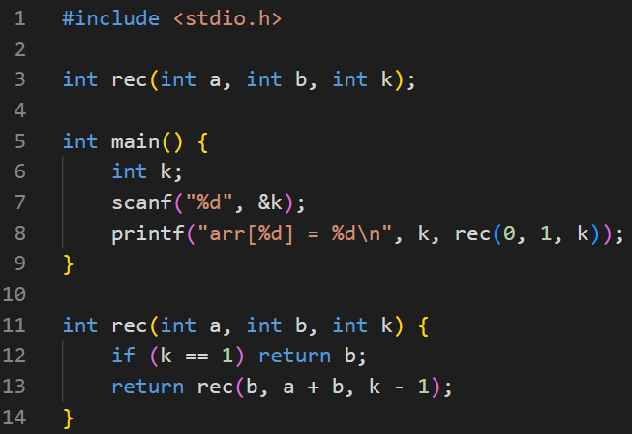

Recursion – Example: Fibonacci Sequence

Slide 62
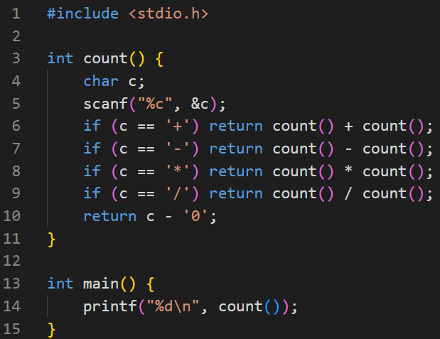
Recursion – Example: Prefix Calaulator
What is prefix calculator?
If we put operator to the front, and we call it prefix expression
For example: (1 + 2) * 4 => * + 1 2 4
*
+
4
1
2

