Slide 1
Figure 1
Analysis & Visualization
Data Collection
Website
Building
Integrated data table onto WordPress-based webpage
Data Filtering
Set up backend automated updating system
Exploratory data analysis on key information including targets, format and clinical status
Automated data processing script with R & Python to process data and generate graphs as they are updated
余馨
肖骁，立飞
肖骁，立飞
Maintaining & Updating
Notes:
The data table containing filtered information was connected to our website, which is build using WordPress system. We used WPDatatable Plugin to integrate the data table from backend to front end of the webpage. The integration established a connection between data source and website front end that allows real-time refreshing as the data are updated. We performed data visualization and analysis on key aspect of antibody therapeutics development that we thought are most beneficial to our audience. These include visualization of the numbers of different proteins being targeted, format and clinical status of the antibodies. We also plotted the distribution of clinical status by country to visualize the progress of clinical trials in each country.

Slide 2
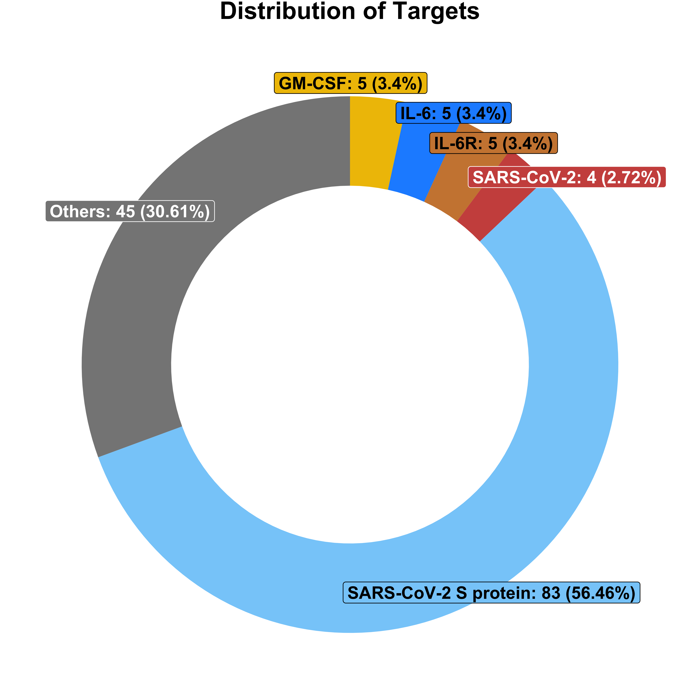
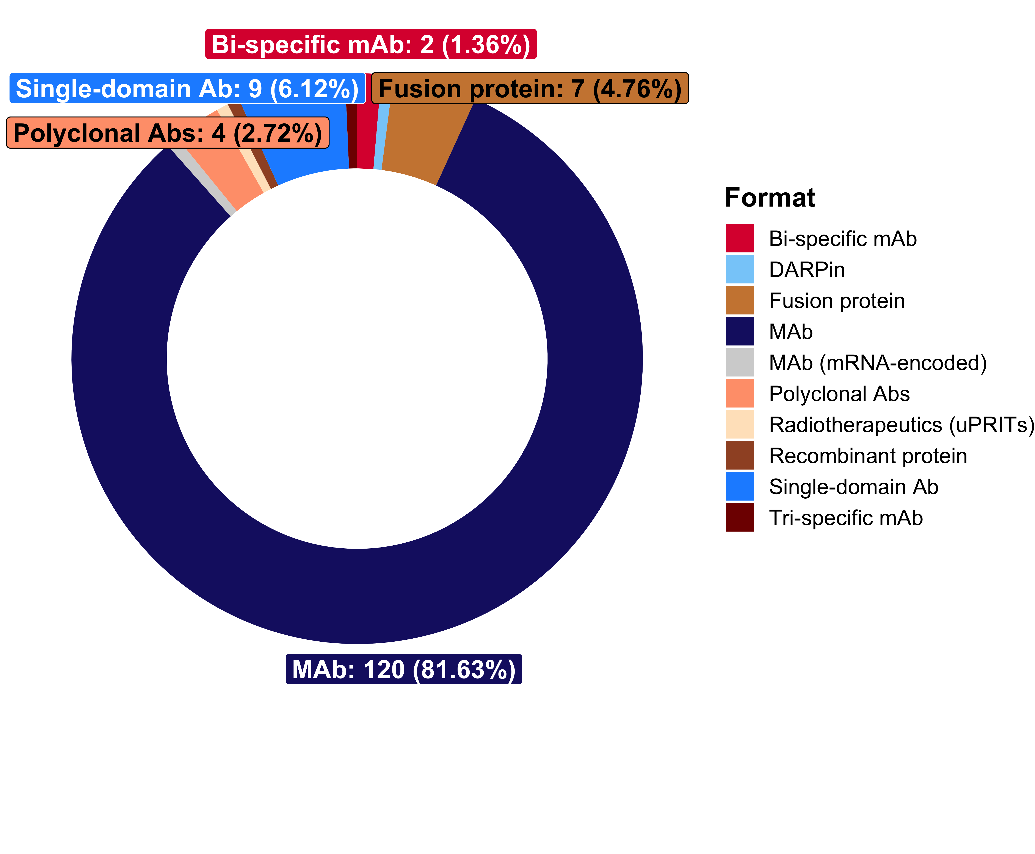
Figure 2: Targets and Format (ongoing)
2A.
2B.
Targets
Format

Slide 3
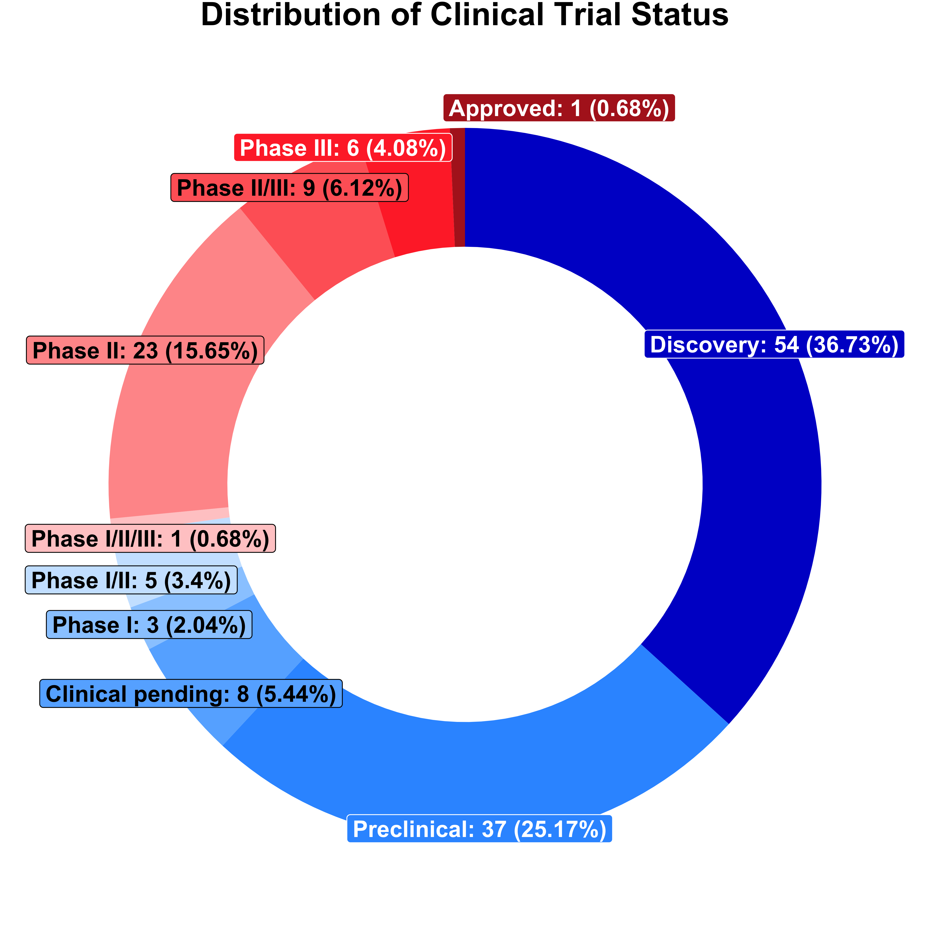
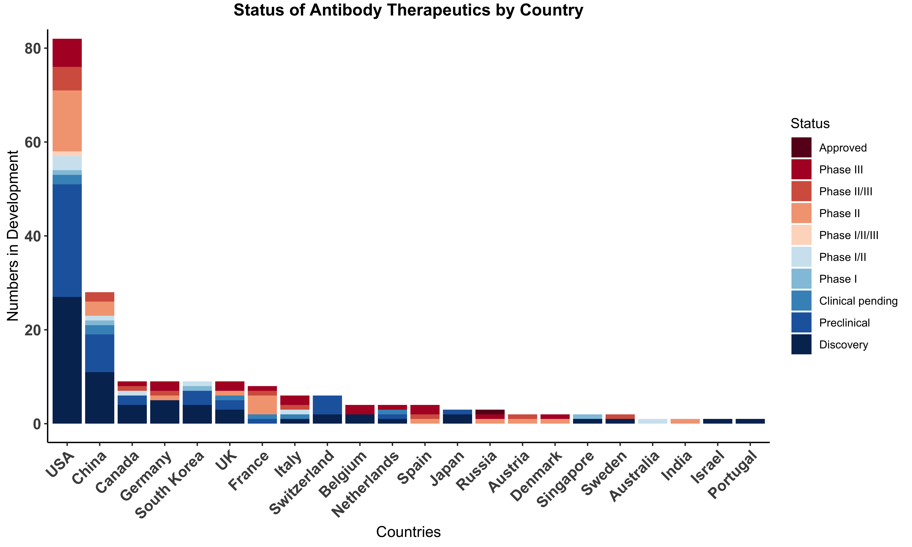
Figure 3: Clinical Trial status(ongoing)
3A.
3B.
Clinical Trial Status
Clinical Trial Status by Country
Notes:
We want to emphasize that there are many multi-national collaborations in developing COVID-19 therapeutic antibodies. Our method is to attribute +1 for each country that participated in the collaboration. For example, if an antibody is jointly developed by institutions/companies in the USA,Germany and China, then each country’s count will add 1.

