Slide 1
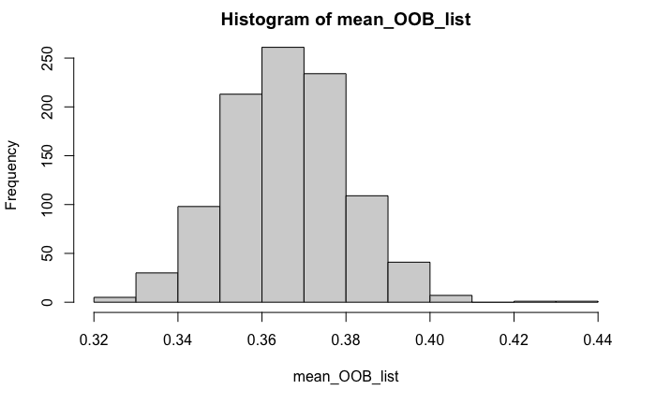
Average Out-of-bag error rate for running 1000 times: 0.3658557

Slide 2
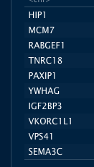
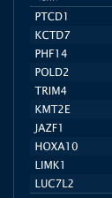
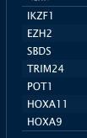

Overlap between the top 200 predicted chr7 tumor suppressor genes with CGC labeled TS: (7 overlaps)
Overlap between the top 200 predicted chr7 tumor suppressor genes with Jeremy’s 96 experimentally discovered putative TS(37 overlaps)

Slide 3
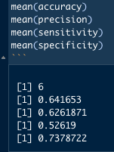
Performance metrics

Slide 4
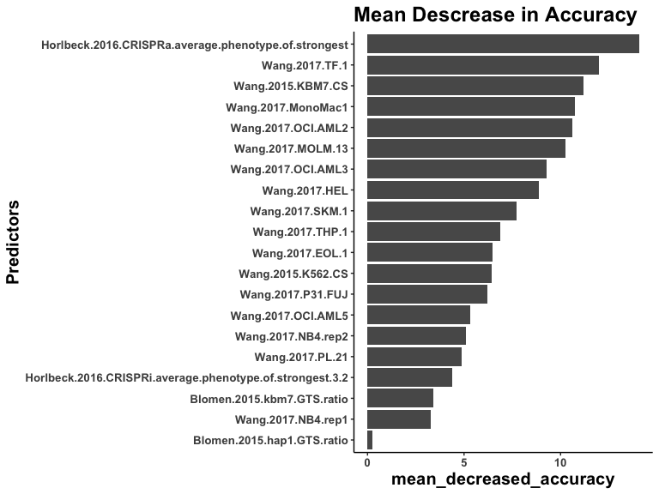
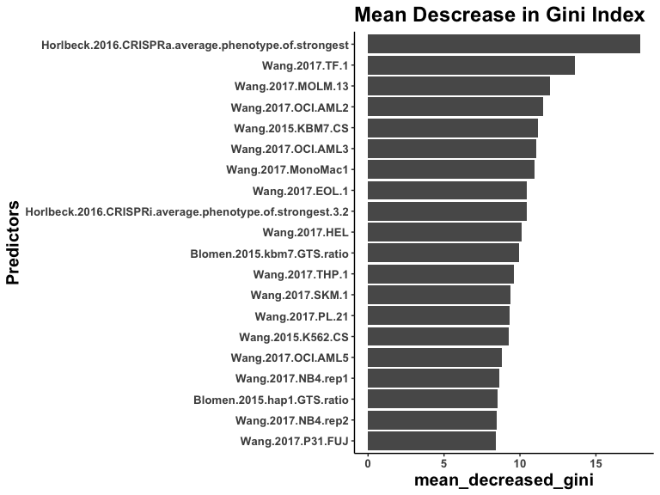

Slide 5
