Slide 1



CatLingo
Android Chinese Words Game App
Undergraduate Project Defence
Liu Weiliang
Telecommunications Engineering with Management
BUPT / QMUL · 2025/26
Notes:
[Sources] - Visual template derived from uploaded file: Copyright PDFs Ally.pptx (title-slide style, gradient background, Queen Mary branding). - Project title, author, programme, and report year cross-checked against thesis PDF title page and uploaded DOCX title page. - Project naming follows the dissertation abstract and introduction in the uploaded PDF (CatLingo / Android Chinese Words Game App). [/Sources]

Slide 2

Background, Problem, and Objectives
Why this project matters and what it set out to achieve
Problem
Objectives
• Many Chinese learning tools still isolate pinyin, vocabulary, or simple drills instead of integrating recognition, pronunciation, and sentence practice.
• Chinese learners must recognise characters, distinguish tones, connect pinyin with written words, and understand sentence order.
• Repetition without progression, feedback, and visible progress makes it difficult to sustain motivation.
1. Build a native Android app with a modular and maintainable structure.
2. Implement three mini-games: Character Matching, Pronunciation Quiz, and Word Puzzle.
3. Support user accounts, difficulty selection, local persistence, achievements, and progress tracking.
4. Provide an engaging learning workflow while remaining educationally meaningful.
Target users: beginner and intermediate Chinese learners on Android
2
Notes:
[Sources] - Uploaded thesis PDF: abstract and keywords (pp. 4–5) for project purpose and scope. - Uploaded thesis PDF: Introduction sections 1.1–1.4 (pp. 7–10) for background, problem statement, aim, objectives, and scope. - Uploaded DOCX initial draft: Abstract and Chapter 1 for cross-checking motivation and project scope. [/Sources]

Slide 3
System Overview
A gamified mobile workflow that connects multiple learning tasks
Character Matching
Pronunciation Quiz
Word Puzzle
Pinyin → Chinese word association
• Random word selection by difficulty
• POS-tag distractors
• Immediate answer feedback
Spoken output with evaluation
• Hold-to-record interaction
• Target word + pinyin support
• Score feedback for each attempt
Sentence-level reconstruction
• Reorder or blank mode
• Token-based sentence processing
• Progress stored per session
Shared support features
User management
Difficulty selection
Session scores
Achievements
Profile & progress
Login / Register
Choose Game
Play by Difficulty
Store Results
Review Progress
3
Notes:
[Sources] - Uploaded thesis PDF: abstract (pp. 4–5) and requirements chapter (pp. 16–20) for the three core mini-games and support features. - Uploaded thesis PDF: design chapter (pp. 22–36) for activity-based workflow and feature grouping. - GitHub repo: activity_game_choice.xml and GameActivity.java for the three game modes and entry flow. [/Sources]

Slide 4
Architecture and Technology Stack
From a Unity concept to a native Android implementation
Layered architecture
Key stack
Activities + XML layouts
Login, game hub, profile, achievements, shared game UI
Platform
Native Android (Java + XML)
Presentation layer
Persistence
SQLite, DAO pattern, JSON-to-SQLite loading
Control layer
MainActivity, game_choice, GameActivity
Navigation, session flow, game dispatch
Game control
Single GameActivity dispatching three modes
SQLite + DAO + DataManager
Users, scores, question details, sentences, word resources
Language data
HanLP / pinyin processing and sentence tokens
Data layer
Speech module
IseEvaluator + SpeechRecognitionHelper integration
External services
Speech evaluation / recognition components
HanLP-assisted sentence processing
Project evolution
Original Unity idea migrated to native Android for maintainability
4
Notes:
[Sources] - Uploaded thesis PDF: design and implementation chapter (pp. 22–25) for layered architecture and activity-based navigation. - GitHub repo: GameActivity.java for single-activity mode dispatch and speech helper initialization. - GitHub repo: README.md and Database_Documentation.md for stack components and runtime database description. - Uploaded DOCX initial draft: Background / Technical context sections for platform migration context. [/Sources]

Slide 5
Data Model and Persistence
Local storage turns separate mini-games into one continuous learning system
Core table groups
11
User module
Game records
Content
users • achievements • user_achievements
game_scores • game_question_details
sentences • sentence_words • game_words
tables in the current
SQLite database
4 grouped modules
Question banks
character_matching • pronunciation_quiz • word_puzzle
Users & achievements
Game records
Sentence resources
JSON → SQLite pipeline
Game question banks
JSON assets
DataManager
Seed loader
SQLite
Play
5
Notes:
[Sources] - Uploaded thesis PDF: design chapter sections 4.4.1–4.4.3 (pp. 25–29) for database rationale, DAO access, and JSON-to-SQLite import. - GitHub repo: Database_Documentation.md for the current 11-table SQLite schema and module grouping. - GitHub repo: GameActivity.java for how session records and per-question details are created and updated. [/Sources]

Slide 6
Core Gameplay Implementation
How the three modules are built and evaluated at runtime
01 Character Matching
02 Pronunciation Quiz
03 Word Puzzle
10 questions per session
Target word + pinyin display
Sentence tokens loaded from SQLite
Random words by difficulty
Hold-to-record interaction
Reorder or blank mode by complexity
POS-tag distractors
Evaluation callback and score mapping
Fallback when token data are missing
Immediate correctness feedback
Stored per-question pronunciation result
Sentence-level result persistence
Implementation highlights
GameActivity dispatches the three modes; session summaries are stored in game_scores and detailed answers in game_question_details; the pronunciation module uses evaluation callbacks, while Word Puzzle switches between reorder and blank-style tasks based on sentence length and token count.
6
Notes:
[Sources] - Uploaded thesis PDF: sections 4.6–4.9 (pp. 30–35) for module design and implementation logic. - GitHub repo: GameActivity.java for runtime constants, mode dispatch, answer feedback, Word Puzzle branching, and speech evaluation callbacks. - GitHub repo: PRONUNCIATION_QUIZ_INTEGRATION.md for pronunciation flow and scoring design. [/Sources]

Slide 7
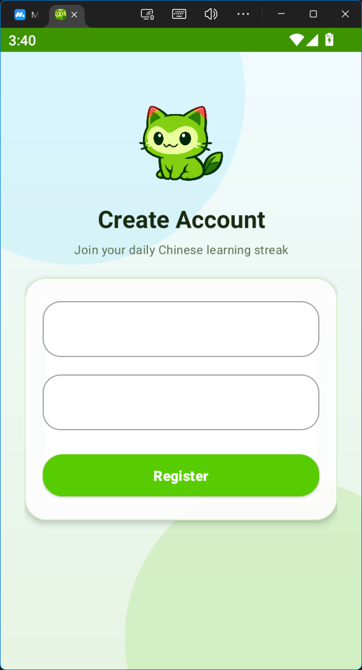
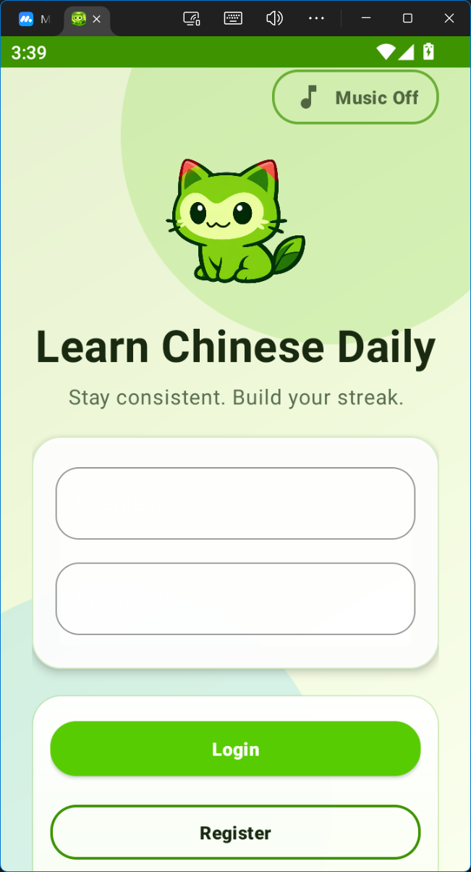
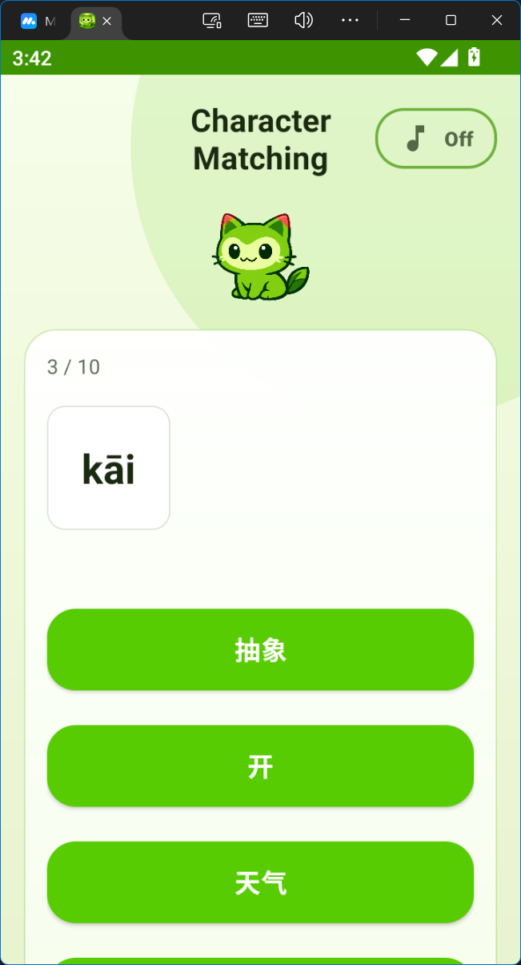
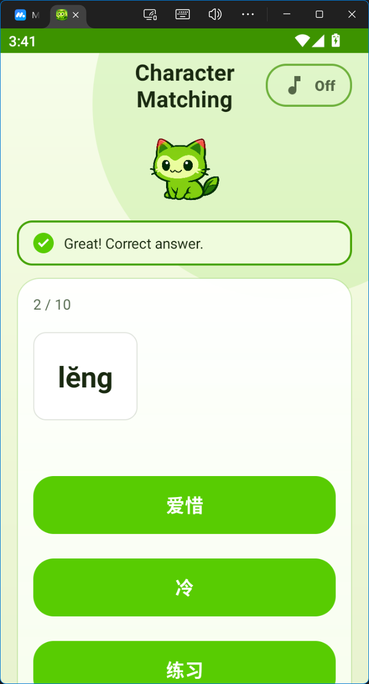
UI and Result Snapshots
Screens from the implemented prototype shown in the dissertation
User & account flow
Character Matching feedback
7
Notes:
[Sources] - All four visual assets on this slide are cropped from dissertation result pages in the uploaded PDF: user management (p. 37), Character Matching (p. 38), Pronunciation Quiz (p. 39), and Word Puzzle (p. 40). - The screenshots correspond to the thesis discussion in Chapter 5 and are used here as implementation evidence. - Template styling continues the uploaded PowerPoint theme (footer gradient and Queen Mary branding). [/Sources]

Slide 8
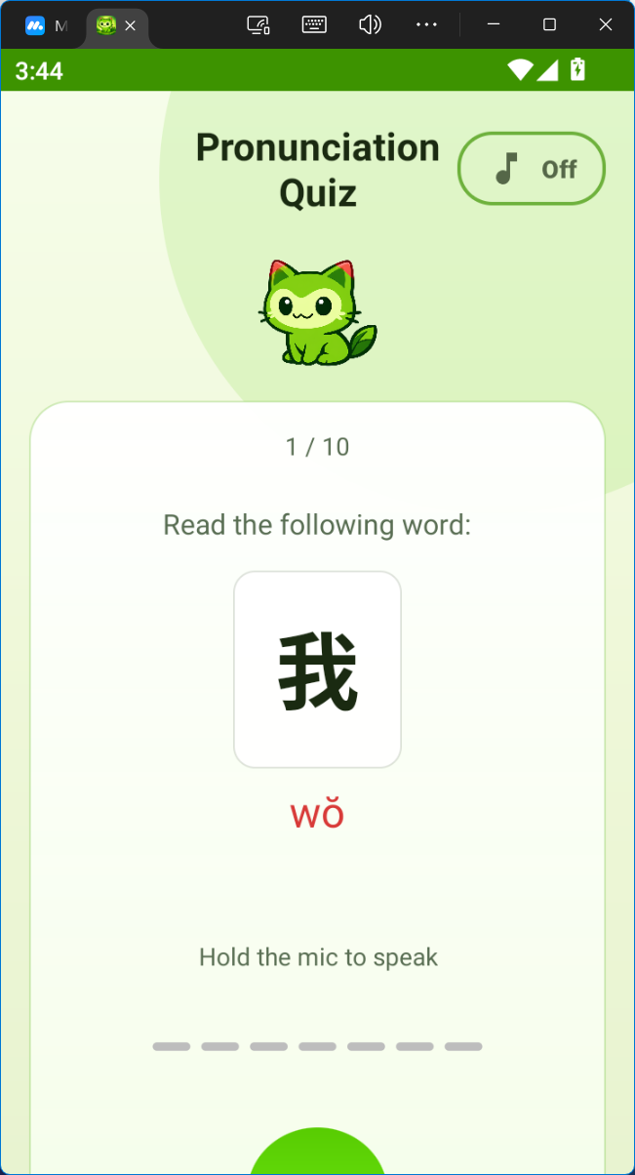
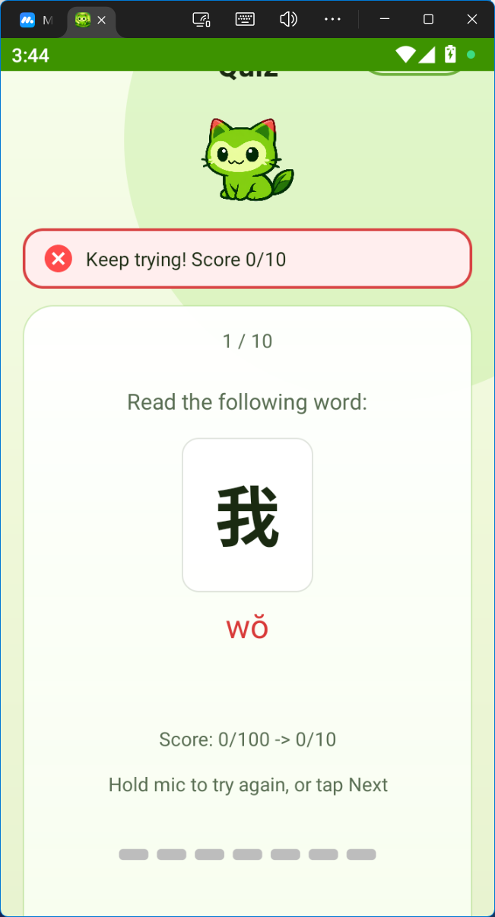
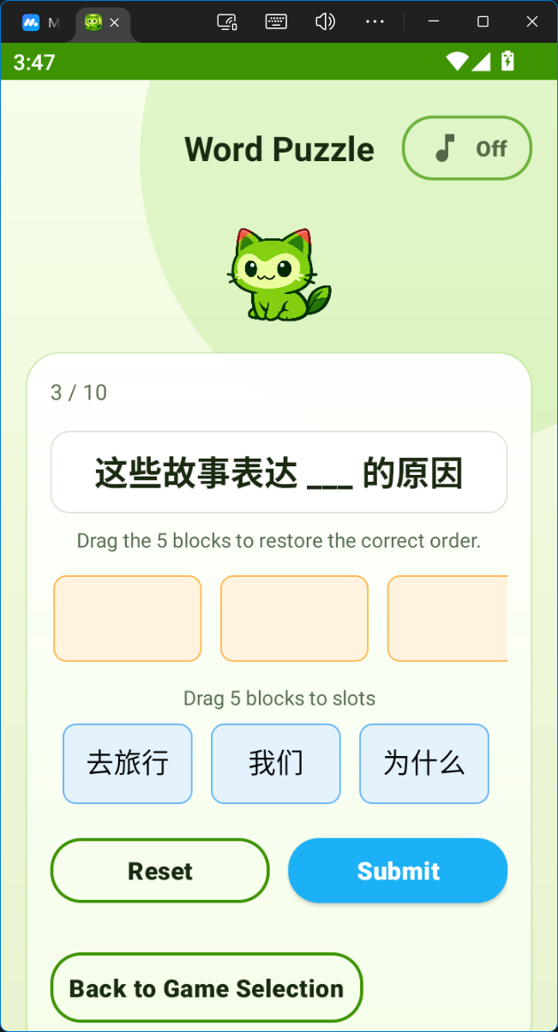
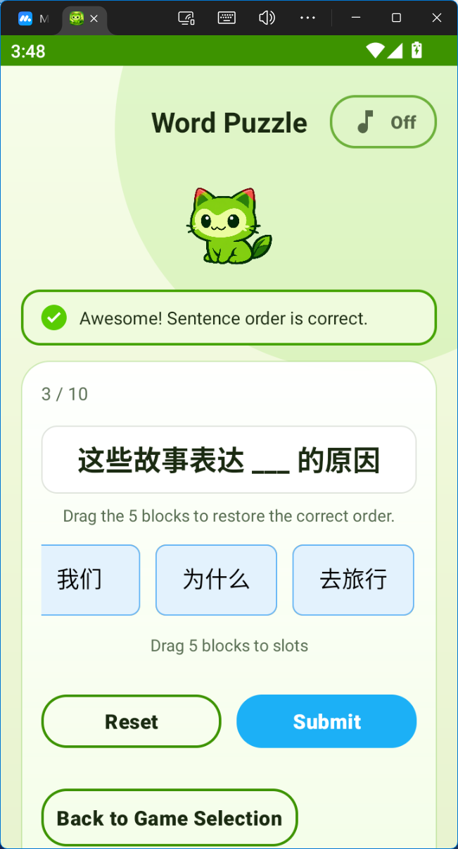
UI and Result Snapshots
Screens from the implemented prototype shown in the dissertation
Pronunciation evaluation
Word Puzzle interaction
8
Notes:
[Sources] - All four visual assets on this slide are cropped from dissertation result pages in the uploaded PDF: user management (p. 37), Character Matching (p. 38), Pronunciation Quiz (p. 39), and Word Puzzle (p. 40). - The screenshots correspond to the thesis discussion in Chapter 5 and are used here as implementation evidence. - Template styling continues the uploaded PowerPoint theme (footer gradient and Queen Mary branding). [/Sources]

Slide 9
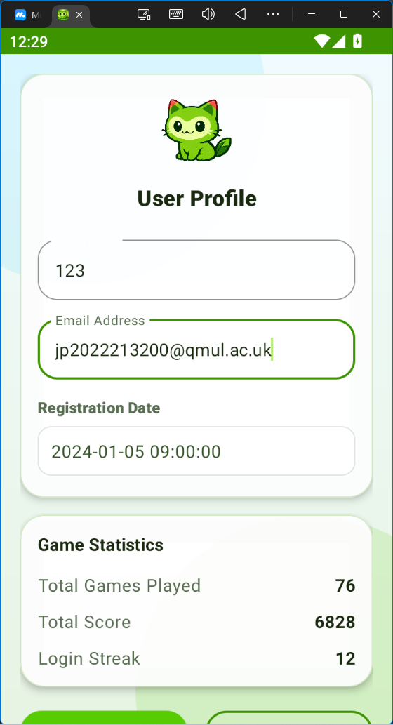
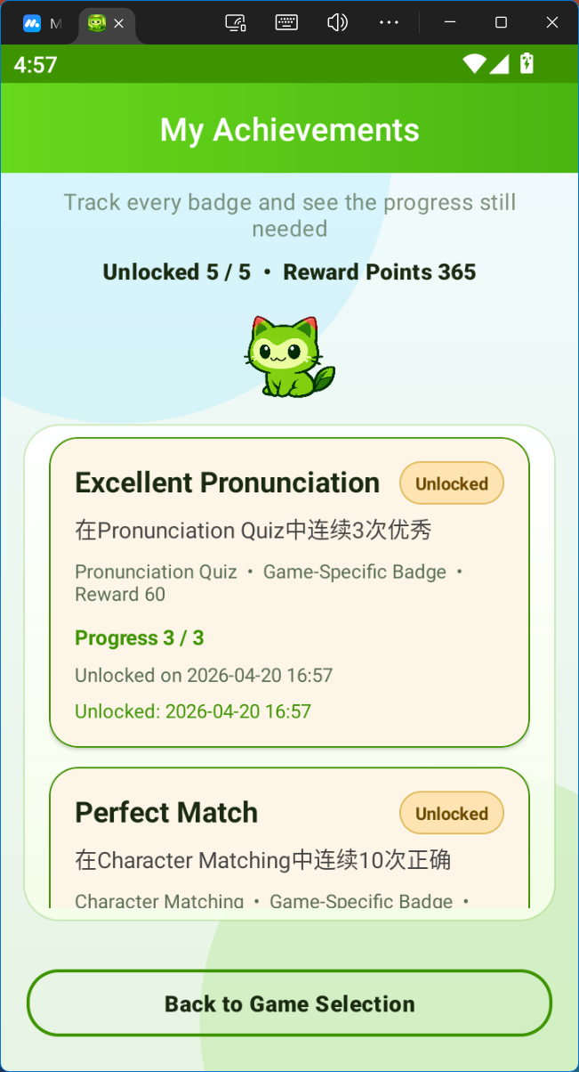
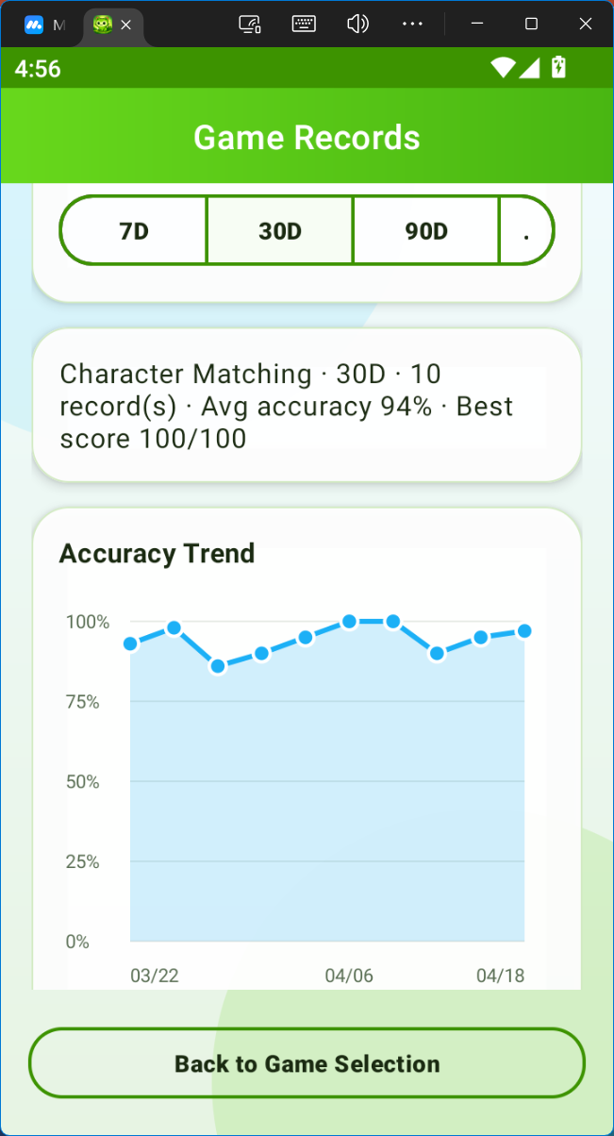
UI and Result Snapshots
Screens from the implemented prototype shown in the dissertation
Profile/progress evidence
9
Notes:
[Sources] - All four visual assets on this slide are cropped from dissertation result pages in the uploaded PDF: user management (p. 37), Character Matching (p. 38), Pronunciation Quiz (p. 39), and Word Puzzle (p. 40). - The screenshots correspond to the thesis discussion in Chapter 5 and are used here as implementation evidence. - Template styling continues the uploaded PowerPoint theme (footer gradient and Queen Mary branding). [/Sources]

Slide 10
Evaluation Against the Original Objectives
Most core goals were achieved; full-scale user evaluation remains future work
Objective status
Key takeaways
Requirements and learner needs analysis
✓
Achieved
• CatLingo already supports a coherent learning workflow: login, game selection, interactive practice, and progress review.
• The prototype is strongest in integrated structure, local persistence, and the technically grounded speaking workflow.
• The current project demonstrates feasibility and internal coherence more strongly than long-term pedagogical impact at scale.
Modular native Android architecture
✓
Achieved
Three educational mini-games
✓
Achieved
SQLite + JSON-backed content pipeline
✓
Achieved
Progress tracking and achievements
✓
Achieved
10
Notes:
[Sources] - Uploaded thesis PDF: Results and Discussion chapter (pp. 37–43) for system effectiveness and objective comparison. - Uploaded thesis PDF: Conclusion section 6.2 and 6.3 (pp. 44–45) for achievement of objectives and remaining limitations. - Profile screenshot is cropped from uploaded PDF p. 41 as evidence of progress tracking. [/Sources]

Slide 11
Limitations and Future Work
The prototype establishes a solid foundation, but not the final endpoint
Limitations
Future work
• Data are stored locally only, which suits a student prototype but limits broader deployment.
• Pronunciation outcomes can vary with device conditions, background noise, and external service behaviour.
• Question quality still depends on dataset balance, preprocessing quality, and distractor design.
• Add cloud-backed accounts and cross-device synchronisation.
• Expand achievement logic and richer progress analytics.
• Improve Word Puzzle curation and difficulty modelling.
• Provide more detailed pronunciation feedback and test under wider conditions.
Positioning: a credible and integrated prototype for future expansion
11
Notes:
[Sources] - Uploaded thesis PDF: Discussion of limitations (p. 42) and conclusion/future work (pp. 44–45). - Uploaded DOCX initial draft: Risk and Environmental Impact Assessment appendix for privacy, fairness, and deployment-related constraints. - Limitations reflect both the dissertation discussion and the current GitHub project state. [/Sources]

Slide 12
Thank you
Questions and discussion
Notes:
[Sources] - Visual style based on the uploaded PowerPoint template closing slide and Queen Mary branding from Copyright PDFs Ally.pptx. [/Sources]

