Slide 1

Android Chinese Words Game App
UNDERGRADUATE DEFENCE
Design and Implementation of a Gamified Native Android App for Chinese Learning
Liu Weiliang | BUPT 2022213200 / QMUL 221166552 | 20 April 2026
Simple, visual, and learner-friendly

Slide 2

Project Background and Problem Statement
Learning Context
Mobile learning supports short, repeatable practice outside the classroom.
Chinese learners must coordinate characters, pinyin, tones, and word order at the same time.
Research Question
How can a native Android app use gamified interaction to improve vocabulary recognition, pronunciation training, and sentence understanding for beginner and intermediate Chinese learners?
Gap in Existing Tools
Many apps emphasise memorisation or display rather than active interaction and feedback.
Pronunciation and sentence-level practice are often weak or disconnected from vocabulary work.

Slide 3
Aim, Objectives and Contributions
Project Aim
Main Contributions
Design and implement a native Android prototype for Chinese learning.
Support beginner and intermediate learners in a low-friction mobile setting.
Combine learning tasks with progress, scores, and motivation mechanics.
Three integrated mini-games in one coherent learning flow.
A practical Java/XML + SQLite architecture for an educational app.
JSON-based question bank expansion without changing the core gameplay logic.
A prototype route that connects UI, persistence, NLP support, and speech evaluation.

Slide 4
System Design Overview
The app turns a learning session into a simple closed loop from entry to feedback.
1. Sign In
2. Select Mode
3. Complete Session
4. Get Feedback
User login, profile, and personal progress entry.
Choose game type and difficulty level.
Play a 10-question training round.
Receive score, accuracy, and result details.
Target Users
Functional Scope
Non-Functional Goals
Beginner and intermediate Chinese learners.
Users who benefit from short, repeatable mobile practice.
Account management, game flow, local records, and achievements.
Three game types with difficulty-based question selection.
Maintainable structure, responsive UI, and practical offline persistence.
A prototype suited to extension rather than full product launch.

Slide 5
Architecture and Technology Stack
Architecture Route
Technology Stack
The project moved from an early Unity/C# idea to a native Android implementation.
Activity-based UI handles navigation, gameplay flow, and user interaction.
A shared GameActivity coordinates the three game modes and session state.
DAO-based persistence reduces SQL coupling inside interface code.
Java 11 + XML for Android application development.
SQLite with DaoFactory and DAO implementations for local storage.
HanLP and pinyin4j for Chinese text processing.
iFlyTek-related modules for pronunciation evaluation support.

Slide 6
Core Learning Modules
Character Matching
Pronunciation Quiz
Word Puzzle
Choose the correct Chinese word from pinyin-guided options.
Designed to strengthen the link between sound and written form.
Speak the target word and receive score-oriented pronunciation feedback.
Turns oral practice into a repeatable game mechanic.
Reorder short sentences or fill blanks in longer ones.
Uses segmented sentence data to support question generation.

Slide 7
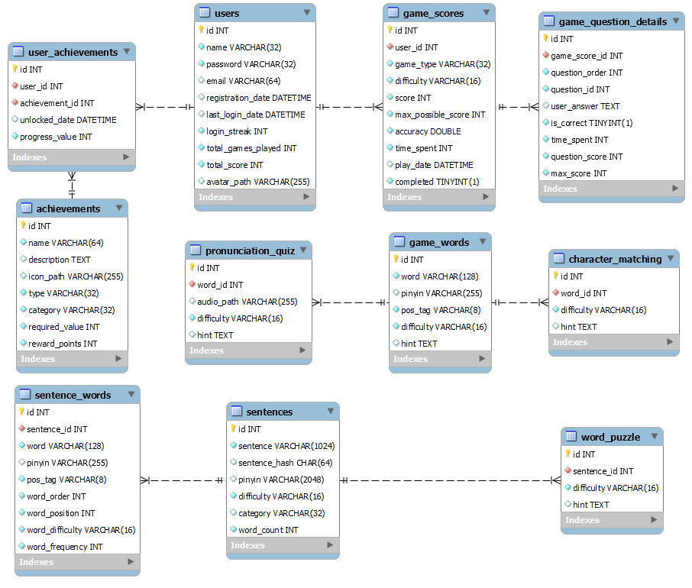
Data Model and Local Persistence
Why this matters
The SQLite schema stores users, achievements, game scores, detailed question logs, sentences, segmented tokens, and question banks. JSON assets can be imported into the local database to expand content cleanly.

Slide 8
Current Implementation Status
3
3
10
game modes
difficulty levels
questions per session
What is already working
Engineering Strengths
Login, profile, game selection, and session-level game flow are implemented.
All three game branches write results into the local database.
Records, achievements, and progress data are already integrated into the prototype.
Shared gameplay controller.
Expandable question-bank pipeline.
Clear local persistence structure.

Slide 9
Limitations and Future Work
Current Limitations
Next Steps
Speech evaluation remains sensitive to pronunciation variation, background noise, and device conditions.
Formal usability testing and broader performance validation are still incomplete.
The interface is usable but not yet fully polished for final delivery quality.
Stabilise the pronunciation-evaluation workflow and improve error handling.
Expand the datasets and strengthen quality control for question generation.
Add structured user evaluation, compatibility checks, and more refined visual feedback.

Slide 10

Conclusion and Q&A
A feasible Android prototype for gamified Chinese learning
The project integrates vocabulary recognition, pronunciation practice, sentence reconstruction, and local progress tracking in one coherent mobile system.
Thank you. Questions are welcome.

