Slide 1
Android Chinese Words Game App
Undergraduate Project Defence
Design and Implementation of a Gamified Native Android App for Chinese Learning
Liu Weiliang | BUPT 2022213200 / QMUL 221166552 | 20 April 2026

Slide 2
Background and Motivation
Mobile apps make language practice flexible, repeatable, and easy to access in short sessions.
Many Chinese learning apps still focus on content display rather than active, feedback-driven practice.
Beginner learners must connect characters, pinyin, pronunciation, and sentence order at the same time.
This project investigates whether a gamified Android app can make that practice more engaging and sustainable.

Slide 3
Aim, Objectives and Contributions
Aim: design and implement a native Android app for beginner and intermediate Chinese learners.
Build three mini-games for character recognition, pronunciation practice, and sentence reconstruction.
Support user accounts, difficulty selection, local persistence, score history, and achievements.
Demonstrate a practical route that combines Android UI, SQLite, NLP tools, and speech evaluation in one prototype.

Slide 4
System Scope and Requirements
Target users: beginner and intermediate learners who need lightweight mobile practice.
Core functions: login and profile management, game selection, 10-question sessions, records, and achievements.
Non-functional goals: responsive interaction, maintainable structure, and support for local offline data.
Scope excludes a full course platform, cloud sync, and a large-scale commercial deployment.

Slide 5
Architecture and Technology Route
Architecture
Technology Stack
Initial Unity/C# planning was replaced by a native Android route better suited to form-based interaction and local storage.
An Activity-based presentation layer handles navigation, gameplay flow, and user interaction.
A shared GameActivity coordinates the three game modes and session logic.
Java 11 + XML for the Android application layer.
SQLite with DAO and DaoFactory for persistence and data access.
HanLP and pinyin4j for Chinese text processing and pinyin support.
iFlyTek-related speech evaluation modules are used to support pronunciation feedback.

Slide 6
Core Learning Modules
Character Matching: learners choose the correct Chinese word from pinyin-guided options.
Pronunciation Quiz: learners speak the target word and receive evaluation-based feedback and scores.
Word Puzzle: learners reorder short sentences or fill blanks in longer ones using segmented sentence data.
Gamification is provided through three difficulty levels, per-session scores, progress records, and achievements.

Slide 7
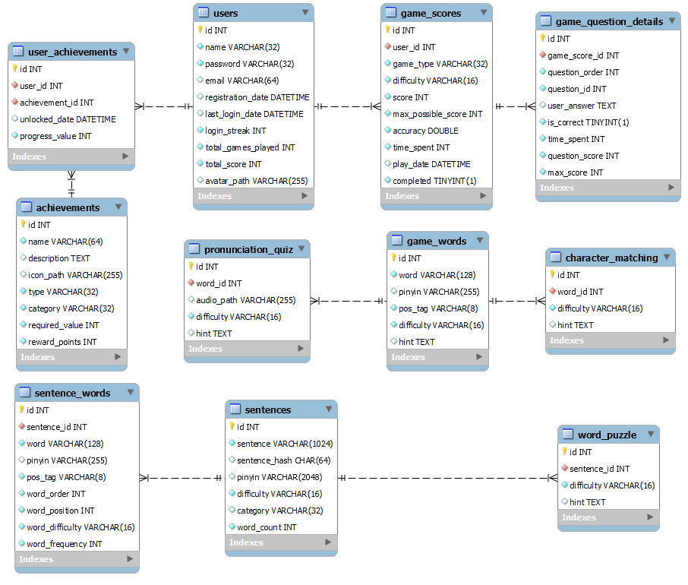
Data Model and Local Persistence
The current SQLite schema stores users, achievements, game scores, per-question records, sentences, segmented tokens, and dedicated question banks. JSON assets are imported into SQLite so the dataset can be expanded without rewriting the application logic.

Slide 8
Current Prototype Results
The prototype already supports an end-to-end flow from login to completed game sessions.
All three game branches are implemented with difficulty selection and 10 questions per session.
Scores, detailed question records, user progress, and achievement data are written to the local database.
The JSON-to-SQLite pipeline makes it practical to expand the question bank during later project stages.

Slide 9
Limitations and Future Work
Speech evaluation quality is still sensitive to device differences, noise conditions, and pronunciation variation.
Systematic usability testing, performance profiling, and broader device validation are not yet complete.
The interface and learning feedback can still be refined for a more polished user experience.
Next steps are to harden the speech module, expand the datasets, and add structured evaluation with users.

Slide 10
Conclusion and Q&A
The project demonstrates a feasible technical route for a gamified Chinese-learning Android prototype.
It integrates vocabulary, pronunciation, and sentence reconstruction in one local system.
Thank you for listening.
Questions are welcome.

