Slide 1

RBC GELP Business Technology Intern JavaScript Test
Wenbin Liu
08/20/2018

Slide 2
Set up local server
To achieve the functionality of reaching .csv files, we need to run a local server for hosting our webpage when testing. The behavior of JS codes will be similar to production, when we will host websites online.
We can use Python3 to start server. In the directory we store the .html, .js, .csv and .css files, run the following command in Terminal/cmd:
python3 -m http.server

Slide 3
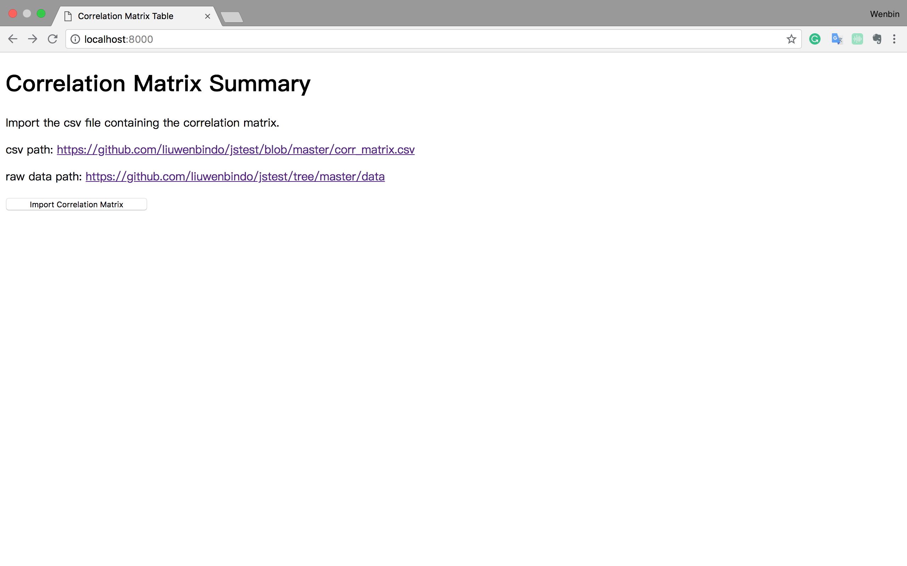
Display main HTML webpage
In our directory, we can set a index.html file to contain our main content. In this project, this html file contains the whole correlation matrix, like the screenshot below.
Content in this html file is controlled by .js and .css files under the same folder.

Slide 4
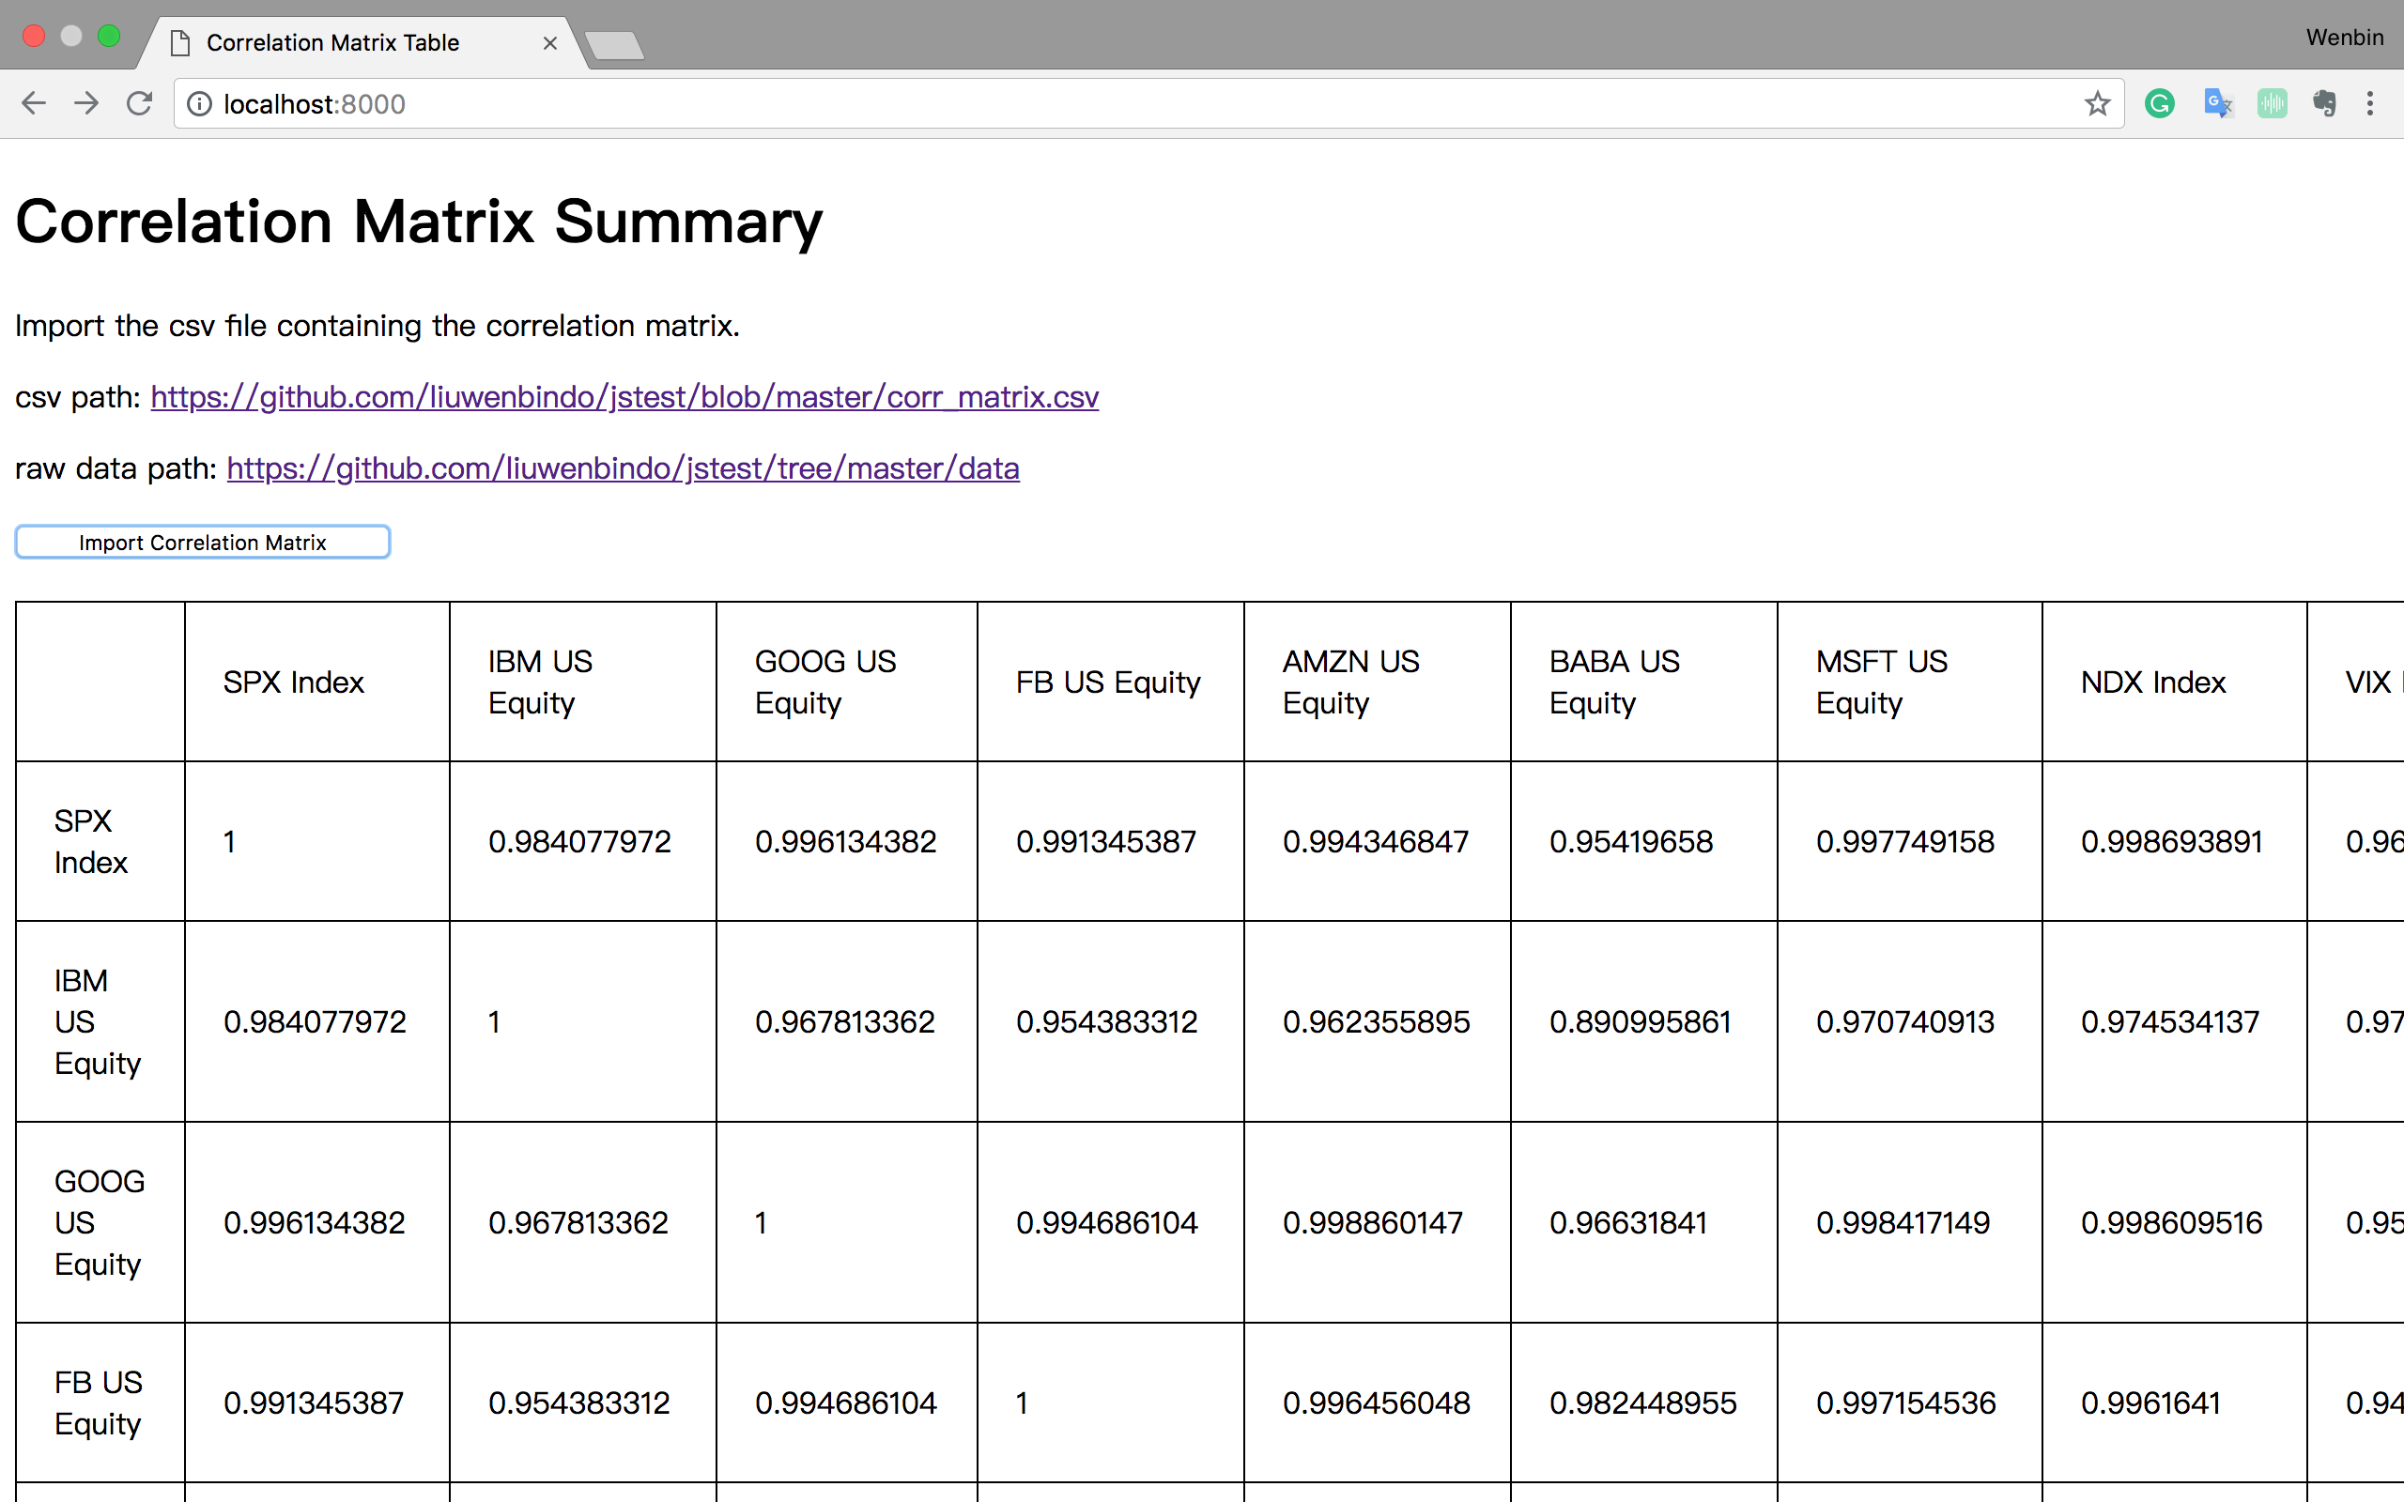
Display main HTML webpage
This page can be viewed by visiting localhost:8000 from the browser (Chrome in this example).
The correlation matrix is imported from a .csv file. We can generate this file from the VBA code in the .xlsm file when computing correlation.
To view the correlation matrix, click the Import Correlation Matrix button.

Slide 5
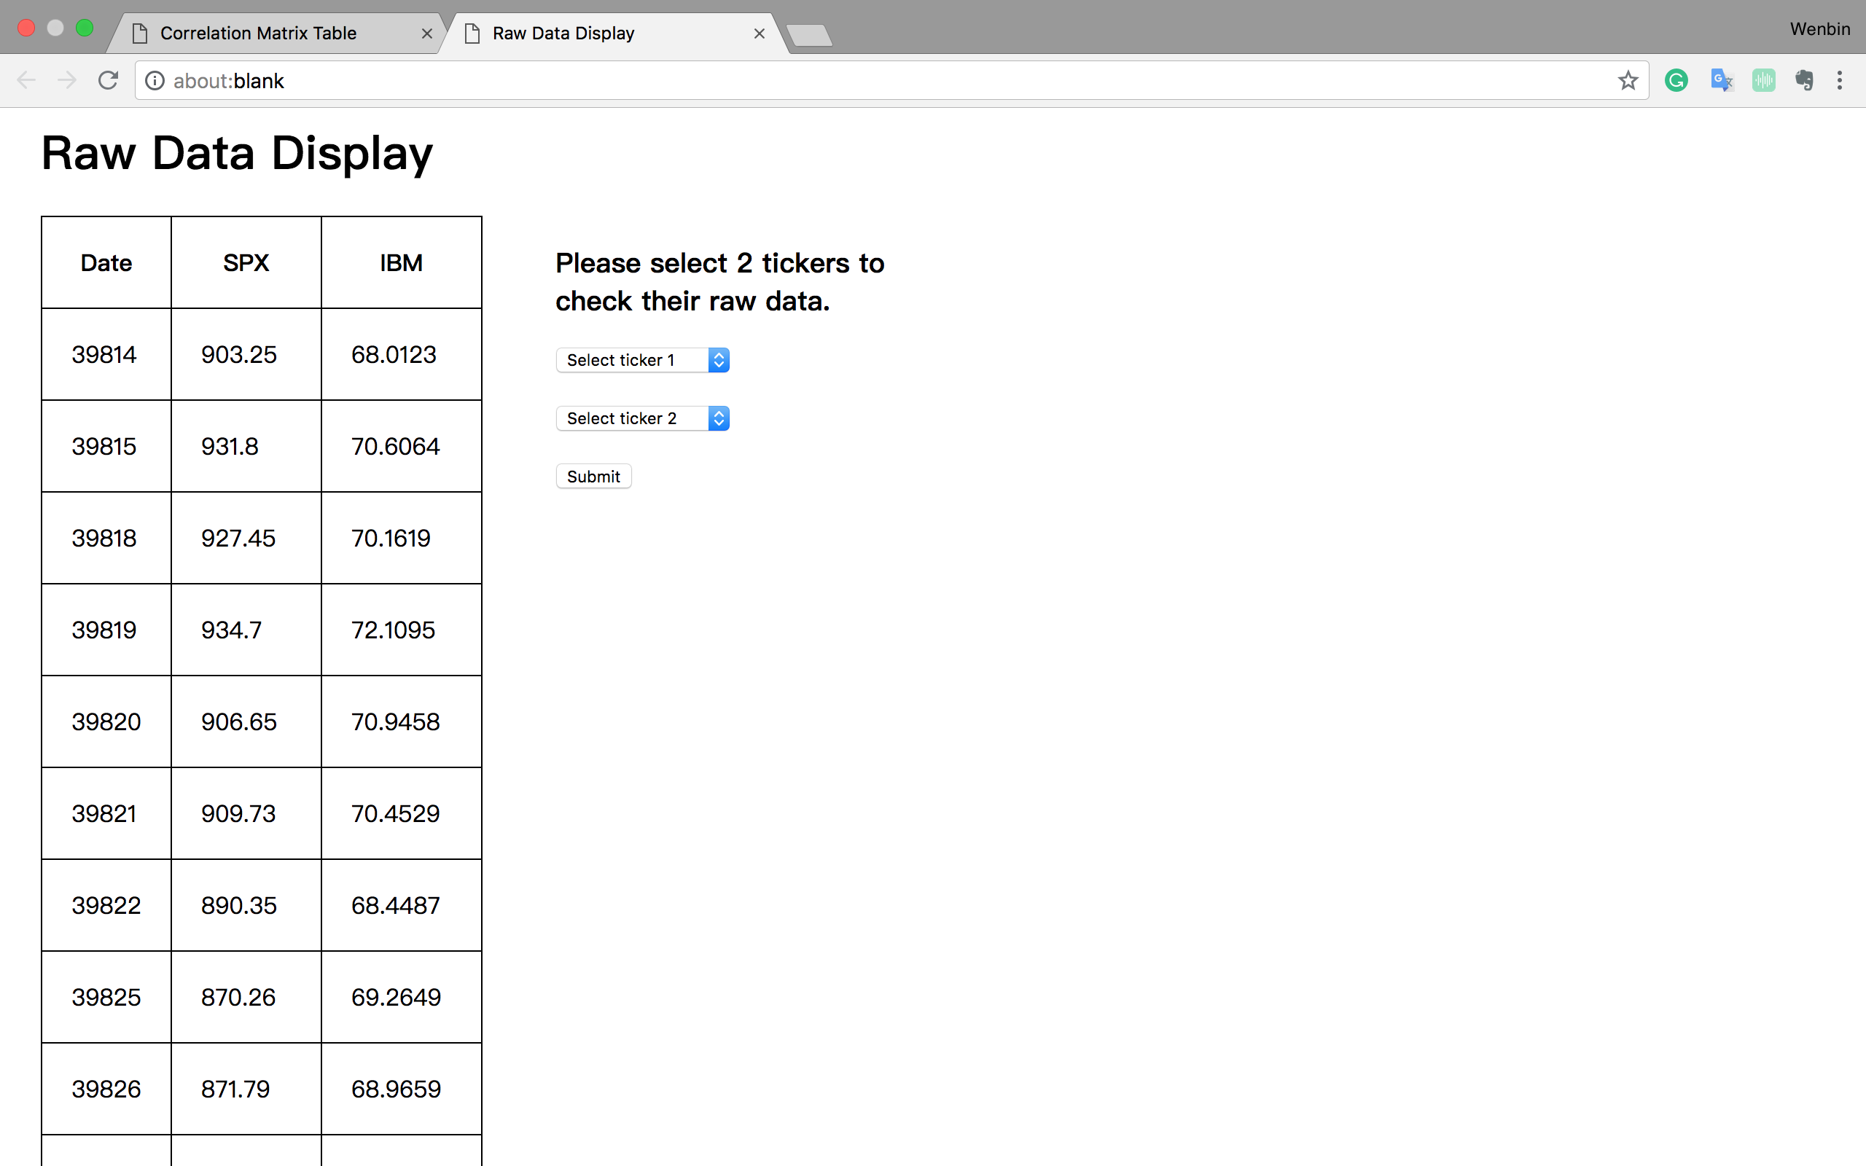
Display raw data by clicking cells
If we click on random data cells in the correlation matrix table, a new window will open and display the raw data series corresponding to the cell being clicked.
For example, the window on the right will open if we click the cell at the SPX Index row and IBM US Equity column.

Slide 6
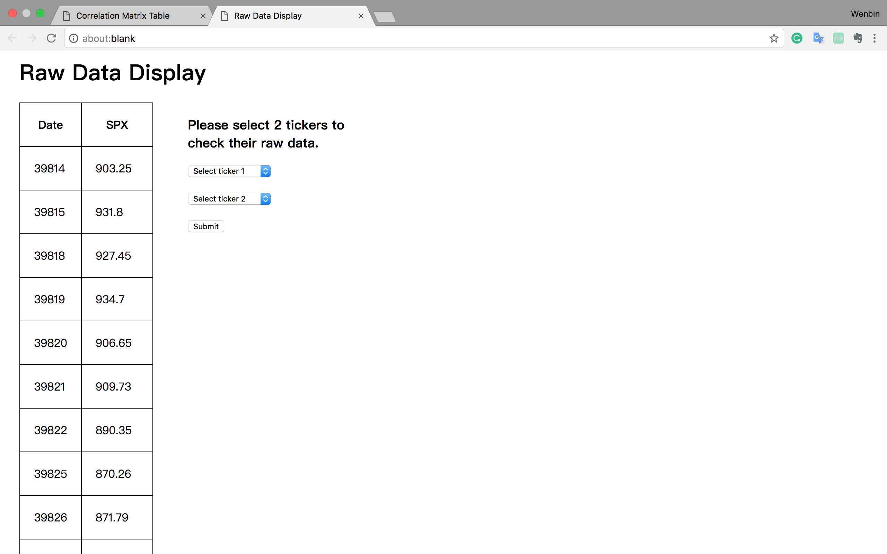
Display raw data by clicking cells
The background JavaScript code will check if the row and column of the cell are the same asset tickers. If so, we will only display the raw data of itself. Like the screenshot to the right.

Slide 7
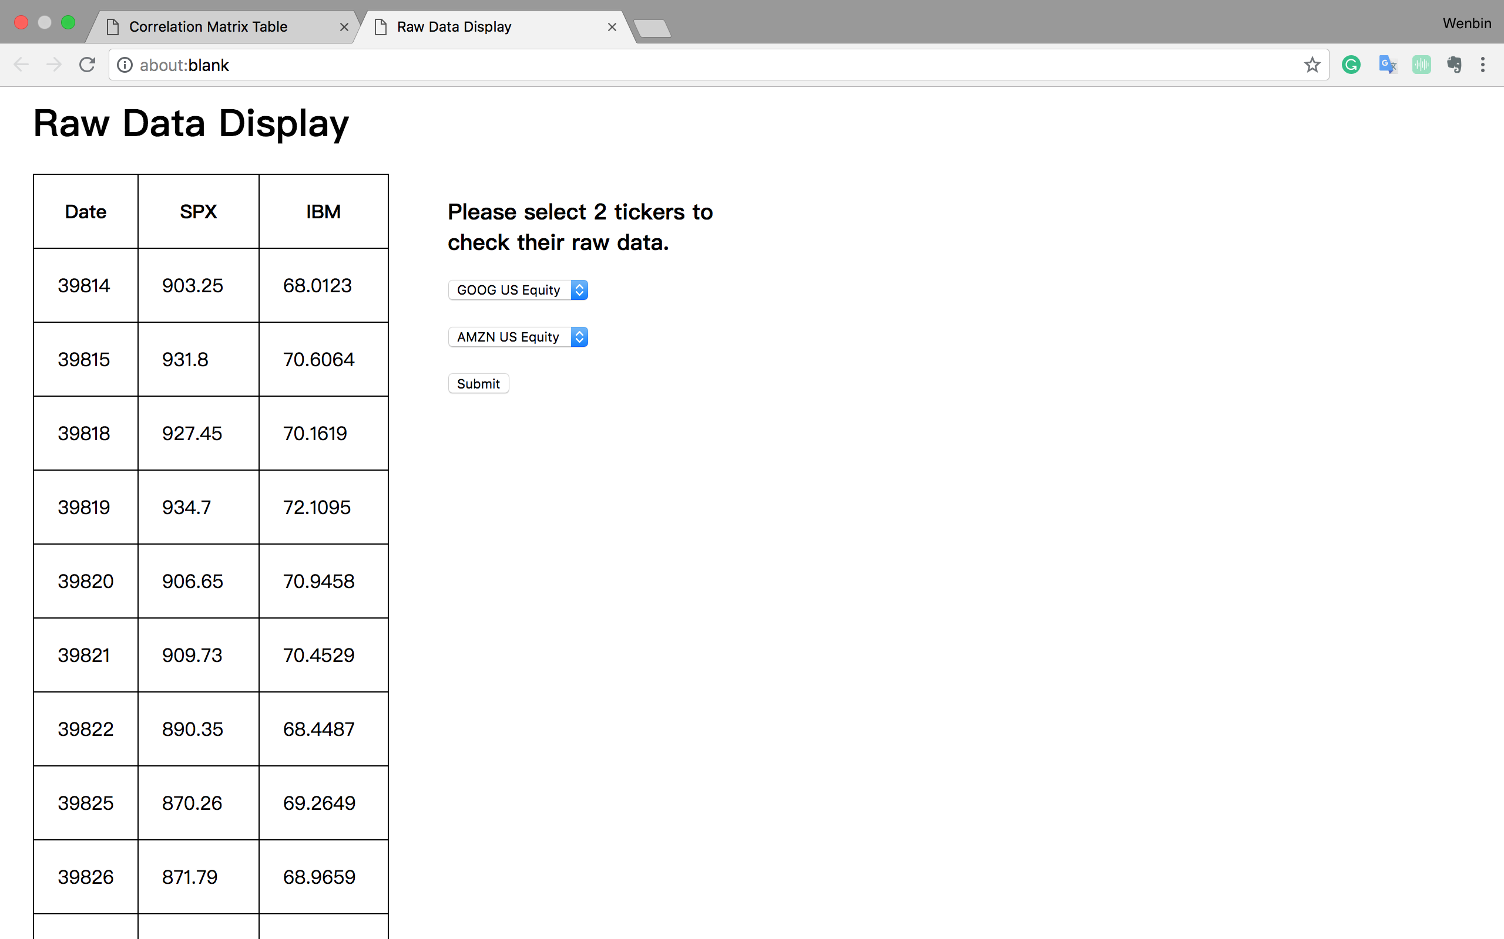
Check other raw data from previous pages
There is two dropdown lists for user to select 2 other asset tickers to check data for. Each drop down list contains all of the available tickers.
After user selects 2 tickers, click submit to pass command to backend, and a new window will open displaying the raw data of tickers selected.

Slide 8
Check other raw data from previous pages
The table is generated by conducting the OUTER JOIN on the two price series by Date.
Here, the Date in the original data is not modified to mm-dd-yy format, but we can achieve this functionality in JavaScript.

Slide 9
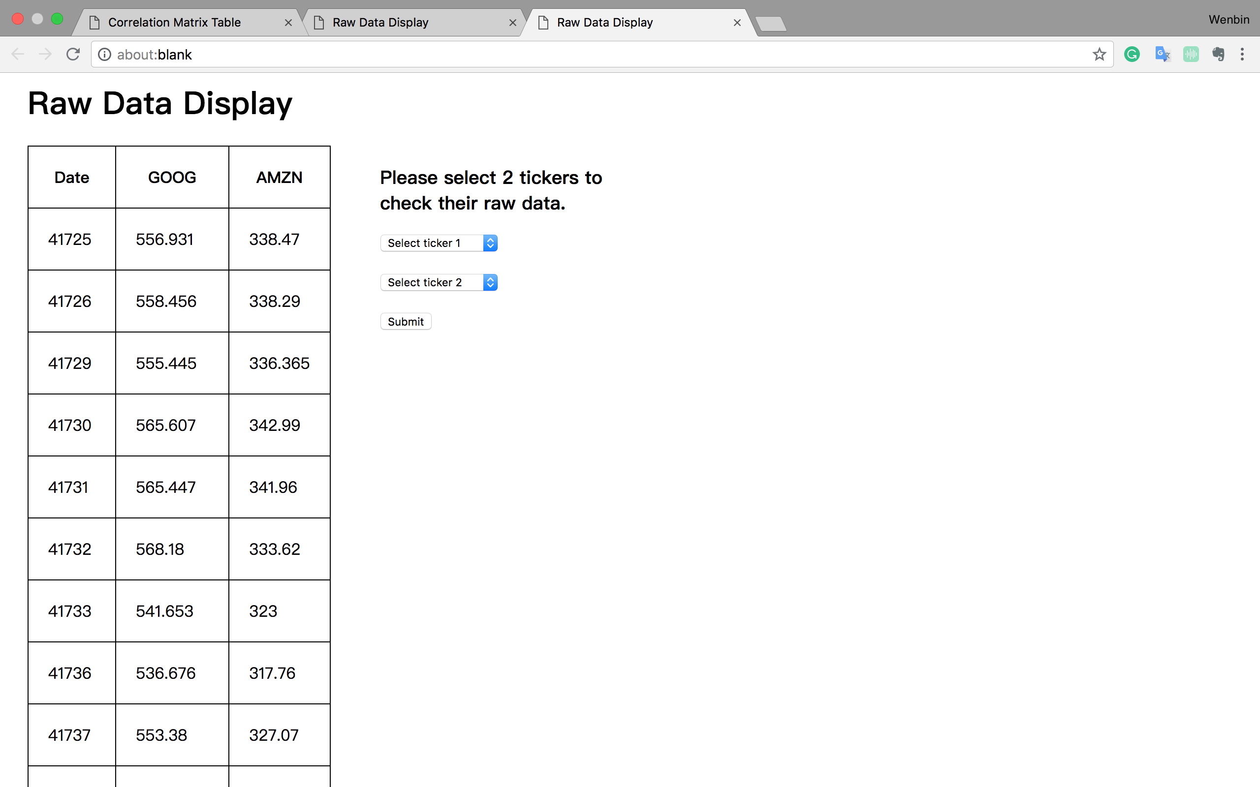
Check other raw data from previous pages
Full functionality can be achieved in the new window.
This page on the right is generated by clicking Submit on the previous page after selecting GOOG US Equity and AMZN US Equity in the drop down list.

Slide 10
Check other raw data from previous pages
To check the historical price of only one asset, just select same tickers on 2 drop down lists.
User doesn’t have to go back to the correlation matrix summary page to view other raw data.

Slide 11
Scaling up the project
To scale up, we just need to import the .csv containing the historical prices of the new stocks, compute the new correlation matrix and update the correlation matrix .csv file.
When we import the new correlation matrix .csv into the application, we can achieve the full functionality given the historical data .csv file exists in the data source.

Slide 12
Possible improvements
There are some aspects to improve for this application.
1. Use more complex .css file to generate better-looking format.
2. Convert the Date columns into normal date format.
3. Create faster OUTER JOIN algorithm to get the joined result of two tables.
4. Hosting the application on server, so we can improve the generation of HTML by using server-side JS, like to use File System (fs) in Node.js. There are some limitations on formatting for writing HTML string to a newly-opened window (the method we are using now).

