Slide 1


















$$b$$
$$c$$
$$a$$
$$a$$
$$a+b$$
$$a+b$$
$$\left(a+b\right)−c$$
$$c$$
$$b$$
$$b$$
$$b+c$$
$$d$$
$$a$$
$$a$$
$$a$$
$$a$$
$$a×(b+c)$$
$$a×(b+c)$$
$$a×\left(b+c\right)−d$$

Slide 2
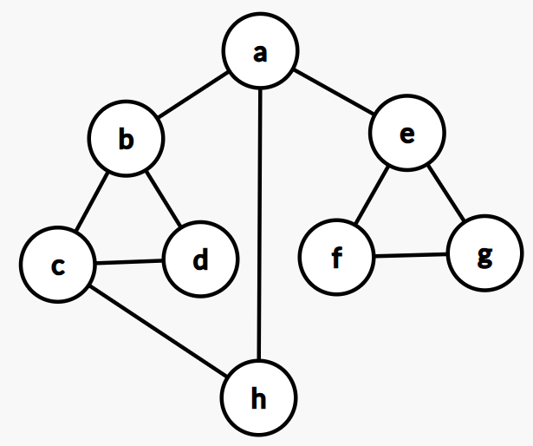

Slide 3
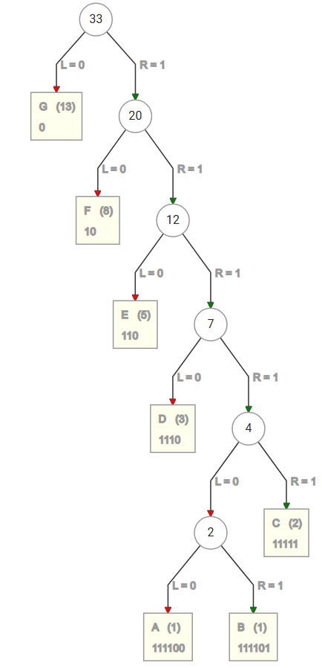
1110100110

Slide 4
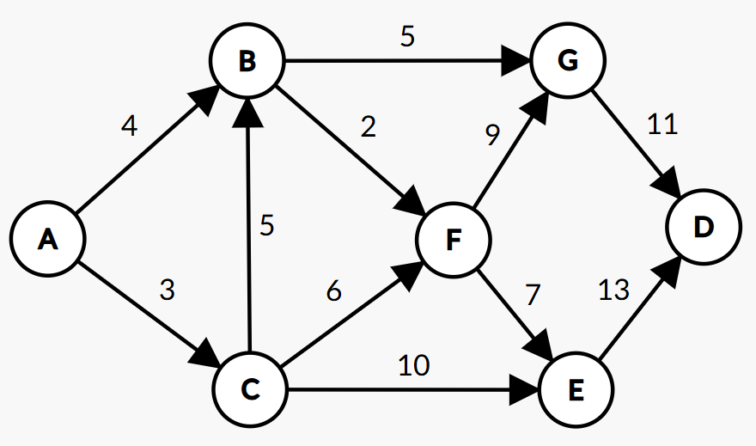

Slide 5
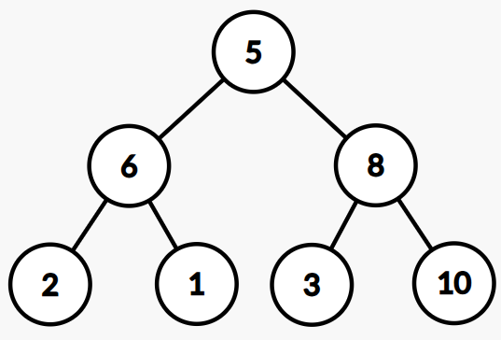

Slide 6
1.
5
2.
5
6
8
6
10
2
1
3
10
2
1
3
8
10
10
3.
4.
6
5
6
8
2
1
3
8
2
1
3
5

Slide 7
8
6
5
2
1
3
10

