Slide 1
Historical figure
Who we learn from and who we will be

Slide 2
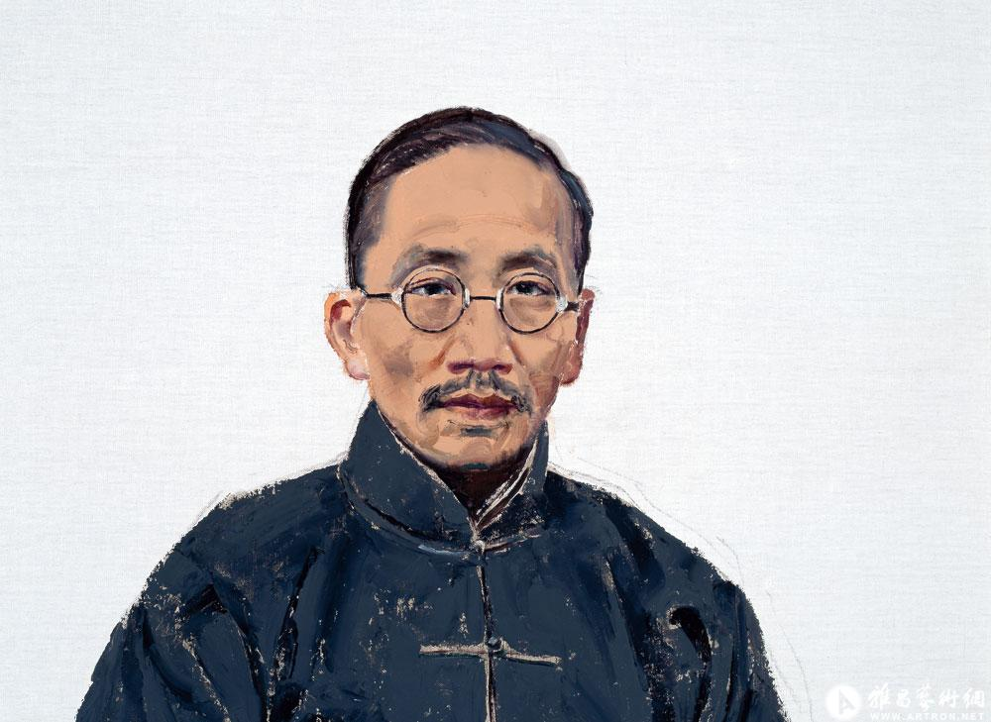
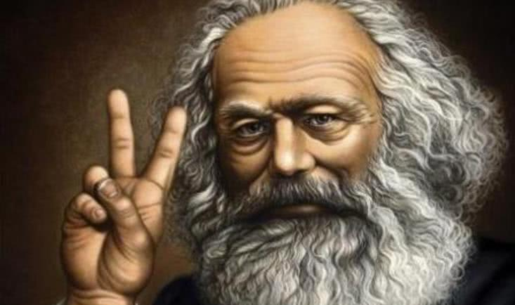
We take them as an example
In fact，generation after generation people acquire wisdom from their predecessors .
They remain alive in memory of others.

Slide 3
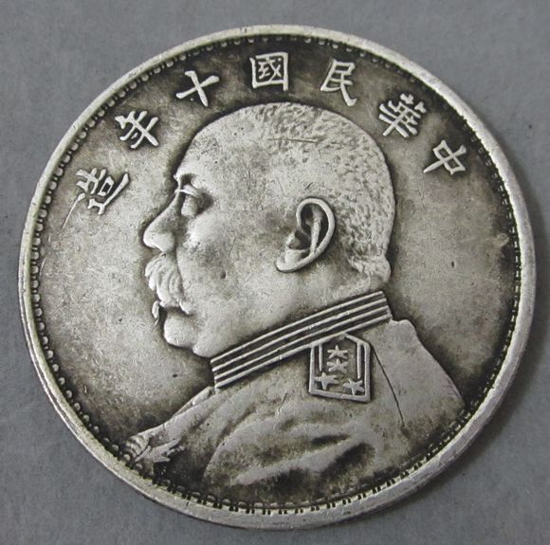
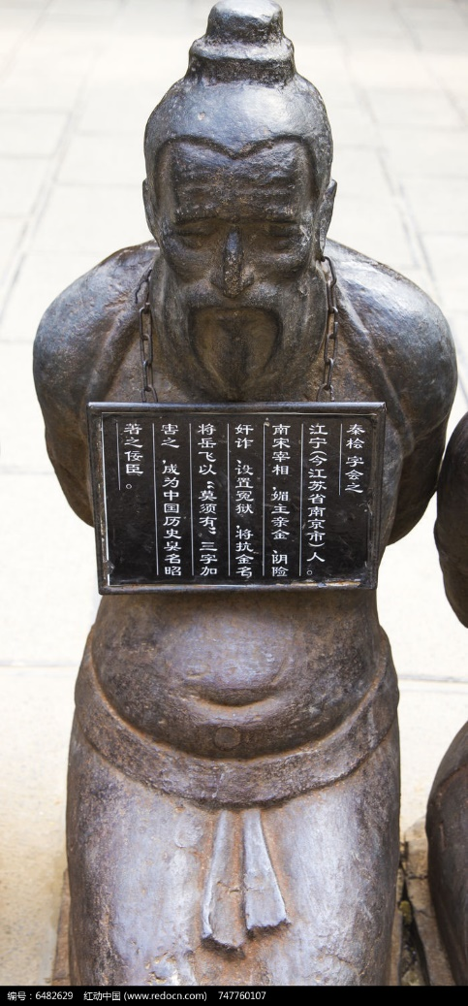
on the contrary

Slide 4
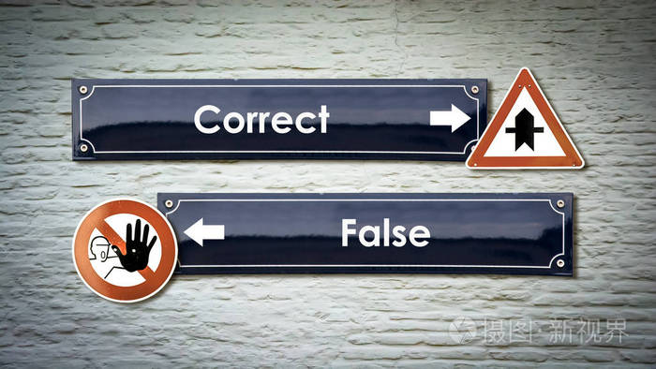
A guidance for us which is necessary.

Slide 5
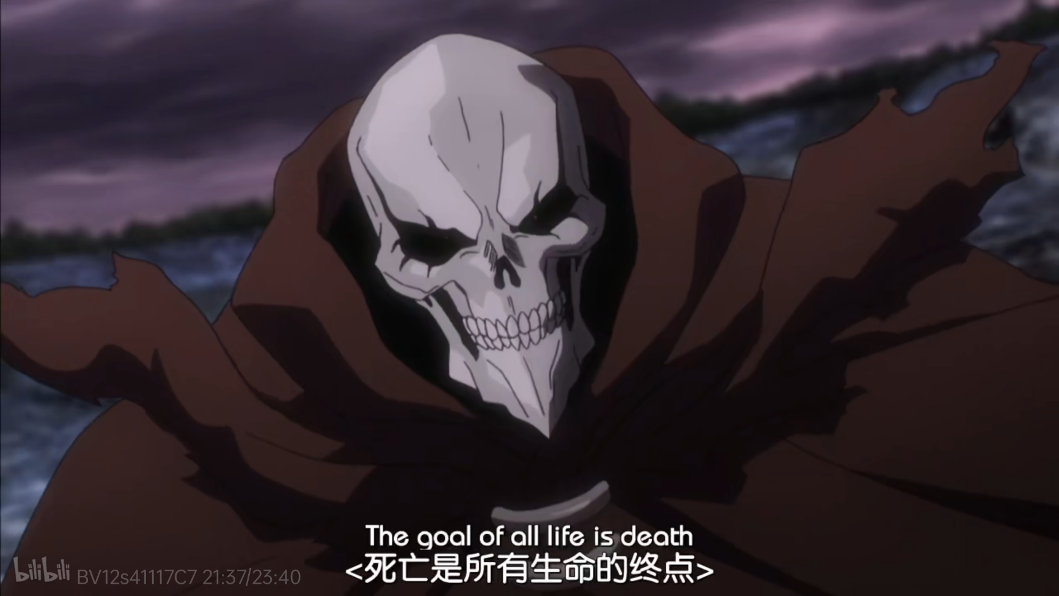
The end of us are

Slide 6
