Slide 1
The Effect of Nasal Mucus Viscosity on Annual Nosebleed Rates
Liuxia Wang
March 18, 2016

Slide 2
Content
Motivation
Exploratory Analysis
Statistical Model
Simulation

Slide 3
Motivation

Slide 4
Motivation
A new treatment (superduprinpine) for unmet need of recurrent serious nosebleeds
Medical Hypothesis
The drug is much more effective in patients with high nasal mucus viscosity
The patients with high volume of tissue usage are more medically serious.
Objectives
Validate the two hypothesis
Build a statistical model to quantify the effectiveness
Simulate the effectiveness using the statistical model

Slide 5
Expletory Analysis

Slide 6
Data Summary
There are totally 444 patients in the data set. Filter out the patients with duration < 300, there are 397 patients left.
Since the response variable – Nosebleeds is a non-negative counting variable, we will use Poisson regression for the rest of presentation
Variable Name | Description | Summary Statistics
Nosebleeds |  | 0.4786 +/- 0.9198
Treatment | Binary Variable with 1 being treatment and 0 in placebo | Treatment: 205 Placebo: 192
Tissue Use |  | High: 174 Medium: 223
Previous Year |  | 2.275 +/- 0.5883
Mucus Viscosity |  | 1.340 +/- 1.1323
Country |  | A B C D E F G H I J 43 68 7 45 36 40 31 79 20 28

Slide 7
Overall Effectiveness
Coefficients:
Estimate Std. Error z value Pr(>|z|)
(Intercept) -0.57536 0.09623 -5.979 2.24e-09 ***
treatment -0.34579 0.14647 -2.361 0.0182 *
For all types of patients in the trial, the treatment effect is significant.

Slide 8
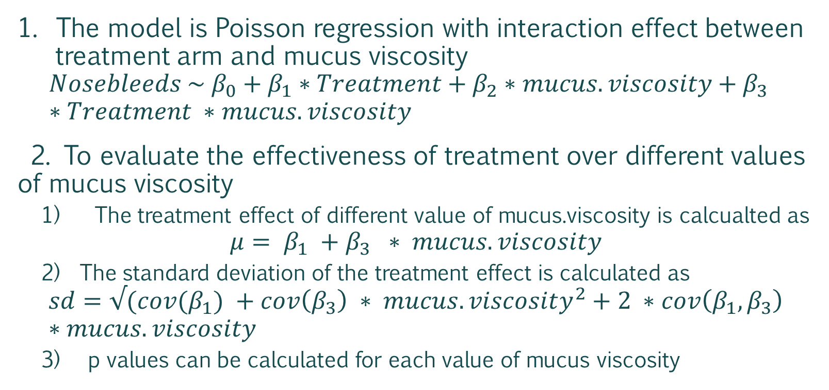
Effect of Mucus Viscosity - Method
Hypothesis: The drug is much more effective in patients with high nasal mucus viscosity
The model is Poisson regression with interaction effect between treatment arm and mucus viscosity
$$Nosebleeds \sim β_{0}+β_{1}∗Treatment+β_{2}∗mucus.viscosity+β_{3} ∗Treatment ∗mucus.viscosity$$
2. To evaluate the effectiveness of treatment over different values of mucus viscosity
The treatment effect of different value of mucus.viscosity is calcualted as
$${μ= β}_{1} +β_{3} ∗ mucus.viscosity$$
The standard deviation of the treatment effect is calculated as
$${sd=√(cov(β}_{1}) +cov\left(β_{3}\right) ∗ mucus.viscosity^{2}+2 ∗cov\left(β_{1}, β_{3}\right)∗mucus.viscosity$$
3) p values can be calculated for each value of mucus viscosity

Slide 9
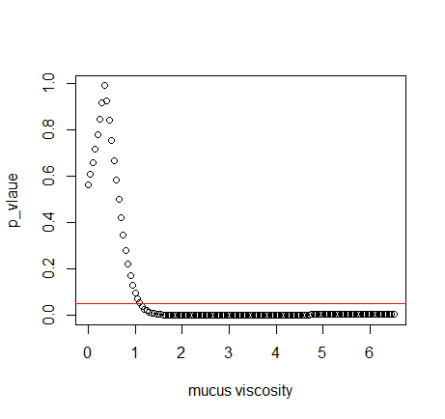
Effect of Mucus Viscosity - Result
The coefficients
Estimate Std. Error z value Pr(>|z|)
(Intercept) -0.65175 0.14715 -4.429 9.46e-06 ***
treatment 0.13524 0.23319 0.580 0.5619
mucus.viscosity 0.05883 0.08332 0.706 0.4801
treatment:mucus.viscosity -0.38216 0.15524 -2.462 0.0138 *
Covariance Matrix
treatment treatment:mucus.viscosity
treatment 0.05437634 -0.02804258
treatment:mucus.viscosity -0.02804258 0.02409858
P_value v.s. mucus viscosity
The cutoff is 1.20
The higher the mucus viscosity is, the more significant is the treatment effect.
When the mucus viscosity is higher than 1.20 the treatment effect is significant.

Slide 10
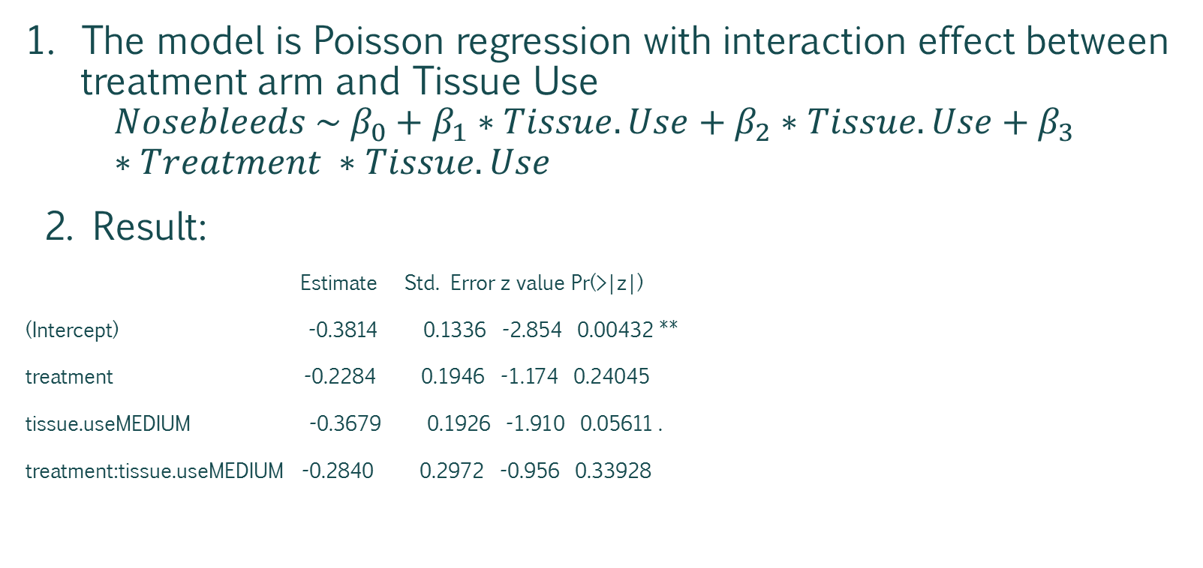
Effect of Tissue Usage
Hypothesis: The drug is more effective in patients with high usage of Tissue
The model is Poisson regression with interaction effect between treatment arm and Tissue Use
$$Nosebleeds \sim β_{0}+β_{1}∗Tissue.Use+β_{2}∗Tissue.Use+β_{3} ∗Treatment ∗Tissue.Use$$
2. Result:
Estimate Std. Error z value Pr(>|z|)
(Intercept) -0.3814 0.1336 -2.854 0.00432 **
treatment -0.2284 0.1946 -1.174 0.24045
tissue.useMEDIUM -0.3679 0.1926 -1.910 0.05611 .
treatment:tissue.useMEDIUM -0.2840 0.2972 -0.956 0.33928
Conclusion: Patients with high volume usage of tissue may not target patients for the drug

Slide 11
Statistical Model

Slide 12
Statistical Model - Methodology
Objective: build a statistical model to understand the effectiveness of drugs on different types of patients
Steps
Start with full model with treatment interaction with all variables, i.e. the formula is
nosebleeds ~ treatment *(mucus.viscosity + tissue.use + previous.year+ country+eye.colour)
Use Elastic Net to do variable selection using cross-validation criterion
The ‘best’ model selected using Elastic Net will be used for simulation later.

Slide 13
Statistical Model - Result
The selected variables along with coefficients
Variable | Coefficients
(Intercept) | -1.2985
tissue.useMEDIUM | -0.0095
previous.year | 0.2609
countryD | -0.0109
countryE | 0.0001
countryF | 0.4595
countryH | -0.2746
treatment:mucus.viscosity | -0.0761
treatment:tissue.useMEDIUM | -0.0279
treatment:countryF | 0.0409
The nosebleeds condition in previous year has positive impact on the nosebleed prediction.
The hospitalization and/or local practice have impact on the number of nosebleeds
The higher is mucus viscosity, the more efficacious is the treatment effect.
When more patient information included in the model, the patients with Medium tissue usage tend to have more significant treatment effect.

Slide 14
Simulation Using Statistical Model

Slide 15
Simulation Scenario
Input
Number of Iterations
Sample size
Significant level, e.g. 0.05
Patient conditions, such as if mucus viscosity > 1.2 and/or tissue use = Medium, or no constraints
Data:
Generate the selected variables using the empirical distribution subject to patient constraints if there are
Previous year, country, mucus viscosity and tissue use
Randomly split the samples into treatment and placebo group
Generate nosebleeds using the estimated model
Output
The power: the percentage of iterations that the treatment effect is significant with pre-specified Type I error.

Slide 16
Simulation Results
The settings
Type I error = .05
Number of Iterations = 1000
Sample Size | Patients Conditions | Power
400 | Whole Population
400 | Mucus viscosity > 1.2
400 | Mucus Viscosity > 1.2 Or Tissue Use = Medium
800 | Whole Population
800 | Mucus Viscosity > 1.2
800 | Mucus Viscosity > 1.2 Or Tissue Use = Medium

Slide 17
Summary

Slide 18
Title and Content Layout with Chart

Slide 19
Two Content Layout with Table
First bullet point here
Second bullet point here
Third bullet point here
 | Group A | Group B
Class 1 | 82 | 95
Class 2 | 76 | 88
Class 3 | 84 | 90

Slide 20
Two Content Layout with Table
First bullet point here
Second bullet point here
Third bullet point here
Group A
Task 1
Task 2
Group B
Task 1
Task 2
Task 3
Task 4
Task 3

