Slide 2
0. Learning Objectives
You should learn to:
  Explain the difference between managers and leaders( 管理者与领导者的区别)
  Describe the trait(个性特征) and behavioral theories of leadership
  Explain the Fiedler contingency model(菲德勒权变模型)
  Contrast the Hersey-Blanchard(何塞-布兰查) and leader participation (参与)models of leadership
  Summarize the path-goal (路径-目标) model

Slide 3
0. Learning Objectives (cont.)
You should learn to:
  Explain the various sources (多种来源)of power a leader might possess
  Describe how leaders can create (创造)a culture of trust(信任)
  Explain gender (性别)and cultural (文化)differences in leadership

Slide 4
一. Leadership 领导
1 . Leader(领导者)
  someone who can influence others(影响别人) and who has managerial authority
    all managers should ideally(最好) be leaders
    not all leaders have the ability to be an effective manager
2. Leadership (领导)
  process of influencing a group toward the achievement of goals
  a heavily researched topic(一个热门的研究题目)

Slide 5
二. Early Leadership Theories 早期理论
1. Trait Theories(特质理论)
  leader traits(领导者个性特征) - characteristics that might be used to differentiate leaders from nonleaders
    might be used as a basis for selecting the “right(合适)” people to assume(任命) formal leadership positions
  proved to be impossible to identify a set of traits that would always differentiate(区分) leaders from nonleaders
    explanations based solely (仅仅)on traits ignored the interactions (相互作用)of leaders, their groups, and situational factors
  Ex.17-1 Seven Traits associated with leadership

Slide 6
二. Early Leadership Theories(续1)
2. Behavioral Theories(领导行为理论)
  knowing what effective leaders do would provide the basis for training leaders(知道有效领导者做什么，用于领导的训练)
  (1) University of Iowa Studies(依阿华大学的研究) - Kurt Lewin(勒文)
    explored three leadership styles(领导模式)
      Autocratic(独裁式)- leader dictated(指定) work methods
      Democratic(民主式) - involved (参与)employees in decision making
        used feedback to coach employees
      laissez-faire(放任式) - gave the group complete freedom
    results were mixed with (不确定)respect to (就)performance-satisfaction higher with democratic leader

Slide 7
二. Early Leadership Theories(续2)
2. Behavioral Theories (cont.)
  (2) Ohio State Studies(俄核俄州大学) - identified two dimensions of leadership(两个影响领导的维度)，组合出四种领导方式
    initiating structure(以工作为重) - extent to which a leader was likely to define and structure her/his role and the roles of group members to seek goal attainment
    Consideration(以人为重) - extent to which a leader had job relationships characterized by mutual trust and respect for group members’ ideas and feelings
    findings - high-high leaders achieved high group task performance and satisfaction
      however, high-high was not always effective(不是始终有效的领导方式)

Slide 8
二. Early Leadership Theories (续3.)
2. Behavioral Theories (cont.)
  (3) University of Michigan(密歇根大学) Studies - identified two dimensions of leadership：两种领导方式
    employee oriented(员工导向) - emphasized interpersonal relationships
      accepts individual differences among subordinates
      associated with high group productivity，高生产效率
    production oriented(生产导向) - emphasized the technical or task aspects of the job
      concerned with accomplishing the group’s tasks
      associated with low group productivity and low job satisfaction，低生产率和低员工满意

Slide 9
二. Early Leadership Theories (续4.)
2. Behavioral Theories (cont.)
  (4) Managerial Grid(管理方格理论) - two-dimensional grid (两维方格)that provides a framework for conceptualizing leadership style
    dimensions are concern for people and concern for production(关心工作)
    five management styles(五种管理方式) described
      impoverished (1,1)，贫乏型- minimum effort to reach goals and sustain organization membership
      task (9,1)，任务型 - arrange operations to be efficient with minimum human involvement
      middle-of-the-road (5,5)，中间型 - adequate performance by balancing work and human concerns

Slide 10
二. Early Leadership Theories (续5.)
2. Behavioral Theories (cont.)
  (2) Managerial Grid (管理方格， cont.)
    five management styles described (cont.)
      country club (1,9)，俱乐部型 - attention to human needs and creation of comfortable work environment
      team (9,9)，团队型- committed people motivated by a common purpose, trust, and mutual respect
    concluded that managers should use (9,9) style
      little empirical evidence to support this conclusion (几乎没有经验证据支持这个结论)
      no rationale for what made a manager an effective leader

Slide 11
Contingency Theories Of Leadership
领导权变理论
*. Basic Assumptions
  leader effectiveness depends on the situation(领导的有效性与情景有关)
  must isolate situational conditions or contingencies(必须分离出情景条件或者说情景变量)

Slide 12
三. Contingency Theories (续1)
1. Fiedler Model(菲德勒模型)
  effective group performance depends on matching the leader’s style(领导方式) and the degree to which the situation permits(让) the leader to control and influence(控制和影响)
  Least-Preferred Coworker (LPC，最喜欢的员工) - measures the leader’s style of interacting with subordinates——来刻画领导模式
    high LPC - least preferred coworker described in relatively favorable terms
      leader is relationship oriented
    low LPC - least preferred coworker described in relatively unfavorable terms
      leader is task oriented

Slide 13
三. Contingency Theories (续2 )
1. Fiedler Model (菲德勒模型，cont.)
  model assumes that leader’s style was always the same and could not change in different situations
  three contingency factors (三个权变因素)that identify eight possible leadership situations that vary in favorability(有利性)。三个因素如下：
    leader-member relations(领导与成员关系) - degree of confidence, trust, and respect members had for leader
    task structure(任务结构) - degree to which job assignments were formalized and procedurized
    position power(职务权力) - degree of influence a leader had over power-based activities

Slide 14
* Findings Of The Fiedler Model
Good
Task
Oriented
Performance绩效
Relationship
Oriented
Poor
Favorable
Moderate
Unfavorable
Category
Leader-Member
Relations
Task Structure
Position Power
I II III IV V VI VII VIII
Good Good Good Good Poor Poor Poor Poor
High High Low Low High High Low Low
Strong Weak Strong Weak Strong Weak Strong Weak

Slide 15
三. Contingency Theories (续3)
1. Fiedler Model (菲德勒模型，cont.)
  results indicated that:
    task-oriented leaders performed better in situations that are very favorable to them and in situations that are very unfavorable
    relationship-oriented(关系导向) leaders performed better in situations that are moderately favorable
  implications for improving leadership
    place leaders in situations suited to their style
    change the situation to fit the leader
  considerable empirical support (经验支持这个理论模型)for the model
  Unrealistic(不现实)to assume that leader cannot alter(改变) their style

Slide 16
三. Contingency Theories (续4)
2. Hersey and Blanchard’s Situational Leadership Theory(何塞-布兰查情景领导理论)
  appropriate leadership style is contingent on the followers’ readiness(成熟性)
    readiness - extent to which people have the ability and willingness (能力和意愿)to accomplish a specific task
  reflects the reality that it is followers who accept or reject the leader
  based on two leadership dimensions(两大领导维度)
    task behaviors：任务行为者
    relationship behaviors：关系行为者

Slide 17
三. Contingency Theories (续5)
2. Situational Leadership Theory (续)
  four leadership styles defined by the two dimensions(识别出四种领导风格或方式)
    Telling，命令型 - leader defines roles and tells people how to do their jobs，--people are neither competent nor confident
    Selling，推销型 - leader is both directive and supportive
      people are unable but willing to do necessary tasks
    Participating，参与型 - leader and follower make decisions
      people are able but unwilling to do the job
    Delegating，授权型 - leader provides little direction or support . -people are able and willing to do the job
  tests of the theory have yielded disappointing results(实证研究结论，令人失望)

Slide 18
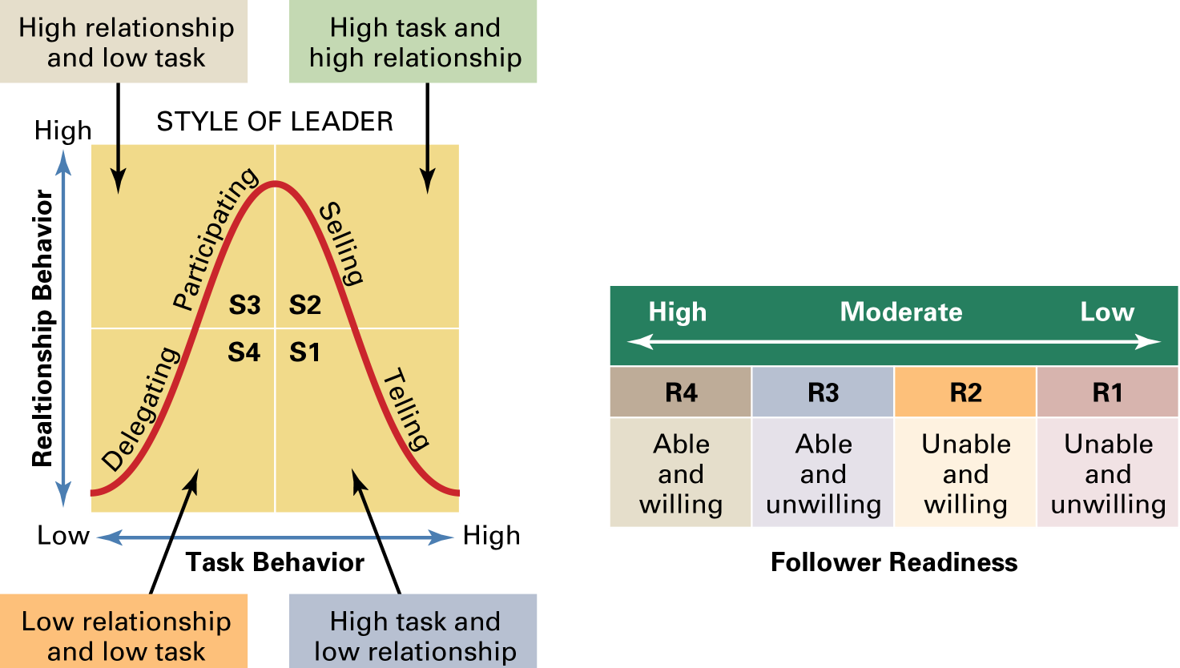
Hersey and Blanchard’s Situational Leadership Model

Slide 19
三. Contingency Theories (续5)
3. Leader-Participation (领导-参与)Model
3.1 理论起源和基本观点：
  Victor Vroom (佛如姆)and associates(同事)- relate leadership behavior and participation to decision making(考察了领导行为与决策的关系)
  provides a sequential set of rules to follow in determining the form and amount of participation in decision making
    rule selection determined by the situation
  provides an excellent(非常有力的) guide to help managers choose an appropriate leadership style to fit the situation

Slide 20
三. Contingency Theories (续6 )
3. Leader Participation Model(cont.)-5 Leadership Styles
    Decide(决断型) - leader makes decision alone, either announcing or selling to group
    Consult Individually(个别咨询型) - leader makes decision after obtaining feedback from group members individually
    Consult Group(顾问团型) - leader makes decision after obtaining feedback from group members in meeting
    Facilitate(促进型) - leader, acting as facilitator, defines problem and boundaries for decision-making after presenting it to group
    Delegate(授权型) - leader permits group to make decision within prescribed limits

Slide 21
三. Contingency Theories (续6)
4. Path-Goal(路径-目标) Model
  Robert House(罗伯特.豪斯) - leader’s job is to assist followers in attaining their goals that are compatible相容 with the overall objectives of the group or organization
  leader behavior is:
    Acceptable，接受 to the degree that group views it as a source of immediate or future satisfaction
    Motivational，激励，to the extent that it:
      makes satisfaction of subordinates’ needs contingent on effective performance
      provides the coaching, guidance, support, and rewards necessary for effective performance

Slide 22
三. Contingency Theories (续7)
4. Path-Goal Model (路径-目标，cont.)
  identifies four leadership behaviors，识别出四种领导行为
    Directive，命令式 - describes tasks, sets schedules, and offers guidance on task performance
    Supportive，支持式 - shows concern for subordinates
    Participative，参与式 - relies on subordinates’ suggestions when making a decision
    Achievement oriented，成就导向式 - sets challenging goals
  Assumes(假定) that a leader can display any or all of the behaviors depending on the situation
  Path→ goal

Slide 23
三. Contingency Theories (续8.)
4. Path-Goal Model (路径-目标，cont.)
  two classes of contingency variables(权变变量)
    Environment(环境) - outside the control of the follower
      determine the type of leader behavior required if follower outcomes are to be maximized
    Personal - characteristics of the follower
      determine how the environment and leader behavior are interpreted
  leader behavior will be ineffective when:
    it is redundant(多余的) with sources of environmental structure
    it is incongruent with(不一致) follower characteristics
  most evidence supports the logic underlying (蕴涵的逻辑) the model

Slide 24
* Path-Goal Theory小结
Environmental
Contingency Factors
Task Structure
Formal Authority System
Work Group
Leader
Behavior
Outcomes
Directive
Supportive
Participative
Achievement oriented
Performance
Satisfaction
Subordinate
Contingency Factors
Locus of Control
Experience
Perceived Ability

Slide 25
Contemporary Issues In Leadership
1. Leaders and Power(领导与权力)
  five sources of power(五种权力来源)
    Legitimate(法定) - authority associated with a position
    Coercive(威胁) - ability to punish or control
      followers react out of fear
    Reward(奖励) - ability to give positive benefits
      provide anything that another person values
    Expert(专业) - influence based on special skills or knowledge
    Referent(声望、品德) - arises because of a person’s desirable resources or personal traits
      leads to admiration and desire to be like that person

Slide 26
四. Contemporary Issues In Leadership (cont.)
2. Creating a Culture of Trust(创造信任的文化)
  Credibility(可信性) - honesty, competence, and ability to inspire(激发，鼓动)
    honesty is the number one characteristic of admired leaders
  Trust - belief in the integrity, character, and ability of the leader
    confident that rights and interests will not be abused(滥用)
    important for empowering subordinates
      must trust employees to use their new authority
    trend toward expanding non-authority relationships within and between organizations widens(扩大) the need for trust

Slide 27
* Building Trust(建立信任 )
Practice
openness
Be fair
Demonstrate
competence
Speak your
feelings
Trust
Maintain
confidences
Tell the
truth
Fulfill your
promises
Show
consistency

Slide 28
四. Contemporary Issues In Leadership (cont.)
3. Leading Through Empowerment(通过授权领导)
  managers increasingly leading by empowerment
    need for quick decisions by people who are most knowledgeable(最清楚)about the issues(问题)
    larger spans of control(控制幅度增大) resulting from downsizing meant that subordinates had to be empowered to deal with work load
4. Gender and Leadership(性别与领导)
  gender provides behavioral tendencies(行为倾向) in leadership
  women adopt more democratic style, share power and information, and attempt to enhance followers’ self-worth(自我价值)
  men more directive, command-in-control style

Slide 29
四. Contemporary Issues In Leadership (cont.)
4. Gender and Leadership (cont.)
  Is different better(有各自的长处)?
    When rated by peers, employees, and bosses, women executives score better than male counterparts
    explanations of difference in effectiveness include:
      Flexibility(灵活性), teamwork(团队工作), trust(信任), and information sharing(信息共享) are replacing (替代)rigid structures, competitive individualism(个人竞争), control, and secrecy(保密)
      best managers listen, motivate, and provide support
      women do the above better than men
    there is still no “one best” leadership style(没有最佳的领导方式)
      can’t assume认为 that women’s style is always better

Slide 30
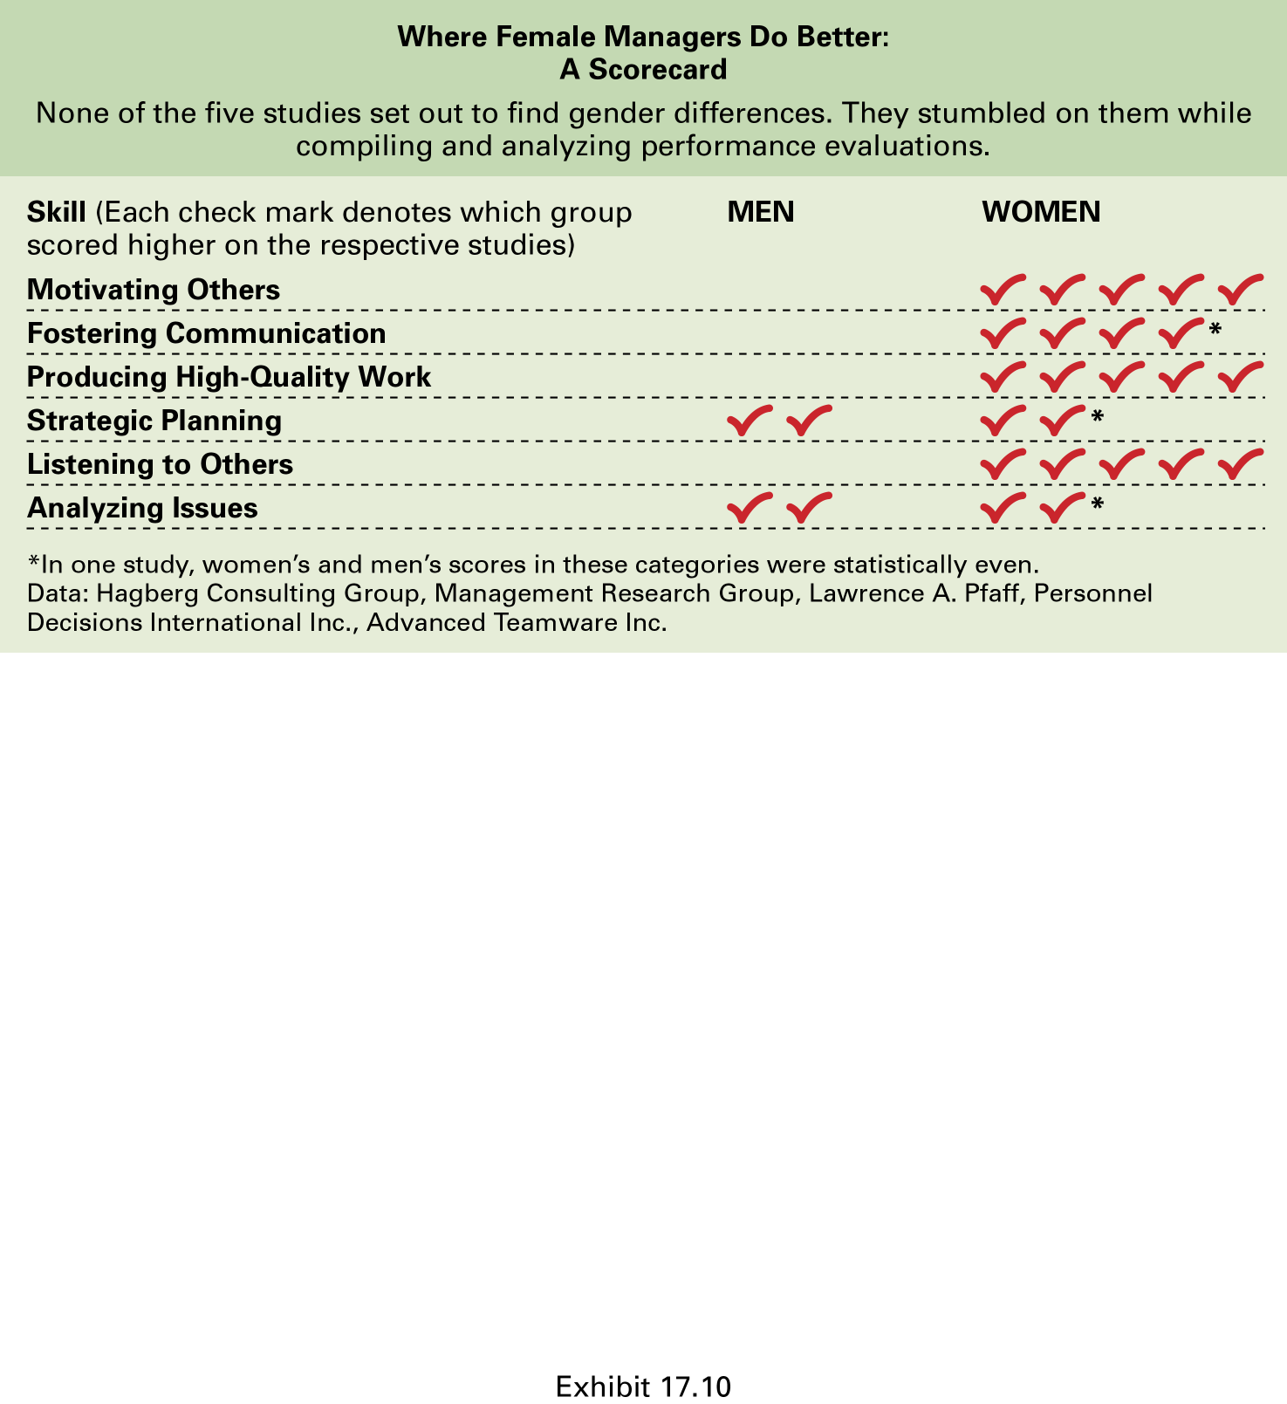
** Where Female Managers Do Better(女领导者的优点)

Slide 31
Contemporary Issues In Leadership (cont.)
5. Leadership Styles in Different Countries
  effectiveness of leadership style influenced by national culture
    Leaders constrained by the cultural conditions their followers have come to expect
  most leadership theories developed in the U.S.
    emphasize follower responsibilities rather than rights
    assume self-gratification(自我满意) rather than commitment to duty(尽职)
    assume centrality of work(以工作中心) and democratic value orientation
    stress rationality(理性) rather than spirituality(精神)

Slide 32
四. Contemporary Issues in Leadership (cont.)
6. Sometimes Leadership is Irrelevant!
  leader behaviors(领导者行为) may be irrelevant in some situations
  factors that reduce leadership importance include:
    follower characteristics(下属特性) - experience, training, professional orientation, or need for independence replace the need for leader support and ability to reduce ambiguity(减少模糊性)
    job characteristics(工作特性) - unambiguous(清楚) and routine tasks, or tasks that are intrinsically(内在的) satisfying, place fewer demands on leaders
    organizational characteristics(组织特性) - explicit(清楚的) goals, rigid(固定的) rules and procedures, and cohesive(内聚力的) work groups can substitute for formal leadership

Slide 33
Current Approaches to Leadership
Transactional Leadership
  Leaders who guide or motivate their followers in the direction of established goals by clarifying role and task requirements.
Transformational Leadership
  Leaders who inspire followers to transcend their own self-interests for the good of the organization by clarifying role and task requirements.
  Leaders who also are capable of having a profound and extraordinary effect on their followers.

Slide 34
Providing Online Leadership
Challenges of Online Leadership
  Communication
    Choosing the right words, structure, tone, and style for digital communications
  Performance management
    Defining, facilitating, and encouraging performance
  Trust
    Creating a culture where trust among all participants is expected, encouraged, and required,

Slide 35
Empowering Employees
Empowerment
  Involves increasing the decision-making discretion of workers such that teams can make key operating decisions in develop budgets, scheduling workloads, controlling inventories, and solving quality problems.
  Why empower employees?
    Quicker responses problems and faster decisions.
    Address the problem of increased spans of control in relieving managers to work on other problems.

Slide 36
Heroic Leadership: Basics of Leadership
Give people a reason to come to work.
Help them to develop a passion for their work
Instill in them a sense of commitment to their colleagues
Develop their sense of responsibility to customers
Be loyal to the organization’s people

Slide 37
Summary
Managers versus Leaders
  why leadership is an important behavioral topic.
Early Leadership Theories
  researches show about leadership traits.
  the findings of the four behavioral leadership theories.
  the dual nature of a leader’s behavior.
Contingency Theories of Leadership
  how Fiedler’s theory of leadership is a contingency model.

Slide 38
Summary (cont’d)
Contingency Theories of Leadership
  situational leadership vs. the leader participation model.
  how path-goal theory explains leadership.
Cutting Edge Approaches to Leadership
  Difference between transactional and transformational leaders.
  charismatic and visionary leadership.
Leadership Issues in the Twenty-First Century
  the five sources of leader’s power.
  the issues today’s leaders face.
  The reasons why leadership is sometimes irrelevant.

