Slide 1
NETWORK
Internet e-commerce
期末答辩
答辩人：刘宪钊
班级：W208

Slide 2
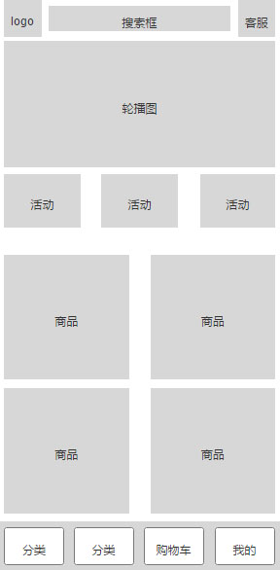
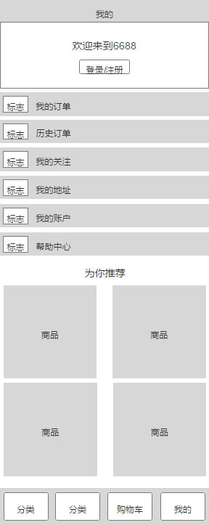
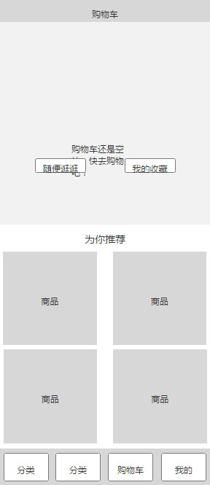
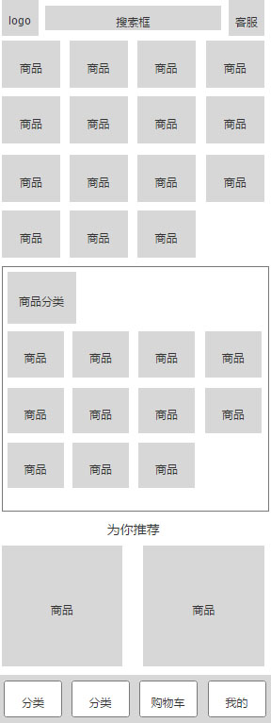

网站介绍
Biscuit oat cake carrot cake muffin jelly

Slide 3

门户网站
Biscuit oat cake carrot cake muffin jelly

Slide 4


APP网站
Biscuit oat cake carrot cake muffin jelly
6688购物网站

Slide 5
NETWORK
Internet e-commerce
期末答辩
谢谢观赏

