Slide 1
Banks
Chapter 2

Slide 2
Nature of Banking
Commercial banking
Taking deposits, making loans (wholesale or retail)
Money center banks operate in the wholesale market and often fund themselves by borrowing
Investment banking
Raising debt and equity for companies; advice on mergers and acquisitions, restructurings, trading, etc

Slide 3
Structure of Banking in the US
Large international banks (small number)
Regional banks (several hundred)
Small community banks (several thousand)

Slide 4
History of Bank Regulation in US (page 27-28)
McFadden Act (1927, 1933)
Douglas Amendment (1956)
Bank Holding Companies Act (1970)
Riegel-Neal Interstate Banking and Branching Efficiency Act (1994)

Slide 5
Example of Simple Bank Balance Sheet: End 2018 (Table 2.2, page 28)
Assets
Cash 5
Marketable Securities 10
Loans 80
Fixed Assets 5
Total 100
Liabilities
Deposits 90
Subord L.T. Debt 5
Equity Capital 5
Total 100

Slide 6
Income Statement: 2018 (Table 2.3, page 28)
Net Interest Income 3.00
Provision for Loan Losses (0.80)
Non-Interest Income 0.90
Non-Interest Expense (2.50)
Pre-Tax Operating Income 0.60

Slide 7
Year 2019
What happens in year 2019 if it is the same as year 2018 except that provision for loan losses is 4.0 instead of 0.8?

Slide 8
What if Balance Sheet Had Been More Aggressive?
Assets
Cash 5
Marketable Securities 10
Loans 80
Fixed Assets 5
Total 100
Liabilities
Deposits 94
Subord L.T. Debt 5
Equity Capital 1
Total 100

Slide 9
Regulation
Regulators set minimum levels for the capital a bank is required to keep
Equity is an example of Tier 1 capital
Subordinated long term debt is an example of Tier 2 capital

Slide 10
Deposit Insurance (pages 30-31)
Most countries have deposit insurance programs that insure depositors against losses up to a certain level
In the US the FDIC has provided protection for depositors since 1933
The amount insured was $2,500 in 1933
It has been increased several times
Following the credit crisis it was increased from $100,000 to $250,000 in October 2008.
Why might deposit insurance encourage a bank to take risks?

Slide 11
Investment Banking
Methods of raising debt or equity
Public offering
Private placement
Best efforts
Firm commitment

Slide 12
Best Efforts vs Firm Commitment (page 33)
50 million shares are to be issued and target price is $30 per share
Best efforts would lead to a fee of 30 cents per share; firm commitment leads to bank buying the shares at $30 per share
 | Best efforts | Firm Commitment
Can sell at $29 | +$15 million | −$50 million
Can sell at $32 | +$15 million | +$100 million

Slide 13
Initial Public Offering (IPO)
Usually on a best efforts basis
Bank will set offering price sufficiently low that shares are almost certain to be sold
Often price rises immediately after IPO
Banks often offer shares only to fund managers and their best customers

Slide 14
Dutch Auction IPO
Individuals and companies bid by indicating the number of shares they want and the price they are prepared to pay
The price paid is the lowest bid that leads to all the shares being sold

Slide 15
Example: How are 1 million shares allocated in this situation?
Bidder | Number of Shares | Price
A | 100,000 | $30.00
B | 200,000 | $28.00
C | 50,000 | $33.00
D | 300,000 | $29.00
E | 150,000 | $30.50
F | 300,000 | $31.50
G | 400,000 | $25.00
H | 200,000 | $30.25

Slide 16
Google’s IPO in 2004 (Business Snapshot 2.1)
A Dutch Auction where Google retained the right to change the number of shares that would be issued and the percentage allocated to each bidder
Investors who bid $85 or more obtained 74.2% of the shares they had bid for

Slide 17
Securities Trading
Exchange-traded vs OTC
Why do banks trade?
Brokerage services
Full service
Discount
On line

Slide 18
Potential Conflicts of Interest
Bank recommends securities investment bank is trying to sell
Commercial bank passes confidential information on a client to investment bank
Stock recommended as a “buy” to please company’s management in order to get investment banking business
Investment bank sell securities for a company so that commercial bank can get rid of a loan

Slide 19
Accounting (page 40)
Banking book vs trading book
Under a new accounting rule (IFRS 9 and an FASB update) lenders have to estimate expected credit losses and subtract them from the amount owed on loans

Slide 20
The Originate-to-Distribute Model
Very popular way of handling mortgages during the 2000 to 2007 period
Banks originated loans and then packaged them into products that were sold to investors
This frees up funds to make more loans

Slide 21
中国的金融监管
三个阶段
Step 1: 1992年之前，集中统一监管体制
Step 2: 1992-2009, 分业监管体制
Step 3: 2009年至今，金融监管体制不断完善
1992年，证监会成立；
1998年，保监会成立；
2003年，银监会成立。
2018年4月，银保监会
“一行三会”
“一行两会”

Slide 22
中国的金融监管
2018年4月，银保监会
4月8日上午8时许，中国银行保险监督管理委员会（以下简称银保监会）揭牌仪式在原银监会南门举行。仪式由银保监会主席郭树清主持，国务院副总理刘鹤、央行行长易纲、证监会主席刘士余出席，银保监会相关领导与工作人员到场参加仪式。
新闻链接：https://mp.weixin.qq.com/s?__biz=MzUzODcwOTI0NA%3D%3D&idx=1&mid=2247483963&scene=21&sn=055ef7cfcc44f9b97b18477a433a3f1a
“一行两会”

Slide 23
中国的金融监管机构
银保监会
http://www.cbirc.gov.cn/cn/index.html
内设机构：http://www.cbirc.gov.cn/cn/list/9101/910103/1.html
监管法规：http://www.cbirc.gov.cn/cn/list/9103/910303/1.htm
证监会
http://www.csrc.gov.cn/pub/newsite/

Slide 24
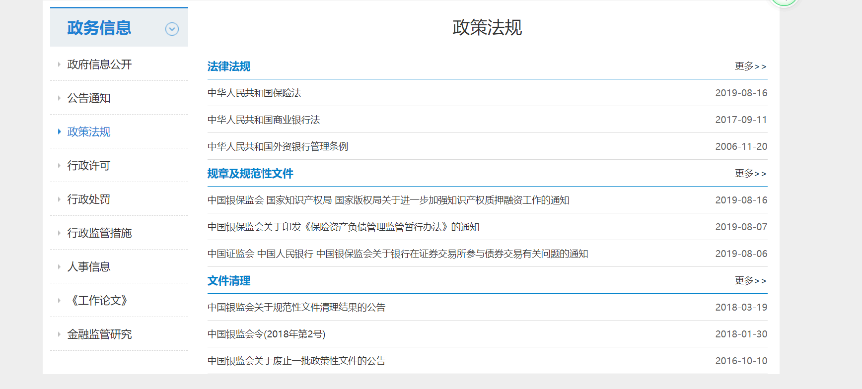
中国的金融监管机构
银保监会
政策法规：http://www.cbirc.gov.cn/cn/list/9103/910303/1.htm

Slide 25
中国的金融监管机构
银保监会__银行
政策法规：http://www.cbirc.gov.cn/cn/list/9103/910303/1.htm
商业银行主要监管指标情况表
商业银行主要指标分机构类情况表
银行业金融机构普惠性小微企业贷款情况表
中国证监会 中国人民银行 中国银保监会关于银行在证券交易所参与债券交易有关问题的通知
《扩大银行参与交易所债券市场范围 提升服务实体经济能力》

Slide 26
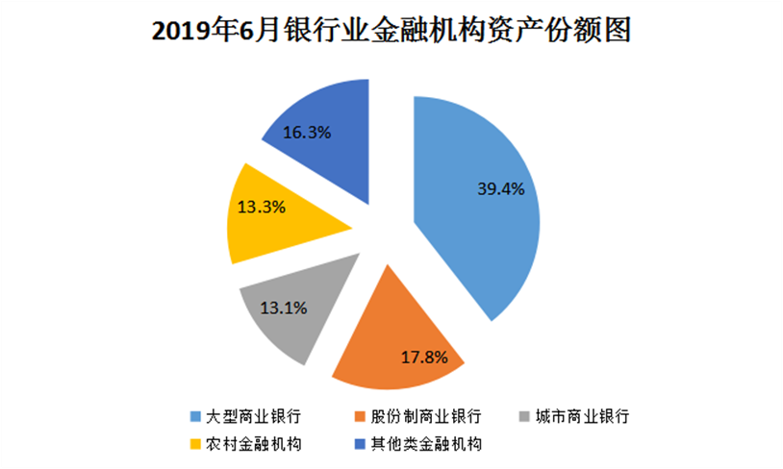
中国的金融监管机构
银保监会__银行

Slide 27
中国的金融监管机构
银保监会__保险
政策法规：http://www.cbirc.gov.cn/cn/list/9103/910303/1.htm
保险业经营情况（2019.1-6月）
财产保险公司经营情况
人身险公司经营情况表
全国各地原保险保费收入情况表

Slide 28
中国的金融监管机构
证监会
http://www.csrc.gov.cn/pub/newsite/
证券市场资信评级机构名录 （ 2019年）
证券投资基金托管人名录 (2019年7月)
合格境外机构投资者名录（2019年7月）
公募证券投资基金名录 (2019年7月)
证券投资咨询机构名录（2019年7月）
公募基金管理机构名录（2019年7月）
基金管理公司从事特定客户资产管理业务子公司名录（2019年7月）

Slide 29
中国的金融监管机构
证监会
http://www.csrc.gov.cn/pub/newsite/
证券公司名录（2019年7月）
期货公司名录（2019年7月）
从事证券期货业务资产评估机构目录（2019年3月）
2019年6月25日证券市场快报
2019年5月统计数据

