Slide 1
IVW Bayes Ridge Regression & AdaBoostRegressor Model Prediction
Group Members: Xiaoyu Liu, Dongqing Zhu
Date: Apr 12, 2022

Slide 2
Seed Program Introduction
In this project, we developed our prediction model based on the seed program from the book Machine Learning and Data Science Blueprints from for Finance by Hariom Tatsat.
We selected chapter 5 Supervised learning: Regression, case study 1: Stock price prediction as our seed program
This model uses the historical price of the stock itself and other features, such as correlated assets and technical indicators, as well as various supervised machine-learning models to predict the stock price of Microsoft.

Slide 3
Improvements to the Seed Program
New data:
Stocks: Alibaba(BABA.csv), Amazon(AMZN.csv), Google(GOOGL.csv), Microsoft(MSFT.csv)
ETF: SKYY, IVW
Indices: Nasdaq(^IXIC.csv), VIX(^VIX.csv)
Indicators: Talib(SMA, RSI, ADX)
Target: Predict the future returns of IVW(daily)
Data pre-processing: Wavelet smoother from PyWavelets(a open source wavelet transform software for python), scaler from StandardScaler function
Feature extraction: PCA from Scikit-learn
Models related improvements:
Use a pipeline with grid search to optimizes the parameters of our selected best model
Use bayesian in Scikit-learn which is not discussed in Tatsat

Slide 4
Inputs and Target
Inputs: All inputs(daily data) were downloaded from yahoo finance, starting from Apr 8th, 2012 to Apr 8th, 2022.
Stocks: Alibaba(BABA.csv), Amazon(AMZN.csv), Google(GOOGL.csv), Microsoft(MSFT.csv)
ETF: IVW (Historical data), SKYY(ETF)
Indices: Nasdaq(^IXIC.csv), VIX(^VIX.csv)
Target: the future weekly returns of IVW(S&P500 Growth ETF)

Slide 5
Input Processing - Scaling
To process the input data, we firstly use the StandardScaler function from sklearn to scale the X, Y variables. The scaler helps to standardize the features, making them look like standard normal distributed.
We apply the scaler to the Pipeline.

Slide 6
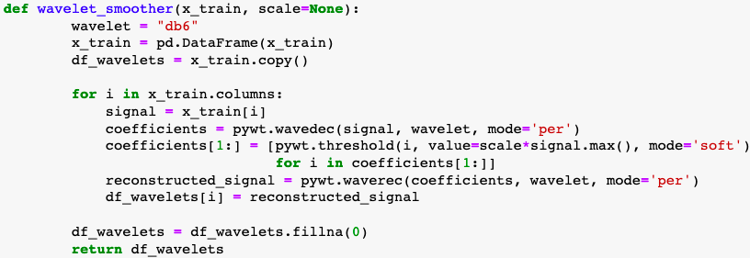
Input Processing - Smoothing
We then use the wavelet function from PyWavelets to define our custom wavelet smoother function, performing 1D multilevel Discrete Wavelet Transform decomposition of given features.
Then, we applied this to the Pipeline.

Slide 7
Input Selection/Extraction - PCA
We use PCA to select the principle component, and apply it to the Pipeline.

Slide 8
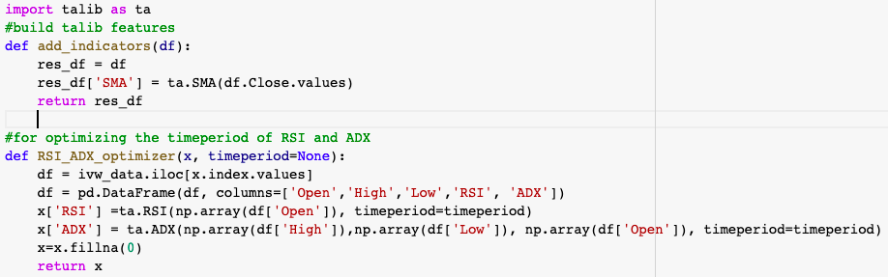
Indicators
We use the indicators from talib: RSA, SMA, ADX.

Slide 9
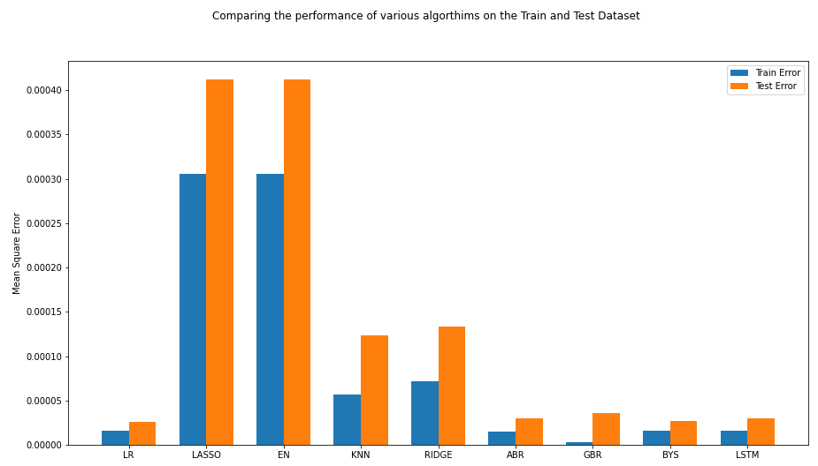
Models - Searching
We compared many models: Linear regression, Lasso, ElasticNet, KNN, Ridge, AdaBoostRegressor, GradientBoostingRegressor, BayesianRidge and LSTM to find the best model for this study. We calculated the tran error and test error of each model.
From the train and test error, we see good results in Linear regression, Bayesian and LSTM models.
We choose AdaBoostRegressor and then Bayesian Ridge Regression to predict the weekly returns of IVW.

Slide 10
AdaBoostRegressor Model Prediction

Slide 11
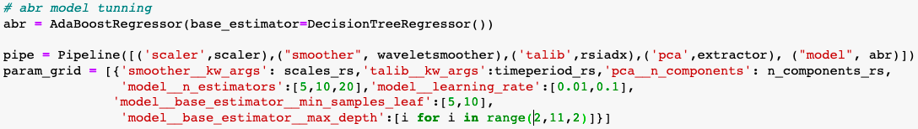
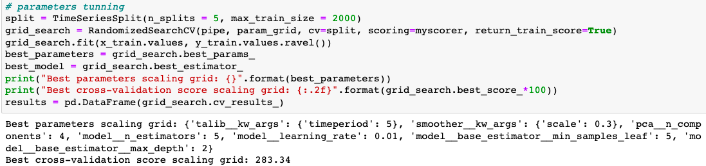
ABR Model and Parameters Search
We first choose AdaBoostRegressor to predict the weekly returns of IVW.
Parameters:
We use Pipeline with Randomized Search to determine the optimal parameters.
timeperiod for talib indicators RSI and ADX
scale values for smoother function
Learning rate, n estimators, min samples leaf and max depth values for AdaBoostRegressor
n_component for PCA
And in our randomized search function, we use the Sharpe Ratio as the scorer function.

Slide 12
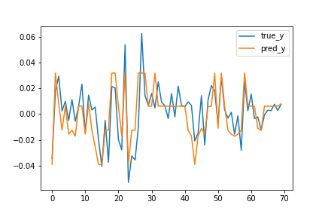
ABR Model Results
Our true y values vs predicted y values, and the mean squared error of train and test is:
train error: 0.00012822959623696894
test error: 0.0002204975953795773

Slide 13
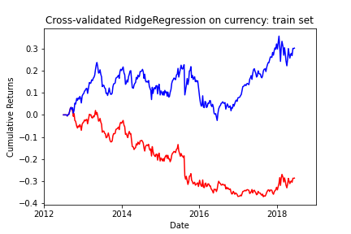
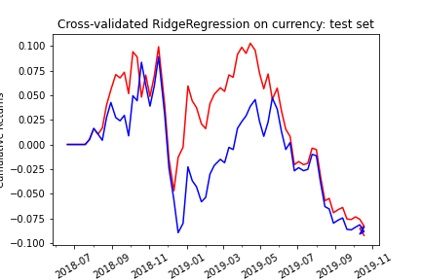
ABR Model Results - equity curves
The blue one is the prediction result and the red one is the true value

Slide 14
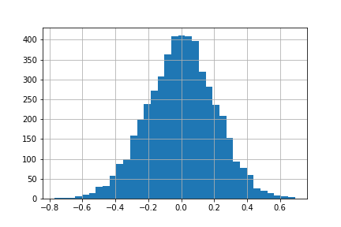
Metrics and Results-ABR
White Reality Check Results:
average return 0.208688
[-0.40776078 0.40538109]
Do not reject Ho = The population distribution of rule returns has an expected value of zero or less (because p_value is not small enough)
p_value: 0.15900000000000003
Metric (fAux) | Results
CAGR | 0.0453959
Sharpe Ratio | 0.420547
maxDD | -0.211603
maxDDD | 223
Calmar Ratio | 0.214533
Rho | 0.745078
PVal | 1.40e-13

Slide 15
Bayes Ridge Regression Model Prediction

Slide 16
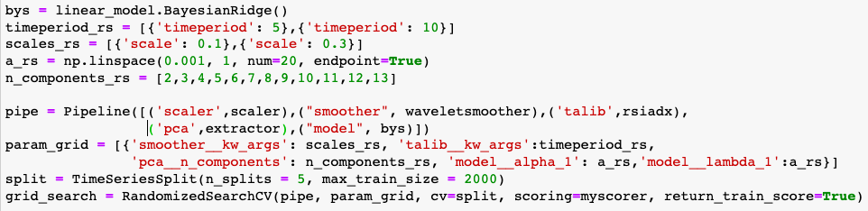
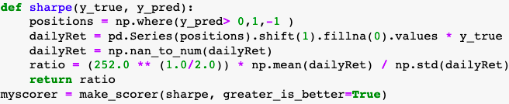
Bayes Model and Parameters Search
Then, we choose Bayesian Ridge Regression to predict the a better results of the weekly returns of IVW.
Parameters:
We use Pipeline with Randomized Search to determine the optimal parameters.
timeperiod for talib indicators RSI and ADX
scale values for smoother function
alpha and lambda values for Bayesian Ridge Regression
n_component for PCA
And in our randomized search function, we use the Sharpe Ratio as the scorer function.

Slide 17
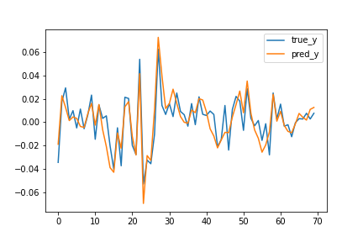
Bayes Model Results
Our true y values vs predicted y values, and the mean squared error of train and test is:
train error:
8.03376456025409e-05
test error: 0.00012220371996507536

Slide 18
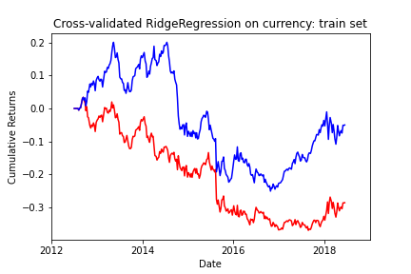
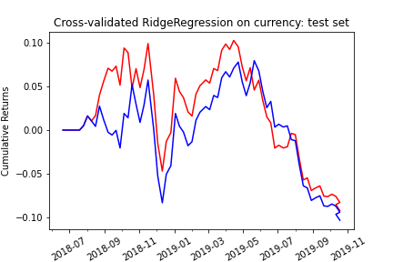
Bayes Model Results - equity curves
The blue one is the prediction result and the red one is the true value

Slide 19
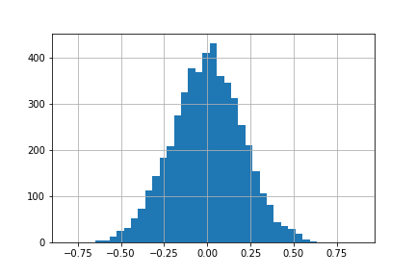
Metrics and Results-Bayes
White Reality Check Results:
average return 0.344135
[-0.39092433 0.39203901]
Reject Ho = The population distribution of rule returns has an expected value of zero or less (because p_value is small enough)
p_value: 0.04400000000000004
Metric (in-sample) | Results
CAGR | -0.00861109
Sharpe Ratio | -0.00649672
maxDD | -0.375734
maxDDD | 256
Calmar Ratio | -0.022918
Rho | 0.815813
PVal | 7.88e-18

Slide 20
Thank you!

