Slide 1
Movie Rating Comparison What movie genre is USA most highly rated？
Xiaoyue Liu

Slide 2
Netflix Dataset
100 million ratings
480 thousand randomly-chosen, anonymous Netflix customers
over 17 thousand movie titles
Format: txt
Movie_title: MovieID,YearOfRelease,Title
Review files: CustomerID,Rating,Date
Main Procedure:
Extract average ratings for each movie, using individual customer review lines for each movie

Slide 3
IMDB Dataset
http://www.omdbapi.com/?t=Wall+E&y=2008&r=json
{"Title":"WALL·E","Year":"2008","Rated":"G","Released":"27 Jun 2008","Runtime":"98 min","Genre":"Animation, Adventure, Family","Director":"Andrew Stanton","Writer":"Andrew Stanton (original story by), Pete Docter (original story by), Andrew Stanton (screenplay), Jim Reardon (screenplay)","Actors":"Ben Burtt, Elissa Knight, Jeff Garlin, Fred Willard","Plot":"In the distant future, a small waste-collecting robot inadvertently embarks on a space journey that will ultimately decide the fate of mankind.","Language":"English","Country":"USA","Awards":"Won 1 Oscar. Another 81 wins & 78 nominations.","Poster":"http://ia.media-imdb.com/images/M/MV5BMTczOTA3MzY2N15BMl5BanBnXkFtZTcwOTYwNjE2MQ@@._V1_SX300.jpg","Metascore":"94","imdbRating":"8.4","imdbVotes":"674,274","imdbID":"tt0910970","Type":"movie","Response":"True"}
Format: json object

Slide 4
Join using SQL
country | genre | number | average rating( (imrating+2*nfrating)/2)
UK | Documentary | 135 | 7.29407407407
Japan | Animation | 179 | 7.09508379888
USA | History | 231 | 7.0874025974
UK | Biography | 111 | 7.04162162162
Japan | Drama | 201 | 6.9815920398
USA | War | 217 | 6.96211981567
USA | Documentary | 680 | 6.94752941176
USA | Biography | 346 | 6.93384393064
USA | Music | 448 | 6.93241071429
Japan | Adventure | 104 | 6.90884615385
Movie | rating_diff(ABS(imrating-2*nfrating)
The Vault | 4.62
Freaks & Geeks: The Complete Series | 4.3
The Who | 4.22
Salsa & Merengue: Cal Pozo's Learn to Dance in Minutes | 4.1
Ben & Arthur | 3.96
Sasquatch | 3.86
The Life | 3.86
Superbabies: Baby Geniuses 2 | 3.8
Meet the Browns | 3.76
Fractured Flickers | 3.74
Movie | ratings( (imrating+2*nfrating)/2)
Band of Brothers | 9.31
The Godfather | 9.1
Firefly | 9.0
Lord of the Rings: The Return of the King | 9.0
Star Wars: Episode V: The Empire Strikes Back | 8.94
The Beatles Anthology | 8.93
Schindler's List | 8.91
The Godfather,Part II | 8.9
Pride and Prejudice | 8.89
Star Wars: Episode IV: A New Hope | 8.85

Slide 5
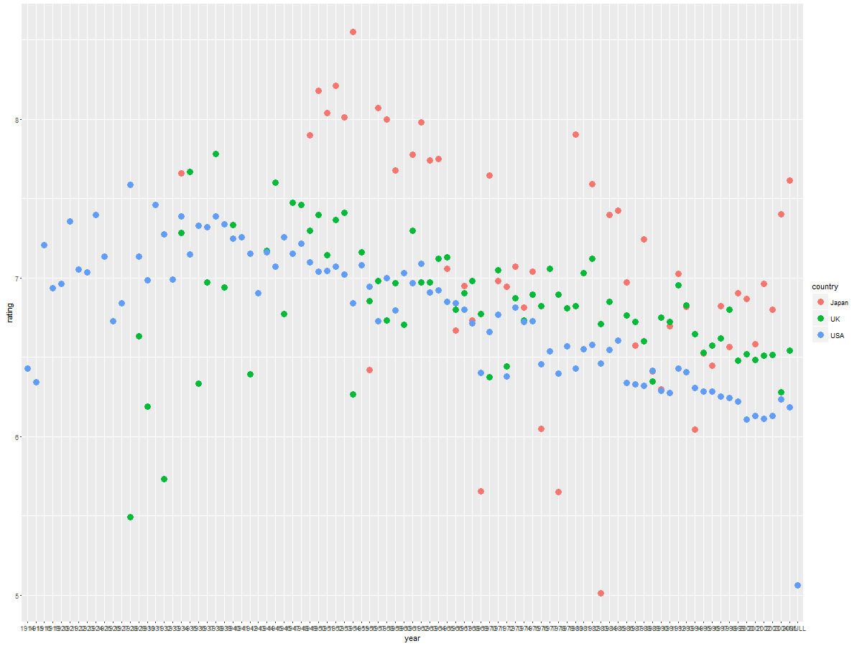
How rating for each country change along years from 1914 to 2005

