Slide 1
Welcome to 601 Data Manipulation
Winter 2015
Instructor: Yuhang Wang (yuhangw@umich.edu)
GSI: Ming Jiang (mjng@umich.edu)
Some slides from: Kevyn Collins-Thompson, Qiaozhu Mei, Charles Severance and Patrick Dudas

Slide 2
About your instructor
Yuhang Wang, Ph.D. Adjunct Lecturer, School of Information Data Scientist, JSTOR (http://www.jstor.org/)
Born in Liaoning province in Northeast China and went to college in Shanghai
Ph.D. in Computer Science (Dartmouth College, 2005)
LinkedIn profile:
www.linkedin.com/pub/yuhang-wang-ph-d/28/535/4b0/
Hobbies:
Biking, kayaking, photography, fixing my own cars
Most relevantly, I write code in Python/Scala/Java/R everyday to process lots of data and enjoy doing it.

Slide 3
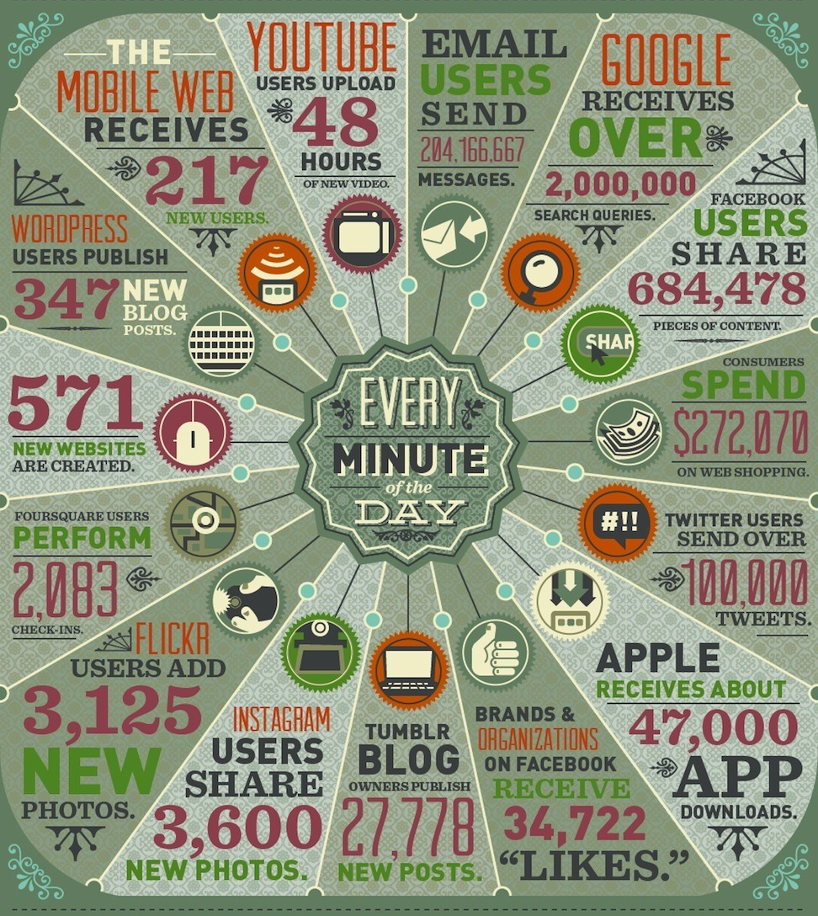
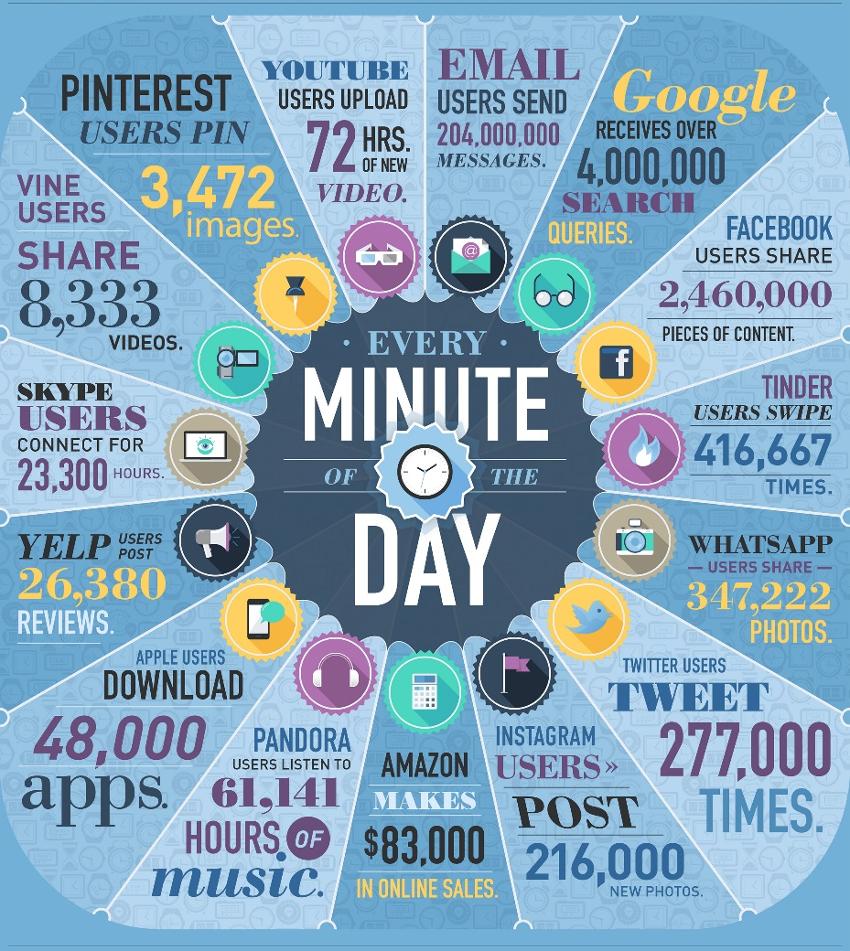
How fast is information being created every minute?
2012
2014
Sources: http://www.domo.com/blog/2012/06/how-much-data-is-created-every-minute/
http://www.domo.com/blog/2014/04/data-never-sleeps-2-0/
Notes:
Google searches, tweets have doubled in volume since 2012.
Represents text, apps, pictures, music, video, …

Slide 4
How much new information is produced in the world every day?
Web pages, photos, instant messages, phone calls, search logs, sensor signals, social media, GPS location data, genomics, surveillance video,…
What’s the total volume of global information production from all sources?
1 exabyte = 1 quintillion bytes = 1,000,000,000,000,000,000 (18 zeros)
2002: 23 exabytes in a year. 2010: 23 exabytes in a week.
The data surge just keeps rising, doubling in volume every two years.
Sources: http://bits.blogs.nytimes.com/2013/06/19/sizing-up-big-data-broadening-beyond-the-internet/
http://www.emc.com/collateral/analyst-reports/idc-digital-universe-are-you-ready.pdf
http://blog.rjmetrics.com/2011/02/07/
http://www2.sims.berkeley.edu/research/projects/how-much-info-2003/

Slide 5
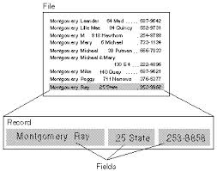
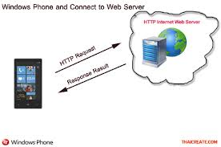
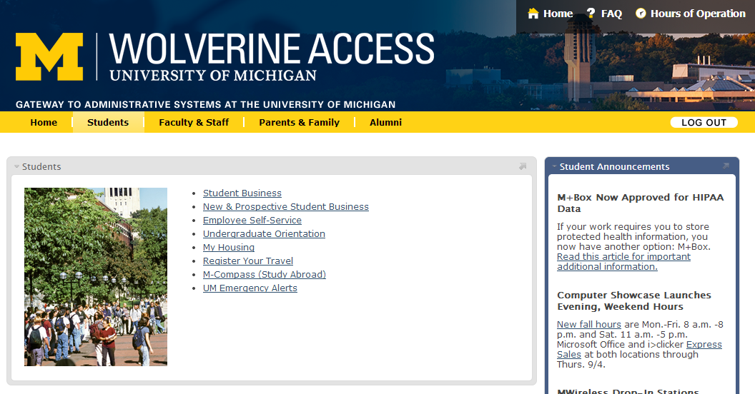
Course plan: Progress thru different ‘flavors’ of data based on structure
The language used in Shakespeare’s day is slightly different to today’s modern English, which is reflected in the text. Our article on Shakespeare & early modern English, or our Shakespeare dictionary, will help you to understand the language as you read through the original textAnother thing to bear in mind as you read the Hamlet text are Shakespeare’s stage directions, which are italicised. Stage directions are instructions and direction to the actors, and not spoken lines. Some stage directions can be a little confusing, so have a read of our understanding Shakespeare’s stage directions article.
The language used in Shakespeare’s day is slightly different to today’s modern English, which is reflected in the text. Our article on Shakespeare & early modern English, or our Shakespeare dictionary, will help you to understand the language as you read through the original textAnother thing to bear in mind as you read the Hamlet text are Shakespeare’s stage directions, which are italicised. Stage directions are instructions and direction to the actors, and not spoken lines. Some stage directions can be a little confusing, so have a read of our understanding Shakespeare’s stage directions article.
Databases
Text
Structured (tagged) documents
Web API
Unstructured
Semi-structured
Structured
Multi-facet
Web APIs

Slide 6
Why this course? (Part 1)
Sheer volume and growth of data is impressive…
But clever software to make sense of all that data is critical
And clever people to use the software even more critical
40,000 - 190,000 more workers with “deep analytical” expertise needed in U.S. (McKinsey)

Slide 7
Why this course? (Part 2)
Data manipulation and analysis is becoming central to managing organizations
Data-driven insights are fueling a shift in the center of gravity of decision making
Away from standard experience and intuition, or relying on a single source or piece of information
“You can’t manage what you can’t measure”
– Erik Brynjolfsson. Director of MIT Center for Digital Business

Slide 8
Goal of the 601/618 Classes
Equip you with the right skills to be competitive in the job market as
Data Analyst
Data Scientist
Business Analyst
Consultant
etc
Many companies are hiring Data Analysts/Data Scientist: Google, Amazon, Yelp, Netflix, Pandora, LinkedIn, Facebook, Microsoft, LivingSocial, Groupon, …

Slide 9
What you’ll learn in 601
Skills:
How to get/read/gather/fetch/crawl data from a variety of sources
How to convert this data to/from important formats
Basic computation and manipulation on the data
Pattern-matching and text analysis
SQL queries and operations, …
Large-scale (big) data processing on Hadoop clusters
Initial methods to explore and visualize to gain more insight into the data (with more in 618)
How to write Python code to solve the above problems
Tools:
Python core functionality
Python packages
Python interfaces to Hadoop clusters
External data APIs and other resources

Slide 10
What's your programming background?
How many people have some experience with any programming language?
How many people have at least some experience writing programs in Python?
How many people have lots of experience writing programs in Python?

Slide 11
Prerequisites for this course
At least some previous experience writing computer programs:
Course experience (e.g. SI 502)
Work experience
Familiarity with core math/statistics, e.g.:
Logs, exponential, linear and quadratic functions
Mean, variance, probability distribution
This should not be your very first programming course.

Slide 12
Let’s Go Through the Syllabus
Instructor: Yuhang Wang (yuhangw@umich.edu) Instructor Office Hours: NQ 1243, Wednesdays 5:15pm - 7:15pm.
GSI: Ming Jiang (mjng@umich.edu) GSI Office Hours: NQ 4352, Mondays 1pm - 3pm and Thursdays 10am - 12pm.
If you have (personal) questions about course materials, homework, lab, or projects, the best way is to come and talk to me during my office hours. You may also contact me via email.
For technical help with assignments or lecture material, Ming is also available during his office hours.
For general questions about homework and lab, please use the discussion forum on CTools.

Slide 13
Text, Description, and Policy
Required:
Charles Severance (2010). Python for Informatics: Exploring Information. (http://open.umich.edu/education/si/resources/python-opentextbook/winter2010)
Python Software Foundation (2015). "Python v2.7.9 Documentation.” (http://docs.python.org/2/)
Recommended: Wes McKinney (2012). Python for Data Analysis. O'Reilly Media. ISBN: 978-1-4493-1979-3, Ebook ISBN: 978-1-4493-1978-6
There will be multiple other sources used throughout the course, but I will note them in the slides

Slide 14
Grading
Homework (50%) There will be up to 6 x 100 point weekly homework assignments during the term. I will drop the lowest score of these assignments. Assignments will be posted on CTools.
Lab (20 %) There will be 6 x 20 point weekly in-class lab assignments during the term. I will drop the lowest score of these labs. Labs will be posted on CTools.
Project (30%) There will be an individual project worth 100 points on a topic of your choice. You will put together a project proposal at the halfway point in the term (1 page, 20 points), a short slide deck summarizing results toward the end of the course (3-5 slides, 15 points) and a final report (typically 4-5 pages, 65 points). You can also optionally give a short presentation during the last class.

Slide 15
Original Work Policy
Unless otherwise specified in an assignment, all submitted work must be your own, original work. You may discuss general approaches with others on individual assignments, but may not copy code or other work and must indicate on your turned-in assignment who you worked with. Any excerpts from the work of others must be clearly identified as a quotation, and a proper citation provided. Any violation of the School’s policy on Academic and Professional Integrity (stated in the Master’s and Doctoral Student Handbooks) will result in severe penalties, which might range from failing an assignment, to failing a course, to being expelled from the program, at the discretion of the instructor and the Associate Dean for Academic Affairs.

Slide 16
SI 601 Data Manipulation: Class Schedule (Some details may change)
Date | Topic | Assignments Due (before start of class)
Jan 13 | Course introduction Basics of Programming with Python | Install software as described in welcome email
Jan 20 | Text Encodings Extracting Patterns from Text with Regular Expressions | Lab 1, Homework 1
Jan 27 | Fetching and Parsing Web content: HTML, XML, JSON, Web APIs. | Lab 2, Homework 2 1-page Project Proposal Due
Feb 3 | Querying data in a SQL Database | Lab 3, Homework 3
Feb 10 | Large-scale data manipulation with MapReduce and Hadoop | Lab 4, Homework 4
Feb 17 | Advanced topics | Lab 5, Homework 5
Feb 24 | Course Review, Final project presentations | Lab 6, Homework 6 Project slides, Project report

Slide 17
Format of the Class
Lecture (70-80 min)
15 min break
Lab (75 min)
Goal: start applying what was covered in lecture
Ming and I will be available to help you
Remember:
Lectures are only the beginning of the learning cycle
Labs and homeworks complete it
You only learn when you apply it

Slide 18
Basics of Programming with Python

Slide 19
Covering
Python
Why Python
Variables
Loops
Arrays
Dictionary
Lists
Functions
File I/O

Slide 20
Why Python?
People use Python for
Data manipulation
Natural Language Processing (NLTK)
Web development (Django web application framework)
Data analysis (SciPy, NumPy, pandas)
Shell scripting
Hadoop Map/Reduce programming (mrjob)
Other fun stuff (e.g. XBMC media player plugins, Minecraft Python API)
Advantages:
Much more readable than Perl
Very high level language
Some support for functional programming
Huge repository of packages
Disadvantage:
Slow

Slide 21
How run Python code?
Interactively using Python shell
Mainly for learning/testing
Write a python program, save it and then run it with Python interpreter

Slide 22
A simple Python script
#!/usr/bin/python –tt
# The interesting stuff goes here
print 'Hello world!'
Usually scripts are saved in files with names like hello_world.py
and then used by running them like this from your operating system command line
instead of being retyped by hand into the interpreter every time..
> python hello_world.py
Hello world!
Notes:
-tt issues an error when a source file mixes tabs and spaces

Slide 23
Indentation Matters
Unlikely many other languages, Python is NOT free-format
Indentation matters and must be consistent
Consistent indentation enhances readability. It is a good thing.
You can use either:
Tab
Spaces (recommended)
Demo of auto-indent in Komodo

Slide 24
Commenting
Commenting in Python
Use “#”
Python ignores these lines, so comment as much as possible (won’t hurt performance)
# This would be a comment
###################
# Also, this..
###################
You may also see this type of comments in some Python code:
“””
Technically, this is not comments, but the
so called heredoc. Works as comments, though.
“””

Slide 25
Basic building blocks for programming in Python
Variables
especially Strings
Loops
Data structures:
Lists and Sorting
Dictionary
Tuple
Set
Functions
File Input/Output

Slide 26
Rules for Variables
Must start with a letter or underscore _
Most consist of letters and/or numbers
Case sensitive
OK
iAmAVariable, variable3, _function
Bad
19number, :variable, another-variable

Slide 27
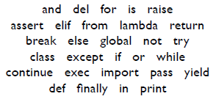
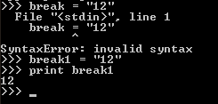
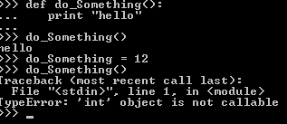
Reserved Words
There are words that cannot be variables. Why?
They’re already functions within Python
Similarly, variables can’t share names with your existing functions.

Slide 28
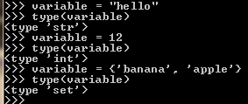
Assignment (Variables)
variable_name = expression
Python will assign type based on the expression
Use “type()” to see what type of variable it is

Slide 29
Variable types in Python
Numbers
int (signed integers) x = 10
long (bigger signed integers) x = -472188529529L
float (floating-point real values) x = -2.71828
complex x = 3.14j
String x = 'pineapple'
List x = [ 'abcd', 786 , 2.23, 'john', 70.2 ]
Tuple (read-only lists) x =('abcd', 786, 'john', 70.2 )
Dictionary x = {'name':'john', 'code':6734, 'dept':'sales'}

Slide 30
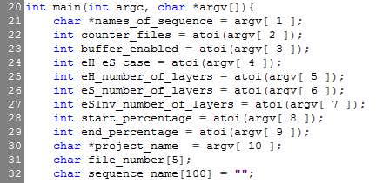
Variables
Variables do not need to be pre-declared, unlike C or Java
C program:
Python program:
Declaration happens automatically when you assign a value to a variable
Notes:
LEGB Rule.
L. Local. (Names assigned in any way within a function (def or lambda)), and not declared global in that function.
E. Enclosing function locals. (Name in the local scope of any and all enclosing functions (def or lambda), form inner to outer.
G. Global (module). Names assigned at the top-level of a module file, or declared global in a def within the file.
B. Built-in (Python). Names preassigned in the built-in names module : open,range,SyntaxError,...

Slide 31

Strings
Python has rich set of functions to manipulate strings
variable = “some string”
More later on how strings are encoded
Whitespace characters:
space ' '
tab '\t'
line terminators (line feed '\n', carriage return '\r', …)

Slide 32
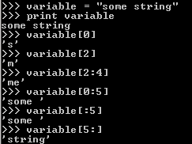
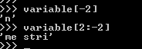
String Indexing/String Slicing
Indexing is done by using brackets [ ]
Negative numbers work!
They index from the end of the string

Slide 33
String methods
Many string manipulations take the form:
some_string.method(…)
split([sep]) breaks a string into a list based on the given seperator string. Default separator: whitespace.
>>> date = '2014/06/23'
>>> date.split('/')
['2014', '06', '23']
>>> date.split('4/')
['201', '06/23']
strip([chars]) removes leading and trailing characters. Default chars to strip: whitespace.
>>> ' spacious '.strip()
'spacious'
>>> 'www.example.com'.strip('cmowz.')
'example'

Slide 34
String Functions
Other string functions (in string library)
capitalize()
lowercase()
rfind()
rstrip()
replace()
startswith()
endswith()
String are iterable
See http://docs.python.org/library/stdtypes.html#string-methods
>>> variable = 'some string'
>>> variable.find("me")
2
>>> variable.capitalize()
'Some string'
>>> variable.replace('str', 'th')
'some thing'

Slide 35
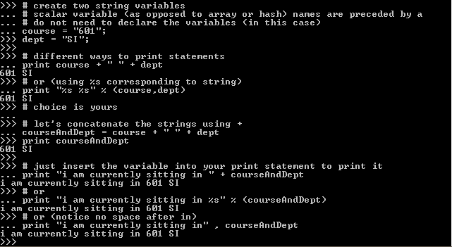
Concatenating/formatting Strings
Method 1: use +
Method 2: use the join(…) method
' '.join('foo', 'bar')
'foo,bar'
Method 3: use % (deprecated in later Python versions)
'The items in the basket are %s and %s' % (x, y)
Notes:
Method 0: string literals can be put next to each other “foo” “bar”
“The items in the basket are %s and %s”, (x, y)

Slide 36
Converting and Formatting Numbers to Strings
Use str() function
Example:
str(100) '100'
str(5/6.0) '0.833333333333'
Use format() to enforce formatting
Floating point fixed width format: '{:0.5f}'.format(5.0/6.0) '0.83333'
Exponent notation: '{:0.5E}'.format(5.0/6.0) '8.33333E-01'
Reference: http://docs.python.org/2/library/string.html#formatspec

Slide 37
Comparisons
Operators
== < <= > >=
cmp(x,y)function
Compare the two objects x and y and return an integer according to the outcome.
The return value is:
Negative if x < y cmp(100, 200) == -1
Zero if x == y cmp('foo', 'foo') == 0
Strictly positive if x > y. cmp('foo', 'bar') == 1
Notes:
When you order a numeric and a non-numeric type, the numeric type comes first.
>>> 5 < 'foo' True >>> 5 < (1, 2) True >>> 5 < {} True >>> 5 < [1, 2] True
When you order two incompatible types where neither is numeric, they are ordered by the alphabetical order of their typenames:
>>> [1, 2] > 'foo' # 'list' < 'str' False >>> (1, 2) > 'foo' # 'tuple' > 'str' True >>> class Foo(object): pass >>> class Bar(object): pass >>> Bar() < Foo() TrueOne exception is old-style classes that always come before new-style classes.
>>> class Foo: pass # old-style >>> class Bar(object): pass # new-style >>> Bar() < Foo() False
Is this behavior mandated by the language spec, or is it up to implementors?
There is no language specification. The language reference says:
Otherwise, objects of different types always compare unequal, and are ordered consistently but arbitrarily.

Slide 38
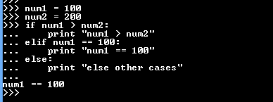

If, Else, Elif?
Condition statements
if something:
Do something
elif something_else:
Do something else
else:
Do another something else
Use Not for negation
if not something:
Do something
http://www.tutorialspoint.com/python/python_basic_syntax.htm

Slide 39
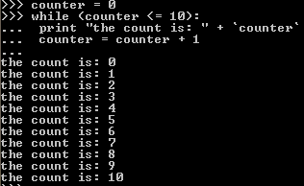
While Loops
Continues to run until condition is met
while condition_true:
do_something
http://www.tutorialspoint.com/python/python_basic_syntax.htm

Slide 40
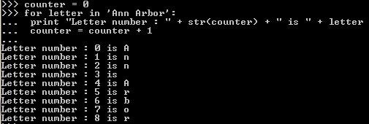
For Loops
Continues to run until condition is met
for iterating_variable in sequence:
[do something]
These are great for lists (we will see this soon)!
http://www.tutorialspoint.com/python/python_basic_syntax.htm
Notes:
Note
There is a subtlety when the sequence is being modified by the loop (this can only occur for mutable sequences, i.e. lists). An internal counter is used to keep track of which item is used next, and this is incremented on each iteration. When this counter has reached the length of the sequence the loop terminates. This means that if the suite deletes the current (or a previous) item from the sequence, the next item will be skipped (since it gets the index of the current item which has already been treated). Likewise, if the suite inserts an item in the sequence before the current item, the current item will be treated again the next time through the loop. This can lead to nasty bugs that can be avoided by making a temporary copy using a slice of the whole sequence

Slide 41
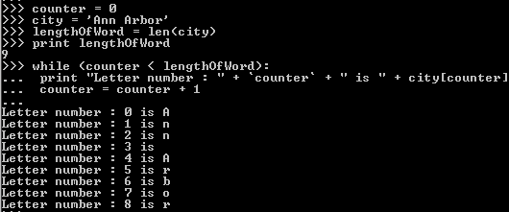
Same Task/Different Loops

Slide 42
Python data structures: The key to manipulating data
Lists
Tuples
Dictionaries
Sets

Slide 43
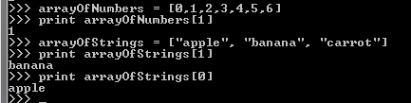
Lists
Elements are assigned a number [ position or index ]
Traditional array (think one-column spreadsheet)
Can mix types, e.g. integer, string, …
Starts index at 0 (with negative allowed: relative to end of list)
s = [1, 2, 3, 4]
s[0] = 1
http://www.tutorialspoint.com/python/python_basic_syntax.htm

Slide 44


Creating and adding to a List
s = list()
s.append(“something”)

Slide 45
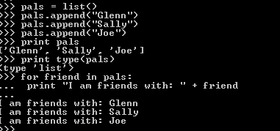
Looping through a List
Using for loop
We create an iterating variable (friend)
The loop continues until all elements of the list have been processed

Slide 46
List comprehension
The Pythonic way of applying a transformation or filter to all elements in a list
Transformation example:
>>> range(10)
[0, 1, 2, 3, 4, 5, 6, 7, 8, 9]
>>> squares = [x**2 for x in range(10)]
>>> squares
[0, 1, 4, 9, 16, 25, 36, 49, 64, 81]
Filter example:
>>> vec = [1, 2, 6, 4, 5, 8]
>>>
>>> even_numbers = [x for x in vec if x%2==0]
>>> even_numbers
[2, 6, 4, 8]
https://docs.python.org/2/tutorial/datastructures.html#list-comprehensions

Slide 47
How to sort a list
Easiest way: use sorted(list) function
Takes a list as input
Returns a new list with elements in sorted order. The original list is not changed.
>>> sorted([5, 2, 3, 1, 4])
[1, 2, 3, 4, 5]
http://docs.python.org/2/library/functions.html#sorted
http://docs.python.org/2/howto/sorting.html

Slide 48
More advanced sorting with the key parameter
>>> sorted("This is a test string from Andrew".split(), key=str.lower)
['a', 'Andrew', 'from', 'is', 'string', 'test', 'This']
The value of the key parameter is a function
The function must take a single argument
It's applied to each instance of the things being sorted
e.g. each string from the output of split() above
The function's output will be used as the sort key
e.g. str.lower("Foo") returns lower-case version "foo"
sorted will use this key for the sort comparison
Source: http://docs.python.org/2/howto/sorting.html

Slide 49
Sorting complex records with key option + custom lambda functions
>>> student_tuples = [
('john', 'A', 15),
('jane', 'B', 12),
('dave', 'B', 10),
]
>>> sorted(student_tuples, key=lambda student: student[2]) # sort by age
[('dave', 'B', 10), ('jane', 'B', 12), ('john', 'A', 15)]
Source: http://docs.python.org/2/howto/sorting.html

Slide 50
Multi-level sort
>>> a = [(1,2,3), (2,2), (2,1), (1,), (1,2), (2,)]
Default sorting for lists of tuples:
First sort by first elements in the tuples,
- Tuples sub-sorted by length
Then sub-sort by the second elements,
… and so on.
>>> sorted(a)
[(1,), (1, 2), (1, 2, 3), (2,), (2, 1), (2, 2)]
# if country_data is a dict:
# Do a three-level sort of country data by year, name, and population
sorted_data = sorted(country_data,
key=lambda x: (x['year'], x['name'], x['population']))

Slide 51
Tuples
A tuple consists of a number of values separated by commas
e.g. (1, 2, 10, ‘good’, 12.0)
Similar to lists
But tuples are immutable (not editable)
More memory efficient than lists
Use cases of tuples:
Tuples can serve as keys in a dictionary
Store records retrieved from a database
If you need to write a function that returns more than more values, you can let the function return a tuple

Slide 52
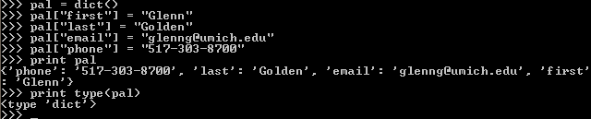
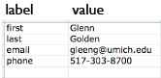
Dictionaries: dict()
Can hold multiple items (like lists)
But entries are key:value pairs that don’t have an order
Think of it like a two-column spreadsheet
Column 0: key value Column 1: stored value
Also known as associative arrays or hash tables
Key Value

Slide 53
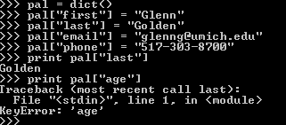
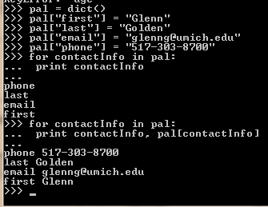
Retrieving Data from Dictionaries
What if you ask for a key that’s not there?
How to cycle through all records in a dictionary
1. for x in dict # loops over keys
2. y = dict.items() # gets list of (key, value) pairs
Use get method:
dict.get(key)
Or better,
dict.get(key,default_value)
avoids lookup errors if key not found

Slide 54
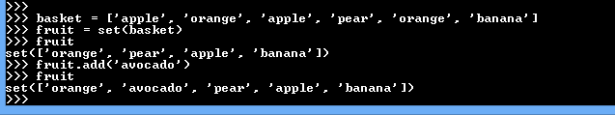
Sets
A set is an unordered collection with no duplicate elements: implemented in sets module
Basic uses include:
Fast membership testing.
Eliminating duplicate entries from a list.
Set objects also support mathematical operations
Union, intersection, difference, symmetric difference.
Example:
Notes:
Difference: set of elements in B but not in A. Symmetric difference: set of elements in A or B but not their intersection

Slide 55
Lists vs Dictionaries vs Sets
list: keep an ordered sequence of items (dict and set are like 'bags' with no ordering of their items)
dict: associates each unique key with a value (list and set just contain values)
set: forbids duplicates and requires items to be immutable: e.g. tuples (list allows duplicates and changeable values)
Usage:
list for an ordered sequence of (possibly duplicated) items
dictionary to associate unique keys with values, e.g. lookup table
set to store a collection of unique items only, e.g. have we seen an item before?
We can create complex data structures:
lists where each element is a dictionary or set
dictionaries where each key points to its own list or set

Slide 56

Functions
Define the function
Give it parameters (not required)
Call function.. You need to use nameOfFunction()
Use return(value) to, well, return a value to caller

Slide 57
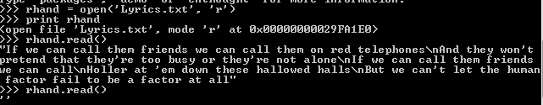
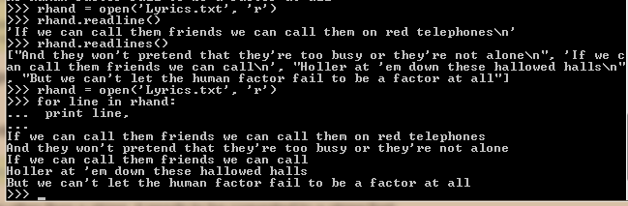
Reading and writing files
open(), close(), read(), readline(), readlines()
Reference: http://docs.python.org/tutorial/inputoutput.html#reading-and-writing-files

Slide 58
Reading and writing files
use rU and w
U for universal newline support
Example:
myfile = open(‘filename.txt’, ‘rU’)
outfile =open(‘filename2.txt’, ‘w’)
[read, write with the file objects]
myfile.close()
outfile.close()
Always close()any open files when you're done with them (why?)

Slide 59
Review reading & reference
Severance:
Chapters 2 – 9 (key sections x.1 – x.4)
Additional background
Google's Python Class
https://developers.google.com/edu/python/
The Python Tutorial
http://docs.python.org/2/tutorial/
sample_programs.zip in Ctools Resources/Week 1
wordcount program: alice.txt
readrepparty: representativesparty.txt

Slide 60
Homework 1
Released on Ctools.
Self-contained project to read a dataset and compute some interesting statistics.
Reading/writing csv files
Manipulating data via dictionaries and lists
Sorting with multiple keys
Both Homework and Lab 1 are due
Before start of class, Jan 20, 5:00pm

Slide 61
Lab time!
Lab 1 tasks: solve some programming mini-exercises in Python.

Slide 62
Extra material

Slide 63
Example for CSV write/read
import csv
# write stocks data as comma-separated values
writer = csv.writer(open('stocks.csv', 'wb', buffering=0))
writer.writerows([
('GOOG', 'Google, Inc.', 505.24, 0.47, 0.09),
('YHOO', 'Yahoo! Inc.', 27.38, 0.33, 1.22),
('CNET', 'CNET Networks, Inc.', 8.62, -0.13, -1.49)
])
# read stocks data, print status messages
stocks = csv.reader(open('stocks.csv', 'rb'))
status_labels = {-1: 'down', 0: 'unchanged', 1: 'up'}
for ticker, name, price, change, pct in stocks:
status = status_labels[cmp(float(change), 0.0)]
print '%s is %s (%s%%)' % (name, status, pct)
Source: https://wiki.python.org/moin/SimplePrograms

Slide 64
Saving a list of records to a .csv file using the ultra-convenient csv.DictWriter class
One way to manipulate a set of records
Make each record (row) a dictionary object
Store column values as entries in the dictionary object
Column name is the entry key in the dictionary
The dataset is a list of rows (dictionaries)
fieldnames = ['name', 'age', 'salary']
output_file = open(output_filename, 'wb')
csvwriter = csv.DictWriter(output_file, delimiter=',', fieldnames=fieldnames)
csvwriter.writeheader()
# fieldnames match the fields of the dict records
for row in list_of_dict:
csvwriter.writerow(row)
output_file.close()

Slide 65
What’s with the #!/usr/bin/python –tt in the first line of a Python script?
In Unix, an executable file that's meant to be interpreted must indicate what interpreter to use by having a #! at the start of the first line, followed by the interpreter (and any flags it may need);
This applies when you run it in Unix by making it executable (chmod +x myscript.py) and then running it directly: ./myscript.py, rather than just python myscript.py
The –tt option will check for tab/space potential problems

Slide 66
What's with the if __name__ == '__main__' check?
When the Python interpreter reads a source file, it executes all of the code found in it. Before executing the code, it will define a few special variables. For example, if the python interpreter is running that module (the source file) as the main program, it sets the special __name__ variable to have a value "__main__". If this file is being imported from another module, __name__ will be set to the module's name. In the case of your script, let's assume that it's executing as the main function, e.g. you said something like python threading_example.py on the command line. After setting up the special variables, it will execute the import statement and load those modules. It will then evaluate the def block, creating a function object and creating a variable called myfunction that points to the function object. It will then read the if statement and see that __name__ does equal "__main__", so it will execute the block shown there. One of the reasons for doing this is that sometimes you write a module (a .py file) where it can be executed directly. Alternatively, it can also be imported and used in another module. By doing the main check, you can have that code only execute when you want to run the module as a program and not have it execute when someone just wants to import your module and call your functions themselves.
Source: http://stackoverflow.com/questions/419163/what-does-if-name-main-do

