Slide 1
Fetching and Parsing Web content:
HTML, XML, JSON and Web APIs.
Winter 2015
Instructor: Dr. Yuhang Wang
Some slides from: Kevyn Collins-Thompson

Slide 2
Stuff to Learn Today
How to fetch web content?
  The urllib2 module
How to parse the retrieved content in HTML format?
  The beautifulsoup4 package
How to parse content in XML format?
  The xml.etree.ElementTree module
JSON parsing and manipulation?
  The json and simplejson modules
Web service APIs
Graph visualization
  Graphviz and pydot

Slide 3
You know the data's out there.. but how do you get it?
Important to understand the basics of Web data transfer
Original Web = HTML (what) + URL (where) + HTTP (how)
URL: Uniform Resource Locator
  Identifies a resource http://www.umich.edu/index.html
  First part of a URL is the protocol to use
  A protocol is a way of communicating that's agreed on in advance
HTTP: Hyper Text Transfer Protocol
  The network protocol of the Web
  Transfers resources not just files: a resource is identified by a URL
    Files, dynamically-generated server script output, media stream…
  HTTP specifies the format of a request and a response
  HTTP is a state-less protocol: does not maintain connection information between transactions.
Client-server model
    a) Client (your browser) opens a connection and
    b) Sends a request message to an HTTP server (www.microsoft.com)
    Server returns a response message, usually containing requested resource.

Slide 4


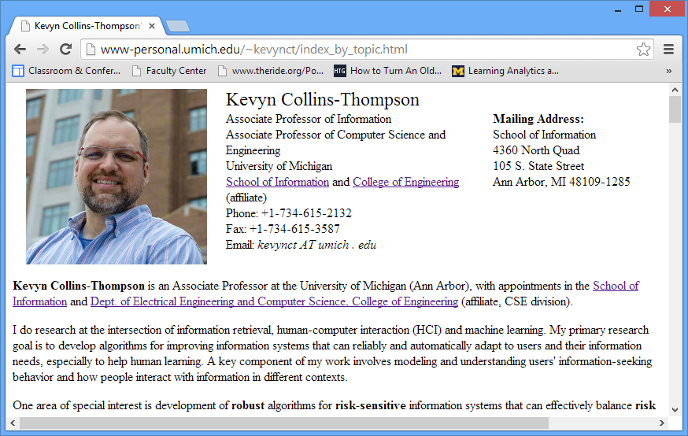
The HTTP request model
Request Line
http://www.umich.edu/~kevynct
GET /~kevynct HTTP/1.1
Accept:*/*
Accept-Language: en-gb
Accept-Encoding: gzip, deflate
User-Agent: Mozilla/4.0 (compatible; MSIE 6.0)
Host: www.umich.com
Connection: Keep-Alive
Client
Server
1. HTTP Request
2. HTTP Response
(with HTML page)
Status Line
HTTP/1.1 200 OK
Server: Microsoft-IIS/5.1
Date: Sun, 22 Sep 2013 12:04:43 GMT
X-Powered-By: ASP.NET
X-AspNet-Version: 1.1.4322
Cache-Control: no-cache
Pragma: no-cache Expires: -1
Content-Type: text/html; charset=utf-8
Content-Length: 8307
<html>
<head>
...
text/html is a MIME type
Examples of other types:
text/plain, application/json, application/pdf
image/gif, video/quicktime
Content Type
(and Encoding)
Content

Slide 5
urllib2
Documentation http://docs.python.org/2/howto/urllib2.html
Review of HTML elements
  http://www.w3schools.com/html/html_elements.asp

Slide 6
Python module for fetching Web resources: urllib2
import urllib2
response = urllib2.urlopen('http://www.umich.edu/~kevynct')
html_doc = response.read()
Also works for other transfer protocols, e.g. file:// and ftp://
Status codes
response.code == 200 Success
response.code == 401 Authentication required
response.code == 403 Request forbidden
response.code == 404 Page not found
response.code in 300-range are redirects, but default handlers process those and you won't see them unless you do special things.

Slide 7
Other urllib2 methods
response.geturl()
The actual URL fetched (may redirect from what you requested)
>>> response = urllib2.urlopen('http://www.umich.edu/~kevynct')
>>> response.geturl()
'http://www-personal.umich.edu/~kevynct/'
response.info()
An instance of httplib.HTTPMessage describing the page fetched. Contains a dict:
>>> response.info().dict
{'content-length': '32890', 'accept-ranges': 'bytes', 'server': 'Apache', 'connection': 'close', 'date': 'Sat, 21 Sep 2013 06:04:50 GMT', 'content-type': 'text/html; charset=utf-8'}

Slide 8
BeautifulSoup
Python library for parsing HTML and XML files.
Its XML features are limited, so we only use it for HTML files in this class.
Documentation:
http://www.crummy.com/software/BeautifulSoup/bs4/doc/

Slide 9
Beautiful Soup
Installation:
pip install beautifulsoup4
easy_install beautifulsoup4
It does Unicode conversion:
  Incoming docs (with HTML entities) → Unicode
  Output docs → UTF8
After parsing a page, you can do things like this:
  Find all the links on the page
  Find all the links of class externalLink
  Find all the links whose urls match "foo.com"
  Find the table heading that's got bold text, then get that text

Slide 10
Beautiful Soup Example
To parse a document, pass it into the BeautifulSoup constructor.
You can pass in a string or an open filehandle:
from bs4 import BeautifulSoup
soup = BeautifulSoup(open("index.html"))
soup = BeautifulSoup("<html>data</html>")
First, the document is converted to Unicode: HTML entities are converted to Unicode characters
BeautifulSoup("Sacr&eacute; bleu!")
<html><head></head><body>Sacré bleu!</body></html>
Beautiful Soup then parses the document using the best available parser.
It will use an HTML parser unless you specifically tell it to use an XML parser. (See Parsing XML.) It turns a complex HTML document into a complex tree of Python objects
You can manipulate, e.g. change tag names
Then optionally save a new file

Slide 11
BeautifulSoup tag tree:
A graphical example of simple HTML
<html><head><title>The Dormouse's story</title></head>
<body>
<p class="title"><b>The Dormouse's story</b></p>
<p class="story">Once upon a time there were three little sisters; and their names were
<a href="http://example.com/elsie" class="sister" id="link1">Elsie</a>,
<a href="http://example.com/lacie" class="sister" id="link2">Lacie</a> and
<a href="http://example.com/tillie" class="sister" id="link3">Tillie</a>;
and they lived at the bottom of a well.</p>
<p class="story">...</p>
tag
string
<head>
<title>
The Dormouse's story
<html>
<p>
<b>
The Dormouse's story
<body>
<p>
Once upon a time there were three little sisters; and their names were
<a>
Elsie
<a>
Lacie
<a>
Tillie
<p>
…
Source: http://www.crummy.com/software/BeautifulSoup/bs4/doc/

Slide 12
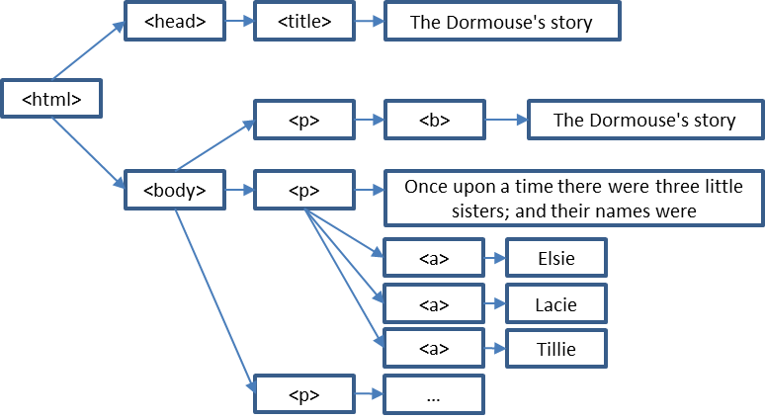
Navigating the parse tree
Use tag name to get the first tag by that name
  soup.head
  soup.title
  soup.a
These return tag objects.
If a tag's child is a string, use .string
  soup.title.string 'The Dormouse's story'
You can zoom in like this:
  soup.body.b
Getting a tag's direct children: .contents and .children
  head_tag = soup.head
  head_tag.contents
  [<title>The Dormouse's story</title>]
  title_tag = head_tag.contents[0]
  title_tag
  # <title>The Dormouse's story</title>
  title_tag.contents
  # [u'The Dormouse's story']
  for child in title_tag.children
  print(child)
for child in head_tag.descendants # recursively iterate
  print(child)

Slide 13
Searching and filtering the tree: find_all method
find_all(tag_name, attributes, recursive, text, limit, **kwargs)
Returns a ResultSet object: a list of tags and strings
tag_name argument:
soup.find_all('a')
movie_table = soup.find_all('table')[0]
for row in movie_table.find_all('tr'):
soup.find_all(["a", "b"]) finds all 'a' AND all 'b' tags
Custom name functions
def has_class_but_no_id(tag):
return tag.has_attr('class')
and not tag.has_attr('id')
Pass this function into find_all() and you’ll pick up all the <p> tags:
soup.find_all(has_class_but_no_id)
# [<p class="title"><b>The Dormouse's story</b></p>,
# <p class="story">Once upon a time there were...</p>,
# <p class="story">...</p>]
In general, find_all looks through all tag descendants and returns
the ones that match your filter conditions.
<html><head><title>The Dormouse's story</title></head>
<body>
<p class="title"><b>The Dormouse's story</b></p>
<p class="story">Once upon a time there were three little sisters; and their names
<a href="http://example.com/elsie" class="sister" id="link1">Elsie</a>,
<a href="http://example.com/lacie" class="sister" id="link2">Lacie</a> and
<a href="http://example.com/tillie" class="sister" id="link3">Tillie</a>;
and they lived at the bottom of a well.</p>
<p class="story">...</p>

Slide 14
Searching and filtering the tree: find_all method
find_all(tag_name, attributes, recursive,
text, limit,**kwargs)
attributes argument:
Any unrecognized argument will be turned into a filter on that tag attribute:
soup.find_all(href="elsie")
# [<a class="sister" href="http://example.com/elsie" id="link1">Elsie</a>]
text argument:
soup.find_all("a", text="Elsie")
# [<a href="http://example.com/elsie" class="sister" id="link1">Elsie</a>]
limit argument:
soup.find_all("a", limit=2)
# [<a class="sister" href="http://example.com/elsie" id="link1">Elsie</a>,
# <a class="sister" href="http://example.com/lacie" id="link2">Lacie</a>]
Good for large documents where you only need a few results
recursive argument:
Search direct children only: recursive=False
<html><head><title>The Dormouse's story</title></head>
<body>
<p class="title"><b>The Dormouse's story</b></p>
<p class="story">Once upon a time there were three little sisters; and their names
<a href="http://example.com/elsie" class="sister" id="link1">Elsie</a>,
<a href="http://example.com/lacie" class="sister" id="link2">Lacie</a> and
<a href="http://example.com/tillie" class="sister" id="link3">Tillie</a>;
and they lived at the bottom of a well.</p>
<p class="story">...</p>

Slide 15
You can filter the tree with regular expressions (remember those?)
import re
for tag in soup.find_all(re.compile("^b")):
print(tag.name)
# body
# b
for tag in soup.find_all(re.compile("t")):
print(tag.name)
# html
# title
<html><head><title>The Dormouse's story</title></head>
<body>
<p class="title"><b>The Dormouse's story</b></p>
<p class="story">Once upon a time there were three little sisters; and their names
<a href="http://example.com/elsie" class="sister" id="link1">Elsie</a>,
<a href="http://example.com/lacie" class="sister" id="link2">Lacie</a> and
<a href="http://example.com/tillie" class="sister" id="link3">Tillie</a>;
and they lived at the bottom of a well.</p>
<p class="story">...</p>
Source: http://www.crummy.com/software/BeautifulSoup/bs4/doc/

Slide 16
Live Coding Demo
Starting point:
week3_demo.py

Slide 17
prettify(): Turn a parse tree into nicely formatted Unicode with each HTML tag on its own line
sibling_soup = BeautifulSoup("<a><b>text1</b><c>text2</c></b></a>")
print(sibling_soup.prettify())
# <html>
# <body>
# <a>
# <b>
# text1
# </b>
# <c>
# text2
# </c>
# </a>
# </body>
# </html>
Source: http://www.crummy.com/software/BeautifulSoup/bs4/doc/

Slide 18
Manipulating HTML: tags
soup = BeautifulSoup('<b class="boldest">Extremely bold</b>')
tag = soup.b
tag.name = "blockquote"
tag['class'] = 'verybold'
tag['id'] = 1
tag
# <blockquote class="verybold" id="1">Extremely bold</blockquote>
del tag['class']
del tag['id']
tag
# <blockquote>Extremely bold</blockquote>
Source: http://www.crummy.com/software/BeautifulSoup/bs4/doc/

Slide 19
Manipulating HTML: strings
markup = '<a href="http://example.com/">I linked to <i>example.com</i></a>'
soup = BeautifulSoup(markup)
tag = soup.a
tag.string = "New link text."
tag
# <a href="http://example.com/">New link text.</a>
Source: http://www.crummy.com/software/BeautifulSoup/bs4/doc/

Slide 20
Fetching and parsing together
response = urllib2.urlopen('http://www.imdb.com/search/title?at=0&sort=num_votes&count=100')
html_doc = response.read()
soup = BeautifulSoup(html_doc)
movie_table = soup.find_all('table')[0]
for row in movie_table.find_all('tr'):
  row.a.get('href')

Slide 21
Beyond Web pages: XML
RSS feeds use XML
What are RSS feeds?
Rich Site Summary
Really Simple Syndication
Channel- and item-based model
Used for news feeds, weather, …
Developed starting in the late
1990s by Netscape, Dave Winer,
and others
  Examples:
  http://rss.weather.com/weather/rss/local/48109
  http://news.yahoo.com/rss/entertainment
<?xml version="1.0" encoding="UTF-8" ?>
<rss version="2.0">
<channel>
<title>RSS Title</title>
<description>This is an example of an RSS feed</description>
<link>http://www.someexamplerssdomain.com/main.html</link>
<lastBuildDate>Mon, 06 Sep 2010 00:01:00 +0000 </lastBuildDate>
<pubDate>Mon, 06 Sep 2009 16:20:00 +0000 </pubDate>
<ttl>1800</ttl>
<item>
<title>Example entry</title>
<description>Here is some text containing an interesting description.</description>
<link>http://www.wikipedia.org/</link>
<guid>unique string per item</guid>
<pubDate>Mon, 06 Sep 2009 16:20:00 +0000 </pubDate>
</item>
<item>
…
</item>
</channel>
</rss>
  Source: http://en.wikipedia.org/wiki/RSS

Slide 22
XML Facts
eXtensible Markup Language
Separation of data and its presentation
  in contrast to HTML
Simple tag-based file format
Developed for the Web 1996-1998 out of older SGML tag spec
File type is .xml, MIME type is application/xml
Applications
  Heavy-duty web services
  Document archiving
  Information exchange between applications
  XML databases
  Web feeds: RSS feeds, Atom feeds, etc.
http://en.wikipedia.org/wiki/XML

Slide 23
Example XML
<?xml version="1.0" encoding="ISO-8859-1"?>
<note>
<to>Tove</to>
<from>Jani</from>
<heading>Reminder</heading>
<body>Don't forget me this weekend!</body>
</note>
http://www.w3schools.com/xml/xml_tree.asp

Slide 24
Root Node
<?xml version="1.0" encoding="ISO-8859-1"?>
<note>
<to>Tove</to>
<from>Jani</from>
<heading>Reminder</heading>
<body>Don't forget me this weekend!</body>
</note>

Slide 25
Child nodes
<?xml version="1.0" encoding="ISO-8859-1"?>
<note>
<to>Tove</to>
<from>Jani</from>
<heading>Reminder</heading>
<body>Don't forget me this weekend!</body>
</note>

Slide 26
Attributes
<?xml version="1.0" encoding="ISO-8859-1"?>
<note date="10/01/2008">
<to>Tove</to>
<from>Jani</from>
<heading>Reminder</heading>
<body>Don't forget me this weekend!</body>
</note>
date = attribute name
"10/01/2008"= attribute value

Slide 27
Example XML with Unicode encoding
<?xml version="1.0" encoding="UTF-8" ?>
<俄语>данные</俄语>

Slide 28
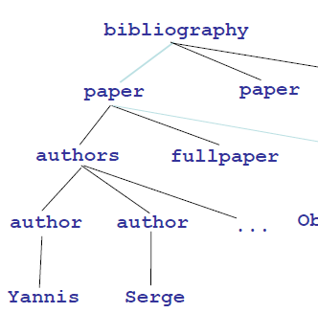
Tree Structure
<bibliography>
<paper >
<authors>
<author>Yannis</author>
<author>Serge</author>
...
</authors>
<fullpaper>Object Fusion</fullpaper>
...
</paper>
</bibliography>

Slide 29
XML parsing in Python
BeautifulSoup(markup,"xml")
  Must install the lxml parser first (pip install lxml)
  No support for XPATH
Other “real ” XML modules:
  xml.dom.* modules
  xml.sax.* modules – an event-based API meant to parse huge documents "on the fly" without loading them wholly into memory
  xml.parser.expat – a direct, low level API to the C-based expat parser
  xml.etree.ElementTree - provides a lightweight Pythonic API that is easy to work with, limited support for XPATH. We use it in this class for is simplicity.
  lxml – provides ElementTree API and has full support for XPATH. My personal favorite.

Slide 30
ET Tutorial
http://docs.python.org/2/library/xml.etree.elementtree.html
Demo the use of Firefox extension XPath Checker

Slide 31
JSON:
JavaScript Object Notation
{"employees": [
{ "firstName":"John" , "lastName":"Doe" },
{ "firstName":"Anna" , "lastName":"Smith" },
{ "firstName":"Peter" , "lastName":"Jones" }
]
}
JSON syntax is a subset of JavaScript object notation
  Data is in name/value pairs
  Data is separated by commas
  Curly braces hold objects
  Square brackets hold arrays
Filename extension ".json"
MIME type (e.g. HTTP header) application/json

Slide 32
JSON:
JavaScript Object Notation
Light-weight interchange format for storing and exchanging text information
  Designed for saving/loading data to/from Javascript apps
  Because of this similarity, instead of using a parser, a JavaScript program can use the built-in eval() function
Similar to XML but smaller, easier and faster to parse
Self-describing, language-independent
Popular and widely available:
  JSON parsers and generators exist for many programming languages and platforms
http://www.w3schools.com/json/json_intro.asp

Slide 33
XML vs JSON
JSON is a lot like XML
  JSON is plain text
  JSON is "self-describing" (human readable)
  JSON is hierarchical (values within values)
  JSON can be parsed by JavaScript
  JSON data can be transported using AJAX (client, async web apps)
JSON is very different from XML
  No end tags
  Shorter
  Quicker to read and write
  Can be parsed using built-in JavaScript eval()
  Uses arrays
  No reserved words

Slide 34
JSON and Python
Default support:
import json
Encoding Python objects & pretty printing
  json.dumps(…)
Decoding JSON
  json.loads(…)
http://docs.python.org/2/library/json.html
http://pymotw.com/2/json/

Slide 35
Using the json module
import json
data = [ { 'a':'A', 'b':(2, 4), 'c':3.0 } ]
print 'DATA:', repr(data) # repr: string version of an object
data_string = json.dumps(data) # dumps: create JSON string
print 'JSON:', data_string
Values are encoded in a manner very similar to Python’s repr() output.
$ python json_simple_types.py
DATA: [{'a': 'A', 'c': 3.0, 'b': (2, 4)}]
JSON: [{"a": "A", "c": 3.0, "b": [2, 4]}]
Source: http://pymotw.com/2/json/

Slide 36
Using the json module
Encoding, then re-decoding may not give exactly the same type of object.
import json
data = [ { 'a':'A', 'b':(2, 4), 'c':3.0 } ]
data_string = json.dumps(data)
print 'ENCODED:', data_string
decoded = json.loads(data_string)
print 'DECODED:', decoded
print 'ORIGINAL:', type(data[0]['b'])
print 'DECODED :', type(decoded[0]['b'])
To create JSON, strings are converted to unicode and tuples become lists.
$ python json_simple_types_decode.py
ENCODED: [{"a": "A", "c": 3.0, "b": [2, 4]}]
DECODED: [{u'a': u'A', u'c': 3.0, u'b': [2, 4]}]
ORIGINAL: <type 'tuple'>
DECODED : <type 'list'>
Source: http://pymotw.com/2/json/

Slide 37
Many useful options to dumps and loads: sort_keys, indent
data = [ { 'a':'A', 'b':(2, 4), 'c':3.0 } ]
print 'JSON:', json.dumps(data)
sort_keys
print 'SORT:', json.dumps(data, sort_keys=True)
JSON: [{"a": "A", "c": 3.0, "b": [2, 4]}] # random
SORT: [{"a": "A", "b": [2, 4], "c": 3.0}] # sorted
indent
print 'INDENT:', json.dumps(data, sort_keys=True, indent=2)
INDENT: [
{
"a": "A",
"b": [
2,
4
],
"c": 3.0
}
]

Slide 38
simplejson
The simpleson module provide the same functionality as the json module, only a lot faster
To install:
pip install simplejson
To use:
import simplejson as json

Slide 39
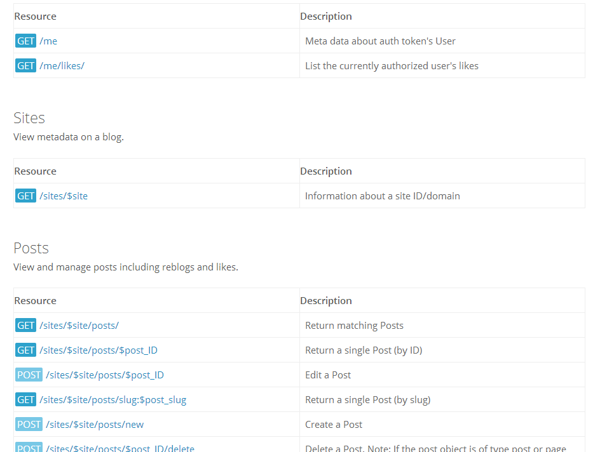
Web services often use APIs
(API: Application Programming Interface)
Input: URL with query parameters
HTTP GET (or POST) the URL
Output: JSON object
WordPress Blog API
Source: http://developer.wordpress.com/docs/api/

Slide 40
An acronym you should know:
Representational State Transfer (REST) APIs
Uniform client–server interface
  Uniform interface separates clients from servers.
  Clients are not concerned with data storage (portability)
  Servers are not concerned with the user interface (simplicity, scalability)
Stateless
  No client context being stored on the server between requests.
  Each client request has all information necessary to service the request
Cacheable
  Clients can cache responses.
  Responses define themselves as cacheable or not, to prevent clients reusing stale data
Layered system
  A client can't tell if the connection is direct or indirect
Code on demand (optional)
  Servers can temporarily extend functionality of a client by the transfer of executable code.
  e.g. Javascript
Most HTTP-based Web services (and certainly the simple ones)
are REST APIs
http://en.wikipedia.org/wiki/Representational_state_transfer

Slide 41
WordPress API: Find all posts for a given blog
{
"found": 894,
"posts": [
{
"ID": 20243,
"author": {
"ID": 47411601,
"email": false,
"name": "Ben Huberman",
"nice_name": "benhuberman",
"URL": "",
"avatar_URL": "http:\/\/0.gravatar.com\/avatar\/663dcd498e8c5f255bfb230a7ba07678?s=96&d=retro",
"profile_URL": "http:\/\/en.gravatar.com\/benhuberman"
},
"date": "2013-09-20T16:00:41+00:00",
"modified": "2013-09-19T18:00:57+00:00",
"title": "Unbound Creativity: Art Blogs on WordPress.com",
"URL": "http:\/\/en.blog.wordpress.com\/2013\/09\/20\/unbound-art-blogs\/",
"short_URL": "http:\/\/wp.me\/pf2B5-5gv",
"content": "<p>From painting and photography... \n",
"excerpt": "<p>From painting and photography to performance art, the art scene on\n",
"slug": "unbound-art-blogs",
"status": "publish",
Request: https://public-api.wordpress.com/rest/v1/sites/en.blog.wordpress.com/posts/?pretty=1

Slide 42
Content Types used by Web Services
Mainly two types:
  JSON-based
    Facebook, Twitter, Yelp, most Google web services
  XML-based
    Some Bing, Google web services, eBay
Most Web Services are JSON-based now
  Some provide both JSON and XML format APIs
Industry has been moving away from XML to JSON:
  XML is overkill
  XML is not easy to work with

Slide 43
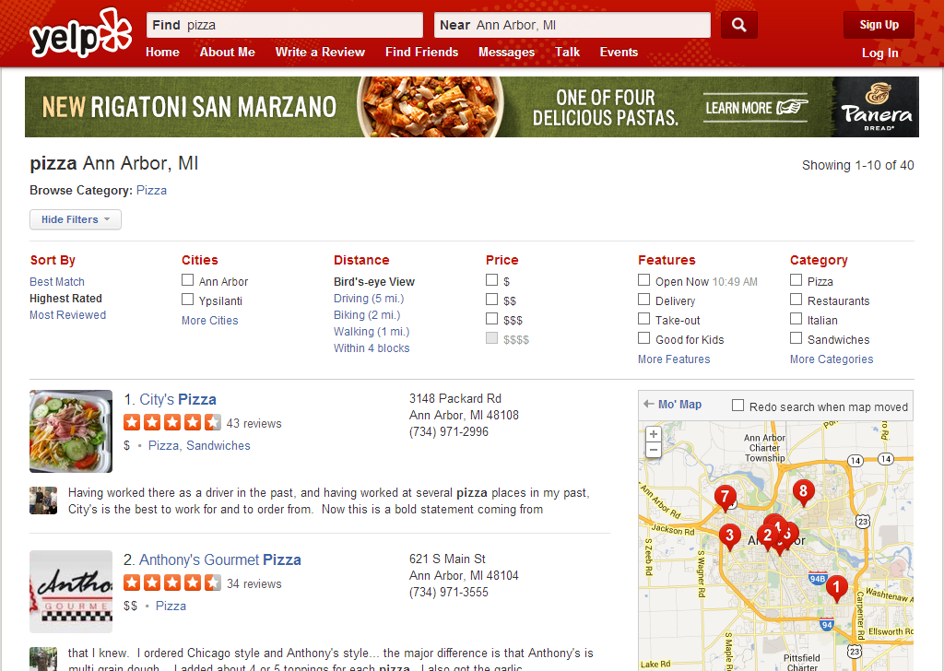
Yelp API
JSON based
Documentation:
http://www.yelp.com/developers/documentation/v2/overview
Needs authentication
Example code in Resources/Week 3:
  yelp_api_example.py

Slide 44
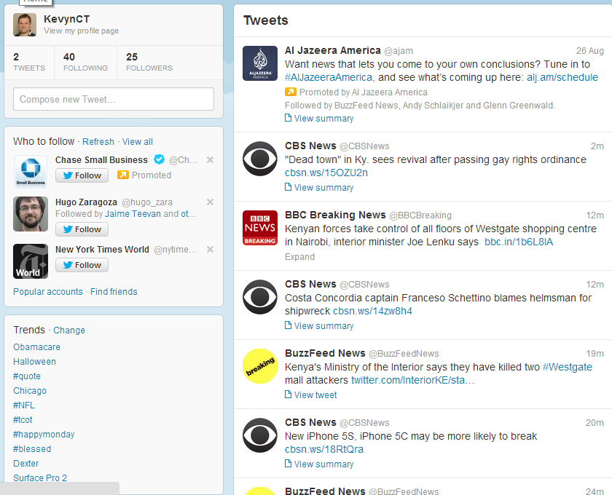
Twitter API
JSON based
Documentation:
https://dev.twitter.com/docs/api/1.1
Twitter API also needs authentication
Example code in Resources/Week 3:
  twitter_api_example.py

Slide 45
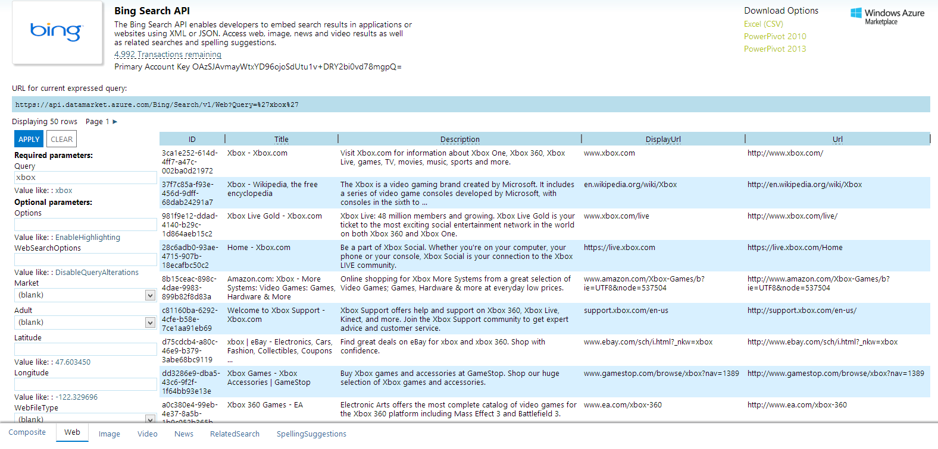
Bing Search API
JSON or XML
Requires API key registration, authentication

Slide 46
What you should know
The basics of how HTTP works and how to fetch Web content using urllib2
How to take an HTML response from urllib2 and parse it using BeautifulSoup
How to parse XML files with ElementTree API
JSON and how to read/write it
Become familiar with what's available via Web services and REST APIs

Slide 47
Resources
Chapter 12, 13, Severance
HTTP tutorial
  http://www.jmarshall.com/easy/http/
Urllib2
  http://docs.python.org/2/howto/urllib2.html
  Review of HTML elements
    http://www.w3schools.com/html/html_elements.asp
BeautifulSoup
  http://www.crummy.com/software/BeautifulSoup/bs4/doc/
ElementTree
  https://docs.python.org/2/library/xml.etree.elementtree.html
json module tutorial:
  http://www.doughellmann.com/PyMOTW/json/

Slide 48
Lab Time!

