Slide 1
Querying data in a SQL Database
Winter 2015
Instructor: Dr. Yuhang Wang
Some slides from: Kevyn Collins-Thompson

Slide 2
SI 601 Data Manipulation: Class Schedule (Some details may change)
Date | Topic | Assignments Due (before start of class)
Jan 13 | Course introduction Basics of Programming with Python | Install software as described in welcome email
Jan 20 | Text Encodings Extracting Patterns from Text with Regular Expressions | Lab 1, Homework 1
Jan 27 | Fetching and Parsing Web content: HTML, XML, JSON, Web APIs. | Lab 2, Homework 2 1-page Project Proposal Due
Feb 3 | Querying data in a SQL Database | Lab 3, Homework 3
Feb 10 | Large-scale data manipulation with MapReduce and Hadoop | Lab 4, Homework 4
Feb 17 | Advanced topics | Lab 5, Homework 5
Feb 24 | Course Review, Final project presentations | Lab 6, Homework 6 Project slides, Project report

Slide 3
Today's Class Roadmap
Overview of database technologies
Structured Query Language (SQL) Basics
Some more advanced SQL operations
SQL support in Python
How to produce graph visualization in Python?
pydot
Graphviz

Slide 4
What is a database? And why are they fascinating and exciting?
A collection of information organized to permit efficient retrieval
Phone book
U.S. Census data
Bibliographic databases
Full-text index
Customer records database
We're going to talk about relational databases
That capture, well, relationships between records

Slide 5
The basic unit of a database is a record
Each record consists of fields of different types
Rows = records, columns = fields
A collection of records forms a table.
"Students" table
ID | Name | Phone | Grade | Program
2403 | Fred Smith | 1-712-555-2321 | 92 | HCI
9832 | Ana Prinz | 1-657-555-9231 | 84 | HCI
9932 | Andrea Martin | 1-432-213-9990 | 99 | IAR
Fields: ID (integer), Name (string), Phone (phone #), Grade (real), Program (string)

Slide 6
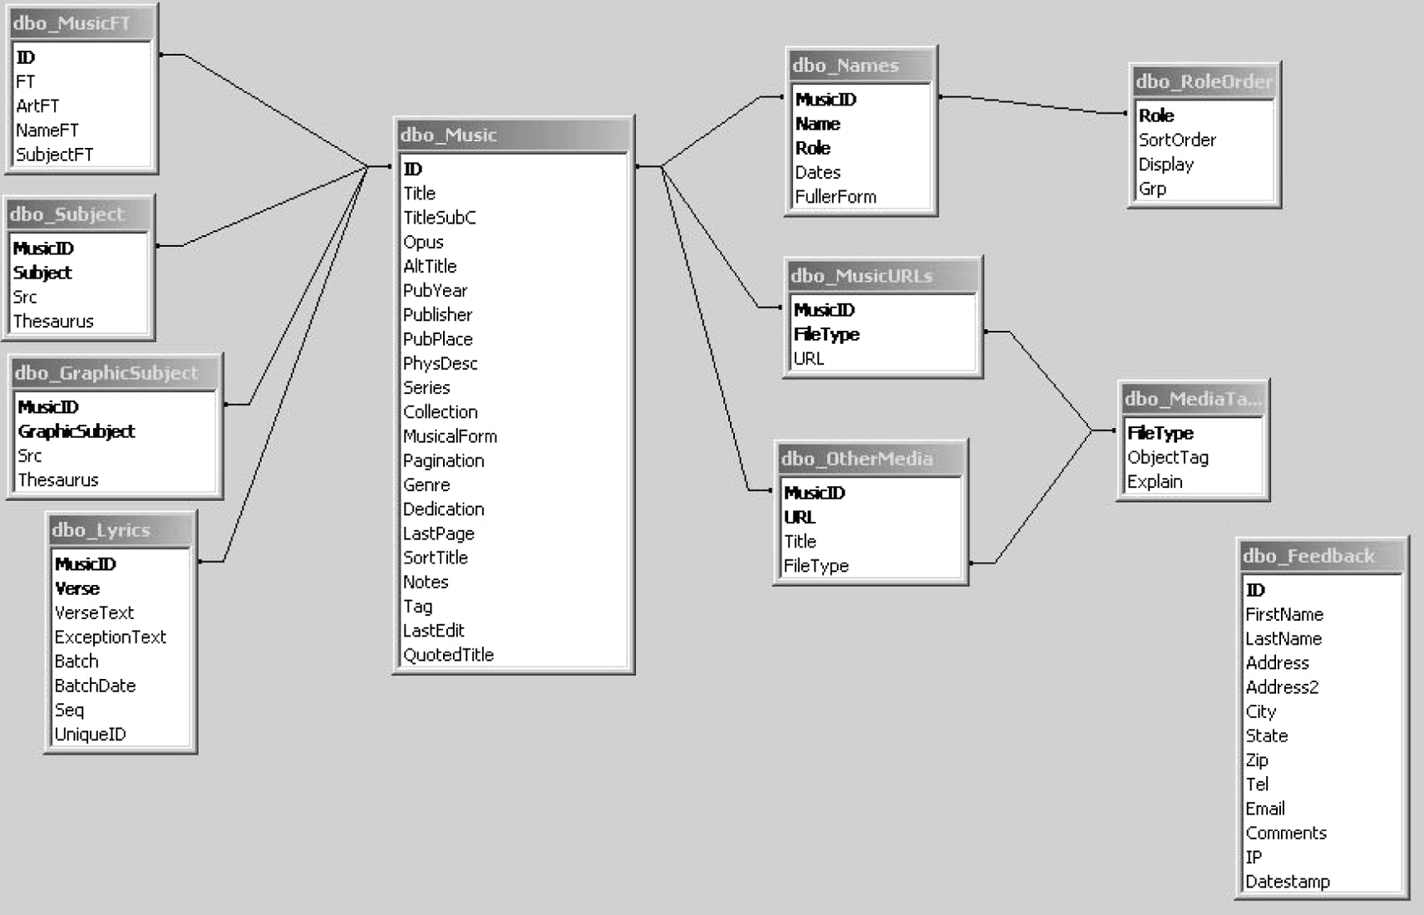
Each table record typically has a special value called a primary key that uniquely identifies the record
Example: Music library
Primary key: Song's unique 10-digit #

Slide 7
The primary key can be used to connect to records in other tables

Slide 8
Example: Relational database of the Maine Music Box: an interactive, multimedia digital music library
The Music ID is a key shared among multiple tables
Source: http://www.emeraldinsight.com/journals.htm?articleid=861431&show=html

Slide 9
Why use a database?
Capture relationships between entities
Songs, Artists, Albums, …
Large data sets where only some variables are needed per access
SQL queries, caching
Large data set sharing across users
Data federation across DBs
Fast query lookup, little other processing
Indexing
Multiple, simultaneous updates to data
Transaction support
On-going data evolution
Journaling, archiving
Web interfaces to data (especially dynamic)
Consistent data query/retrieval model, external schemas

Slide 10
Relational Databases
Popular relational database management systems (RDBMS)
MySQL (open source)
PostgreSQL (open source)
SQL/Server (Microsoft, proprietary)
Oracle (proprietary)
Sybase (proprietary, now part of SAP)
Limitations of RDBMS
Limited abilities with unstructured data (text)
Relationships may not fit into the table paradigm well
e.g. entity-relationship graphs
Gets expensive (software & hardware) when you have hundreds of terabytes of data
Fixed schema, difficult to add columns

Slide 11
Other revolutionary database technologies
'NoSQL'
Cassandra
HBase
MongoDB
MarkLogic
SQL shell for MapReduce:
Hive
Hosted solutions:
Amazon Redshift

Slide 12
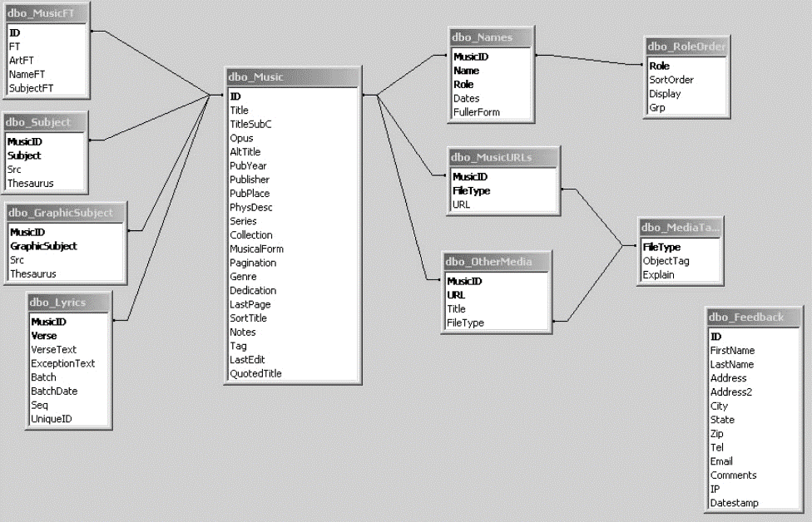
What is a typical RDBMS?
A database is a collection of tables and relations
Tables are two-dimensional
Rows: observations /records
Columns: variables
Special columns: keys that create relations between tables
Records retrieved using a query language (e.g. SQL)
Little further analysis before returning results
Database server: containing possibly many databases
Financial data: relational
Web and scientific computing data: often non-relational

Slide 13
How is data in a relational database accessed? Most popular: Structured Query Language (SQL)
Structured Query Language is known as:
Its acronym, SQL, or
SEQUEL, the name of the original version of SQL
SEQUEL was developed by IBM in the mid-1970s.
Supported by all major database systems
Various SQL dialects used for large-scale computation frameworks
e.g. HiveQL, Cloudera Impala, Microsoft SCOPE
A great SQL tutorial is at http://www.w3schools.com/sql/default.asp

Slide 14
What operations might we want to perform on a database?
Find and extract records that meet certain criteria
ID | Name | Phone | Grade | Program
2403 | Fred Smith | 1-712-555-2321 | 92 | HCI
9832 | Ana Prinz | 1-657-555-9231 | 84 | HCI
9932 | Andrea Martin | 1-432-213-9990 | 99 | IAR
Name, Grade, Program
Grade > 90
Name | Grade | Program
Fred Smith | 92 | HCI
Andrea Martin | 99 | IAR

Slide 15
What operations might we want to perform on a database?
Group records by field, then calc something on each group
ID | Name | Phone | Grade | Program
2403 | Fred Smith | 1-712-555-2321 | 92 | HCI
9832 | Ana Prinz | 1-657-555-9231 | 84 | HCI
9932 | Andrea Martin | 1-432-213-9990 | 99 | IAR
Group by program
Calc average Grade
Grade | Program
88 | HCI
99 | IAR

Slide 16
What operations might we want to perform on a database?
Join records in two different tables by a key field
ID | Name | Phone | Grade | Program
2403 | Fred Smith | 1-712-555-2321 | 92 | HCI
9832 | Ana Prinz | 1-657-555-9231 | 84 | HCI
9932 | Andrea Martin | 1-432-213-9990 | 99 | IAR
ID | Club
2403 | Chess
9932 | DataDive
54325 | Camping
Join by ID
ID | Name | Phone | Grade | Program | Club
2403 | Fred Smith | 1-712-555-2321 | 92 | HCI | Chess
9932 | Andrea Martin | 1-432-213-9990 | 99 | IAR | DataDive

Slide 17
What operations might we want to perform on a database?
Operation | SQL keyword
Filter and extract records | SELECT, DISTINCT
Group records by key | GROUP BY
Sort records | ORDER BY
Merge records from different tables | JOIN
Add, delete table | CREATE TABLE, DROP TABLE
These types of operations come up again and again in many data
manipulation frameworks

Slide 18
The parts of an example SQL SELECT statement
SELECT [Columns] FROM [TABLES] WHERE [Filter condition] ORDER BY [Sort column(s)]

Slide 19
SQL syntax is English-like
"Students" table
SELECT fields: what columns will be retrieved?
FROM tables: which table contains the column data?
ID | Name | Phone | Grade | Program
2403 | Fred Smith | 1-712-555-2321 | 92 | HCI
9832 | Ana Prinz | 1-657-555-9231 | 84 | HCI
9932 | Andrea Martin | 1-432-213-9990 | 99 | IAR
SELECT ID, Grade FROM Students;
ID | Grade
2403 | 92
9832 | 84
9932 | 99

Slide 20
DISTINCT
"Students" table
Eliminating duplicate rows on the output…
SELECT DISTINCT Program FROM Students;
ID | Name | Phone | Grade | Program
2403 | Fred Smith | 1-712-555-2321 | 92 | HCI
9832 | Ana Prinz | 1-657-555-9231 | 84 | HCI
9932 | Andrea Martin | 1-432-213-9990 | 99 | IAR
Program
HCI
IAR

Slide 21
WHERE Clause
Reducing the output based on specified conditions …
SELECT Name FROM Students WHERE Grade >= 90.0;
ID | Name | Phone | Grade | Program
2403 | Fred Smith | 1-712-555-2321 | 92 | HCI
9832 | Ana Prinz | 1-657-555-9231 | 84 | HCI
9932 | Andrea Martin | 1-432-213-9990 | 99 | IAR
Name
Fred Smith
Andrea Martin

Slide 22
Comparison Operators
Equals: =
Not equals: <>
Greater than: >
Greater than or equal: >=
Less than: <
Less than or equal: <=
Within a list of values: IN
Logical: NOT
Within a range: BETWEEN

Slide 23
The “In” Thing.. Or Not
SELECT Name
FROM Students
WHERE State IN (“PA”, “MI”, “CA”);
SELECT Name
FROM Students
WHERE State NOT IN (“NJ”, “NM”, “NY”);

Slide 24
BETWEEN
"Students" table
SELECT ID, Name, Phone FROM Students
WHERE ID BETWEEN 1000 AND 9000;
ID | Name | Phone | Grade | Program
2403 | Fred Smith | 1-712-555-2321 | 92 | HCI
9832 | Ana Prinz | 1-657-555-9231 | 84 | HCI
9932 | Andrea Martin | 1-432-213-9990 | 99 | IAR
ID | Name | Phone
2403 | Fred Smith | 1-712-555-2321
But beware: Different databases define BETWEEN inconsistently: some define endpoints as inclusive, some exclusive, and some [inclusive, exclusive)

Slide 25
Wildcards and LIKE
The LIKE keyword is used in place of the = sign when you use wildcard characters.
The underscore character (_) is a single character substitution
The percent character(%) is a multi-character substitution
SELECT Name FROM Students
WHERE Name LIKE “A%”;
Name
Ana Prinz
Andrea Martin

Slide 26
Using LIKE & “_”
SELECT Name FROM Students
WHERE Name LIKE “M_r%”;
Results: Mark, Marion, Mork

Slide 27
NULL Means Nothing
"Students" table
A NULL character means that nothing has been entered. This is different from
SELECT ID, Name FROM Student WHERE Program IS NULL;
ID | Name | Phone | Grade | Program
2403 | Fred Smith | 1-712-555-2321 | 92 | HCI
9832 | Dana Prinz | 1-657-555-9231 | 84
9932 | Andrea Martin | 1-432-213-9990 | 99 | IAR
ID | Name
9832 | Dana Prinz

Slide 28
ORDER BY Clause
SELECT Name
FROM Students
ORDER BY Name DESC; # DESC = descending order
Results: Zack, Terry, Patrick, Melissa, April
SELECT Name
FROM Students
ORDER BY Name;
Results: April, Melissa, Patrick, Terry, Zack

Slide 29
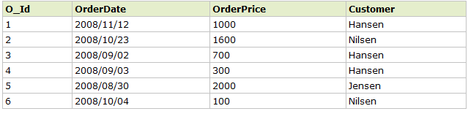

Grouping/Aggregation Functions
SELECT Customer, SUM(OrderPrice) FROM Orders GROUP BY Customer
http://www.w3schools.com/sql/sql_groupby.asp

Slide 30
The HAVING clause
SELECT Customer, SUM(OrderPrice) as OrderSum FROM Orders GROUP BY Customer HAVING OrderSum >= 2000
Customer | OrderSum
Hansen | 2000
Jensen | 2000
http://www.w3schools.com/sql/sql_having.asp

Slide 31
Aggregation Functions
Counting number of rows COUNT
Adding the values in a column SUM
Averaging the values in a column AVG
Finding the maximum value in a column MAX
Finding the minimum value in a column MIN

Slide 32
Examples
SELECT Count(*)
FROM Students
WHERE Program = “HCI”;
SELECT Sum(Amount)
FROM SalesReceipt;
SELECT Max(Grade)
FROM Assignments;

Slide 33
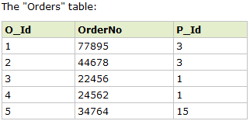
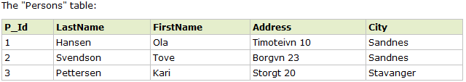
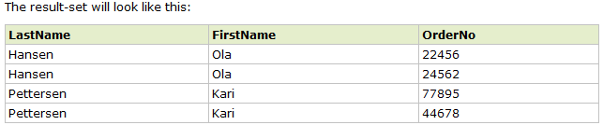
(INNER) JOIN
SELECT Persons.LastName, Persons.FirstName, Orders.OrderNo FROM Person JOIN Orders ON (Persons.P_Id=Orders.P_Id) ORDER BY Persons.LastName

Slide 34
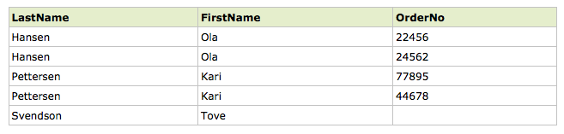
LEFT (OUTER) JOIN
SELECT Persons.LastName, Persons.FirstName, Orders.OrderNo FROM Person LEFT OUTER JOIN Orders ON (Persons.P_Id=Orders.P_Id) ORDER BY Persons.LastName
http://www.w3ctutorial.com/sql-advanced/sql_join_left

Slide 35
Quiz
In the previous example, what kind of SQL query can we write to find customers with no orders?

Slide 36
Python database support: sqlite
Python comes “batteries included”
sqlite3 is already included in Python 2.7.x official distribution
No need to install anything. “import sqlite3”
sqlite3 documentation: http://docs.python.org/2/library/sqlite3.html

Slide 37
What is SQLite?
A self-contained, serverless, zero-configuration, transactional SQL database engine.
The most widely deployed SQL database engine in the world. [According to http://www.sqlite.org/]
Packaged as a C library
Doesn’t require a separate server process
Allows accessing the database using a nonstandard variant of the SQL query language. Some applications can use SQLite for internal data storage.
Reference: http://docs.python.org/2/library/sqlite3.html

Slide 38
Using Sqlite
Create a connection to the database
Create a cursor object and use it to execute SQL commands

Slide 39
Step 1. Using sqlite connection object
import sqlite3
Option 1: Opening/creating a database on disk
conn = sqlite3.connect('/path/to/example.db')
Option 2: Creating a database in memory
Fast transactions on more limited-size datasets
conn = sqlite3.connect(':memory:')

Slide 40
Step 2: Using the sqlite cursor object to write changes to a database
c = conn.cursor()
# Create table
c.execute('CREATE TABLE stocks
(date text, trans text, symbol text, qty real, price real)')
# Insert one row of data
c.execute('INSERT INTO stocks VALUES ('2006-01-05','BUY','RHAT',100,35.14)')
# Insert several rows of data
purchases = [('2006-03-28', 'BUY', 'IBM', 1000, 45.00),
('2006-04-05', 'BUY', 'MSFT', 1000, 72.00),
('2006-04-06', 'SELL', 'IBM', 500, 53.00),
]
c.executemany('INSERT INTO stocks VALUES (?,?,?,?,?)', purchases)
# Save (commit) the changes
conn.commit()
# We can also close the connection if we are done with it.
# Just be sure any changes have been committed or they will be lost.
conn.close()
Source: http://docs.python.org/2/library/sqlite3.html

Slide 41
Creating and deleting tables and records
Creating a table
CREATE TABLE customer(C_CUSTKEY INT, C_NAME TEXT)
cur.executemany("INSERT INTO customer VALUES(?, ?, ?, ?, ?, ?, ?, ?)", lot)
Deleting a table
DROP TABLE IF EXISTS customer
SQL Datatypes (sqlite 3)
NULL. The value is a NULL value.
INTEGER. A signed integer, stored in 1, 2, 3, 4, 6, or 8 bytes depending on the magnitude of the value.
REAL. Floating point value, stored as an 8-byte IEEE floating point number.
TEXT. The value is a text string, stored using the database encoding (UTF-8, UTF-16BE or UTF-16LE).
BLOB. The value is a blob of data, stored exactly as it was input.

Slide 42
Retrieving data with SELECT statements in sqlite
Use the cursor as an iterator
results = c.execute('SELECT * FROM stocks ORDER BY price')
for row in results:
print row
Call results.fetchone()to retrieve a single matching row.
Call results.fetchall()to retrieve a list of the matching rows.

Slide 43
Other Python Packages for Database Connection
MySQLdb
MySQLdb is an interface to the popular MySQL database server for Python.
http://pypi.python.org/pypi/MySQL-python/1.2.4
cx_Oracle
Python interface to Oracle database
http://pypi.python.org/pypi/cx_Oracle

Slide 44
Graphviz and pydot
Graphviz is open source graph visualization software. http://www.graphviz.org/
pydot is a Python interface to Graphviz's Dot language. http://code.google.com/p/pydot/
To install it , type in a terminal: pip install pydot You may need to add sudo at the beginning

Slide 45
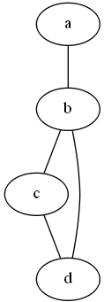
Graph (network) creation with pydot Graph visualization with Graphviz
graph = pydot.Dot(graph_type='graph', charset="utf8")
edge = pydot.Edge('a', 'b')
graph.add_edge(edge)
edge = pydot.Edge('b', 'c')
graph.add_edge(edge)
edge = pydot.Edge('b', 'd')
graph.add_edge(edge)
edge = pydot.Edge('c', 'd')
graph.add_edge(edge)
graph.write(graph_output_name)
.dot file
graph G {
charset="utf8"
a -- b;
b -- c;
b -- d;
c -- d;
}
Result
Reference: https://code.google.com/p/pydot/

