Slide 1
Large-scale Data Manipulation on Hadoop Clusters: MapReduce and Pig
Winter 2015
Instructor: Dr. Yuhang Wang
Some slides from: Kevyn Collins-Thompson, Danny Wu

Slide 2
Agenda
What is big data?
Leading platform: Hadoop
MapReduce
Hadoop Distributed File System (HDFS)
Hardware Architecture
Programming
Python mrjob
Apache Pig

Slide 3
What is big data?
Volume
Velocity
Variety

Slide 4
What is big data?
Volume
Terabytes to Petabytes
Challenges and opportunities
Velocity
Growing exponentially
Both incoming and outgoing
Variety
Various types and sources of data
Documents, databases
Images, voice, videos, sensors, GSP location data, …
Notes:
Terabytes – 10¹²
Petabytes – 10¹⁵

Slide 5
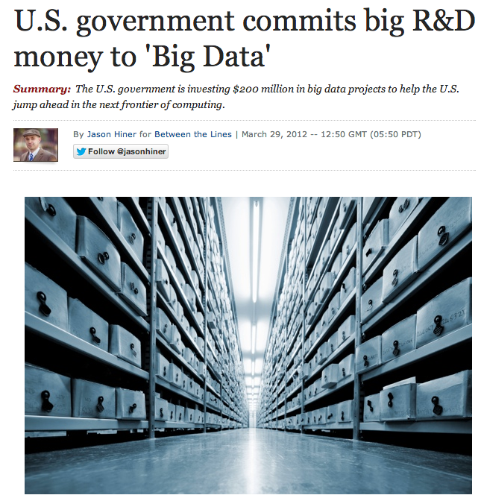

Slide 6

How to deal with the big wild?
Part 2

Slide 7
Problem: Growing datasets like the Web
20 billion Web pages x 20 Kb > 400 terabytes
Computer can read 35Mb/sec from hard drive
Four months to scan the Web!
Hundreds of hard drives needed
Source: http://static.googleusercontent.com/media/research.google.com/en/us/pubs/archive/32721.pdf

Slide 8
Solution:
Wouldn't it be great if there were a general-purpose programming language and set of core libraries that handled all of that for us?
Well, actually…
Buy 1,000 computers
Have each computer scan its own piece of the 400 terabyte dataset
Done in < 3 hours
New issues:
1. This requires programming work
Computers must communicate and coordinate
Load balancing
Network and disk optimization
How to recover from computer failure (1000 CPU = 1 per day)
How to optimize? Debug?
Data locality
2. You need to repeat this for every type of problem you want to solve.
Source: http://static.googleusercontent.com/media/research.google.com/en/us/pubs/archive/32721.pdf

Slide 9
Divide and conquer
A technique we use everyday!
Split the task in sub-tasks
Put resources to handle subtasks in parallel
Combine the results
This is a simple example of distributed computing
We are distributing the workload across different CPUs

Slide 10


A Leading Open-Source Platform for Distributed Computing: Hadoop
Legend has it that the name ‘hadoop’ was invented by Doug Cutting’s toddler son.

Slide 11

Leading framework: Hadoop
A software framework for distributed computing
Take 100 'commodity' machines that don't share memory or disk storage
Turns commodity machines into a cluster
Redundant and Reliable
Powerful and Scalable
Cost-effective
Java-based APIs to Hadoop services
But calling these directly is tedious and error-prone so people use programming languages like pig to perform Hadoop jobs
Batch mode
Notes:
Commodity does not mean consumer-class, but just not specialized enterprise machines

Slide 12


Leading framework: Hadoop
Google File System (GFS)
Hadoop Distributed File System (HDFS)
http://research.google.com/archive/gfs.html
MapReduce
Hadoop MapReduce
http://research.google.com/archive/mapreduce.html
BigTable
Hadoop HBase
http://research.google.com/archive/bigtable.html
Originally developed at Google. See paper links.
Notes:
From Google white papers

Slide 13
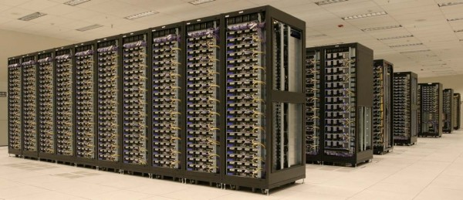
Leading framework: Hadoop
Major components
MapReduce (algorithm)
A programming model for large-scale data processing
Hadoop Distributed File System (data storage)
Stores and aggregates data on cluster machines
Hardware Architecture
Networked machines
Cluster of machines running Hadoop at Yahoo! (Source: Yahoo!) via
http://www.michael-noll.com/tutorials/running-hadoop-on-ubuntu-linux-multi-node-cluster/

Slide 14
A typical MapReduce problem
This framework is the same for all problems:
We just change Map and Reduce steps to fit the problem
Read a bunch of data (set of records)
Map: for each record,
Extract something you care about.
Sort and group the extracted records
Reduce: For all groups:
Summarize, filter, transform, aggregate
Collapse the group into a result row
Write out the results

Slide 15
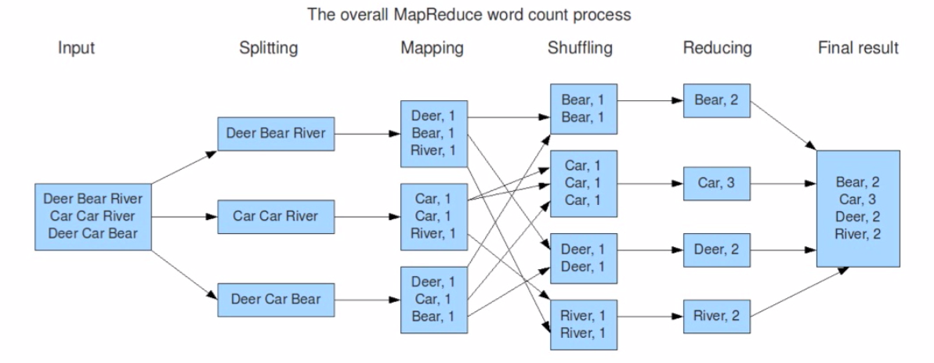
MapReduce – Word Count
Copy data between nodes based on the keys
Slide from Basic Introduction to Apache Hadoop
http://www.youtube.com/watch?v=OoEpfb6yga8

Slide 16
Assumptions of MapReduce
The task can be broken into multiple pieces
Pieces can be processed in parallel with minimal communication between pieces
Results of each piece can be combined in the end to produce final result

Slide 17

Questions?

Slide 18
Quiz
Is using a reducer necessary?
No, if there are no sorting or grouping tasks
Example: change all words into upper case
Shuffle seems computationally heavy; how to reduce the loading?
A combiner before shuffling

Slide 19
MapReduce – Word Count
Car, 2
Car, 1
Car, 2
River, 1
Slide from Basic Introduction to Apache Hadoop
http://www.youtube.com/watch?v=OoEpfb6yga8
Notes:
If your algorithm involves computing aggregates of any sort, chances are you can use a Combiner in order to perform some kind of initial aggregation before the data hits the reducer. The MapReduce framework runs combiners intelligently in order to reduce the amount of data that has to be written to disk and transfered over the network in between the Map and Reduce stages of computation.

Slide 20
Hadoop Distributed File System (HDFS)
Also need a mechanism to support the process at the data level.
HDFS is designed to be…
Scalable in storage and I/O bandwidth
Highly fault-tolerant (check periodically)
Optimized for commodity machines
Typical Settings:
Save a file into blocks (128MB)
Replicate 3 times
Notes:
http://www.youtube.com/watch?v=1_ly9dZnmWc

Slide 21
Hadoop Distributed File System (HDFS)
Client
Name Node
Namespace metadata
Know where the data pieces are
Single point of availability failure
Data Node
Data Node
Data Node
Data Node
Responsible for actual read and write
Notes:
Secondary name node is not a demon. It pull the metadata from master name node and save it as a file image, then feed back to the master node fro persistence.

Slide 22
Hadoop Distributed File System (HDFS)
Client
Name Node
1
2
3
4
1
2
3
4
1
2
1
2
2
1
3
4
3
4
3
4
Hadoop Tutorial: Intro to HDFS
http://www.youtube.com/watch?v=ziqx2hJY8Hg
Notes:
Secondary name node is not a demon. It pull the metadata from master name node and save it as a file image, then feed back to the master node fro persistence.
Tolerance = 2 nodes

Slide 23
Hadoop MapReduce v1 Architecture
Job Tracker
Name Node
Task
Tracker
Task
Tracker
Task
Tracker
Data Node
Data Node
Data Node

Slide 24
Hadoop MapReduce v1 Architecture
Job Tracker
Name Node
Name Node2

Slide 25
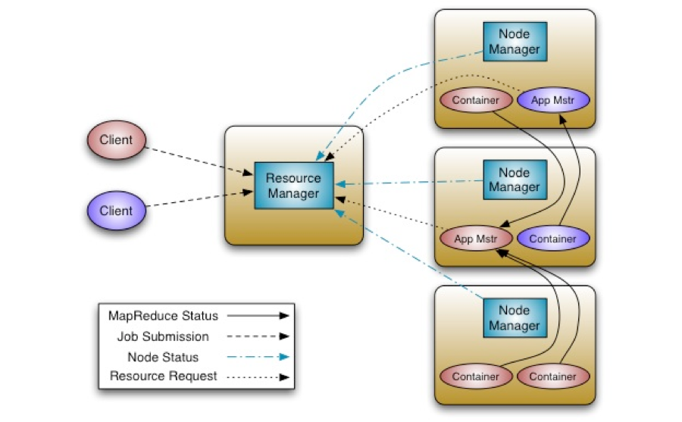
Hadoop MapReduce v2 Yarn Architecture
http://hortonworks.com/blog/apache-hadoop-yarn-concepts-and-applications/

Slide 26
How to write data processing code on Hadoop?
Plain Java MapReduce
In any language with Hadoop Streaming (http://hadoop.apache.org/docs/r1.1.1/streaming.html)
Pig (http://pig.apache.org/)
Hive (http://hive.apache.org/)
Java with Cascading (http://www.cascading.org/)
Scala with Scalding (https://github.com/twitter/scalding)
Python with mrjob (https://github.com/Yelp/mrjob)
Spark with Scala, Java and Python API

Slide 27
Pig vs Hive
Pig Latin is a programming language for describing data manipulation jobs
Think of your data like a big table
You can LOAD, FILTER, GROUP, etc rows in your table
Semi-structured data e.g. log files
Hive enables Hadoop to operate as a data warehouse.
It superimposes structure on data in HDFS
Good for static structured data
Permits SQL-like queries over the data
Like pig, can write custom modules

Slide 28
Introduction to MRjob
MRjob (https://github.com/Yelp/mrjob) is a Python 2.5+ package that helps you write and run Hadoop Streaming jobs.
Very easy to use
Reduces 90% of lines of code compared to Java
Same code can run on locally on one machine, or on a Hadoop cluster with 1000 nodes, or on Amazon EMR
Documentation: http://packages.python.org/mrjob/

Slide 29
The Fladoop Cluster at UM
http://caen.github.io/hadoop/
As of Feb 10, 2015, it is running
CDH 5.2
Hadoop 2.5 Yarn
Pig 0.12.0
Spark 1.1
mrjob development version

Slide 30
Going over code examples
mr_wordcount.py
mr_cityfilter.py
mr_citybusinesscount.py
mr_avg_stars_per_category.py
mr_good_business_per_category.py
pig_examples.pig
Word count in Pig
Hortonworks Pig tutorial
http://hortonworks.com/hadoop-tutorial/how-to-use-basic-pig-commands/

