Slide 1
Introduction to Apache Spark and Machine Learning Algorithms
Winter 2015
Instructor: Dr. Yuhang Wang
Some slides from: Kevyn Collins-Thompson

Slide 2
Agenda for Today
Introduction to Apache Spark
What is Spark? Why Spark?
How does Spark code run on clusters?
Basic Spark concepts
Spark code examples
Class Evaluation (10 minutes)
Introduction to Machine Learning algorithms
10-min Break
Lab Time

Slide 3
One time Office Hour change
Original time: 5:30pm – 7:30 on Feb 18
New time: 5:30pm – 7:30 on Feb 20

Slide 4
Project and lab/homework6
Project report and slides are due at 5pm on Feb. 24, 2015. No late days allowed.
Lab/homework 6 also due at 5pm on Feb. 24, 2015. No Late days allowed.
Wouldn’t you want to present your project finding to the whole class? Send me an email if you’d like to do the optional project presentation on Feb 24.

Slide 5
Spark - Fast and general engine for large-scale data processing
Up to 100 times faster than Hadoop MapReduce
Written in Scala, providing Scala, Java and Python APIs
Supports both batch mode and real-time data stream processing
Write once, run everywhere
Spark runs on Hadoop, Mesos, standalone, or in the cloud. It can access diverse data sources including HDFS, Cassandra, HBase, S3.
Spark has over 465 contributors in 2014, making it the most active project in the Apache Software Foundation and among Big Data open source projects.
Sources: https://spark.apache.org, http://en.wikipedia.org/wiki/Apache_Spark

Slide 6
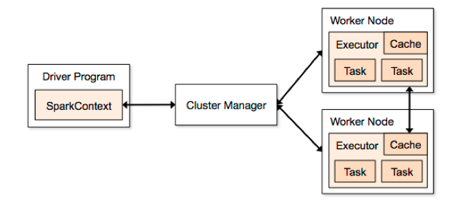
How Spark runs on clusters
Source: https://spark.apache.org/docs/1.1.1/cluster-overview.html

Slide 7
Basic Spark Concepts
SparkContext
represents the connection to a Spark cluster, and can be used to create RDDs, accumulators and broadcast variables on that cluster.
Resilient Distributed Dataset (RDD)
RDDs have actions, which return values,
and transformations, which return new RDDs
Two code execution modes:
Interactive Python shell: PySpark
Running standalone applications: spark-submit

Slide 8
Spark Documentation
https://spark.apache.org/docs/1.1.1/quick-start.html
https://spark.apache.org/docs/1.1.1/programming-guide.html
https://spark.apache.org/docs/1.1.1/api/python/index.html
RDD methods: https://spark.apache.org/docs/1.1.1/api/python/pyspark.rdd.RDD-class.html

Slide 9
Spark on Fladoop
Spark 1.1 is currently installed
http://caen.github.io/hadoop/user-spark.html
Usage demo

Slide 10
First Spark Example: Word Count
spark_wordcount.py

Slide 11
Spark Solution to HW5 Extra Credit Problem
spark_si601_w15_hw5ec.py

Slide 12
Spark Examples: Yelp data processing
spark_cityfilter.py
spark_citybusinesscount.py
spark_avg_stars_per_category.py

Slide 13
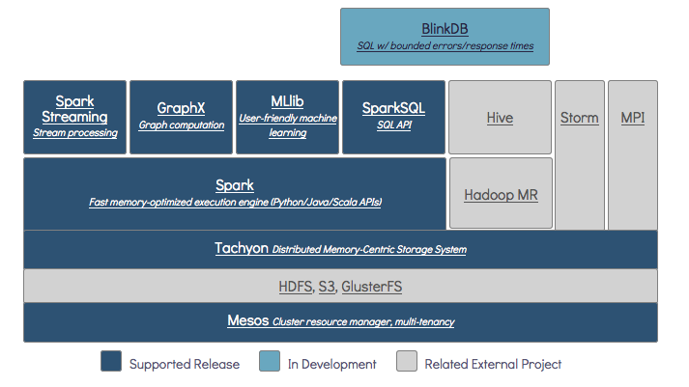
Berkeley Data Analytics Stack
Source: https://amplab.cs.berkeley.edu/software/

Slide 14
Big data: Which technologies will be critical for data gathering, manipulation, analysis?
A/B testing, experimental data gathering
Crowdsourcing
Data fusion and integration
Genetic algorithms
Machine learning
Natural language processing
Signal processing
Simulation
Time series analysis
Visualization
Source: http://www.mckinsey.com/insights/business_technology/big_data_the_next_frontier_for_innovation

Slide 15
Course Evaluation Time
Course evaluation: please complete if you haven't
See CTools "Evaluate This Class" link
10 minutes

Slide 16
Big data: Which technologies will be critical for data gathering, manipulation, analysis?
A/B testing, experimental data gathering
Crowdsourcing
Data fusion and integration
Genetic algorithms
Machine learning
Natural language processing
Signal processing
Simulation
Time series analysis
Visualization
Source: http://www.mckinsey.com/insights/business_technology/big_data_the_next_frontier_for_innovation

Slide 17
Three core problems in modeling and predicting relationships in data
Regression
Problem: Predicting a continuous output variable from one or more continuous input variables
Algorithms: Linear models, Logistic regression
Clustering
Problem: Assignment of each data instance to one of K cluster labels
Algorithms: Hierarchical clustering, k-means
Classification
Problem: Predicting a categorical output from continuous and/or categorical variables

Slide 18
Three core problems in modeling and predicting relationships in data
Regression
Problem: Predicting a continuous output variable from one or more continuous input variables
Algorithms: Linear models, Logistic regression
Clustering
Problem: Assignment of each data instance to one of K cluster labels
Algorithms: Hierarchical clustering, k-means
Classification
Problem: Predicting a categorical output from continuous (real-valued) and/or categorical variables

Slide 19
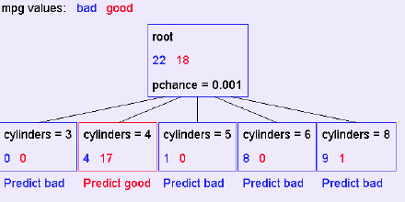
Decision Trees
Widely used classifier/classification algorithm/predictive analytics method
A mini decision tree:

Slide 20
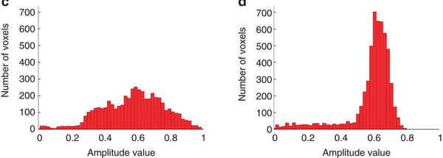
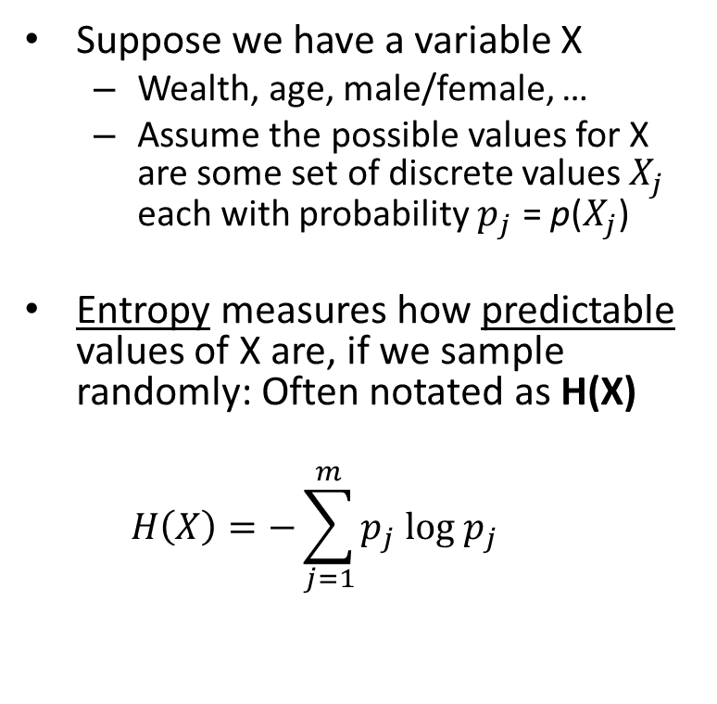
Entropy as a measurement of uncertainty
Suppose we have a variable X
Wealth, age, male/female, …
Assume the possible values for X are some set of discrete values each with probability = p()
Entropy measures how predictable values of X are, if we sample randomly: Often notated as H(X)
H(X) = 5.67
H(X) = 1.23

Slide 21
High vs low entropy
High entropy means X is unpredictable and takes a wide range of values
Flatter, more uniform distribution
Less information about X
Low entropy means X takes a more predictable range of values
From a varied (peaks and valleys) distribution
More information about X
High entropy
Low entropy
Source: http://www.nature.com/ncomms/journal/v3/n8/full/ncomms1994.html

Slide 22
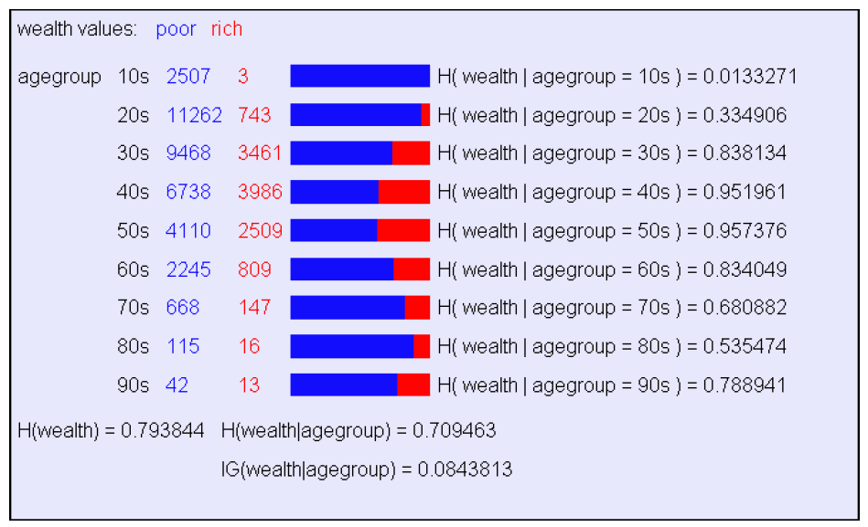
What does knowing someone's age tell us about their likely wealth?
Source: UCI U.S. Census 1990 subsample

Slide 23
Information gain (IG) measures the reduction in uncertainty we get from seeing some information
How much is entropy reduced by knowing some new information Z?
Wealth given gender
Wealth given age group
IG(wealth|agegroup) = H(wealth) – H(wealth|agegroup)
= 0.084
H(wealth) = 0.793
H(wealth|agegroup)
= 0.709

Slide 24
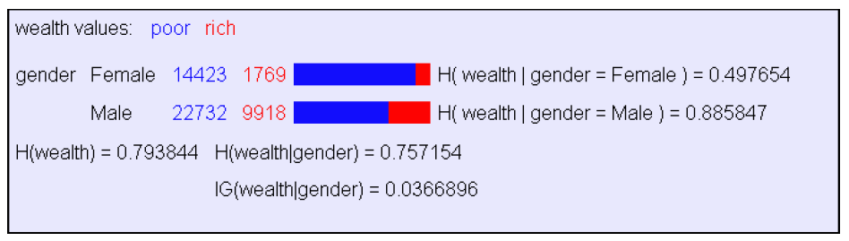
What does knowing someone's gender tell us about their likely wealth?
Source: UCI U.S. Census 1990 subsample

Slide 25
How is information gain used for data exploration and mining?
Will someone live longer than 80 years?
From historical data:
IG(LongLife | HairColor) = 0.01
IG(LongLife | Smoker) = 0.20
IG(LongLife | Gender) = 0.25
IG(LongLife | LastDigitOfSSN) = 0.00001
Information gain is used to build decision trees
Decision trees are a method of predicting the value of an outcome variable Y given some input variables X1, X2, …

Slide 26
Learning Decision Trees
Decision tree:
A tree-structured plan for a set of attributes to test in order to predict the output.
Which attribute should be tested first?
Find the one with highest information gain
Then recurse…
Source: Decision Tree Tutorial, Andrew Moore

Slide 27
Predicting a car's fuel efficiency category from its features
Assume MPG is a binary attribute: good efficiency, bad efficiency
Given a car's features (input variables) like number of cylinders, horsepower, etc…
Predict if its MPG is: bad, or good
Bad < 20 miles per gallon, good if >= 20.
We can start by looking at the information gain about MPG that comes from observing the value of one of the input variables…
Source: UCI Dataset, and Decision Tree Tutorial, Andrew Moore

Slide 28
Suppose we had to predict MPG good/bad using only one input attribute: number of cylinders
Bad: mpg < 20.0 Good: mpg >= 20.0
Bad/good overall: 21 bad, 18 good
Bad/good with cylinders = 4: 4, 17 Predict: good
Bad/good with cylinders = 6: 8, 0 Predict: bad
Bad/good with cylinders = 8: 9, 1 Predict: bad

Slide 29
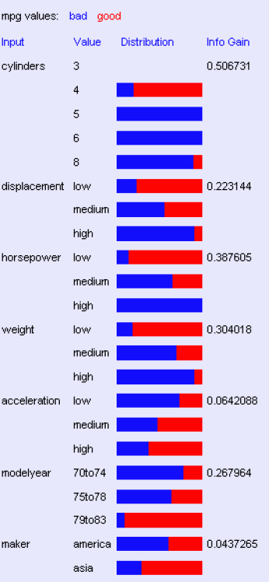
Look at all the information gains
Source: Decision Tree Tutorial, Andrew Moore

Slide 30
A decision stump
Source: Decision Tree Tutorial, Andrew Moore

Slide 31
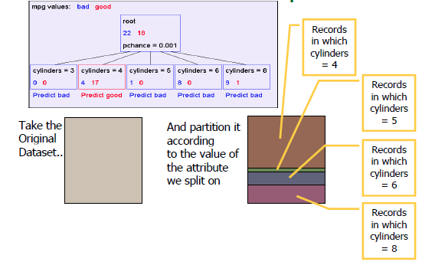
Recursion step
Source: Decision Tree Tutorial, Andrew Moore

Slide 32
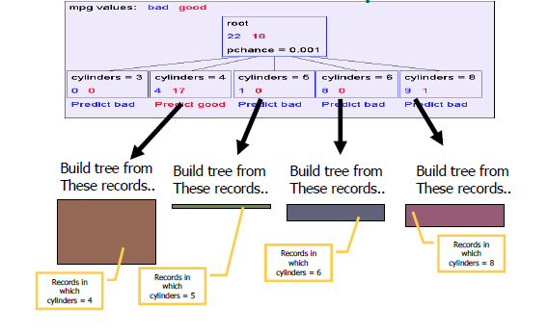
Recursion step
Source: Decision Tree Tutorial, Andrew Moore

Slide 33
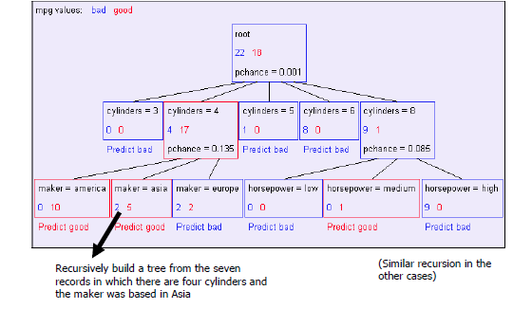
Second level of tree
Source: Decision Tree Tutorial, Andrew Moore

Slide 34
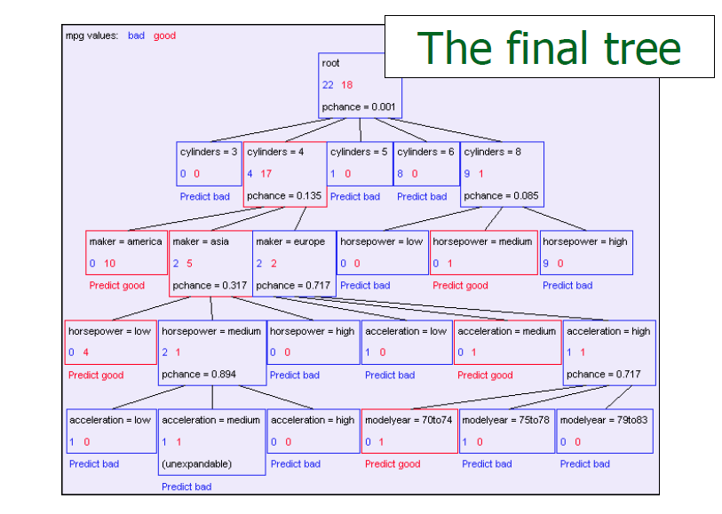
Decision tree to predict mpg
Source: Decision Tree Tutorial, Andrew Moore

Slide 35
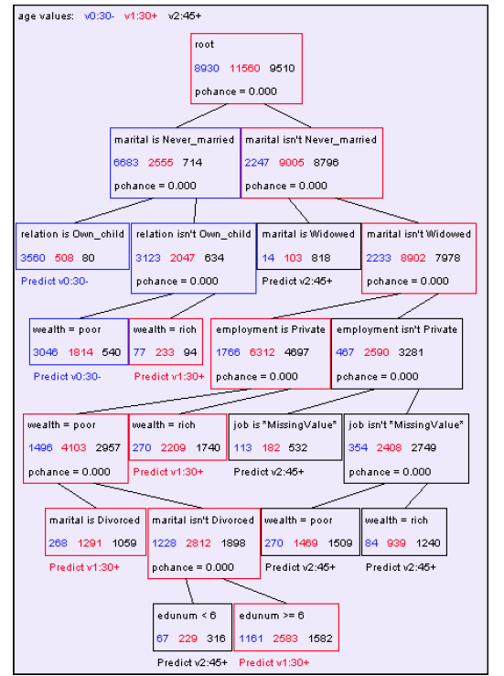
Example: Predicting a person's age from census variables
Source: Decision Tree Tutorial, Andrew Moore

Slide 36
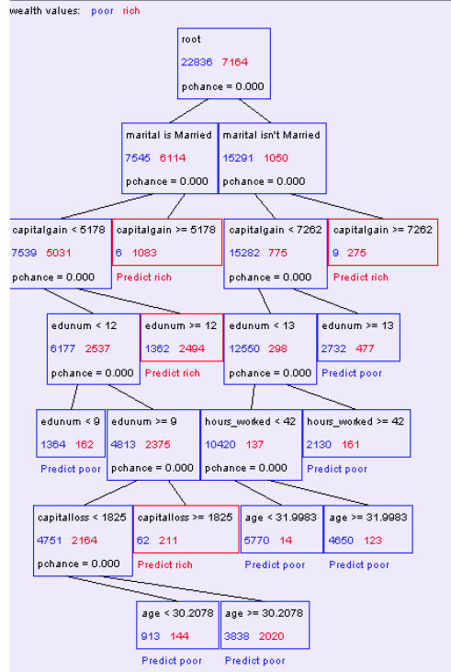
Example: Predicting a person's wealth from census variables
Source: Decision Tree Tutorial, Andrew Moore

Slide 37
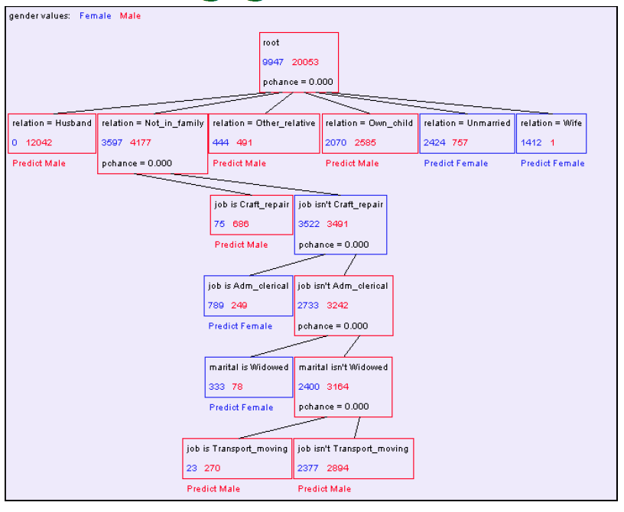
Example: Predicting gender from census variables
Source: Decision Tree Tutorial, Andrew Moore

Slide 38
Decision trees
Decision trees are the #1 most popular data mining tool
Easy to use
Easy to interpret the results
Easy to implement
Computationally efficient
They do classification
Predicting a categorical output from categorical and/or real-valued inputs

Slide 39
We just solved a classification problem
Target variable: predict binary bad/good
Input variables: vehicle properties
Training data: mileage dataset

Slide 40
Time to stop and reflect: why are we doing this analysis
Sometimes to explore relationships in existing dataset only.
Including, e.g. predicting missing values
More often to predict the categories for future data we have not yet seen.
We're entering the world of machine learning
Let’s look at another machine learning approach to classification…

Slide 41
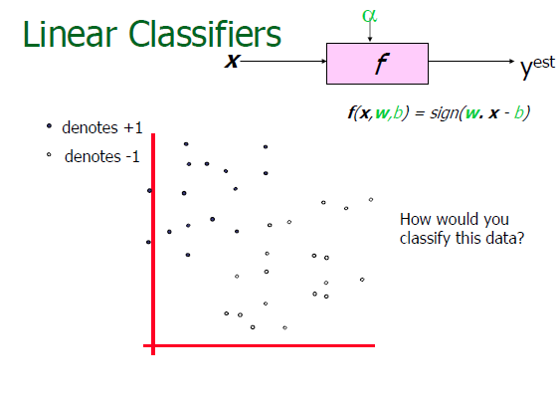
Source: The following SVM slide series is from the SVM Tutorial by Andrew Moore

Slide 42
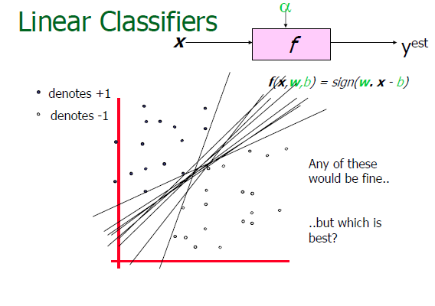
Source: The following SVM slide series is from the SVM Tutorial by Andrew Moore

Slide 43
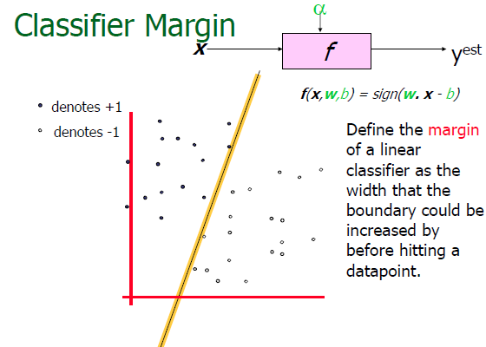

Slide 44
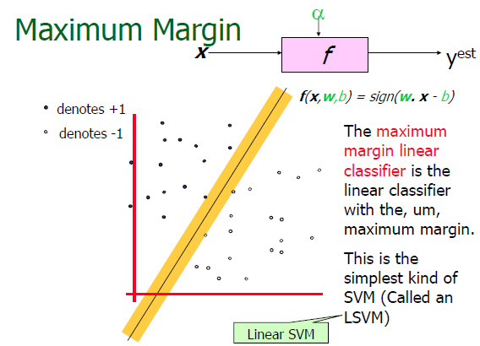

Slide 45
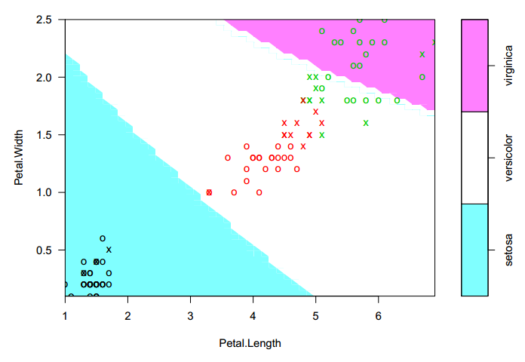
SVMs applied to a famous flower classification problem (the iris dataset)
Support vectors: x True classes: symbol color Predicted classes: background color

Slide 46
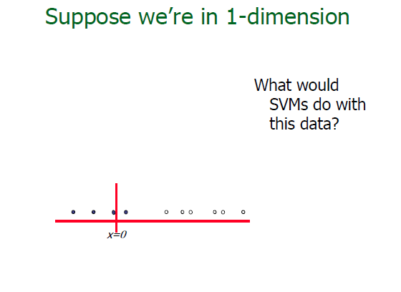

Slide 47
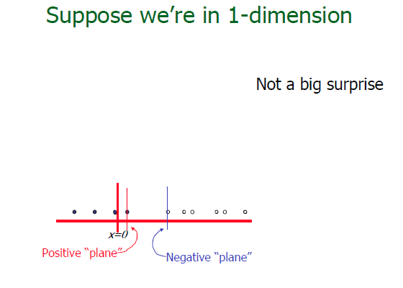

Slide 48
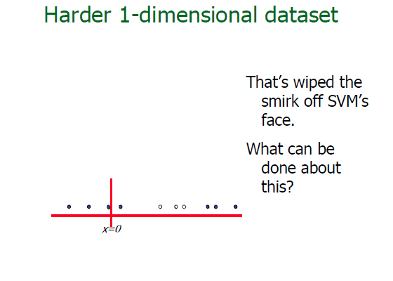

Slide 49
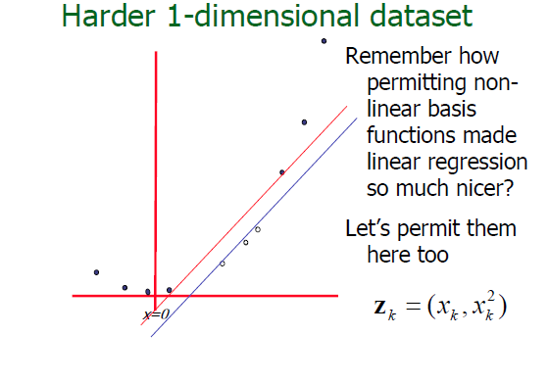
Let's transform the input data using a non-linear function
Let's transform the input data using a non-linear function

Slide 50
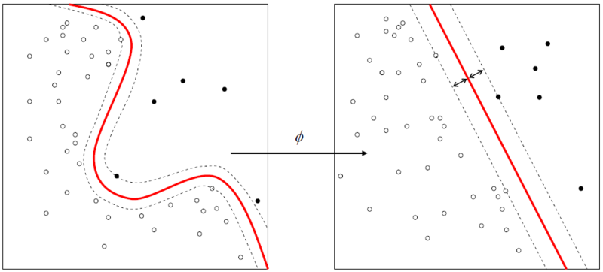
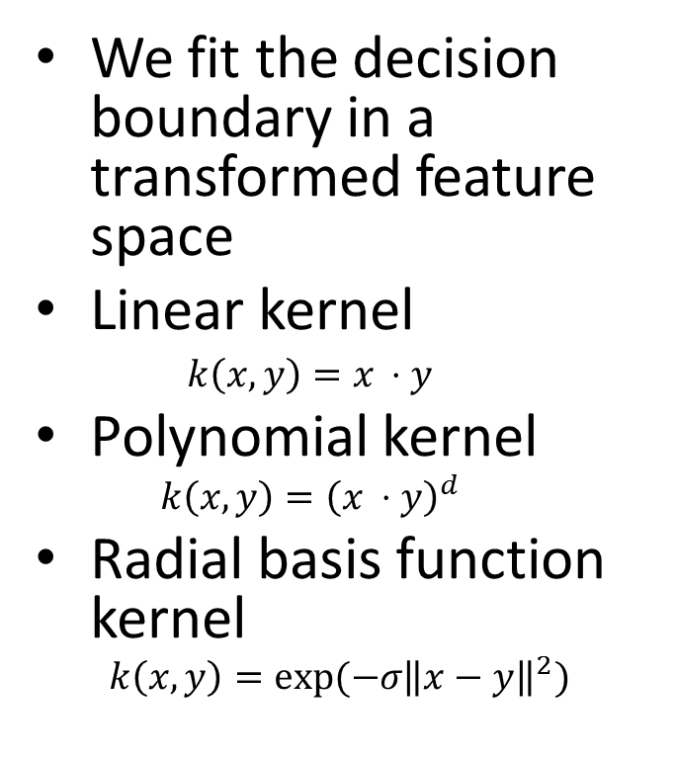
A kernel defines what it means for two points to be 'close'
We fit the decision boundary in a transformed feature space
Linear kernel
Polynomial kernel
Radial basis function kernel
Mathematically easy to plug in different choices of kernel in SVMs

Slide 51
Decision trees vs SVM
Decision tree output is easy for people to interpret..
Not so for SVM's list of support vectors
Anecdotally SVMs work well: higher accuracy on many tasks vs ordinary decision trees
SVMs naturally deal with highly non-linear decision boundaries
Substitute different kernel functions

Slide 52
Further reading and resources
C4.5: Programs for Machine Learning by J. Ross Quinlan (Morgan Kaufmann Series in Machine Learning)
C.J.C Burges. A tutorial on support vector machines for pattern recognition. Data Mining and Knowledge Discovery. 2(2):955-974, 1998.
Lots of software implementations on the Web
e.g. Weka Toolkit is a very popular machine learning package http://www.cs.waikato.ac.nz/ml/weka/

Slide 53
Next steps…
We'll be covering these types of data mining/learning techniques and more in 618

