Slide 1
Unsupervised Learning in Python using Scikit-learn
Data Science Skills Series
Márcio & Corey
http://scikit-learn.org/

Slide 2
Outline
Brief introduction to Machine Learning
Unsupervised and supervised learning
Unsupervised learning
Principal Component Analysis (PCA), K-Means
Core
Brief review of the methodology
Using Python & Scikit-learn to apply the methodology

Slide 3
What is machine learning?
A branch of artificial intelligence, concerned with the design and development of algorithms that allow computers to evolve behaviors based on empirical data.
As intelligence requires knowledge, it is necessary for the computers to acquire knowledge.

Slide 4
What is machine learning?
Traditional Programming
Machine Learning
Data
Computer
Output
Program
Data
Computer
Program
Output

Slide 5


Algorithms
Unsupervised learning ( )
Dimensionality reduction
Clustering
Supervised learning ( )
Decision tree induction
Rule induction
Instance-based learning
Bayesian learning
Neural networks
Support vector machines
Model ensembles
Learning theory

Slide 6
Unsupervised learning: Principal Component Analysis (PCA)

Slide 7
Summarization of data with many (p) variables by a smaller set of (k) derived (synthetic, composite) variables.
p
k
A
X
n
n

Slide 8
Geometric Rationale of PCA
The objective of PCA is to rigidly rotate the axes of this p-dimensional space to new positions (principal axes) that have the following properties:
ordered such that principal axis 1 has the highest variance, axis 2 has the next highest variance, .... , and axis p has the lowest variance
covariance among each pair of the principal axes is zero (the principal axes are uncorrelated).

Slide 9
2D Example of PCA
Variables X₁ and X₂ have positive covariance
Each variable has a similar variance

Slide 10
2D Example of PCA
PC 1 has the highest possible variance (9.88)
PC 2 has a variance of 3.03
PC 1 and PC 2 have zero covariance.

Slide 11
A summary of the PCA approach
Standardize the data
Obtain the Eigenvectors and Eigenvalues from the covariance matrix or correlation matrix, or perform Singular Vector Decomposition
Sort eigenvalues in descending order and choose the k eigenvectors that correspond to the k largest eigenvalues where k is the number of dimensions of the new feature subspace (k≤d)
Construct the projection matrix W from the selected k eigenvectors
Transform the original dataset X via W to obtain a k-dimensional feature subspace Y.

Slide 12
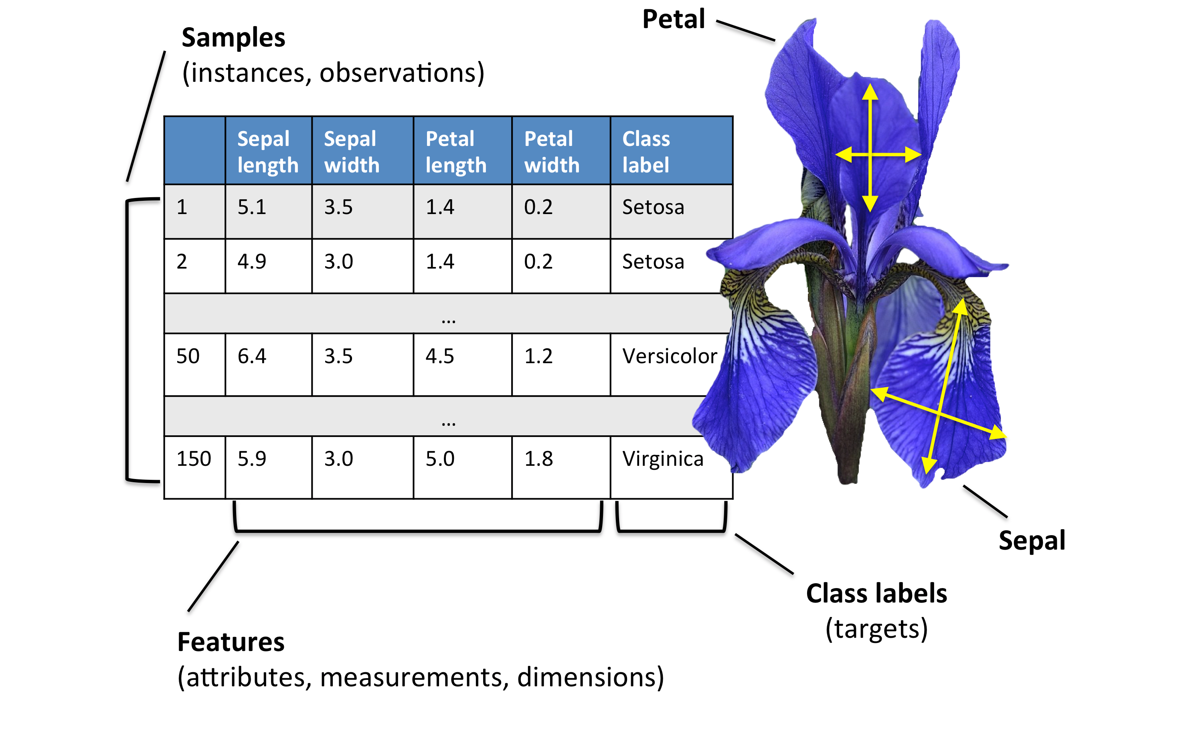
The Iris dataset

Slide 13
References
http://scikit-learn.org/
http://sebastianraschka.com/Articles/2015_pca_in_3_steps.html
http://cs.wellesley.edu/~cs315/315_PPTs/...L17-Clustering/k-Means-Clustering-Example.ppt
https://cs.brown.edu/courses/cs143/lectures/17.ppt
www.cs.kent.edu/~jin/DM07/ClassificationDecisionTree.ppt
www.cs.uoi.gr/~tsap/teaching/2012s.../datamining-lect10.pdf

