Slide 1
Machine Learning in Python using Scikit-learn
Data Science Skills Series
Márcio & Corey
http://scikit-learn.org/

Slide 2
Outline
Brief introduction to Machine Learning
Unsupervised and supervised learning
K-Means, Nearest-Neighbor, Naïve Bayes, Decision Trees
Linear regression, Logistic regression and Support Vector Machines (SVM)

Slide 3
What is machine learning?
A branch of artificial intelligence, concerned with the design and development of algorithms that allow computers to evolve behaviors based on empirical data.
As intelligence requires knowledge, it is necessary for the computers to acquire knowledge.

Slide 4
What is machine learning?
Traditional Programming
Machine Learning
Data
Computer
Output
Program
Data
Computer
Program
Output

Slide 5


Algorithms
Unsupervised learning ( )
Clustering
Dimensionality reduction
Supervised learning ( )
Decision tree induction
Rule induction
Instance-based learning
Bayesian learning
Neural networks
Support vector machines
Model ensembles
Learning theory

Slide 6
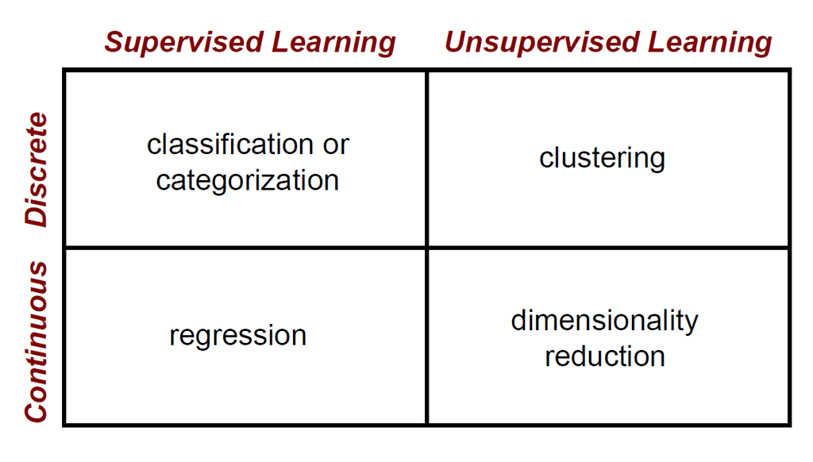
Algorithms

Slide 7
Unsupervised learning: K-Means

Slide 8
K-Means problem
Partitioning Clustering Approach
Learn a partition on a data set to produce several non-empty clusters
Optimal partition achieved via minimizing the sum of squared distance to its “representative object” in each cluster
e.g., Euclidean distance

Slide 9
Lloyd’s algorithm
Given a set of data points as input
Randomly assign each point to one of the k clusters
Repeat until convergence
Calculate model (center) of each of the k clusters
Assign each point to the cluster with the closest model (center)

Slide 10
Example

Slide 11
Example
Randomly assign each point to one of the clusters

Slide 12
Example
Calculate center of each cluster

Slide 13
Example
Calculate center of each cluster

Slide 14
Example
Calculate center of each cluster

Slide 15
Example
Assign each point to closest cluster center

Slide 16
Example
Calculate center of each cluster

Slide 17
Example
Calculate center of each cluster

Slide 18
Example
Calculate center of each cluster

Slide 19
Example
Assign each point to closest cluster center

Slide 20
Example
Calculate center of each cluster

Slide 21
Example
Calculate center of each cluster

Slide 22
Example
Calculate center of each cluster

Slide 23
Example
Convergence

Slide 24
Some features..
Relatively efficient: O(tkn), where n is # objects, k is # clusters, and t is # iterations. Normally, k, t << n
Often terminates at a local optimum. It is good to restart it several times
Applicable only when mean is defined
Need to specify k, the number of clusters, in advance

Slide 25
The Iris dataset
This data sets consists of 3 different types of irises’ (Setosa, Versicolour, and Virginica) based on four attributes
The data is stored in a 150x4 numpy.ndarray, the rows being the samples and the columns being: Sepal Length, Sepal Width, Petal Length and Petal Width

Slide 26
Exercise 1
Create a clustered dataset X using [X,target]=aux_funcs.init_board_gauss(nPoints,nClasses,s2)
Visualize the dataset X (suggestion: use plt.scatter)
Use Kmeans to find k centroids
Plot centroids

Slide 27
Algorithms

Slide 28
Classification: Definition
Given a collection of records (training set )
Each record contains a set of attributes, one of the attributes is the class.
Find a model for class attribute as a function of the values of other attributes.
Goal: previously unseen records should be assigned a class as accurately as possible.
A test set is used to determine the accuracy of the model. Usually, the given data set is divided into training and test sets, with training set used to build the model and test set used to validate it.

Slide 29
Illustrating Classification Task

Slide 30
Examples of Classification Task
Predicting tumor cells as benign or malignant
Classifying credit card transactions as legitimate or fraudulent
Classifying secondary structures of protein as alpha-helix, beta-sheet, or random coil
Categorizing news stories as finance, weather, entertainment, sports, etc

Slide 31
Supervised learning: Nearest-Neighbor

Slide 32
Nearest-Neighbor Classifier
Requires three things
The set of stored records
Distance Metric to compute distance between records
The value of k, the number of nearest neighbors to retrieve
To classify an unknown record:
Compute distance to other training records
Identify k nearest neighbors
Use class labels of nearest neighbors to determine the class label of unknown record (e.g., by taking majority vote)

Slide 33
Nearest-Neighbor Classifier
K-nearest neighbors of a record x are data points that have the k smallest distance to x

Slide 34
Some features..
k-NN classifiers are lazy learners
It does not build models explicitly
Unlike eager learners such as decision tree induction and rule-based systems
Classifying unknown records are relatively expensive
Naïve algorithm: O(n)

Slide 35
Supervised learning: Naive Bayes Classifier

Slide 36
Bayes Theorem
Given a hypothesis h and data D which bears on the hypothesis:
P(h): independent probability of h: prior probability
P(D): independent probability of D
P(D|h): conditional probability of D given h: likelihood
P(h|D): conditional probability of h given D: posterior probability

Slide 37
Bayes Classifier
Assumption: training set consists of instances of different classes described cj as conjunctions of attributes values
Task: Classify a new instance d based on a tuple of attribute values into one of the classes cj ∈ C
Key idea: assign the most probable class using Bayes Theorem.

Slide 38
Parameters estimation
We can estimate P(c_{j}) & P(x₁,x₂,…,x_{n}|c_{j}) from the training examples
Independence Assumption: attribute values are conditionally independent given the target value: naïve Bayes

Slide 39
Some features..
Incrementality: with each training example, the prior and the likelihood can be updated dynamically: flexible and robust to errors.
Combines prior knowledge and observed data: prior probability of a hypothesis multiplied with probability of the hypothesis given the training data
Probabilistic hypothesis: outputs not only a classification, but a probability distribution over all classes

Slide 40
Supervised learning: Decision trees

Slide 41
Example of a Decision Tree
categorical
categorical
continuous
class
Splitting Attributes
Refund
Yes
No
NO
MarSt
Single, Divorced
Married
TaxInc
NO
< 80K
> 80K
NO
YES
Training Data
Model: Decision Tree

Slide 42
Apply Model to Test Data
Test Data
Start from the root of tree.
Refund
Yes
No
NO
MarSt
Single, Divorced
Married
TaxInc
NO
< 80K
> 80K
NO
YES

Slide 43
Apply Model to Test Data
Test Data
Refund
Yes
No
NO
MarSt
Single, Divorced
Married
TaxInc
NO
< 80K
> 80K
NO
YES

Slide 44
Apply Model to Test Data
Test Data
Refund
Yes
No
NO
MarSt
Single, Divorced
Married
TaxInc
NO
< 80K
> 80K
NO
YES

Slide 45
Apply Model to Test Data
Test Data
Refund
Yes
No
NO
MarSt
Single, Divorced
Married
TaxInc
NO
< 80K
> 80K
NO
YES

Slide 46
Apply Model to Test Data
Test Data
Refund
Yes
No
NO
MarSt
Single, Divorced
Married
TaxInc
NO
< 80K
> 80K
NO
YES

Slide 47
Apply Model to Test Data
Test Data
Refund
Yes
No
NO
MarSt
Single, Divorced
Married
Assign Cheat to “No”
TaxInc
NO
< 80K
> 80K
NO
YES

Slide 48
How to determine the best split?
Before Splitting: 10 records of class 0, 10 records of class 1
Which test condition is the best?

Slide 49
How to determine the best split
Need a measure of node impurity:
Non-homogeneous,
High degree of impurity
Homogeneous,
Low degree of impurity
Gini Index
Entropy
Misclassification error

Slide 50
Some features..
Simple to understand and to interpret. Trees can be visualized
The cost of using the tree (i.e., predicting data) is logarithmic in the number of data points used to train the tree
Able to handle both numerical and categorical data. Other techniques are usually specialized in analyzing datasets that have only one type of variable
Decision-tree learners can create over-complex trees that do not generalise the data well
Decision trees can be unstable because small variations in the data might result in a completely different tree being generated
There are concepts that are hard to learn because decision trees do not express them easily, such as XOR, parity or multiplexer problems

Slide 51
Exercise 2
Create a clustered dataset X using [X,target]=aux_funcs.init_board_gauss(nPoints,nClasses,s2)
Create a couple of new points for classification
Use KneighborsClassifier, GaussianNB or the DecisionTreeClassifier to train the model
Make and evaluate predictions

Slide 52
References
http://scikit-learn.org/
http://cs.wellesley.edu/~cs315/315_PPTs/...L17-Clustering/k-Means-Clustering-Example.ppt
https://cs.brown.edu/courses/cs143/lectures/17.ppt
www.cs.kent.edu/~jin/DM07/ClassificationDecisionTree.ppt
www.cs.uoi.gr/~tsap/teaching/2012s.../datamining-lect10.pdf

