Slide 1
Outline
Description of K-Means algorithm
Metrics for measuring cluster performance
Document clustering example

Slide 2

K-Means problem
Partitioning Clustering Approach
Assumes that there are K clusters in the data set, with each observation belonging to a single cluster.
Models clusters in terms of cluster centers, with observations in a cluster being close to the cluster center.
Optimal partition achieved via minimizing the inertia, or sum of squared distances from each observation to its cluster center.
where $d(x.m_{k}$) is the Euclidean distance

Slide 3
Lloyd’s algorithm
1a) Randomly assign each observation to one of the K clusters.
1b) Randomly pick K observations to serve as cluster centers and assign each observation to the cluster with closest center.
2. Repeat until convergence:
Calculate the center of each cluster.
Assign each observation to the cluster with the closest center.

Slide 4
Example

Slide 5
Example
Randomly assign each observation to one of the clusters

Slide 6
Example
Calculate center of each cluster

Slide 7
Example
Calculate center of each cluster

Slide 8
Example
Calculate center of each cluster

Slide 9
Example
Assign each observation to closest cluster center

Slide 10
Example
Calculate center of each cluster

Slide 11
Example
Calculate center of each cluster

Slide 12
Example
Calculate center of each cluster

Slide 13
Example
Assign each observation to the closest cluster center

Slide 14
Example
Calculate center of each cluster

Slide 15
Example
Calculate center of each cluster

Slide 16
Example
Calculate center of each cluster

Slide 17
Example
Convergence

Slide 18
Some features..
Relatively efficient: O(tkn), where n is the number of observations, k is the number of clusters, and t is the number of iterations. Normally, k, t << n
Often terminates at a local optimum. It is good to restart it several times
Applicable only when mean is defined
Need to specify k, the number of clusters, in advance

Slide 19
sklearn.cluster.KMeans
Sklearn.cluster.Kmeans is the class that implements Kmeans clustering in Scikit-learn.
Documentation is available at http://scikit-learn.org/stable/modules/generated/sklearn.cluster.KMeans.html
Key options:
n_clusters (default 8)
n_init (default 10): The number of times to run the algorithm with different centroid seeds
init (default “k-means++”, other possible values “random” or an ndarray): Methods of initialization for cluster centers
Outputs:
cluster_centers_: Coordinates of the cluster centers
labels_: Cluster classification for the observations
inertia_: The sum of the squares of distances from the samples to their closest cluster center

Slide 20
Measuring clustering effectiveness
If we know the class assignments, then we can evaluate cluster effectiveness by measuring the extent to which pairs of observations in the same class are in the same cluster and vice versa.
Precision: the percentage of pairs of observations in the same cluster that are in the same class
Recall: the percentage of pairs of observations in the same class that are in the same cluster
Fowlkes-Mallows index: the geometric mean of precision and recall
We can also take an information-theoretic approach.
Homogeneity: the extent to which knowing the clusters reduces the entropy of the class assignment
Completeness: the extent to which knowing the classes reduces the entropy of the clustering
V-measure: the harmonic mean of homogeneity and completeness.
All of these metrics lie on a scale from 0 (independence) to 1 (perfect clustering)

Slide 21
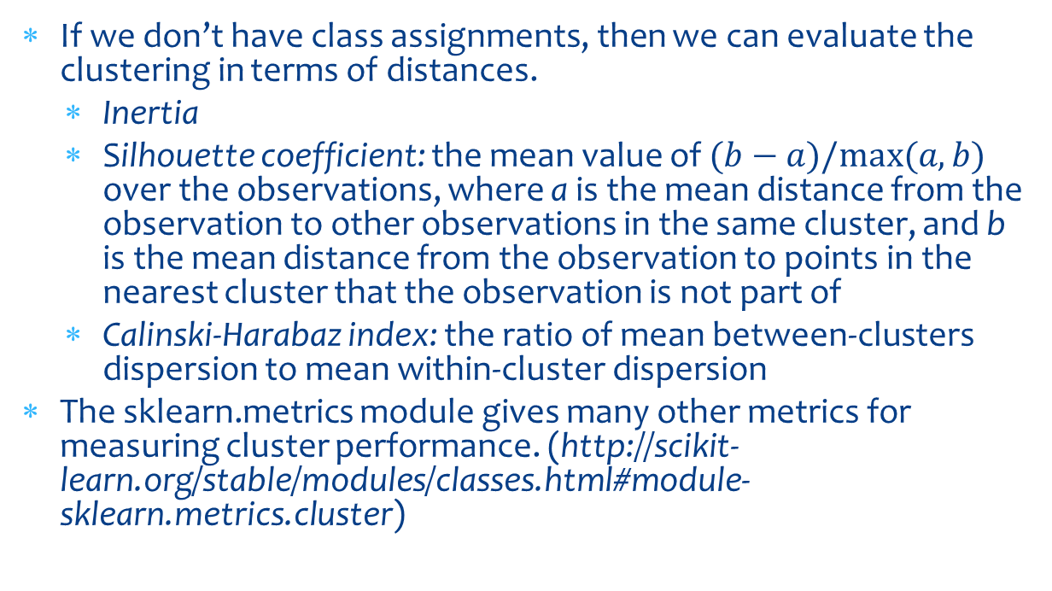
Measuring clustering effectiveness (continued)
If we don’t have class assignments, then we can evaluate the clustering in terms of distances.
Inertia
Silhouette coefficient: the mean value of $(b−a)/max⁡(a,b)$ over the observations, where a is the mean distance from the observation to other observations in the same cluster, and b is the mean distance from the observation to points in the nearest cluster that the observation is not part of
Calinski-Harabaz index: the ratio of mean between-clusters dispersion to mean within-cluster dispersion
The sklearn.metrics module gives many other metrics for measuring cluster performance. (http://scikit-learn.org/stable/modules/classes.html#module-sklearn.metrics.cluster)

