Slide 1
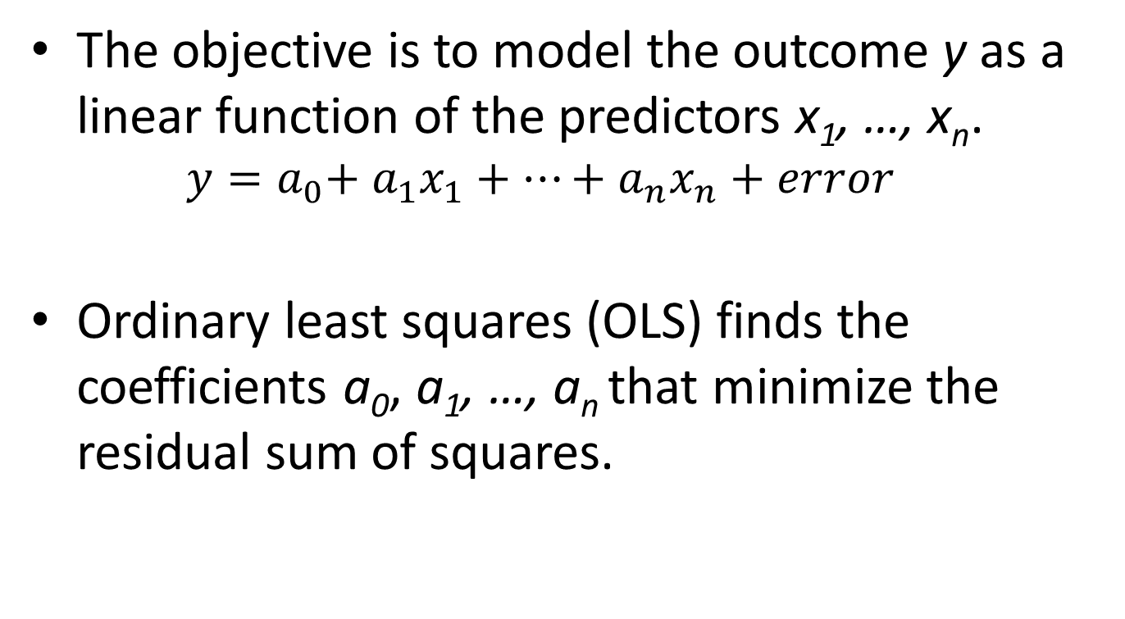
Linear Regression
The objective is to model the outcome y as a linear function of the predictors x₁, …, x_{n}.
$$y={a_{0}{{+ a}_{1}x_{1}+…+a}_{n}x}_{n}+error$$
Ordinary least squares (OLS) finds the coefficients a₀, a₁, …, a_{n} that minimize the residual sum of squares.

Slide 2
Least Squares Linear Regression Using Scikit-Learn
The sklearn.linear_model.LinearRegression class implements least squares linear regression.
Key parameters:
fit_intercept: If True (the default), then the model will fit an
intercept.
normalize: If True (default False), then the model will normalize the predictors to lie in the range from 0 to 1.
n_jobs: Only use this option if you creating regression models for multiple outcomes.
For more details, see
http://scikit-learn.org/stable/modules/generated/sklearn.linear_model.LinearRegression.html

Slide 3
Regularization
If you use too many variables in the model, then you risk overfitting the model.
An overfit model will perform very well on the training data, but poorly on test data.
Regularization methods combat overfitting by shrinking coefficients to 0 (Ridge regression) or forcing coefficients to 0 (Lasso).

Slide 4
Ridge regression
Ridge regression minimizes the quantity
residual sum of squares + α(a₁² + … + a_{n}²)
The larger the value for α, the greater the shrinkage of the coefficients toward 0.
The class sklearn.linear_model.Ridge implements Ridge regression
For more details, see
http://scikit-learn.org/stable/modules/generated/sklearn.linear_model.Ridge.html

Slide 5
Lasso
Lasso minimizes the quantity
residual sum of squares + α(|a₁| + … + |a_{n}|)
Lasso forces coefficients to 0, unlike Ridge regression
The larger the value for α, the more that coefficients will be forced to 0.
The class sklearn.linear_model.Lasso implements Ridge regression
For more details, see
http://scikit-learn.org/stable/modules/generated/sklearn.linear_model.Lasso.html

Slide 6
Linear Regression Exercise
Load the load_boston dataset from sklearn.datasets.
Divide the dataset into training and test sets of equal size.
Fit a linear regression model using the training set. What are the coefficients in the model? How does the performance of the model (mean squared error, score) differ from the training set to the test set?
Fit a Ridge regression model using the test set to optimize the penalty. How do the coefficients and performance of the optimal Ridge regression model compare to that of the linear regression model in 3?
Fit a Lasso model using the test set to optimize the penalty. How do the coefficients and performance of the optimal Lasso model compare to those of the Ridge regression and linear regression models?
You will need to use trial and error choose appropriate values for alpha in 4 and 5. The np.logspace(a,b,n,base=10) function might be useful here. This function produces n points starting at a and ending at b that are equidistant after taking the log to the appropriate base (default 10)

Slide 7
Classification
The goal with a categorical outcome is to predict a classification for the outcome based on other data.
We will focus here on binary outcomes coded as 0 (no) and 1 (yes).
We can make a hard classification of yes or no, or make a soft classification by estimating the chance of a yes given the data.

Slide 8
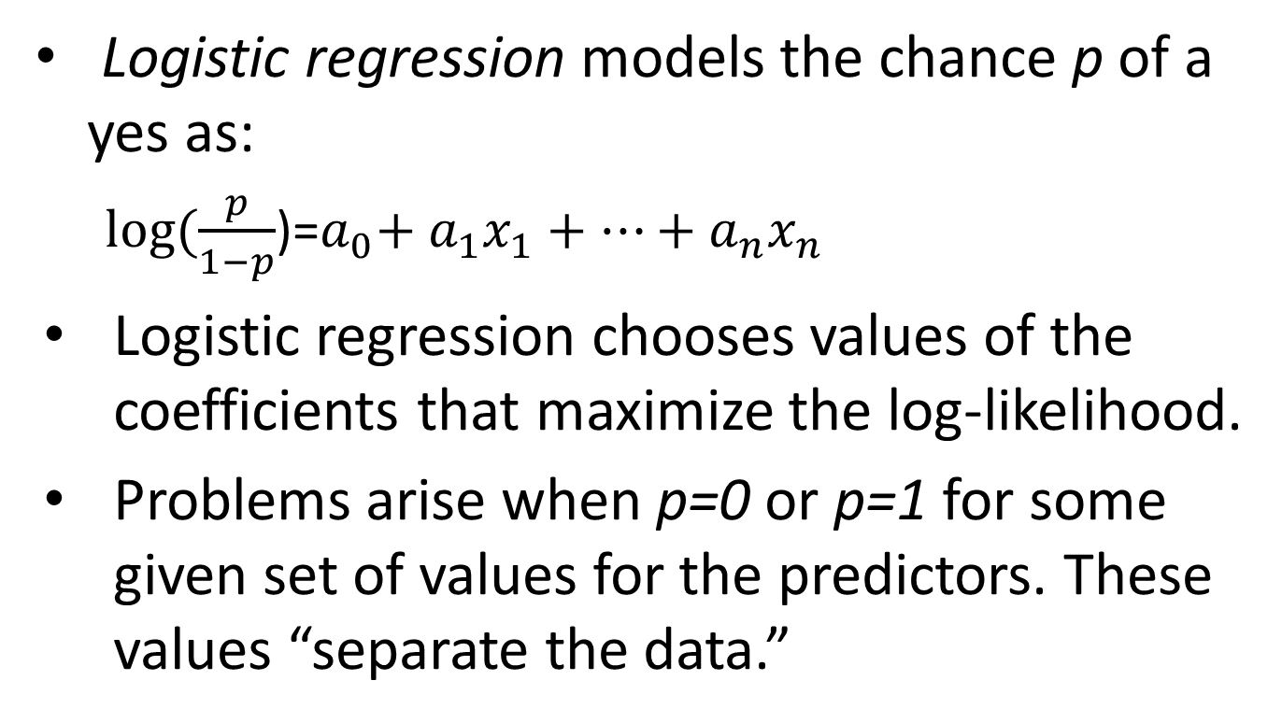
Modeling The Chance of a Yes
Logistic regression models the chance p of a yes as:
$log⁡(\frac{p}{1−p}$)=${a_{0}{{+ a}_{1}x_{1}+…+a}_{n}x}_{n}$
Logistic regression chooses values of the coefficients that maximize the log-likelihood.
Problems arise when p=0 or p=1 for some given set of values for the predictors. These values “separate the data.”

Slide 9
Logistic Regression using Scikit-Learn
The class sklearn.linear_model.LogisticRegression implements logistic regression.
This class fits the coefficients by minimizing a cost function with a penalty for the size of the coefficients.
If the parameter C (default value 1.0) is large, then the penalty is small, and vice versa.
See http://scikit-learn.org/stable/modules/linear_model.html and http://scikit-learn.org/stable/modules/generated/sklearn.linear_model.LogisticRegression.html for more information.

Slide 10
Logistic Regression Exercise
Determine the value of C (try 0.01, 0.1, 1, 10, 100, for example), that maximizes the following on the test set.
Accuracy
F-measure
Use the same data set and outcome as in the example.

Slide 11
Support Vector Machines
See http://www.svm-tutorial.com/2014/11/svm-understanding-math-part-1/ for a good introduction to the basics of Support Vector Machines (SVMs) for classification.
How does the algorithm work if the classes aren’t linearly separable?

Slide 12
Support Vector Machines Using Scikit-Learn
The class sklearn.svm.SVC implements support vector machines for classification.
SVC fits the coefficients of the hyperplane by minimizing a function that balances the margin of the hyperplane with the cost of misclassification.
The parameter C represents the cost of misclassification.
The kernel represents the type of functions that are used to separate the data.
linear: hyperplanes
See http://scikit-learn.org/stable/modules/generated/sklearn.svm.SVC.html and http://scikit-learn.org/stable/modules/svm.html for more information.

