Slide 1
GUI编程
vipjr

Slide 2
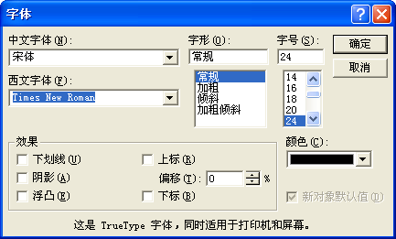
Tkinter的常用构件类
Button
Canvas
Checkbutton
Entry
Frame
Label
Listbox
Menu
Message
Radiobutton
Text
Toplevel

Slide 3
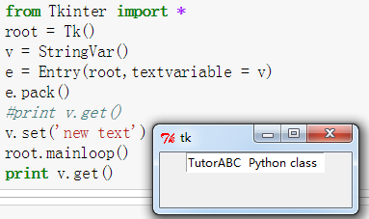
常用构件:文本编辑区
类Entry:单行文本编辑
e = Entry(窗口,选项设置)
textvariable: StringVar类型的控制变量
例如
v = StringVar()
e = Entry(root,textvariable = v)
e.pack()
print v.get()
v.set('new text')
print v.get()

Slide 4
编程案例:汇率换算器1.0版
设计图形界面的汇率换算器，实现外币和人民币间换算。
程序规格
汇率换算器程序用于在外币与人民币之间进行换算。
输入：换算方向，金额
输出：等值的目标币种金额

Slide 5
编程案例:汇率换算器
界面设计
Dollar($)
RMB(￥)
→
←
关闭

Slide 6
编程案例:汇率换算器
# -*- coding: UTF-8 -*-
from Tkinter import *
class GUICal:
def __init__(self, cal):
self.root = Tk()
self.cal = cal
self.root.title("Currency Converter")
self.fc = StringVar()
self.fc.set("USD")
self.to = "RMB"
self.amt = 0
self.aRMB = StringVar()
self.aRMB.set("0.00")
self.aFC = StringVar()
self.aFC.set("0.00")

Slide 7
编程案例:汇率换算器
Label(self.root, textvariable = self.fc).grid(row = 0, column = 0, sticky = W)
Label(self.root, text = "RMB").grid(row = 0, column = 2, sticky = W)
self.e1 = Entry(self.root, textvariable = self.aFC)
self.e1.grid(row = 1, column = 0, rowspan = 2)
self.e2 = Entry(self.root, textvariable = self.aRMB)
self.e2.grid(row = 1, column = 2, rowspan = 2)
self.b1 = Button(self.root, text = "---->", command = self.toRMB)
self.b1.grid(row = 1, column = 1)
self.b2 = Button(self.root, text = "<----", command = self.toFC)
self.b2.grid(row = 2, column = 1)

Slide 8
编程案例:汇率换算器
self.f = Frame(self.root)
self.f.grid(row = 3, column = 0, columnspan = 3)
self.qb = Button(self.root, text = "Quit", command = self.close)
self.qb.grid(row = 5, column = 1)
self.root.mainloop()

Slide 9
编程案例:汇率换算器
def showInfo(self):
rStr = "%.2f"
if self.to == "RMB":
r = self.cal.calRMB(self.fc.get(), self.amt)
self.aRMB.set(rStr % r)
else:
r = self.cal.calFC(self.fc.get(), self.amt)
self.aFC.set(rStr % r)
def toRMB(self):
self.to = "RMB"
self.amt = eval(self.aFC.get())
self.showInfo()
def toFC(self):
self.to = self.fc.get()
self.amt = eval(self.aRMB.get())
self.showInfo()
def close(self):
self.root.quit()
self.root.destroy()

Slide 10
创建运算程序
fc：换算的外币
amt：换算的金额
实现模型
class Cal:
def __init__(self):
self.xRate = {"USD":6.306, "Euro":8.2735, "Yen":0.0775, "Pound":10.0486}
def calRMB(self, fc, amt):
return amt * self.xRate[fc]
def calFC(self, fc, amt):
return amt / self.xRate[fc]

Slide 11
执行程序
使用
cc = Cal()
inter = GUICal(cc);

Slide 12
课后作业
将例子补充完整，人民币换算为美元

