Slide 1
数据类型
vipjr

Slide 2
Python字符串

Slide 3
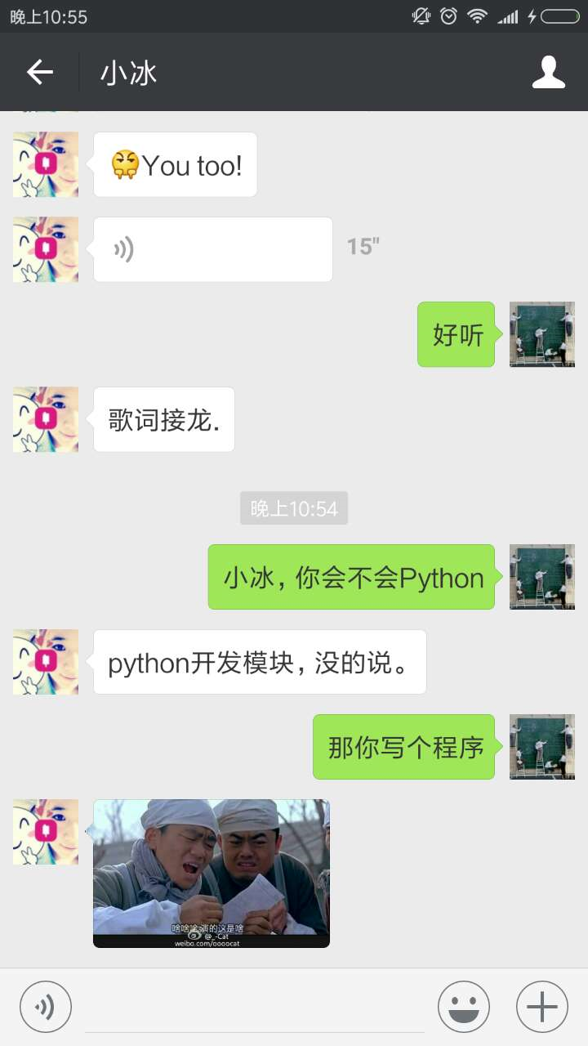
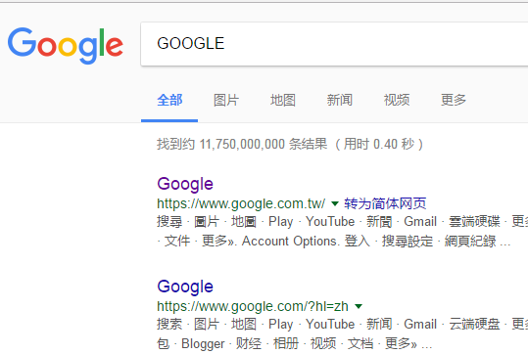
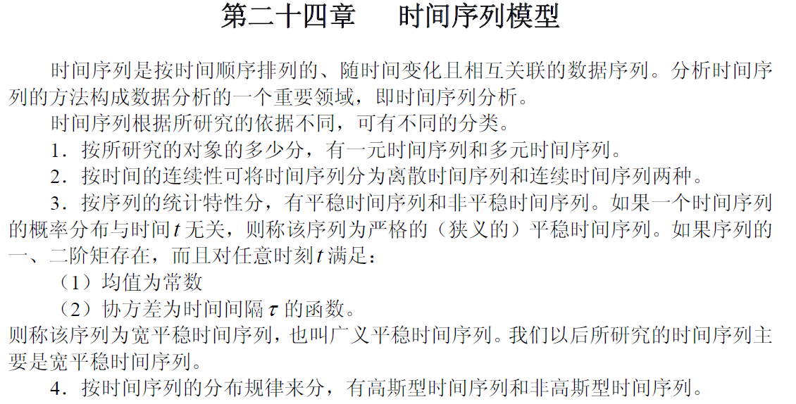
引例
文本信息

Slide 4
字符串类型
如何构建字符串呢？
字符串字面值：用一对引号(单/双/三)括住.
>>>'hello world'
>>>"~!@#$%^&*"
>>>"汉字也是字符"
>>>'''line one,
line two'''
>>>"""line one,
line two""“
字符串类型str:字符序列
界定符
三引号可使字符串跨行

Slide 5
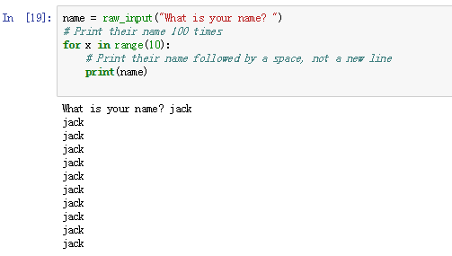
字符串类型
name = raw_input("What is your name? ")
# Print their name 10 times
for x in range(10):
# Print their name followed by a space, not a new line
print(name, end = “ “)

Slide 6
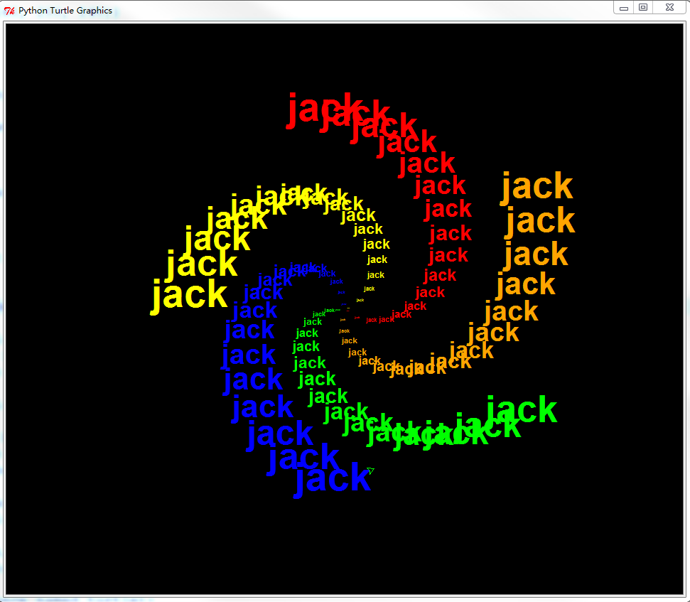
使用字符串绘图
将用户输入的内容以螺旋线的形式输出

Slide 7
使用字符串绘图
import turtle # set up turtle graphics t=turtle.Pen() turtle.bgcolor('black') # Set up a list of any 10 valid Python color names colors=['red', 'yellow', 'blue', 'green', 'orange','purple', 'white', 'gray', 'brown', 'sea green'] # ask the user's name using turtle's textinput popup window your_name = raw_input( "What is your name?") # ask the number of sides sides = int(raw_input("How many sides do you want (1-10)?, 5, 1, 10")) # draw a spiral of the name on the screen, written 100 times for x in range(100): t.pencolor(colors[x%sides%10]) # rotate through the 10 colors t.penup() # don't draw the regular spiral lines t.forward(x*4) # just move the turtle on the screen t.pendown() # now, write the user's name, bigger each time t.write(your_name, font=("Arial", int( (x*2 + 4) / 4), "bold") ) t.left(360/sides+2) # turn left 360/sides+2 degrees for sides turtle.done()

Slide 8
使用字符串绘图
(1)建立画笔环境
import turtle # set up turtle graphics

Slide 9
使用字符串绘图
(2) 打开画笔，并且将背景设置为黑色
t=turtle.Pen() turtle.bgcolor('black')

Slide 10
使用字符串绘图
(3) 设置一些列可供选择的颜色
colors=['red', 'yellow', 'blue', 'green', 'orange','purple', 'white', 'gray', 'brown', 'sea green']

Slide 11

使用字符串绘图
(4) 要求用户输入名字和图形的边数
your_name = raw_input( "What is your name?") # ask the number of sides sides = int(raw_input("How many sides do you want (1-10)?, 5, 1, 10"))

Slide 12
使用字符串绘图
(5) 开始绘图
for x in range(100): t.pencolor(colors[x%sides%10]) # rotate through the 10 colors t.penup() # don't draw the regular spiral lines t.forward(x*4) # just move the turtle on the screen t.pendown() # now, write the user's name, bigger each time t.write(your_name, font=("Arial", int( (x*2 + 4) / 4), "bold") ) t.left(360/sides+2) # turn left 360/sides+2 degrees for sides

Slide 13
使用字符串绘图
(6) 绘图结束
turtle.done()
Notes:
中文名字有问题

Slide 14
Python包的引入
使用已经写好的个中工具
绘图工具turtle
如果没有这个绘图工具，该怎么办呢
系统提供了这样的工具包，直接去使用
使用关键字import
Import turtle 即可将工具包加载到程序中供我们使用。

Slide 15
课后作业
修改绘图代码，当输入不同的边数时，查看输出图形

