Slide 1

nGrinder 3.0 Load Test even Kids can do
NHN

Slide 2

nGrinder
1
Since 2011
What’s my servers maximum TPS?
What’s the optimal DB pool size?

Slide 3

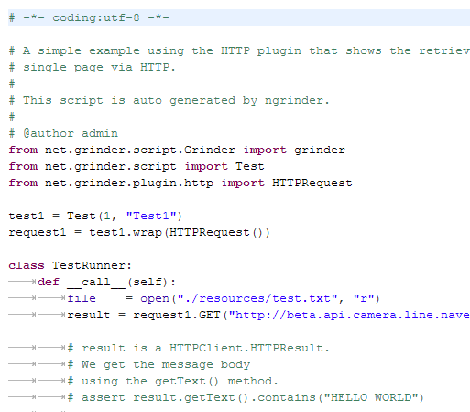
nGrinder
1
Since 2011
Base on grinder technology. LINE, Cubrid and a lot of services uses nGrinder for performance tests in NHN
nGrinder Farm
Agent
컨트롤러
PYTHON
Agent
Agent
Agent

Slide 4
Difficult Situation
2
I can not test because we didn’t reserve the farm. We should release this by tomorrow. ☹
All host based performance test tools needs a reservation. (nGrinder 2.X, Performance Center)
The tool should be always available whenever users need.
Should I get a training for just one day use?
The tool should be easy enough for novices to use.
We needs performance test tools which even kids can do anytime.

Slide 5
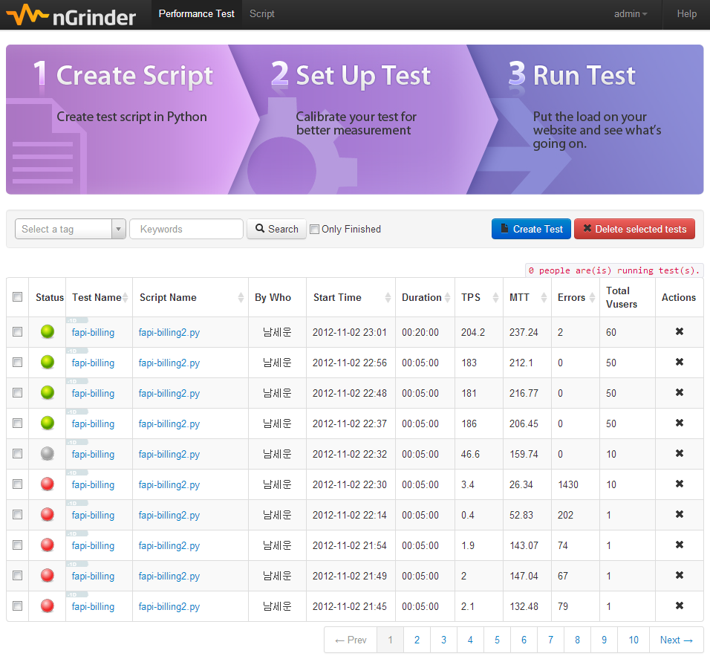
nGrinder 3.0
2
Since 2012.11 – Born again

Slide 6
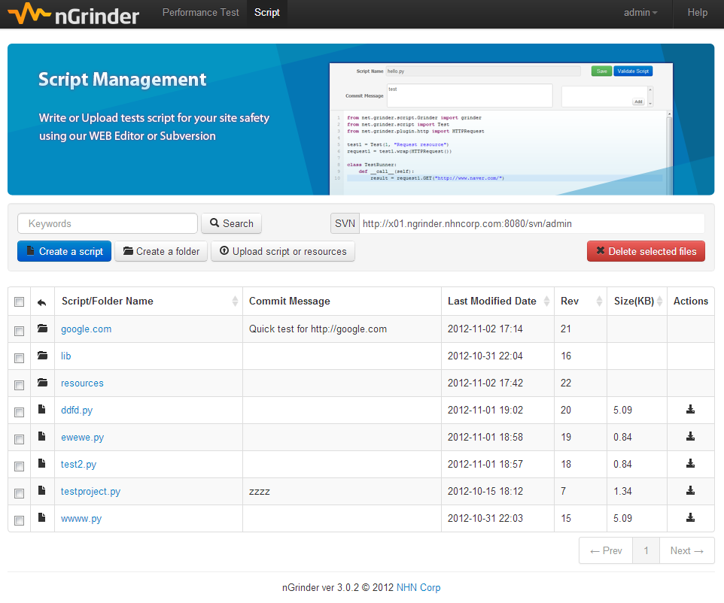
nGrinder 3.0
2
Since 2012.11 – Born again

Slide 7
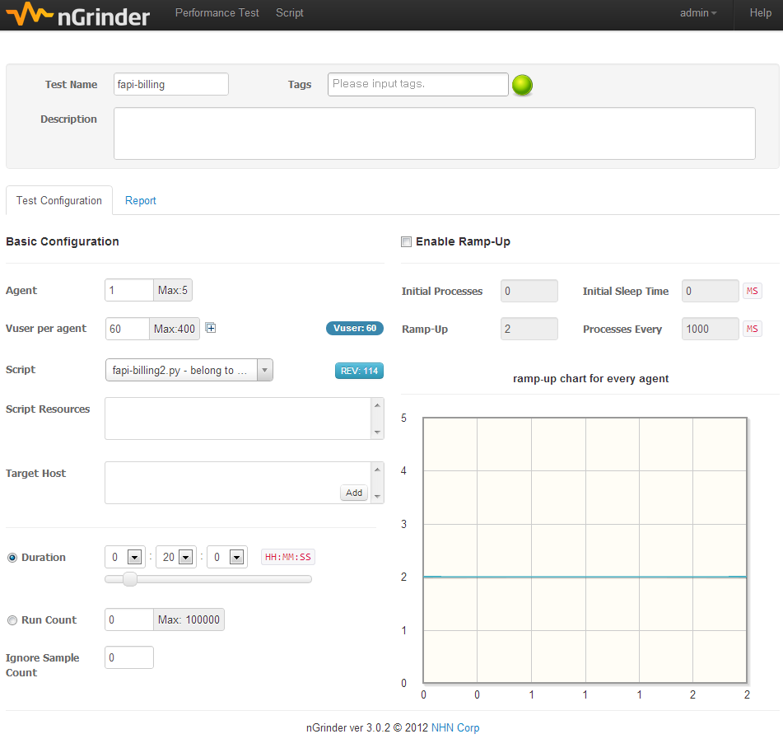
nGrinder 3.0
2
Since 2012.11 – Born again

Slide 8
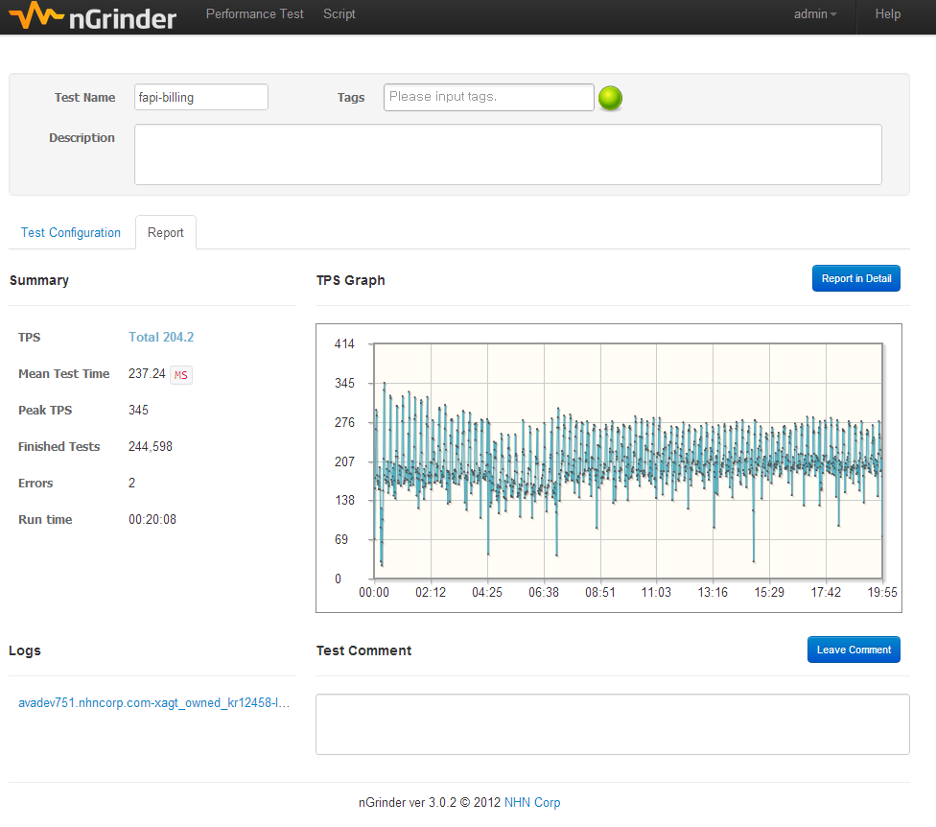
nGrinder 3.0
2
Since 2012.11 – Born again

Slide 9
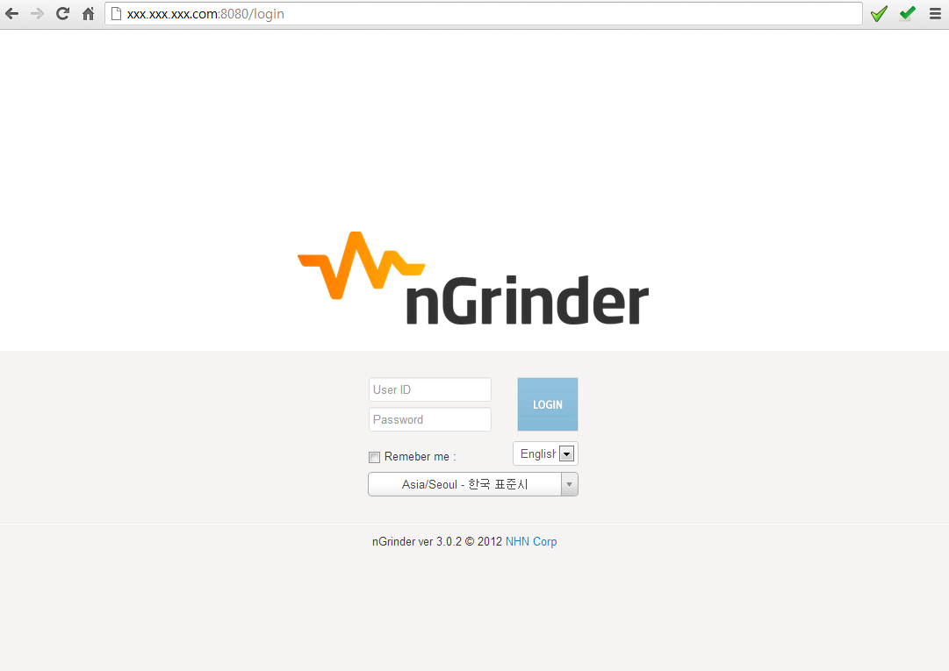

nGrinder 3.0
3
What’s changed?
Availability
Reservation? NO!! Anytime!!
Just access to your preinstalled nGrinder instance.
It was really good to use even when I was really busy

Slide 10
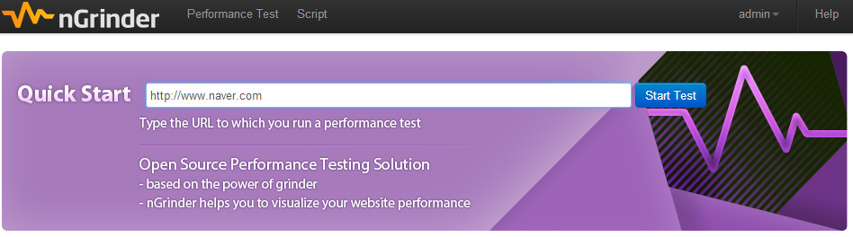
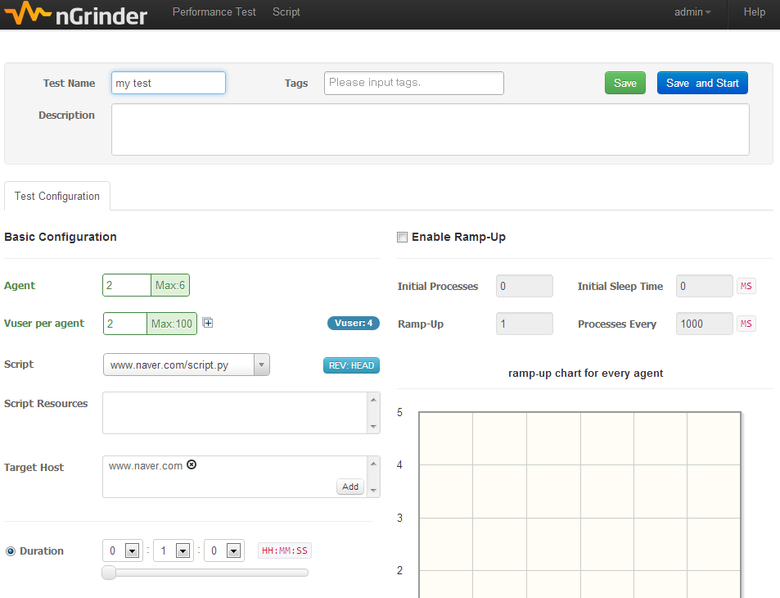


nGrinder 3.0
3
What’s changed?
Availability
Reservation? NO!! Anytime!!
Usability
It’s easy enough for kids to run tests. Only 5 fields are necessary to set
You can run test within 1 min
It has the UI which users likes to continue to use

Slide 11
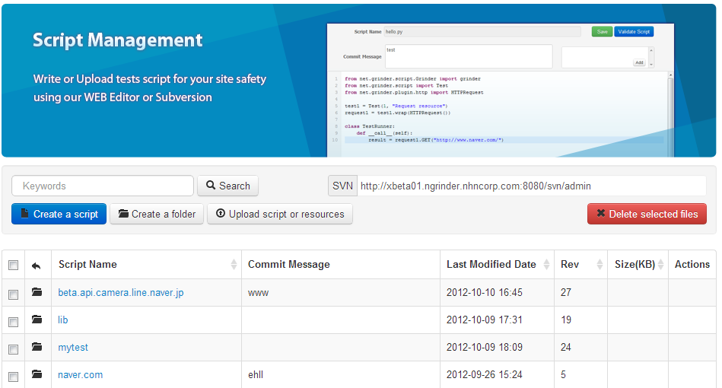
nGrinder 3.0
3
What’s changed?
Availability
Reservation? NO!! Anytime!!
Usability
It’s easy enough for kids to run tests. Only 5 fields are necessary to set
Usability
Use your favorite IDE then commit through SVN

Slide 12
nGrinder 3.0
3
What’s changed?
Availability
Reservation? NO!! Anytime!!
Usability
It’s easy enough for kids to run tests. Only 5 fields are necessary to set
Usability
Use your favorite IDE then commit through SVN
Installability
Just download and run!
Zero Configuration
run_agent.bat controller_ip

Slide 13

nGrinder 3.0
3
What’s changed?
Availability
Reservation? NO!! Anytime!!
Usability
It’s easy enough for kids to run tests. Only 5 fields are necessary to set
Usability
Use your favorite IDE then commit through SVN
Installability
Just download and run!
Stability
Bugs? Not much than before… ☺
The best Quality Control among all previous versions.

Slide 14
nGrinder 3.0
3
What’s changed?
Availability
Reservation? NO!! Anytime!!
Usability
It’s easy enough for kids to run tests. Only 5 fields are necessary to set
Usability
Use your favorite IDE then commit through SVN
Installability
Just download and run!
Stability
Bugs? Not much than before… ☺
OK!! Let’s see how to run it.

Slide 15
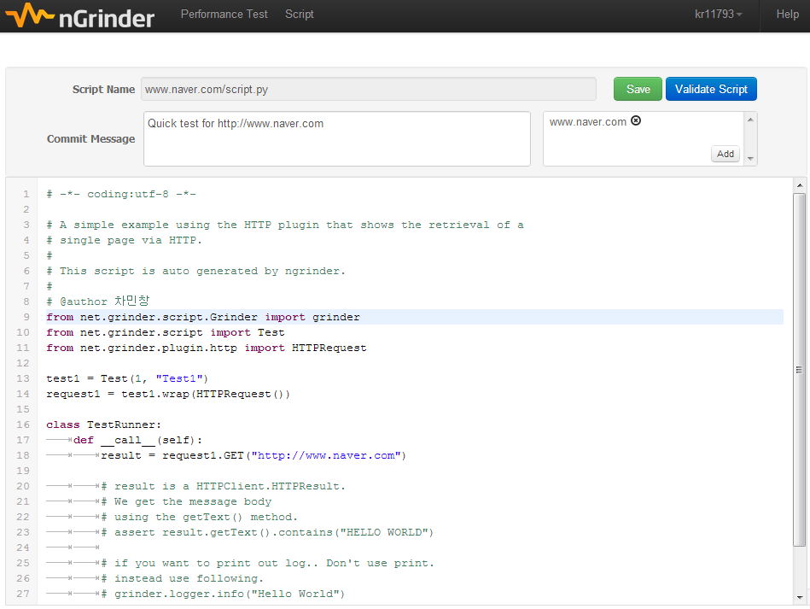
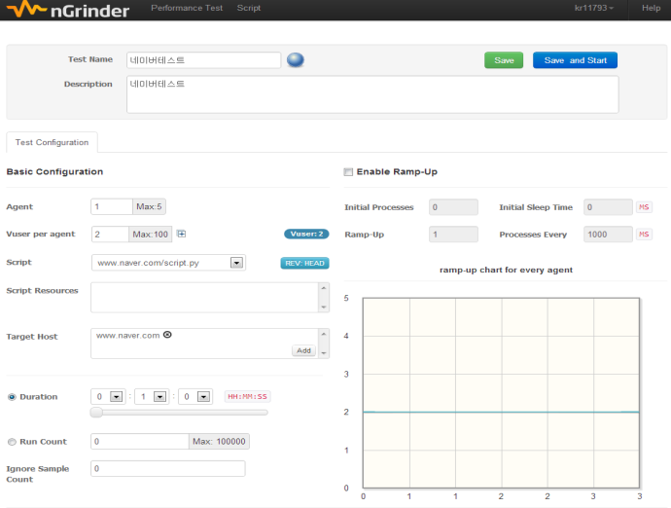
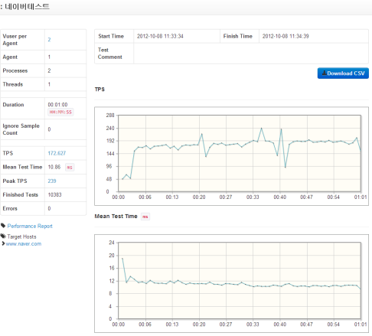
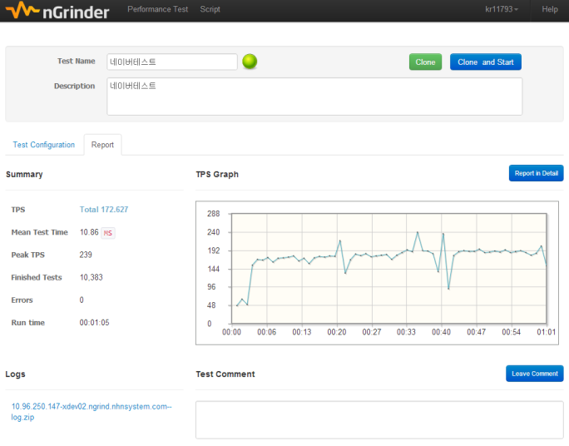
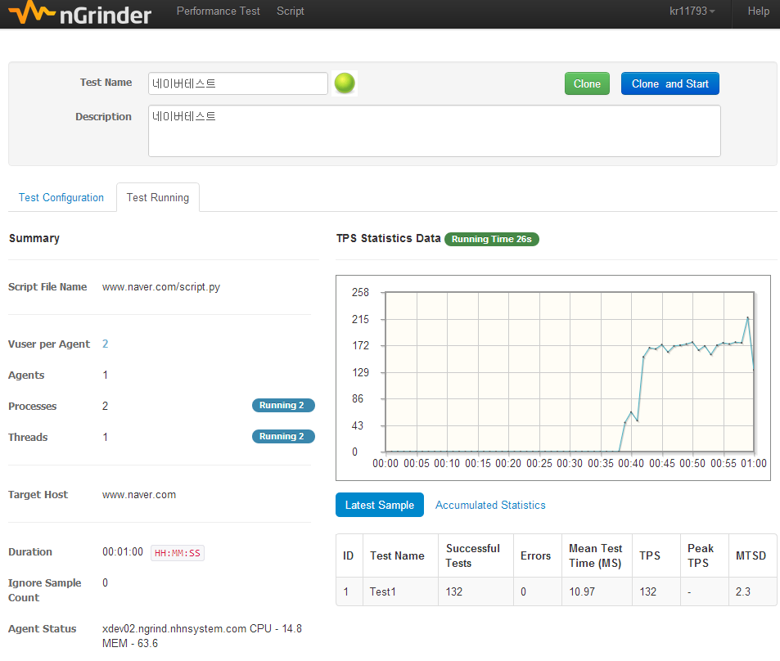
Demo
4
Write Script
Configure Test (ex:Vuser)
See the detailed result
Final Report
Run test

Slide 16

http://www.nhnopensource.org/ngrinder/

Slide 17
nGrinder Script Sample
A1
It’s same as grinder.
# -*- coding:utf-8 -*-
from net.grinder.script.Grinder import grinder
from net.grinder.script import Test
from net.grinder.plugin.http import HTTPPluginControl, HTTPRequest
from HTTPClient import NVPair
url = "http://beta.api.camera.line.naver.jp"
header = (NVPair('User-Agent', 'Mozilla/5.0 (Windows; U; Windows NT 5.0; en-US; rv:1.8.0.1) Gecko/20060111 Firefox/1.5.0.1'),)
test1 = Test(1, "Test1")
def page():
result1 = HTTPRequest(url=url, headers=header).GET("/stamp/overview")
result2 = HTTPRequest(url=url, headers=header).GET("/stamp/log/pick/CV/myDeviceId/101")
result3 = HTTPRequest(url=url, headers=header).GET("/stamp/section/36")
result4 = HTTPRequest(url=url, headers=header).GET("/stamp/log/pick/CV/myDeviceId/101")
assert result1.getText().find("SPONSOR") != -1
assert result2.getText().find("error") == -1
assert result3.getText().find("Beads") != -1
assert result4.getText().find("error") == -1
page = test1.wrap(Page)
class TestRunner:
def __call__(self):
page()

Slide 18
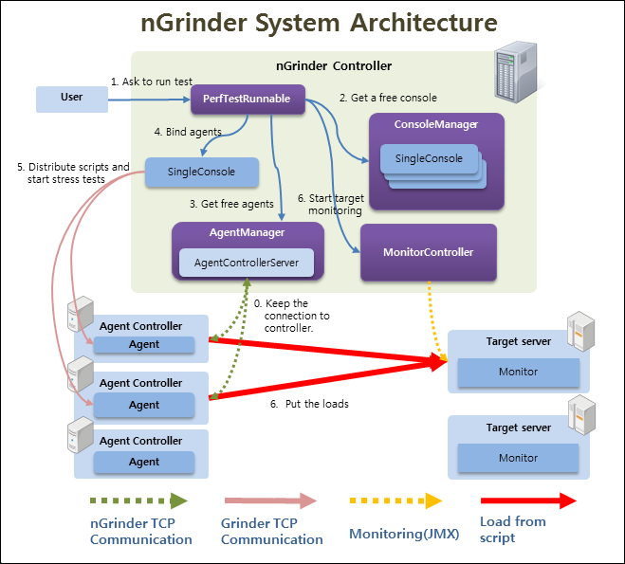
nGrinder: Architecture
A2

