Slide 1

nGrinder 3.0 Load Test even Kids can do
NHN

Slide 2

nGrinder
1
Since 2011
What’s my servers maximum TPS?
What’s the optimal DB pool size?

Slide 3

nGrinder
1
Since 2011
Base on grinder technology. LINE, Cubrid and a lot of services uses nGrinder for performance tests in NHN
nGrinder Farm
Agent
컨트롤러
Agent
Agent
Agent

Slide 4
nGrinder
1
Since 2011
nGrinder Farm
Agent
컨트롤러
Agent
Agent
Agent

Slide 5
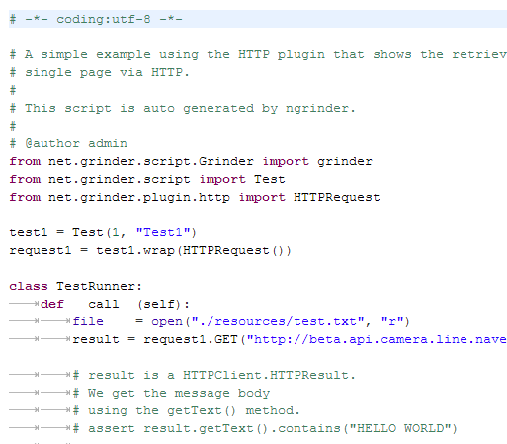
nGrinder
1
Since 2011
nGrinder Farm
Agent
컨트롤러
PYTHON
Agent
Agent
Agent

Slide 6
nGrinder
1
Since 2011
nGrinder Farm
Agent
컨트롤러
PYTHON
Agent
Agent
Agent

Slide 7
nGrinder
1
Since 2011
nGrinder Farm
Agent
컨트롤러
PYTHON
Agent
Agent
Agent

Slide 8
Difficult Situation
2
I can not test because we didn’t reserve the farm. We should release this by tomorrow. ☹
All host based performance test tools needs a reservation. (nGrinder 2.X, Performance Center)
The tool should be always available whenever users need.

Slide 9
Difficult Situation
2
I can not test because we didn’t reserve the farm. We should release this by tomorrow. ☹
All host based performance test tools needs a reservation. (nGrinder 2.X, Performance Center)
The tool should be always available whenever users need.
Should I get a training for just one day use?
The tool should be easy enough for novices to use.

Slide 10
Difficult Situation
2
I can not test because we didn’t reserve the farm. We should release this by tomorrow. ☹
All host based performance test tools needs a reservation. (nGrinder 2.X, Performance Center)
The tool should be always available whenever users need.
Should I get a training for just one day use?
The tool should be easy enough for novices to use.
We needs performance test tools which even kids can do anytime.

Slide 11
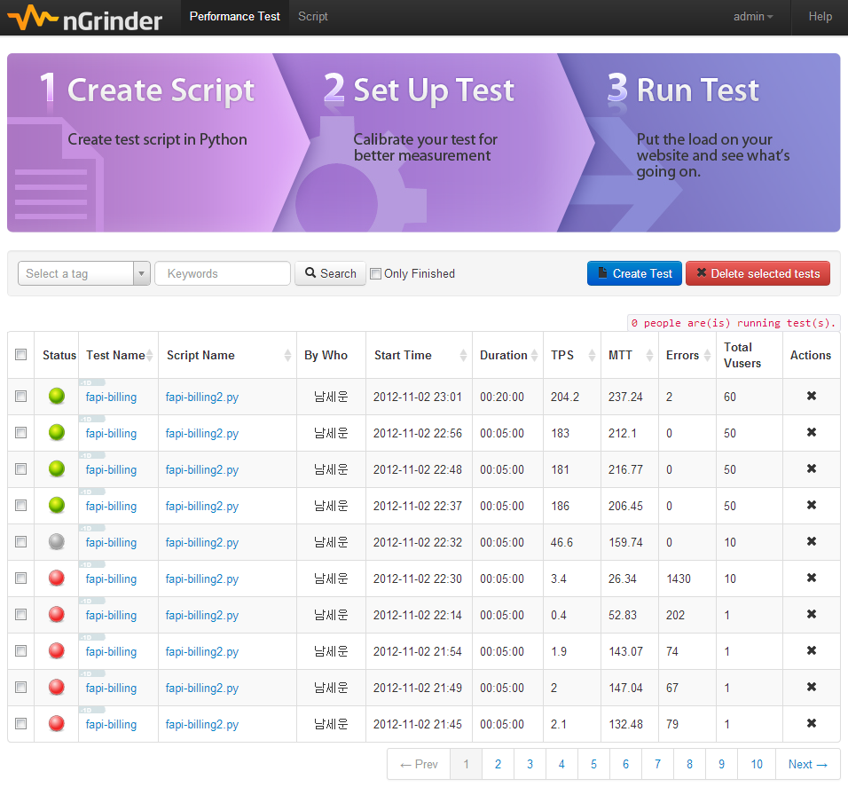
nGrinder 3.0
2
Since 2012.11 – Born again

Slide 12
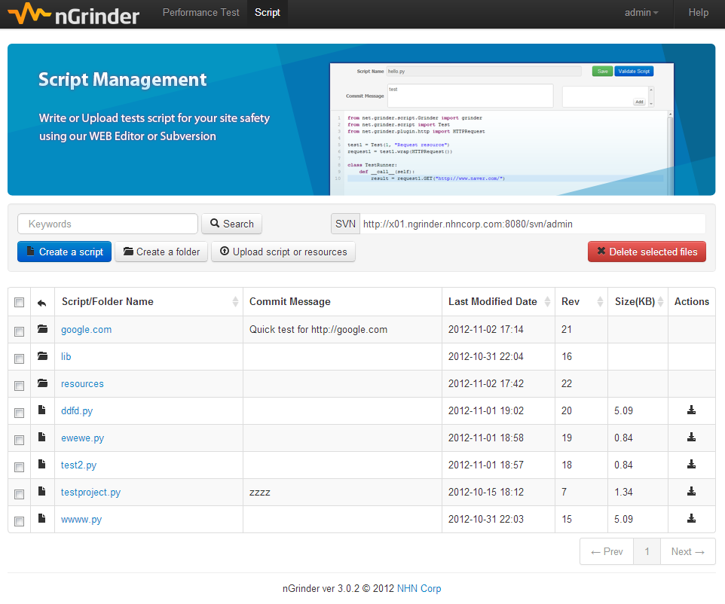
nGrinder 3.0
2
Since 2012.11 – Born again

Slide 13
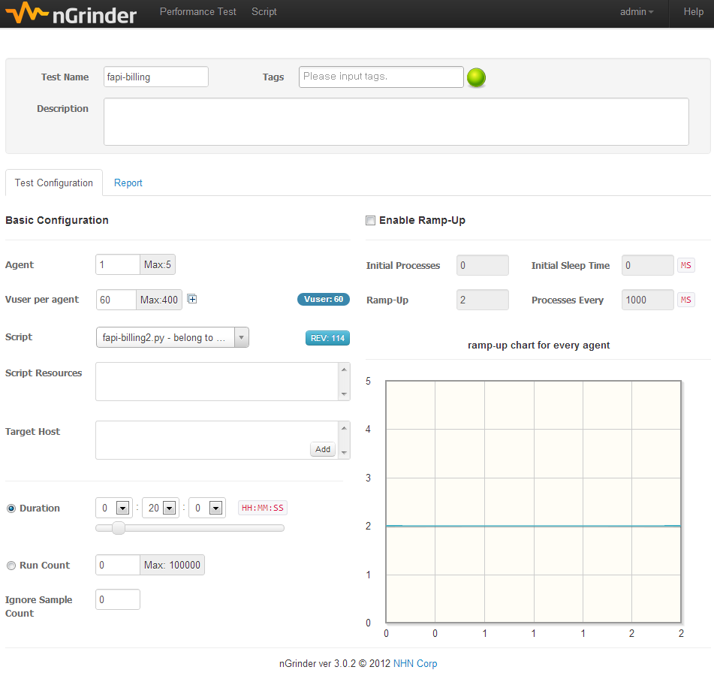
nGrinder 3.0
2
Since 2012.11 – Born again

Slide 14
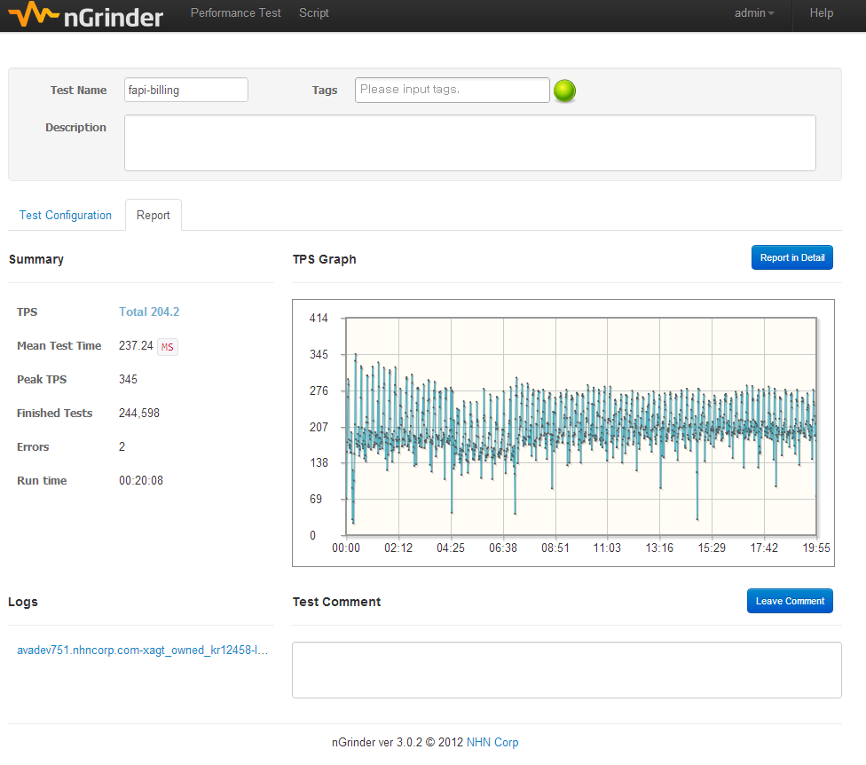
nGrinder 3.0
2
Since 2012.11 – Born again

Slide 15
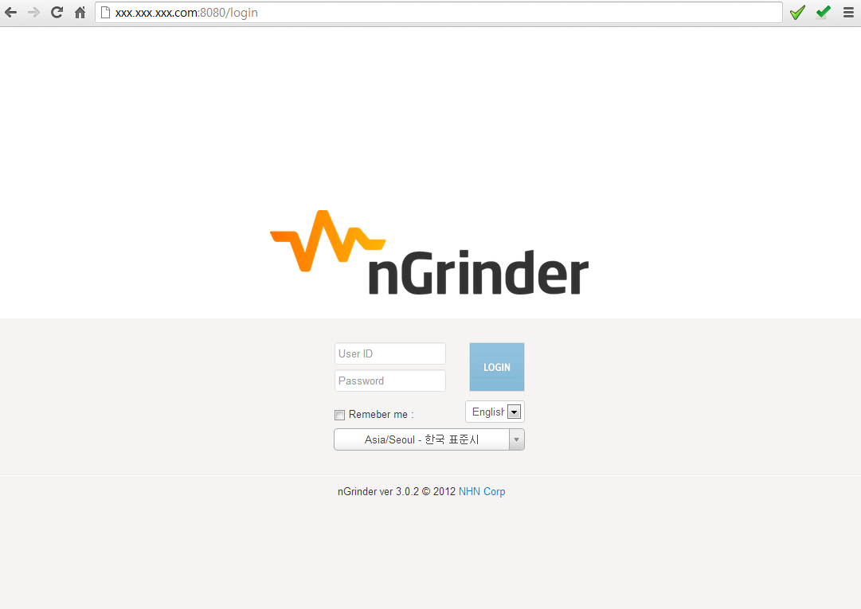
nGrinder 3.0
3
What’s changed?
Availability
Reservation? NO!! Anytime!!
Just access to your preinstalled nGrinder instance.

Slide 16

nGrinder 3.0
3
What’s changed?
Availability
Reservation? NO!! Anytime!!
It was really good to use even when I was really busy

Slide 17
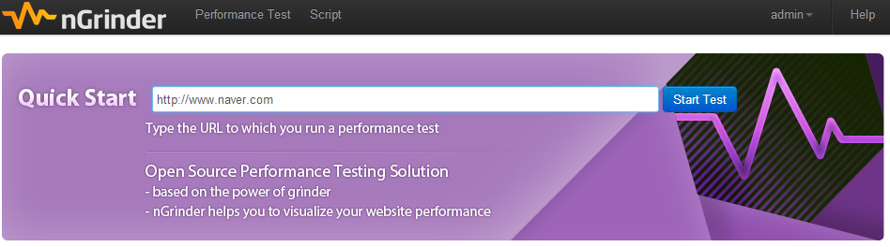

nGrinder 3.0
3
What’s changed?
Availability
Reservation? NO!! Anytime!!
Usability
It’s easy enough for kids to run tests. Only 5 fields are necessary to set

Slide 18
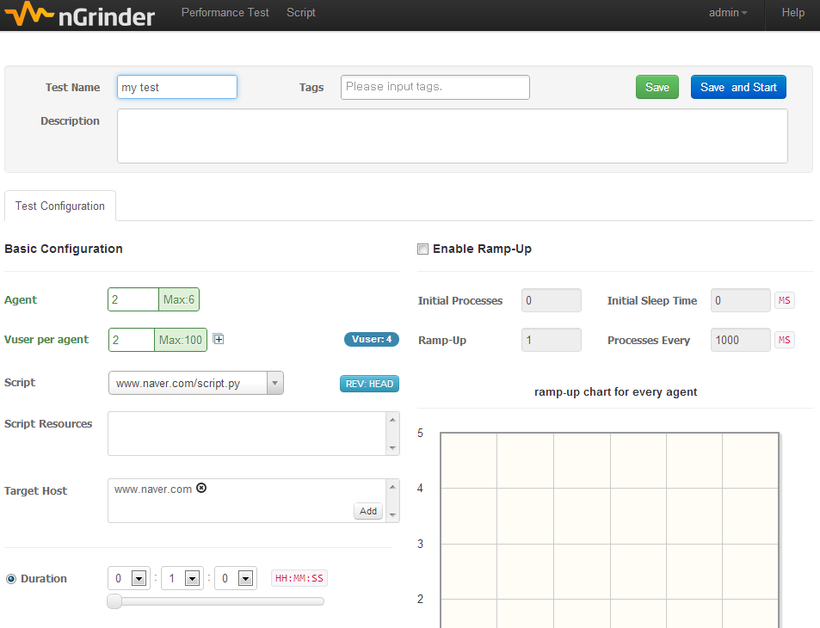
nGrinder 3.0
3
What’s changed?
Availability
Reservation? NO!! Anytime!!
Usability
It’s easy enough for kids to run tests. Only 5 fields are necessary to set

Slide 19
nGrinder 3.0
3
What’s changed?
Availability
Reservation? NO!! Anytime!!
Usability
It’s easy enough for kids to run tests. Only 5 fields are necessary to set
You can run test within 1 min

Slide 20

nGrinder 3.0
3
What’s changed?
Availability
Reservation? NO!! Anytime!!
Usability
It’s easy enough for kids to run tests. Only 5 fields are necessary to set
It has the UI which users likes to continue to use

Slide 21
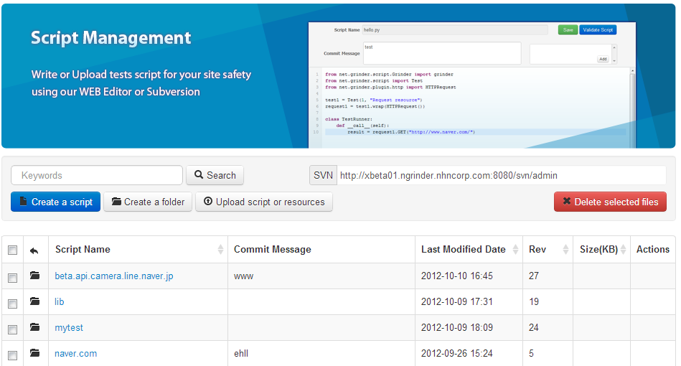
nGrinder 3.0
3
What’s changed?
Availability
Reservation? NO!! Anytime!!
Usability
It’s easy enough for kids to run tests. Only 5 fields are necessary to set
Usability
Use your favorite IDE then commit through SVN

Slide 22
nGrinder 3.0
3
What’s changed?
Availability
Reservation? NO!! Anytime!!
Usability
It’s easy enough for kids to run tests. Only 5 fields are necessary to set
Usability
Use your favorite IDE then commit through SVN

Slide 23
nGrinder 3.0
3
What’s changed?
Availability
Reservation? NO!! Anytime!!
Usability
It’s easy enough for kids to run tests. Only 5 fields are necessary to set
Usability
Use your favorite IDE then commit through SVN
Installability
Just download and run!
Zero Configuration
run_agent.bat controller_ip

Slide 24

nGrinder 3.0
3
What’s changed?
Availability
Reservation? NO!! Anytime!!
Usability
It’s easy enough for kids to run tests. Only 5 fields are necessary to set
Usability
Use your favorite IDE then commit through SVN
Installability
Just download and run!
Stability
Bugs? Not much than before… ☺
The best Quality Control among all previous versions.

Slide 25
nGrinder 3.0
3
What’s changed?
Availability
Reservation? NO!! Anytime!!
Usability
It’s easy enough for kids to run tests. Only 5 fields are necessary to set
Usability
Use your favorite IDE then commit through SVN
Installability
Just download and run!
Stability
Bugs? Not much than before… ☺
OK!! Let’s see how to run it.

Slide 26
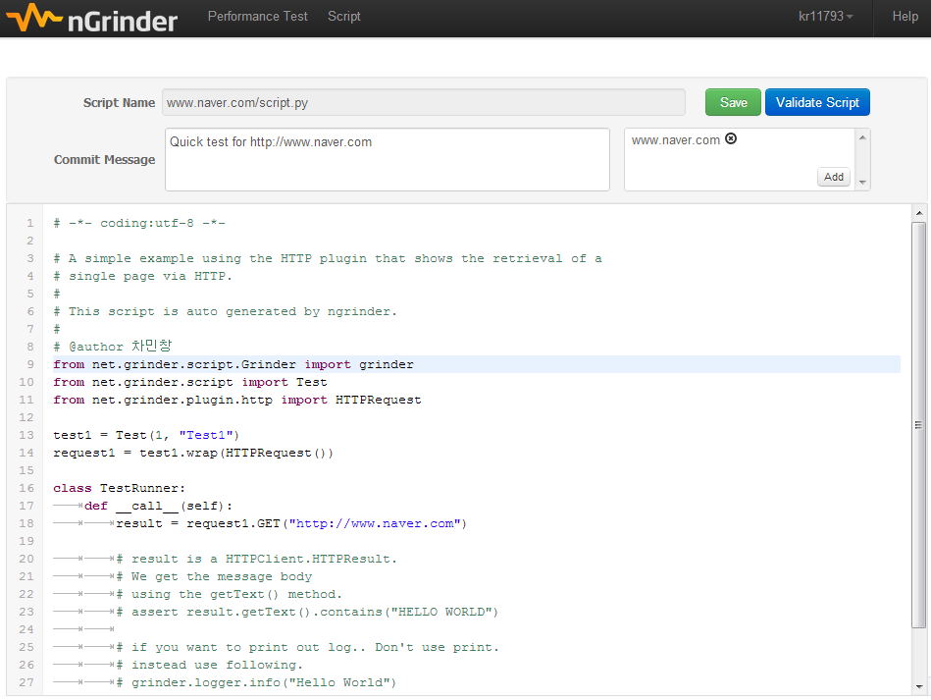
Demo
4
Write Script

Slide 27
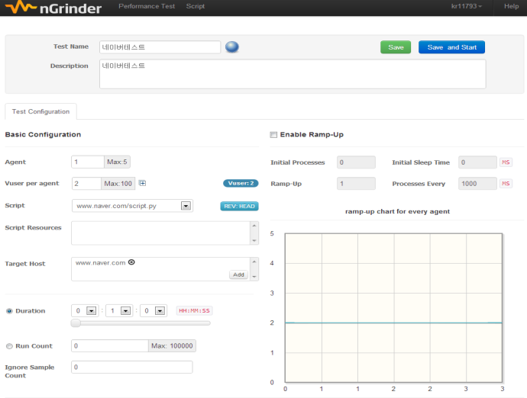
Demo
4
Write Script
Configure Test (ex:Vuser)

Slide 28
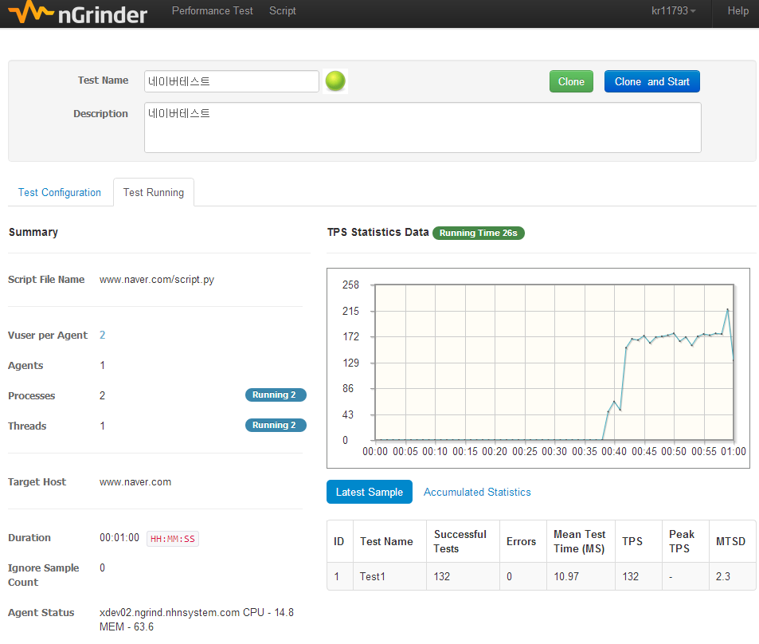
Demo
4
Write Script
Configure Test (ex:Vuser)
Run test

Slide 29
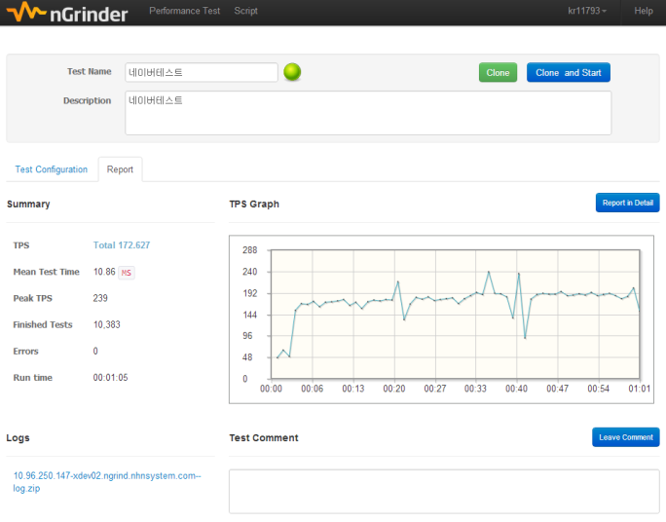
Demo
4
Write Script
Configure Test (ex:Vuser)
Final Report
Run test

Slide 30
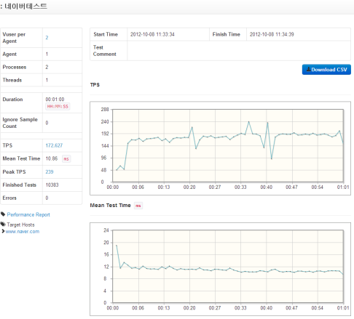
Demo
4
Write Script
Configure Test (ex:Vuser)
See the detailed result
Final Report
Run test

Slide 31

http://www.nhnopensource.org/ngrinder/

Slide 32
nGrinder Script Sample
A1
It’s same as grinder.
# -*- coding:utf-8 -*-
from net.grinder.script.Grinder import grinder
from net.grinder.script import Test
from net.grinder.plugin.http import HTTPPluginControl, HTTPRequest
from HTTPClient import NVPair
url = "http://beta.api.camera.line.naver.jp"
header = (NVPair('User-Agent', 'Mozilla/5.0 (Windows; U; Windows NT 5.0; en-US; rv:1.8.0.1) Gecko/20060111 Firefox/1.5.0.1'),)
test1 = Test(1, "Test1")
def page():
result1 = HTTPRequest(url=url, headers=header).GET("/stamp/overview")
result2 = HTTPRequest(url=url, headers=header).GET("/stamp/log/pick/CV/myDeviceId/101")
result3 = HTTPRequest(url=url, headers=header).GET("/stamp/section/36")
result4 = HTTPRequest(url=url, headers=header).GET("/stamp/log/pick/CV/myDeviceId/101")
assert result1.getText().find("SPONSOR") != -1
assert result2.getText().find("error") == -1
assert result3.getText().find("Beads") != -1
assert result4.getText().find("error") == -1
page = test1.wrap(Page)
class TestRunner:
def __call__(self):
page()

Slide 33
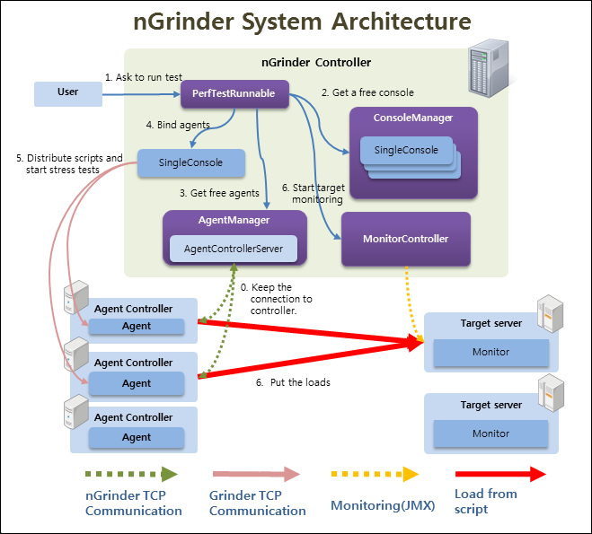
nGrinder: Architecture
A2

