Slide 1


nGrinder System Architecture
nGrinder Controller
2. Get a free console
1. Ask to run test
PerfTestRunnable
ConsoleManager
4. Bind agents
SingleConsole
SingleConsole
SingleConsole
SingleConsole
5. Distribute scripts and start stress tests
3. Get free agents
6. Start target monitoring
AgentManager
MonitorController
AgentControllerServer
0. Keep the connection to controller
Agent Controller
Agent
Target Server
Agent Controller
Monitor
6. Put the loads
Agent
Target Server
Agent Controller
Monitor
Agent
nGrinder TCP communication
grinder TCP communication
Monitoring(JMX)
Load from scripts

Slide 2
nGrinder controller without clustering
Spring Security
Console manager
Agent manager
Spring MVC
Grinder Console
Agent
EhCache
Spring Service
Plugins
Spring Data
SVNkit
APF
(Atlassian Plugin Framework)
DB (H2, Cubrid)
Home directory ${NGRINDER_HOME}
One ngrinder controller serve all users request and all tests

Slide 3
nGrinder controller with clustering
L4 (Load Balancer)
Region A
Spring Security
Spring Security
Region B
Console manager
Agent manager
Console manager
Agent manager
Spring MVC
Spring MVC
Grinder Console
Agent
Grinder Console
Agent
EhCache
Replicate
EhCache
Plugins
Spring Service
Spring Service
Plugins
APF
(Atlassian Plugin Framework)
Spring Data
SVNkit
Spring Data
SVNkit
APF
(Atlassian Plugin Framework)
Logging
Ex config.
Local FS
${NGRINDER_HOME_EX}
DB (Cubrid Master)
Home directory on network FS
${NGRINDER_HOME}
Local FS
${NGRINDER_HOME_EX}
DB (Cubrid Slave)
Each ngrinder controller can serve all users request evenly
but handles responsible regional tests in the background

Slide 4
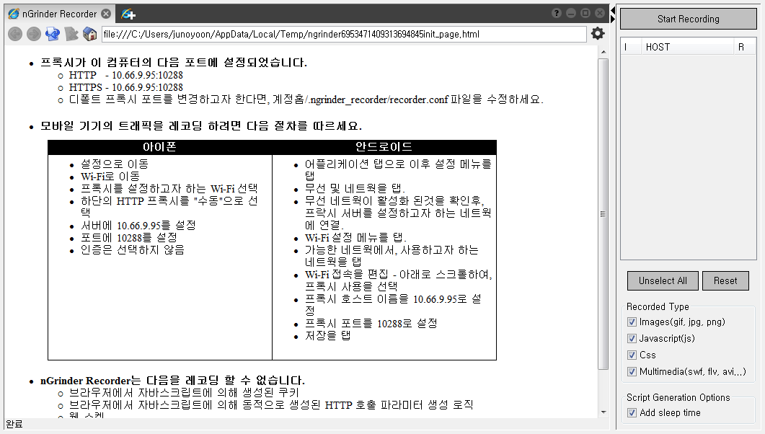


nGrinder Recorder Architecture
1. Run Recorder
6. Start Recording
18. Stop Recording
Recorder
2. Run HTTP / HTTPS proxy in local PC 3. Get the proxy port
7. Run TCPProxy recorder
4. Create Browser instance
5. Set the proxy port on the instance
10. Send HTTP request to Proxy
17. Send HTTP Response back
11. Register connection
12. Check if the connection is filtered or not
JxBrowser
TCPProxy
9. browse recording target
private
Connection Filter
14. Record Request
16. Record Response
HTTPRecording
DelegateSSLEngine
19. Filter requests with connection again and analyze the relation b/w requests
13. Decode user request with private cert.
15. Decode response with web server’s cert and encode response with private cert and send back.
HTTPRecordingResult ProcessorWithFreeMarker
13. Send the request to target 15. Return the response
public
20. Generate script with template
Web Server

