Slide 2
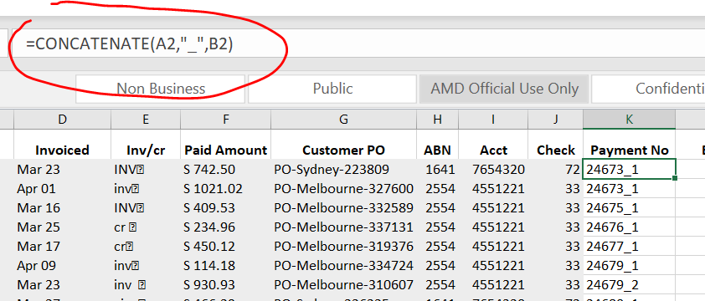
Concatenate function (joins text together)
Concatenate 2 cell strings with “_”:

Slide 3
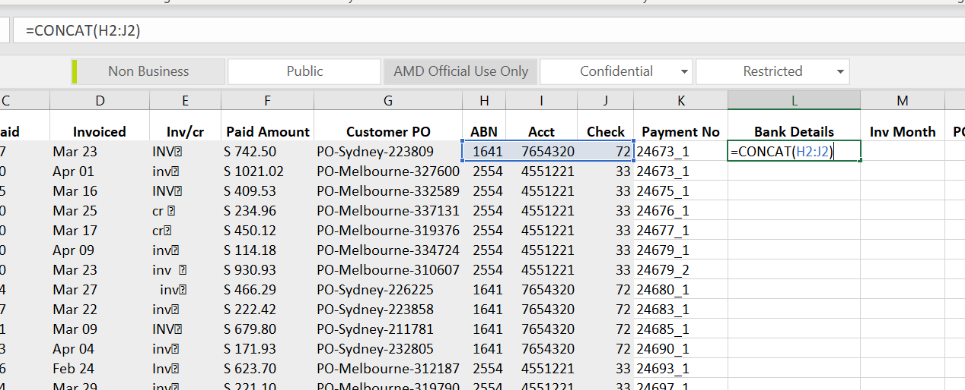
Concat Operator (concate ajacent elements)

Slide 4
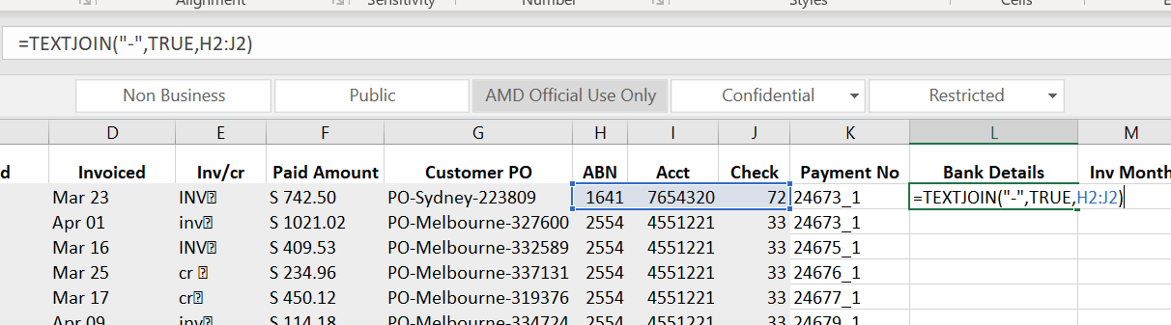
TEXTJOIN (advanced options in combing cells)

Slide 5
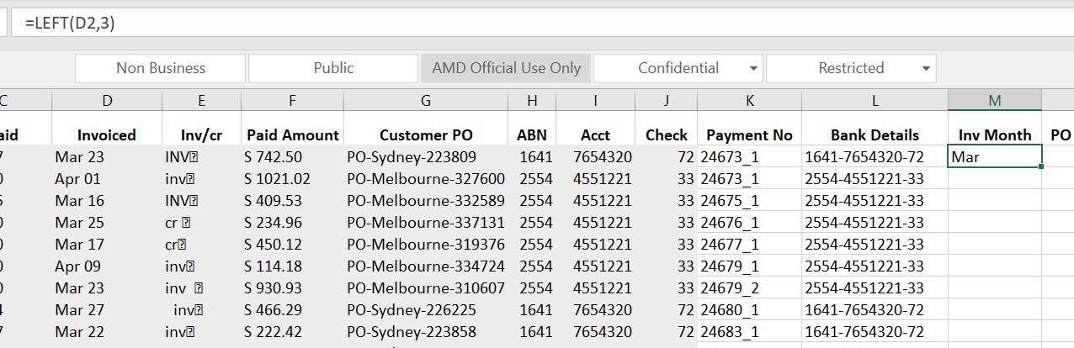
LEFT(Returns the leftmost characters from a text value)
It only work if the target is text format not date format

Slide 6
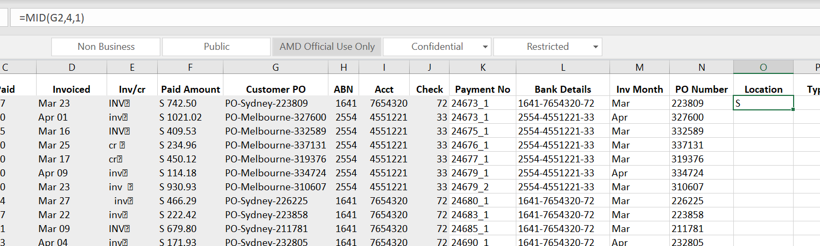
MID(returns a specific number of characters starting at a specifiedposition)

Slide 7
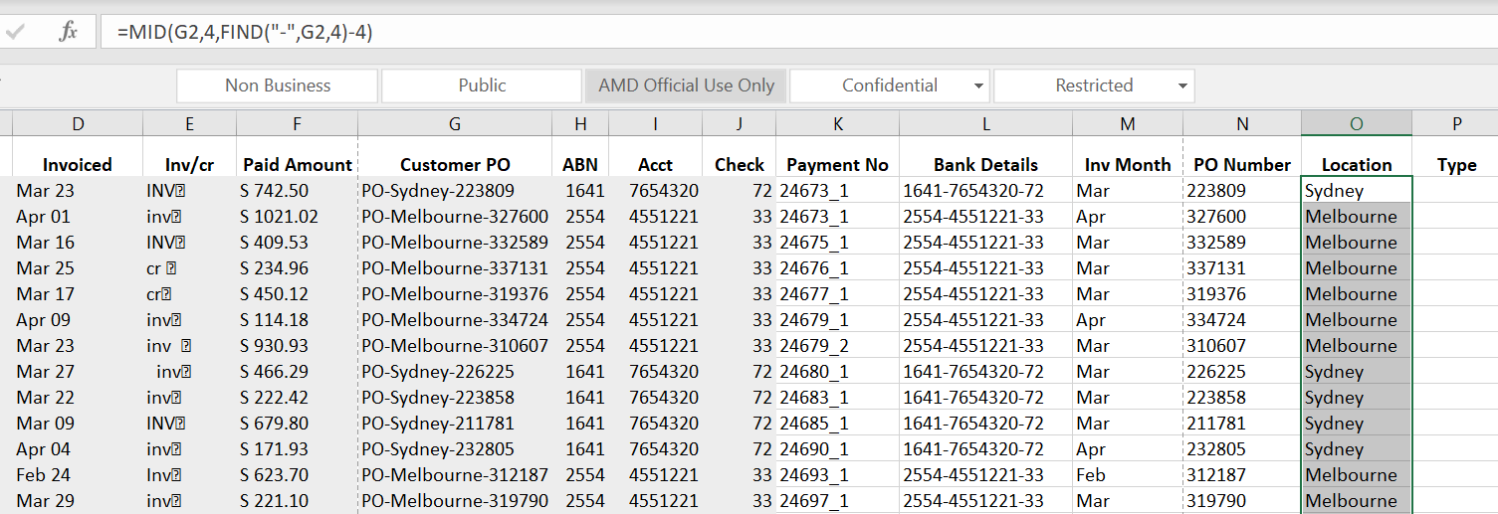
Find (find one text value within another text value)

Slide 8
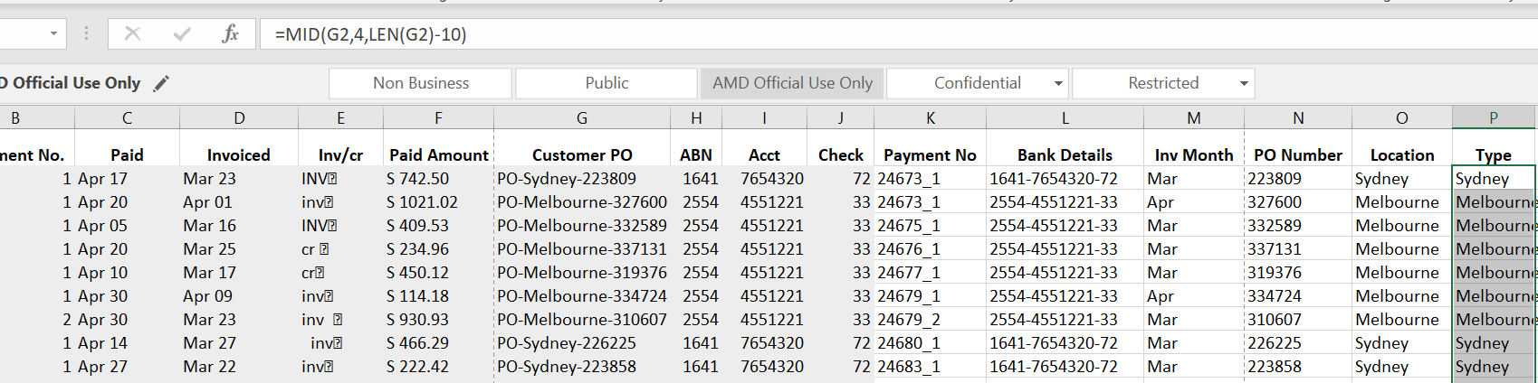
LEN (Return the number of characters in a text string)

Slide 9
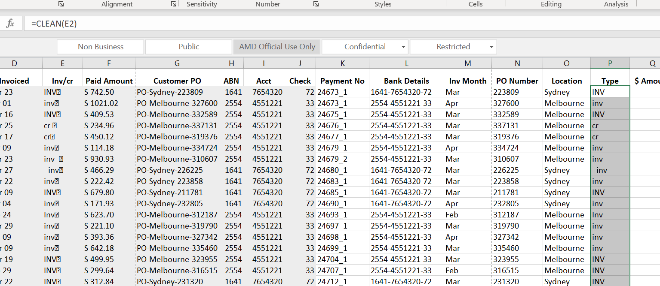
Clean (strips non-printable characters from text)

Slide 10
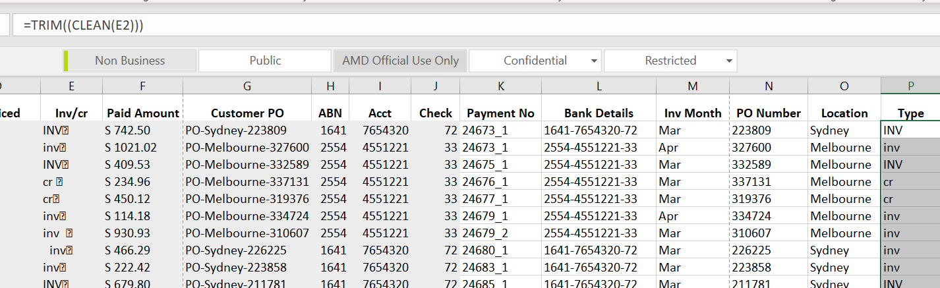
Trim (removes extra spaces from text)

Slide 11
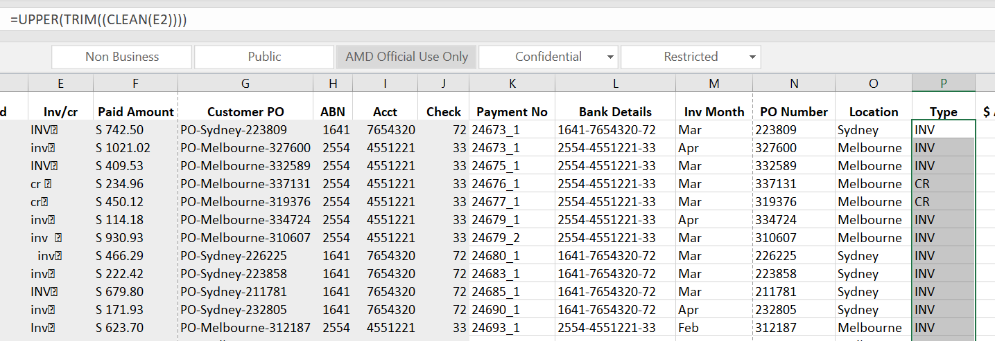
Change case
UPPER
LOWER
PROPER(Capitalizes only the first letter of each word)

Slide 12
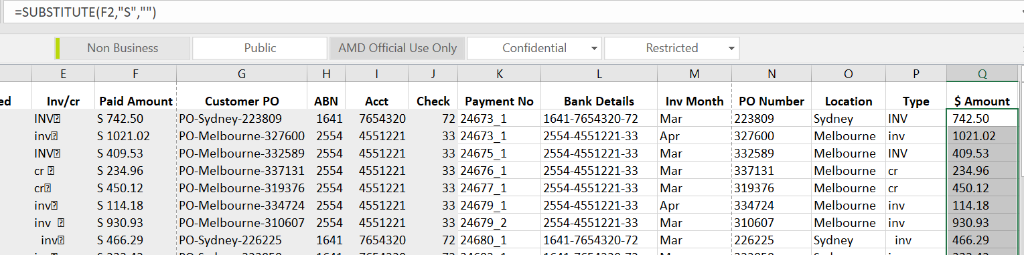
Substitute
Replace text based on content

Slide 13
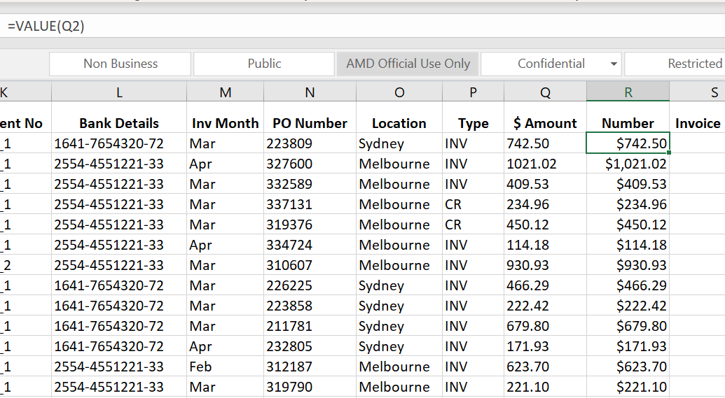
Value (convert text to a numerical value)

Slide 14
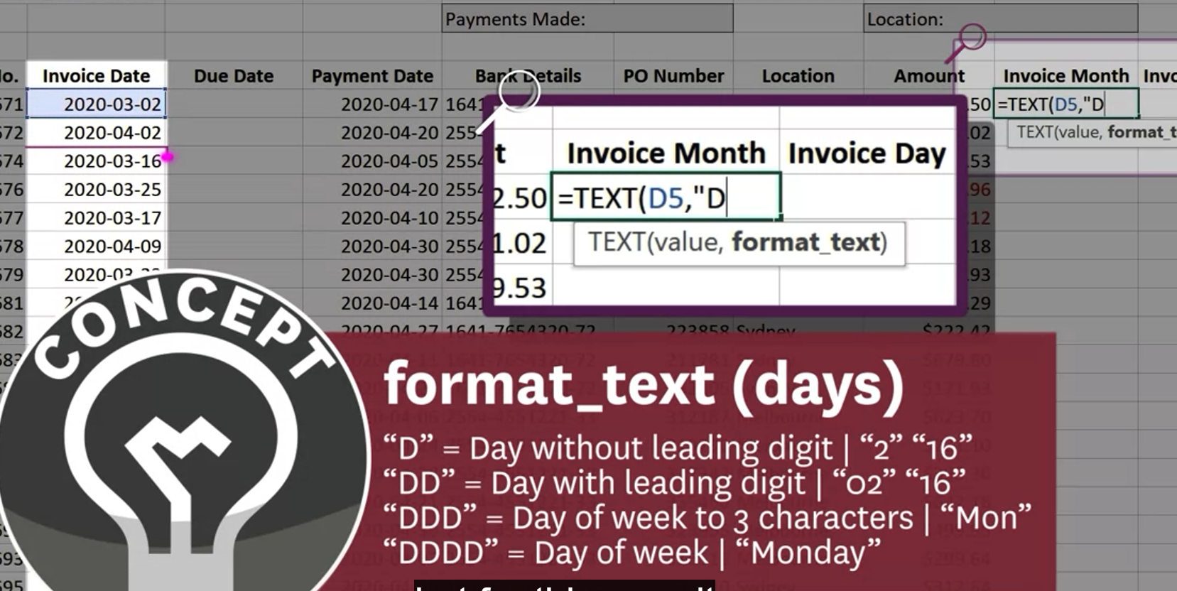
Text(convert and return date as plain text)

Slide 15
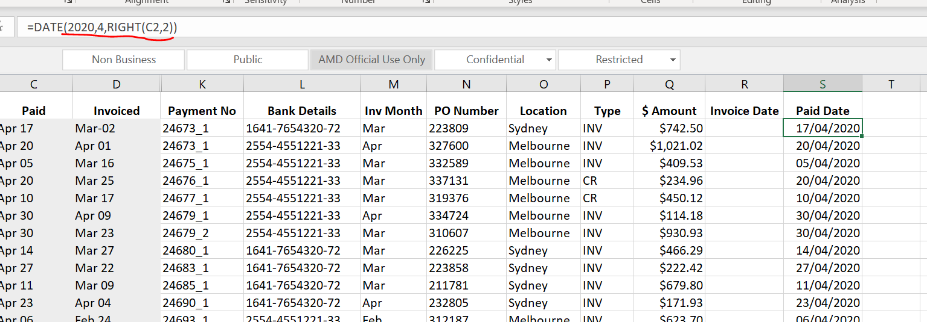
Date (convert text to date)
Must be all numbers
Extract C2 date information

Slide 16
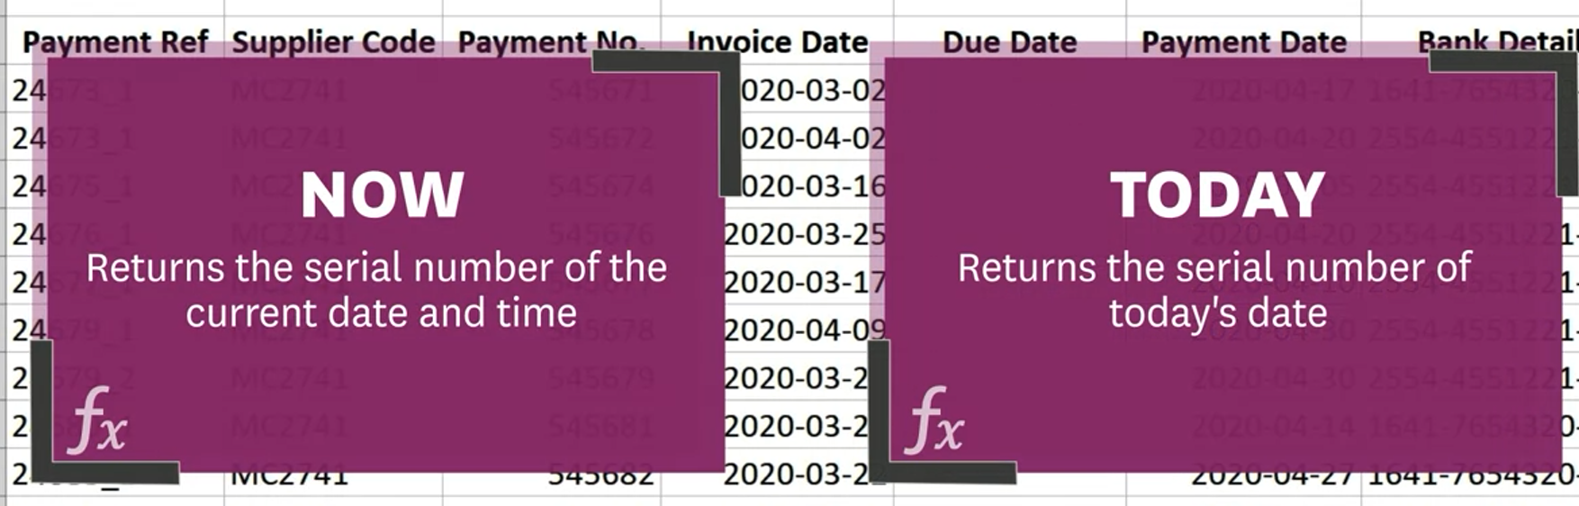
Now & TODAY function

Slide 17
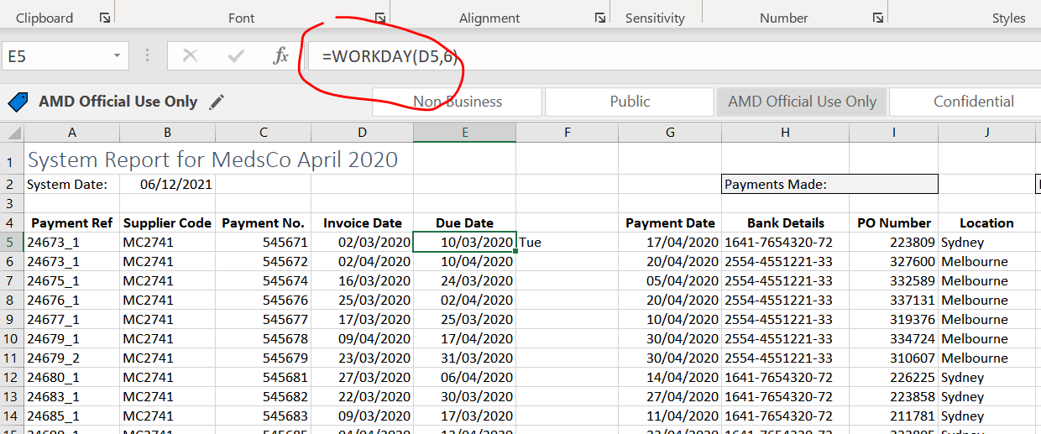
WORKDAY
6 workdays after particular date (assume sat/sun are non-working days)

Slide 18
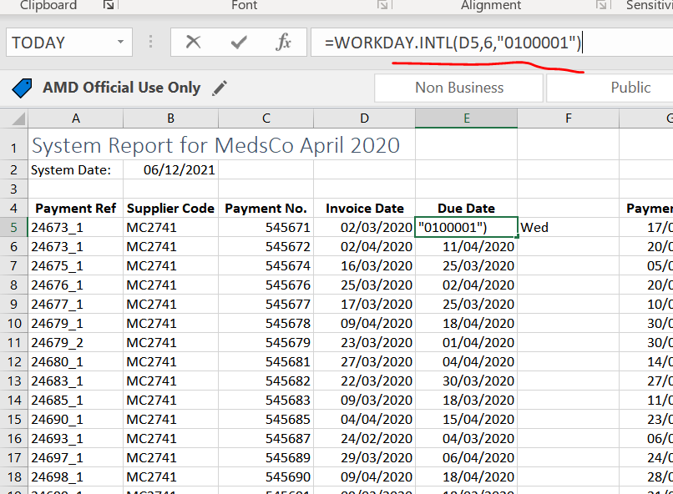
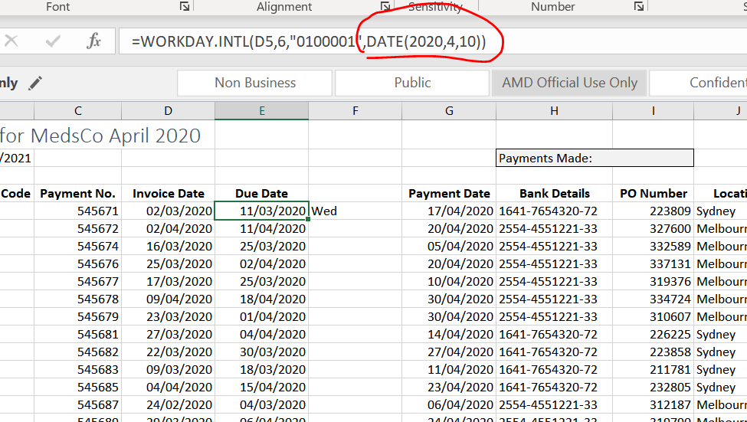
Workday.intl
6 workdays after (assume Tue/Sun are non-working days, so put “1”, the rest days put “0”)
If we want to take into a account of holiday(eg, April 10)

Slide 19
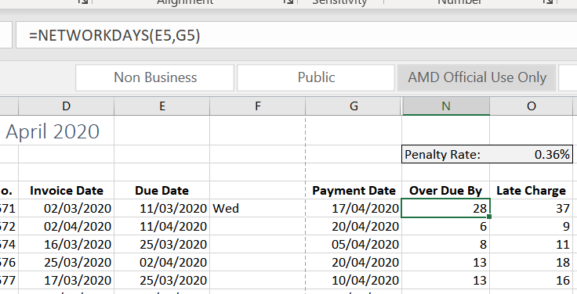
Networkdays (return the number of whole working days between a start/end date)
Assume sat/sun holiday

Slide 20
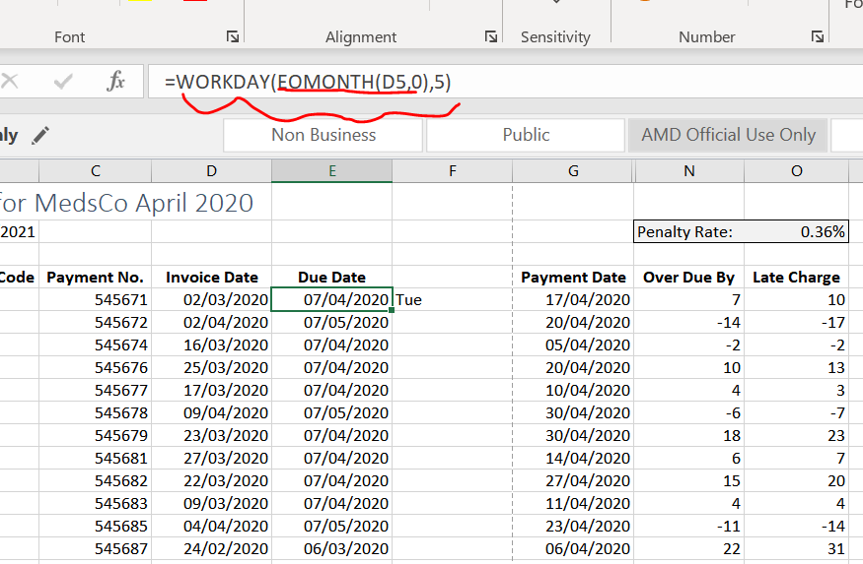
EOMONTH(date of last day of particular month)
Date of last day of this month
5 days after last day of this month

