Slide 1
Excel Essentials

Slide 2
Workbook and worksheet
When you open Microsoft Excel (a spreadsheet program), you're opening a workbook. A workbook can contain one or more different worksheets that can be accessed through the tabs at the bottom of the worksheet your currently viewing.

Slide 3
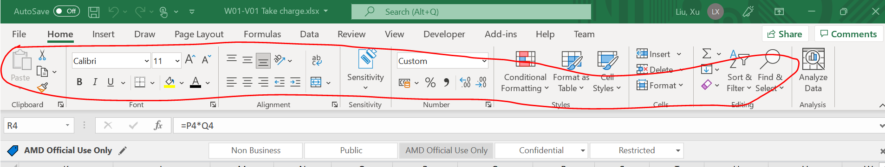
Appear/disappear ribbon tabs
Tab
Ribbon

Slide 4
Navigate worksheet
Ctrl+ Home (how to quickly return to line 1)
Jump from line 1 to line2 (press ‘pg up’ or ‘pg down’)

Slide 5
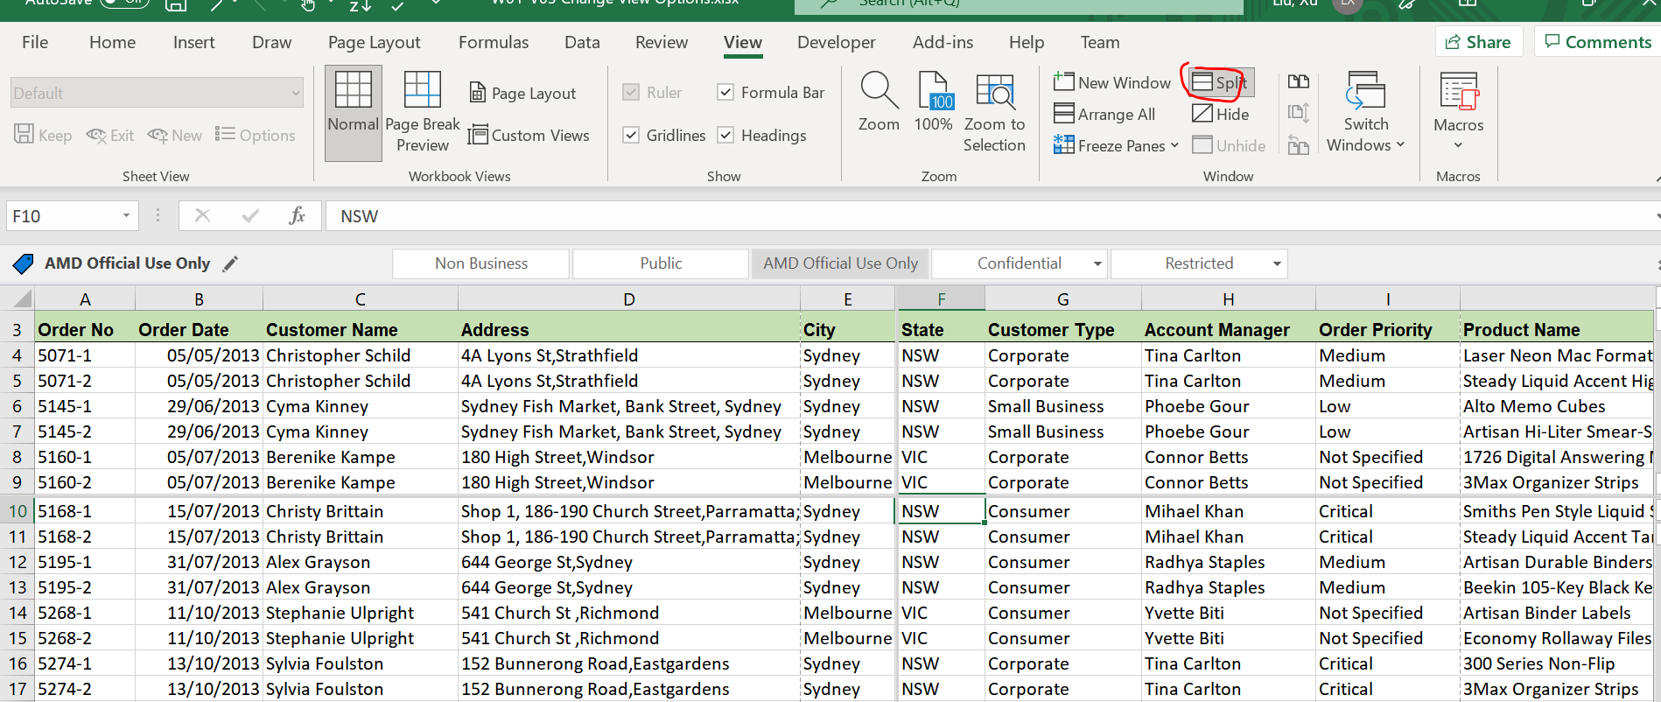
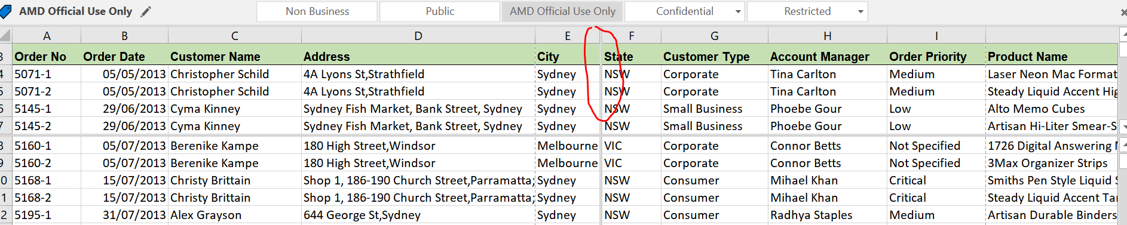
View worksheet
Split page:
1) Select “View” -> “Split”
2)Double click the vertical split line to remove it

Slide 6
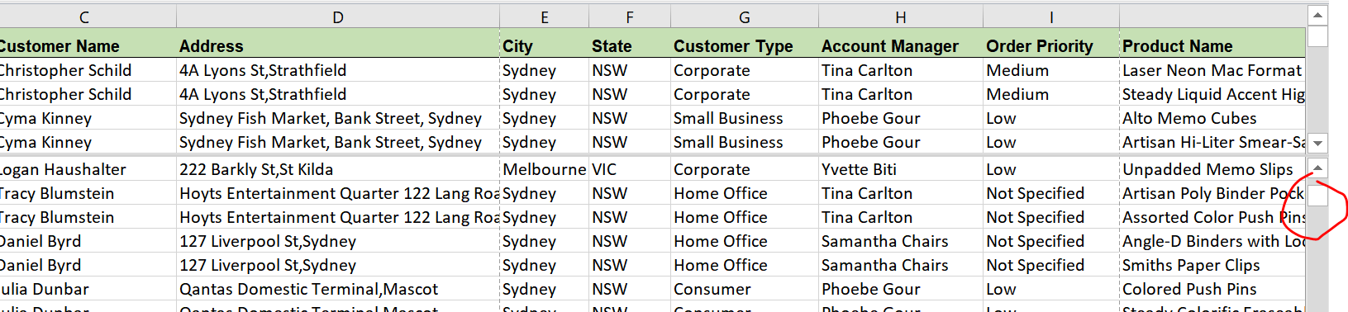
3) Move scroll up/down button to compare 2 sets of data

Slide 7
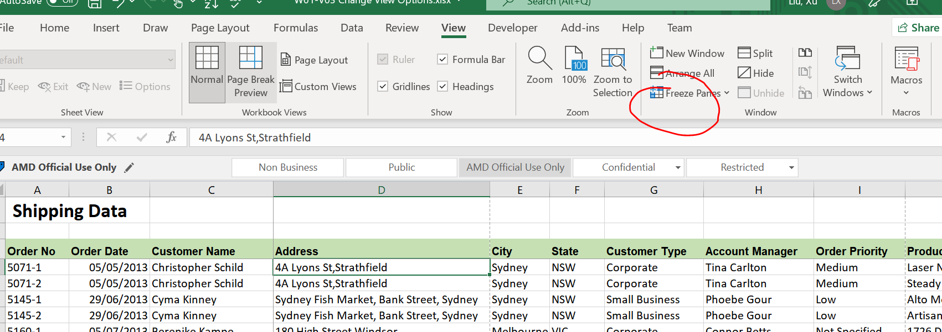
Freeze pane
If we want to still view the headings while scroll up/down, we can use freeze panes
Example givens below if we want to free the first 3 columns & rows
Put cursor on D4 and click “freeze Panes” under view -> “Freez Panes”

Slide 8
How to copy across sheets
E.g. Copy data from sheet 1 to sheet 2
Put “=“ in sheet 2 cell and go to sheet 1 select particular cell which contains the infor we want to copy over
Press “Enter” while still in Sheet1

Slide 9
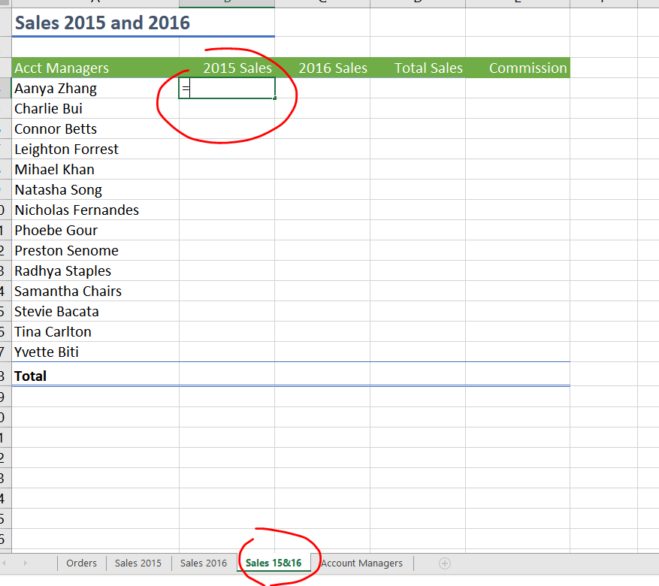
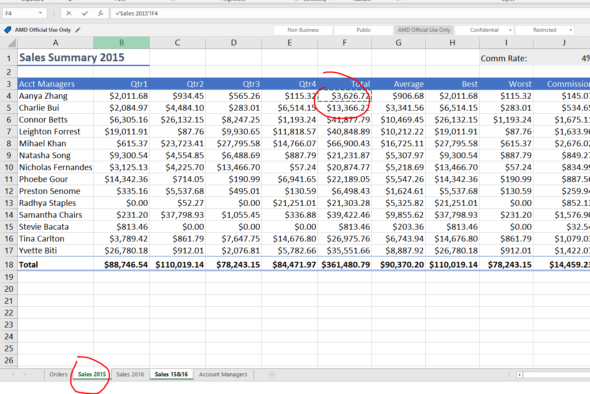
How to copy across sheets
Step 1
Step 2

Slide 10
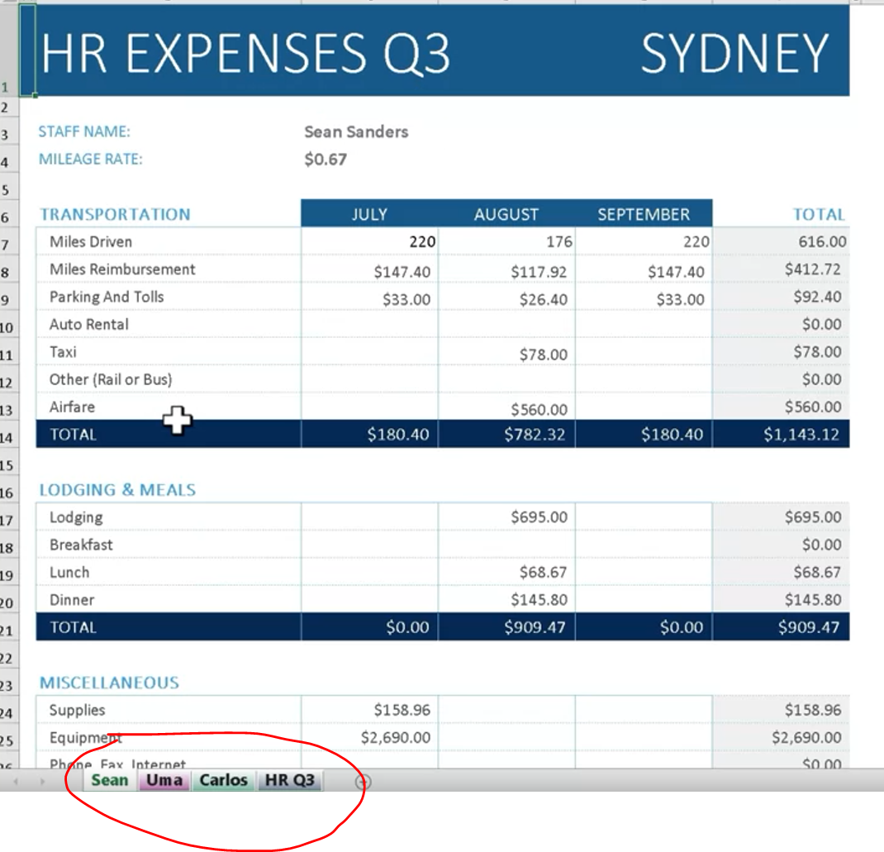
To Change multiple worksheet simultaneously
Select worksheet 1 by 1 (click while holding ctrl key). Make changes on any of the worksheet, the changes will be applied to the rest worksheets as well

Slide 11
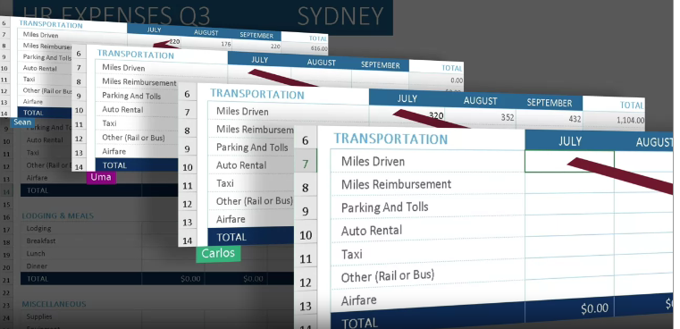
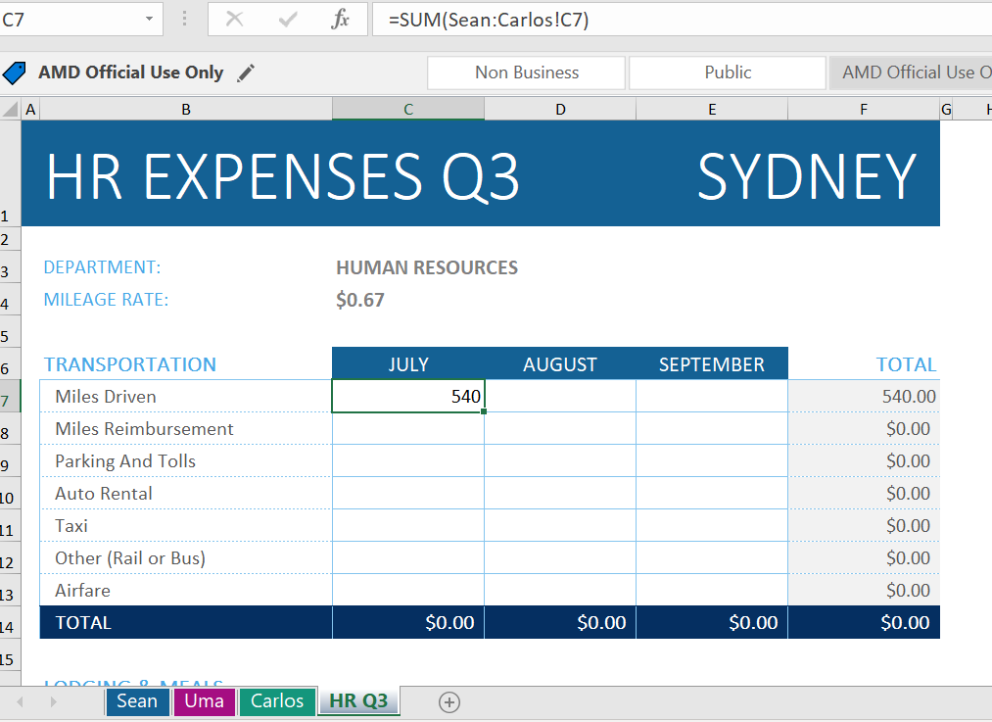
How to add values from different worksheet
3D formula
We want to add all the the worksheet C7 value
Type =SUM(
Click first workshett (Sean) C7. While holding “Shift” key ,click Carlos Worksheet. It will include all the worksheets inbetween (include Uma) as well

Slide 12
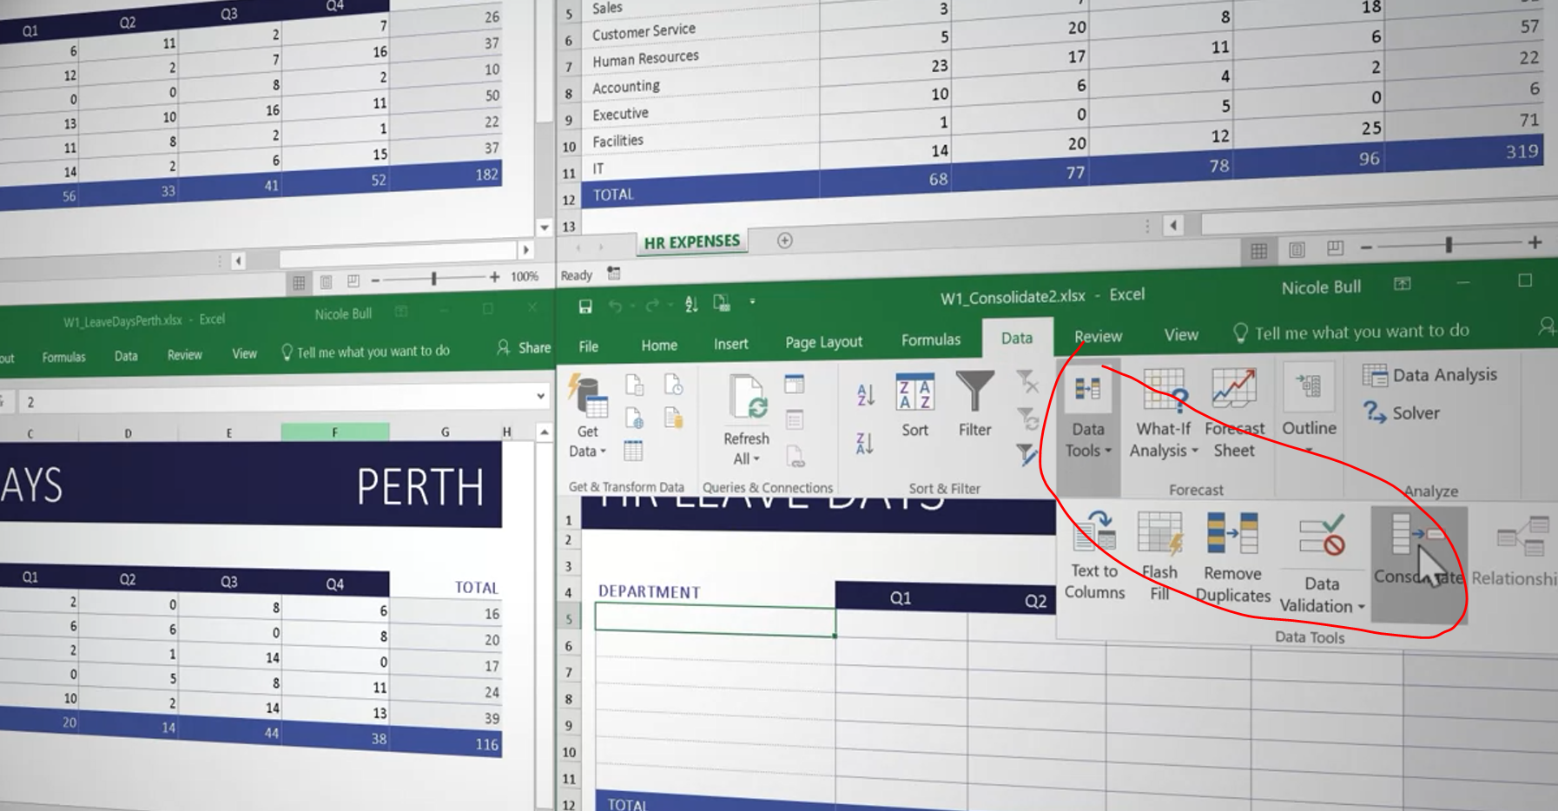
Consolidate (consolidate data from diff workbook to the current workbook)
Open all the workbooks and put them side by side : “View”->”arrange all” -> “Tiled”
Data-> datatools-> consolidate

Slide 13
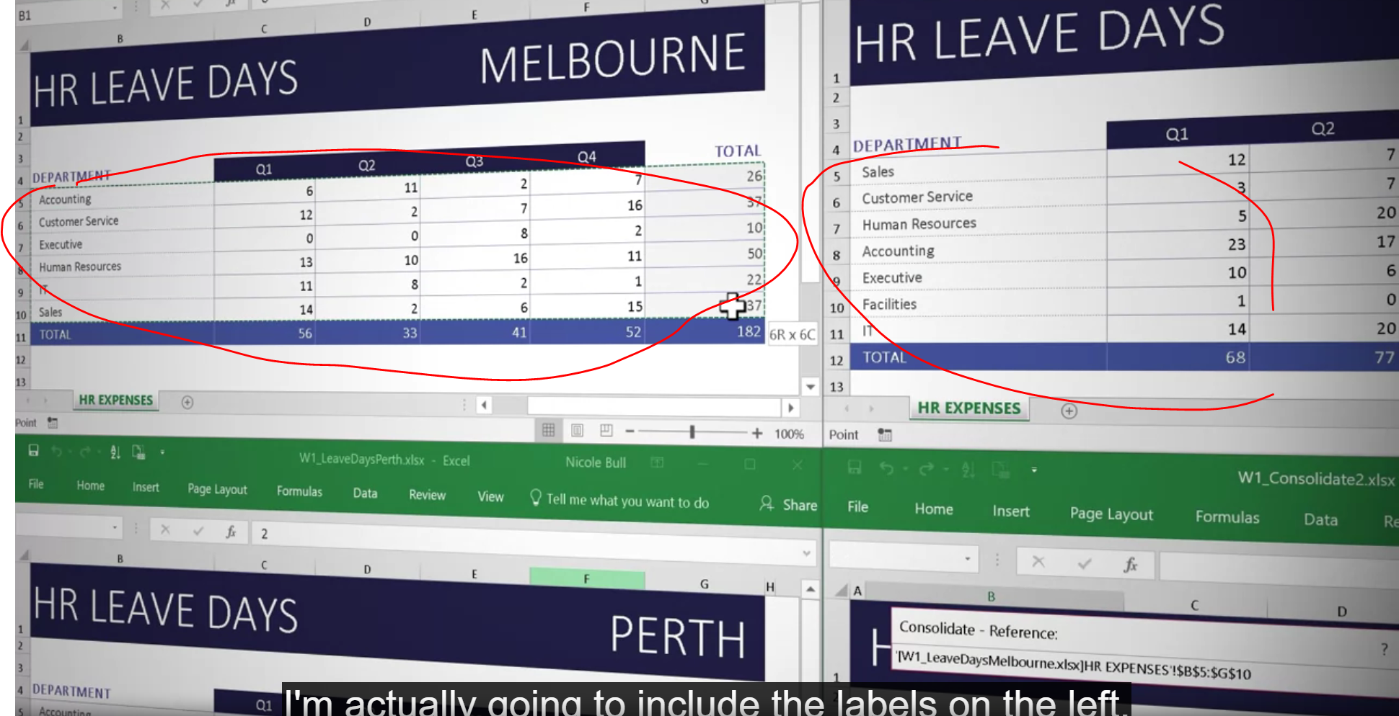
Continue…
Select data range from diff workbooks

