Slide 2
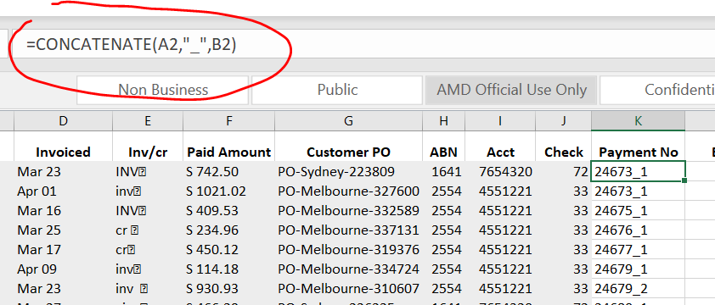
Concatenate function (joins text together)
Concatenate 2 cell strings with “_”:

Slide 3
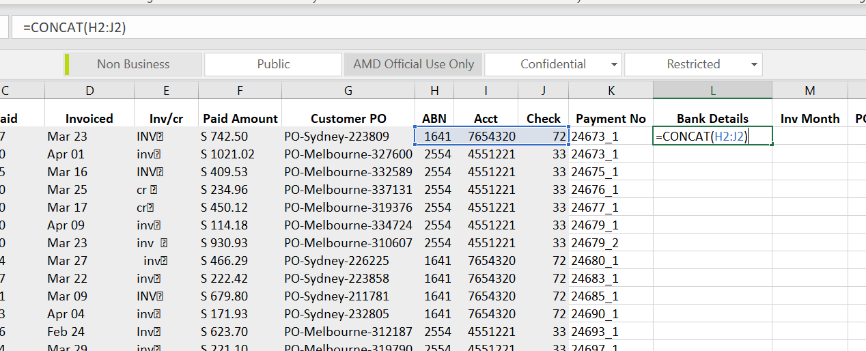
Concat Operator (concate ajacent elements)

Slide 4
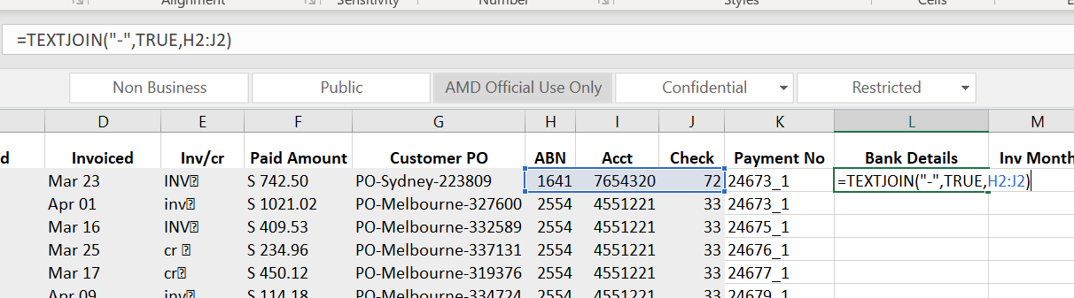
TEXTJOIN (advanced options in combing cells)

Slide 5
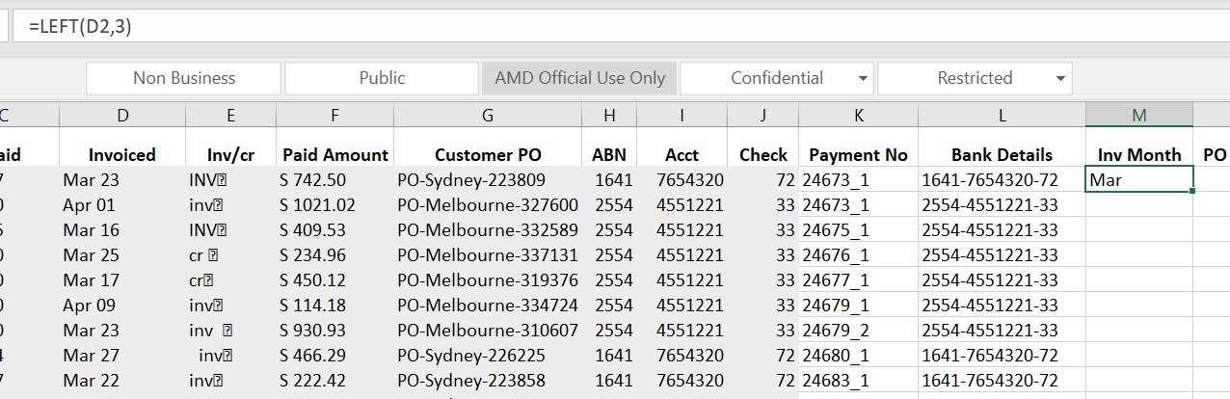
LEFT(Returns the leftmost characters from a text value)

Slide 6
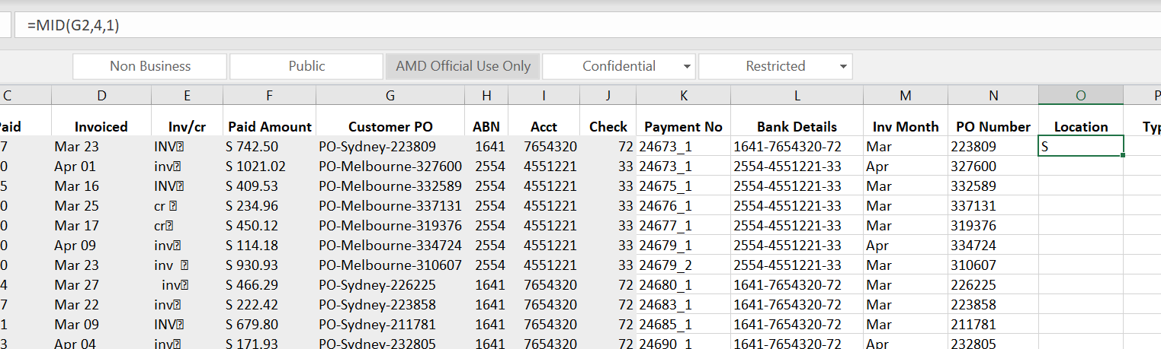
MID(returns a specific number of characters starting at a specifiedposition)

Slide 7
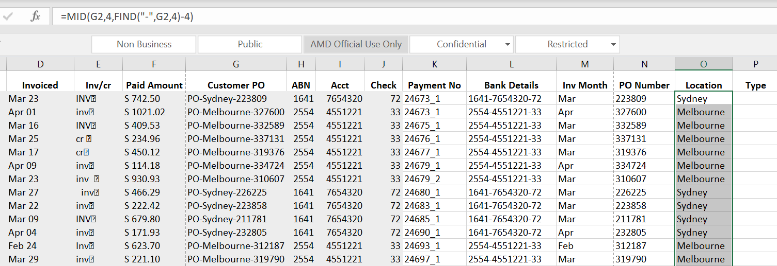
Find (find one text value within another text value)

Slide 8
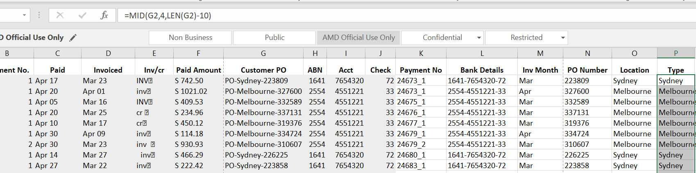
LEN (Return the number of characters in a text string)

