Slide 1
VBA

Slide 2
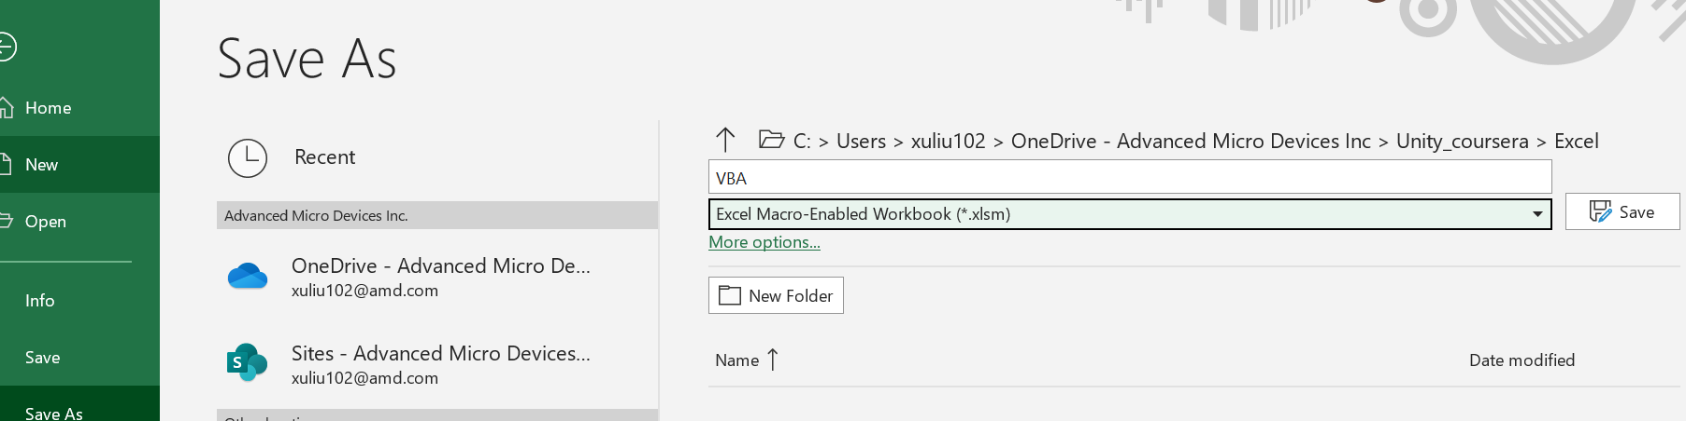
VBA file format

Slide 3
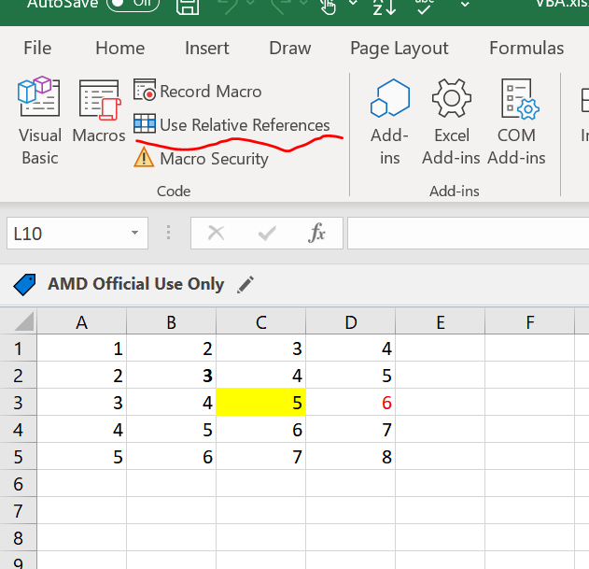
Absolute vs Relative Macro
Click here to enable
To review the code

Slide 4
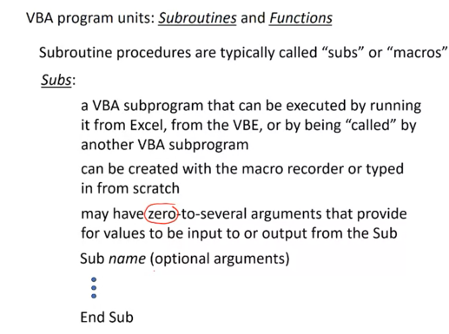
Subroutines and Functions
Example of subroutines:
Most of the cases, user no need to provide any arguments

Slide 5
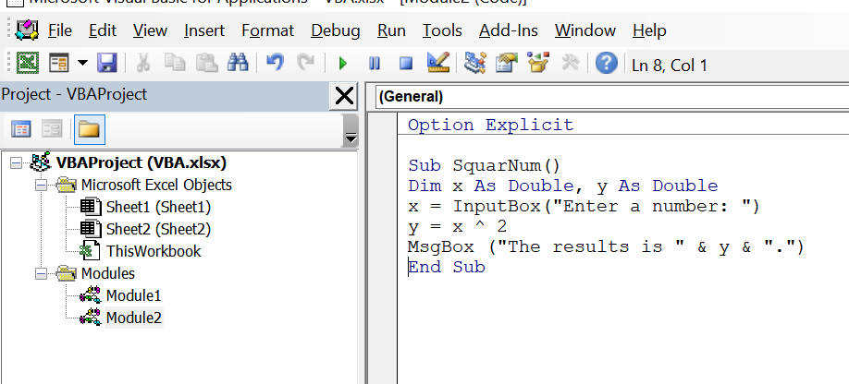
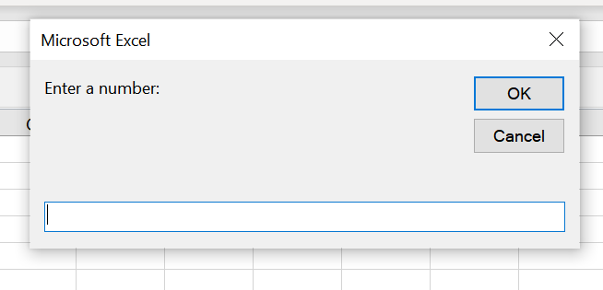
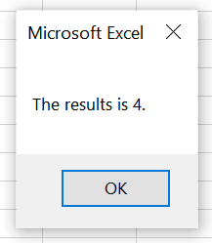
Example of subroutine
To capture any syntax error

Slide 6
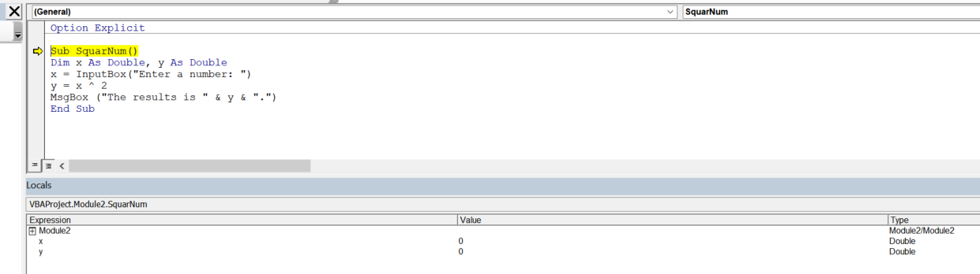
How to step each line output
Press “F8”

Slide 7
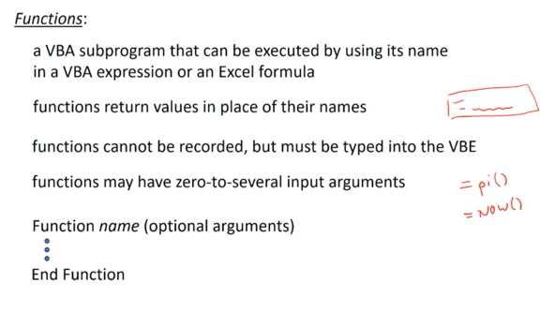
Functions
Most of functions have arguments

Slide 8
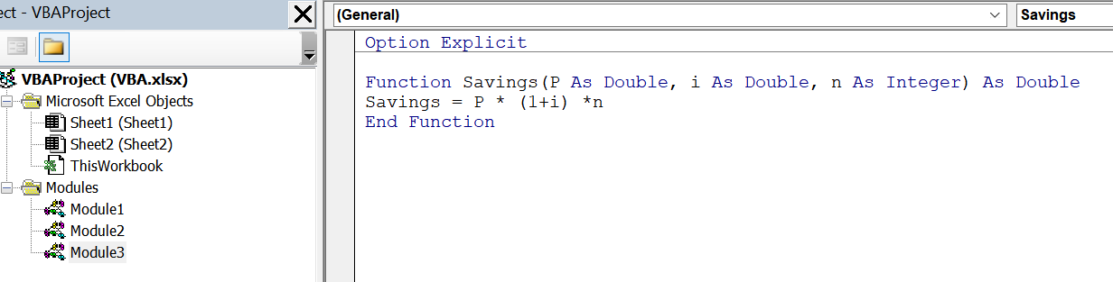
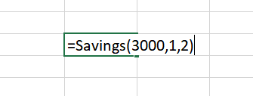
Example of functions
Function output is double
Must be the same name with Functions!

Slide 9
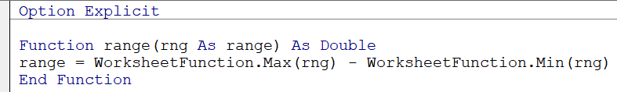
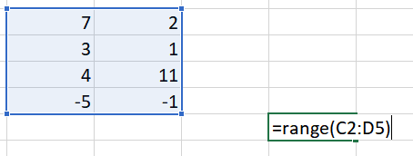
Can borrow excel functions as well…
Excel worksheet function find max over a range of number
Excel worksheet function find min over a range of number

Slide 10
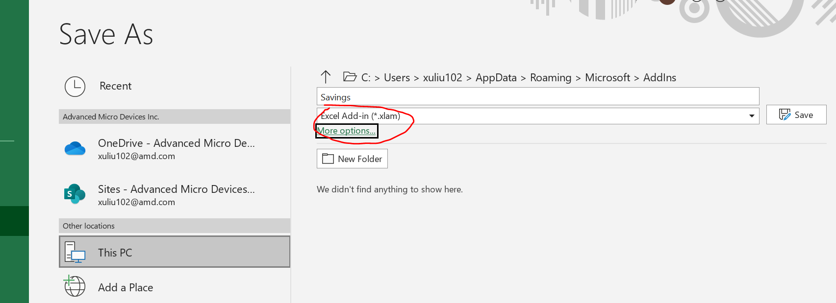
Convert a user-defined function to excel add-in
Save the self defined function to .xlam file format

Slide 11
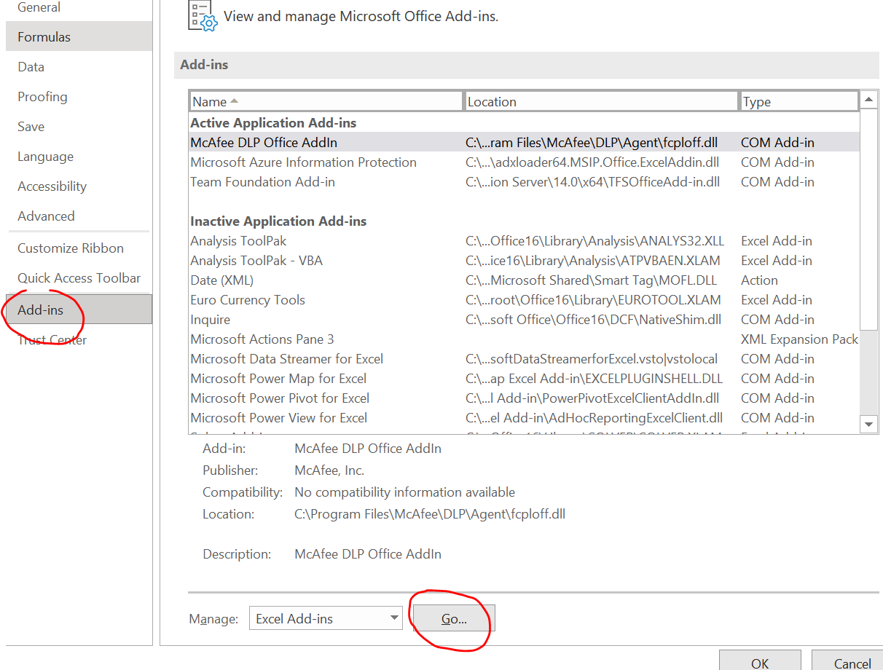
Continue..
If a new workbook wants to use the function, click “file”-> “options”-> “Add-ins” and lick “go” at the bottom and “browse” and find the “xlam” file we saved earlier on

Slide 12
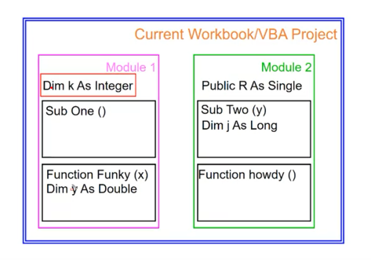
Variable scope
If we declare variable R here, it available for both modules. Workbook level
If we declare variable here, the variable k is available for both “sub one” and “Funky” functions. Modular level
Variable y is only available for “Funky” function

Slide 13
Customized user function

