Slide 1
Excel Essentials

Slide 2
Workbook and worksheet
When you open Microsoft Excel (a spreadsheet program), you're opening a workbook. A workbook can contain one or more different worksheets that can be accessed through the tabs at the bottom of the worksheet your currently viewing.

Slide 3
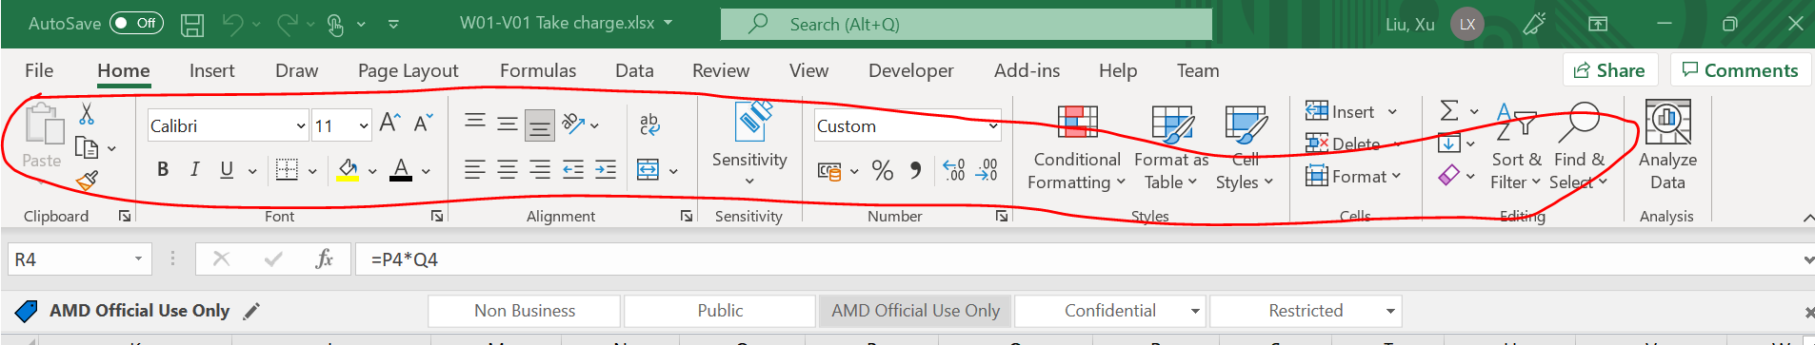
Appear/disappear ribbon tabs
Tab
Ribbon

Slide 4
Navigate worksheet
Ctrl+ Home (how to quickly return to line 1)
Jump from line 1 to line2 (press ‘pg up’ or ‘pg down’)

Slide 5
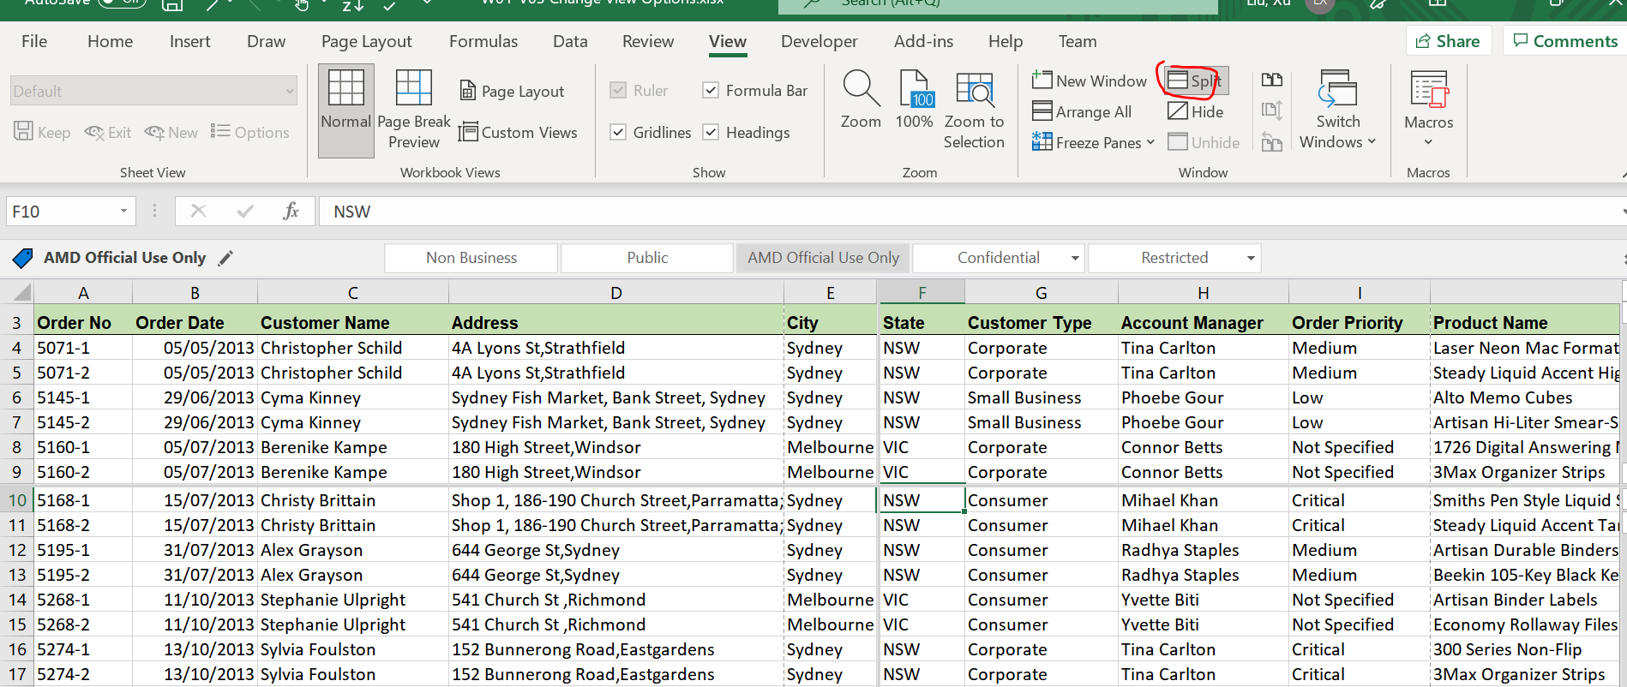
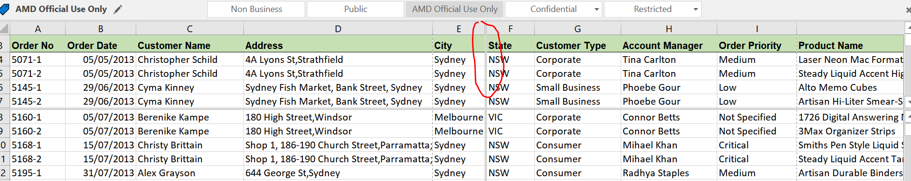
View worksheet
Split page:
1) Select “View” -> “Split”
2)Double click the vertical split line to remove it

Slide 6
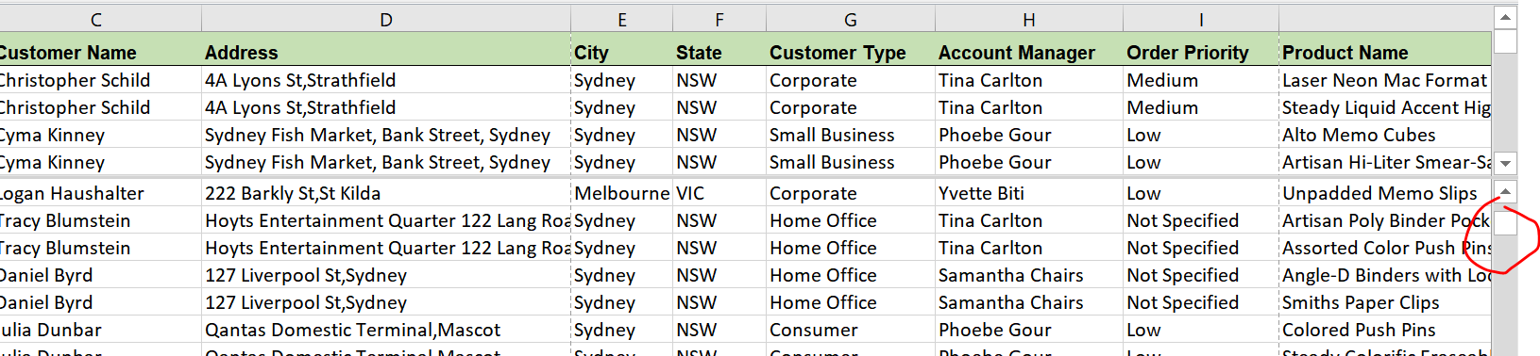
3) Move scroll up/down button to compare 2 sets of data

Slide 7
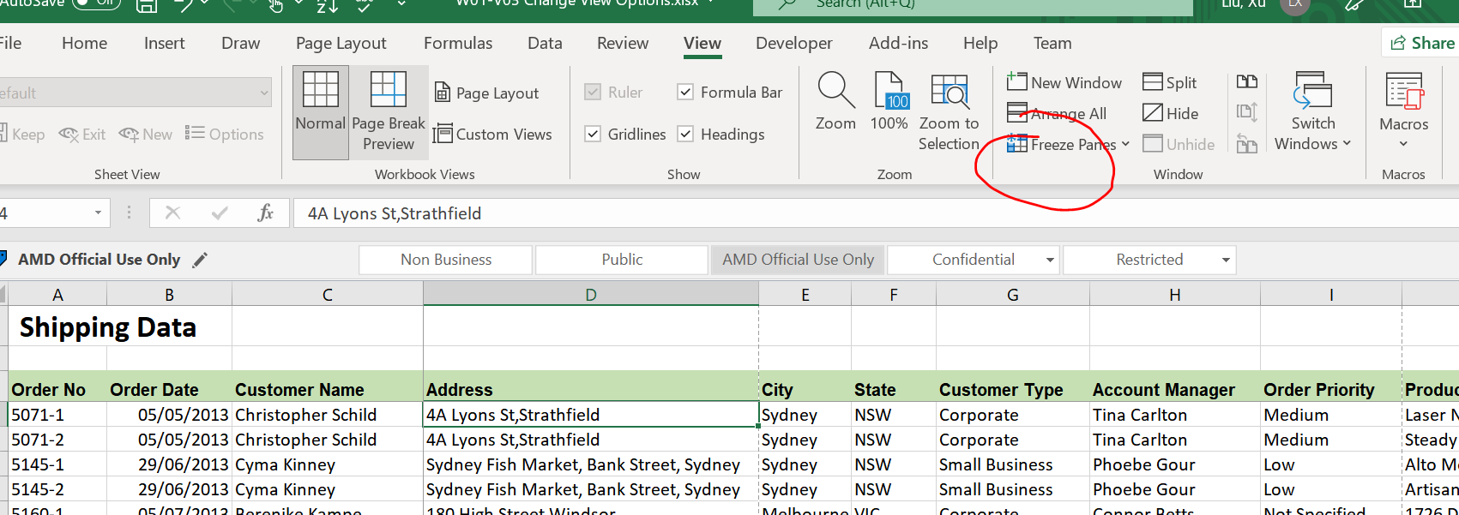
Freeze pane
If we want to still view the headings while scroll up/down, we can use freeze panes
Example givens below if we want to free the first 3 columns & rows
Put cursor on D4 and click “freeze Panes” under view -> “Freez Panes”

Slide 8
How to copy across sheets
E.g. Copy data from sheet 1 to sheet 2
Put “=“ in sheet 2 cell and go to sheet 1 select particular cell which contains the infor we want to copy over
Press “Enter” while still in Sheet1

Slide 9
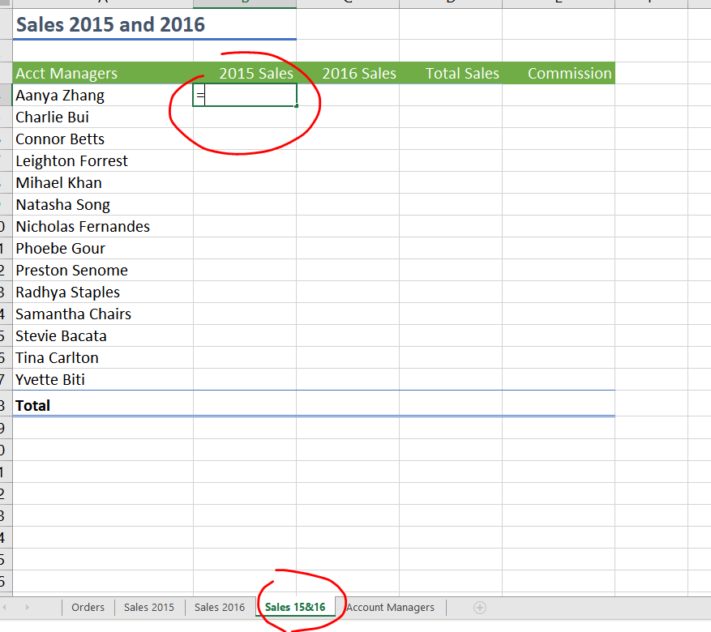
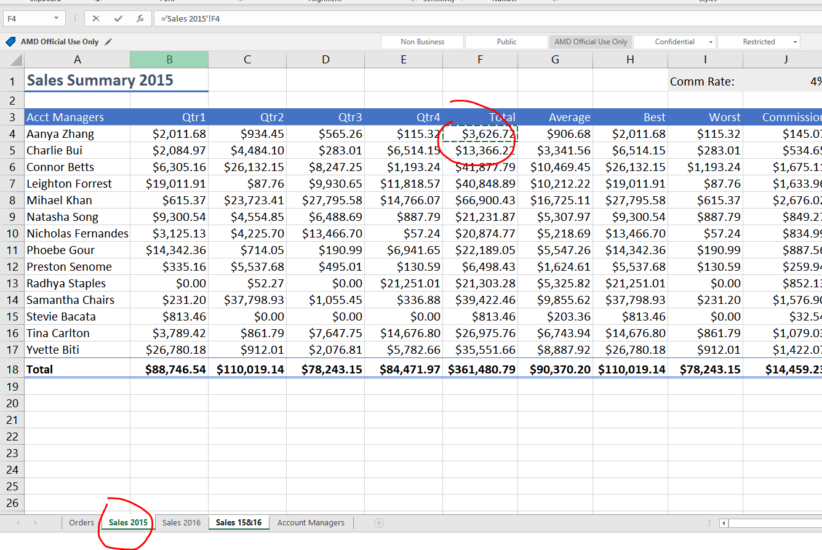
How to copy across sheets
Step 1
Step 2

