Slide 1
VBA

Slide 2
To turn on Developer
File-> options-> customize ribbon-> developer

Slide 3
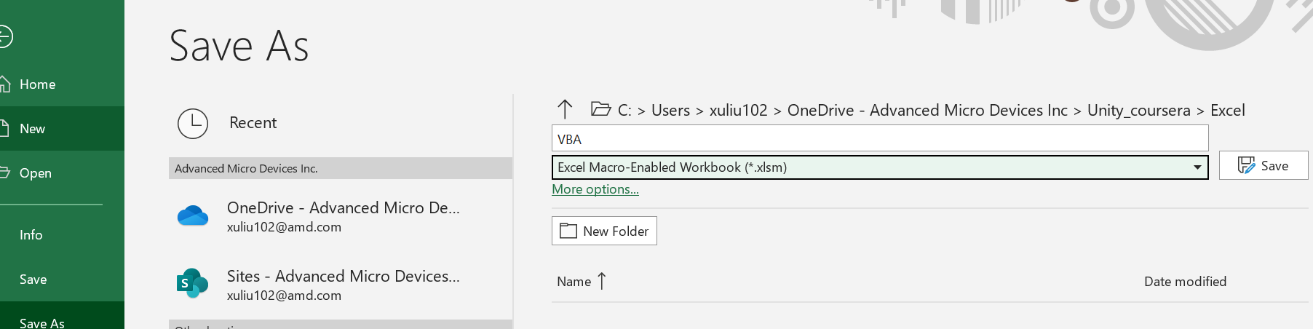
VBA file format

Slide 4
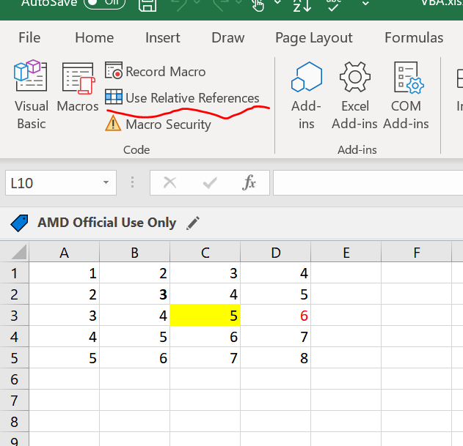
Absolute vs Relative Macro
Click here to enable
To review the code

Slide 5
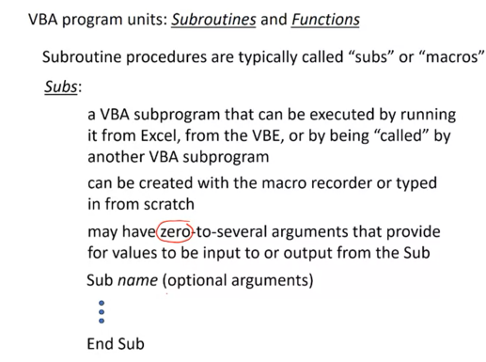
Subroutines and Functions
Example of subroutines:
Most of the cases, user no need to provide any arguments

Slide 6
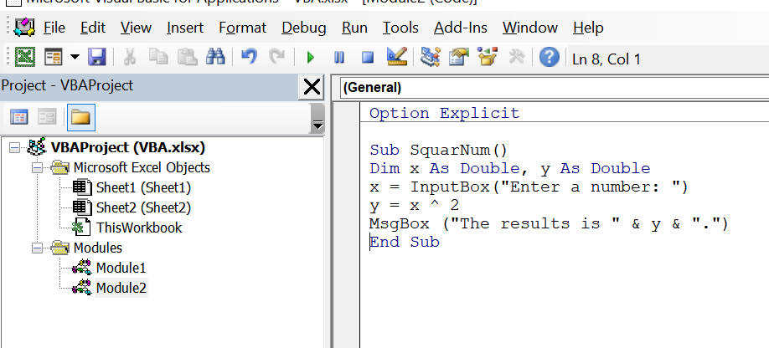
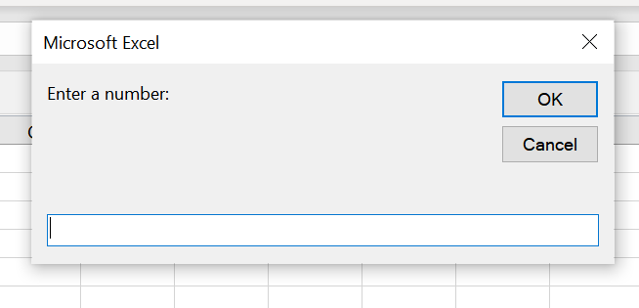
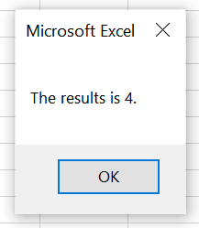
Example of subroutine
To capture any syntax error

Slide 7
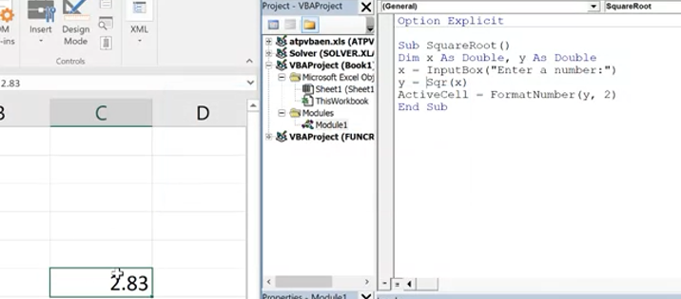
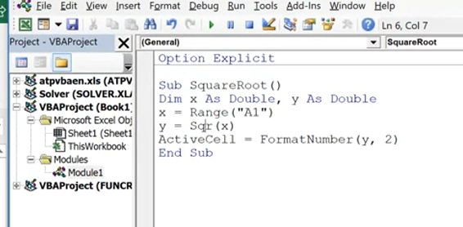
Example of subroutine 1
To print the result in active cell
Take input from A1 cell instead of inputbox

Slide 8
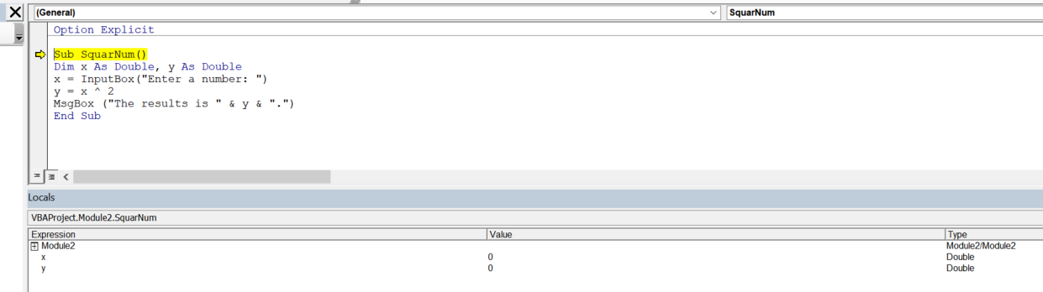
How to step each line output
Press “F8”to step each line

Slide 9
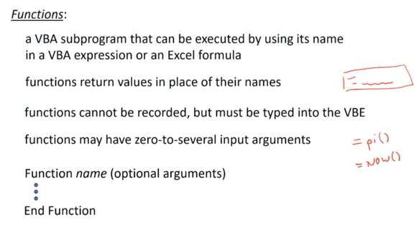
Functions
Most of functions have arguments

Slide 10
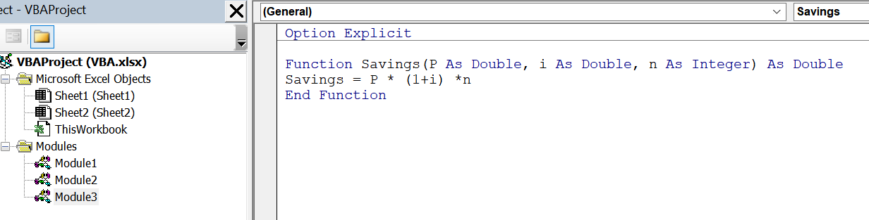
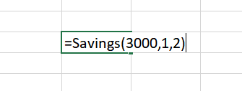
Example of functions
Function output is double
Must be the same name with Functions!

Slide 11
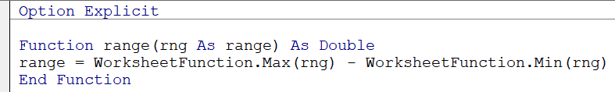
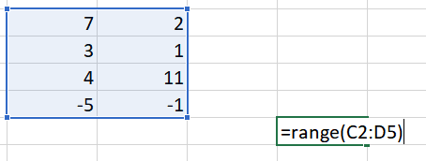
Can borrow excel functions as well…
Excel worksheet function find max over a range of number
Excel worksheet function find min over a range of number

Slide 12
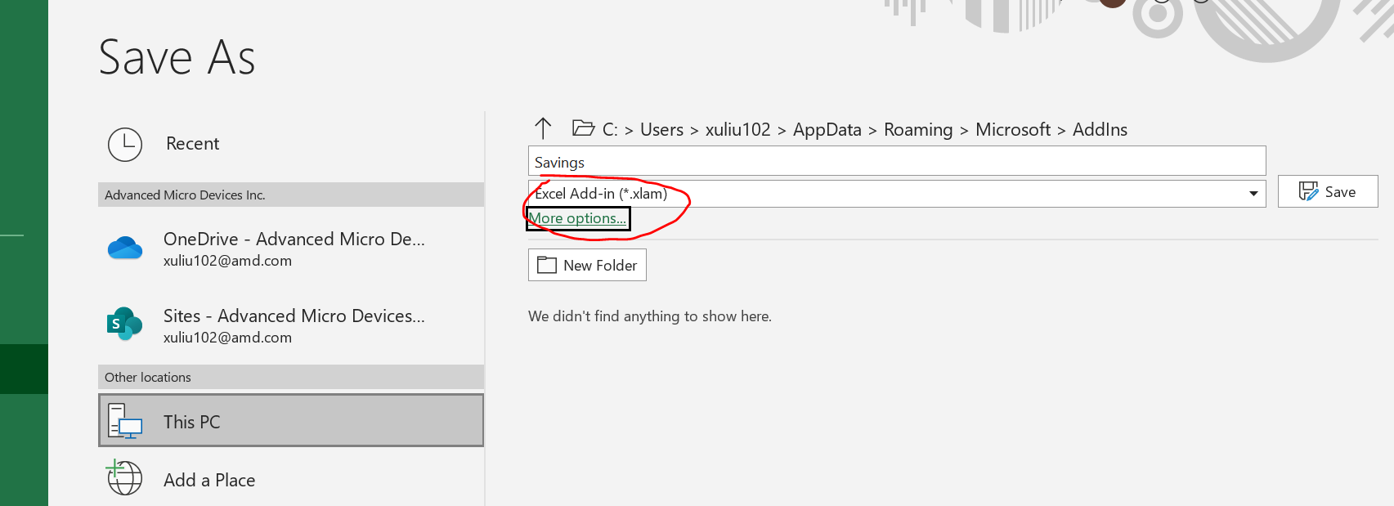
Convert a user-defined function to excel add-in
Save the self defined function to .xlam file format

Slide 13
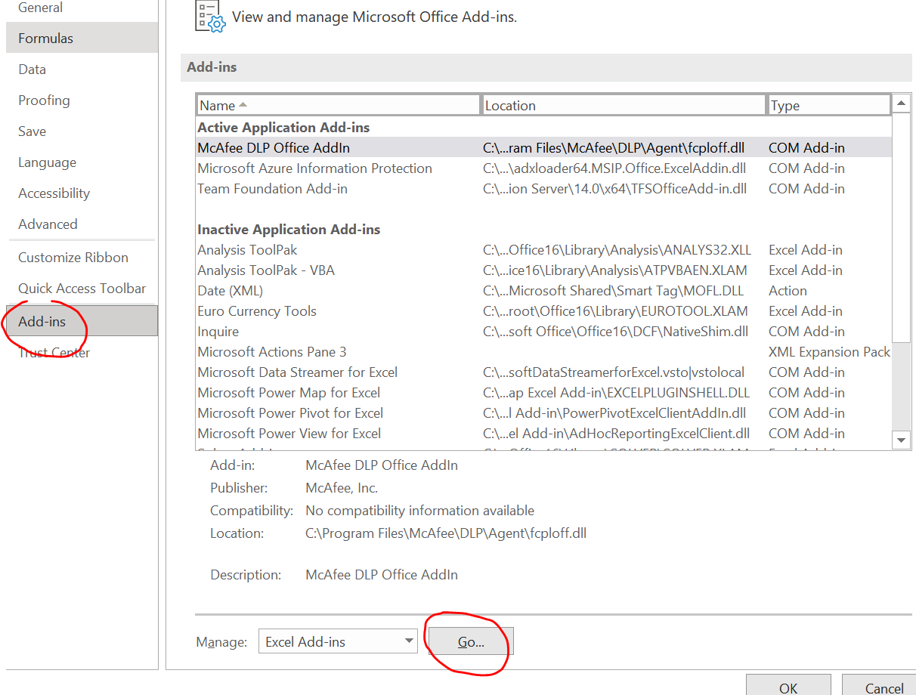
Continue..
If a new workbook wants to use the function, click “file”-> “options”-> “Add-ins” and lick “go” at the bottom and “browse” and find the “xlam” file we saved earlier on

Slide 14
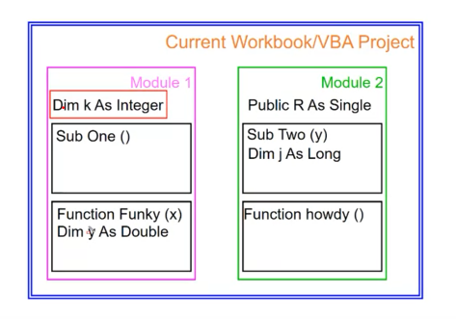
Variable scope
If we declare variable R here, it available for both modules. Workbook level
If we declare variable here, the variable k is available for both “sub one” and “Funky” functions. Modular level
Variable y is only available for “Funky” function

Slide 15
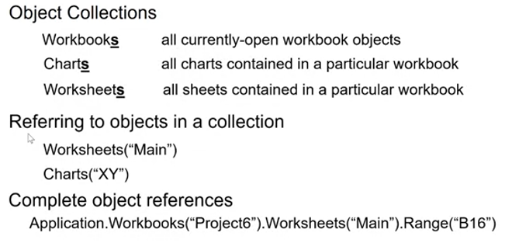
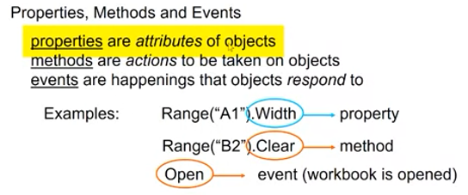
Objects, properties, method and events
Refer workbook ‘project6’ and worksheets “Main”, range B16
Access object’s properties, method and events

Slide 16
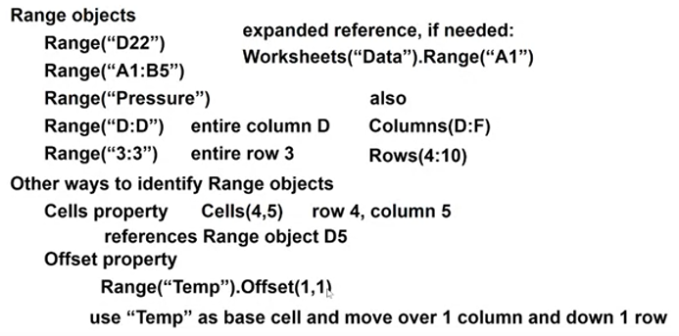
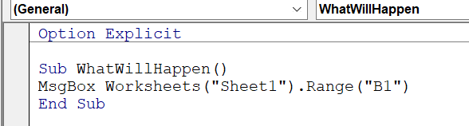
Continue..
Correction “D:F”
Correction “4:10”
Print sheet1, B1 cell data

Slide 17
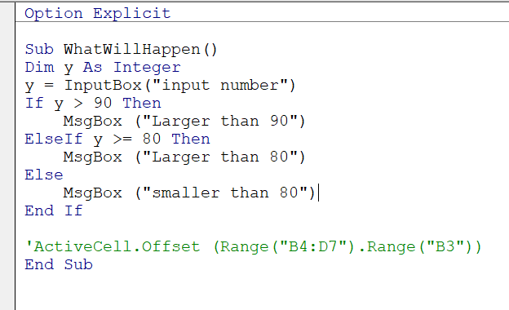
Conditional (if,else) statement

Slide 18
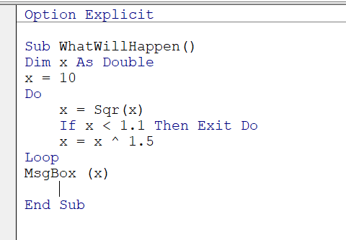
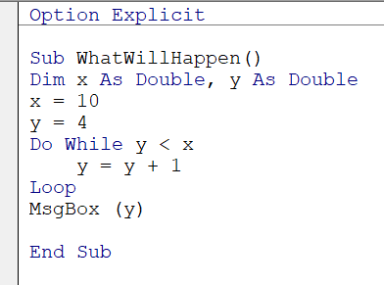
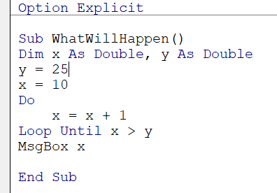
Iteration(Do loop)
Not a pre-defined number of iterations. Interate until some condition is met

Slide 19
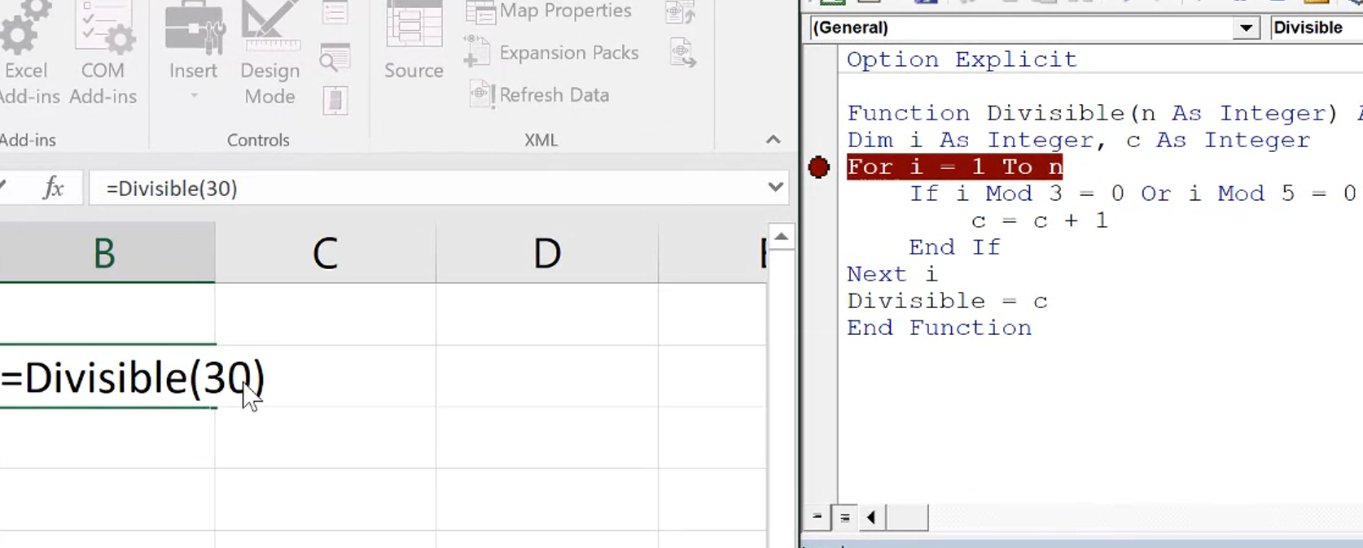
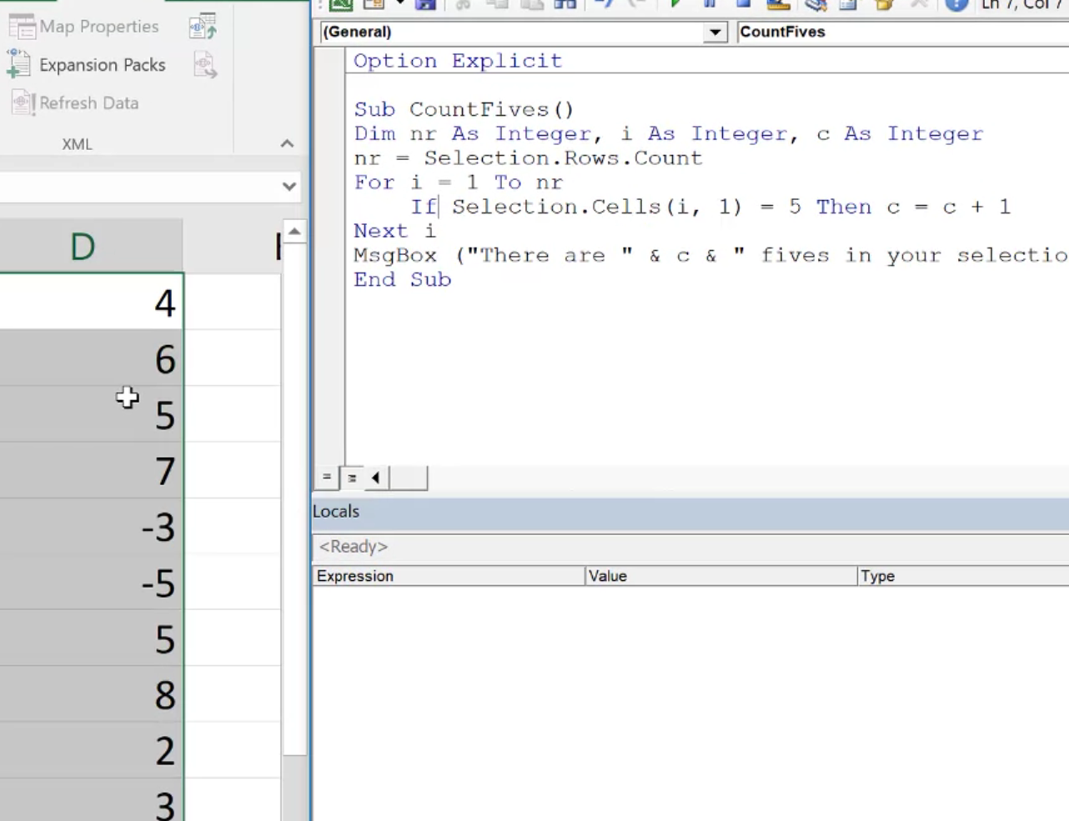
Iteration (For..Next)
A pre-defined number of iterations.
Count how many 5s are there in the selected cells
Count how many numbers can be divided by 3 or 5 (from 1 to 30)

