Slide 1
Excel Essentials

Slide 2
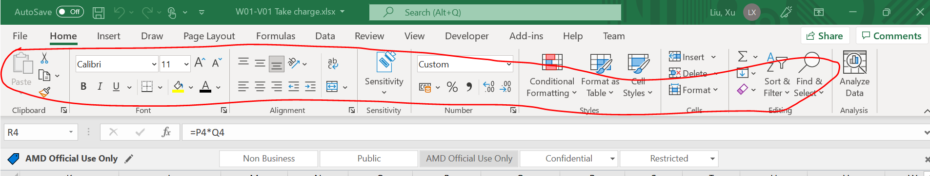
Appear/disappear ribbon tabs
Tab
Ribbon

Slide 3
Navigate worksheet
Ctrl+ Home (how to quickly return to line 1)
Jump from line 1 to line2 (press ‘pg up’ or ‘pg down’)

Slide 4
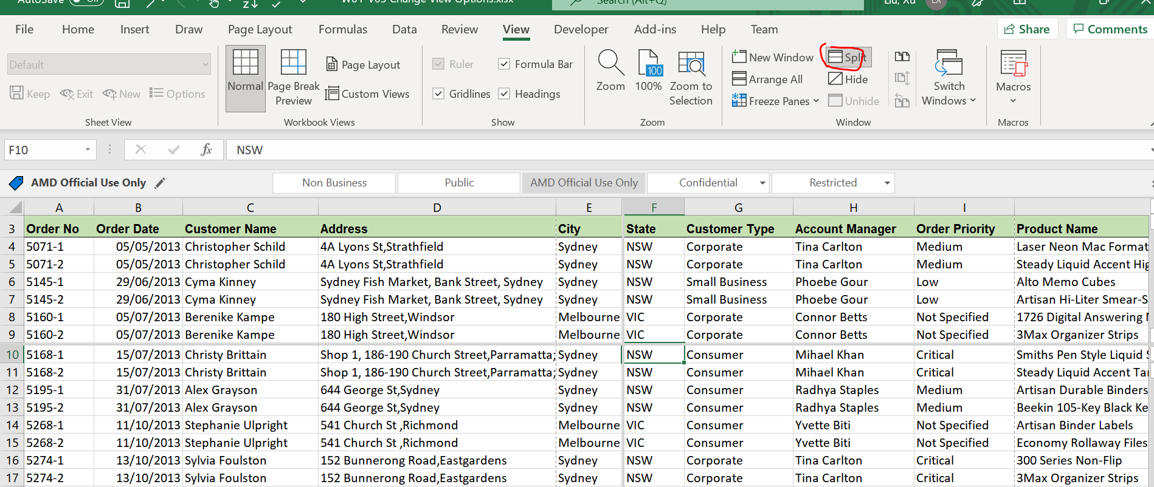
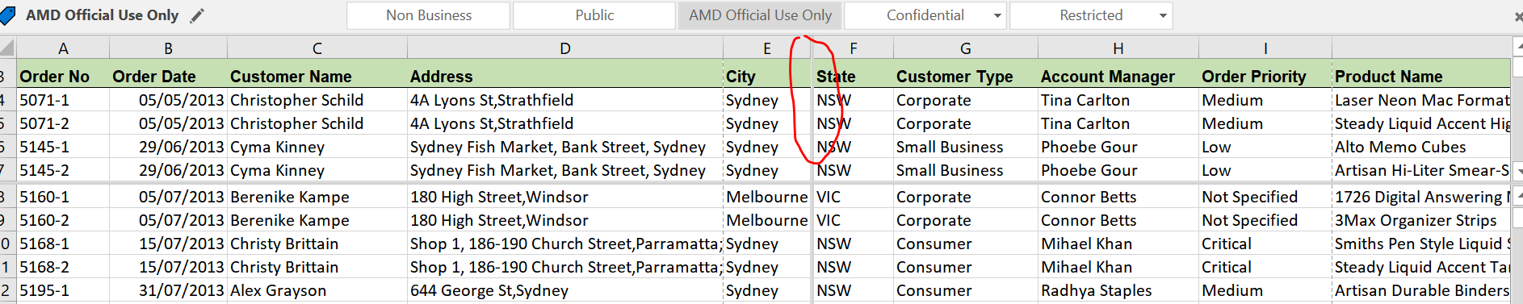
View worksheet
Split page:
1) Select “View” -> “Split”
2)Double click the vertical split line to remove it

Slide 5
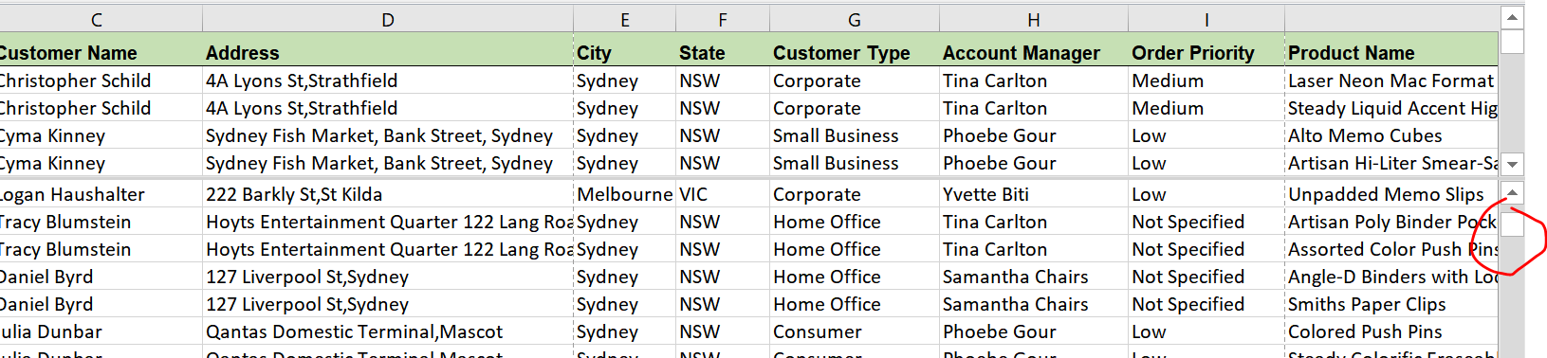
3) Move scroll up/down button to compare 2 sets of data

Slide 6
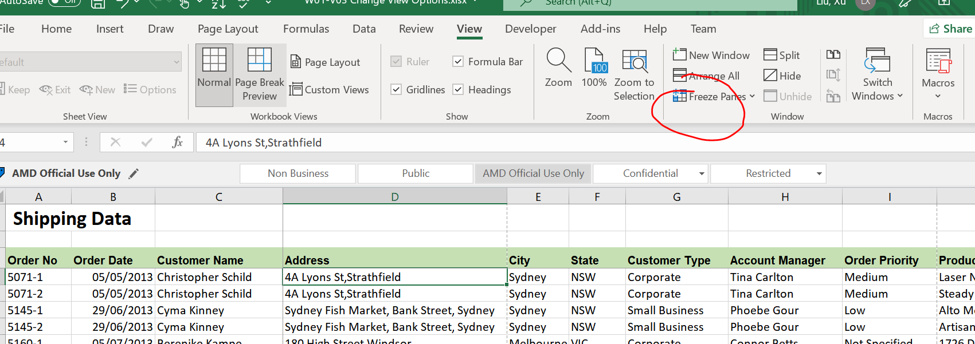
Freeze pane
If we want to still view the headings while scroll up/down, we can use freeze panes
Example givens below if we want to free the first 3 columns & rows
Put cursor on D4 and click “freeze Panes” under view -> “Freez Panes”

Slide 7
How to copy across sheets
E.g. Copy data from sheet 1 to sheet 2
Put “=“ in sheet 2 cell and go to sheet 1 select particular cell which contains the infor we want to copy over
Press “Enter” while still in Sheet1

Slide 8
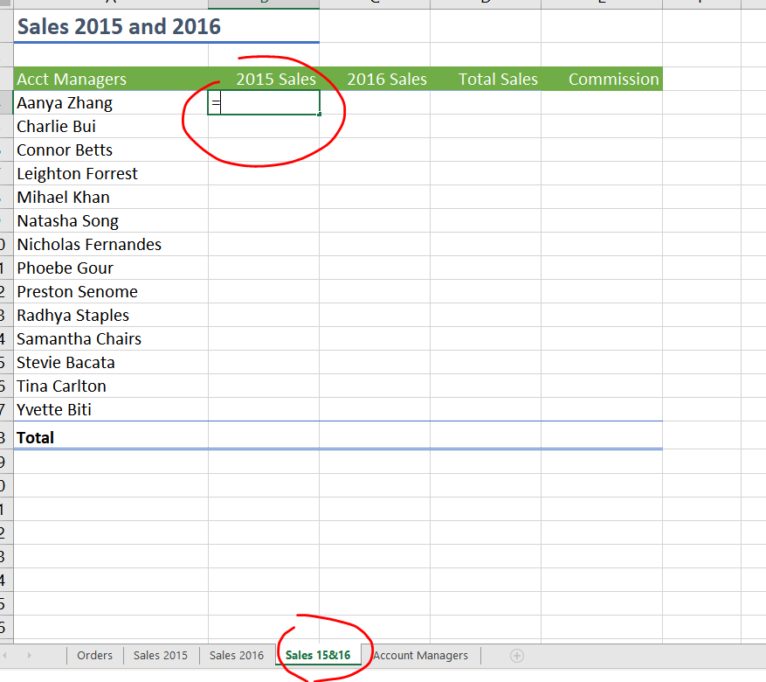
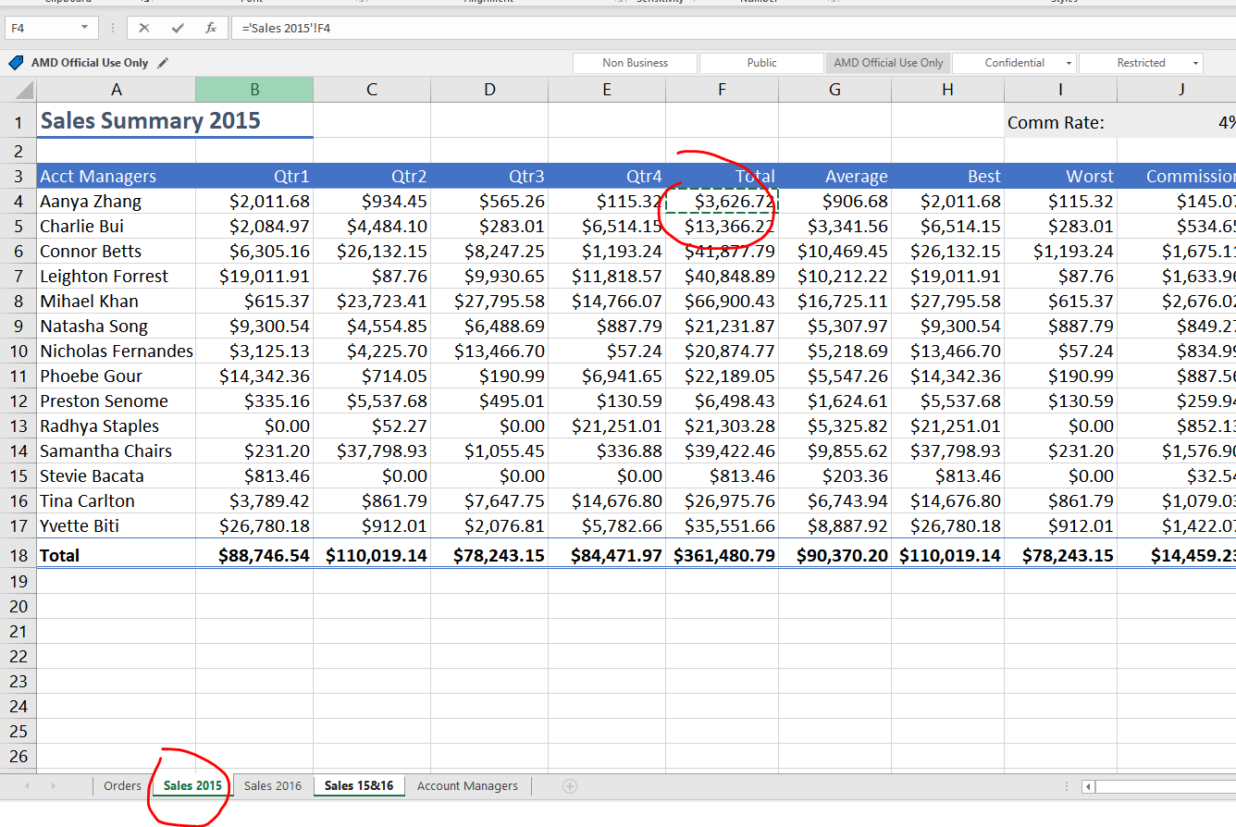
How to copy across sheets
Step 1
Step 2

