Slide 2
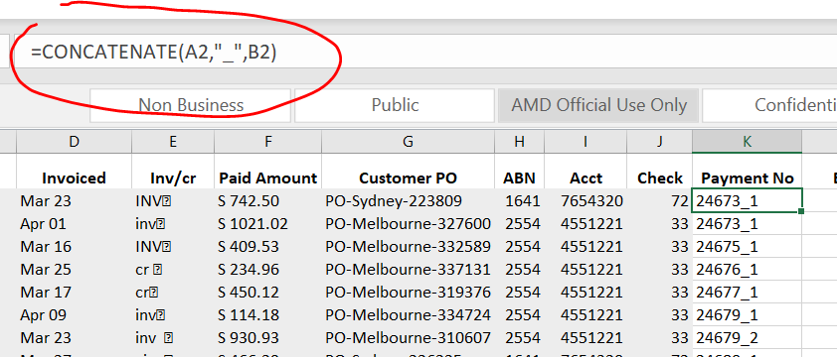
Concatenate
Concatenate 2 cell strings with “_”:

