Slide 2
Useful link(HTML,CSS and Javascript)
https://www.dukelearntoprogram.com//course1/doc/

Slide 3
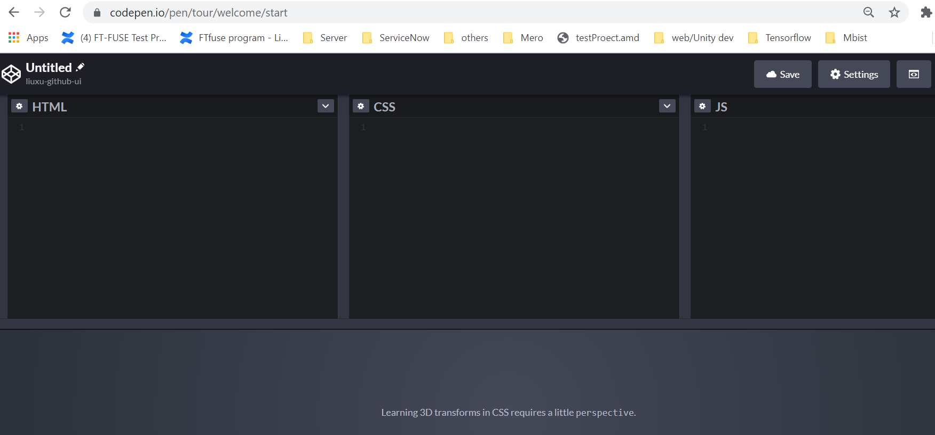
HTML online tools
https://codepen.io
Login in with github account

Slide 4

What is HTML
HTML is a language used to make weg pages
Not a programming language but a markup language
It does not run on a computer like typical programming language but used by web browser to display a page
Describe what you want to appear in the webpage
In order for different browers to interpret HTML on webpages, there must be standards, HTML5 is the current version of HTML
Notes:
What is mark up language?
It is a way to mark the web page(e.g., mark the web text to bold, underlined, italics, etc.)

Slide 5
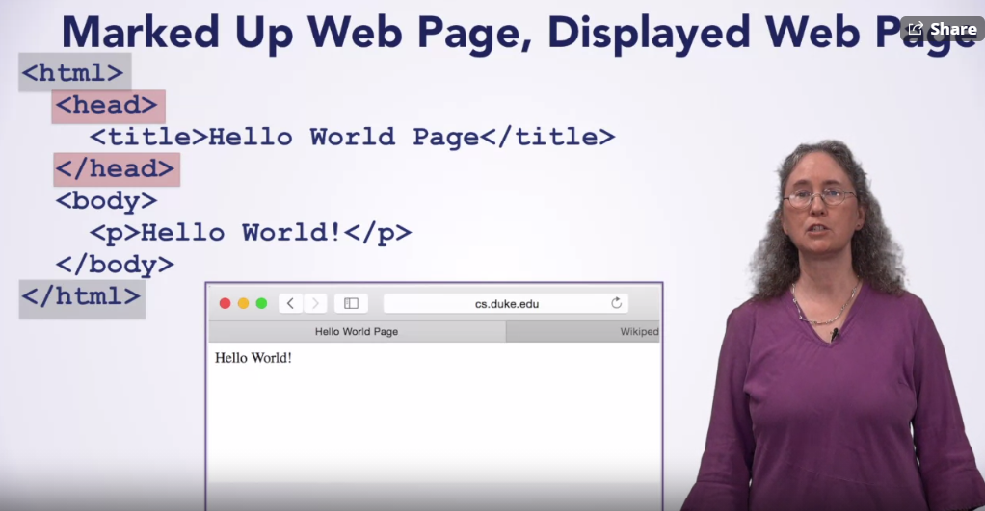
Continue…

Slide 6
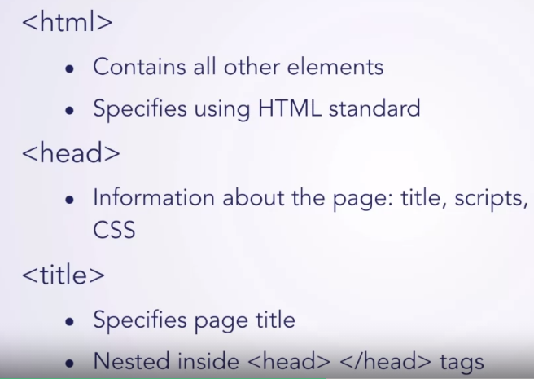
Metadata and sectioning Elements
Metadata elements:

Slide 7
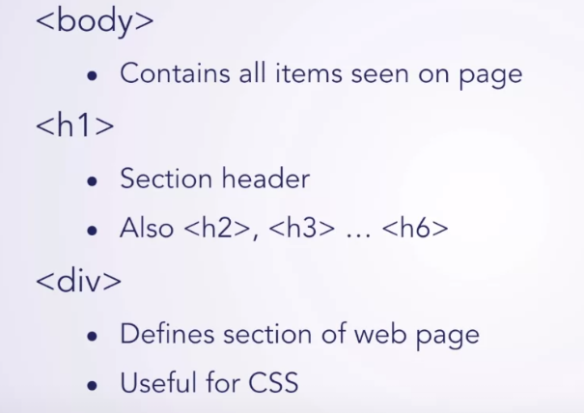
Sectioning elements

Slide 8
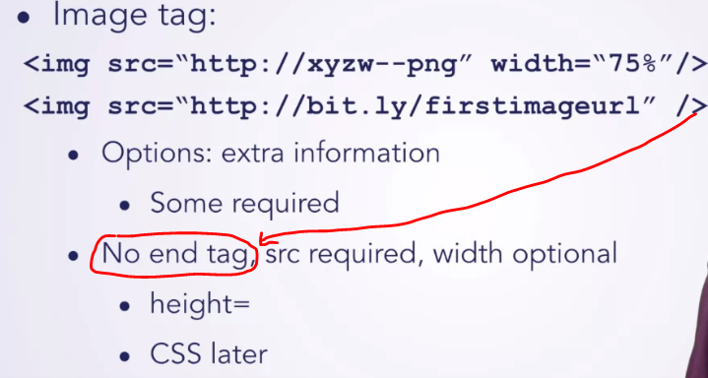
Images and links
Image tag

Slide 9
CSS
Cascading Style Sheets
Specifies look and formatting
HTML specifics the content
Design that Scales
Apply 1 css file to multiple html pages

Slide 10
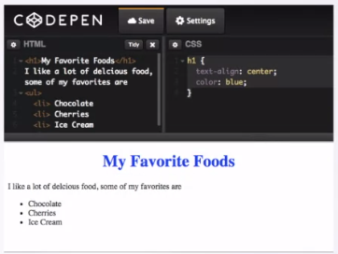
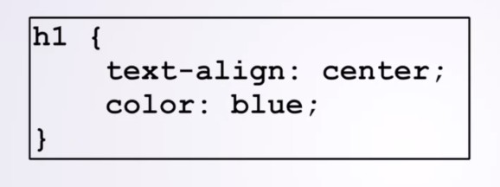
CSS Basics
Example

Slide 11
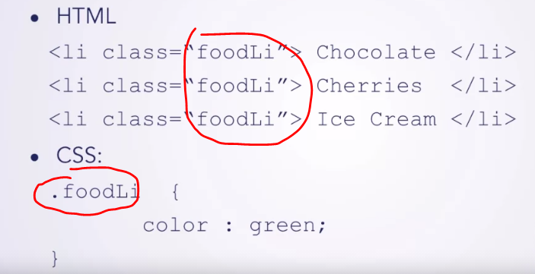
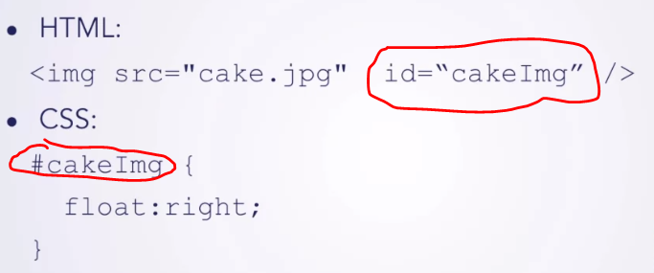
CSS select certain elements
How to style only particular elements
Class
ID

