Slide 2
Javascript
Variable
var x =3;
var fgImage = new SimpleImage(“drewRobert.png”)
Method
Invoke a new object
var w = fgImage.getWidth();
var pixel = fmImage.pixel(0,0)
Function
Not invoked on objects
Example print(x).
Types
Notes:
SimpleImage is not standard Javascript library (developed by Duke so that user can use it in Duke environment. Will learn how to use it in Codepen )

Slide 3
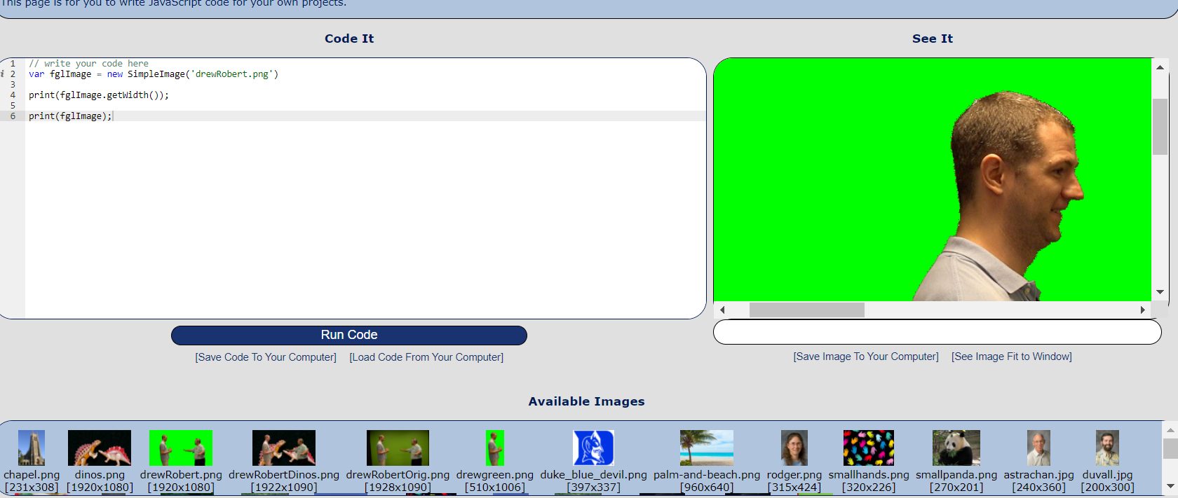
DukeLearnto Program environment
https://www.dukelearntoprogram.com//course1/example/index.php

Slide 4
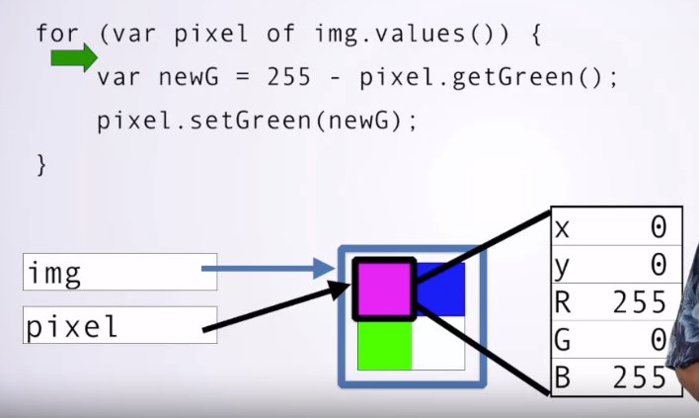
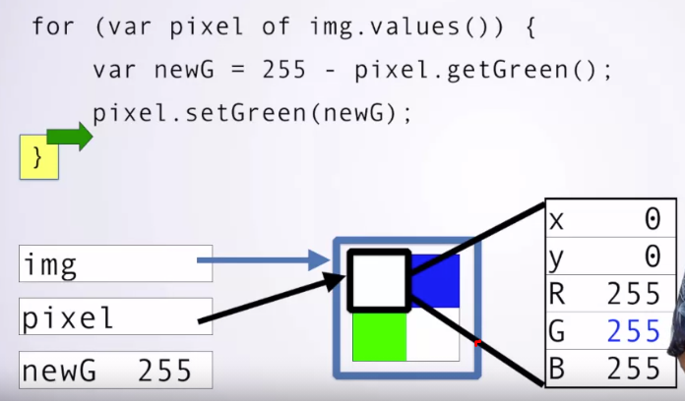
For loops

Slide 5
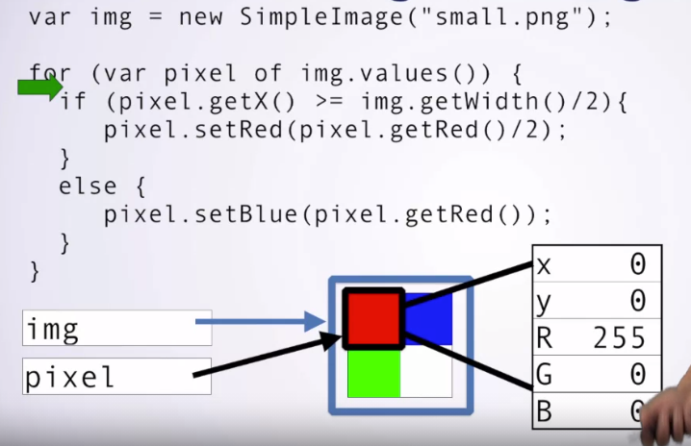
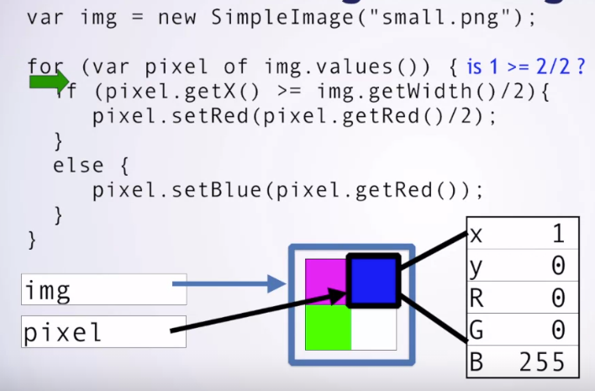
Conditional Execution

Slide 6
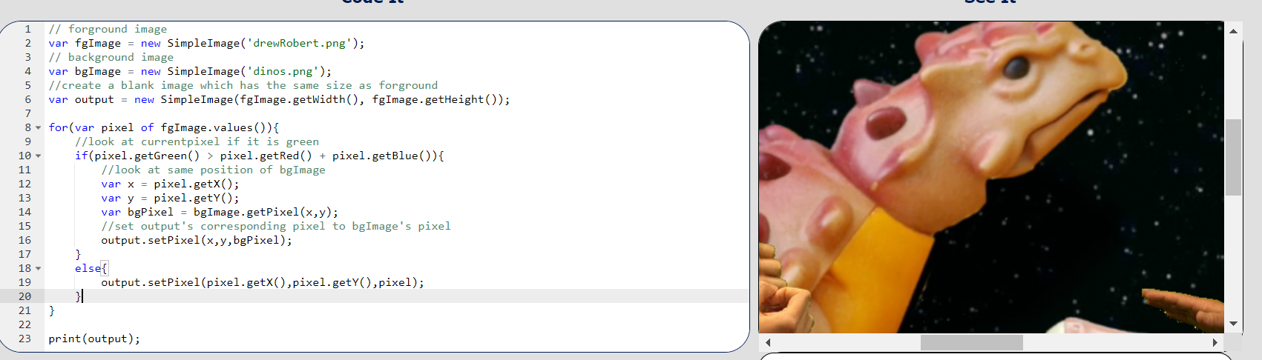
Merge 2 pictures together

