Slide 1
Internet of Things

Slide 2
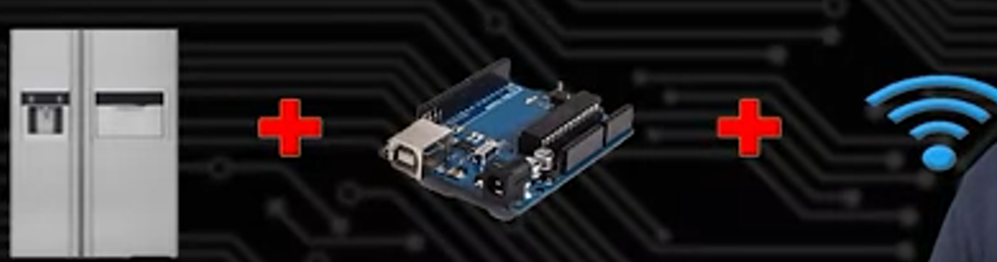
Internet Of things & examples
A “thing” :anything besides a traditional computer(e.g. refrigerator)
Add computational intelligence (e.g. microcontroller, processor) to improve the function of the device.
Add network connection to further enchance its function

Slide 3
Example of IOT
Refrigerator detects/senses no food (nutritious food e.g. egg, seafood) avaiable. It connects to the internet and search from different sources (to find the lowest price) and buy food automatically

Slide 4
What are embedded system?
An embedded system is a small computer (special purposed computer) that forms part of a larger system, device or machine. Its purpose is to control the device and to allow a user to interact with it (the complexity is embedded/hidden). They tend to have one, or a limited number of tasks that they can perform.
Example phone, camera, watch,etc…

Slide 5
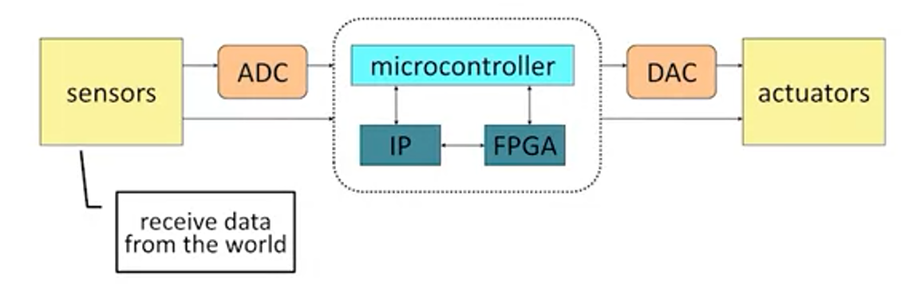
Generic view of Embedded system

Slide 6
Memory
Register: Store only a single bit .very fast but expensive. Several special-purpose registers, used internally (in CPU)
Cache is a small amount of memory which is a part of the CPU - closer to the CPU than RAM . It is used to temporarily hold instructions and data that the CPU is likely to reuse.
RAM (main memory): Separate from CPU. Slow.

Slide 7
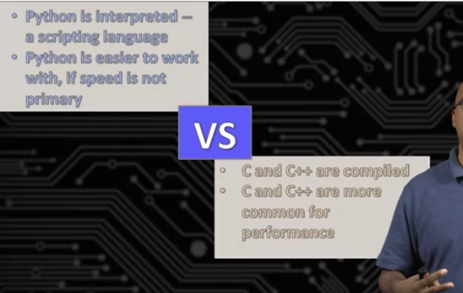
Intepreted and compiled languge
Python is interpreated lanauge means it needs to translated to machine language everytime it runs(slower)
C++ is compiled lanauge means it needs to translated to machine language onetime. Subsequent use just need to run the machine language(faster)

Slide 8
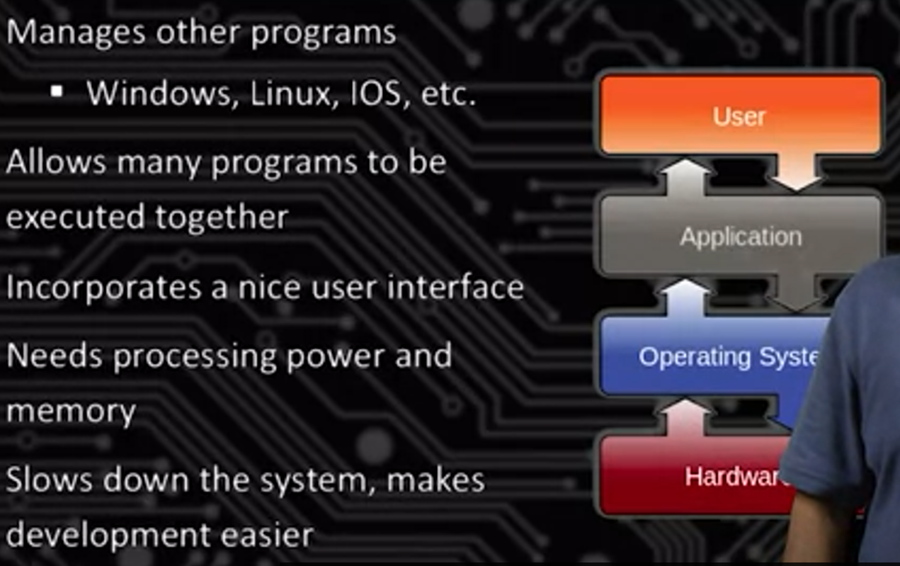
Operating system
Operating system: Between actual application and hardware. Application interact with hardware via operating system

