Slide 1
Java syntax & concepts

Slide 2
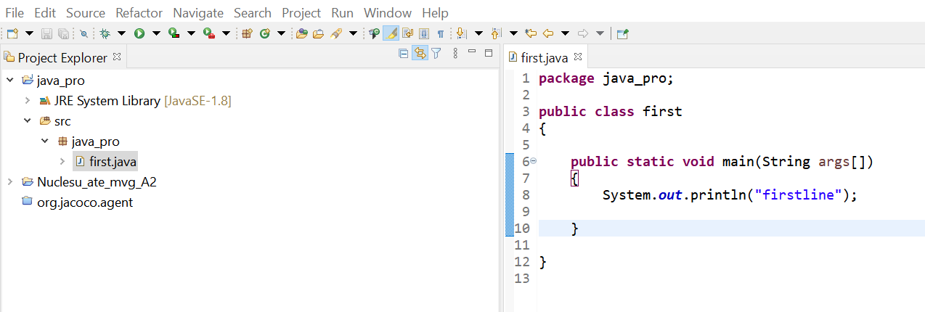
main

Slide 3
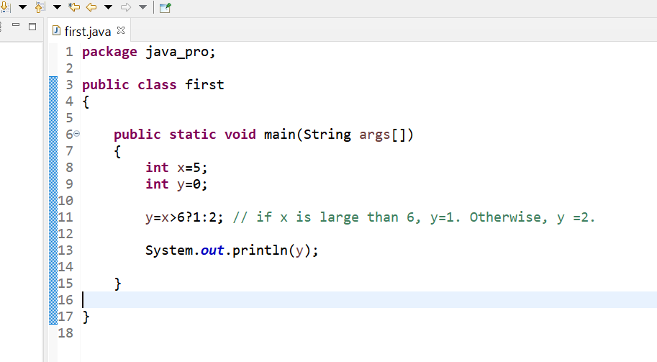
Ternary

Slide 4
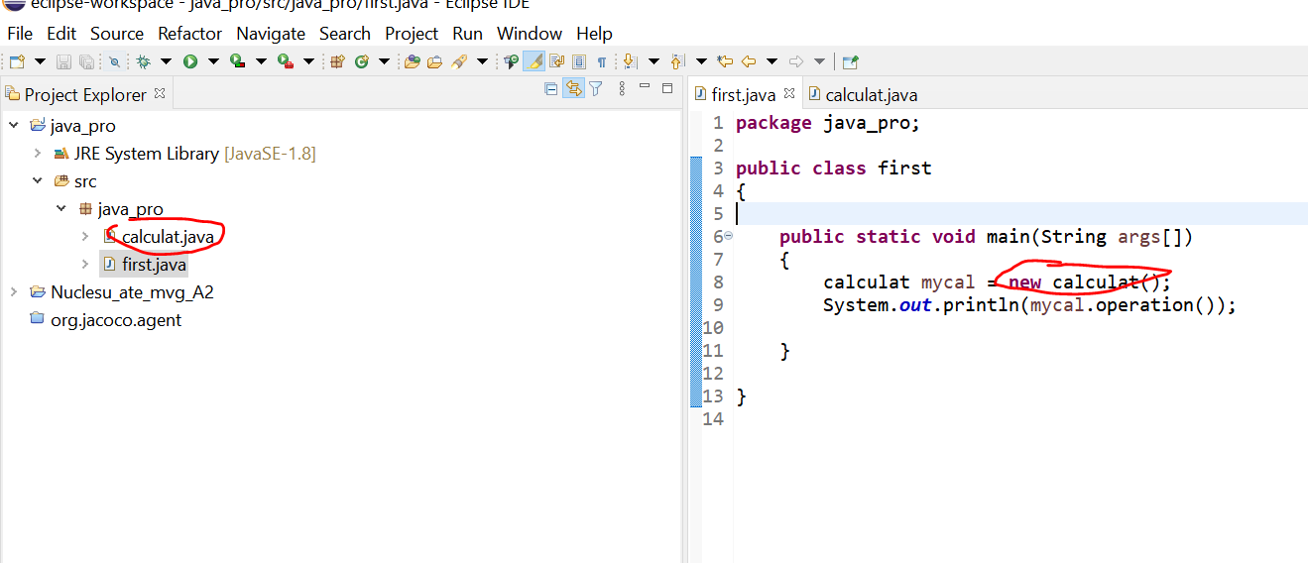
Class and object

Slide 5
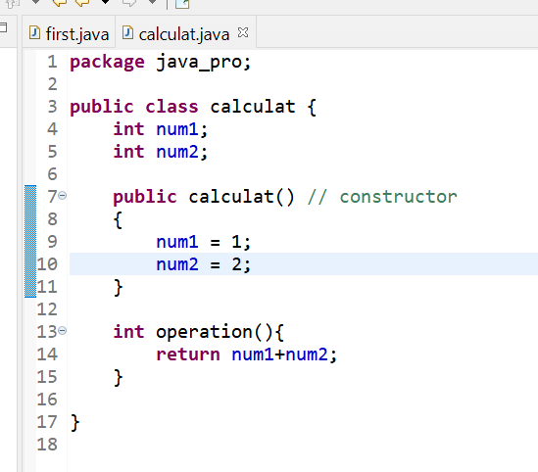
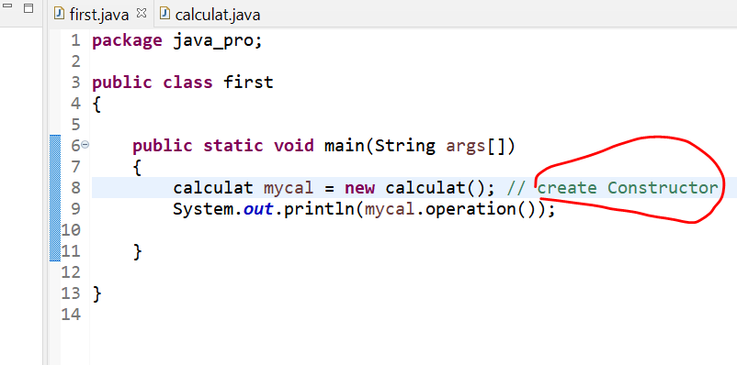
Constructor (initialize the newly created object)

Slide 6
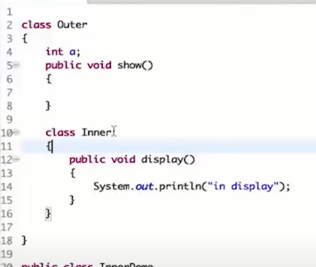
Inner class ( we can create a class in another class)

Slide 7
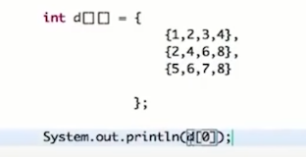
2D array

Slide 8
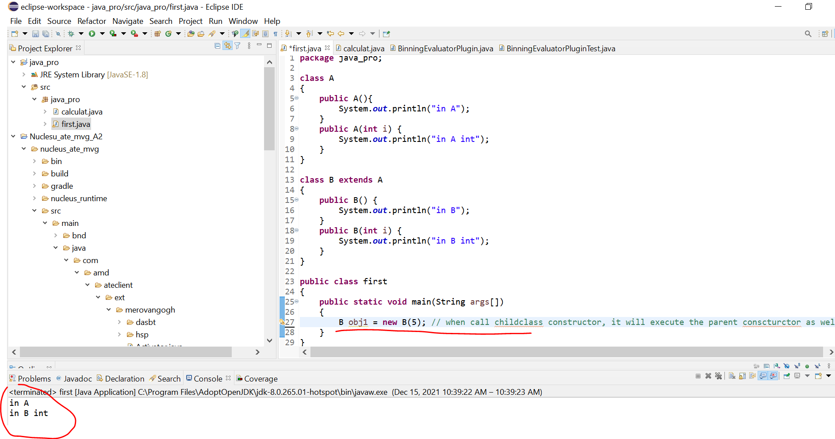
Super method
when call childclass constructor, it will execute the parent constructor as well

Slide 9
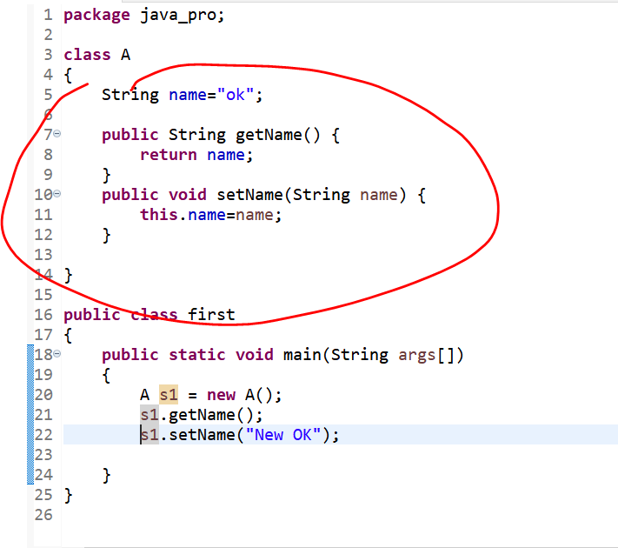
Encapsulation (get/set class variable using method)

Slide 10
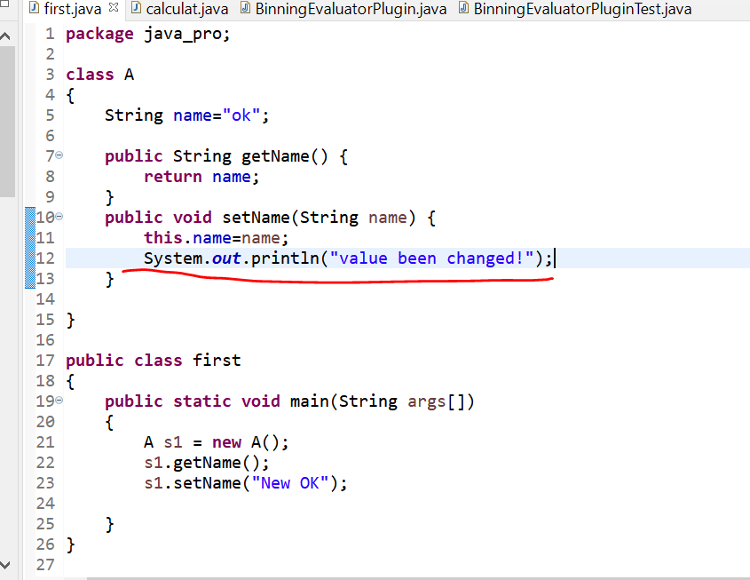
Why need to use Encapsulation
We can get a log file if we use encapsulation

Slide 11
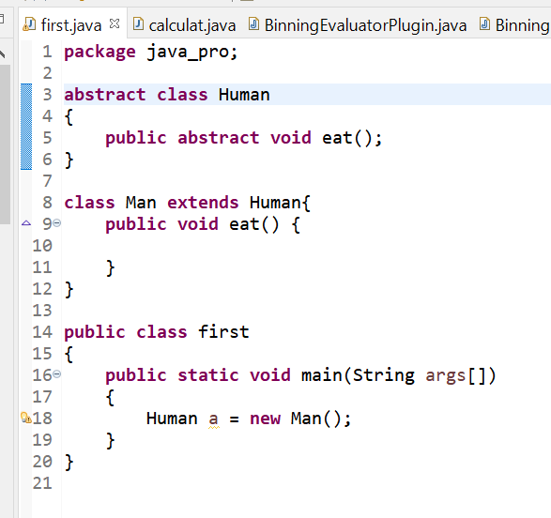
Abstract (can use in class & method)
When we don’t want define a method (e.g.eat method), we can make it abstract and the class which contains the method must also be an abstract class
If the child class extends the abstract class, child class must have the same methods in the parent class

Slide 12
Final (Variable, Method and class)
If put a “final” in front of variable, it becomes a constant (can’t be changed anymore once it has been assigned). E.g. final int Pi = 3.14f
If we make the parent class as final, child class can’t extend parent class
If we make the method (parent class) as final, child class can’t override this method
Notes:
Reference: https://www.tutorialspoint.com/what-is-a-constant-and-how-to-define-constants-in-java

