Slide 1
Java syntax & concepts

Slide 2
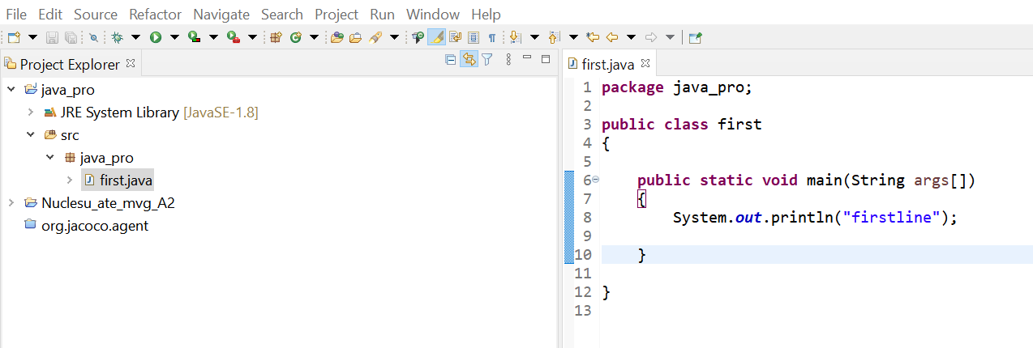
main

Slide 3
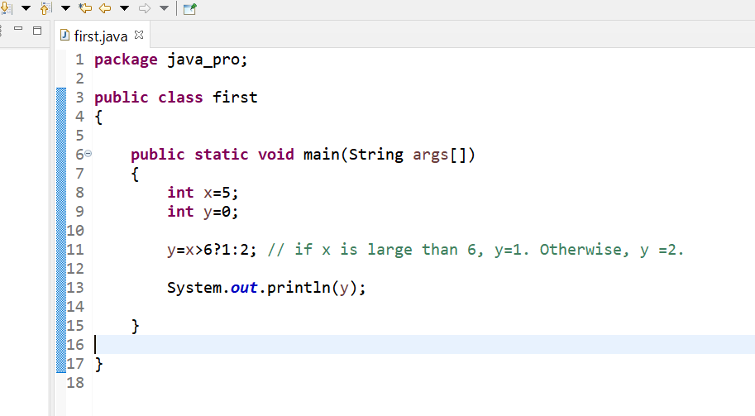
Ternary

Slide 4
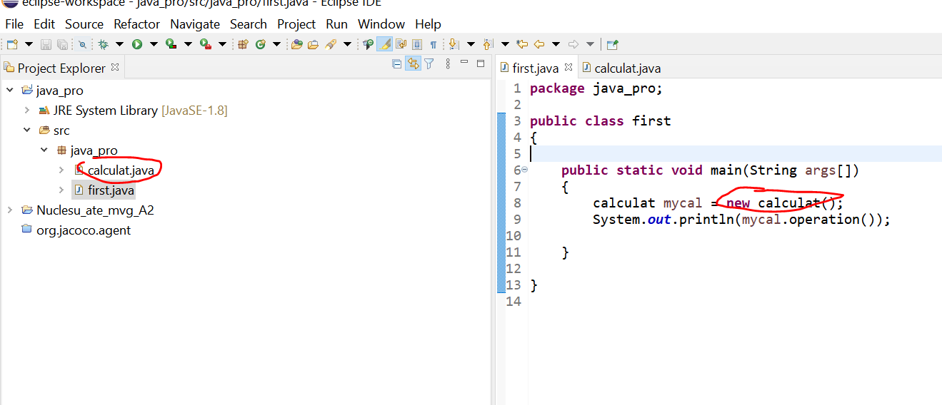
Class and object

Slide 5
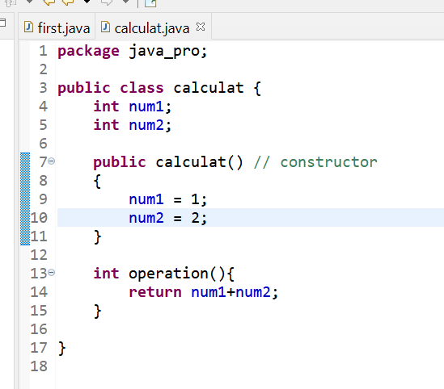
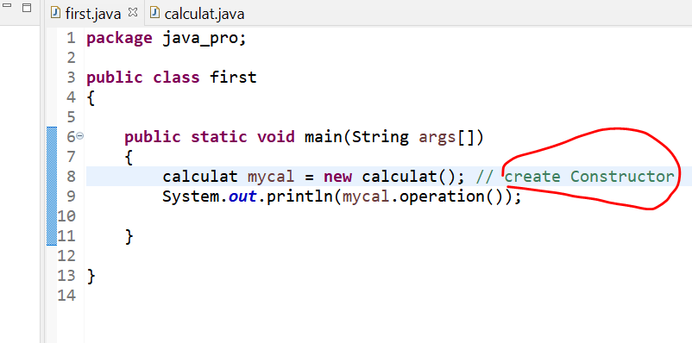
Constructor (initialize the newly created object)

Slide 6
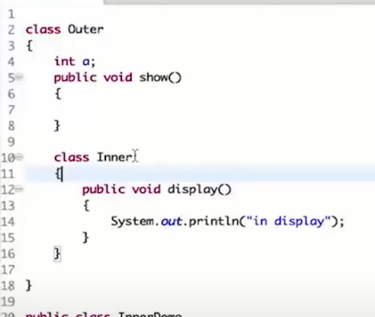
Inner class ( we can create a class in another class)

Slide 7
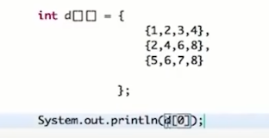
2D array

Slide 8
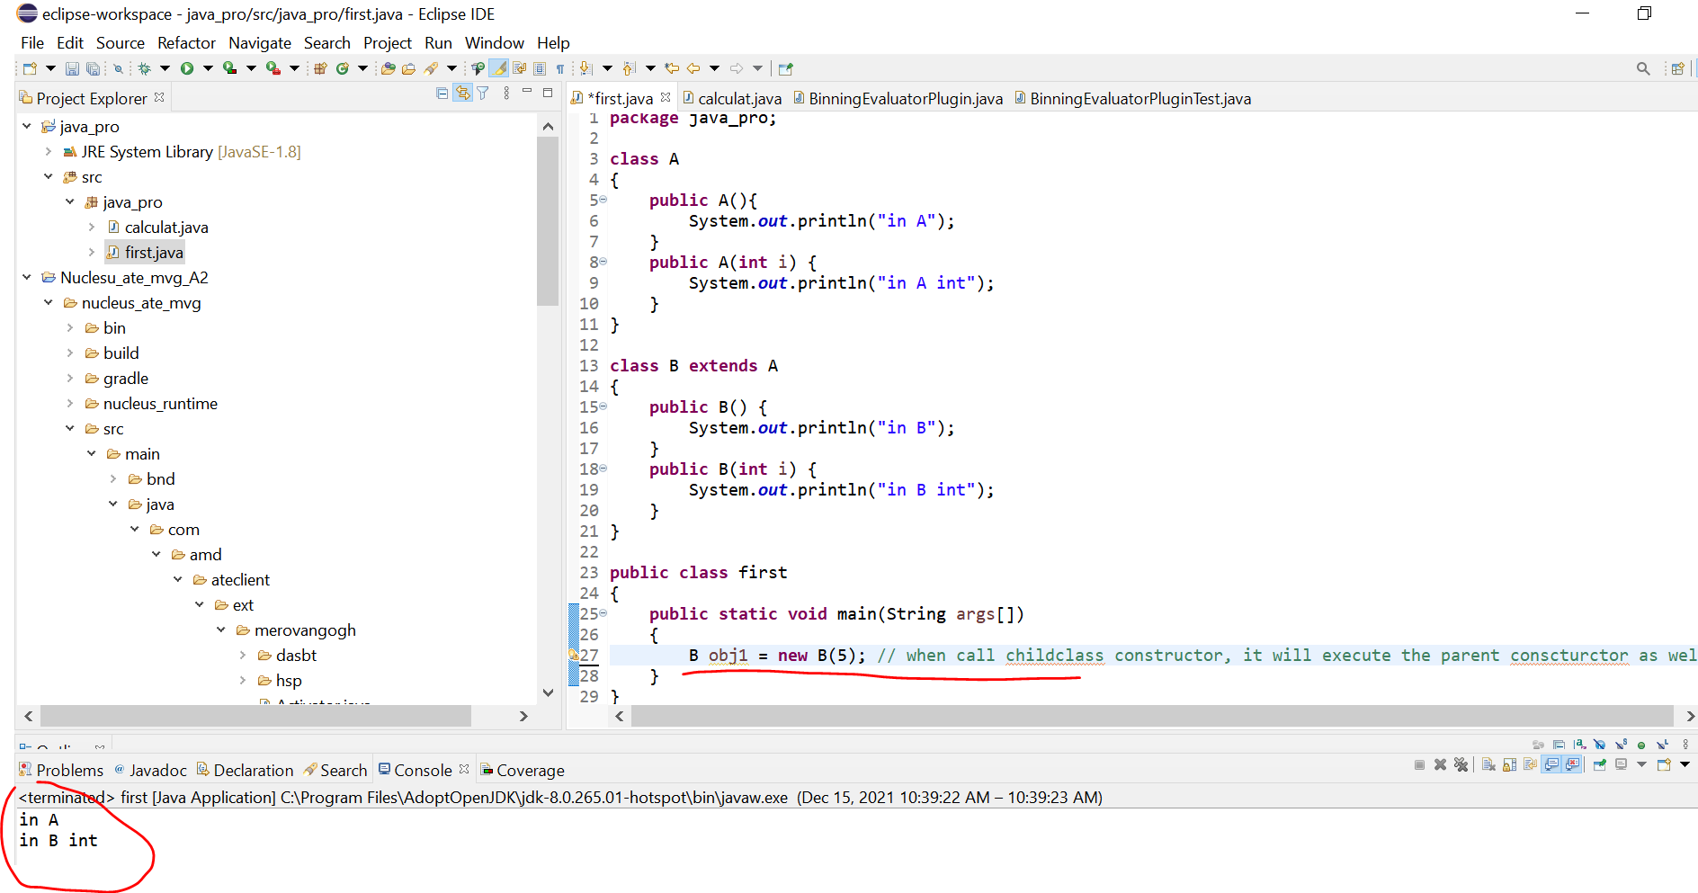
Super method
when call childclass constructor, it will execute the parent constructor as well

Slide 9
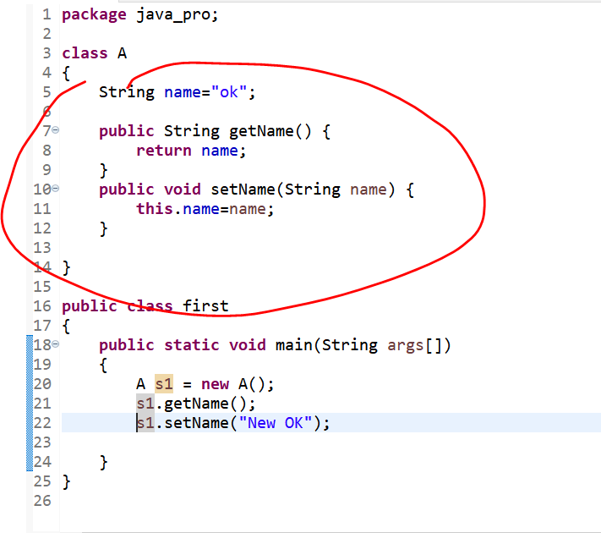
Encapsulation (get/set class variable using method)

Slide 10
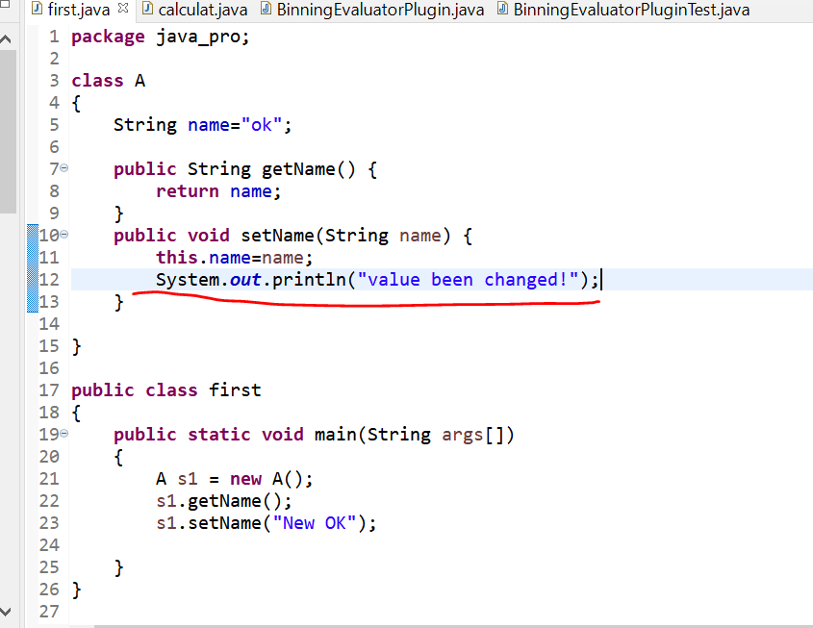
Why need to use Encapsulation
We can get a log file if we use encapsulation

Slide 11
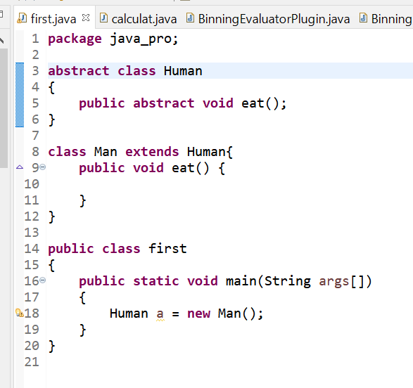
Abstract (can use in class & method)
When we don’t want define a method (e.g.eat method), we can make it abstract and the class which contains the method must also be an abstract class
If the child class extends the abstract class, child class must have the same methods in the parent class
Notice that we can only extend 1 class, what if there is another class called “Resident” and man class wants to extend both Human and Resident class? Apparently just using abstract can’t do this because it only allow extend 1 class.

Slide 12
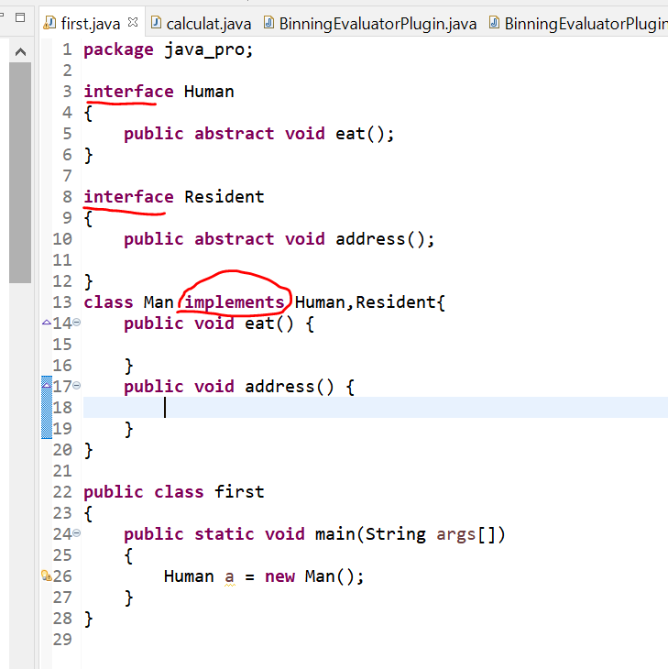
Interface
To solve the problem of child class can only extend 1 parent class, we use interface instead of abstract class
Note the way how to declare an interface
Child class can implement both interfaces

Slide 13
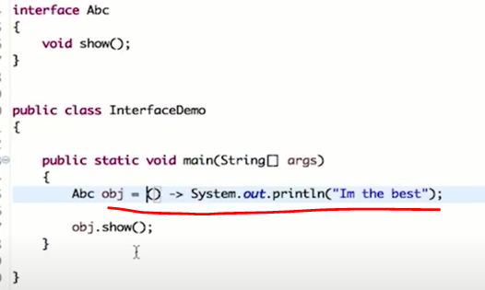
Lambda expression
Lambda expression (basically is just a short cut). It’s the same as create a new class which implements the interface and in the new class there is method which prints “Im the best”

Slide 14
Final (Variable, Method and class)
If put a “final” in front of variable, it becomes a constant (can’t be changed anymore once it has been assigned). E.g. final int Pi = 3.14f
If we make the parent class as final, child class can’t extend parent class
If we make the method (parent class) as final, child class can’t override this method
Notes:
Reference: https://www.tutorialspoint.com/what-is-a-constant-and-how-to-define-constants-in-java

Slide 15
Access modifier (Final, Abstract, public, private, default, protected)
Public: no limits (can access from different classes / packages. Which explain why class can’t be private or protected. Normally it’s public but can be final or abstract depends on the need) .
Private: limit to same class
Default: Same package (class A/B under same package)
Protected: Same package (class A/B under same package) or different package (eg, class A in package A and class B in package B) but Class A is a child class of B.

Slide 16
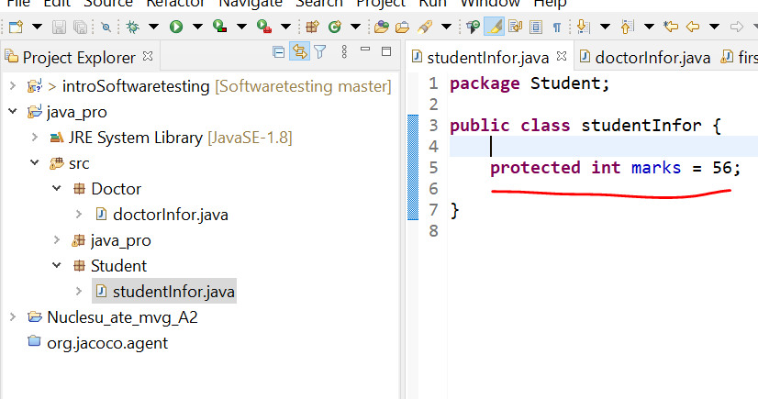
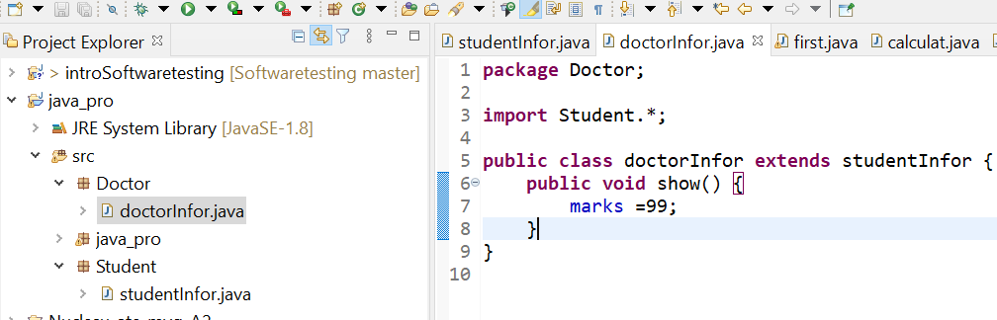
Example of protected access modifier
Student package
Class under Student package
Doctor package
Class under doctor package and this class extend student package

Slide 17
Multi-threading
Concept similar to multi-task because of mutli-core (muti CPUs) in modern computer
Instead of just let 1 core finish the task, we can break the task and let all 4 or 8 cores run simutiously

