Slide 2
Install IDE
Eclipse :special type of editor for java and it can also helps to compile the code (editor + compiler)

Slide 3
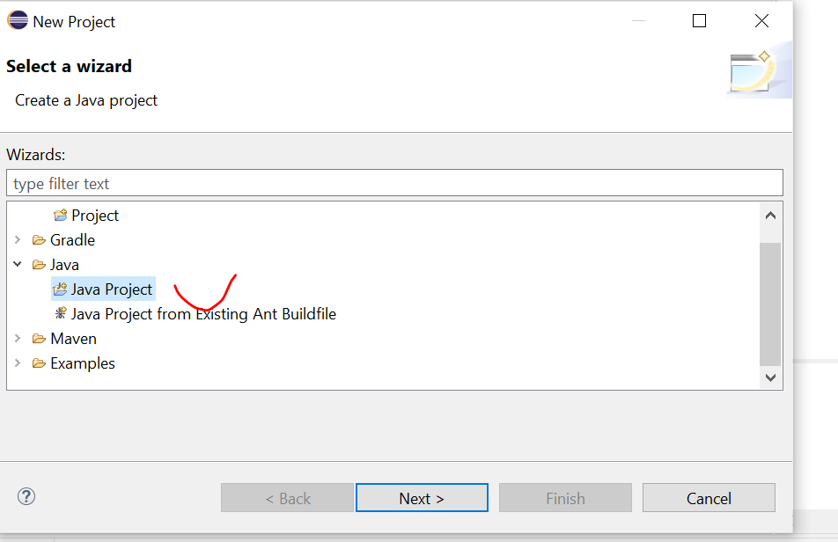
Create project
Right click “new” -> select “java project”

Slide 4
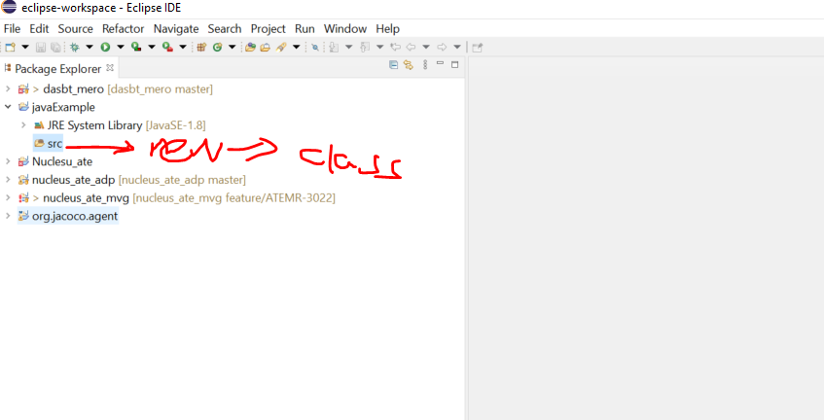
Create new class
Right click “src”-> new -> class

Slide 5
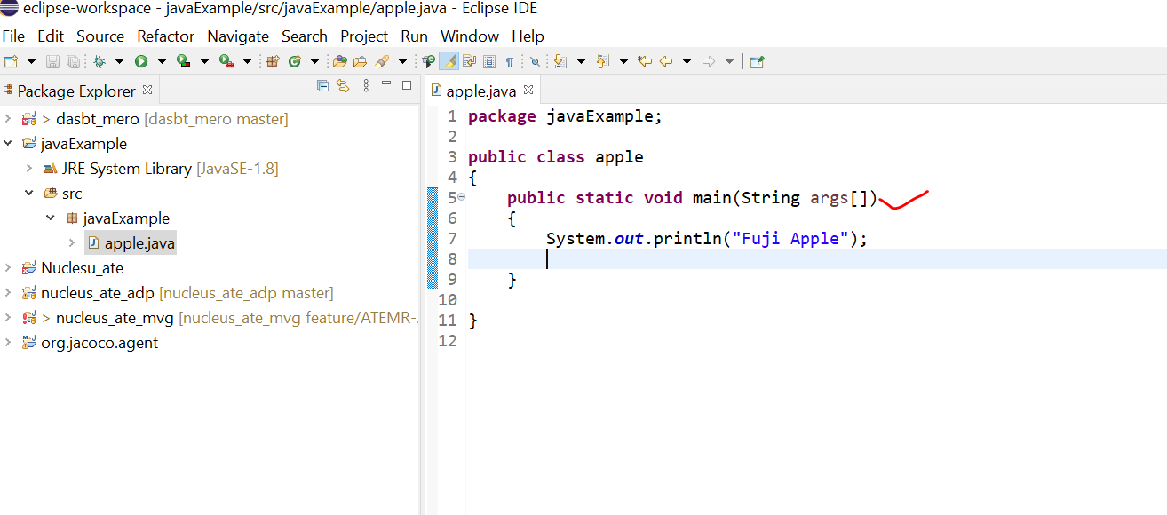
Cont’…

Slide 6
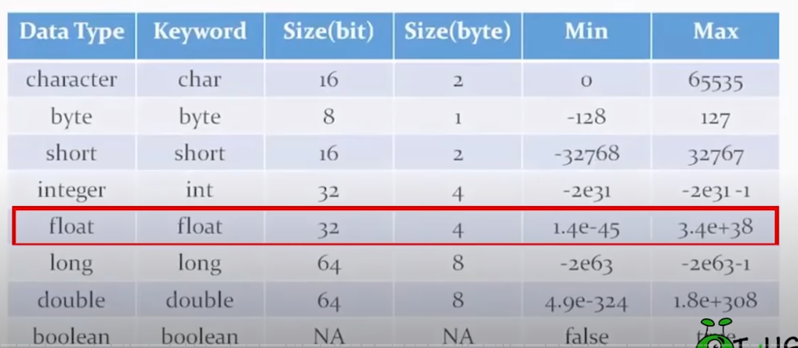
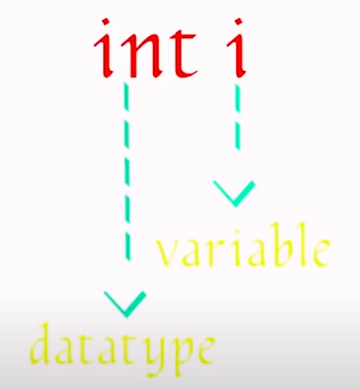
Variables

Slide 7
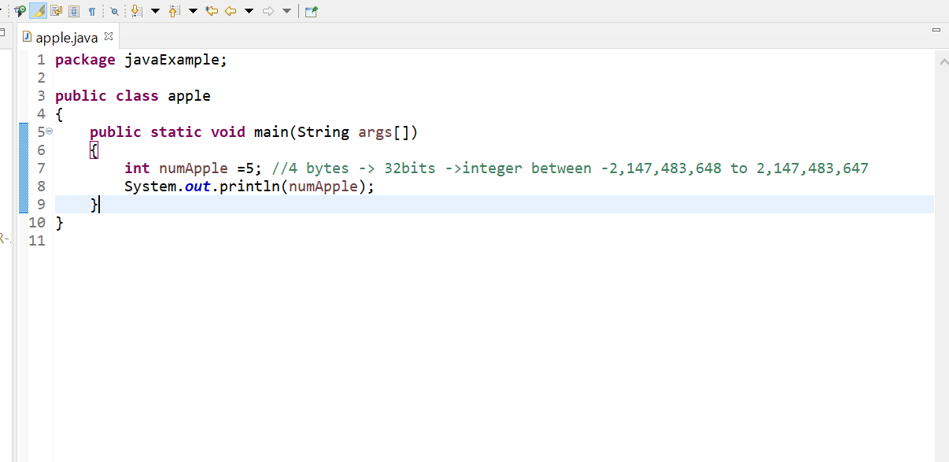
Cont’..

Slide 8
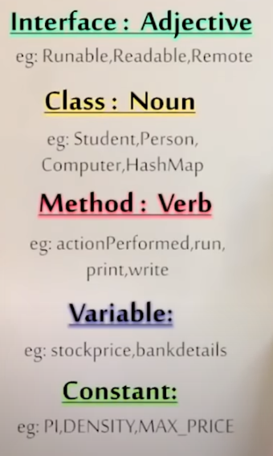
Naming convention (don’t simply use x,y,z)
Class first char should be capital!
Small letter!
All capital letters!

Slide 9
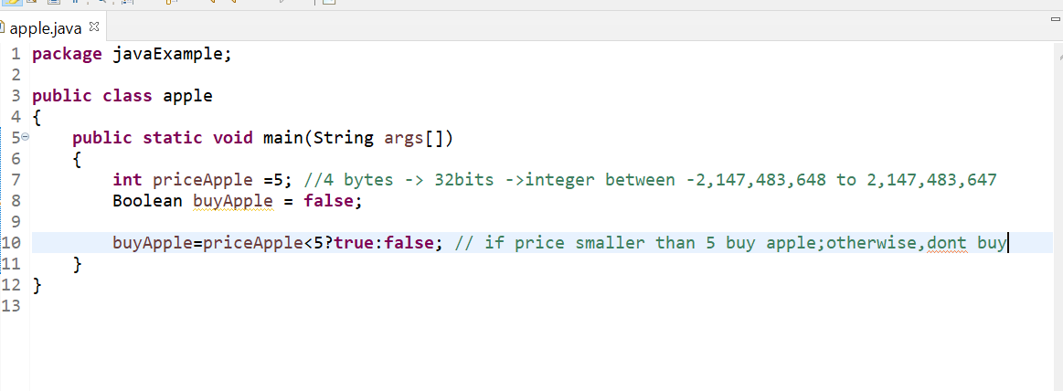
Ifelse selection (switch & ternary operator)
Ternary operator

Slide 10
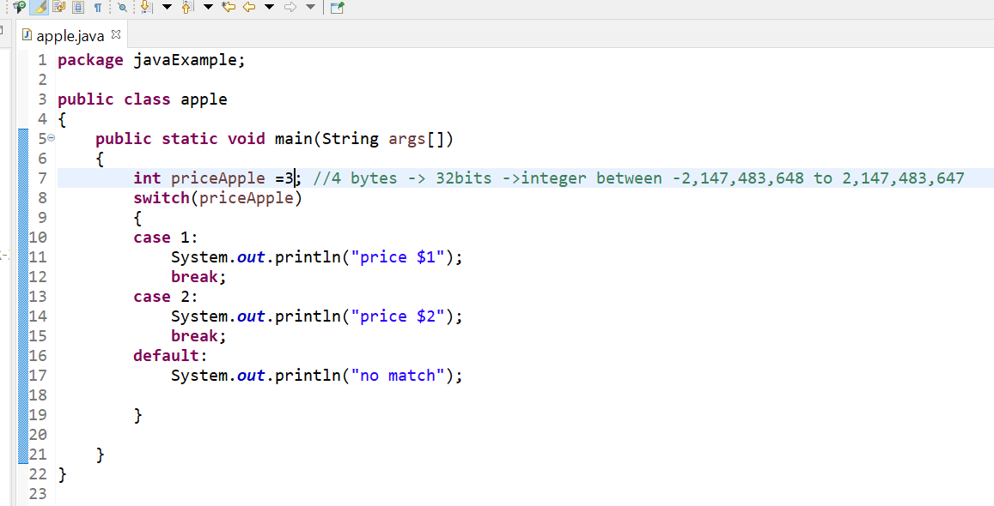
Cont’…
Switch statement

Slide 11
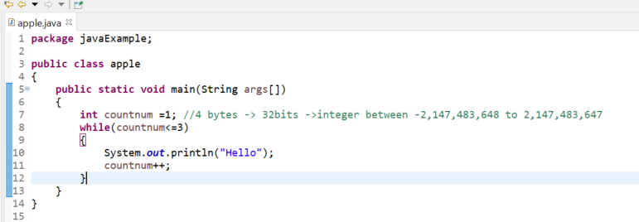
While loop

Slide 12
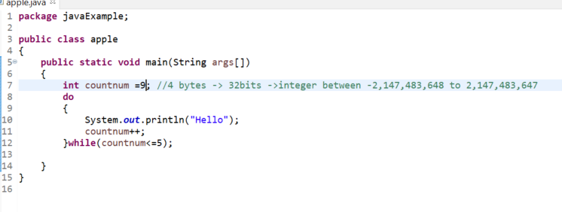
dowhile loop
dowhile will execute at least once even it doesn’t meet the condition

Slide 13
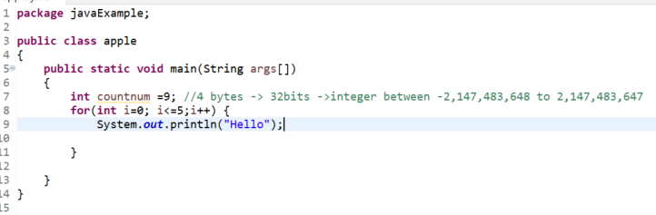
For loop

Slide 14
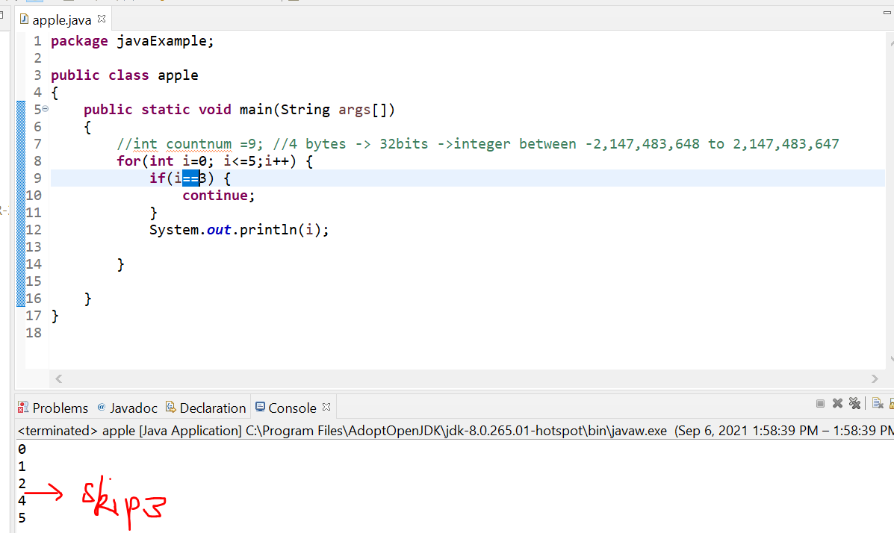
Continue/break
Continue will not execute the current step and jump to next step

Slide 15
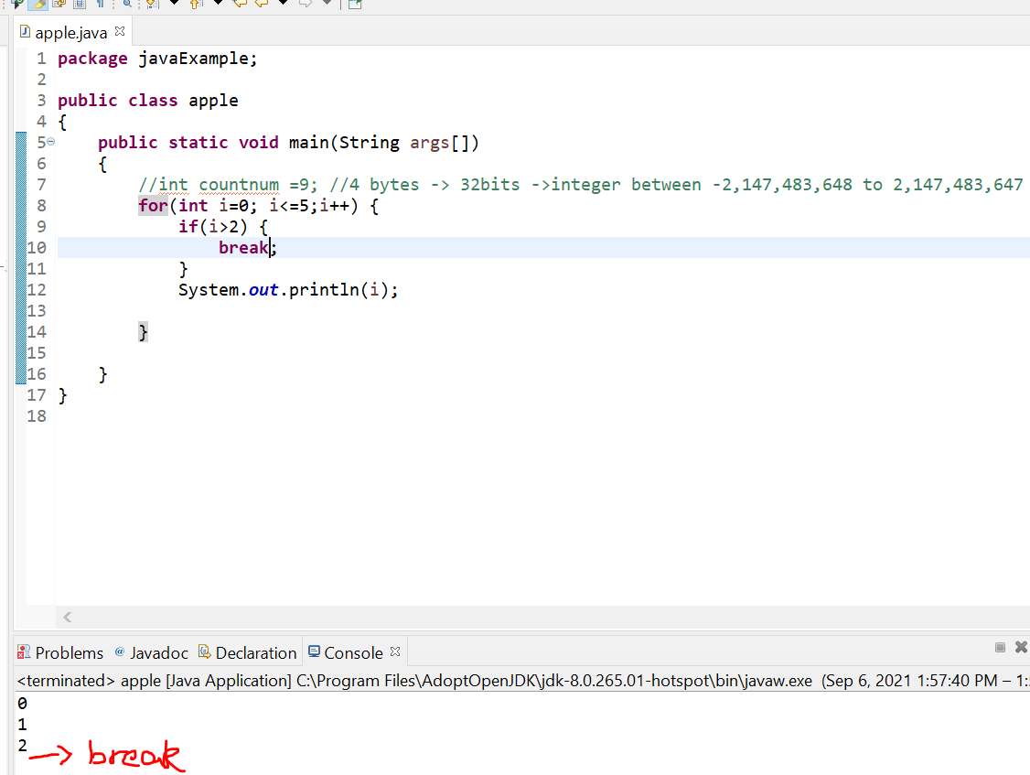
Cont’..
Break will stop the loop

Slide 16
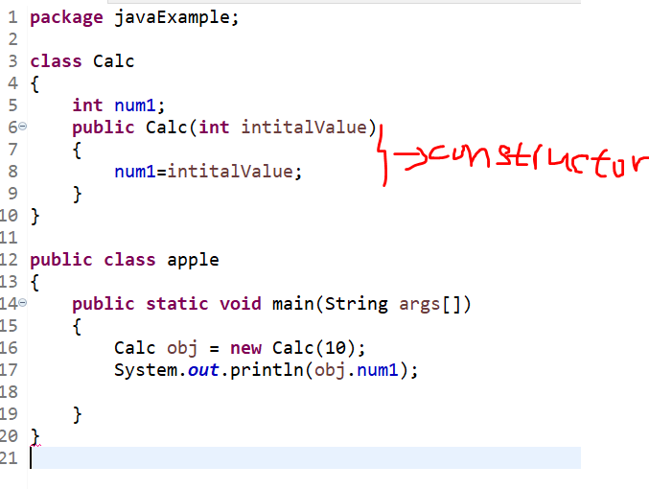
Class & constructor &object

Slide 17
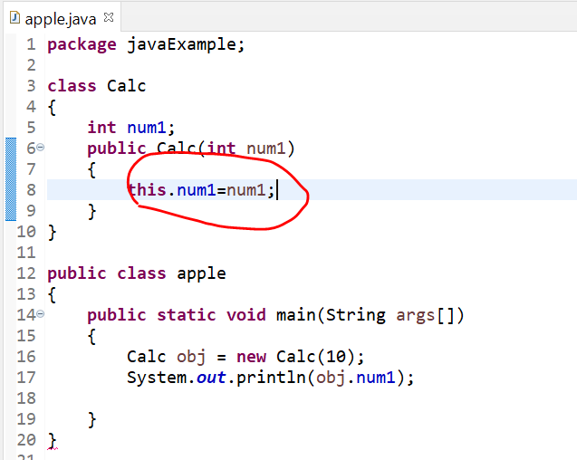
This keyword

Slide 18
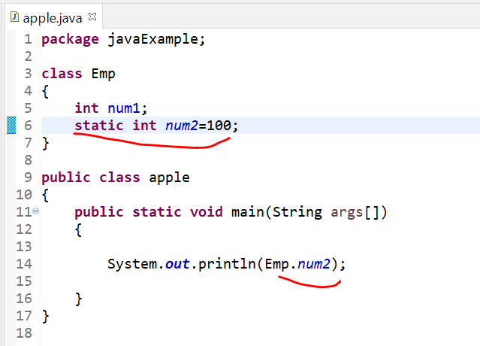
Static
Static no need to create instance

Slide 19
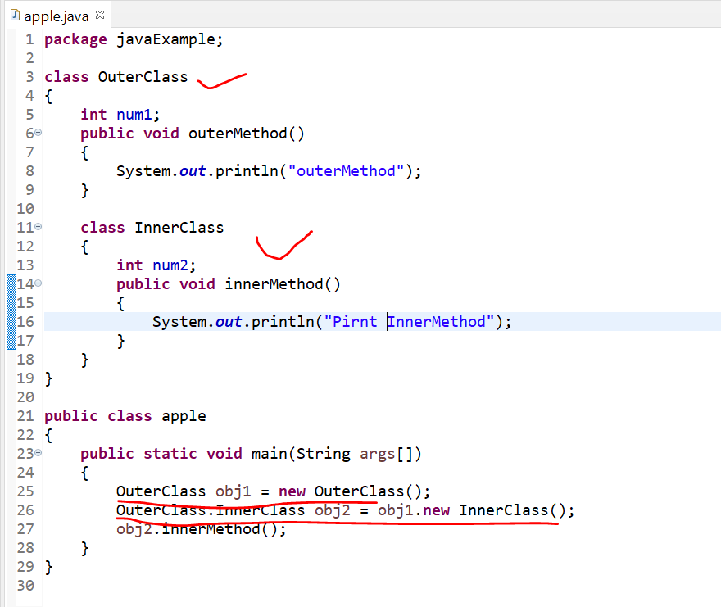
Inner class
Class inside another class

Slide 20
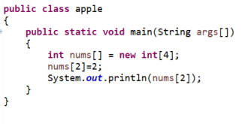
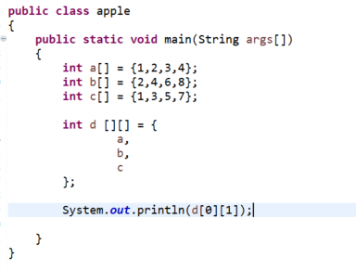
Array
1 D :
2D:

Slide 21
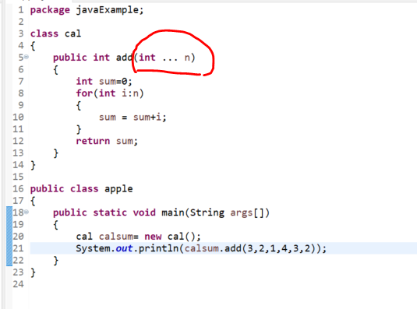
Varargs

Slide 22
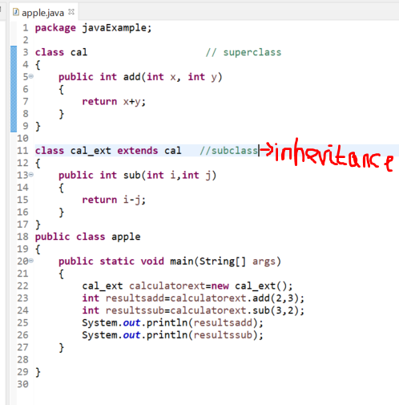
Inheritance

Slide 23
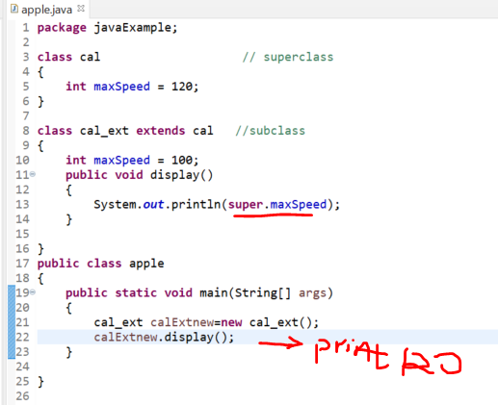
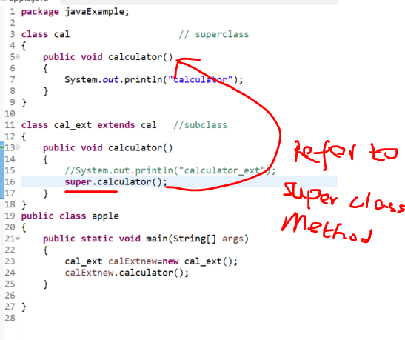
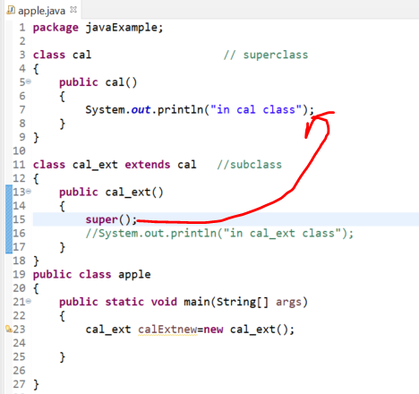
Super variables, method, constructors

Slide 24
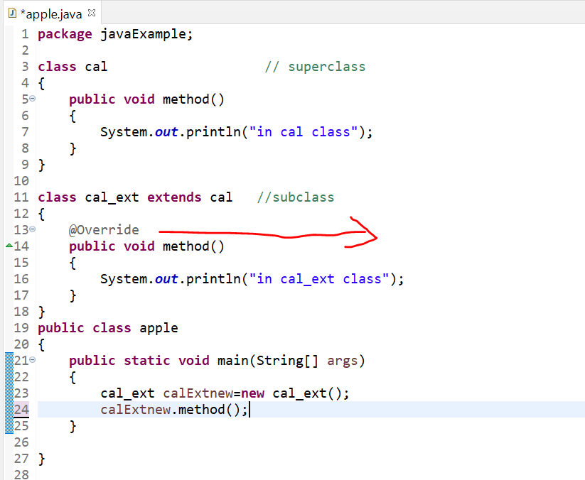
Method overriding
Child method override parent method

