Slide 1
Java Junit

Slide 2
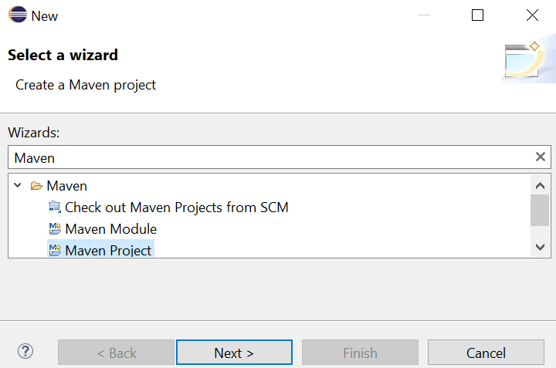
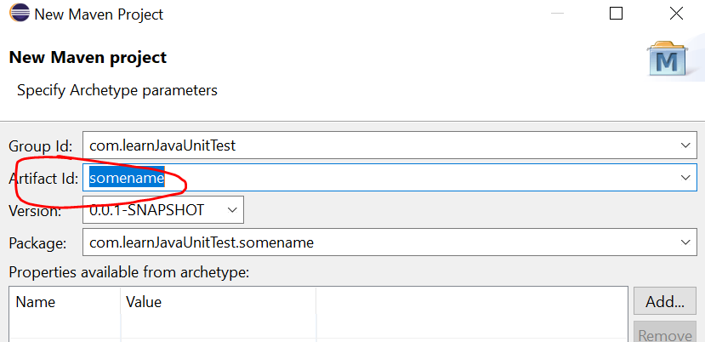
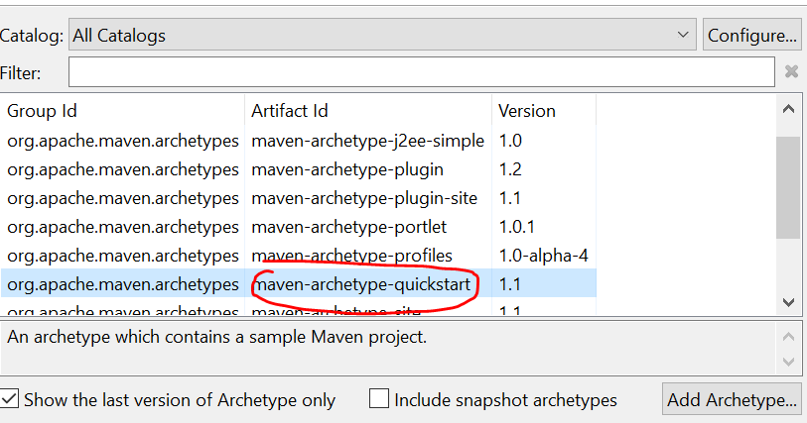
Create Maven project
Maven is a build tool which has lots of library (jar file) available to use (by default we have junit dependencies available, so no need to download it).
File-> New-> others-> type “Maven” and select “Maven project”
Select “maven-archetype-quickstart”
Name it under “Artificat id”

Slide 3
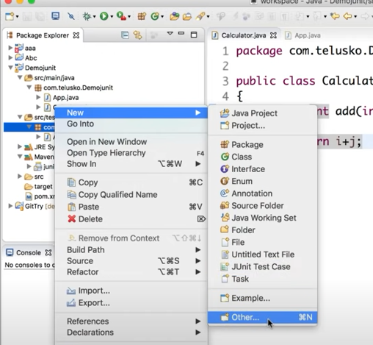
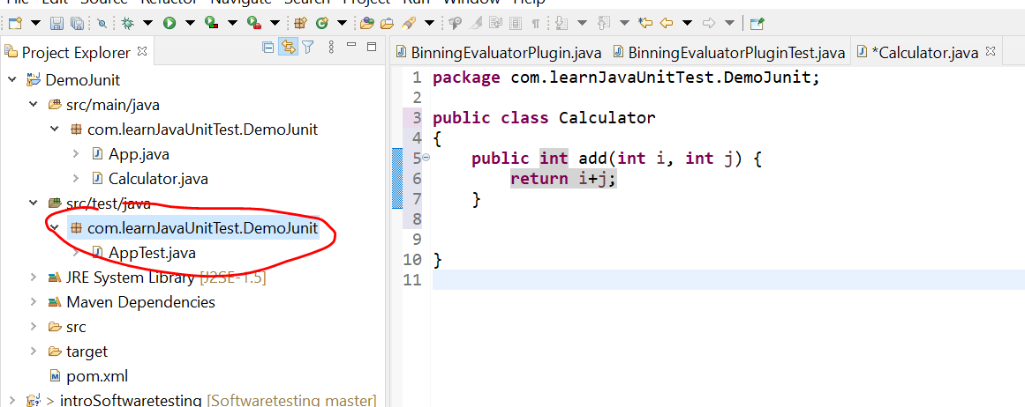
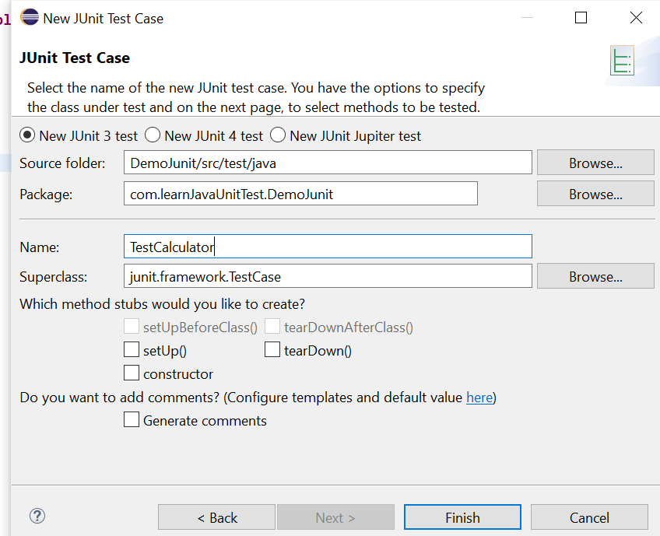
To create a testcase
Right click on the package , New -> Other -> Search “Junit Test Case”
Name the testcase

Slide 4
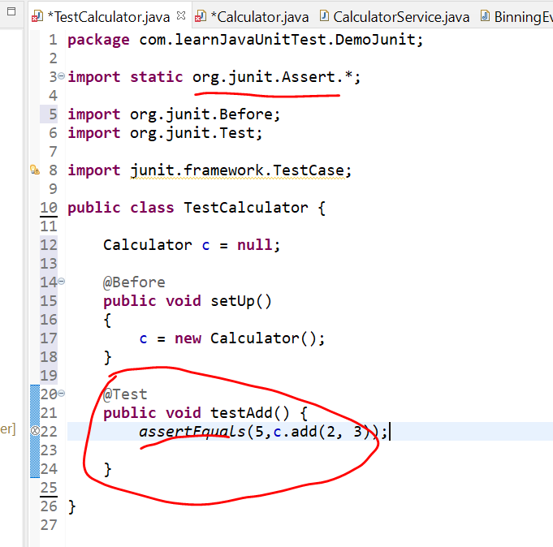
Syntax

Slide 5
What is mokito and why use it?
It’s to simulate server. Imagine we need to pass data to server to enquiry data, and we need to create a mock server which simulate the task perform by the server.
User no need to worry about the server and focus on other testings (we enquiry infor from server to perform tasks. Can focus on testing those tasks)

Slide 6
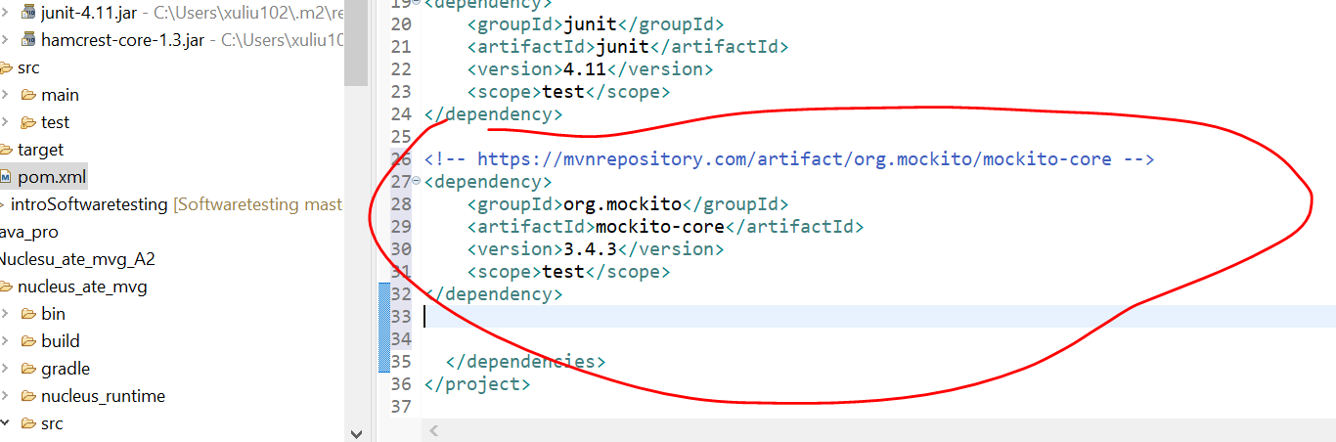
Add Mockito dependency to pom.xml
https://mvnrepository.com/artifact/org.mockito/mockito-core/3.4.3

Slide 7
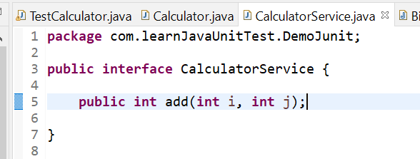
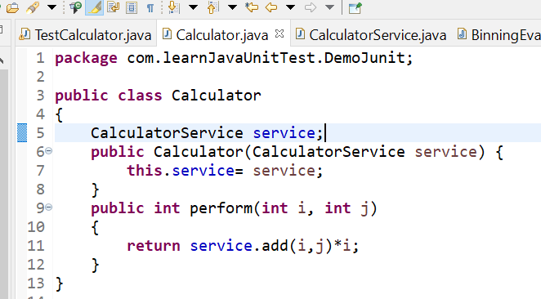
Code
server
Calculator

Slide 8
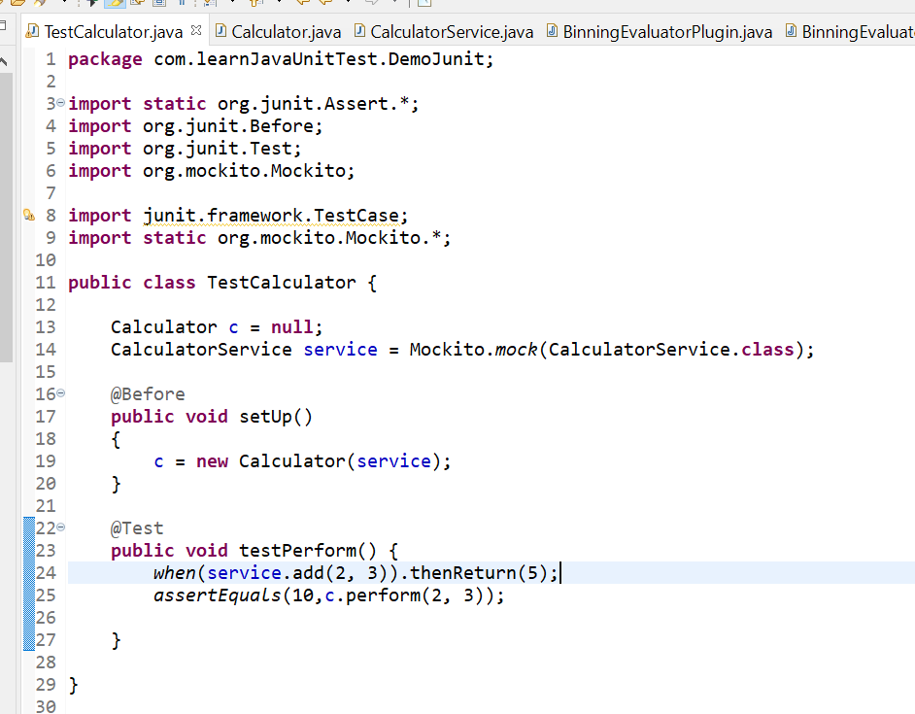
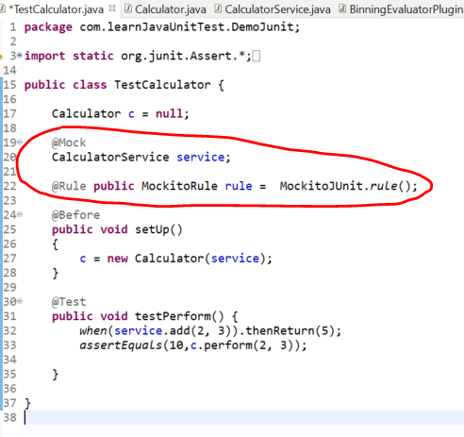
Continue..
=
Create object of the server service
Simulate server calculate
results and return it back

