Slide 2
Install IDE
Eclipse :special type of editor for java and it can also helps to compile the code (editor + compiler)

Slide 3
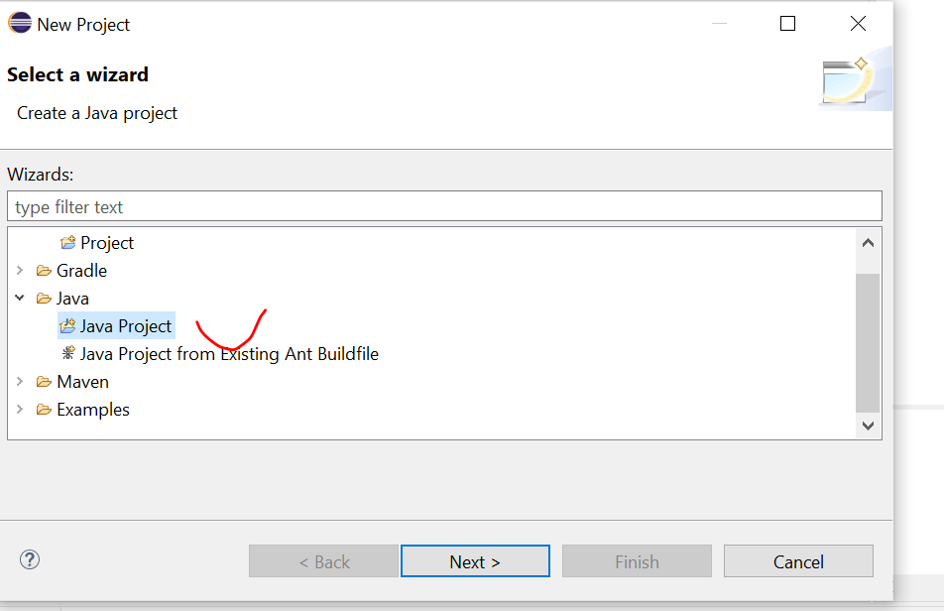
Create project
Right click “new” -> select “java project”

Slide 4
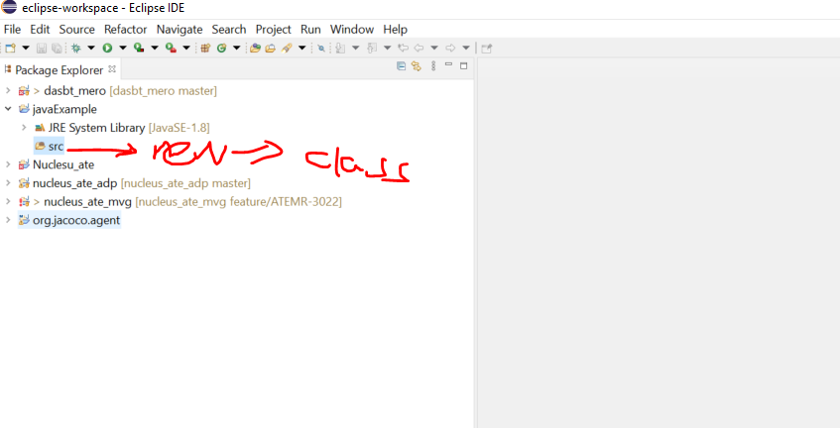
Create new class
Right click “src”-> new -> class

Slide 5
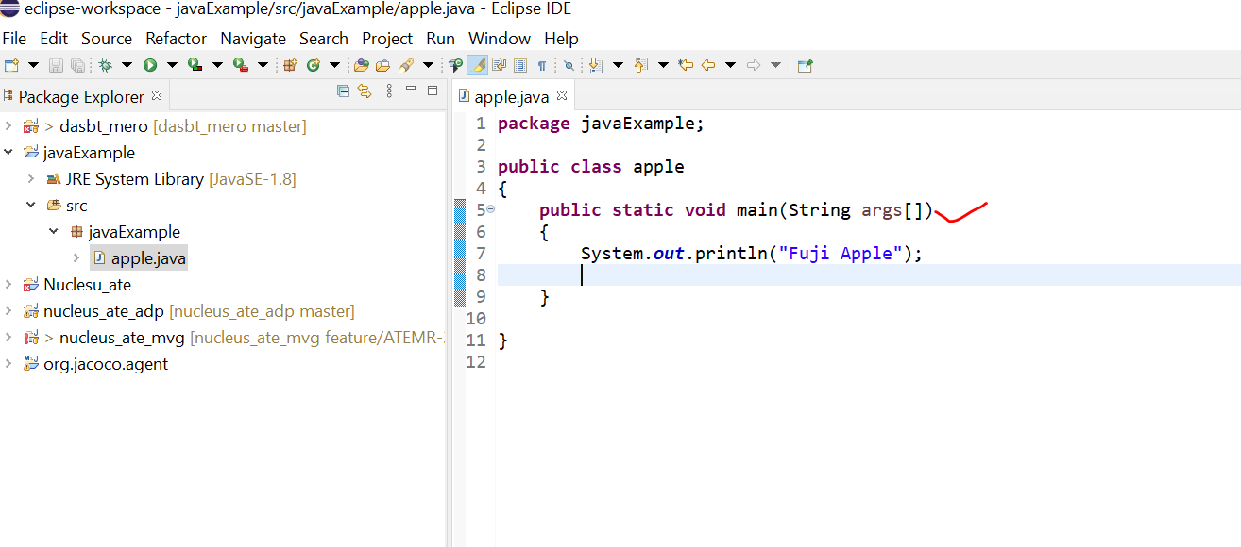
Cont’…

Slide 6
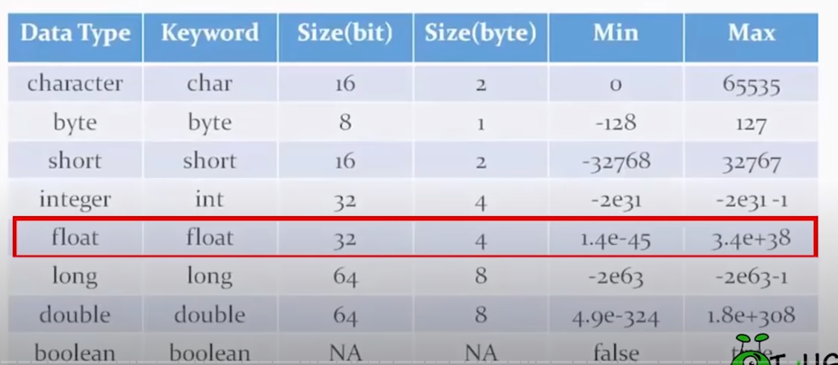
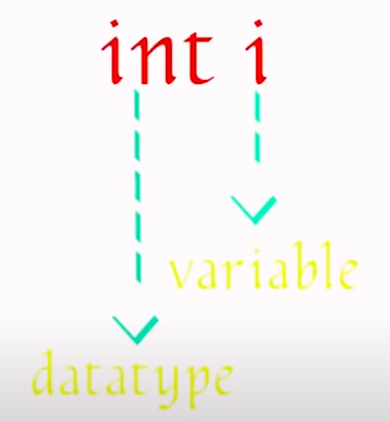
Variables

Slide 7
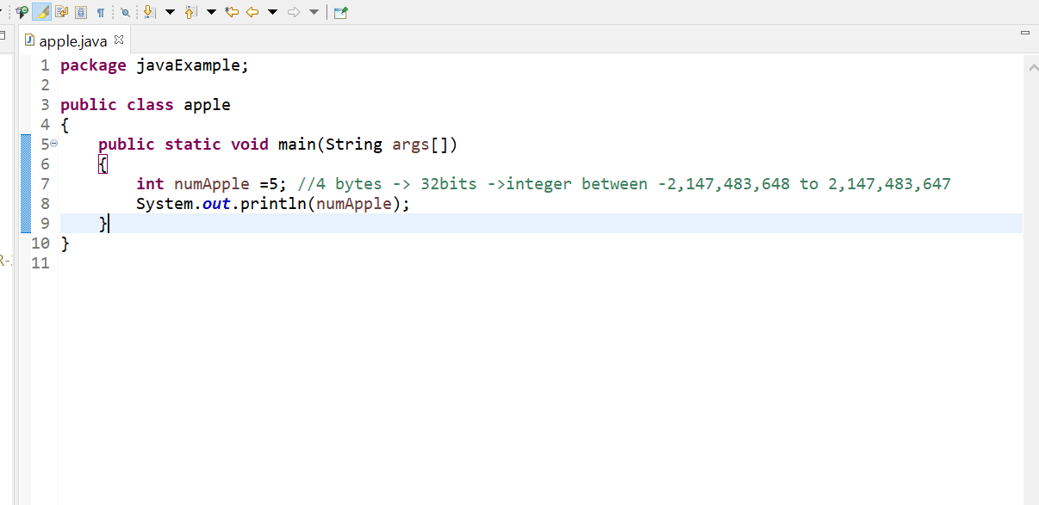
Cont’..

Slide 8
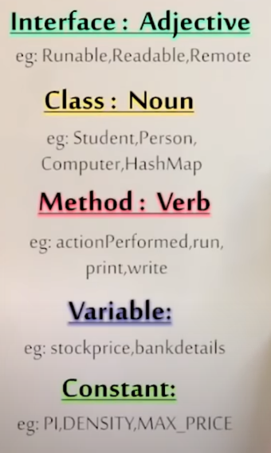
Naming convention (don’t simply use x,y,z)
Class first char should be capital!
Small letter!
All capital letters!

Slide 9
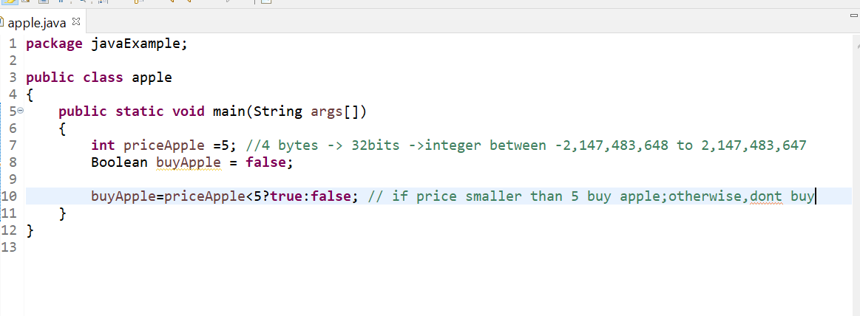
Ifelse selection (switch & ternary operator)
Ternary operator

Slide 10
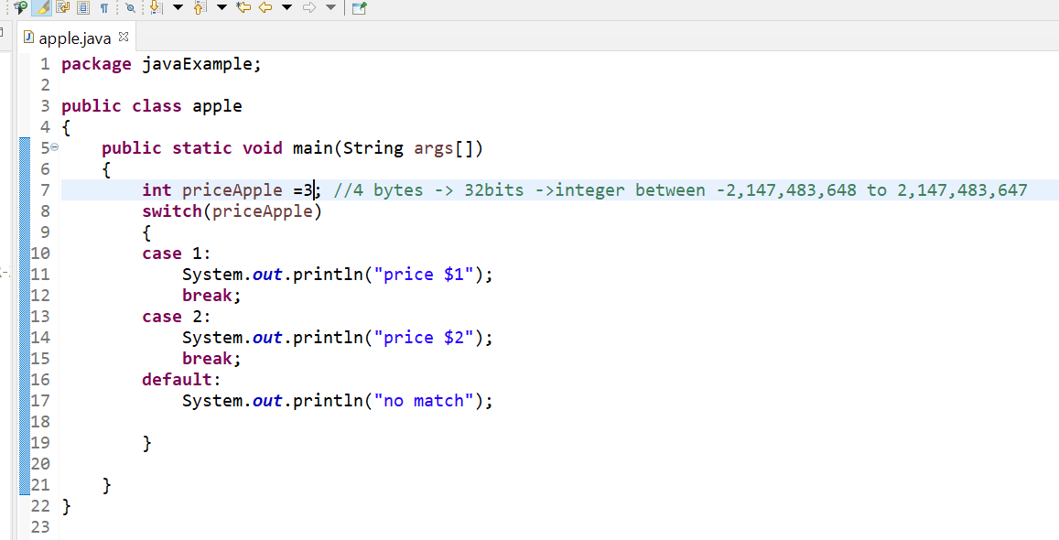
Cont’…
Switch statement

