Slide 2
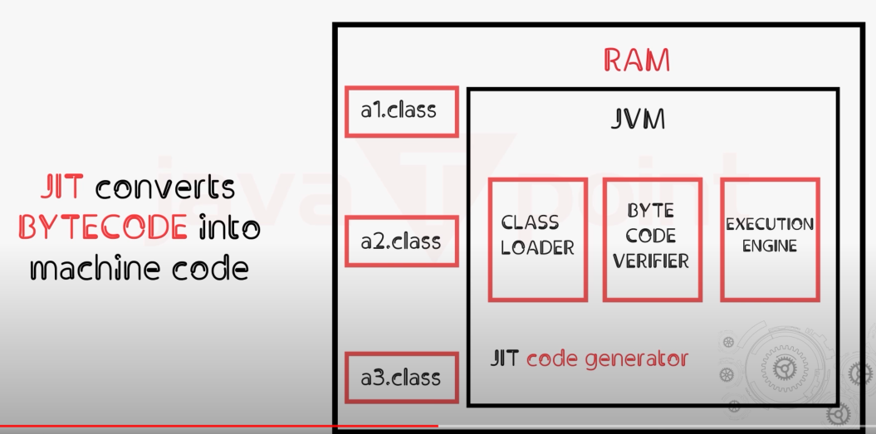
JAVA JDK
Main part of JDK is JVM (which helps to translate bytecode .class to machine code)

Slide 3
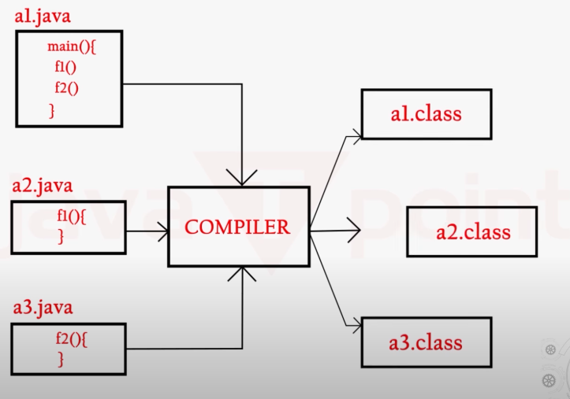
IDE
IDE: Special type of editor for java and it also helps to compile the code (translate source code to bytecode)

Slide 4
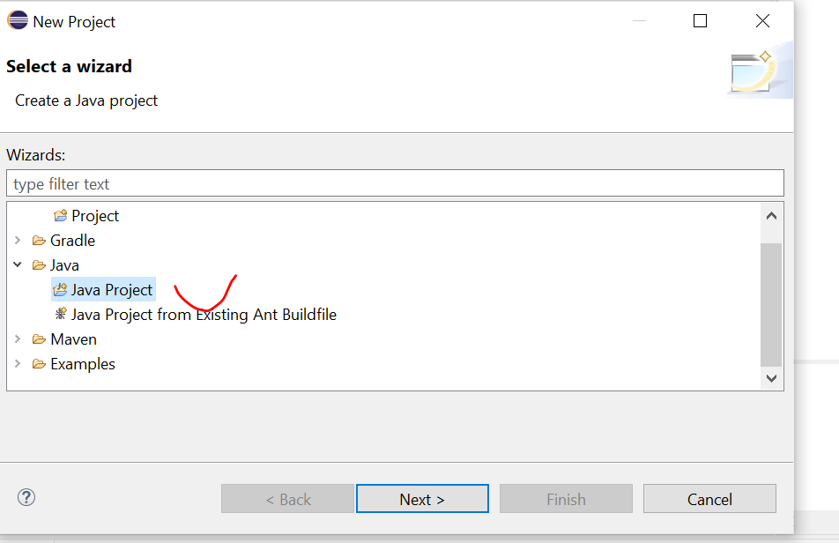
Create project
Right click “new” -> select “java project”

Slide 5
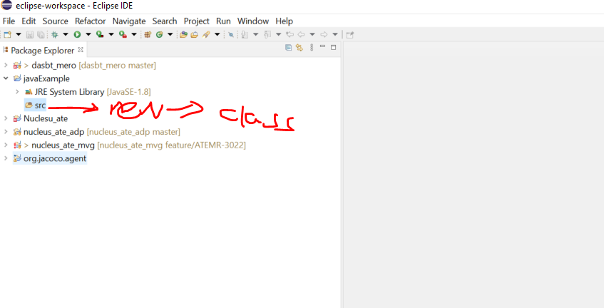
Create new class
Right click “src”-> new -> class

Slide 6
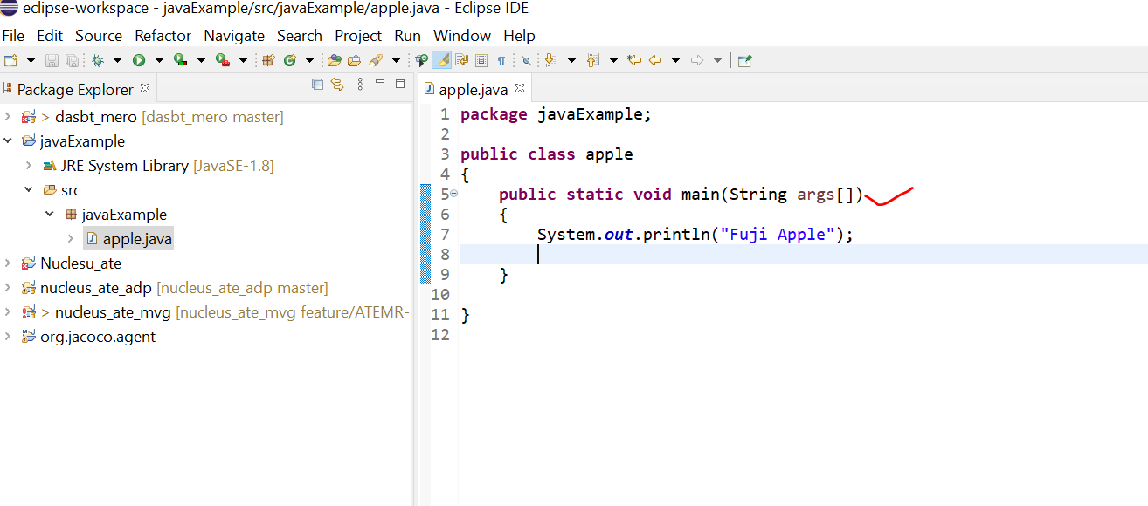
Cont’…

Slide 7
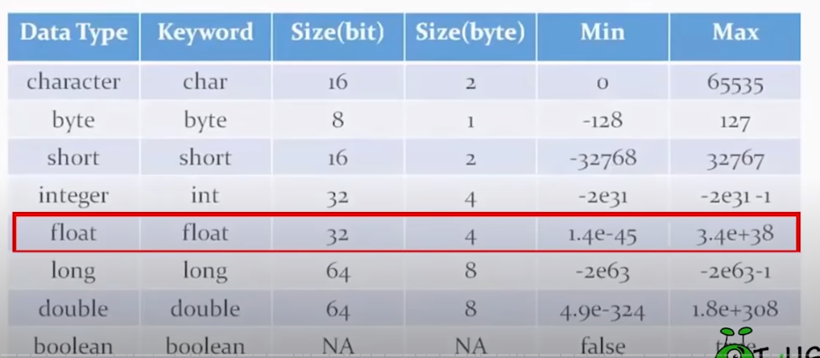
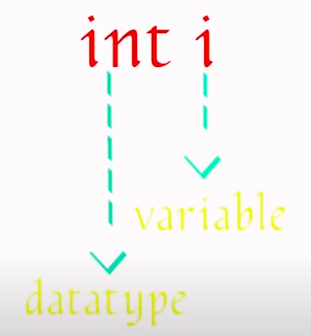
Variables

Slide 8
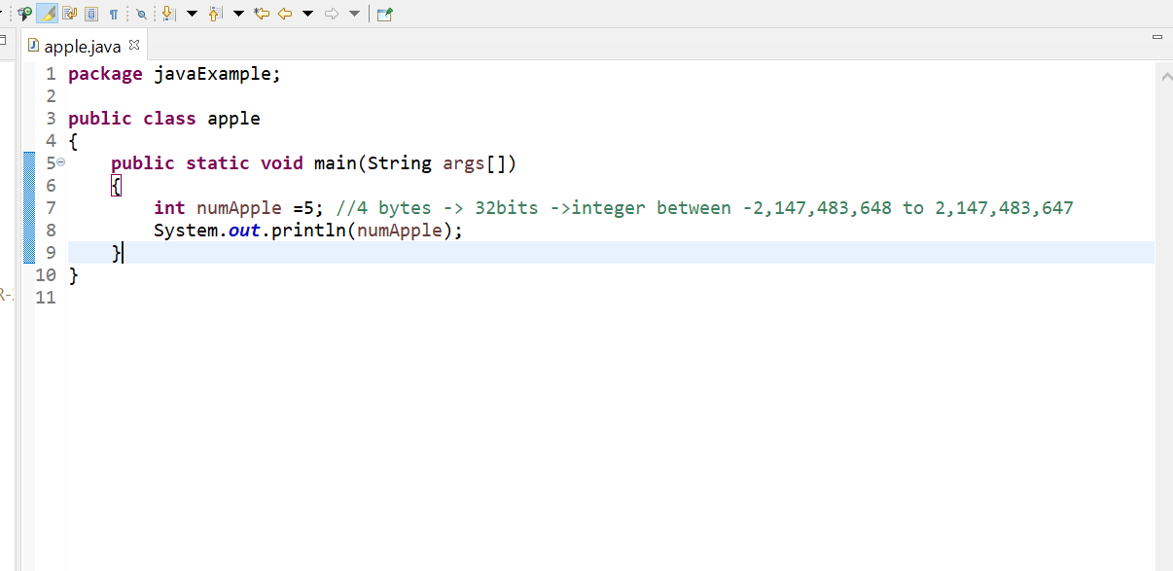
Cont’..

Slide 9
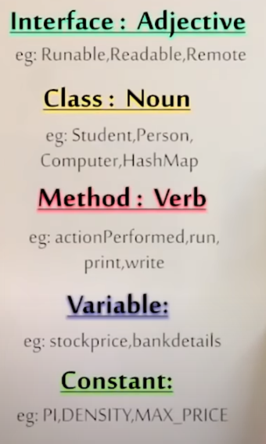
Naming convention (don’t simply use x,y,z)
Class first char should be capital!
Small letter!
All capital letters!

Slide 10
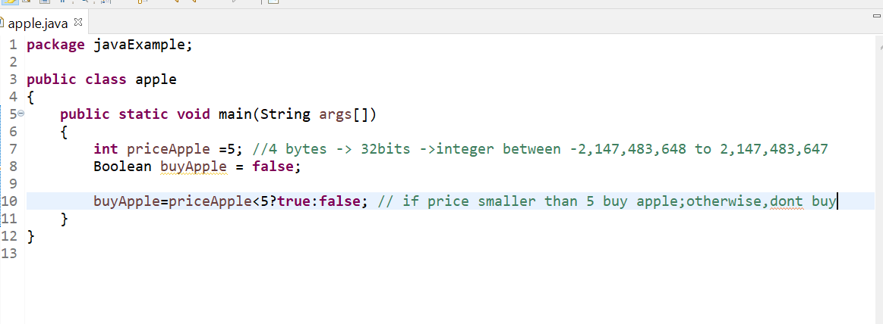
Ifelse selection (switch & ternary operator)
Ternary operator

Slide 11
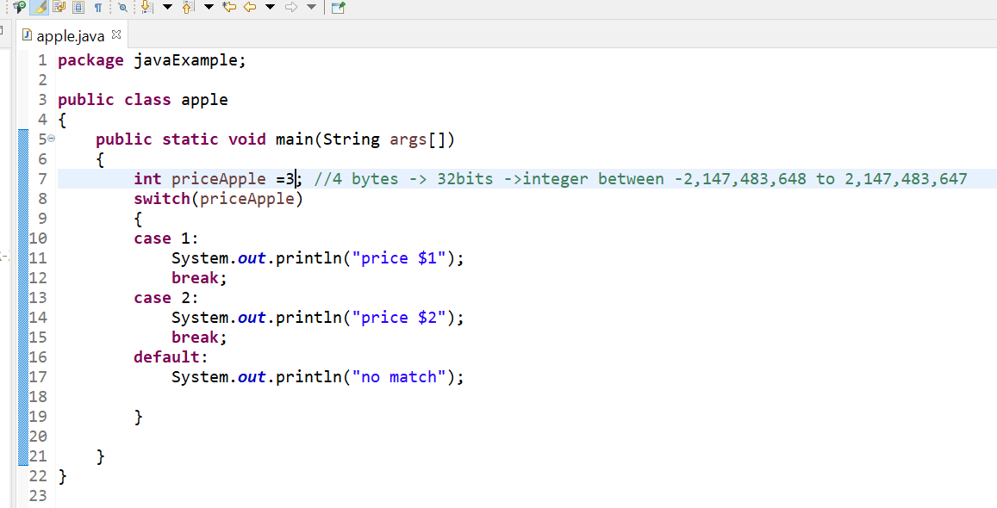
Cont’…
Switch statement

Slide 12
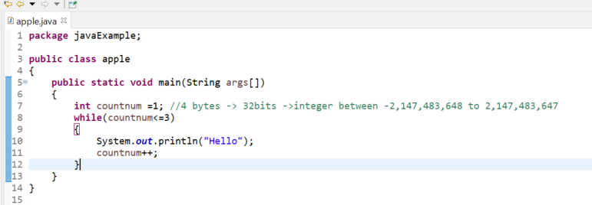
While loop

Slide 13
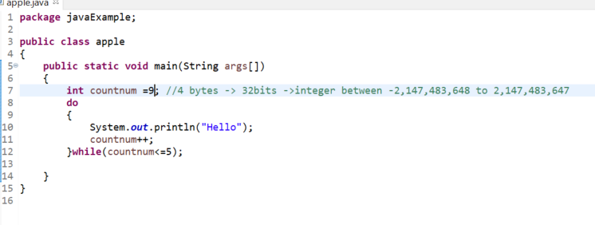
dowhile loop
dowhile will execute at least once even it doesn’t meet the condition

Slide 14
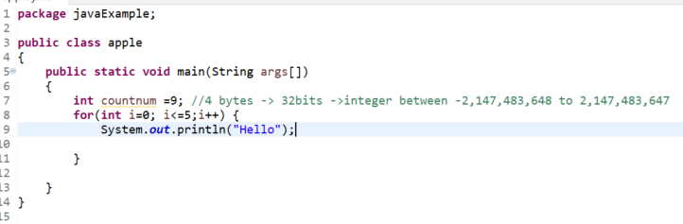
For loop

Slide 15
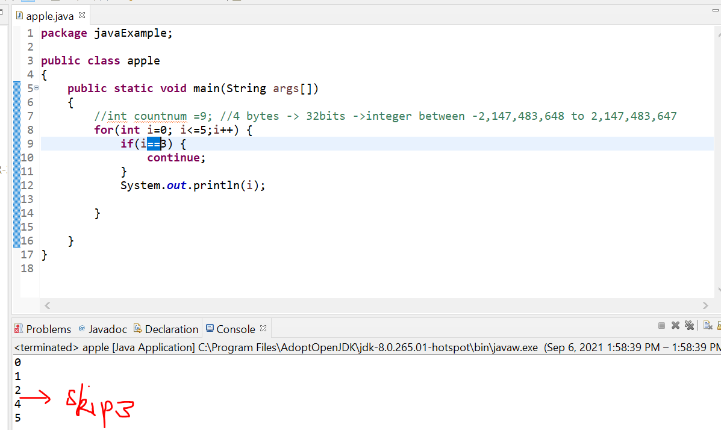
Continue/break
Continue will not execute the current step and jump to next step

Slide 16
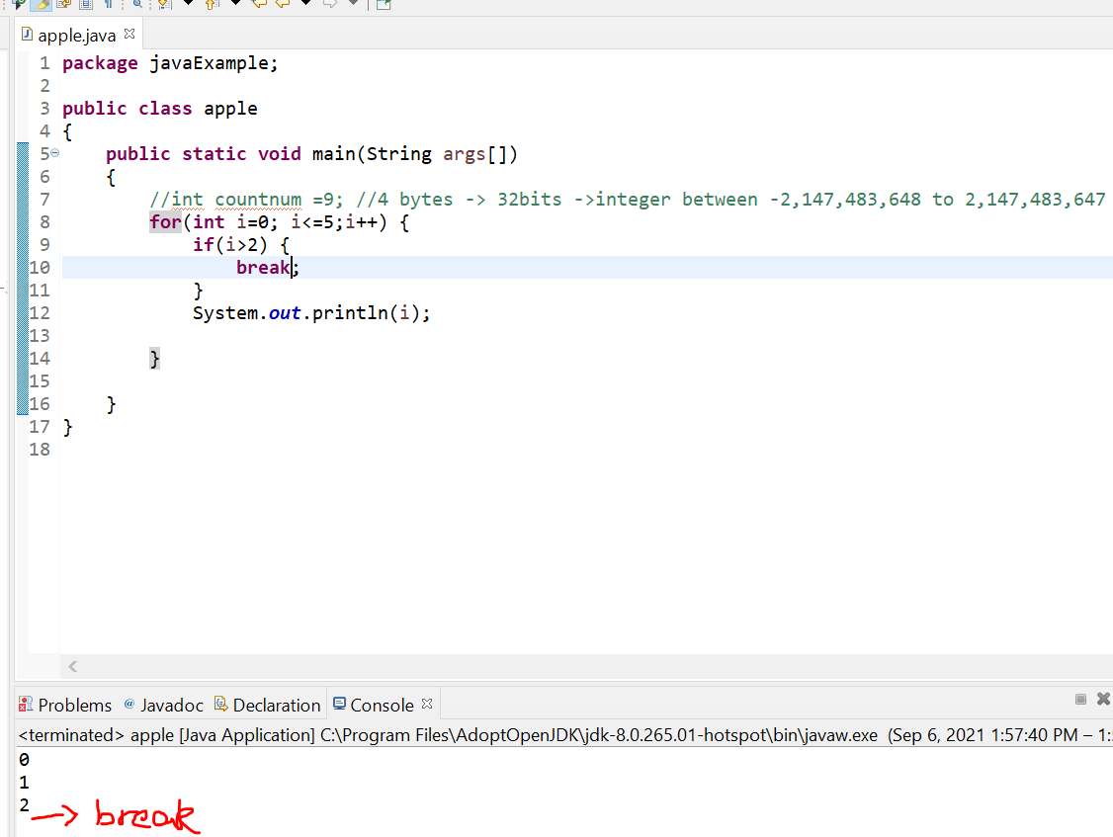
Cont’..
Break will stop the loop

Slide 17
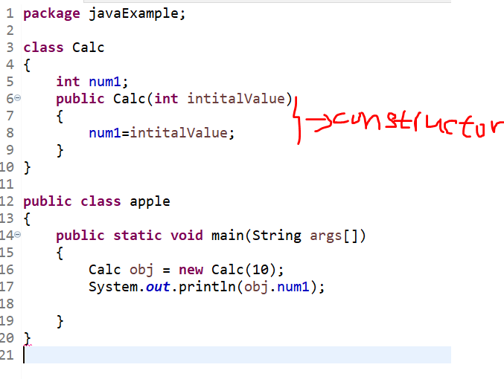
Class & constructor &object

Slide 18
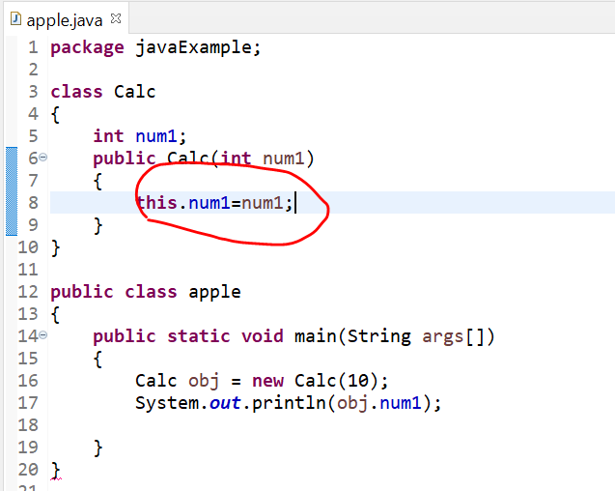
This keyword

Slide 19
Field
Field is declared under class not method
Can be shared across classes or within class (depends on wheather it’s private and public)

Slide 20
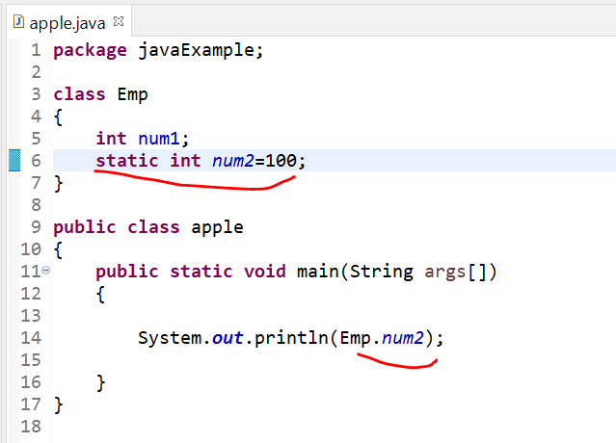
Static
Static no need to create instance

Slide 21
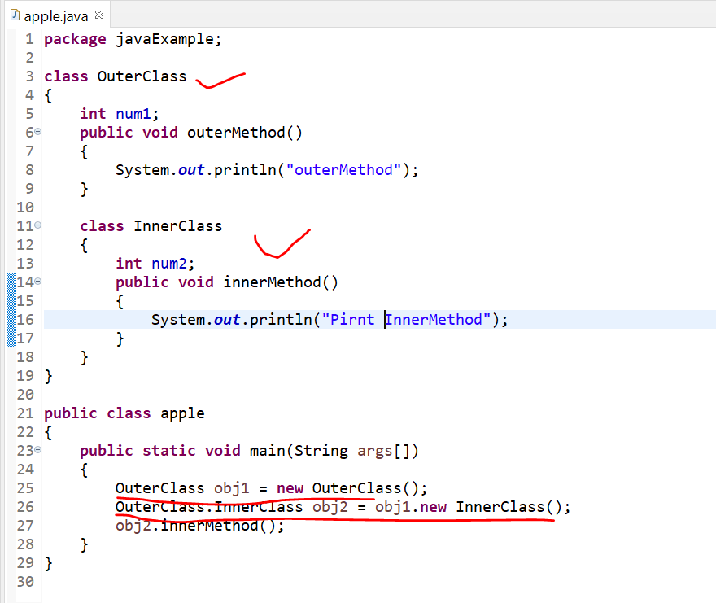
Inner class
Class inside another class

Slide 22
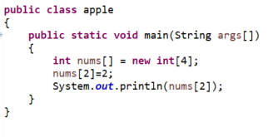
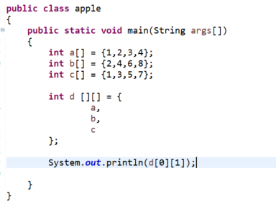
Array
1 D :
2D:

Slide 23
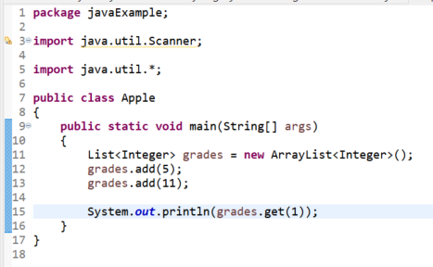
ArrayList
ArrayList can change size (dynamic) but Array size always fix

Slide 24
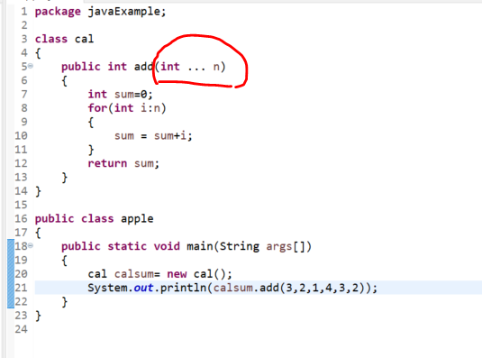
Varargs

Slide 25
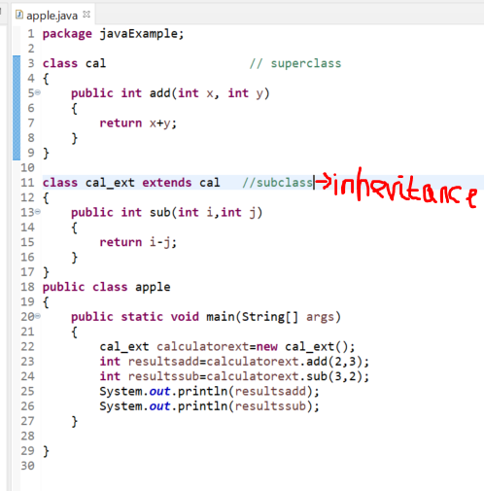
Inheritance

Slide 26
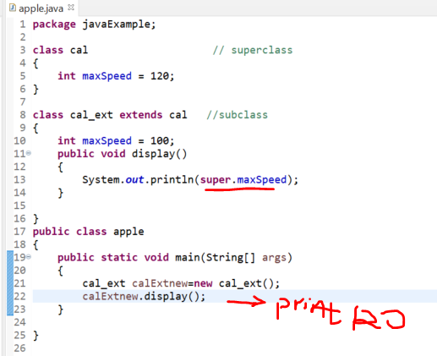
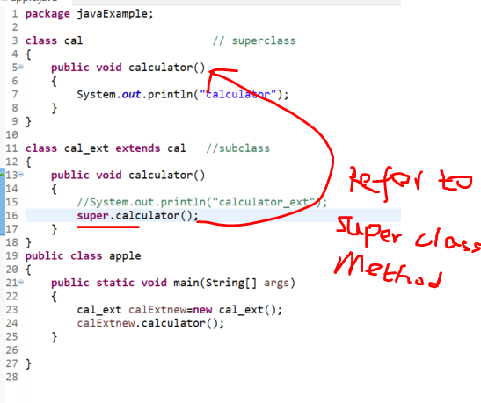
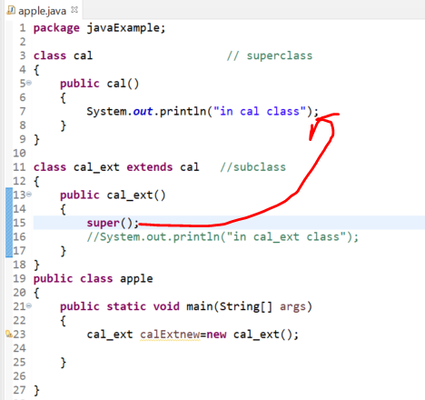
Super variables, method, constructors
Child class method override the parent class method but for whatever reason, we want to invoke the parent class method

Slide 27
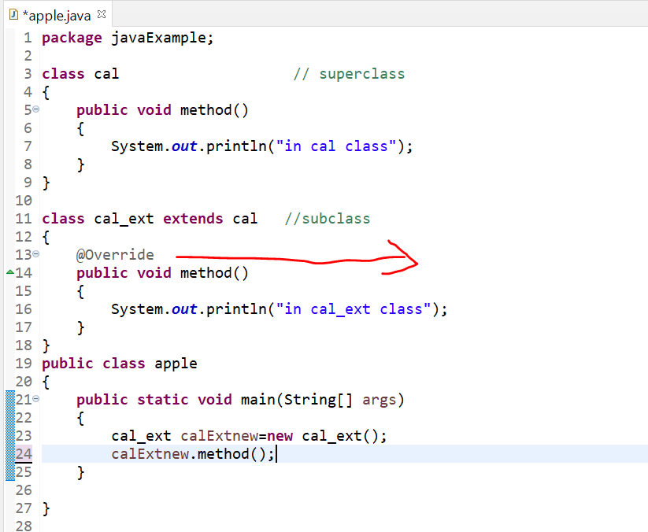
Method overriding
Child method override parent method

Slide 28
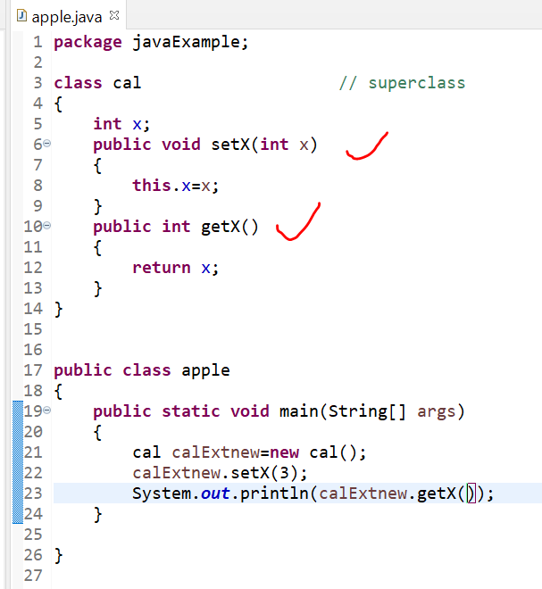
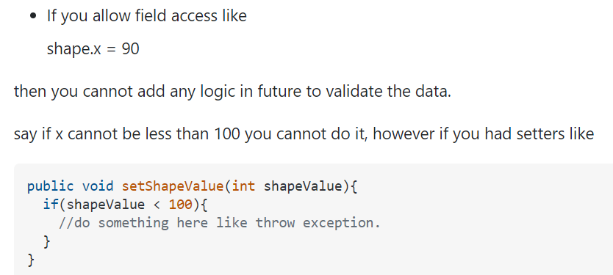
Encapsulation (setters&getter)
Purpose: Binnding data with setters and getter method. Other class can only access/read data via method (instead of directly access the variable). We can also put some limits in the method

Slide 29
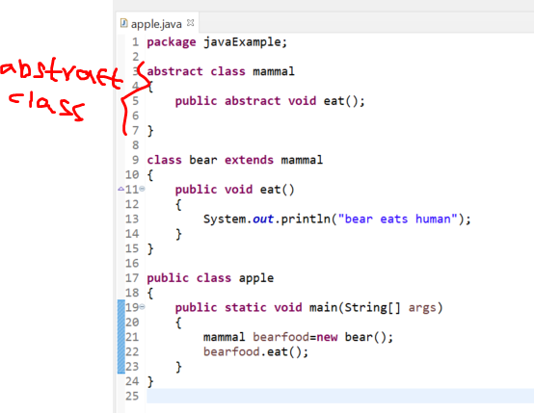
Abstract
If method in class is abstract, class also needs to be abstract (e.g. mammal is something abstract, we can create the class as abstract class)
We can not instantize an abstract class unless we create a child class which extent the parent abstract class
But if a child class (e.g. bear) extent the parent abstract class, child class must declare a method( this method is same in the abstract method in the parent class)

Slide 30
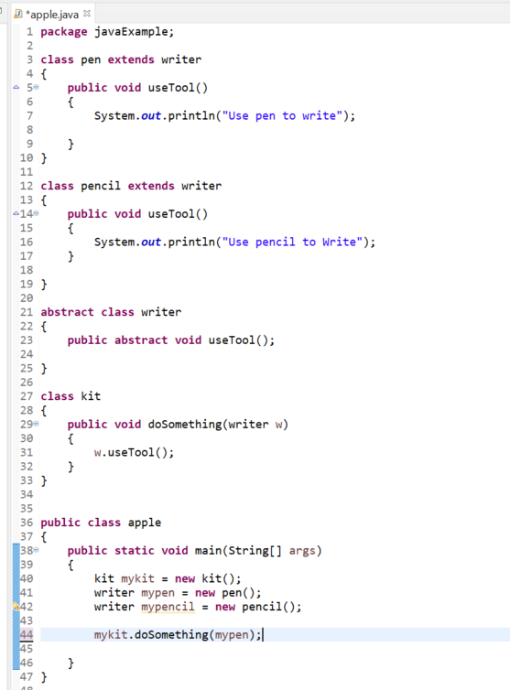
Cont.

Slide 31
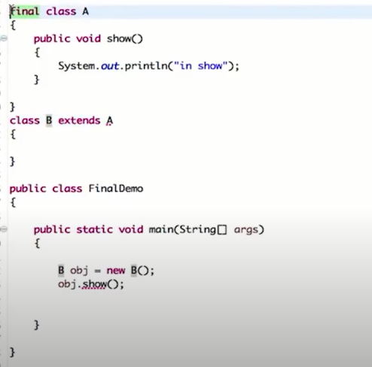
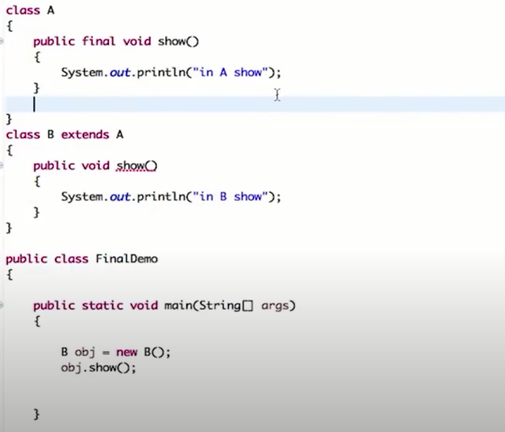
Final
Child method can’t overwrite parent final method
No other class can extents the final class

Slide 32
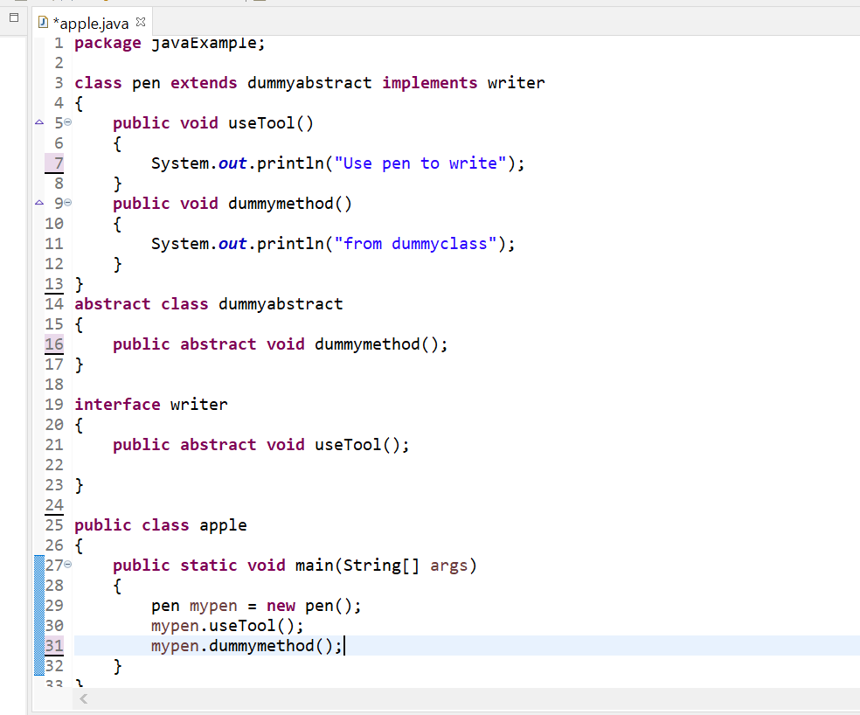
Interface
Interface is very similar to abstract but it allows child class to extend multiple classes

Slide 33
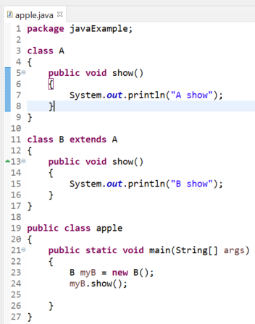
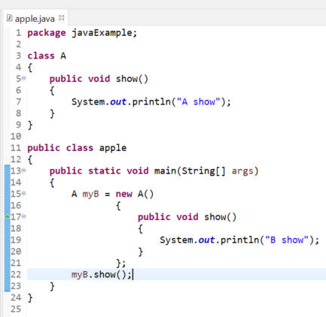
Anonymous inner class

Slide 34
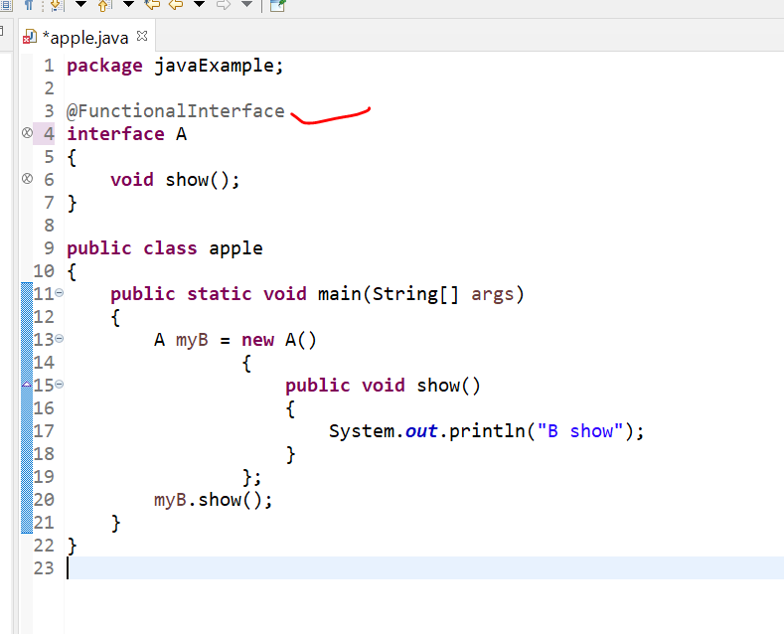
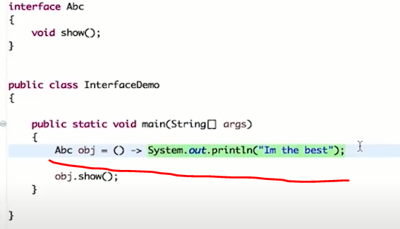
Functional interface lambda expression
Functional interface (interface with only 1 method)
Lambda expresson: Short form

Slide 35
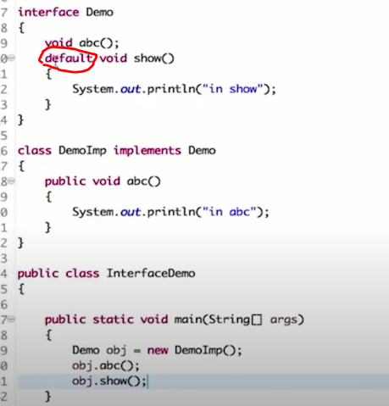
Default method in interface

Slide 36
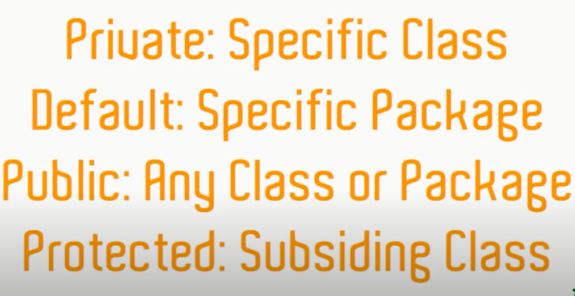
Access modifier

Slide 37
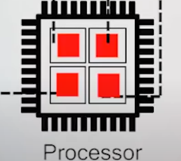
Multi-threading
Multi-tasking
Run diff tasks on diff cores at the same time
Single CPU has multiple cores (small unit which helps to execute diff instructions)

